Slide 1
Large-Scale and Multi-Structured Databases Project Design
My Anime Library
Jacopo Carlon
Ayoub El Ourrak
Nicola Riccardi

Slide 2
Application Highlights
MyAnimeLibrary is an anime social-networking and social-cataloging application.
With our website you will be able to:
• Create Your List: Our users can create a personalized list from thousands of anime. You will be able to organize and track which titles you’ve completed, your current progress, what you plan to watch, and much more
• Be the Community: Write reviews for the anime you loved the most (or hated), check up on other users’ opinions, make friends, and see what they like.
And behind the scenes, our admins keep the library up to date with the newest releases, and the analytics true to YOUR votes.

Slide 3
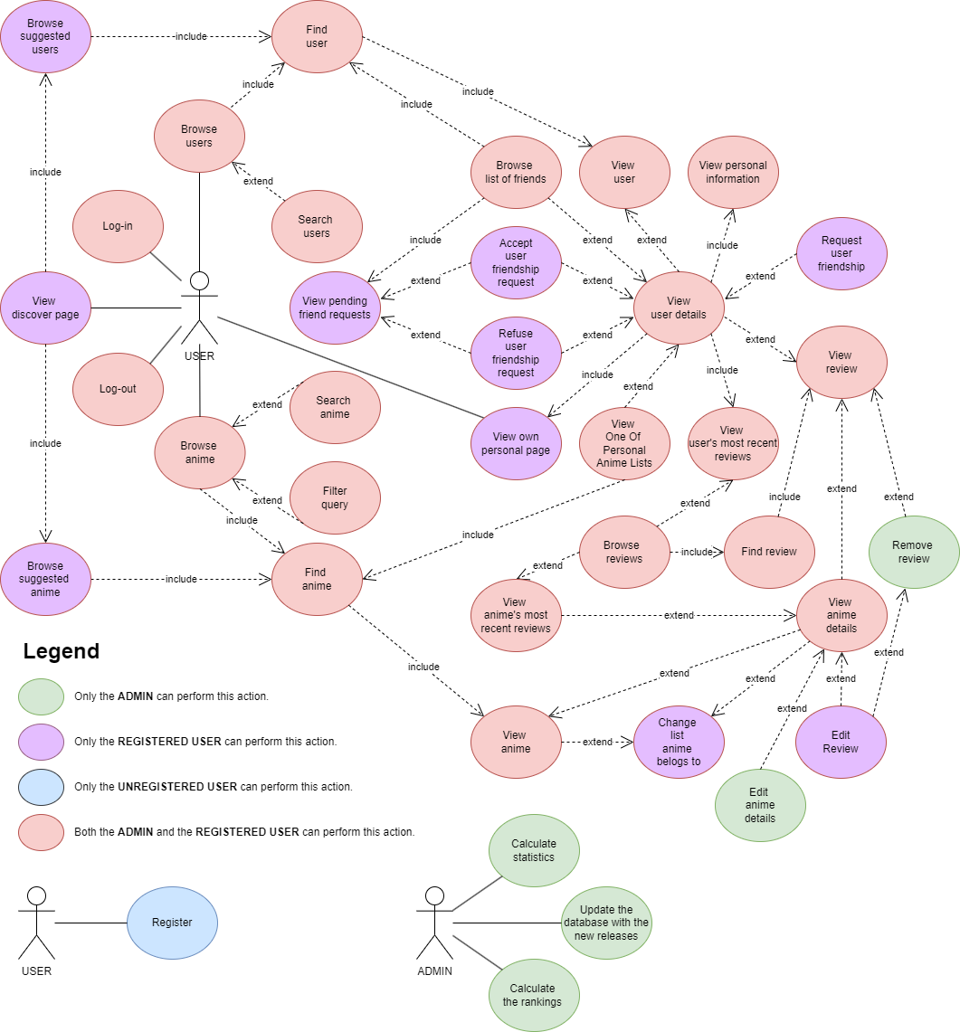
Actors and main supported functionalities

Slide 4
Dataset Description
Source:
https://myanimelist.net/ (anime_info, user_anime_lists, user data)
https://sourceforge.net/projects/anime-offline-database.mirror/ (anime_info, images)
https://www.name-generator.org.uk/quick/ (user data)
https://1000randomnames.com/ (user data)
Description:
Dataset contains real anime and users information, as well as list of anime per user.
The name/surname of the users are randomly generated.
Volume:
The scraped dataset has three .csv files:
User_List : 15.75 MB
Anime_details : 6.33 MB
List of anime for each user : 2.26 GB
Anime_info and images : 47.3 MB
a
The initial volume of the scraped DB was about 2.5GB
Variety:
The data comes from the complete database of the original website, and have the same distribution as the real users

Slide 5
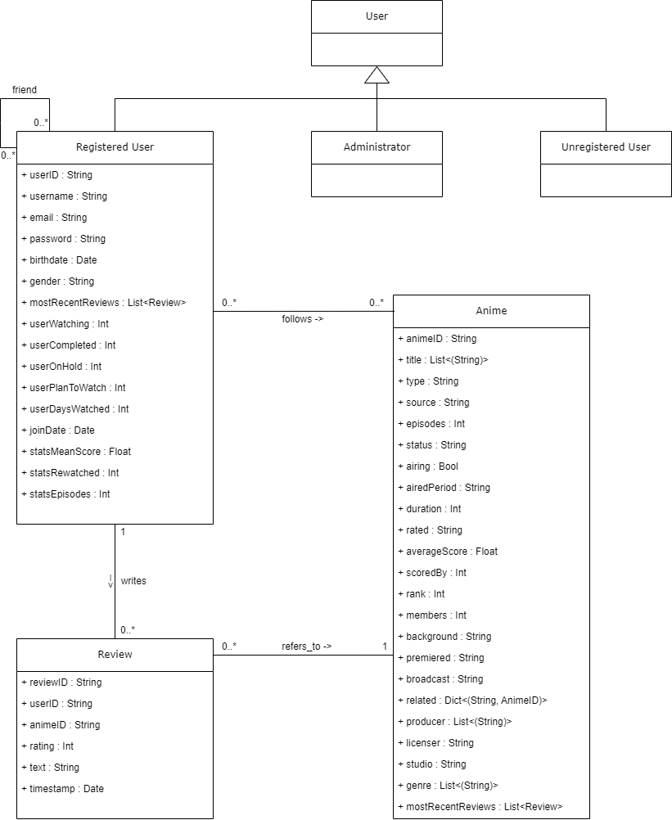
Preliminary UML Class Diagram

Slide 6
CAP Theorem

Slide 7
Requirements and Entities handled by Document DB

Slide 8
Requirements and Entities handled by Key-Value DB

Slide 9
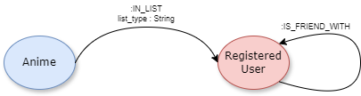
Requirements and Entities handled by Graph DB

Slide 10
Software Architecture Preliminary Idea
Include also the frameworks and tools that the group would like to use (programming languages, DBMSs, etc..)

