Slide 1
Large-Scale and Multi-Structured Databases Project Design
My Anime Library
Jacopo Carlon
Ayoub El Ourrak
Nicola Riccardi

Slide 2
Application Highlights
MyAnimeLibrary is an anime social-networking and social-cataloging application.
With our website you will be able to:
• Create Your List: Our users can create a personalized list from thousands of anime. You will be able to organize and track which titles you’ve completed, your current progress, what you plan to watch, and much more
• Join the Community: Write reviews for the anime you loved the most (or hated), check up on other users’ opinions, make friends, and see what they like.
And behind the scenes, our admins keep the library up to date with the newest releases, and the analytics true to YOUR votes.

Slide 3
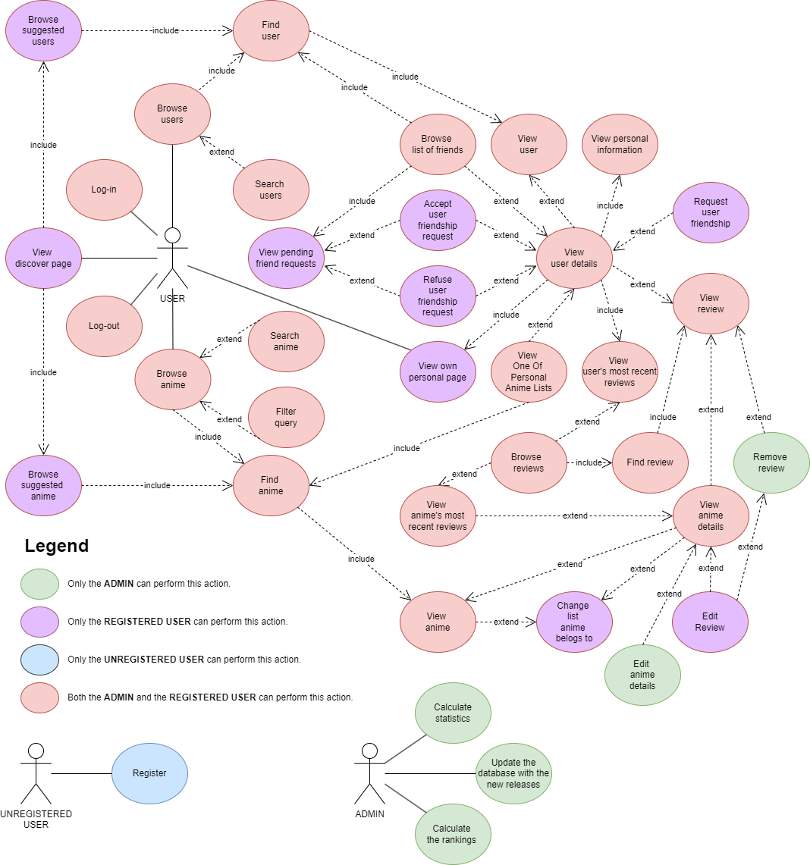
Actors and main supported functionalities

Slide 4
Dataset Description
Source:
https://myanimelist.net/ (anime_info, user_anime_lists, user data, reviews)
https://sourceforge.net/projects/anime-offline-database.mirror/ (anime_info, images)
https://1000randomnames.com/ (user data)
Description:
Dataset contains real anime and users information, as well as list of anime per user.
The name/surname of the users are randomly generated.
Volume:
The scraped dataset has three .csv files:
User_List : 15.75 MB
Anime_details : 6.33 MB
List of anime for each user : 2.26 GB
Reviews : 654,14 MB
Anime_info and images : 47.31 MB
User_data (125.000 names and surnames): 1.826 KB
Variety:
Three different sources have been used to build the dataset

Slide 5
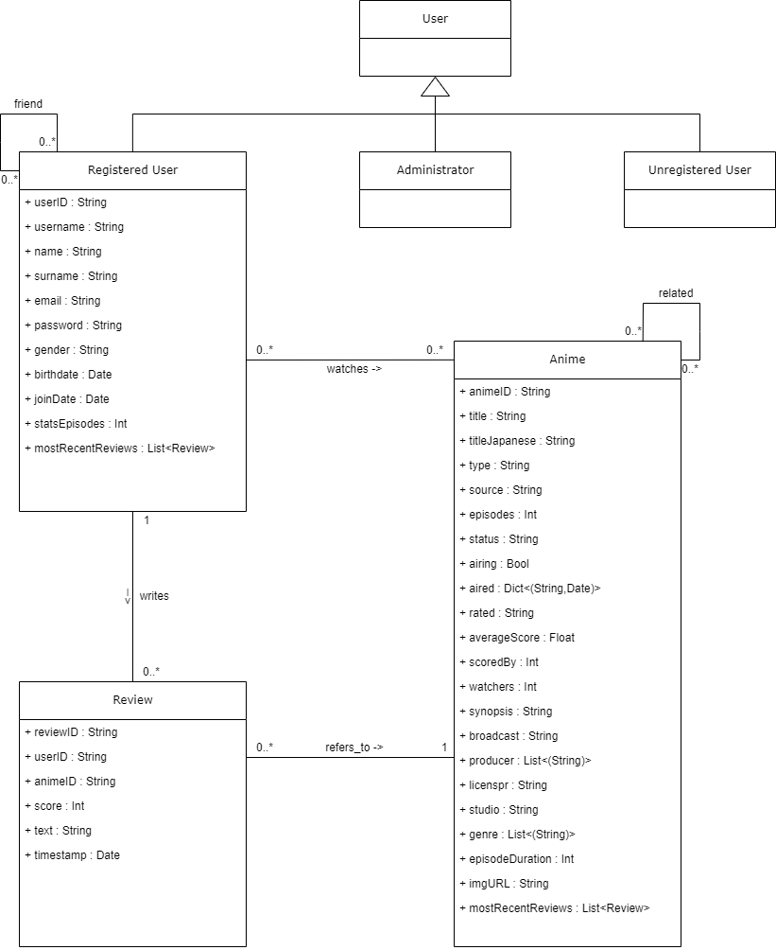
Preliminary UML Class Diagram

Slide 6
Product Requirements : - Usability : the application must be simple and user friendly - High availability : the displayed data might not be up to date - Low latency : we want a responsive application, therefore accessing the databases must be quick - Tolerance : data loss is tolerated, but we must avoid single point of failure Organizational Requirement : - The admin must be able to quickly correct erroneous uploads - If a review is added or removed, the rankings must be eventually updated accordingly - Encryption of passwords
Non-Functional Requirements

Slide 7
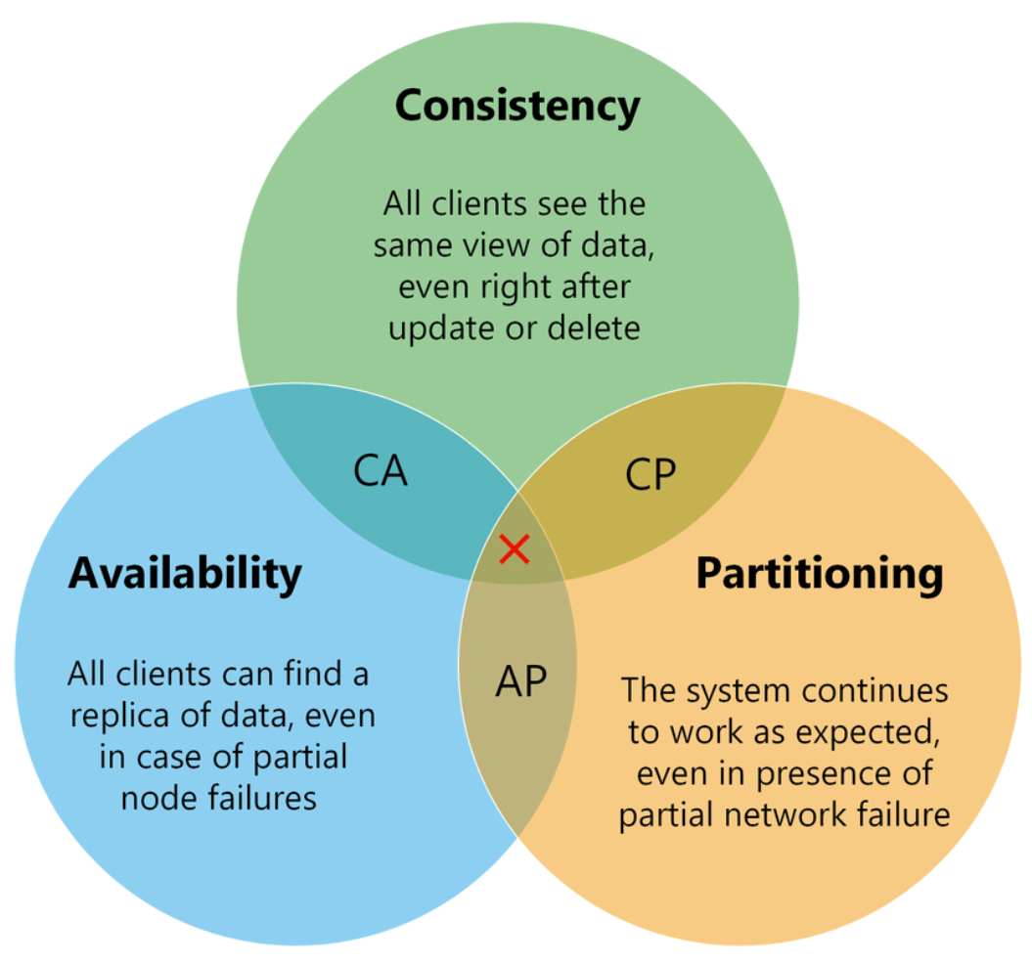
CAP Theorem
In order to satisfy the
non-functional requirements,
it is reasonable to sacrifice consistency,
in favor of
high-availability and
partition-tolerance.
Thus, an AP solution is used.

Slide 8
Requirements and Entities handled by Document DB
Entities :
Anime
User
Review
Queries :
Show Anime details
Show user details/credentials
Show anime with highest score
Show user’s review per anime
Show anime number of watchers
Show anime reviews
Top anime by genre
Show most reviewed anime in the last week

Slide 9
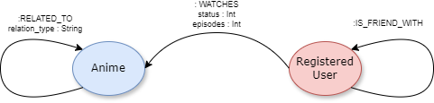
Requirements and Entities handled by Graph DB
Entities :
Anime
User
Relationships :
RELATED_TO
IS_FRIEND_WITH
WATCHES (in which list an anime is for a specific user)
QUERIES :
Show the most watched anime by the most numerous group of friends
Anime most watched among my friends
Recommend anime that is related to another one that the user has watched
Rank friends based on most anime watched
Recommend new friend based on common tastes
Show most watched anime franchise
Show most dropped anime

Slide 10










Software Architecture Preliminary Idea
Programming language :
Java
Python
Frameworks :
Maven
Java FX
Spring
DBMS :
MongoDB
Neo4j
Web Side :
HTML
CSS
JS

