Slide 1
Data Compression Project
Notes:
È possibile utilizzare questo modello come file di partenza per creare un album di foto.

Slide 2
huffman algorithm by marini silvio, moscioni jacopo and basile cosimo
Presentation

Slide 3

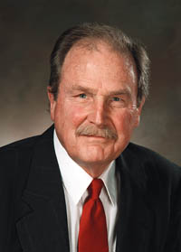
Huffman algorithm is a lossless compression algorithm created by Hufffman in 1952 while he was PhD student at MIT.
Huffman coding uses a specific method to choose the representation for each symbol. The encoding obtained depends by the frequency of each symbol. Symbols with high frequency will be rappresented with less charatters than less common symbols.

Slide 4
How it work?
Datavector : « NEVER EVER »
Huffman algorithm gets in input a text called Datavector D={x₁,x₂,..x_{n}} over the k-ary alphabet A={ a₁,a₂,..a_{k} }.
Character | Occurrences
E | 4
V | 2
R | 2
N | 1
_ | 1
It counts the occurrences of each character and creates the vector of frequency F={ f₁,f₂,..f_{w} }.

Slide 5
How it work?
Thus it makes a binary tree of nodes, each distinct character represents a leaf of the tree
4
2
2
1
1
E
V
R
N
_

Slide 6
How it work?
then it creates a parent node for two children that have lowest occurrences.
This node is the concatenation of the child nodes and assign a value equal to a sum of the child's value
2
4
2
2
1
1
E
V
R
N
_

Slide 7
How it work?
10
repeats this process until it creates the root.
6
4
2
4
2
2
1
1
E
V
R
N
_

Slide 8
How it work?
the algorithm assigns a bit for each node and the leaves of tree have a code create by the root-leaf path, so it creates a code word for each symbol
10
0
1
6
0
1
4
2
0
1
0
1
4
2
2
1
1
E
V
R
N
_
100

Slide 9
How it work?
Character | Codeword
E | 0
V | 100
R | 101
N | 110
_ | 111
Now algorithm can replace each symbol with it’s codeword.
110 0 100 0 101 111 0 100 0 101
N E V E R _ E V E R
1100100010111101000101

Slide 10
Modification!

Slide 11
Modification!
Modification 1 :
Use the Huffman algorithm with characters and more frequently words
Create a list of words and its occurrences inside the text
Choose the more frequent words and add it in the symbols list
execute Huffman Algorithm and check if it is convenient.

Slide 12
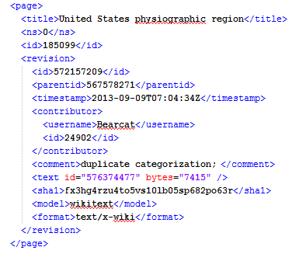

Slide 13
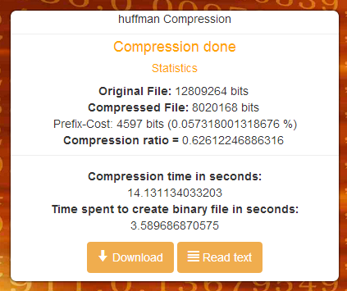

Huffman
Modification 1
62%
55%

Slide 14
Modification!
Modification 2 :
Use the Huffman algorithm with characters and more frequently sequences of letters.
scan the text character by character and create an Array key-value, that contains the sequence of characters and its frequencies
Choose the more frequent sequence of characters and add it in the symbol list
execute Huffman Algorithm and check if it is convenient.

Slide 15
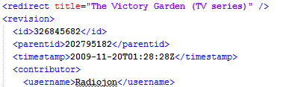
Char sequence id
Char sequence ser

Slide 16
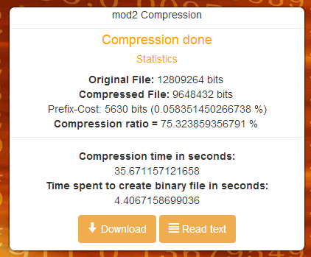
Huffman
Modification 2
62%
75%

Slide 17
Implementation!

Slide 18
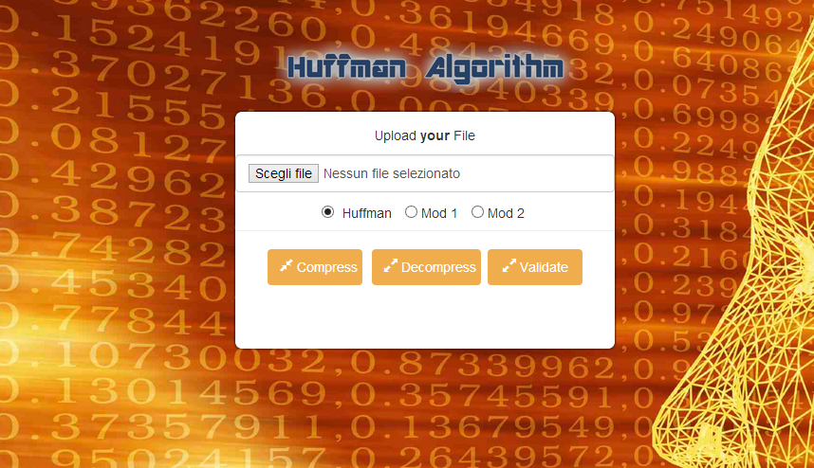
Implementation
We realized a web application based on HTML and PHP

Slide 19
Implementation
Select a file to compress and method of compression
After that click «Compress»

Slide 20
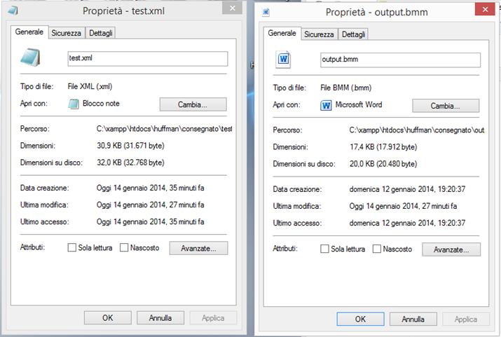
Implementation
Property of the original file and compressed file

Slide 21
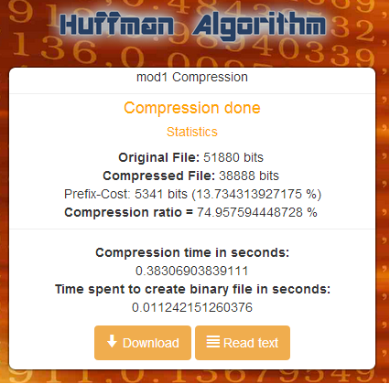
Implementation
This is the result and statistics of the compression
Statistics about
Compression ratio
Statistics about time of compression
Download or view compressed file

Slide 22
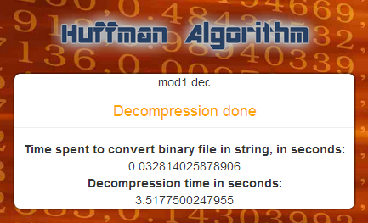
Implementation
This is decompression’s report
Statistics about decompression’s time

Slide 23
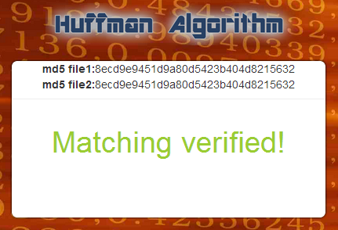
Implementation
This is for verify the result of compression/decompression

Slide 24
Thank you for your attention!

