Slide 1
Audio Anomaly Detection on Water Pumps
Learning a ConvAE Latent Space for Unsupervised Fault Detection
Jacopo Simonini
Digital Forensics and Biometrics — A.A. 2025/2026

Slide 2
MOTIVATION
What is Acoustic Anomaly Detection?
Condition Monitoring
Unsupervised / One-Class
Represent → Detect
Detect machine faults early, directly from the sound they emit.
Real deployments only have healthy audio; faults are rare and unlabeled.
First learn a feature space, then flag samples that fall outside it.

Slide 3
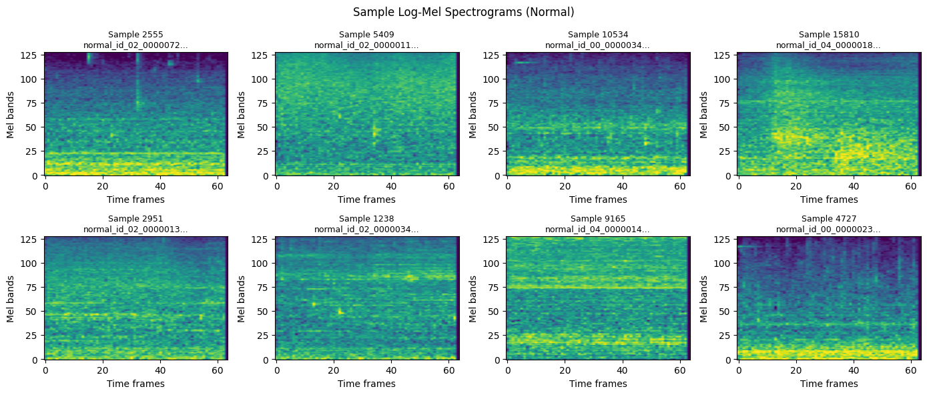
DATASET
Water-Pump Audio Dataset
4
16 kHz
9
200 / 320
machine IDs (00 / 02 / 04 / 06)
mono audio
windows per 10 s clip
normal / anomaly test files
ID 06 is never seen by the AE or the detectors — it appears only in tuning and test data. File-level splits, seed 42.

Slide 4
Data & Preprocessing

Slide 5
PREPROCESSING
From Waveform to Spectrogram
Load audio — mono, 16 kHz
Slice — 2 s windows, 1 s hop (9 / clip)
Log-mel spectrogram — 128 × 64
1
2
3
4
Normalize to [0, 1]

Slide 6
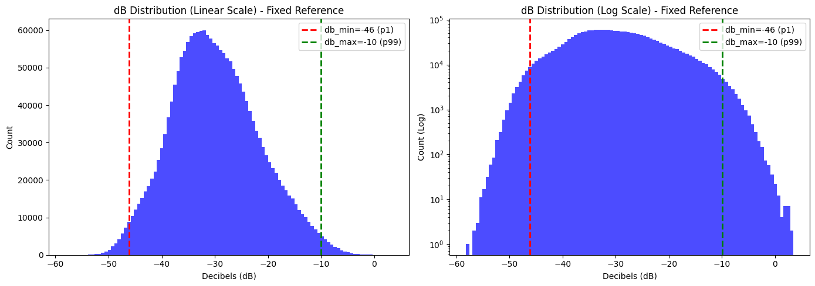
PREPROCESSING
A Normalization Choice That Matters
Fixed reference preserves loudness
• Convert to dB with ref = 1.0, not per-image max.
• A per-image max would erase absolute intensity across files.
• Clip to 1st / 99th percentile (≈ −46 / −10 dB), then map to [0, 1].

Slide 7
The ConvAE Representation

Slide 8
MODEL
Convolutional Autoencoder
32
64
128
256
z∈ℝ⁶⁴
256
128
64
32
Encoder (spectrogram → latent)
Decoder (latent → reconstruction)
8192 → 64
128×
NORMAL only
input values → latent
compression ratio
training data

Slide 9
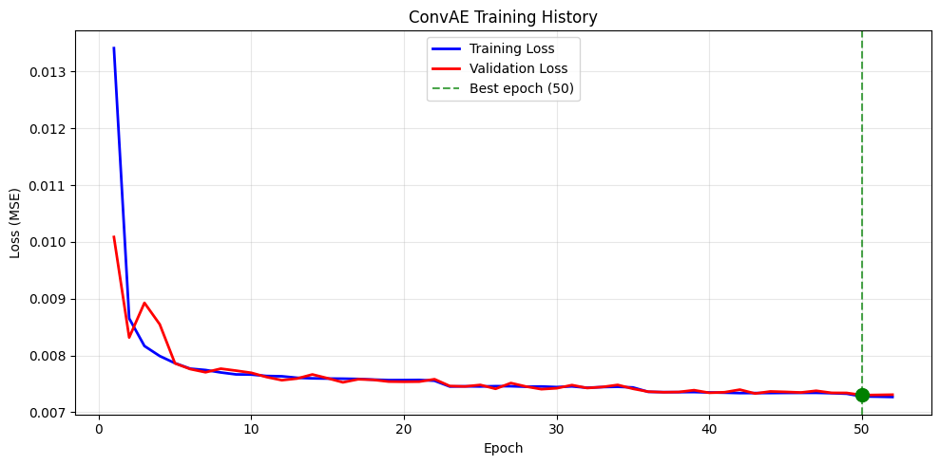
MODEL
Training Converges Cleanly
Clean convergence
• 52 epochs, best validation MSE ≈ 0.0073.
• Early stopping + reduce-on-plateau scheduler.
• Train and validation track closely — no training failure.

Slide 10
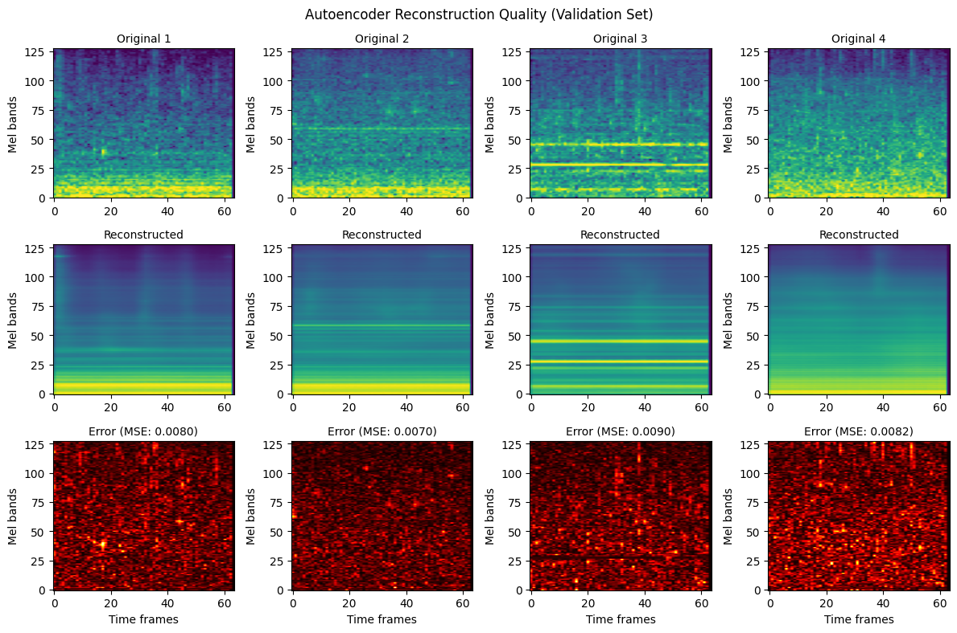
MODEL
Reconstruction Quality
The AE rebuilds spectrograms well
• Faithful reconstructions on normal windows, as expected.
• But it also reconstructs many anomalies acceptably…
• …foreshadowing why plain reconstruction error is a weak score.

Slide 11
Detecting Anomalies

Slide 12
METHODOLOGY
Two Families of Detectors
All operate on the frozen ConvAE (latent vector or reconstruction error).
Unsupervised
Supervised
• Reconstruction Error (per-window MSE)
• Isolation Forest (latent)
• Local Outlier Factor — LOF (latent)
• One-Class SVM (latent)
• SVM-RBF (latent)
• XGBoost (latent)
• SVM on MFCC statistics

Slide 13
METHODOLOGY
Detectors on the Latent Space
One-Class SVM
Local Outlier Factor
Isolation Forest
Learns a single rigid boundary around normal data.
Density-based: flags points in low-density regions.
Isolates outliers with random splits in feature space.

Slide 14
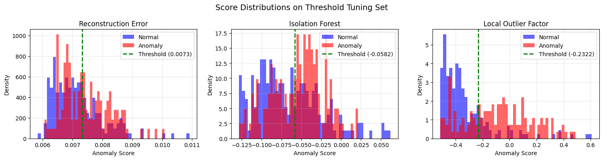
METHODOLOGY
Thresholding & Evaluation
• Window scores → file scores by mean aggregation.
• Threshold tuned only on the tuning split (balanced accuracy).
• Final test untouched; report AUC-ROC / PR (threshold-free).

Slide 15
Results & Analysis

Slide 16
RESULTS
Winner: ConvAE + LOF
73.3%
0.788
Balanced Accuracy
AUC-ROC
held-out file-level test
threshold-independent
Best assignment-aligned unsupervised method.

Slide 17
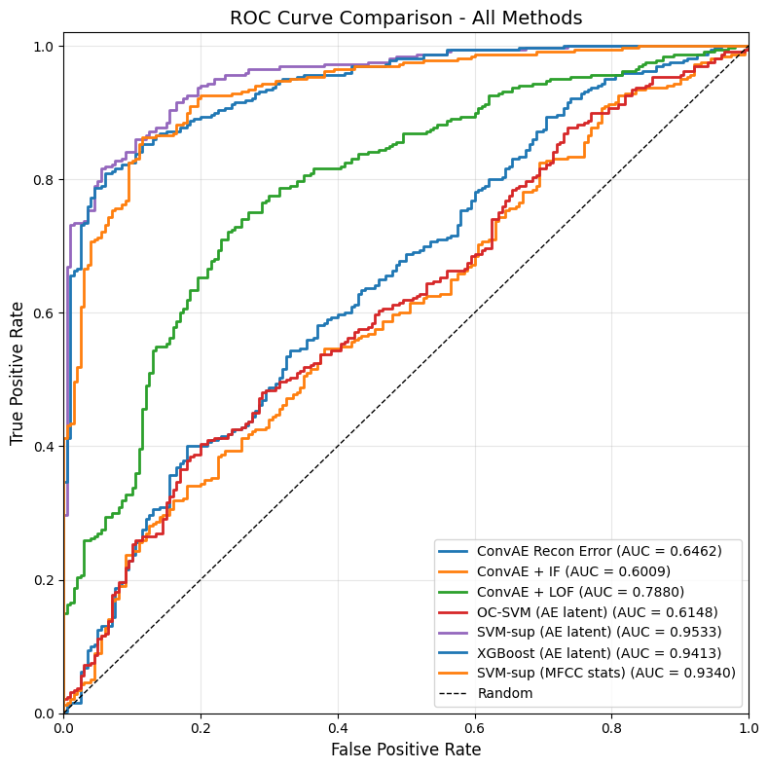
RESULTS
All Methods Compared
Method | Bal Acc | AUC
ConvAE Recon Error | 0.595 | 0.646
ConvAE + IF | 0.560 | 0.601
ConvAE + LOF | 0.733 | 0.788
One-Class SVM | 0.545 | 0.615
PANNs + LOF | 0.702 | 0.761
SVM-sup (latent) | 0.827 | 0.953
XGBoost (latent) | 0.827 | 0.941
SVM-sup (MFCC) | 0.854 | 0.934
Grey rows use anomaly labels (diagnostic baselines).

Slide 18
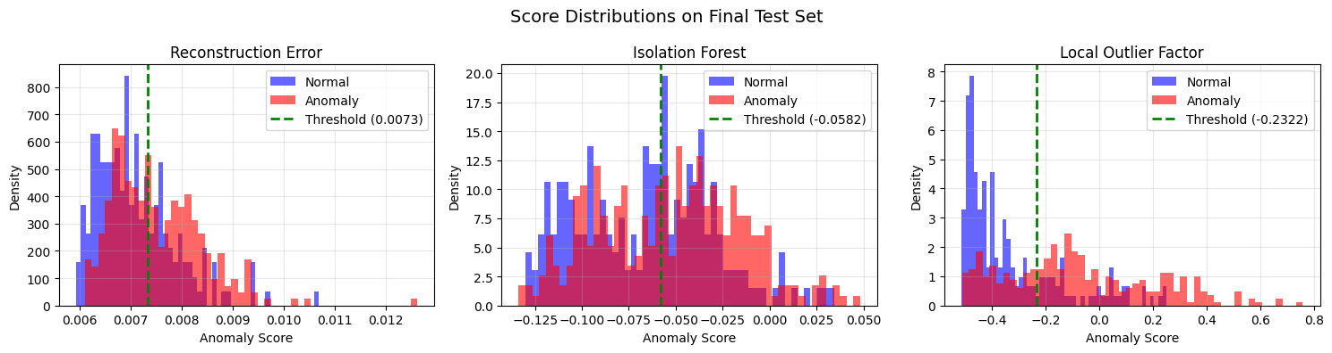
RESULTS
Why Reconstruction Error Is Weak
• Reconstruction-error and IF scores overlap heavily.
• LOF separates normal and anomaly files best.
• Average pixelwise MSE misses local, textural faults.
Overlap vs separation

Slide 19
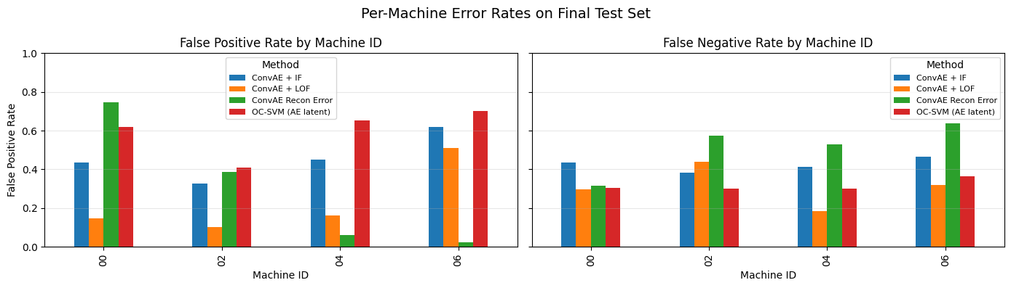
DIAGNOSIS
The ID 06 Problem
One unseen machine drives false alarms
• ID 06 LOF false-positive rate: 51.1%.
• Other IDs: 14.5% / 10.2% / 16.3%.
• The model confuses a new normal machine with an anomaly.

Slide 20
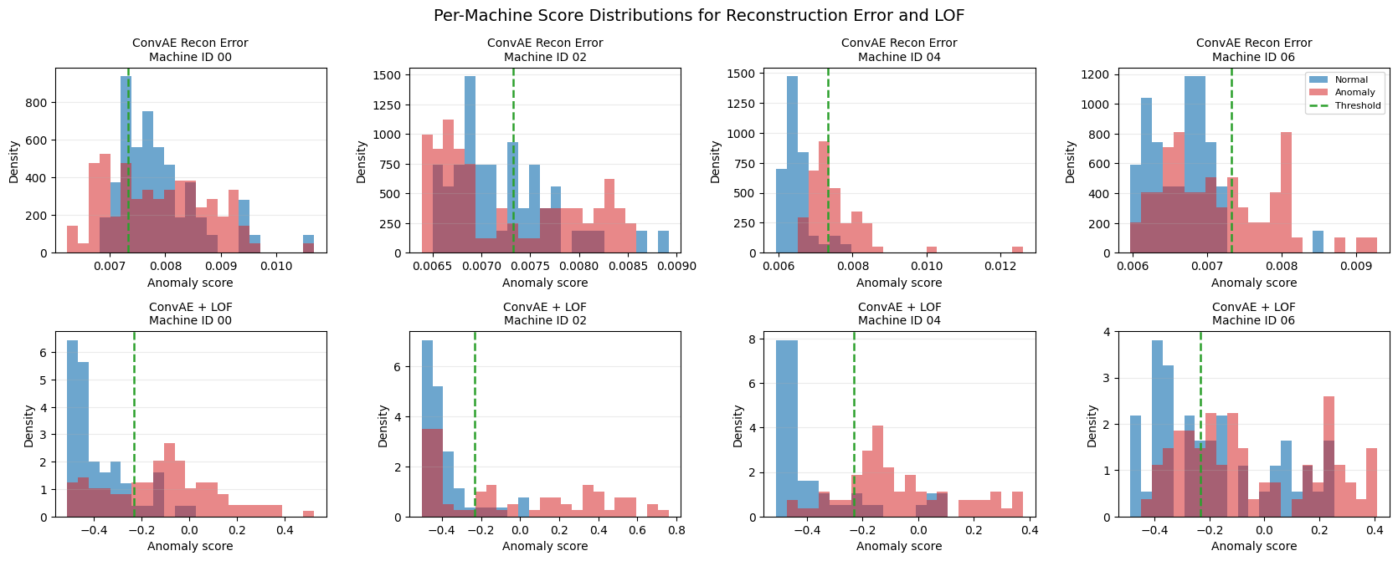
DIAGNOSIS
Per-Machine Score Distributions
• ID 06 normal LOF scores straddle the threshold — the 51% FPR, visually.
• For recon error, ID 06 normals sit below threshold (lowest FPR).
• The ID 06 problem lives in the latent-density model, not reconstruction.

Slide 21
DIAGNOSIS
Ablation — Add ID 06 Normals (Protocol 2)
51% → 40%
0.79 → 0.81
ID 06 false-positive rate
LOF AUC-ROC
lower is better
slight overall gain
ID 06 normals taken from the tuning split — test set unchanged. FNR rises 31.9% → 34.8%: overlap remains, so unseen-machine variation is only a partial cause.

Slide 22
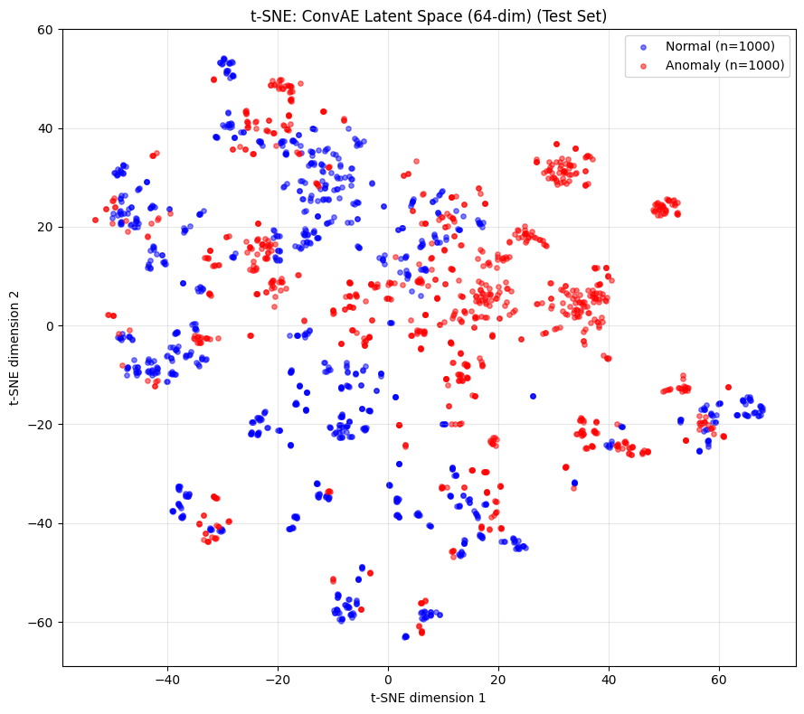
DIAGNOSIS
The Latent Space Is Only Partly Separable
Qualitative view
• t-SNE of ConvAE latents on the test set.
• Normal and anomaly points partially overlap.
• Consistent with the moderate unsupervised scores.

Slide 23
DIAGNOSIS
A Diagnostics Recap
✓ Normalization
✓ Tuning & aggregation
Fixed dB ref = 1.0, clipped to the training 1st / 99th percentiles (−46 / −10 dB) — absolute loudness preserved, verified on the training distribution.
4 aggregation strategies × 3 tuning metrics swept — mean is the most stable. Thresholds tuned on a separate split, no leakage.
✓ MFCC sanity baseline
✓ Unseen-machine ablation
With anomaly labels, an SVM on hand-crafted MFCC statistics reaches 0.854 BA (AUC 0.93) — the signal exists; the unsupervised gap is not missing information.
Adding ID 06 normals to training helps only partially (FPR 51% → 40%, FNR rises) — genuine overlap remains.
⟶ The signal exists — but without labels, subtle faults overlap with normal machine variation.

Slide 24
CONCLUSION
Conclusion
Achieved
• ConvAE latent space + LOF: 0.733 BA / 0.788 AUC, fully unsupervised.
• Reconstruction error alone is insufficient for subtle pump faults.
• Diagnosed the unseen-machine (ID 06) false-positive effect.

Slide 25
Thank you.
Questions?

