Slide 1

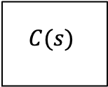
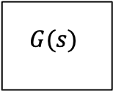
$$r$$
$$C(s)$$
$$G(s)$$
+
-

