Slide 1
OMA Assignment 2017-2018
Examination Time Tabling : Group 03
Jacopo Maggio – Stefano Munna – Jacopo Nasi – Andrea Santu – Marco Torlaschi

Slide 2
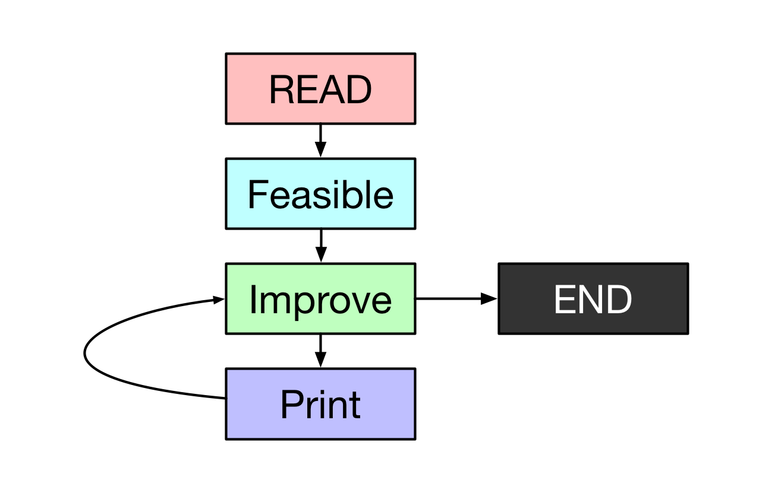
The Problem
Solving a time scheduling problem trying to minimize the penalties of exam proximities.
Step:
Read & Store data input
Finding a feasible solution
Improving founded feasible

Slide 3
Data Structure
The software is written in C due to its high performance.
We have not implemented multithreading to focusing on algorithms development.
The main structure is a GRAPH built on a adjacency matrix.
When two exams CAN’T be sustained in the same time slot adjM[e1][e2] = n (# of students enrolled in both exams), otherwise -1.

Slide 4
Feasible

Slide 5
Finding Feasible
The initial idea was to implement a TABU SEARCH over the data. Starting with this strategy resulted a little bit slow with those instances that have an high grade of complexity and conflicts.
The final version use a GREEDY algorithm to reduce the complexity and then it pass this partial solution to the TABU implementation.
From ~3 minutes to ~10 seconds.

Slide 6
Greedy
Trying to reduce ”the complexity” of the problem.
Initial data is sorted from the exam with more collision to the the fewer ones.
Workflow:
Use the FIRST available (no collision) time slot for each exam.
If there aren’t enough timeslots with this configuration it adds more timeslots.
The added timeslots will be removed with the next step.

Slide 7
Tabu Search
It reduces the number of added (by the greedy) time slot till the correct number.
Workflow:
Reduce the timeslots
Try to resolve conflict with the reduced number of timeslots.
If is not able to solve: BACKTRACK
Otherwise: Restart from point 1.
The TABU is of 1000 moves with 7 iterations.
ADVANTAGES:
Very reliable
DRAWBACKS:
Not too fast

Slide 8
Improve
Used techniques

Slide 9
Local Swap
Implements a STEEPEST DESCENT STRATEGY.
Evaluates Neighborhood N(x) of the current optimal solution x.
Workflow:
Switches exams scheduled in a timeslot with those contained in any another to find a new feasible solution x’.
If x’ has a better benchmark than that of x, then x=x’.
Loop until there is no improvement anymore
Slower than FIRST IMPROVEMENT strategy but more efficient.

Slide 10
Local Search
Our local search implements 3 different algorithms:
Move Exam: Change the timeslot of an exam.
Swap Exams: Swap the timeslots of two exams.
Bounded Shift: Shift a portion of timeslots.
These 3 (+ the previous local swap) procedures are used until the solution is improving.

Slide 11
Simulated Annealing
Workflow:
Start from a feasible solution.
Move an exam to another timeslots.
If WORST or UNFEASIBLE accept the solution, with probability, depending on temperature.
Reduce temperature to converge to a minimum.
Reuse the TABU SEARCH to restore the feasibility.
Apply local search to find a minimum.

Slide 12
Greedy Slot Shuffle
Starting from a feasible, it adds, one at a time a timeslot evaluating the benchmark.
ADVANTAGES:
Random
Fast

Slide 13
Improve
Other techniques tried but not used in the final version...

Slide 14
Genetic
Starting from two or more parents it performs a cross-over between them and occasionally a mutating.
This algorithm not fit very well this problem because it could generate a lot of unfeasible solution due to its randomness.
DRAWBACKS:
Not too easy
Lot of unfeasible solutions

Slide 15
Execution

Slide 16
Average % Algorithm Execution Time

Slide 17
Notes:
- Anneling not change related to #exam - Benchmark calculation require time

Slide 18
Performance

Slide 19
Benchmark
Our algorithms is flown over 5 different steps:
v0.1: Tabu List search
v0.3: Greedy Preparation at begin
v0.4: Adding Simulated Annealing and local search
v0.5: Implementing Local Swap
v0.6: Various Tuning
In the next graph is possible to view the benchmark results at each step.

Slide 20
Notes:
All versions improve all problem, get a good solution in any case.

Slide 21
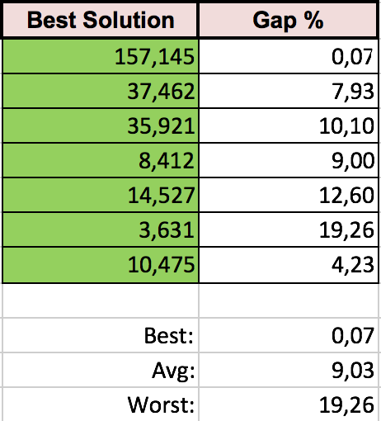
Latest Result

Slide 22

Repository
The whole project with code, math model, instances, presentation and benchmark results are available on a GitHub public repository:
https://github.com/Jacopx/OMA_ExamTimeTable

Slide 23
Thanks for the attention!

