Slide 1
OMA Assignment 2017-2018
Examination Time Tabling : Group 03
Jacopo Maggio – Stefano Munna – Jacopo Nasi – Andrea Santu – Marco Torlaschi

Slide 2
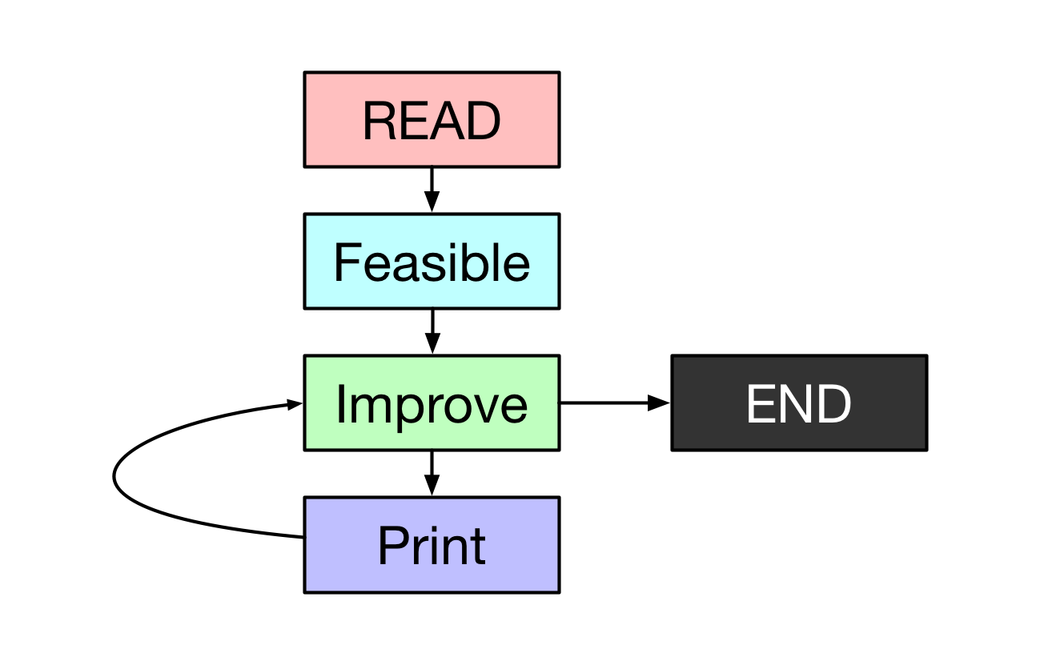
The Problem
Solving a time scheduling problem trying to minimize the penalties of exam proximities.
Step:
Read & Store data input
Finding a feasible solution
Improving finded feasible

Slide 3
Data Structure
The software is written in C due to its high performance.
The main structure is a GRAPH built on a adjacency matrix.
When two exams CAN’T be helded in the same time slot adjM[e1][e2] = 1, otherwise -1.
The TABU is of 1000 moves with 7 iterations.

Slide 4
Feasible

Slide 5
Finding Feasible
The initial idea was to implement a TABU SEARCH over the data. This was a little bit slow in case of high number of exams.
The final version use a GREEDY algorithm to reduce the complexity and than it pass this partial solution to the TABU implementation.
From ~3 minutes to ~10 seconds.

Slide 6
Greedy
Trying to reduce ”the complexity” of the problem.
Initial data is sorted from the exam with more collision to the the fewer ones.
Workflow:
Use the FIRST available (no collision) time slot for each exam.
If there aren’t enough timeslots with this configuration it adds more timeslots.
The added timeslots will be removed with the next step.

Slide 7
Tabu Search
It reduces the number of added (by the greedy) time slot till the correct number.
TO DO...

Slide 8
Improve
Used techniques

Slide 9
Local Search

Slide 10
Local Swap

Slide 11
Simulated Annealing

Slide 12
Improve
Other techniques tried but not used in the final version...

Slide 13
Benchmark Insertion
Starting by selecting a random timeslot and then adding one at the time the best one by checking the benchmark of that temporary solution.
ADVANTAGES:
Avoid ”local minimum” problem
Fast and easy to be implemented
DRAWBACKS:
Too random

Slide 14
Genetic
Starting from two or more parents it performs a cross-over between them and occasionally a mutating.
This algorithm not fit very well this problem because it could generate a lot of unfeasible solution due to its randomness.
DRAWBACKS:
Not too easy
Lot of unfeasible solution

Slide 15
Performance

Slide 16

Repository
The whole project with code, math model, instances, presentation and benchmark is available in the GitHub repository:
https://github.com/Jacopx/OMA_ExamTimeTable

Slide 17
Thanks for the attention!

