Slide 1






Current
Planned

Slide 2
Catalogue sub-system integration
Supplier sources
Catalogues
Parts
Pricing
Define preferred pricing
Alternates
Replacements
Supersessions
Images
Bulk pricing import
Preferred order from
Master Base Price list
Master SKU
Images
Suppliers
Sales pricing
Products
Country Currency
Trading Currency
Currencies
Catalogue
Customers
Optimised replenishment
Order tracking
BOM
Parts & application
Images
Decision Support
BOM
Parts & application
Images
Procurement
Sales Force

Slide 3
Catalogue Data Persistence - logical
Manufacturer
Ford, BMW, Opel …
Vehicle
BMW 318
Engine
1,8 90-KW
Cooling
Fan belt
Water pump
Crank Shaft
Electrical
Alternator

Slide 4

Warehouse Structure Planning
EP Sales Staff
EP Customer
Catalogue Lookup
Add selection to sales order
Release to Picking

Slide 5
Warehouse Structure Planning
Assembly
Consists of sub-assemblies
(Self Referencing)
Part(s)

Slide 6
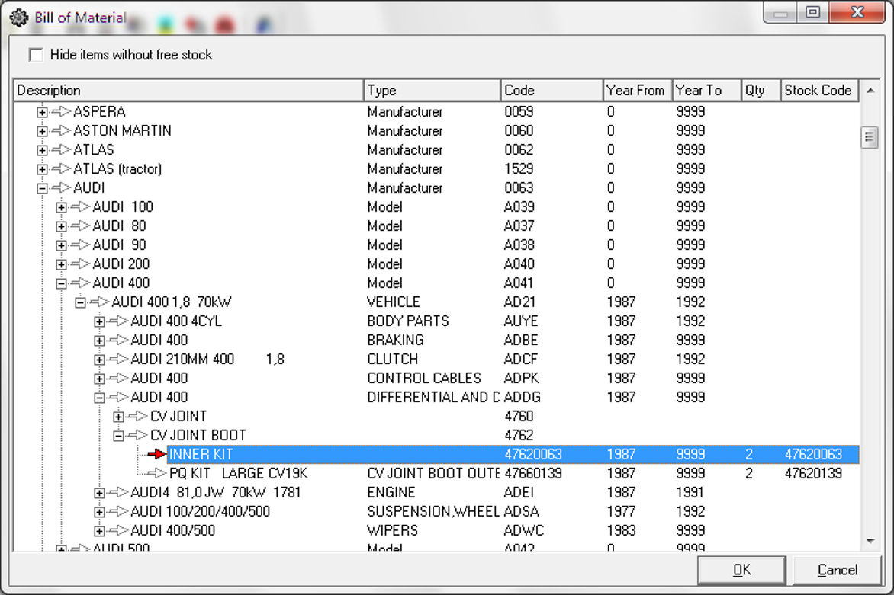
Assembly / sub-assembly relationship
Assembly / sub-assembly categories & permissible linking
Vehicle year
Stocking unit & qty needed

Slide 7


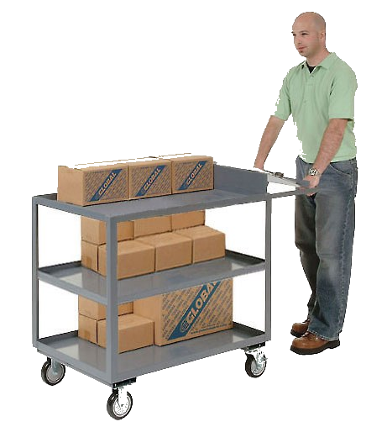




4.1 Goods Returned – retained credit
4.2 Counter Sales
Order fulfilment progress
4.3 Order release
4.4 Picking Starts
4.5 Picking ends
4.6 Goods at Counter
4.7 Call customer to cashier
4.8 Receive Payment
Include any credits for returns
4.9 Collect goods & Invoice

Slide 8

Warehouse Readiness Review
2018/03/28
The objective is to bring the warehouse into an effective functioning state in the shortest possible time whilst operationally active.
The review aim is to highlight constraints to attain the stated objective.

Slide 9

AGENDA
Introduction
Inbound Fulfilment
Supplier Goods Receiving
Warehousing Inbound Goods
Customer / Branch Returns
Item Master Planning
Bulk to fine pick replenishment
IBT – replenishment cycle
Stock Assurance - Cycle count
Stock Assurance – Wall to Wall count
Stock journals – cost adjustment
Outbound Customer Order Fulfilment
Picking Strategies
Product recall
Manufacturing
Additional
Investment Review
Time permitting
Courier integration
POD management

Slide 10


Slide 11
Inbound Fulfilment
Strategic
Service provider
Operational
Admin
‘Nett Stock’ Optimised Demand Planning
Supplier Availability
Purchasing Modelling
Purchase Orders
Revisit stock costing / forward cover
Supplier Execution
Letter of Credit
Shipping / Courier Notification
Receiving Planning
Order Validation
Revisit Supplier Statement to remittance format
Adjust Purchasing Modelling
Variance Notification
Goods Receiving
Supplier Remittance

Slide 12
Supplier Goods Receiving
Operational – container
Operational – rejected goods
Supplier Returns Process
Record container to shipping Documentation
Unpack goods received – record start of process
DIMS / Weight
Offload container – start / end times
Inspection & scan / record ALL goods received
Generate Supplier RMA report
Validate pallets/packing to shipping docs
Record end of process
(Staff / process metrics)
Generate receiving JOB exception report
Manufactured Goods injection
Warehouse Goods
Get MRA from Supplier & record
Visual check pallet / other damage
Quarantine goods not ordered
Generate Supplier RFC
Notify interested parties
Return goods local suppliers / adjust P/Order
Arrange Courier Collection
Quarantine damaged goods
Escalate non-conforming import suppliers
Courier / own fleet system

Slide 13
Warehousing Inbound
Operational – Staging
Operational – rejected goods
System Management
GRV ALL goods
System directed binning locations
Items NOT in sellable state
System directed: DIMS & Weight recording
Floor directed binning locations used
Generate Management with binning exceptions
Move to appropriate W/House staging location
Record why
Adjust bin capacity
Create & Record start of Binning Job
Reasons to Warehouse Housekeeping to fix
Relocate stock if new bin allocated
Do bin stock take if triggered
Timestamp each put-away action
Items in sellable state
Record end of Binning Job

Slide 14
Customer & Branch Returns
Operational
Operational
Financial
Authorisation to return goods (RMA)
Identify which invoices goods are returned on
Escalate if
Items not on Invoice
Returned qty > sold qty
Review relaxed returns policy
Receive goods at returns receiving
Decline & return rejected goods
Identify Customer or Branch returning goods
Destruction process with permission
Inspect and classify goods / bad / repairable
Generate Debtors RFC request
Debtors Subledger – apply RFC to items sold on invoices
Generate IBT RFC request
No VAT
Re-stocking fee???
Move to W/House staging location for binning
Payment: IBT loan account

Slide 15


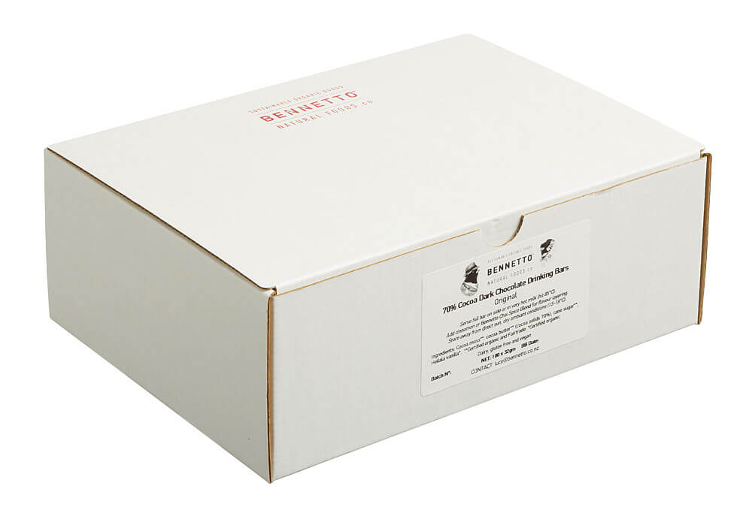
Item Master Planning
Same item with synonym item codes catering for packaging
ABC001-E
ABC001-P
ABC001-E1
ABC001-C
ABC001-E2
Same item differing DIMMS / weight

Slide 16
Bulk to fine pick replenishment
Operational – fine pick
Operational
Management
Fine Pick items with Min/Max levels per item
Generate replenishment stock move
Alert – fine pick critically below min level
Sales Order confirmed
Select stock from pre-defined bulk locations
Management Information
Current WIP replenishments
Too frequent triggers
Bulk out of stock / critical level
Bin below Min level
Y
Confirm move to fine pick location(s)

Slide 17
IBT - replenishment
Operational
Operational
Management
‘Nett Stock’ Optimised Demand Planning
Generate replenishment stock IBT
Alert – fine pick critically below min level
All items with Min/Max levels per item
Select stock from pre-defined bulk locations
Management Information
Current WIP replenishments
Too frequent triggers
Bulk out of stock / critical level
IBT enter picking
Bin below Min level
Y
QC
Review ‘Nett Stock’ model
Despatch
Accounting: stock in transit
Branch supplier receipt
Accounting: remove in transit status

Slide 18
Stock Assurance - Cycle count
Planning
Operational
Management
Items classified by A,B,C on movement frequency
Daily cycle count completed?
Define Cycle Count Model
Count all items in 1 month
A items once per week
B items bi-weekly
C items once per month
Manpower available
Y
N
Add manpower
Change ABC frequency
Generate cycle count model for month
Change model & regenerate for remaining period – increase workload
Daily cycle count in production time
Real-time transaction tracking calc on-hand in time space
Non-conformance warehouse (picking) events inject count following day
Review non-conformance
Authorise & apply Adjustments

Slide 19
Stock Assurance – Wall to wall count
Planning
Operational
Management
Ensure inbound is cleared of WIP goods
Teams scan each bin code and count ALL items in location
Match team A with team B counts and both to theoretical
Ensure customer returns WIP is up to date as possible
Teams scan bin recount requests from audit team
Per Bin and Item:
TA != TB
TA = TB != theoretical AND value > tolerance
All outbound processing cleared - invoiced
Periodically upload scan results whilst in operation
Audit team inspection & correct / isolate
Assess resources – staff handhelds etc & create count teams A & B
Upload re-count request to teams for inspected bins / items
Snapshot theoretical stock master
END stock take on time-out or all counts completed
Management variances assessment within acceptable tolerances & authorise
Generate count schedules sectioned per teams A & B to cover entire warehouse
Review items not counted
Review recounts not done
Apply adjustments
Latest TA = Latest TB
Latest TA = theoretical
Latest TB = theoretical
No stock is moved post snapshot until process complete
Allow normal warehouse activity to continue

Slide 20
Stock Journals– Cost Adjustment
Planning
Operational
Management
Identify disposable stock
Isolate old / end of life stock items to dispose warehouse
Scrap / sell - remove from warehouse
Isolate slow moving stock
Determine new selling price
Adjust selling price
Adjust cost price < selling
Identify items with cost value > replacement value
Adjust cost price NRV
Adjust selling price > new cost

Slide 21
Outbound Customer Order Fulfilment
Sales
Picking
Checking
Despatch
Capture Customer Order
Group / prioritise Orders by departure times
Checking receives goods
Scan verify consigned goods
Release to Picking
Release Picking jobs by picker
Scan verify picked goods
POD documentation
Recall order from Picking NOT issued to picker
Record start / end times for operating metrics
Non conformance – quarantine for picking
Loading manifest per vehicle (own)
Place picker job on hold with reason code
Pack goods & label each package
Courier solution
Refer non-conformance to warehouse controller
Insert invoice / delivery note in last package
Verify returned POD’s
Insufficient stock orders cancelled as per customer rule – customer master
Pass packed goods to despatching
Return to stock undelivered & rejected goods
Pass picked goods through hatch to checking
Invoice re-print control

Slide 22
Picking Strategies
Planning
Operational
Pick by Order (1:1)
Pass through after picked
Pick by Order size (n:1)
Collate by packing slip
Wave picking
Collate by packing slip

Slide 23
Product Recall
Management
Operational
CRM / Admin
Item recall identified
Quarantine faulty stock by batch / supplier delivery …
Generate recall list per Customer and invoices with specific item
Customer review sold by customer to be recalled
Recall quantity
Credit approval
Replace Recall quantity through sales orders
Rework / destroy / supplier return

Slide 24
Manufacturing
Granite Workflow per GSSM implementable
Items consumed financial entries to be reviewed
‘Item acquisition value’ transferred to production job?
Stock adjustment for items consumed at zero cost at job completion?
Finished item Cost of Sales determination to be reviewed
Item cost when purchased (include packaging i.e. blister packs)
Indent costs (landed cost, insurance, import tariff, transport to warehouse etc)
Add standard costing for waste materials (Tape, staples etc)
Equipment running cost per unit of production (electricity, maintenance, replacement provision etc)
Staff costs per unit of production
Carton costs if bulked
Warehousing cost per sq meter (company cost)

Slide 25


Slide 26
Warehouse Structure Planning
Operational
Operational
Financial

Slide 27

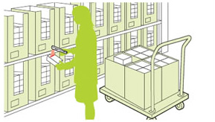

Warehouse Structure Planning
Main warehouse – fine pick
Checking & packing
Despatching

