Slide 1






$$\vec{b}x\vec{a}$$
$$−\vec{a}x\vec{b}$$
$$\vec{a}$$
$$\left\|\vec{a}x\vec{b}\right\|$$
$$\vec{b}$$
$$\vec{a}x\vec{b}$$

Slide 2







$λ$₁
$${\vec{e}}_{1}$$
$$\vec{a}$$
$λ′$₁
$λ′$₂
$${\vec{e}}_{2}$$
$λ$₂

Slide 3

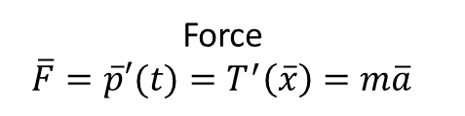
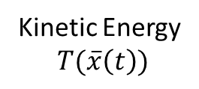


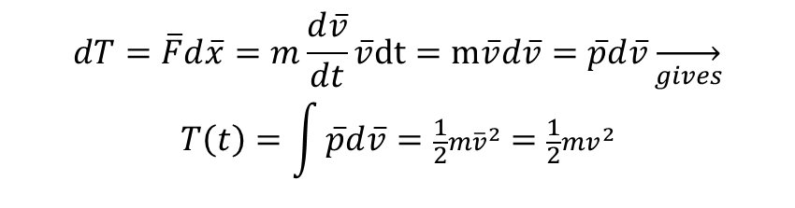
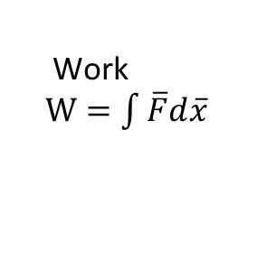

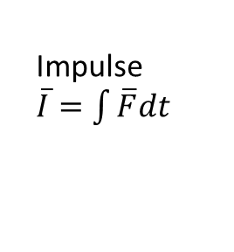

Motion
has
change
change
Momentum
$\overline{p}(t)$
Kinetic Energy
$T(\overline{x}\left(t\right))$
Impulse
$\overline{I}=\int{\overline{F}dt}$
Work
$W=\int{\overline{F}d\overline{x}}$
$$\frac{d\overline{p}}{dt}$$
rate of change
$$\frac{dT}{d\overline{x}}$$
Force
$\overline{F}=\overline{p}′(t)=T^{′}\left(\overline{x}\right)=m\overline{a}$
Sum$d\overline{p}=\overline{F}dt$
Sum$dT=\overline{F}d\overline{x}$
$$dT=\overline{F}d\overline{x}=m\frac{d\overline{v}}{dt}\overline{v}dt=m\overline{v}d\overline{v}=\overline{p}d\overline{v}\overset{→}{gives}$$
$$T\left(t\right)=\int{\overline{p}d\overline{v}=\frac{1}{2}m{\overline{v}}^{2}}=\frac{1}{2}mv^{2}$$

