Slide 1


Slide 2
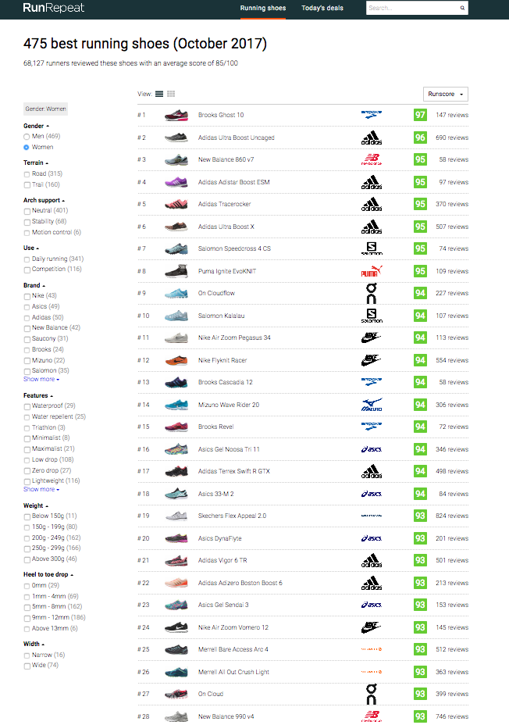
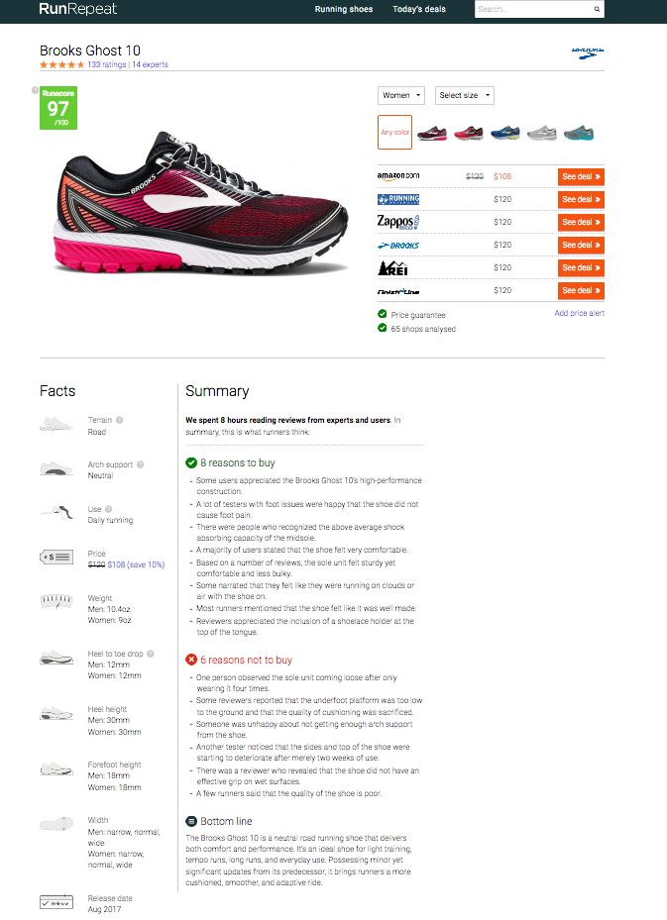

Slide 3
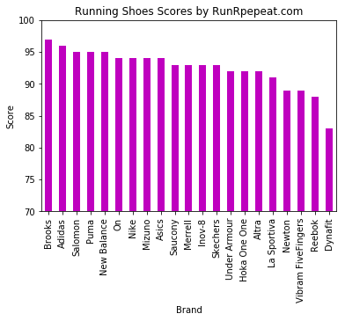
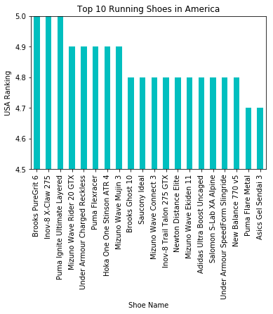
Top Brands

Slide 4
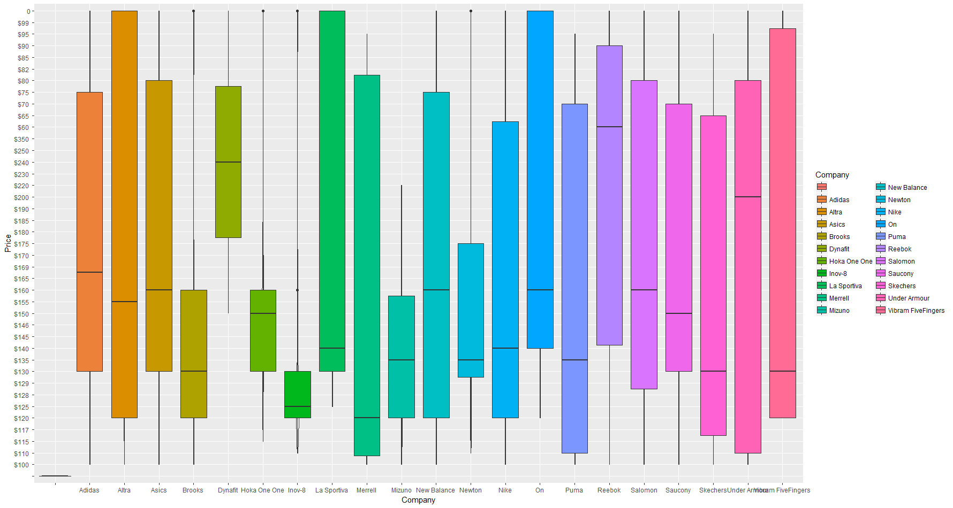
Price Distribution

Slide 5
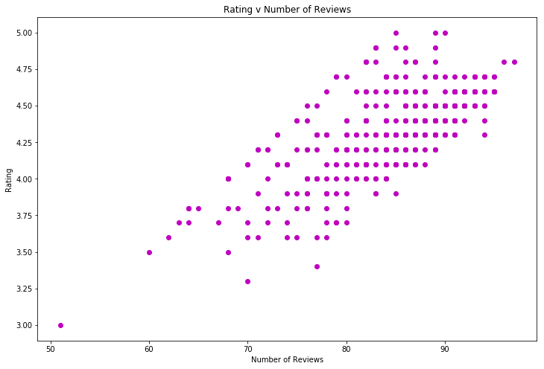
Reviews and Ratings

Slide 6
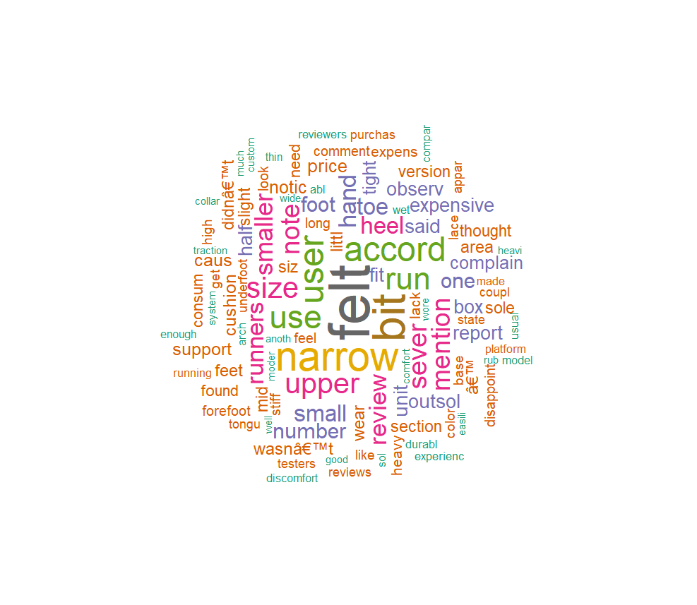
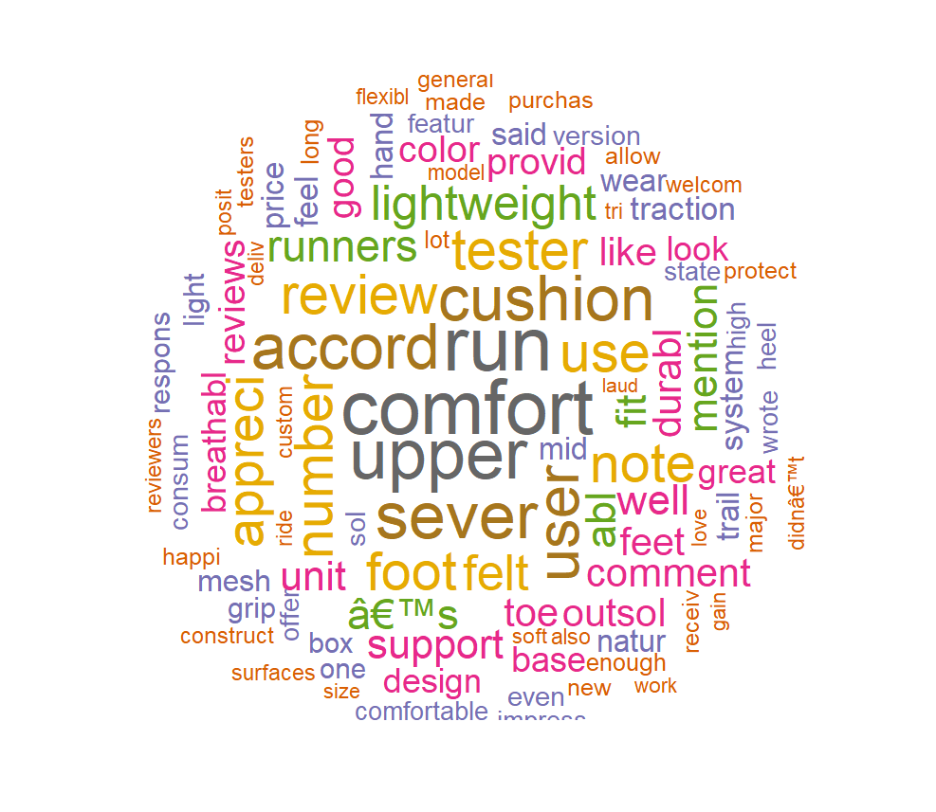
Good v Bad Reviews

Slide 7
Conclusion
1. There is a correlation between number of reviews and ratings.
2. A ‘Comfortable fit’ is an important feature for a good rating.
Improvements
1. Sentiment Analysis
2. Scrape runnersworld, amazon.com, zappos.com

