Slide 1
Employee Data Analysis using Excel
STUDENT NAME: Jacqueline Christina Cobb
REGISTER NO:312203317 954ECB952672FCEA7AA420267C3CC1C3
DEPARTMENT: B.Com
COLLEGE: Prince Shri Venkateshwara Arts & Science College

Slide 2
PROJECT TITLE
Employee Performance Analysis using Excel

Slide 3


AGENDA
Problem Statement
Project Overview
End Users
Our Solution and Proposition
Dataset Description
Modelling Approach
Results and Discussion
Conclusion
3/21/2024 Annual Review

Slide 4

PROBLEM STATEMENT
We are conducting employee data analysis in Excel to efficiently track performance metrics and identify trends for better decision-making. It helps in visualizing data and deriving insights to improve employee retention and productivity.
Notes:
Why we are doing this. Write 2 lines about it

Slide 5

PROJECT OVERVIEW
Employee analysis involves examining various aspects of employee data, such as performance, engagement, and turnover rates, to gain insights that can enhance workforce management. This analysis helps organizations identify strengths and areas for improvement, optimize talent utilization, and make informed decisions that support employee development and retention. By understanding patterns and trends within the workforce, companies can create strategies that align with business goals and foster a productive work environment.
.
Notes:
Short summary about our project. 5 lines or a para…. About employee analysis

Slide 6
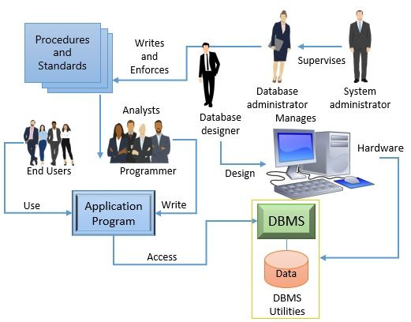

WHO ARE THE END USERS?
Notes:
Employees, employer, managers, all hirechy (also add logos, charts)

Slide 7

OUR SOLUTION AND ITS VALUE PROPOSITION
CONDITIONAL FORMATTING – Highlights cell rules – More rules – Format only cell with – Blanks – Choose colour and ok.
FILTERING - Remove the Blank Cells.
FORMULA – Performance
PIVOT TABLE - Analysis of Data
GRAPH – Data Visualization
Notes:
Enter the techniques used (conditional formatting, filtering, formula –performance, pivot table , graph- data visualization ) explain all the topics

Slide 8
Dataset Description
Employee Dataset – Kaggle – TOTAL – 26 Features
USED – 9 Features
Employee ID – 3433…..
Name – Text
Employee type
Performance level – Very High, High, Medium, Low
Gender – Male, Female
Employee Rating – Numerical
Employee Status – Active, Future Start
Business Unit – BPC, CCDR, EW, MSC, NEL, PL, PYZ, SVG, TNS, WBL
Notes:
Mention the dataset details ( employee dataset – kaggle 26- features, 9- features, emp id-num , name- text, emp type, performance level, gender, employee rating- numerical ) features u added

Slide 9

THE "WOW" IN OUR SOLUTION
Categories the Employee Based On Rating
=IFS(Z8>=5,”VERY HIGH”,Z8>=4,”HIGH”,Z8>=3,”MEDIUM”,TRUE,”LOW”)
2. ADMAIL
Styles – Hyperlink
3/21/2024 Annual Review
9
Notes:
New ideas you used (formulas)

Slide 10
MODELLING
Data Collection:
1) Department
2) Division
3) Job Function
4) Employee Classification
Feature Collection:
1) Styles
2) Conditional formatting
3) Filtering
4) Pivot Table
Data Cleaning:
1) Start Date
2) End Date
10

Slide 11
Pivot Table:
1) Pivot Chart Field List
2) Pivot Chart Filter Pane
Performance Level:
1) Very High
2) High
3) Medium
4) Low

Slide 12
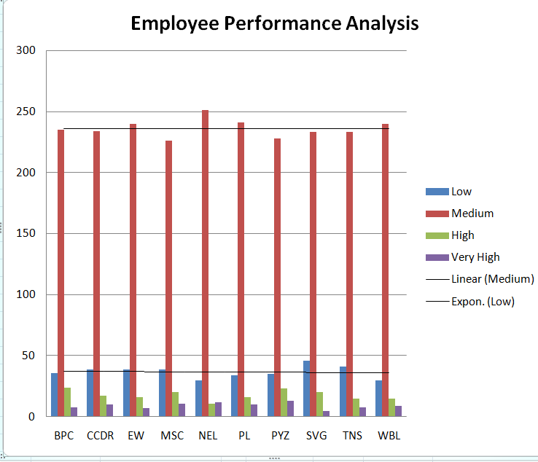
RESULTS
12

Slide 13
conclusion
The chart shows varying employee performance across categories, with some employees scoring from low to high. Performance is uneven, indicating differing levels of efficiency among employees in each category.

