Slide 1

Healthcare Disparities Primary Care access analysis
Jacqueline Clinesmith, Tony Ferri, and Jenny Johnson
MSU Data Analytics Boot Camp, 2022

Slide 2
Healthcare Disparities Primary Care Access Analysis
What are we trying to Do?
Data exploration
Analysis Results

Slide 3
What Are we trying to Do?
Notes:
We wanted to do something related to health care because each of us has someone close to us who is managing a pre-existing condition or has one themselves. Access to quality care is essential in those situations.

Slide 4
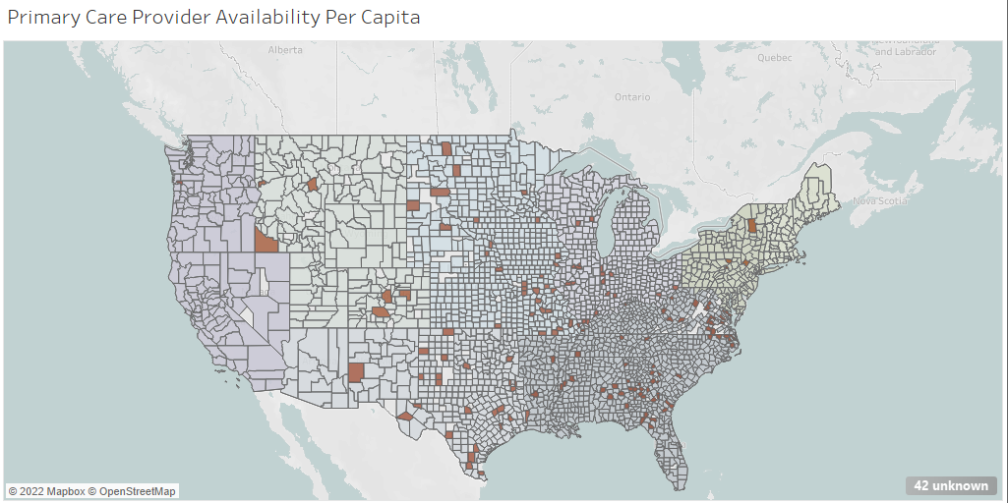
We built a machine learning model to try and determine primary care physician availability
We’re hoping to determine:
Are there counties in the United States that will be underserved by primary care physicians?
Are there any other factors that impact availability, like income, region, or population?
Meaningful access to a primary care physicians can help reduce health care disparities.
Notes:
We built a machine learning model to try and determine primary care physician availability because meaningful access can help reduce health care disparities.
Hoping to determine:
Are there counties that will be underserved
Are there any factors that impact availability, like income, region, or population

Slide 5



Tools and Technologies Used
Python
pandas
matplotlib
numpy
pathlib
collections
sklearn.metrics
Tableau
PostgreSQL
Quick DBD
Notes:
Here are the tools we used in this project. Tony will tell us about they were used to explore the data.

Slide 6
Data exploration

Slide 7

Data Exploration
Merged Data
Population
physicians
Income
Zip Codes
Model
Data from official government sources was given preference due to accuracy and reliability
Data preprocessing included:
Removing irrelevant information
Standardizing zip codes
Removing headers and footers
Standardizing column names
Transformed into bins
Calculating primary care physicians by county
Determine csv encoding1
Defining key data:
Underserved county: A county with a Primary Care physician per capita that is less than or equal to 1 standard deviation from the mean. In this data set it was 0.488
Primary Care physician's primary specialty is listed as: family medicine, nurse practitioner, general practice, preventative medicine, emergency medicine, physician assistant, internal medicine, pediatric medicine, obstetrics / gynecology
Underserved US Counties
Appropriately served US Counties
Population provided by US Census Bureau physicians provided by The Centers for Medicare and Medicaid Services
Income provided by US Bureau of Economic Analysis
Zip Codes provided by simplemaps
Notes:
Four sources of data oInitial analysis was by zip code oDecided that doing an analysis by county was more beneficial •Wanted to use government data whenever possible for accuracy and reliability oThe Centers for Medicare & Medicaid Services (CMS) oBureau of Economic Analysis (BEA) oUS Census Bureau COVID-19 Site oSimplemaps •Main data cleaning items oFilter by general practice / primary care ▪Used ten different primary specialties to define: •Family Medicine •Nurse Practitioner •General Practice •Preventative Medicine •Emergency Medicine •Physician Assistant •Internal Medicine •Pediatric Medicine •Obstetrics / Gynecology oStandardizing number of digits for zip code ▪Needed all to be five digits for comparison oEncoding prior to creation of DataFrame oRemove headers and footers prior to reading in csv file oRemoving unnecessary columns that were not relevant to our analysis •Calculated columns and bins after merging oCalculate: ▪Number of physicians per county ▪Physicians per capita oCreate categories: ▪Four equal bins for population density ▪Function to determine US region based on state ▪Create bins for physicians per capita and define “underserved” •Mean for physicians per capita was 2.551 •Standard Deviation was 2.063 •Decided that the one standard deviation less than the mean was our criteria o0.488 physicians per capita

Slide 8
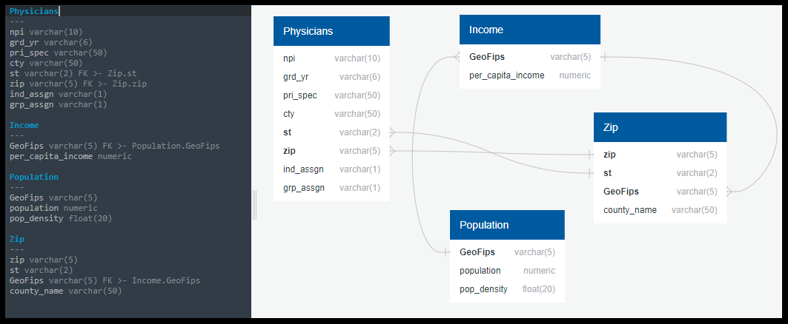
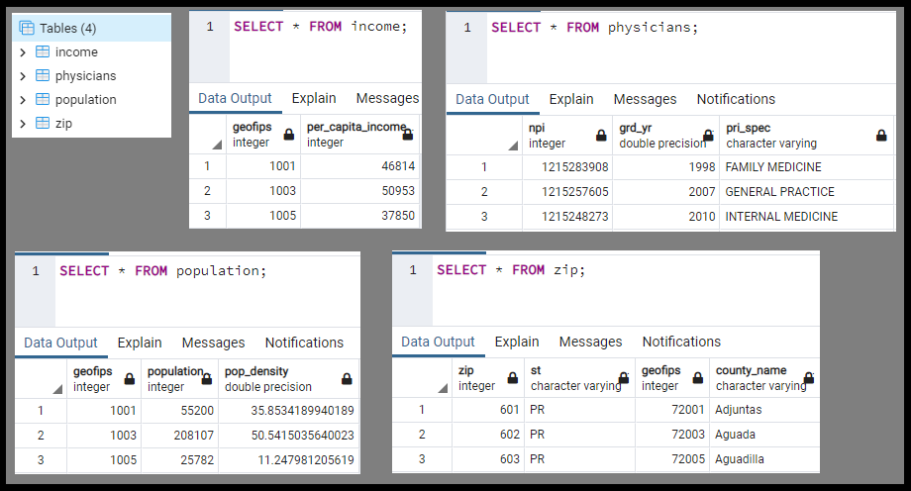
Database
Cleaned data sources were loaded into a PostgreSQL database
Cleaned data was used for Tableau and machine model
Notes:
Used 4 data sources: physicians table, income, zip (code), and population. Income, zip, and population were all joined by "GeoFips" column (counties), and those were then joined to the physicians table via the "state" and "zip" fields linked to the zip table. These can then be merged and exported to be loaded into the machine learning model. We have our data loaded into the database by which to perform queries, but primarily used Python for data manipulation.

Slide 9
Analysis Results

Slide 10
Analysis Results
Out of 3,092 counties, 148 are underserved, or ~5% of all counties, while 2881 counties, or ~95% of counties are appropriately served.
Due to the data being split 19:1, the model must include oversampling and the removal of extraneous data.
Before the logistic regression model included oversampling, the accuracy score was 96.2%, however, the r-squared score was -.077%, meaning the model was an exceptionally poor fit and could not predict new data points with accuracy.
Hyper tuning using SMOTE (Synthetic Minority Oversampling Technique) random oversampling and SMOTEENN (oversampling using SMOTE and cleaning using Edited Nearest Neighbor) using combination sampling does not improve the accuracy score or r-squared score of the model (both remain the same)
Undersampling using random undersampling or cluster centroids undersampling lowers the accuracy score and drastically lowers the r-squared score, meaning the model is no longer a good fit and can no longer accurately predict new data. For this reason, undersampling the data should be avoided.
Logistical Regression
Accuracy score: 99.9%
R-squared score: 93.8%
Notes:
Used logistic regression with oversampling, and achieved an accuracy score of 99.9% and an r-squared score of 93.8%, so the model is slightly overfitted. After we determined we were going to use pcp_per_capita_bins, a simple logistic regression model was no longer suitable, as the data was far too skewed and left us with a negative r-squared score so there was virtually no fit. The machine learning model was hyper tuned using SMOTE and SMOTEENN and did not change the accuracy score or the r-squared score. Just out of curiosity we tried undersampling and the accuracy dropped below 89% and the r-squared score was negative again, so oversampling is the way to go. For this model, there were 34 true positives, 0 false positives, 2 false negatives, and 722 true negatives. OVERALL ANALYSIS: we found that 95% of the counties included are appropriately served (have at least .488 PCP per capita) and 5% are underserved. Some solutions to solve this inequity in PCP access is increasing utilization of virtual healthcare meetings (telehealth), providing loans to physicians to open new clinics, address primary care physician shortages by increasing funding for medical students to attend medical school, and empowering registered nurses legally and monetarily to provide care similar to a primary care physician.

Slide 11
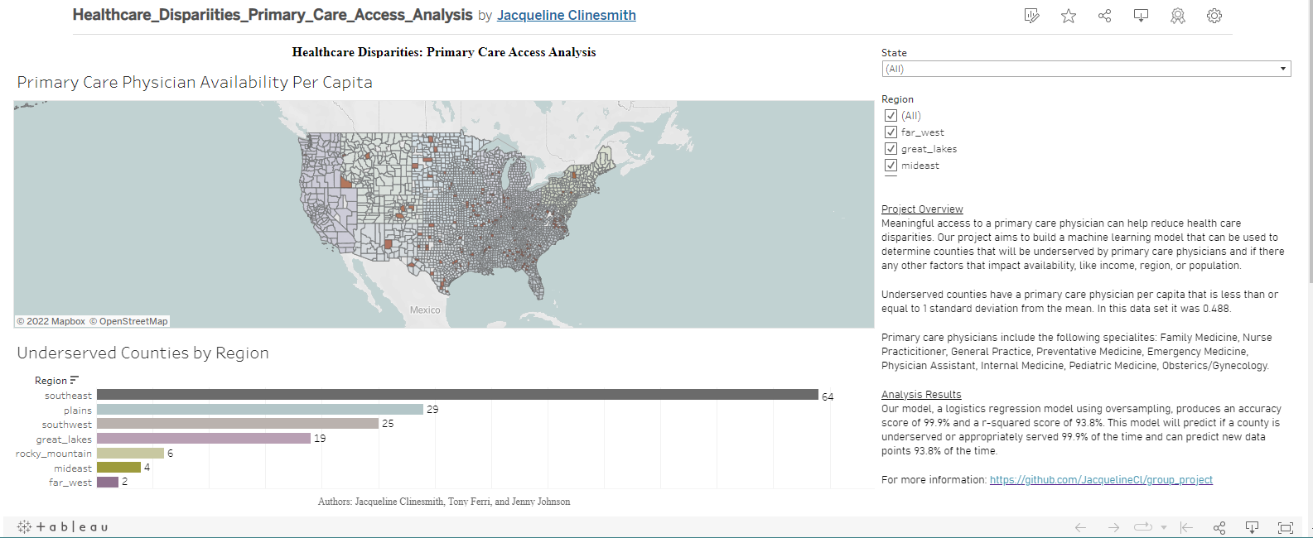
A Tableau Dashboard was created to visualize the data and allow for easy filtering.
Notes:
Created the Tableau dashboard to visualize the data and allow for easy filtering.
Demo dashboard

Slide 12
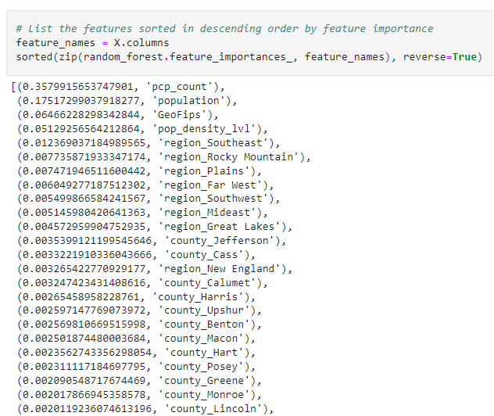
Factors the model found impactful
Notes:
We looked at the feature importance to see which features the model found impactful.

Slide 13

Questions

Slide 14
Appendix

Slide 15
Data Sources
Source | Information Used | Location
Income data from US Bureau of Economic Analysis | GeoFips and 2020 from bea_income_2020.csv | https://apps.bea.gov/iTable/iTable.cfm?reqid=70&step=30&isuri=1&major_area=4&area=xx&year=2020&tableid=20&category=720&area_type=4&year_end=-1&classification=non-industry&state=xx&statistic=3&yearbegin=-1&unit_of_measure=levels
Region data from US Bureau of Economic Analysis | Regions by State from website | https://www.bea.gov/news/2015/gross-domestic-product-state-advance-2014-and-revised-1997-2013/regional-maps
Population data from US Census Bureau | GEOID, B01001_001E, and B01001_calc_PopDensity from population_census.csv | https://covid19.census.gov/datasets/average-household-size-and-population-density-county/explore?location=15.251650%2C0.315550%2C3.67&showTable=true
Zip code data from simplemaps Basic Download | zip, state_id, county_fips, and county_name from uszips.csv | https://simplemaps.com/data/us-zips
physician data from The Centers for Medicare and Medicaid Services | NPI, grd_yr, pri_spec, city, st, zip, ind_assgn, and grp_assgn from physician_data.csv | https://data.cms.gov/physician-data/dataset/mj5m-pzi6

