Slide 1

Healthcare Disparities Primary Care access analysis
Jacqueline Clinesmith, Tony Ferri, and Jenny Johnson
MSU Data Analytics Boot Camp, 2022

Slide 2
Healthcare Disparities Primary Care Access Analysis
What are we trying to Do?
Data exploration
Analysis Results

Slide 3
What Are we trying to Do?

Slide 4
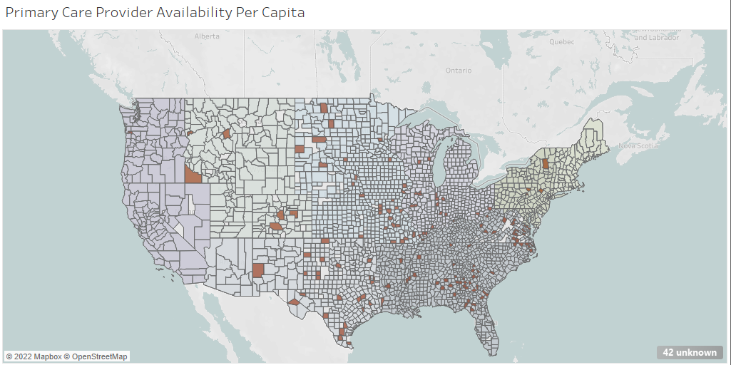
We’re building a machine learning model to try and determine primary care physician availability
We’re hoping to determine:
Are there counties in the United States that will be underserved by primary care physicians?
Are there any other factors that impact availability, like income, region, or population?
Meaningful access to a primary care physicians can help reduce health care disparities.

Slide 5



Tools and Technologies Used
Python
pandas
matplotlib
numpy
pathlib
collections
sklearn.metrics
Tableau
PostgreSQL
Quick DBD

Slide 6
Data exploration

Slide 7

Data Exploration
Merged Data
Population
physicians
Income
Zip Codes
Model
Data from official government sources was given preference due to accuracy and reliability
Data preprocessing included:
Removing irrelevant information
Standardizing zip codes
Removing headers and footers
Standardizing column names
Transformed into bins
Calculating primary care physicians by county
Determine csv encoding1
Defining key data:
Underserved county: A county with a Primary Care physician per capita that is less than or equal to 1 standard deviation from the mean. In this data set it was 0.488
Primary Care physician's primary specialty is listed as: family medicine, nurse practitioner, general practice, preventative medicine, emergency medicine, physician assistant, internal medicine, pediatric medicine, obstetrics / gynecology
Underserved US Counties
Appropriately served US Counties
Population provided by US Census Bureau physicians provided by The Centers for Medicare and Medicaid Services
Income provided by US Bureau of Economic Analysis
Zip Codes provided by simplemaps

Slide 8
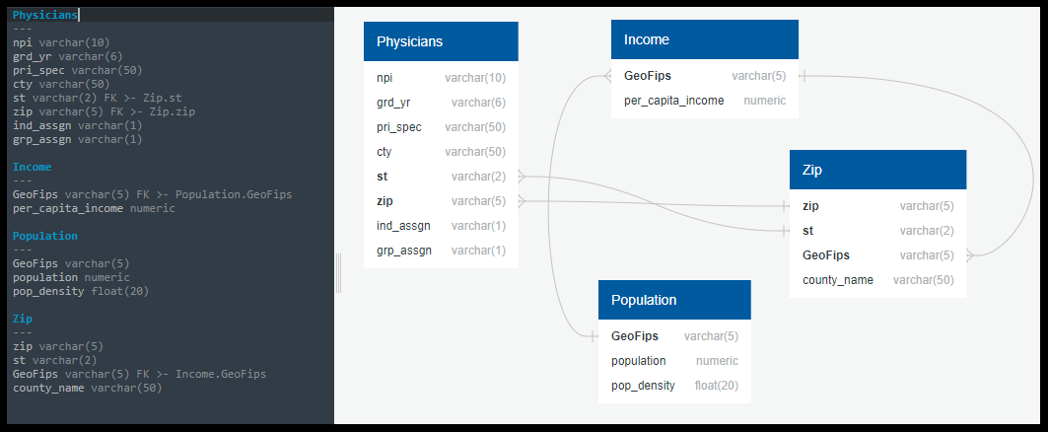
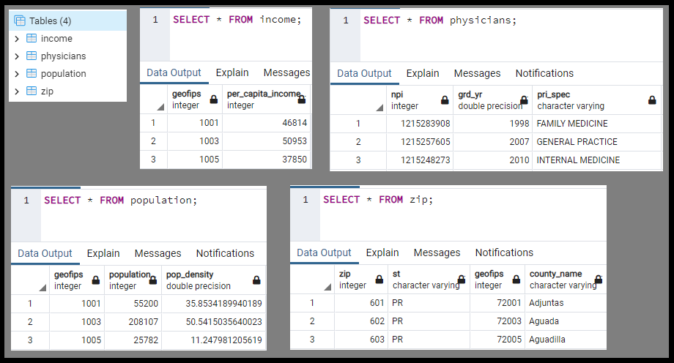
Database
Cleaned data sources were loaded into a PostgreSQL database
Cleaned data was used for Tableau and machine model

Slide 9
Analysis Results

Slide 10
Analysis Results
Out of 3,092 counties, 148 are underserved, or ~5% of all counties, while 2881 counties, or ~95% of counties are appropriately served.
Due to the data being split 19:1, the model must include oversampling and the removal of extraneous data.
Before the logistic regression model included oversampling, the accuracy score was 96.2%, however, the r-squared score was -.077%, meaning the model was an exceptionally poor fit and could not predict new data points with accuracy.
Hyper tuning using SMOTE (Synthetic Minority Oversampling Technique) random oversampling and SMOTEENN (oversampling using SMOTE and cleaning using Edited Nearest Neighbor) using combination sampling does not improve the accuracy score or r-squared score of the model (both remain the same)
Undersampling using random undersampling or cluster centroids undersampling lowers the accuracy score and drastically lowers the r-squared score, meaning the model is no longer a good fit and can no longer accurately predict new data. For this reason, undersampling the data should be avoided.
Logistical Regression
Accuracy score: 99.9%
R-squared score: 93.8%

Slide 11
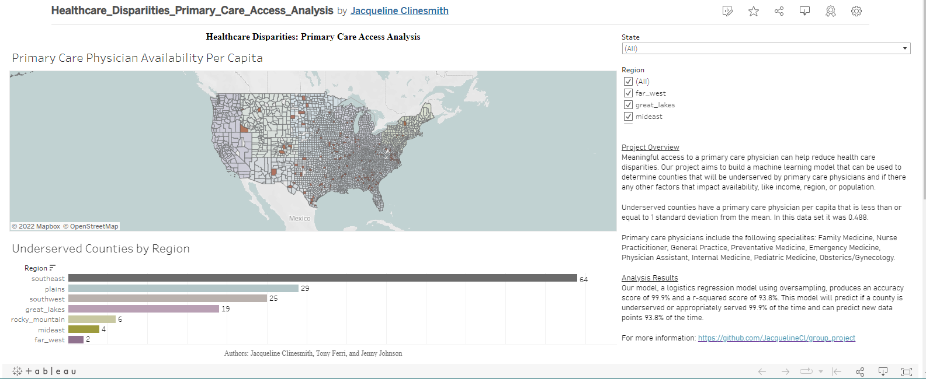
A Tableau Dashboard was created to visualize the data and allow for easy filtering.

Slide 12
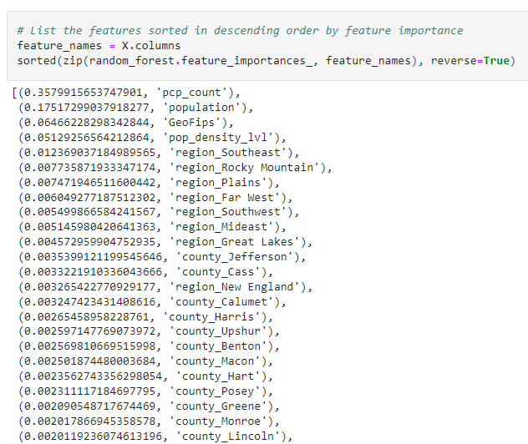
Factors the model found impactful

Slide 13

Questions

Slide 14
Appendix

Slide 15
Data Sources
Source | Information Used | Location
Income data from US Bureau of Economic Analysis | GeoFips and 2020 from bea_income_2020.csv | https://apps.bea.gov/iTable/iTable.cfm?reqid=70&step=30&isuri=1&major_area=4&area=xx&year=2020&tableid=20&category=720&area_type=4&year_end=-1&classification=non-industry&state=xx&statistic=3&yearbegin=-1&unit_of_measure=levels
Region data from US Bureau of Economic Analysis | Regions by State from website | https://www.bea.gov/news/2015/gross-domestic-product-state-advance-2014-and-revised-1997-2013/regional-maps
Population data from US Census Bureau | GEOID, B01001_001E, and B01001_calc_PopDensity from population_census.csv | https://covid19.census.gov/datasets/average-household-size-and-population-density-county/explore?location=15.251650%2C0.315550%2C3.67&showTable=true
Zip code data from simplemaps Basic Download | zip, state_id, county_fips, and county_name from uszips.csv | https://simplemaps.com/data/us-zips
physician data from The Centers for Medicare and Medicaid Services | NPI, grd_yr, pri_spec, city, st, zip, ind_assgn, and grp_assgn from physician_data.csv | https://data.cms.gov/physician-data/dataset/mj5m-pzi6

