Slide 1

Healthcare Disparities Primary Care access analysis
Jacqueline Clinesmith, Tony Ferri, and Jenny Johnson
MSU Data Analytics Boot Camp, 2022

Slide 2
Healthcare Disparities Primary Care Access Analysis
What are we trying to Do?
Data exploration
Analysis Results

Slide 3
What Are we trying to Do?

Slide 4
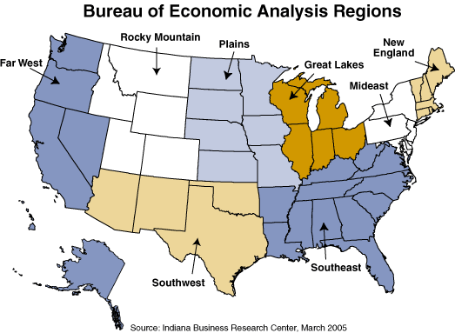
Build a machine learning model that can determine primary care provider availability
We’re hoping to determine:
Are there counties in the United States that will be underserved by primary care providers?
Are there any other factors that impact availability, like income, region, or population?
Meaningful access to a primary care providers can help reduce health care disparities.

Slide 5
Data exploration

Slide 6

Data Exploration
Merged Data
Population
Providers
Income
Zip Codes
Model
Data from official government sources was given preference due to accuracy and reliability
Data preprocessing included:
Removing irrelevant information
Standardizing zip codes
Removing headers and footers
Standardizing column names
Transformed into bins
Calculating primary care providers by county
Determine csv encoding1
Underserved US Counties
Appropriately served US Counties
Population provided by US Census Bureau Providers provided by The Centers for Medicare and Medicaid Services
Income provided by US Bureau of Economic Analysis
Zip Codes provided by simplemaps

Slide 7
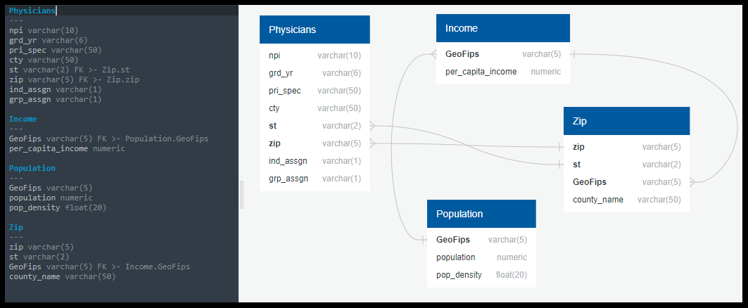
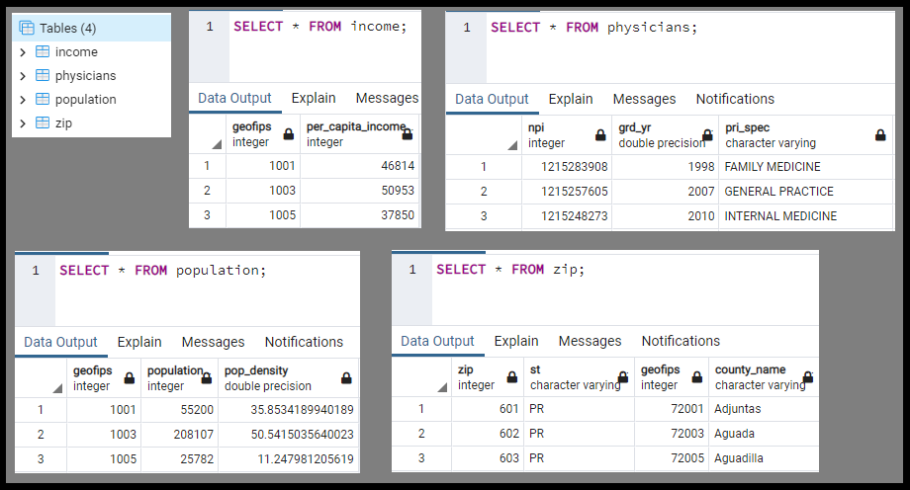
Database
Cleaned data sources were loaded into a PostgreSQL database
Next steps:
Join all tables in Postgres
Connect merged table to analysis

Slide 8
Analysis Results

Slide 9
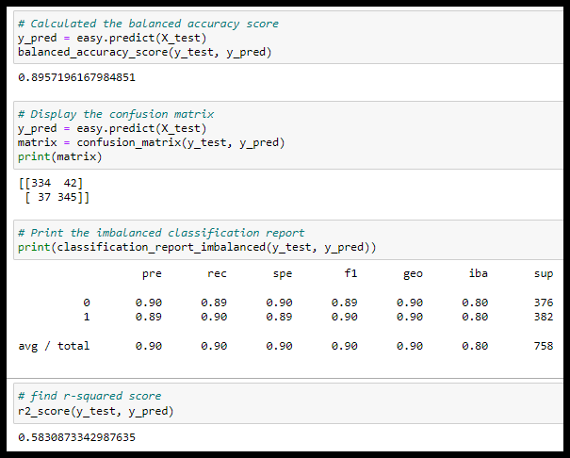
Analyze Results
Logistical Regression
Accuracy score: 89.6%
R-squared score: 58.3%

Slide 10
Story Board Title
Map of US by county or region color coded by underserved and appropriately served
Information on benefits of Primary Care Providers
Counts of underserved counties by region and percentage of counties that is
Interesting graphic/image/etc
Weight of model factors affecting underserved designation
Authors and References

Slide 11

Questions

Slide 12
Appendix

Slide 13
Data Sources
Source | Information Used | Location
Income data from US Bureau of Economic Analysis | GeoFips and 2020 from bea_income_2020.csv | https://apps.bea.gov/iTable/iTable.cfm?reqid=70&step=30&isuri=1&major_area=4&area=xx&year=2020&tableid=20&category=720&area_type=4&year_end=-1&classification=non-industry&state=xx&statistic=3&yearbegin=-1&unit_of_measure=levels
Region data from US Bureau of Economic Analysis | Regions by State from website | https://www.bea.gov/news/2015/gross-domestic-product-state-advance-2014-and-revised-1997-2013/regional-maps
Population data from US Census Bureau | GEOID, B01001_001E, and B01001_calc_PopDensity from population_census.csv | https://covid19.census.gov/datasets/average-household-size-and-population-density-county/explore?location=15.251650%2C0.315550%2C3.67&showTable=true
Zip code data from simplemaps Basic Download | zip, stae_id, county_fips, and county_name from uszips.csv | https://simplemaps.com/data/us-zips
Physician data from The Centers for Medicare and Medicaid Services | NPI, grd_yr, pri_spec, city, st, zip, ind_assgn, and grp_assgn from physician_data.csv | https://data.cms.gov/provider-data/dataset/mj5m-pzi6

