Slide 1
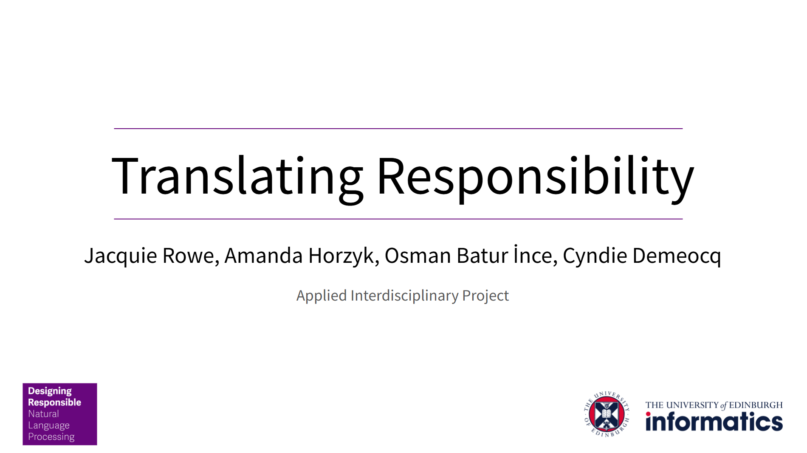


DR-NLP Workshop
Monday 25 November
12.30-14.00

Slide 2
WELCOME
Timing: 12.30-14.00 then lunch
Investigating:
How do CDT students define “responsible” in the context of Responsible AI/NLP?
What sources of knowledge or people influence and shape CDT students’ opinions on Responsible AI/NLP?
What are CDT students’ experiences with Responsible AI?
There are no right or wrong answers!

Slide 3
HOUSEKEEPING
Consent forms
Audio recording
Talk one at a time
Private, non-recorded feedback sessions also available
Chatham House Rule
Any questions?

Slide 4





ACTIVITY 1: ICEBREAKER (10 MINS)
How important is each concept for understanding “responsibility” in AI and NLP research and practice?

Slide 5

ACTIVITY 1: ICEBREAKER (10 MINS)
How important is each concept for understanding “responsibility” in AI and NLP research and practice?
FLIP
Will the ranking change?

Slide 6
ACTIVITY 2: DISCUSSION (25 MINS)
1. How would you define responsible AI/NLP?
Has your definition changed over time due to a particular experience or situation? How did it change?
Are there aspects of Responsible AI that you feel are especially important in NLP? If so, why?

Slide 7
ACTIVITY 2: DISCUSSION (25 MINS)
2. What sources most influence your understanding, approach or opinion of Responsible AI/NLP?
e.g. academic industry guidelines, personal research, groups, individuals
Are there any specific organisations, or frameworks that have influenced your view on Responsible AI/NLP? How does your field or workplace influence your approach to Responsible AI/NLP?

Slide 8
ACTIVITY 2: DISCUSSION (25 MINS)
3. Can you describe your experiences working with Responsible AI? How have these shaped your approach to AI and NLP?
What challenges have you encountered in implementing Responsible AI practices? How have these experiences impacted your perspective?
What considerations does Responsible AI bring to NLP? Do practices or ethical guidelines differ for responsible AI in NLP versus other AI applications?

Slide 9
ACTIVITY 3: SCENARIO (45 MINS)
BRIEF
Your group has been selected to carry out a responsible AI project to develop assistive technology for undergraduate deaf students, in partnership with Jisc*. You must:
Develop a personalised quiz-question generation tool which is specialised for the needs of deaf students. This will accompany the video-based learning resources currently used by deaf undergraduate students. This resources include captions.
Work with your supervisors throughout the project, who specialise in Deaf studies and assistive technology, as well as with Jisc
Deliver the software within the timeline of 12 months
Keep resource costs to within £10,000 (funding provided by Jisc)
*Jisc is a digital, data and technology agency focused on tertiary education, research and innovation. It is a CDT partner and is a not-for-profit organisation.

Slide 10
ACTIVITY 3: SCENARIO (45 MINS)
BRIEF
Your group has been selected to carry out a responsible AI project to develop assistive technology for undergraduate deaf students, in partnership with Jisc*. You must:
Develop a personalised quiz-question generation tool which is specialised for the needs of deaf students. This will accompany the video-based learning resources currently used by deaf undergraduate students. This resources include captions.
Work with your supervisors throughout the project, who specialise in Deaf studies and assistive technology, as well as with Jisc
Deliver the software within the timeline of 12 months 3 months
Keep resource costs to within £10,000 £2,000 (funding provided by Jisc)
*Jisc is a digital, data and technology agency focused on tertiary education, research and innovation. It is a CDT partner and is a not-for-profit organisation.

Slide 11
THANK YOU!

