Slide 1


CRAZY PREPARED
Processing Reserve items at point of order
(AND OTHER FACTS ON ALMA COURSE RESERVES)
Jackie Saavedra, Cataloging/Metadata Librarian

Slide 2
BACKGROUD INFORMATION
Experience in Circulation and Cataloging
University of the District of Columbia
The only public university in Washington, DC
Offer 75 undergraduate and graduate degree programs
Current FTE ~4,000 students
UDC Library
Part of the Washington Research Library Consortium
Migrated to Alma and Primo VE in July of 2018
7 (soon to be 8) Librarians and ~20 staff

Slide 3
UDC’S RESERVES PROGRAM
Given funding by the CAO to purchase textbooks for Fall 2019
Previous Reserve services were ad hoc and unofficial
Library compiled a list of textbooks from
University departments
UDC bookstore
Then we created a “Master List” spreadsheet shared by Acquisitions, Cataloging, and Circ
Two Reserve locations at UDC
Main Campus
Community College
Final order date of 8/1/2019
We only use Alma, not Leganto; but this workflow can be used in both systems

Slide 4
ACQUISITIONS WORKFLOW
1. Order from Amazon or Campus Boosktore
2. Input order information into Alma

Slide 5
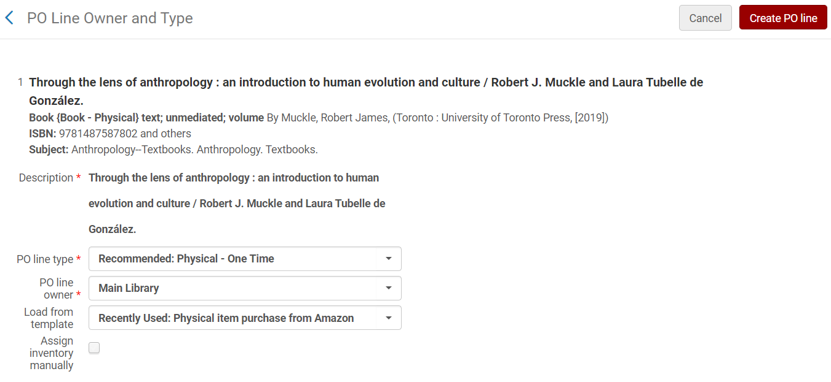
ACQUISITIONS WORKFLOW
2. Input order information into Alma

Slide 6
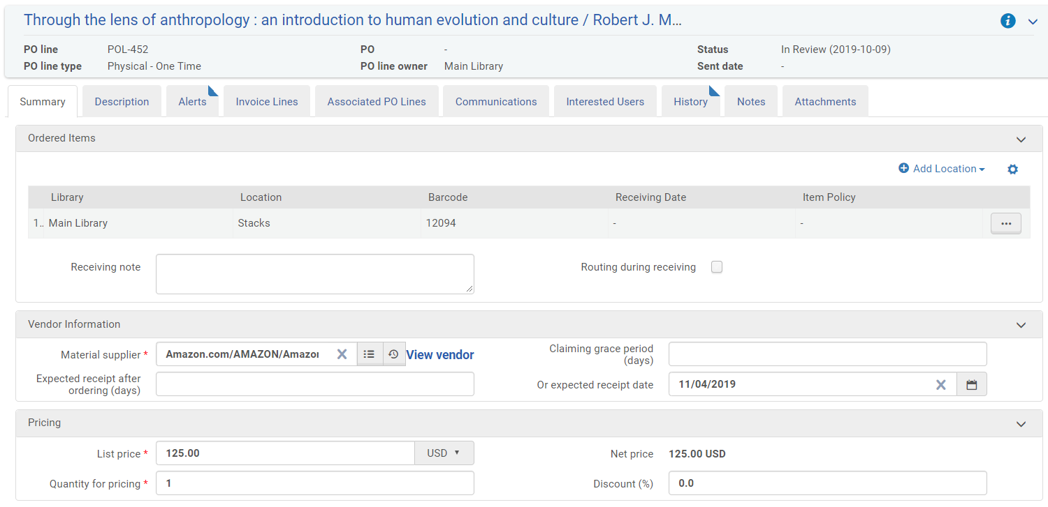
ACQUISITIONS WORKFLOW
2. Input order information into Alma

Slide 7
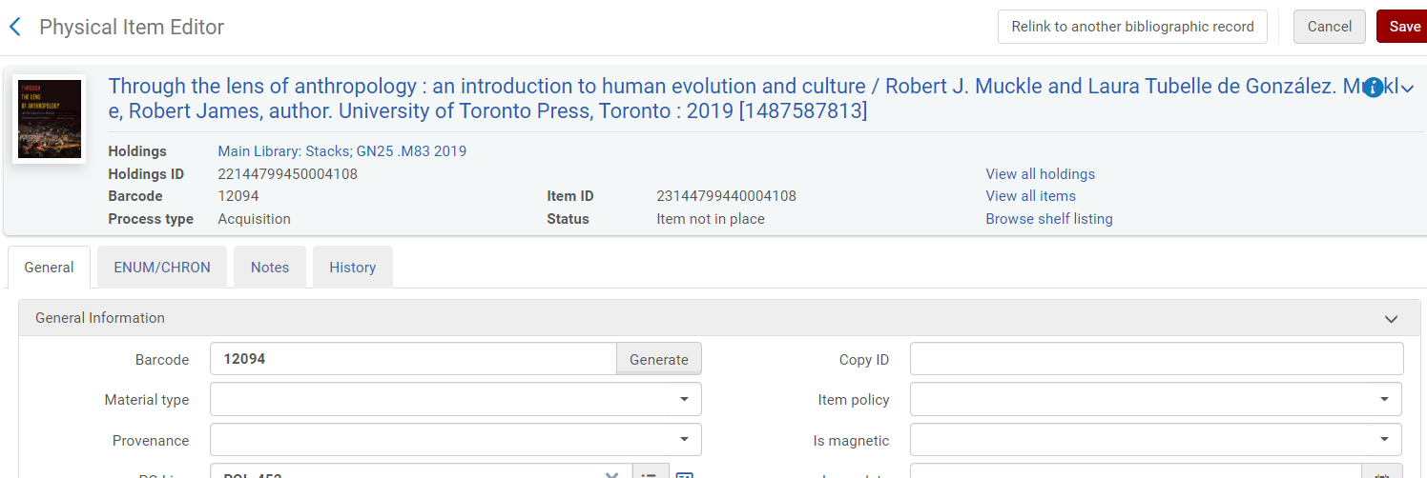
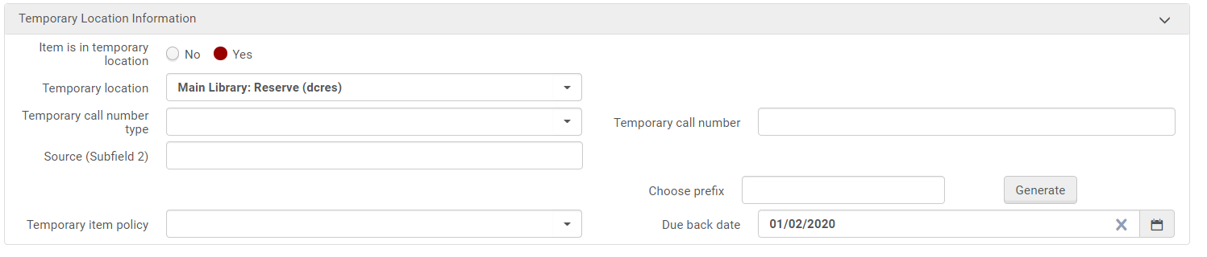
ACQUISITIONS WORKFLOW
2. Input order information into Alma

Slide 8
ACQUISITIONS WORKFLOW
2. Input order information into Alma

Slide 9
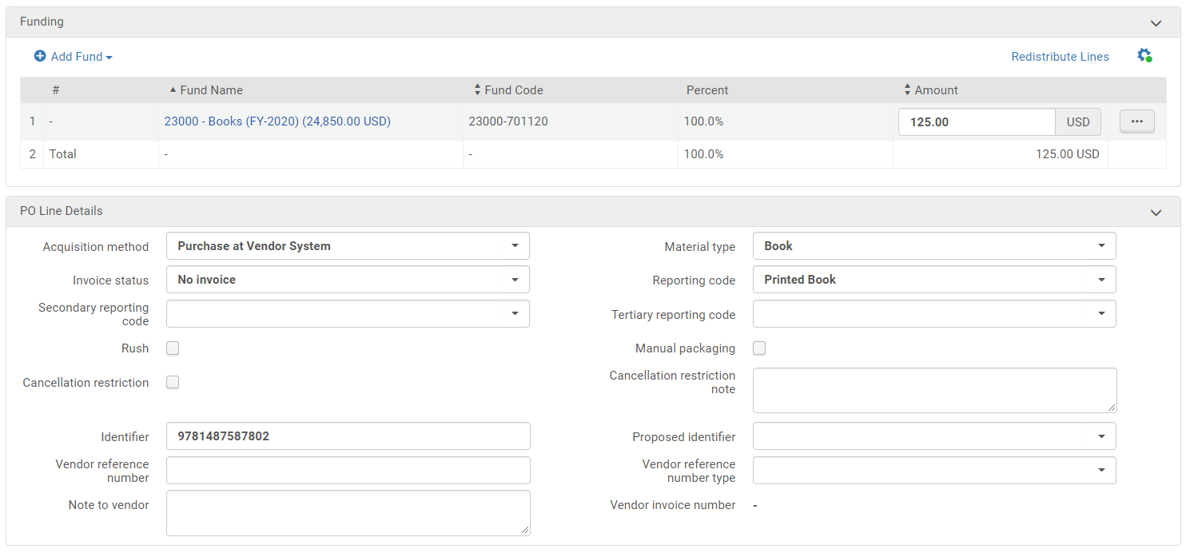
ACQUISITIONS WORKFLOW
2. Input order information into Alma

Slide 10
ACQUISITIONS WORKFLOW
1. Order from Amazon or Campus Boosktore
2. Input order information into Alma
3. Items marked as Purchased in Master List

Slide 11
CIRCULATION WORKFLOW
Course 1
Citation 1
Citation 2
Citation 3
Reading List 1
Course 2
Reading List 2
Citation 4
Citation 5

Slide 12
CIRCULATION WORKFLOW
Can create Courses and Reading Lists in batch via S/FTP connection
https://knowledge.exlibrisgroup.com/Alma/Product_Documentation/010Alma_Online_Help_(English)/090Integrations_with_External_Systems/040Fulfillment/010Courses_and_Reading_Lists/Configuring_Course_Loading
Create Courses & Reading Lists

Slide 13
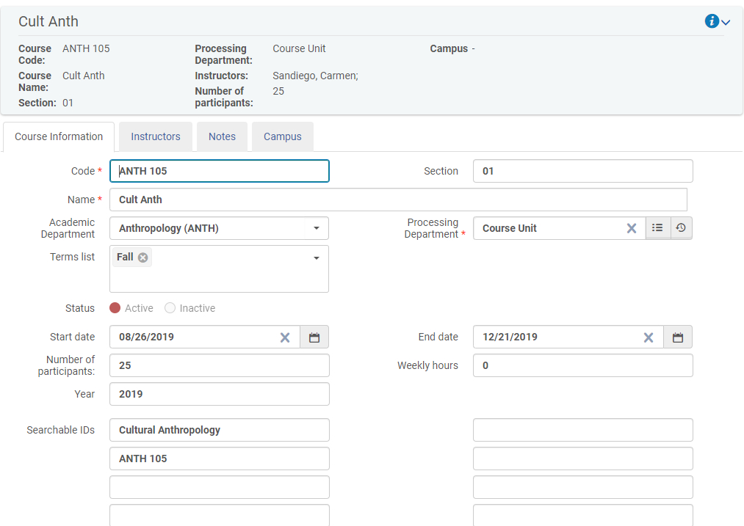
CIRCULATION WORKFLOW
Create Courses & Reading Lists

Slide 14
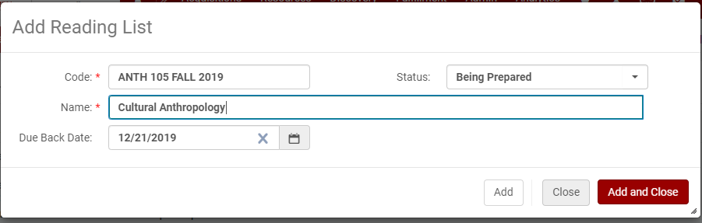
CIRCULATION WORKFLOW
Create Courses & Reading Lists

Slide 15
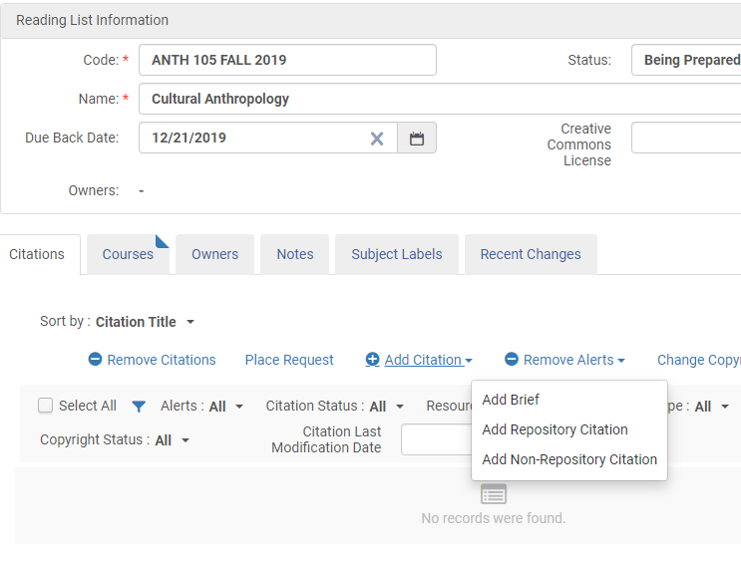
CIRCULATION WORKFLOW
Create Courses & Reading Lists
Attach Citations to Reading Lists

Slide 16
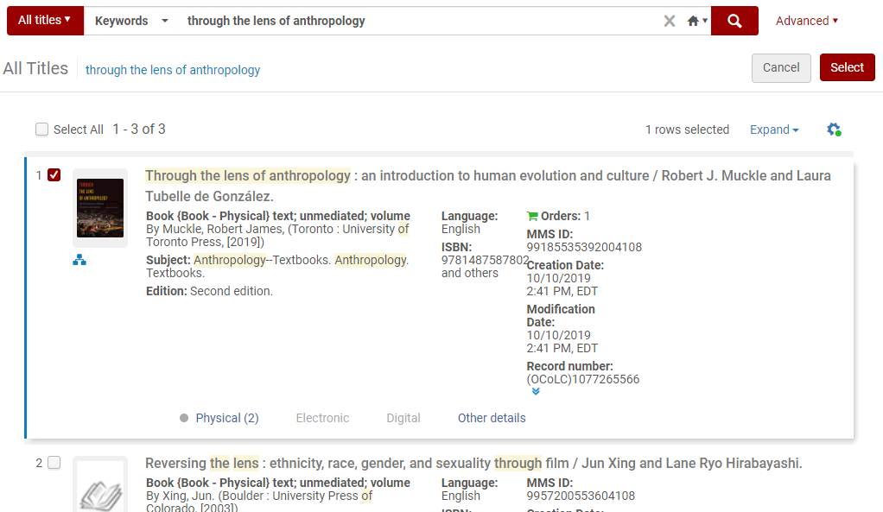
CIRCULATION WORKFLOW
Create Courses & Reading Lists
Attach Citations to Reading Lists
Mark items as Done in Master List

Slide 17
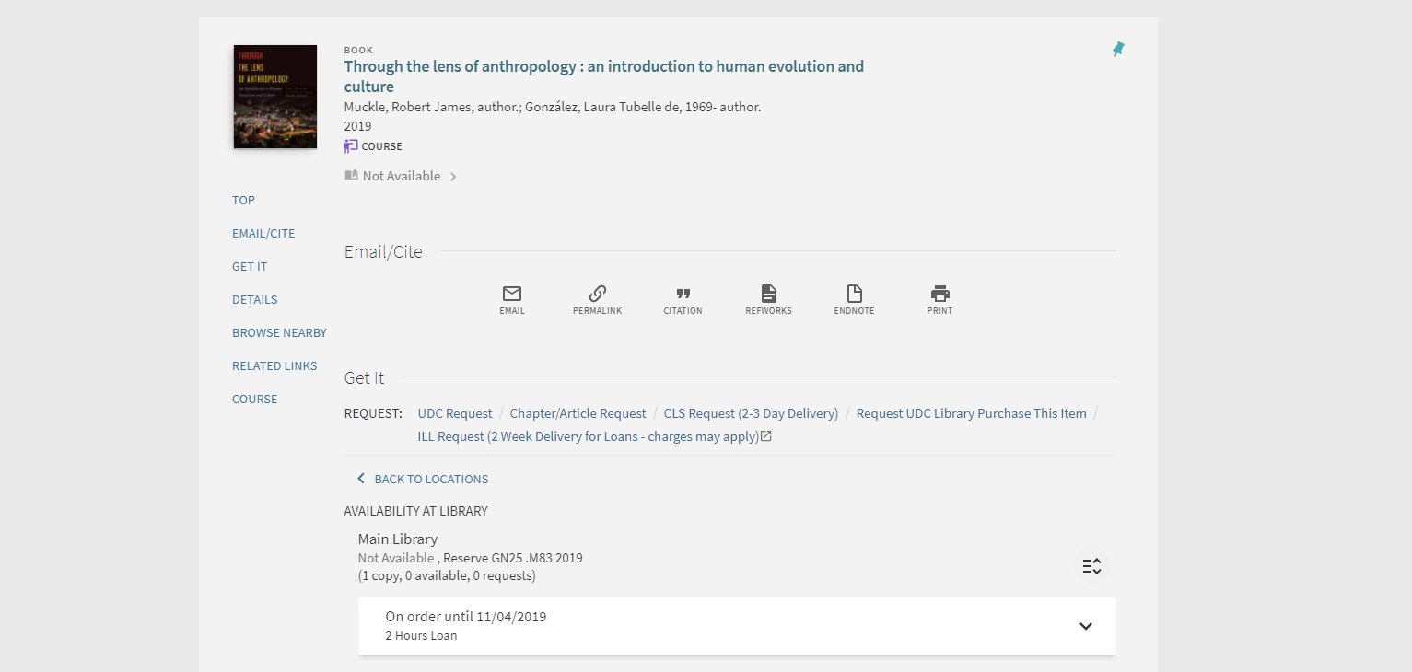
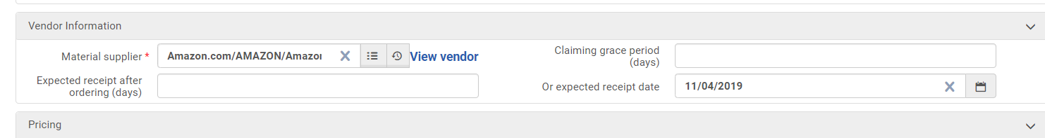
PRIMO VIEW

Slide 18
ONCE THE ITEMS ARRIVE…
Mark items as received
Catalog items
Scan in items and shelve
1. ACQUISITIONS
2. CATALOGING
3. CIRCULATION

Slide 19
CATALOGING TIPS FOR THIS WORKFLOW
Bib
Holdings
Item
Course Reserve citation is attached to the Bib record
PO Line is attached to the item record

Slide 20
CATALOGING TIPS FOR THIS WORKFLOW
Bib
Holdings
Item with PO Line
Updating the bib record for an item already attached to a Course
OVERLAID
If the bib record is overlaid, the citation will remain attached to the course

Slide 21
CATALOGING TIPS FOR THIS WORKFLOW
Bib
Holdings
Item with PO Line
Bib
You must delete the old citation and add the new one to the Reading List.
Course Reserve citation is still attached to the original Bib record.

Slide 22
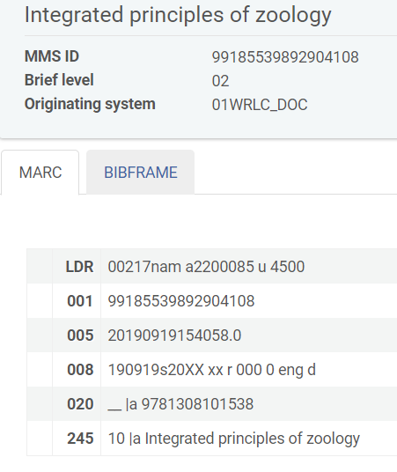
CATALOGING TIPS FOR THIS WORKFLOW
How comfortable is your Library with allowing stub records to be unsuppressed?
If it is unsuppressed, patrons and staff will know when the book will arrive
BUT these are often suppressed because the records are sparse, may contain incorrect information, etc.

Slide 23
TIPS FOR RESERVES IN GENERAL
Start dates for Courses in Reserves dictate when it is searchable in Primo under the Course Reserve search scope - set the start date to before the actual start of the semester

Slide 24
CHANGES FOR SPRING 2020
Start dates for courses will be January 1, 2020
Create Master List solely from UDC Bookstore’s textbook adoption list
Create more dynamic Master List spreadsheet
With the added ability to state which records have been relinked and therefore need to be updated in the Reading List
Creating Courses and Reading Lists in batch via S/FTP connection

Slide 25
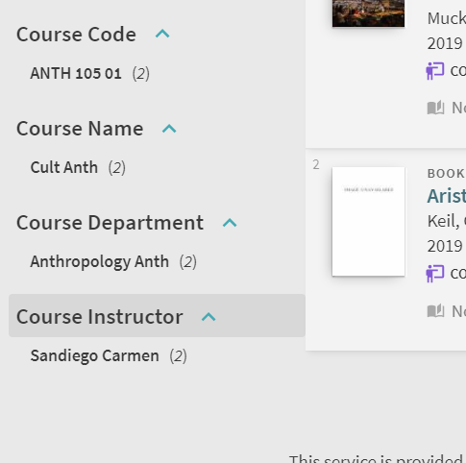
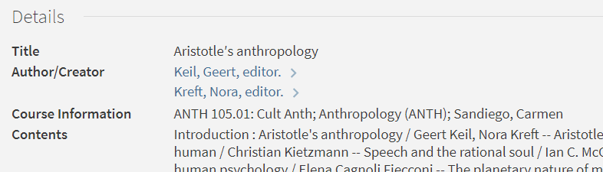
CHANGES FOR SPRING 2020
Add more Primo VE Features for the Course Reserves search scope
Facets
Full Record Details
https://knowledge.exlibrisgroup.com/Primo/Product_Documentation/020Primo_VE/025Display_Configuration/Configuring_Course_Reserves_for_Primo_VE

Slide 26
QUESTIONS?
Jackie Saavedra
Cataloging/Metadata Librarian,
jacqueline.saavedra@udc.edu
202 274 6030

