Slide 1
From Data Entry to MARC
Transforming Spreadsheets
Into MARC Records Using MARCEdit
Jackie Saavedra | Cataloger/Metadata Librarian
University of the District of Columbia

Slide 2
Background
Backlog of old theses dating from the 1950s to 1990s
Theses were scanned a few years ago, but the scans were not available online – largely because theses would need original catalog records
Unfortunately no one with the necessary cataloging training in Tech Services had the time!
BUT many of our staff were comfortable with spreadsheets and data entry

Slide 3
Workflow
Data entry into a spreadsheet
Export spreadsheet to an .mrk file using MARCEdit’s Delimited Text Translator
Transform to acceptable MARC21 Records in MARCEdit
Upload to ILS

Slide 4
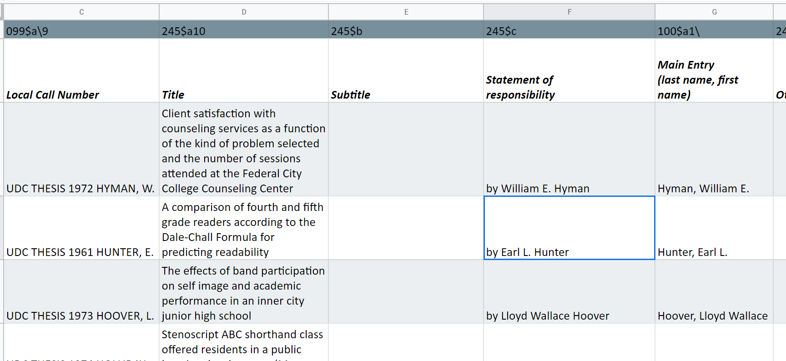
Step #1 : Data entry
Each row represented one thesis
Each column represented either a MARC field or subfield

Slide 5
Step #1 : Data entry
Some basic cataloging skills had to be taught
Ways to cut down on typing errors
Automatically set values. EX. Place of production is always Washington, DC
Drop down lists. EX. Degree type
Spreadsheet is reviewed and edited by a cataloger
Each row marked on spreadsheet when it was ready to be uploaded to MARCEdit

Slide 6

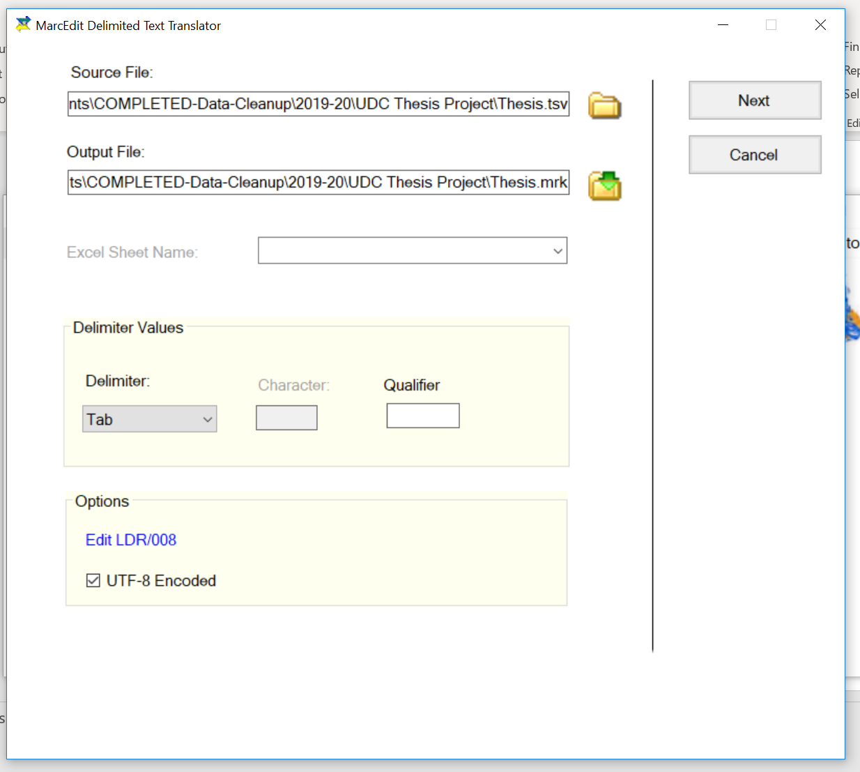
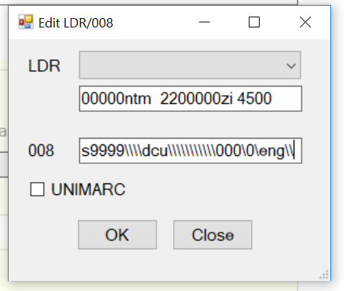
Step #2 : Export to MARCEdit
Export spreadsheet as a Tab Separated Value (.tsv) file
Open MARCEdit’s Delimited Text Translator

Slide 7
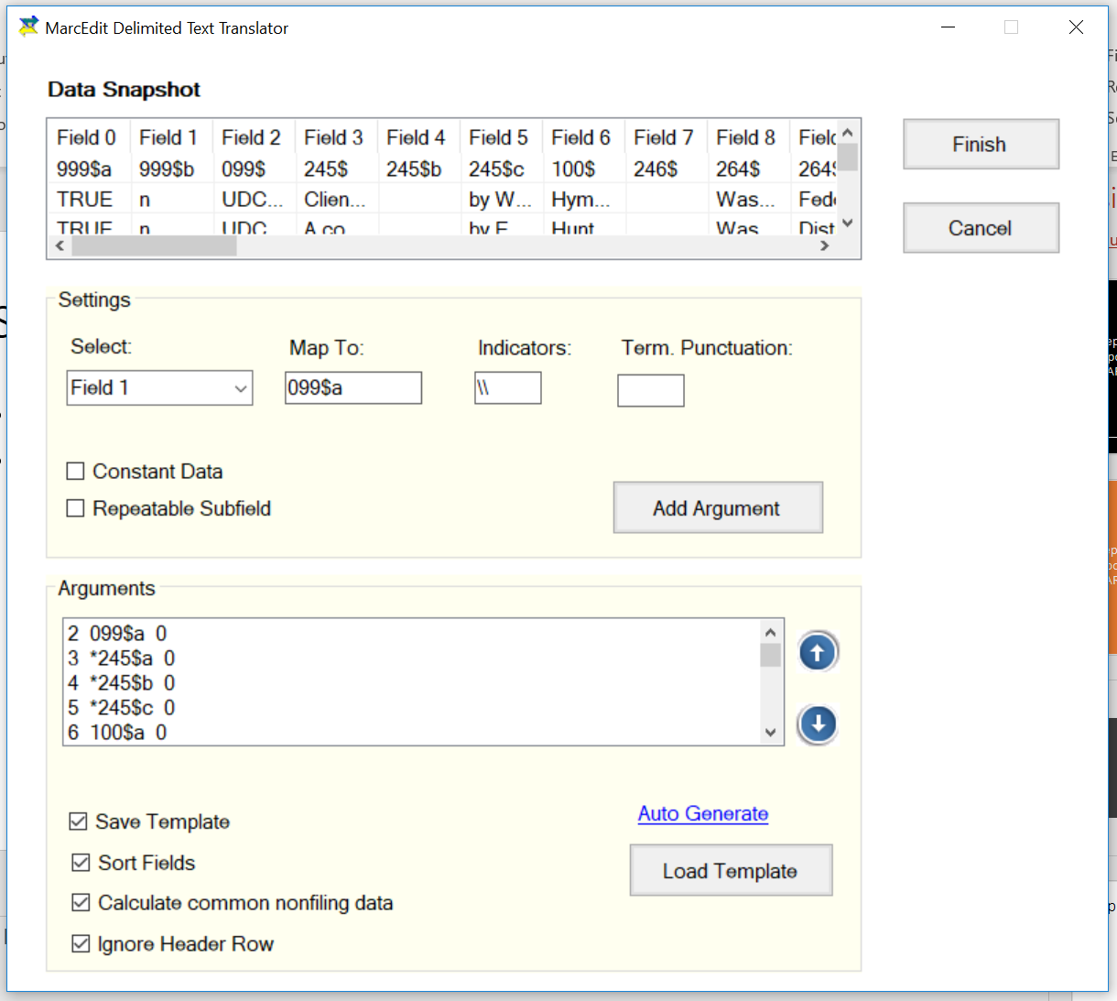
Step #2 : Export to MARCEdit

Slide 8
Step #3 : Transform to MARC21 in MARCEdit
Open the newly created .mrk file in MARCEdit
Edit records using a task list
Add ISBD punctuation, sometimes using regular expressions
Add extra fields that are needed in every record
Add info from other fields to 008 field using regular expressions
RDA Helper
Validate MARC Records

Slide 9
Step #4 : Upload to ILS
Save as .mrc file
Upload to your ILS using your own workflow

Slide 10
Helpful Resources
How to use Delimited Text Translator
http://guides.library.illinois.edu/c.php?g=463460&p=3168299
How to create a task list in MARCEdit
http://guides.library.illinois.edu/c.php?g=463460&p=3168022
https://www.youtube.com/watch?v=gmqTGfTubU4
Regular expressions
The basics https://github.com/zemkat/OLAC2017/tree/master/RegularExpressions
Regular expressions in MARCEdit https://www.youtube.com/watch?v=5XFkcfg0ghw
RegEx Rules! Using regular expressions in MARCEdit https://library.law.fordham.edu/marcedit-workshops/

Slide 11

QUESTIONS?
Jackie Saavedra
Cataloger/Metadata Librarian,
jacqueline.saavedra@udc.edu
202 274 6030
https://github.com/JacquelineSaavedra/From-data-entry-to-MARC

