Slide 1
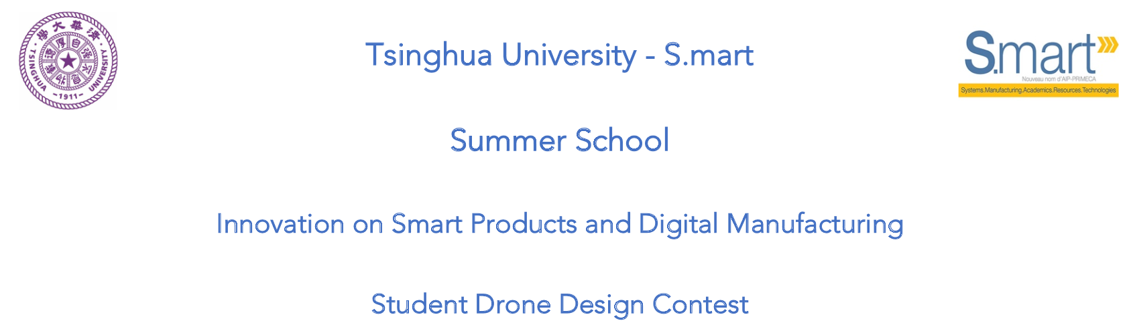
Chenzi Cusseau Haoyun Hung Lagabbe Larue Yang Di

Slide 2
Functional analysis
Our need: “Find systems to reduce aircraft downtime by detecting early-onset failures”
4 parts:

Slide 3
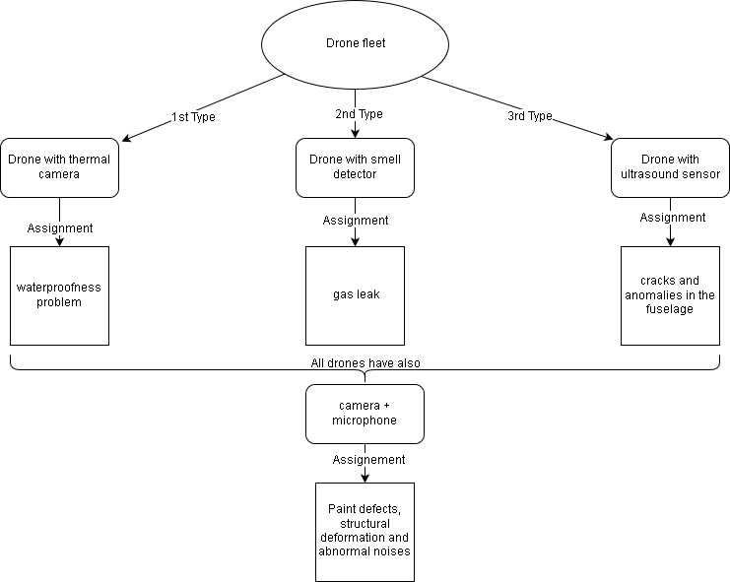
Our Concept

Slide 4
Our drone

Slide 5
Conclusion

