Slide 1
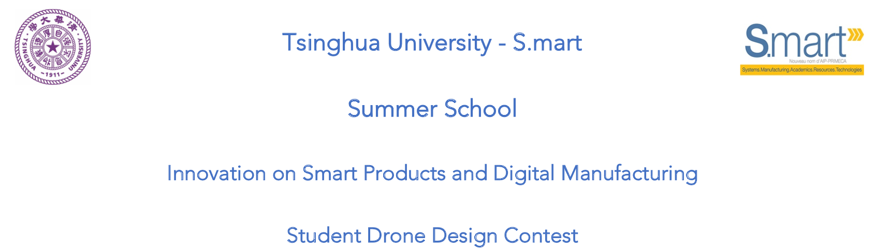
Chenzi Cusseau Haoyun Hung Lagabbe Larue Yang Di

Slide 2
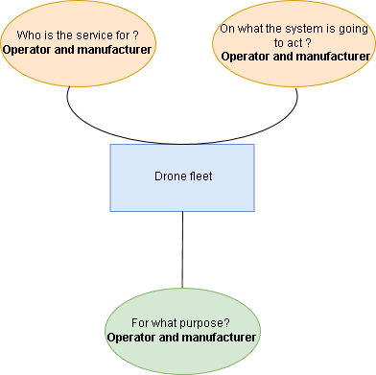
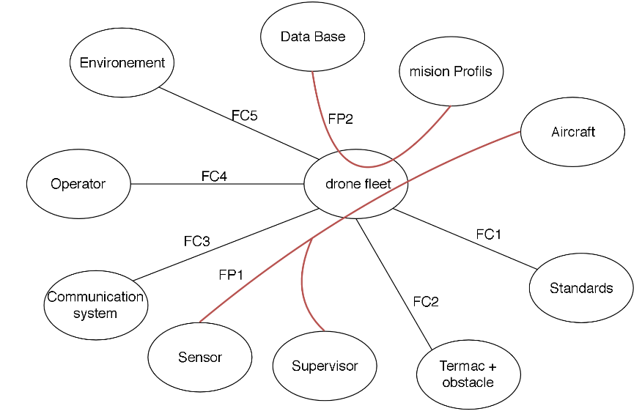
Functional analysis
Our need: “Find systems to reduce aircraft downtime by detecting early-onset failures”
4 parts:
E
mission execution

Slide 3
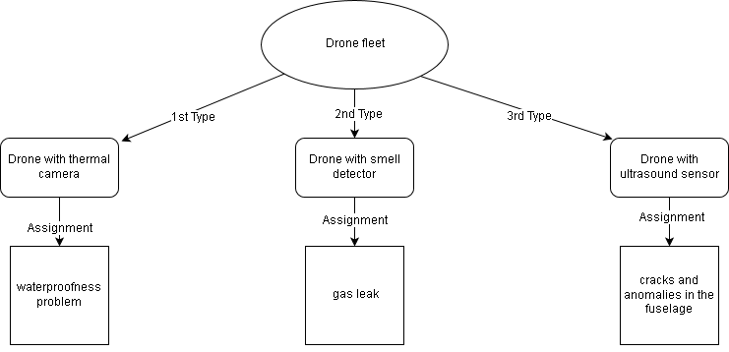
Our Concept
3 types of drones

Slide 4
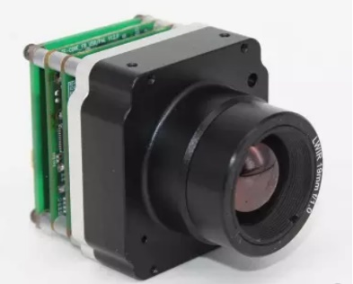
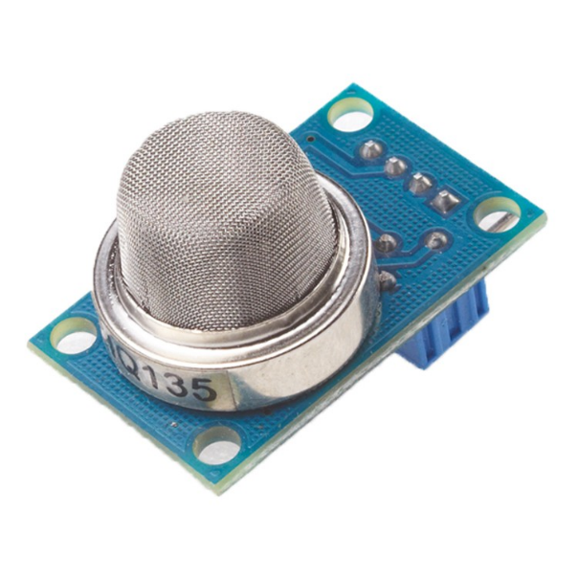
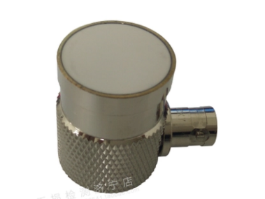
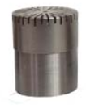
Our drone
a base and different sensors

Slide 5
Our drone
how are the sensors fixed ?
PHOTO DE LA MODELISATION

Slide 6
Our drone
how maintenance works

Slide 7
Conclusion

