Slide 1



Chenzi Cusseau Haoyun Hung Lagabbe Larue Yang Di

Slide 2
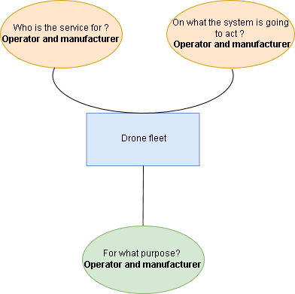
Functional analysis
The needs
Our need: “Find systems to reduce aircraft downtime by detecting early-onset failures”
4 steps:
Start of the mission
mission execution
Mission analyze
Return from the mission

Slide 3
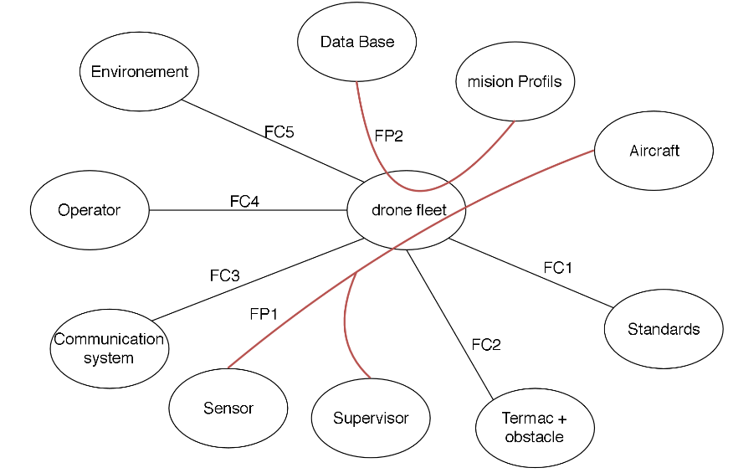
Functional analysis
Research of functions: «octopus diagram»
«Octopus diagram» for Mission execution
2 Service function :
FP1 : Allow a supervisor o inspect a device using a set of sensors
FP2 : Executes a mission profile, based on a database specific to the aircraft / aircraft model

Slide 4
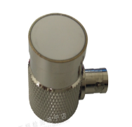
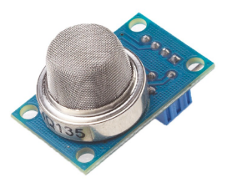
Functional analysis
Research of functions: «FAST»

Slide 5
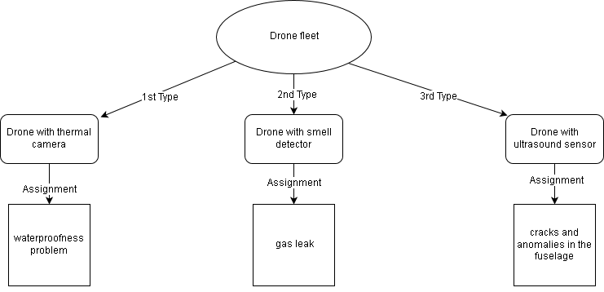
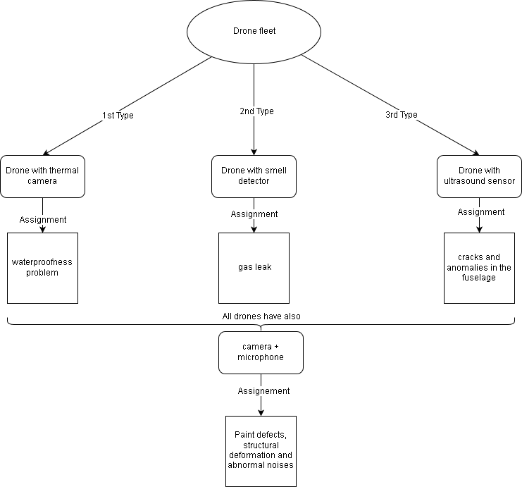
Our concept
3 types of drones
All the drones have also:

Slide 6
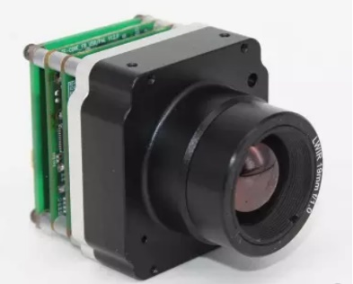
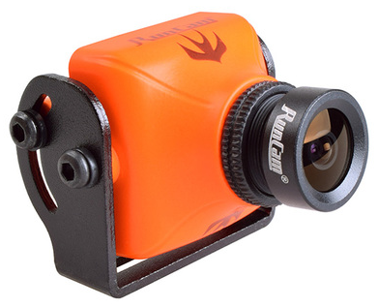


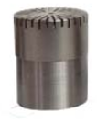
Our drone
a base and different sensors
Thermal camera
camera
Smell sensor
Microphone
Ultrasound sensor

Slide 7
Our drone
how are the sensors fixed ?
PHOTO DE LA MODELISATION

Slide 8
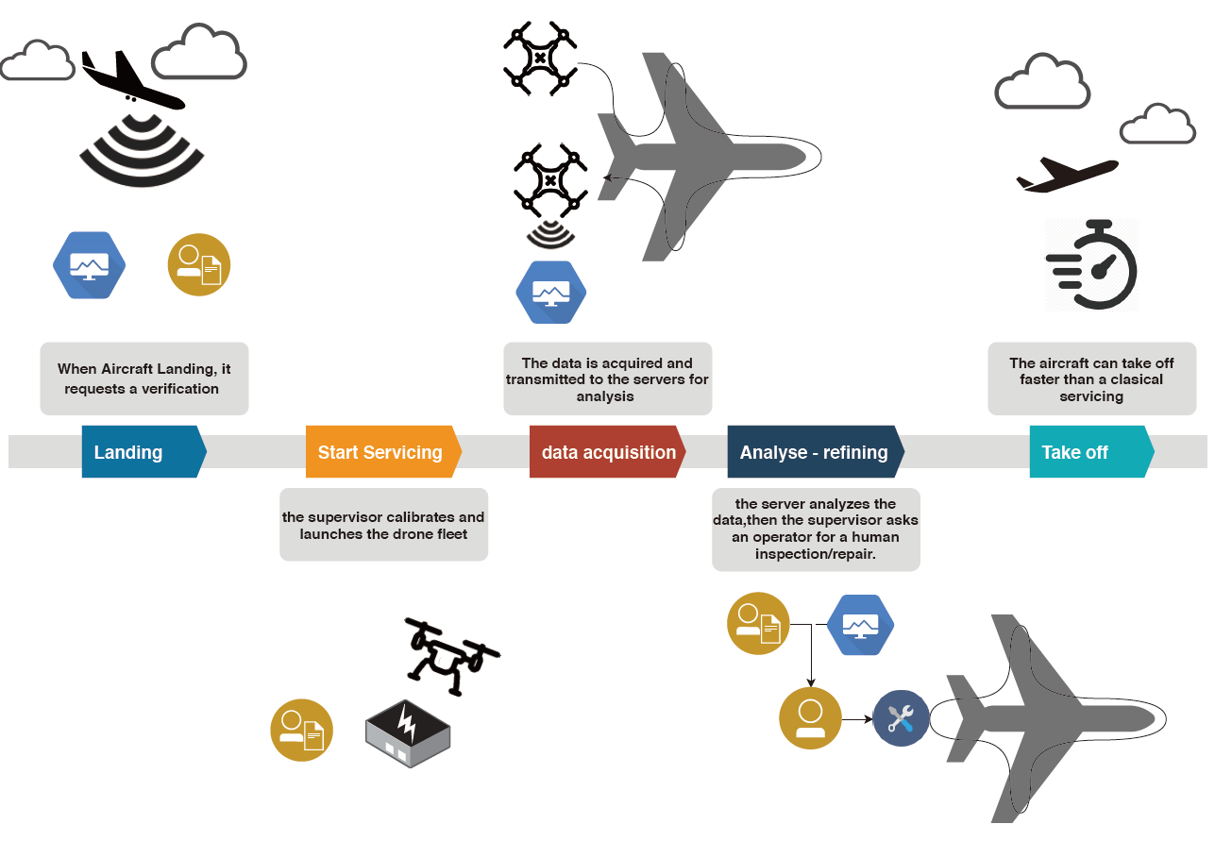
Our drone
how maintenance works

Slide 9
Conclusion

