Slide 1

Chenzi Cusseau Haoyun Hung Lagabbe Larue Yang Di

Slide 2
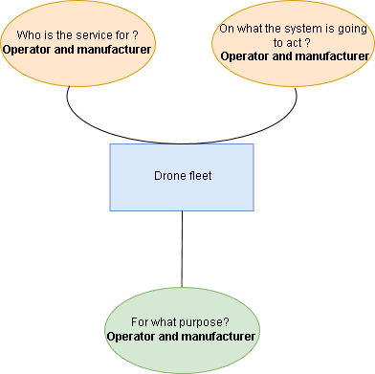
Functional analysis
Our need: “Find systems to reduce aircraft downtime by detecting early-onset failures”
4 steps:
Start of the mission
mission execution
Mission analyze
Return from the mission

Slide 3
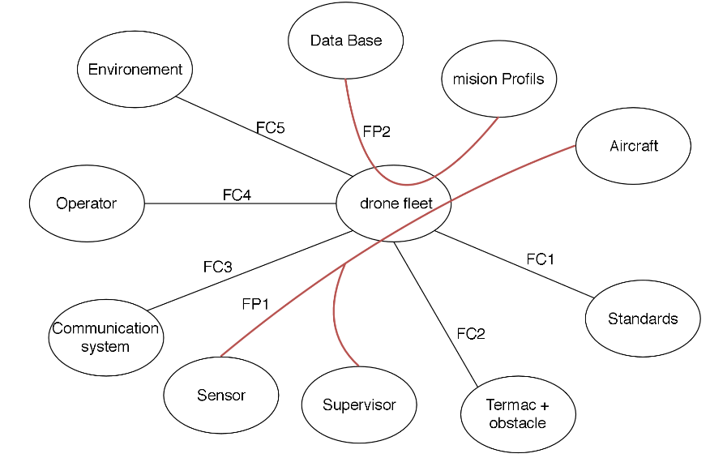

Slide 4
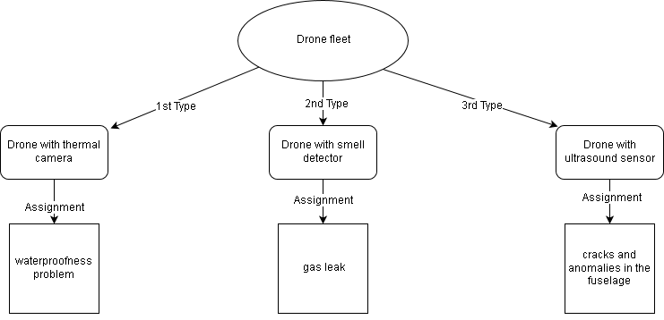
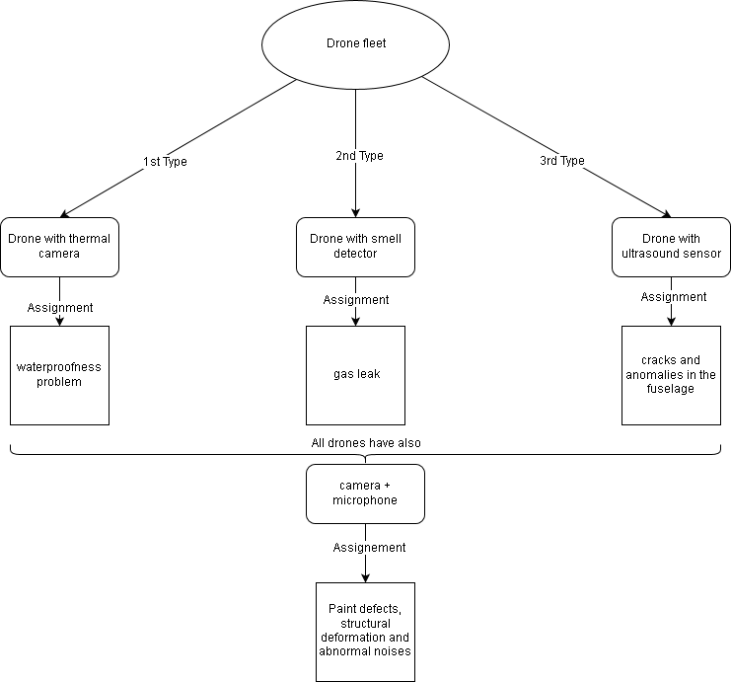
Our Concept
3 types of drones
All the drones have also:

Slide 5
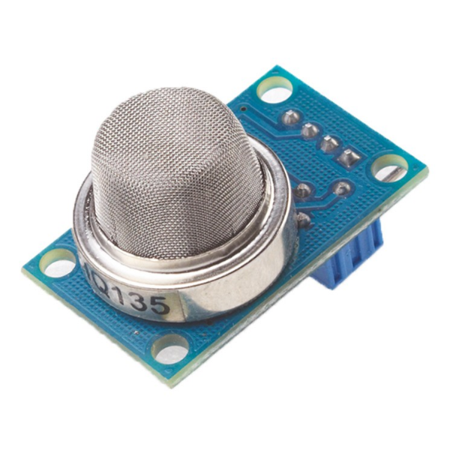
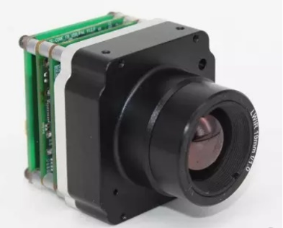
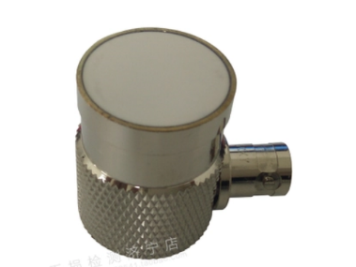
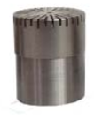
Our drone
a base and different sensors
Thermal camera
Microphone

Slide 6
Our drone
how are the sensors fixed ?
PHOTO DE LA MODELISATION

Slide 7
Our drone
how maintenance works

Slide 8
Conclusion

