Slide 1


SafeWisdom
SafeWisdom
Software by ChaiYing
Show the wisdom and security of software and emphasize the importance and improvement of users' safety knowledge.
Sign In
Sign Up

Slide 2

< Back
Sign In
Username
Password
Login
Welcome Back!
Don’t have account?
Create account
You can sign into access with your existing account.

Slide 3

< Back
Create Account
Username
Email
Password
Confirm Password
Start your journey
Sign Up
today
Already have an account?
Login

Slide 4
SafeWisdom
SAFEWISDOM
software
19: 12: 38
Thursday, December 19, 2019

Slide 5

SafeWisdom
Why is computer security important?
Computer security is very important because it can protect your information. In general, people usually do not consider computer security, which leads to the potential problem of security vulnerabilities. It's also important to take care of your computer's overall "health"; Proper security helps prevent viruses and malicious code from spreading, thus making programs run faster and more smoothly.

Slide 6
SafeWisdom
Common Types of Cyber Threats
What is malware?
Malware, short for “malicious software,” is a blanket term that refers to a wide variety of software programs designed to do damage or do other unwanted actions to a computer, server or computer network Common examples include viruses, spyware and trojan horses. Malware can slow down or crash your device or delete files. Criminals often use malware to send spam, obtain personal and financial information and even steal your identity.
What is spyware?
Spyware is a type of malware that attaches itself and hides on a computer’s operating system without your permission to make unwanted changes to your user experience. It can be used to spy on your online activity and may generate unwanted advertisements or make your browser display certain website sites or search results.
What is phishing?
Phishing attacks use email or fraudulent websites to try to trick you into providing personal or financial information to compromise an account or steal money by posing as a trustworthy entity. They may claim there’s a problem with payment information or that they’ve noticed activity on an account and ask you to click on a link or attachment and provide personal information.

Slide 7
SafeWisdom
Advantages Computer Security
Protect sensitive personal information
Nowadays, data has become a precious commodity and data containing personal information is in great demand. Hackers can use malicious software and other tools of illegal access to personal data, to extort money or damage your reputation. Cyber security can prevent such attacks in the first place because it is a proactive approach.
Decreased data theft hazard
The main benefit of network security is to prevent unauthorized or malicious users from accessing the system. High security protocols are implemented to prevent significant data theft and to make the experience more relaxed.

Slide 8

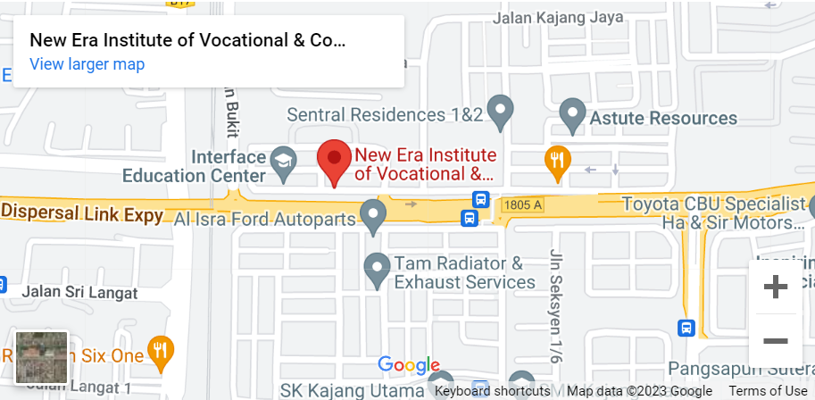
SafeWisdom

Slide 9
SafeWisdom
Telephone:
013-389 9284
Fax:
03-8943 2537
Facebook:
SafeWisdom
Email:
safewisdom@gmail.com
Address:
B5-B7, Block B, Jalan TKS 1,
Taman Kajang Sentral,
43000 Kajang, Selangor, Malaysia

Slide 10
SafeWisdom
Performance
View
Computer performance refers to the speed and efficiency with which computers process and perform tasks. It is estimated from the accuracy, efficiency, and speed with which the instructions of a computer program are executed. You can press the “View” button to view the performance of your computer.

Slide 11
Performance
CPU:
0%
RAM:
0%
Disk:
0%

Slide 12
SafeWisdom
Scanner
Simple
>
Simple mode
One scan calculates the MD5 value of a file and compares it with the MD5 value of a known virus to confirm whether the file is a virus or malware. Used to verify that the file has been tampered with or implanted with malicious code.
Advanced mode
Use VirusTotal scanned, it is divided into three parts: file scanning, URL scanning and other scanning. Compared to the MD5 simple scan, it will show more detailed information, such as virus species, virus source, etc.

Slide 13
Scanning
File
Help
Name
MD5
Status: N/A
Start

Slide 14
Help
It can only scan files to help you check whether they are virus files or not.
How to use
1. Find the “File” tab on the top left directory bar, click on it and select “Browser”
2. In File Explorer, select the file you want to scan
OK

Slide 15
VirusTotal
VirusTotal Webpages

Slide 16
SafeWisdom
VPN
Start
VPN is a kind of technology used to establish a secure encrypted connection network. It can hide the real IP address, to protect the user's privacy and services. This leads to a lower hackers or other malicious attackers steal the user's sensitive information. You can click “Start” to experience.

Slide 17
VPN
The following username and password can be tested
host:
username:
example
password:
123456
hostname
<
Host
Username
Password
Connect
Disconnect

Slide 18
SafeWisdom
Logout
Are you sure want to log out?
Yes
No

Slide 19
SafeWisdom
Update
SafeWisdom Update
check for update?
No
Yes

Slide 20
–
□
╳
 SafeWisdom Update
Update Summary
SafeWisdom
Update file size: 3.24MB
(description)
Next
Cancel

