Slide 1
A Software Subsystem of Learning Management System
Ary Hernandez
Jacquelyn Johnson
Andrew Samuel
John Tomich
Julio Quintero

Slide 2

Democratic Team
Group makes decisions together
Encouraged to find faults in “shared” code
Positive attitude towards finding faults → find faults >
Works well for difficult problems

Slide 3
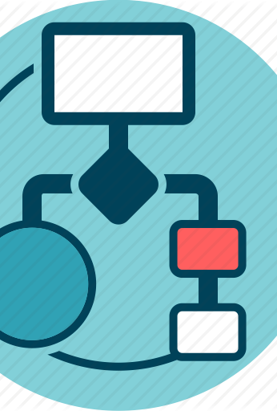
Unified Modeling Language (UML)
Integrated set of diagrams developed to help system and software developers for specifying, visualizing, constructing, and documenting the artifacts of software systems, as well as for business modeling and other non-software systems

Slide 4
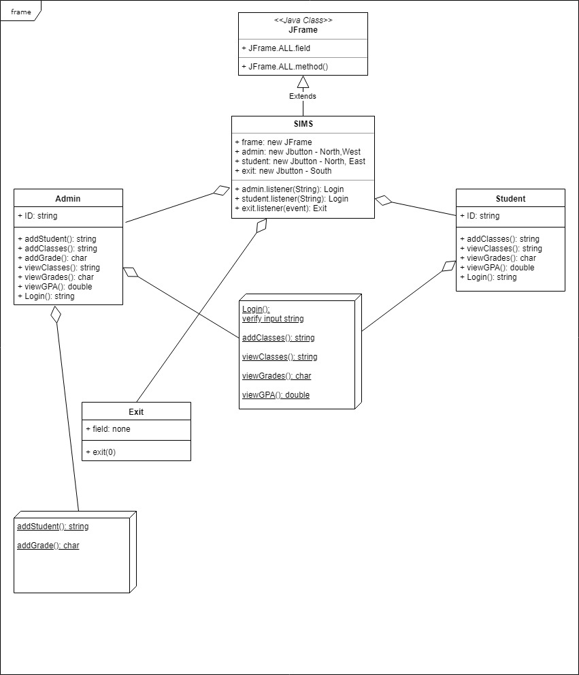

Slide 5
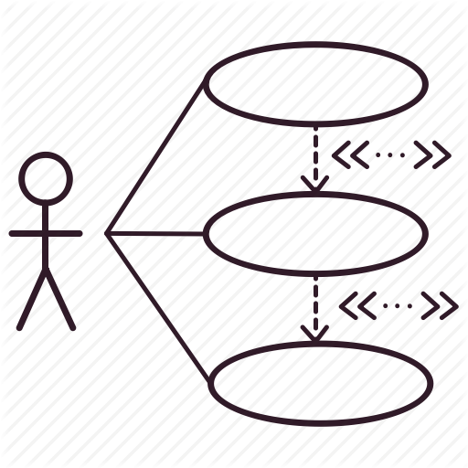
Use case diagram
Simplest representation of a user's interaction with the system that shows the relationship between the user and the different use cases in which the user is involved

Slide 6
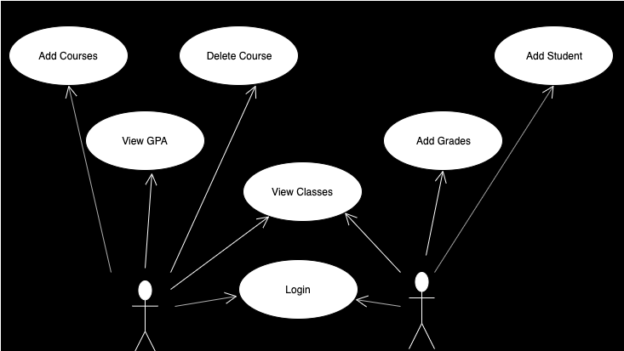

Slide 7
Tools
GitHub
NetBeans
Draw.io

Slide 8

Code
Github Project

Slide 9
Plans for the future
Create a Database using SQL
01
Manipulate the database through the Java GUI
02
Update the UML
03
Update the SPMP
04

