Slide 1



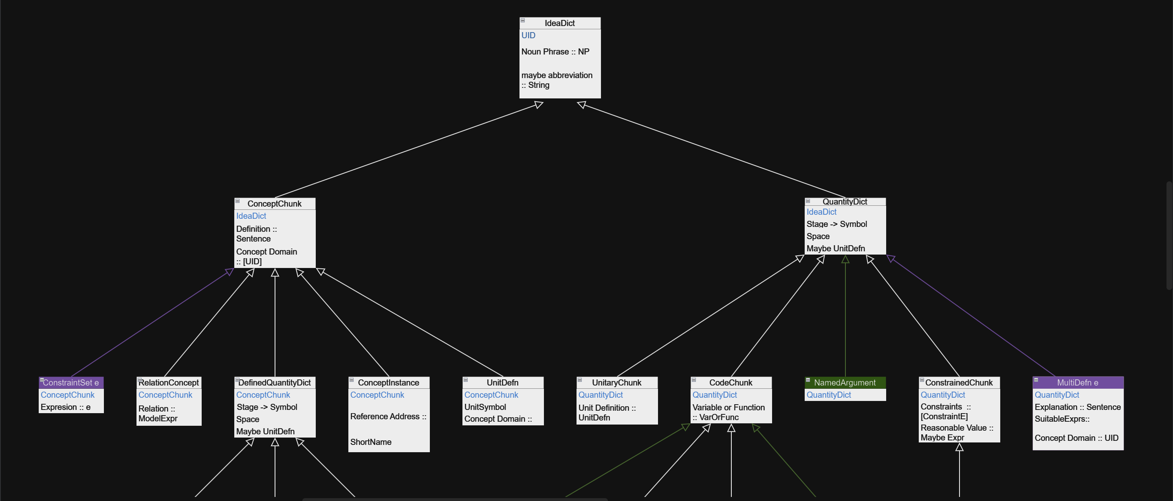
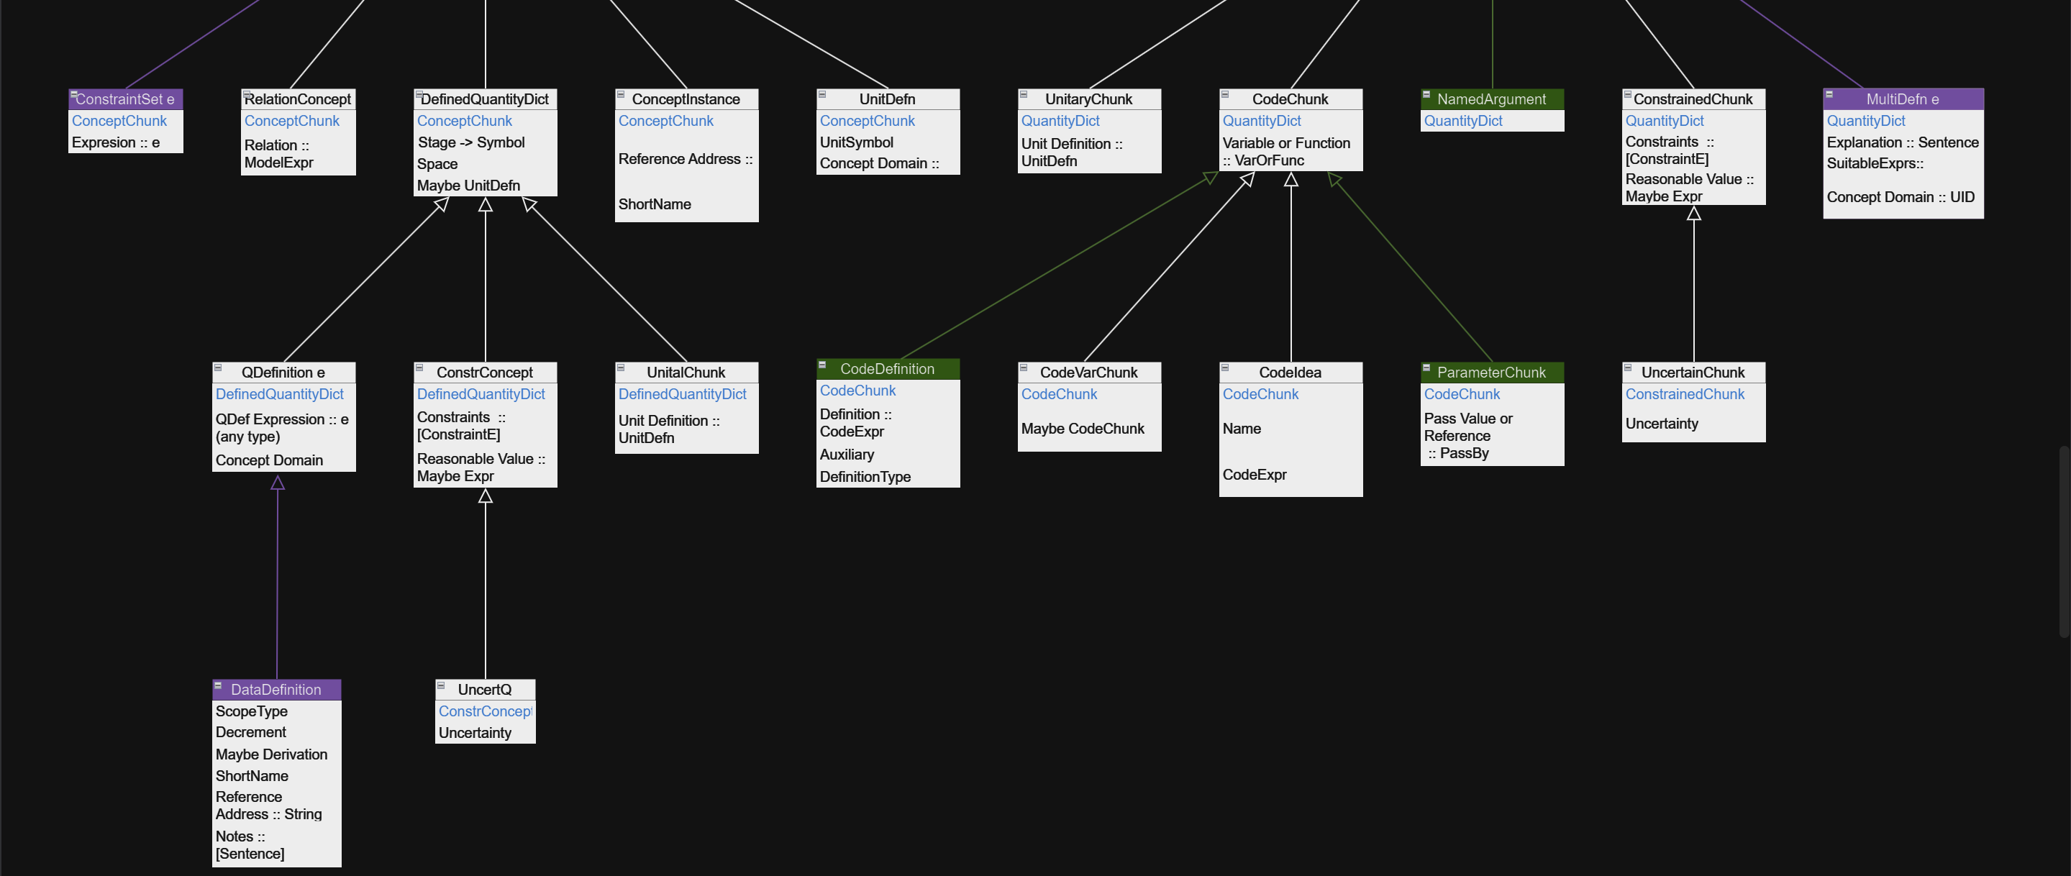
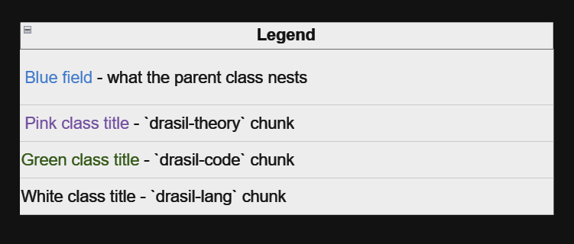
data IdeaDict = IdeaDict { _nc' :: NamedChunk, mabbr :: Maybe String }
Zooming Out: The importance of UML diagrams
Noah Cardoso, Dr. Jacques Carette, Dr. Spencer Smith
Department of Computing and Software, McMaster University, Hamilton, ON, Canada
Introduction
Diagram
What are the results?
Goal: To create a visual representation of pieces of knowledge to aid in our understanding of how they are connected in Drasil.
What I did: Created a hierarchy diagram to show how the Chunks relate to each other and the information they carry.
As a result we started to work on a redesign of our Chunk hierarchy
Changes:
Replaced ConceptInstance: Introduced an Abbreviations chunk instead.
Renaming:
IdeaDict -> Idea
ConceptChunk -> IdeaDef
Inheritance and Type System:
Removed QuantityDict, moved all inheritance to DefinedQuantityDict, and renamed it to Variable.
Added a type variable for the type system used.
Simplification:
Removed Stage -> Symbol from DefinedQuantityDict/Variable.
Removed Maybe UnitDefn from Variable.
Removed UnitalChunk completely.
Background
What is Drasil? Drasil is a software framework written in Haskell that generates all software artifacts (requirements, design, code, tests, build scripts,
documentation) based on a single specification in a domain-specific language (DSL).^{[1]}
What is a Chunk? A Chunk is a fragment of knowledge that stores information. Chunks serve as building blocks in a hierarchical system, where each chunk can be progressively "wrapped" with additional information to create more complex structures.
Design Process
Conclusion
Define the Purpose and Scope
Identify and Label Classes
Add Attributes
Show Relationships
Review, Refine, Share, Iterate
The diagram helped to uncover issues within our project which has sparked new ideas for a re-design of our current chunk hierarchy.
The diagram aid used in an issue of the naming convention of our chunks
References
[1] D. Szymczak, S. Smith and J. Carette, "POSITION PAPER: A Knowledge-
Based Approach to Scientific Software Development," 2016 IEEE/ACM
International Workshop on Software Engineering for Science
(SE4Science), Austin, TX, USA, 2016, pp. 23-26
How is it helpful?
Acknowledgements
Use: It allowed us to see the bigger picture. Made us re-think many of our assumptions about how the chunks are related to each other.
Benefits: Visual Representation: Provides a high-level overview of a system’s design. Communication: Helps communicate the structure of the software to developers and stakeholders. Documentation: Serves as documentation for the system’s architecture and design.
Acknowledgements: I want to acknowledge the support of Dr. Carette and Dr. Smith in making this opportunity available to me and being available for guidance throughout the summer. I would like to acknowledge Jason Balaci for his guidance, for taking the time to help get me up to speed and for providing day–to–day advice and assistance. Lastly, I would like to thank the Dean of Engineering for a portion of my funding this summer

