Slide 1



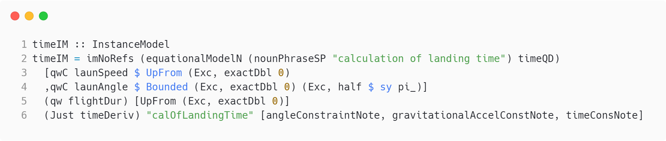
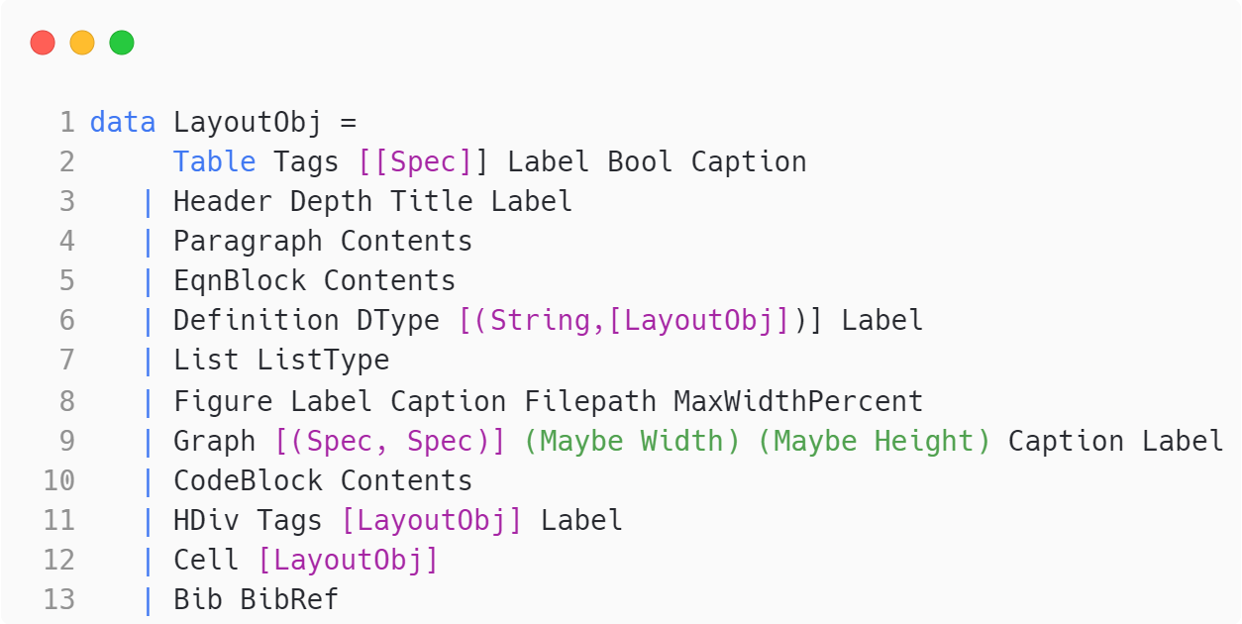
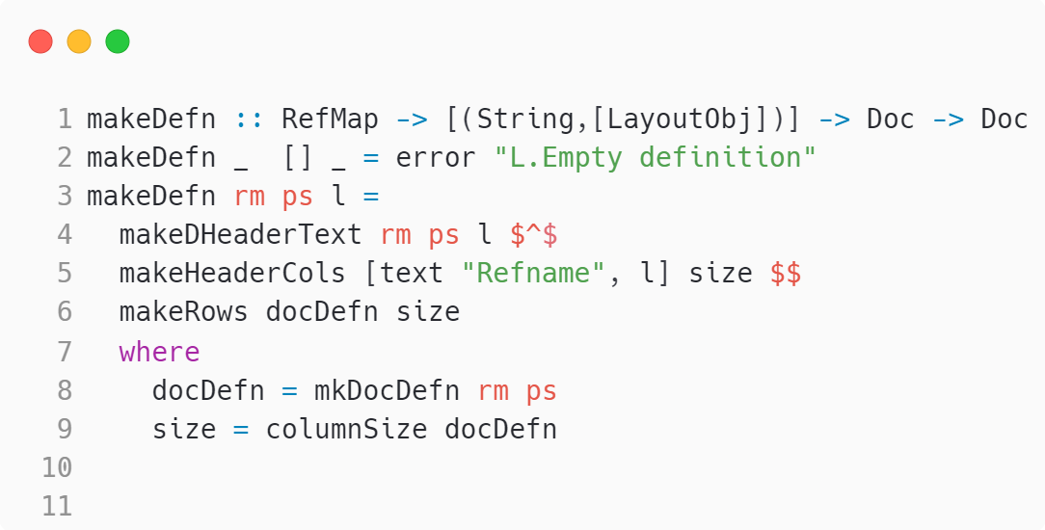
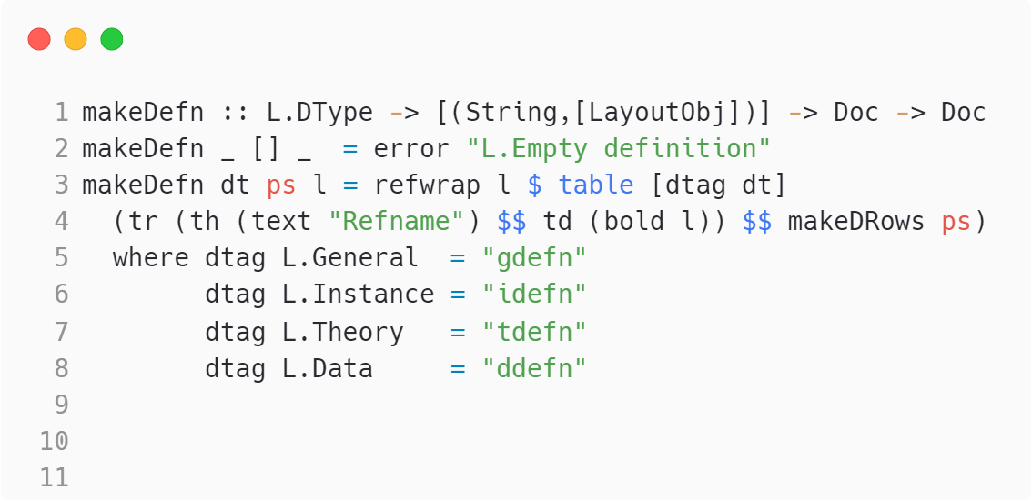
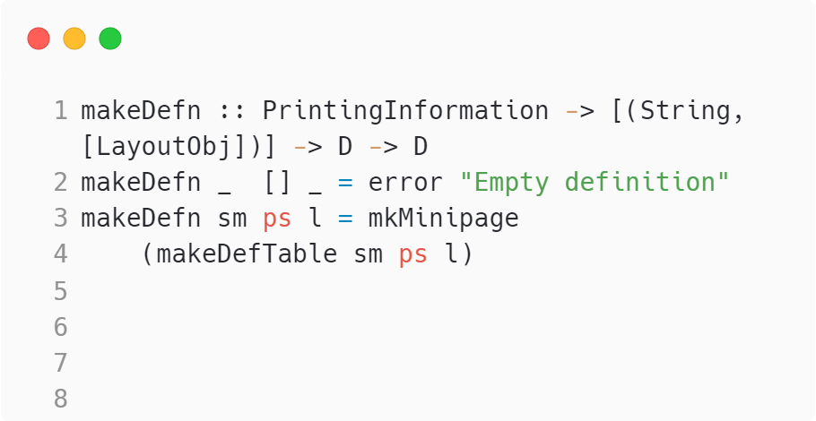
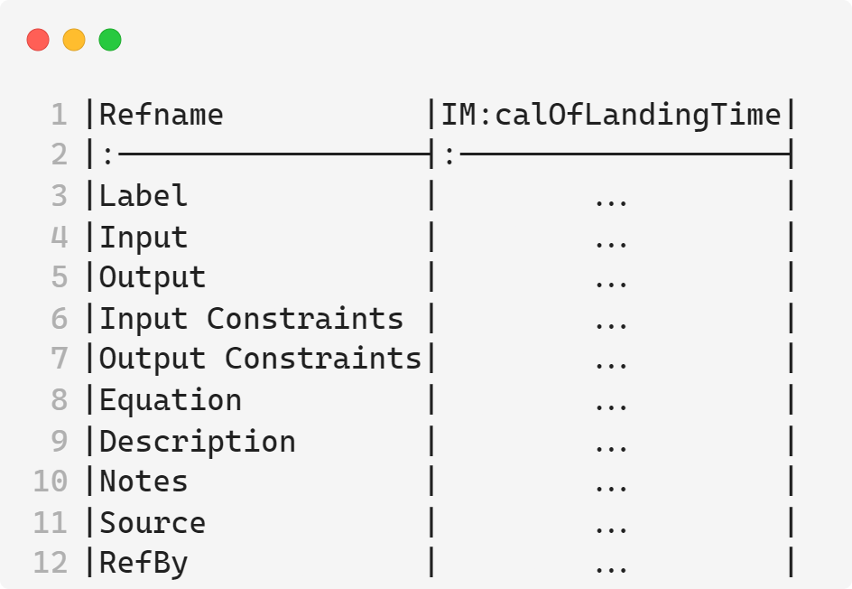
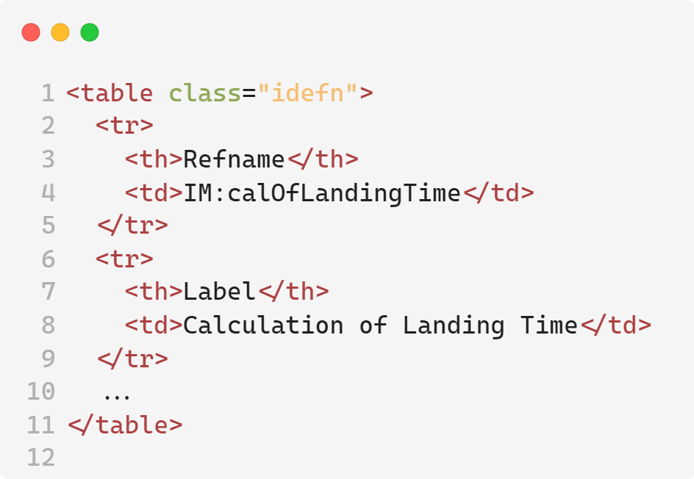
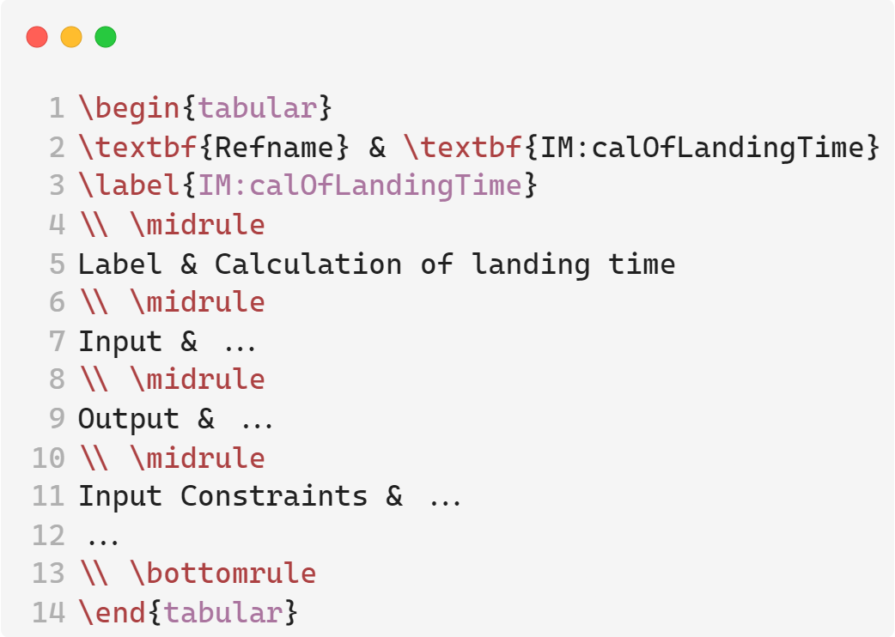
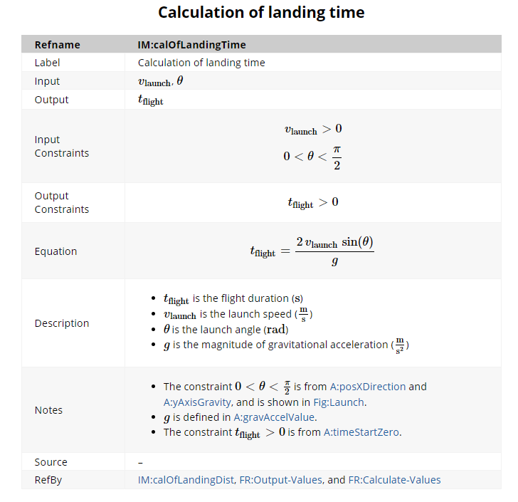
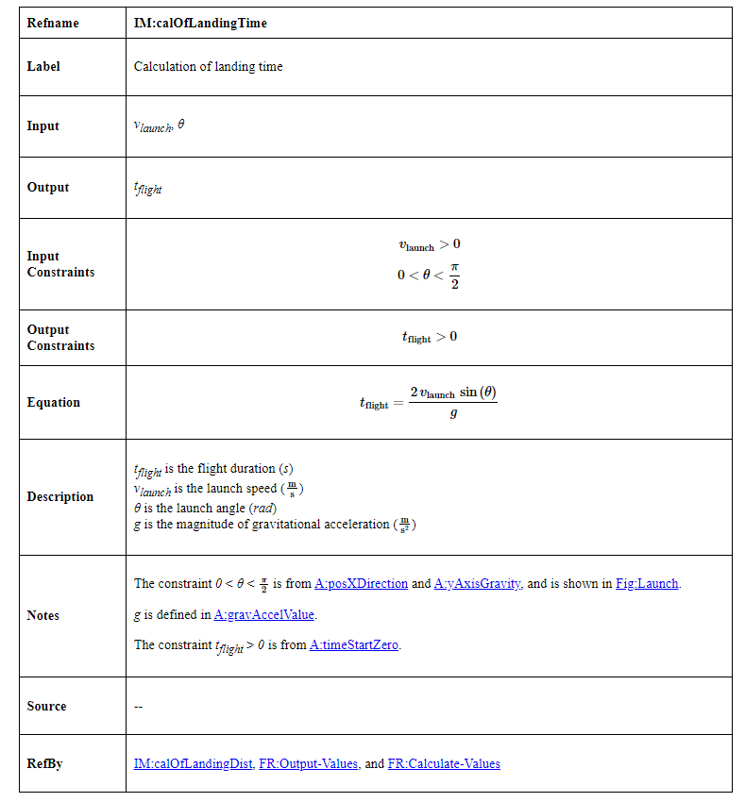
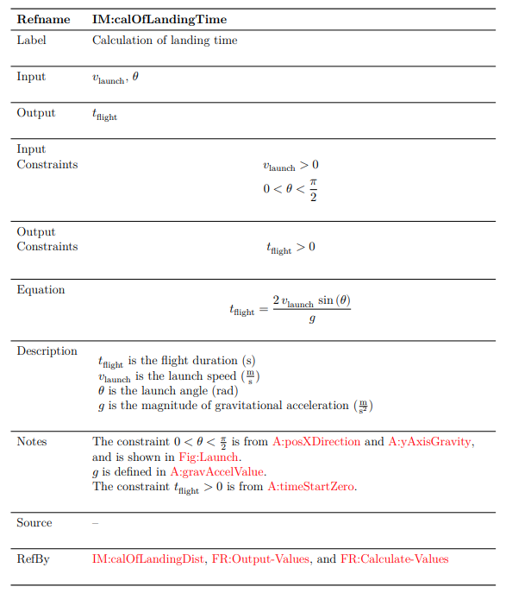
Leveraging Generative Programming for Software Documentation
Mohammad Bilal, Dr. Jacques Carette, Dr. Spencer Smith
Department of Computing and Software, McMaster University, Hamilton, ON, Canada
Introduction
Results
Discussion
Problem:
Considerable Duplication: Handwritten software artifacts often contain repeated information. ^{[1]}
Lack of traceability: It is challenging to track the origins and dependencies of various software components. ^{[2]}
Lack of maintainability: Maintaining and updating handwritten software is cumbersome and time-consuming. ^{[2]}
Solution:
Drasil: a software framework written in Haskell that generates all software artifacts (requirements, design, code, tests, build scripts, documentation, etc.) based on a single specification in a domain-specific language (DSL). ^{[2]}
Accomplishes two primary objectives: complete traceability and elimination of knowledge duplication. ^{[2]}
Area of Focus:
This research poster focuses on Drasil’s document generation capabilities, specifically the Software Requirements Specification (SRS).
Users define the SRS once in a single location, and Drasil generates the SRS in various output formats.
Prior to the work done in this research poster, Drasil could generate documentation in HTML, LaTeX, and Jupyter Notebook.
The adoption of mdBook for generating documents within Drasil not only enhances the quality and usability of the documentation but also aligns with the framework’s goals of achieving complete traceability and eliminating knowledge duplication.
Information is defined once and reused consistently across all documentation.
Maintaining and updating documentation is simplified, as editing the Drasil source code automatically updates all related documentation.
With a Markdown definition DSL now established in Drasil, future work can focus on incorporating various Markdown flavors and generating new documentation formats.
Drasil source code: The code authored by the user.
Drasil’s internal representation of a document.
Benefits of Generative Programming
Streamlined LaTeX updates: The rendering of the multiplication operator in LaTeX was updated, requiring only a 4-line change of Drasil code. This small adjustment resulted in approximately 1360 modifications across 67 files of generated code, showcasing the efficiency of Drasil’s generative approach.
In the graph below, software documentation generated using Drasil required only 1,422 lines of user-written code, resulting in 7,243 lines of generated code. That is approximately a 1:5 ratio!
Domain-Specific Languages (DSLs) for transforming Drasil’s internal representation into specific formats.
Objective
Goal:
Expand Drasil’s document generation capabilities by generating Software Requirement Specifications (SRS) in mdBook.
What is mdBook?
mdBook is a command line tool designed for creating books in Markdown.^{[3]}
Content is authored in Markdown, and mdBook converts it into HTML, automatically applying styles and layout to enhance presentation.
Advantages of mdBook:
Improved Navigation: Unlike the existing single-page formats, mdBook separates each section into its own page.
Enhanced Styling: Offers advanced styling and layout options for better readability and organization.
MathJax Support: Allows you to include mathematical equations and symbols in your documentation using LaTeX. ^{[3]}
Generated Code
Figure 3: A comparison of user-written code vs. generated code lines.
References
[1] Carette, Jacques & Smith, Spencer & Balaci, Jason. (2023). Generating Software for Well-Understood Domains. 10.48550/arXiv.2302.00740.
[2] D. Szymczak, S. Smith and J. Carette, "POSITION PAPER: A Knowledge- Based Approach to Scientific Software Development," 2016 IEEE/ACM International Workshop on Software Engineering for Science (SE4Science), Austin, TX, USA, 2016, pp. 23-26.
[3] “MdBook documentation,” Introduction - mdBook Documentation, https://rust-lang.github.io/mdBook/ (accessed Aug. 8, 2024).
Workflow
Manually port an example case study into mdBook.
Create a Markdown definition DSL in Drasil.
Create an encoding of an mdBook-based project.
Create a renderer for the SRS into the mdBook-based project encoding.
Rendered Output
Acknowledgements
I would like to express my gratitude to the Natural Sciences and Engineering Research Council of Canada (NSERC) for funding this position. I am also thankful to Dr. Spencer Smith and Dr. Jacques Carette for offering me this invaluable opportunity to learn and contribute to the Drasil project. Lastly, I extend my appreciation to Jason Balaci and Samuel Crawford for their support throughout the summer.
mdBook
HTML
LaTeX
Figure 1: A flowchart detailing the steps followed to achieve the objective.
Figure 2: A flowchart illustrating a simplified version of the document generation process in Drasil. The items highlighted in red represent the contributions from this research poster.

