Slide 1
Code generation in drasil

Slide 2
OVERVIEW
1. Current code generation design
2. Results of current generator
3. Next steps

Slide 3
Current Design

Slide 4
Design Approach
Small case study used to guide the development of code generation
Designed bottom-up rather than top-down: using case study, features added as necessary
Current design based on a “code specification” + set of choices

Slide 5
Code Specification
Specification:
Database of symbols used in the code
Inputs to the program
Outputs of the program
Relations between symbols
Built from captured knowledge
Using the code specification, Drasil finds a path from inputs to outputs through the set of relations
Generates code using these relations to transform inputs to outputs

Slide 6
Choices
Allow user to make decisions about features of the generated code
Examples of choices:
Programming language?
Library vs program?
Logging?
Documentation in code?
Input/output structure?
Which algorithm to use?

Slide 7
GOOL
Generic Object-Oriented Language
Developed by Jason Costabile as MEng project, 2012
Abstract syntax tree (AST) for OO languages
Integrated into Drasil and extended
Allows rendering code in multiple OO languages
C++, C#, Java, Python

Slide 8
Current Design
+
Captured
Knowledge
Choices
Code
Specification
+
GOOL
Code
C++, C#, Java, Python

Slide 9
Results

Slide 10
GlassBR Case Study
GlassBR:
Computes whether a given plate of glass will resist a blast force
Small: ~200 lines
Simple: Input -> Calculations -> Output
Good starting point for developing code generation in Drasil
Currently able to generate complete working code for GlassBR
C++, C#, Java, and Python!

Slide 11
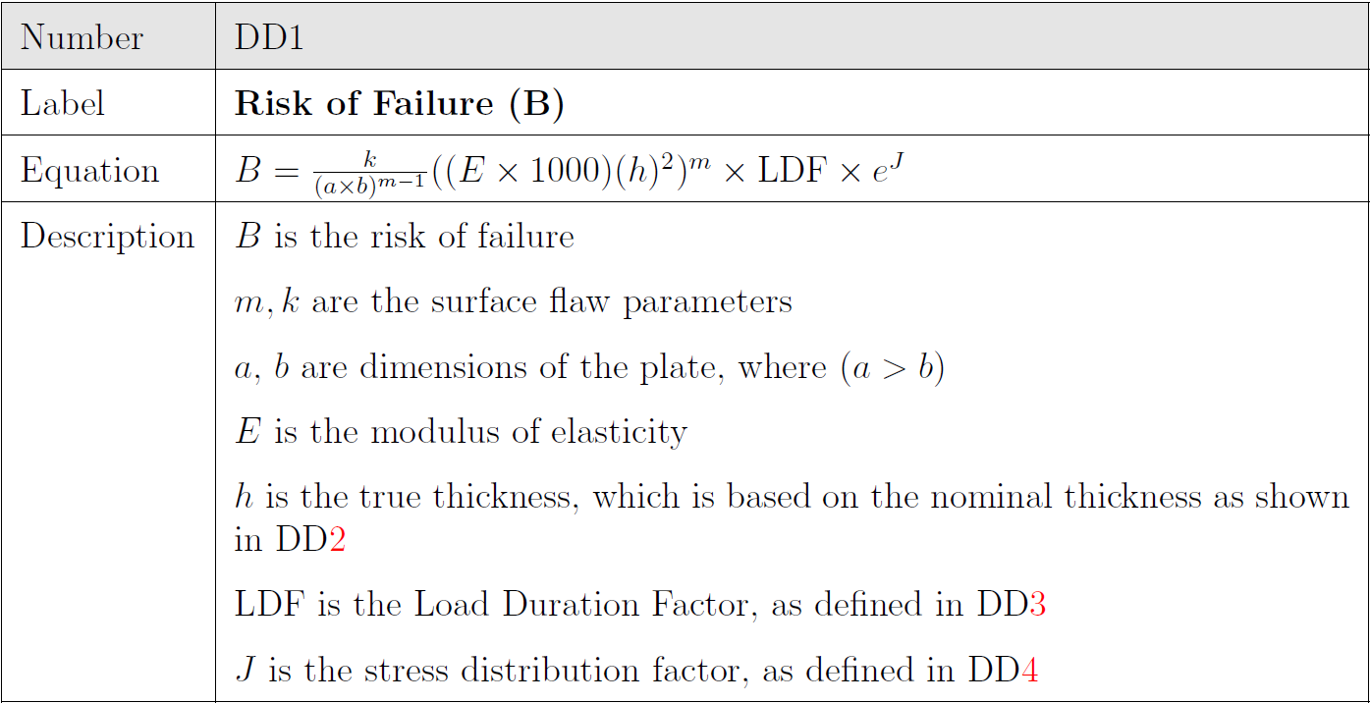
Risk of Failure From GLASSBR THEORY

Slide 12
Risk of Failure: Drasil Code
risk_eq :: Expr
risk_eq = ((C sflawParamK) / (Grouping ((C plate_len) *
(C plate_width))) :^ ((C sflawParamM) - 1) *
(Grouping (C mod_elas * 1000) * (square (Grouping (C act_thick))))
:^ (C sflawParamM) * (C lDurFac) * (exp (C stressDistFac)))

Slide 13
Risk of Failure: Drasil Code
risk_eq :: Expr
risk_eq = ((C sflawParamK) / (Grouping ((C plate_len) *
(C plate_width))) :^ ((C sflawParamM) - 1) *
(Grouping (C mod_elas * 1000) * (square (Grouping (C act_thick))))
:^ (C sflawParamM) * (C lDurFac) * (exp (C stressDistFac)))
B
k
a
b
m
E
h
m
LDF
J

Slide 14
Risk of Failure: Generated Code
double func_B(InputParameters &inParams, double J) {
return ((((2.86 * (pow(10, -(53)))) / (pow(inParams.a * inParams.b, 7 - 1))) *
(pow(((7.17 * (pow(10, 7))) * 1000) * (pow(inParams.h, 2)), 7))) *
(pow(3 / 60, 7 / 16))) * (exp(J));
}
public static double func_B(InputParameters inParams, double J) {
return ((((2.86 * (Math.Pow(10, -(53)))) /
(Math.Pow(inParams.a * inParams.b, 7 - 1))) *
(Math.Pow(((7.17 * (Math.Pow(10, 7))) * 1000) *
(Math.Pow(inParams.h, 2)), 7))) * (Math.Pow(3 / 60, 7 / 16))) * (Math.Exp(J));
}
C++:
C#:

Slide 15
Risk of Failure: Generated Code
def func_B(inParams, J):
return ((((2.86 * (10 ** (-(53)))) / ((inParams.a * inParams.b) **
(7 - 1))) * ((((7.17 * (10 ** 7)) * 1000) *
(inParams.h ** 2)) ** 7)) * ((3 / 60) ** (7 / 16))) *
(math.exp(J))
public static double func_B(InputParameters inParams, double J) throws Exception {
return ((((2.86 * (Math.pow(10, -(53)))) /
(Math.pow(inParams.a * inParams.b, 7 - 1))) *
(Math.pow(((7.17 * (Math.pow(10, 7))) * 1000) *
(Math.pow(inParams.h, 2)), 7))) * (Math.pow(3 / 60, 7 / 16))) * (Math.exp(J));
}
Python:
Java:

Slide 16
CHOICE: Function commenting
def func_B(inParams, J):
# function 'func_B': risk of failure
# parameter 'inParams':
# parameter 'J': stress distribution factor (Function)
return ((((2.86 * (10 ** (-(53)))) / ((inParams.a * inParams.b) **
(7 - 1))) * ((((7.17 * (10 ** 7)) * 1000) *
(inParams.h ** 2)) ** 7)) * ((3 / 60) ** (7 / 16))) *
(math.exp(J))

Slide 17
CHOICE: Function logging
def func_B(inParams, J):
# function 'func_B': risk of failure
# parameter 'inParams':
# parameter 'J': stress distribution factor (Function)
outfile = open("log.txt", "w")
print("function func_B(", end='', file=outfile)
print(inParams, end='', file=outfile)
print(", ", end='', file=outfile)
print(J, end='', file=outfile)
print(") called", file=outfile)
outfile.close()
return ((((2.86 * (10 ** (-(53)))) / ((inParams.a * inParams.b) **
(7 - 1))) * ((((7.17 * (10 ** 7)) * 1000) *
(inParams.h ** 2)) ** 7)) * ((3 / 60) ** (7 / 16))) *
(math.exp(J))

Slide 18
Next steps

Slide 19
Recall: Current Design
+
Captured
Knowledge
Choices
Code
Specification
+
GOOL
Code
C++, C#, Java, Python

Slide 20
Limitations of current design
Works only for simple program structures:
Read inputs, do some (serial) computations, write outputs
Lacks expressiveness for the user:
The current design is rigid
Tries to do too much in an automated way
Need a way for the user of Drasil to specify the design of the code
Design language

Slide 21
FUTURE DESIGN
Captured
Knowledge
Design
Language
Choices
+
+
Implementation Language
Paradigm Specific ASTs
Functional
Imperative
GOOL
Code

