Slide 1



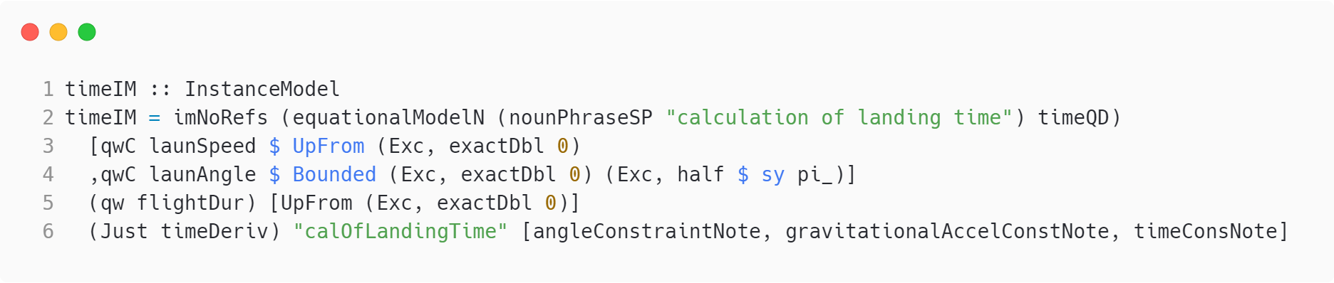
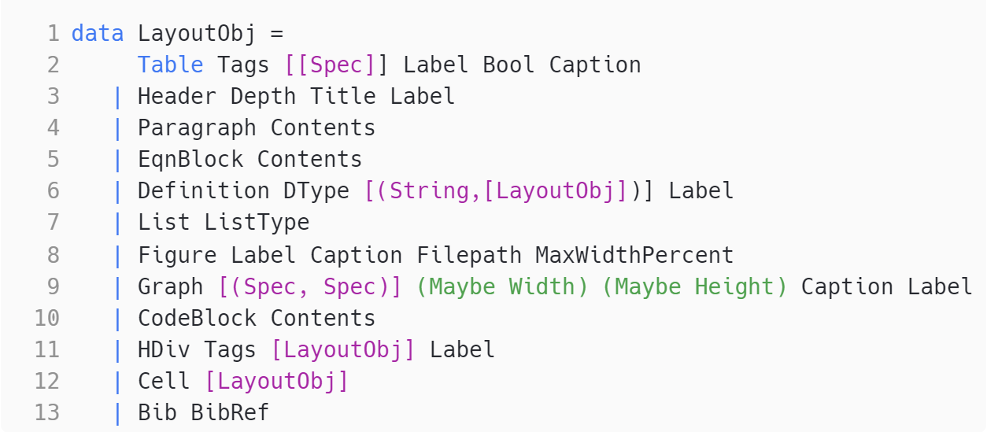
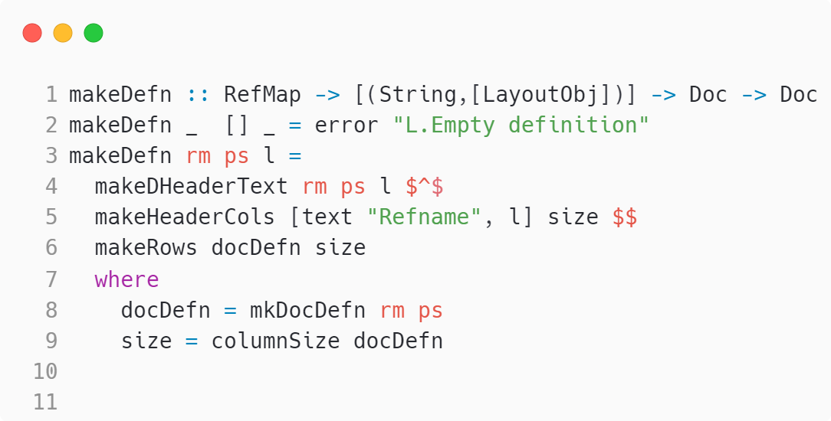
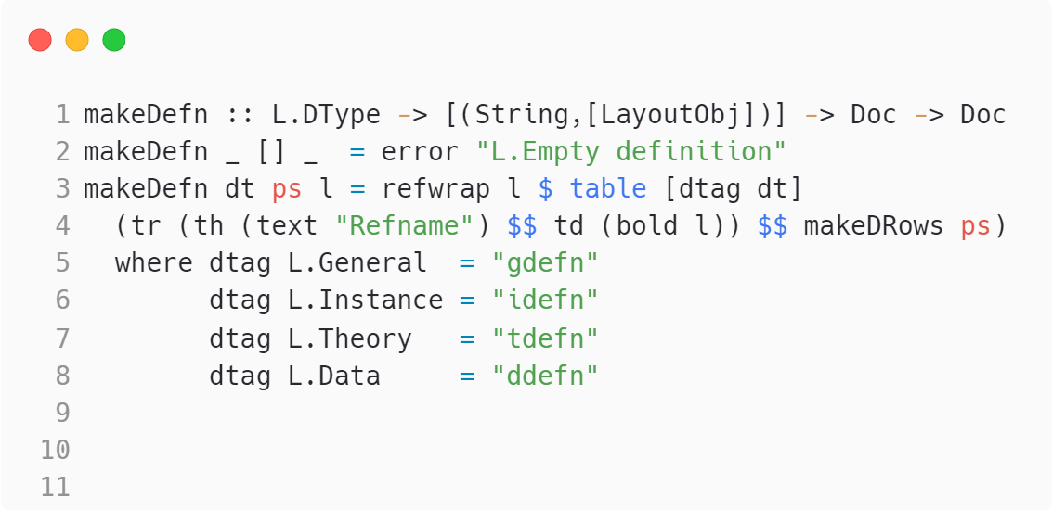
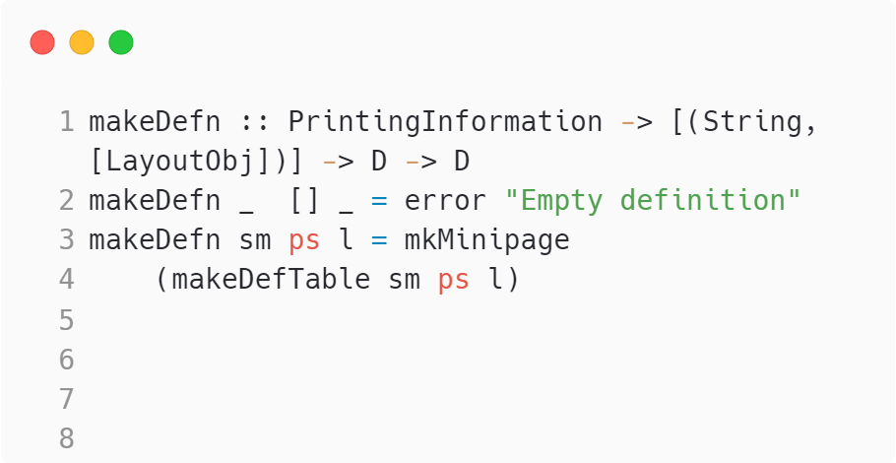
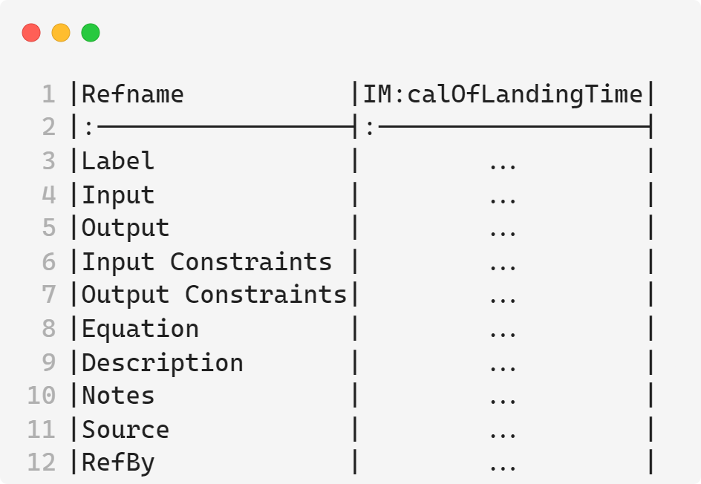
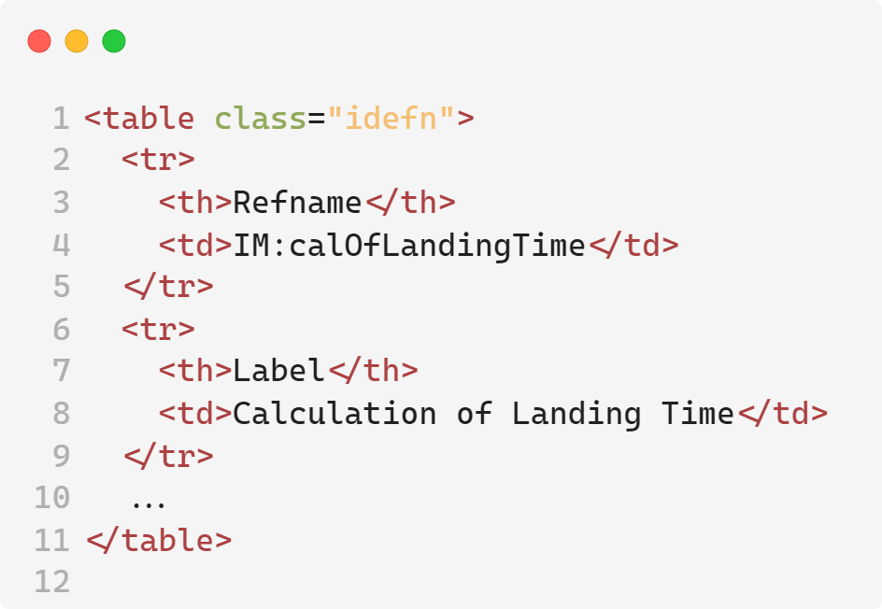
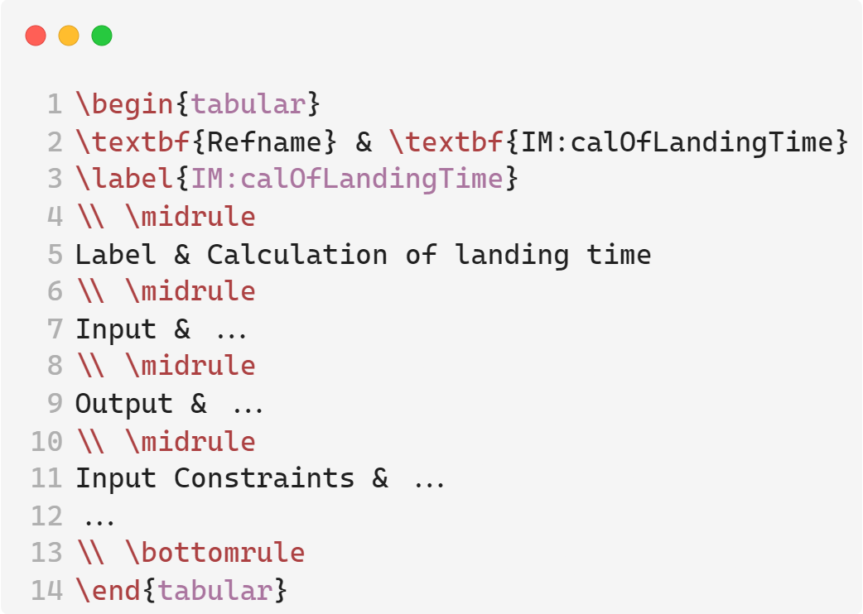
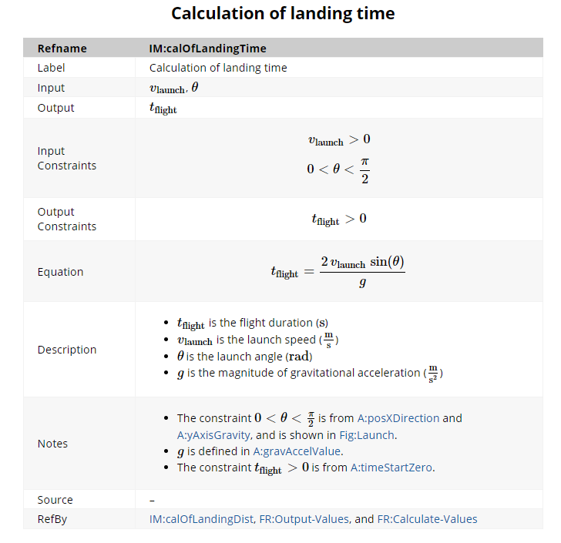
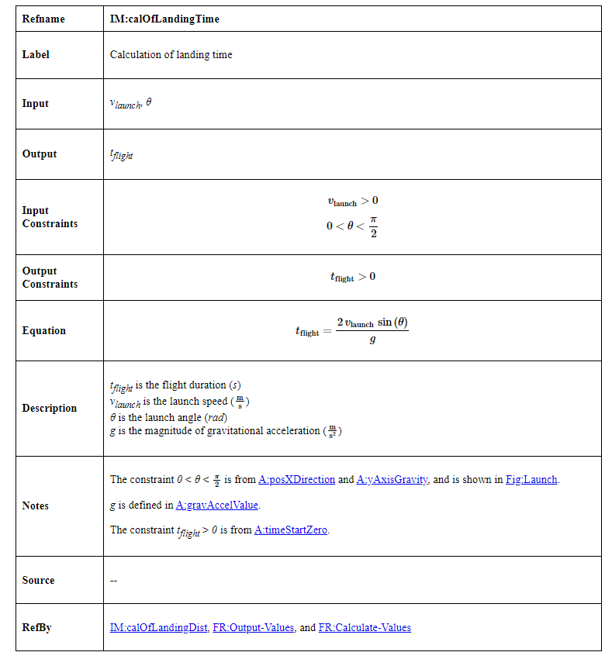
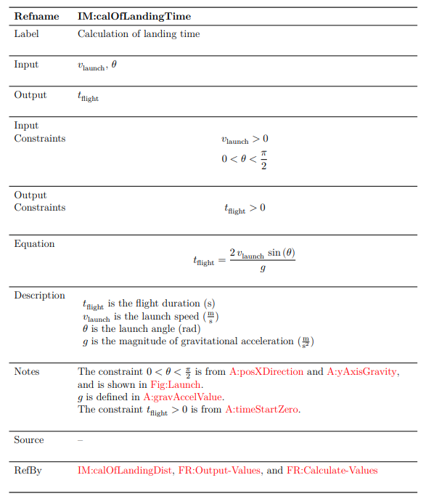
Leveraging Generative Programming for Software Documentation
Mohammad Bilal, Dr. Jacques Carette, Dr. Spencer Smith
Department of Computing and Software, McMaster University, Hamilton, ON, Canada
Introduction
Results
Benefits of Generative Programming
Objective: Generate Software Requirements Specification (SRS) in mdBook format from codified knowledge within Drasil, a generative programming framework.
What is mdBook? A command line tool for creating books in Markdown, converting content into styled HTML. ^{[1]}
Advantages of mdBook:
Navigation: Sections are separated into individual pages.
Styling: Advanced styling options for better readability and organization.
MathJax Support: Includes LaTeX for mathematical equations and symbols. ^{[1]}
Streamlined LaTeX updates: Updating the multiplication operator in LaTeX required just a 4-line change in Drasil code. This minor adjustment led to around 1,360 modifications across 67 generated files, highlighting Drasil’s efficiency.
The graph below illustrates that software documentation generated with Drasil needed only 1,422 lines of user-written code, producing 7,243 lines of generated documentation code—a 1:5 ratio!
User-Written Code
Motivation for Drasil
Drasil’s internal representation of a document.
Problem:
Duplication: Handwritten software artifacts often repeat information. ^{[2]}
Traceability: Tracking origins and dependencies of software components is difficult. ^{[3]}
Maintainability: Updating handwritten software is cumbersome and time-consuming. ^{[3]}
Solution:
Drasil: a software framework written in Haskell that generates all software artifacts (requirements, design, code, tests, build scripts, documentation, etc.) based on a single specification in a domain-specific language (DSL). ^{[3]}
Objectives: Improves traceability and eliminates knowledge duplication. ^{[3]}
Area of Focus:
This research poster focuses on Drasil’s document generation capabilities, specifically the Software Requirements Specification (SRS).
Users define the SRS once in a single location, and Drasil generates the SRS in various output formats.
Prior to the work done in this research poster, Drasil could generate documentation in HTML, LaTeX, and Jupyter Notebook.
Domain-Specific Languages (DSLs) for transforming Drasil’s internal representation into specific formats.
Figure 3: A comparison of user-written code vs. generated code lines.
Conclusions
Adopting mdBook in Drasil enhances documentation quality and usability, aligning with goals of improved traceability and eliminating duplication.
Information is defined once and reused consistently across all documentation.
Ex. 1,422 lines of user-written code → 7,243 lines of generated code
Maintaining and updating documentation is simplified, as editing the Drasil source code automatically updates all related documentation.
With a Markdown definition DSL now established in Drasil, future work can focus on incorporating various Markdown flavors and generating new documentation formats.
Generated Code
Workflow
References
[1] “MdBook documentation,” Introduction - mdBook Documentation, https://rust-lang.github.io/mdBook/ (accessed Aug. 8, 2024).
[2] Carette, Jacques & Smith, Spencer & Balaci, Jason. (2023). Generating Software for Well-Understood Domains. 10.48550/arXiv.2302.00740.
[3] D. Szymczak, S. Smith and J. Carette, "POSITION PAPER: A Knowledge- Based Approach to Scientific Software Development," 2016 IEEE/ACM International Workshop on Software Engineering for Science (SE4Science), Austin, TX, USA, 2016, pp. 23-26.
Manually port an example case study into mdBook.
Create a Markdown definition DSL in Drasil.
Create an encoding of an mdBook-based project.
Create a renderer for the SRS into the mdBook-based project encoding.
Rendered Output
Acknowledgements
I would like to express my gratitude to the Natural Sciences and Engineering Research Council of Canada (NSERC) for funding this position. I am also thankful to Dr. Spencer Smith and Dr. Jacques Carette for offering me this invaluable opportunity to learn and contribute to the Drasil project. Lastly, I extend my appreciation to Jason Balaci and Samuel Crawford for their support throughout the summer.
mdBook
HTML
LaTeX
Figure 1: A flowchart detailing the steps followed to achieve the objective.
Figure 2: A flowchart illustrating a simplified version of the document generation process in Drasil. The items highlighted in red represent the contributions from this research poster.

