Slide 1



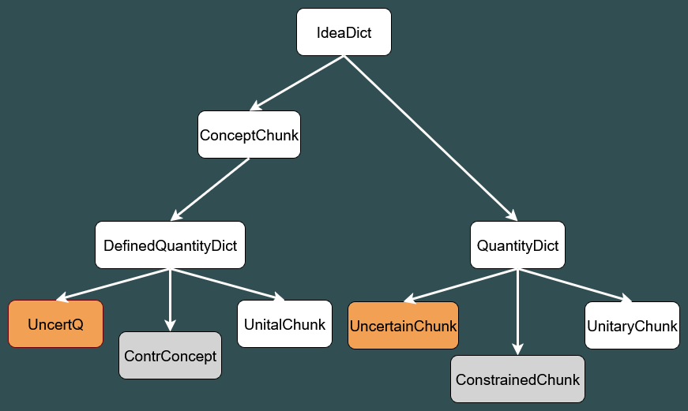
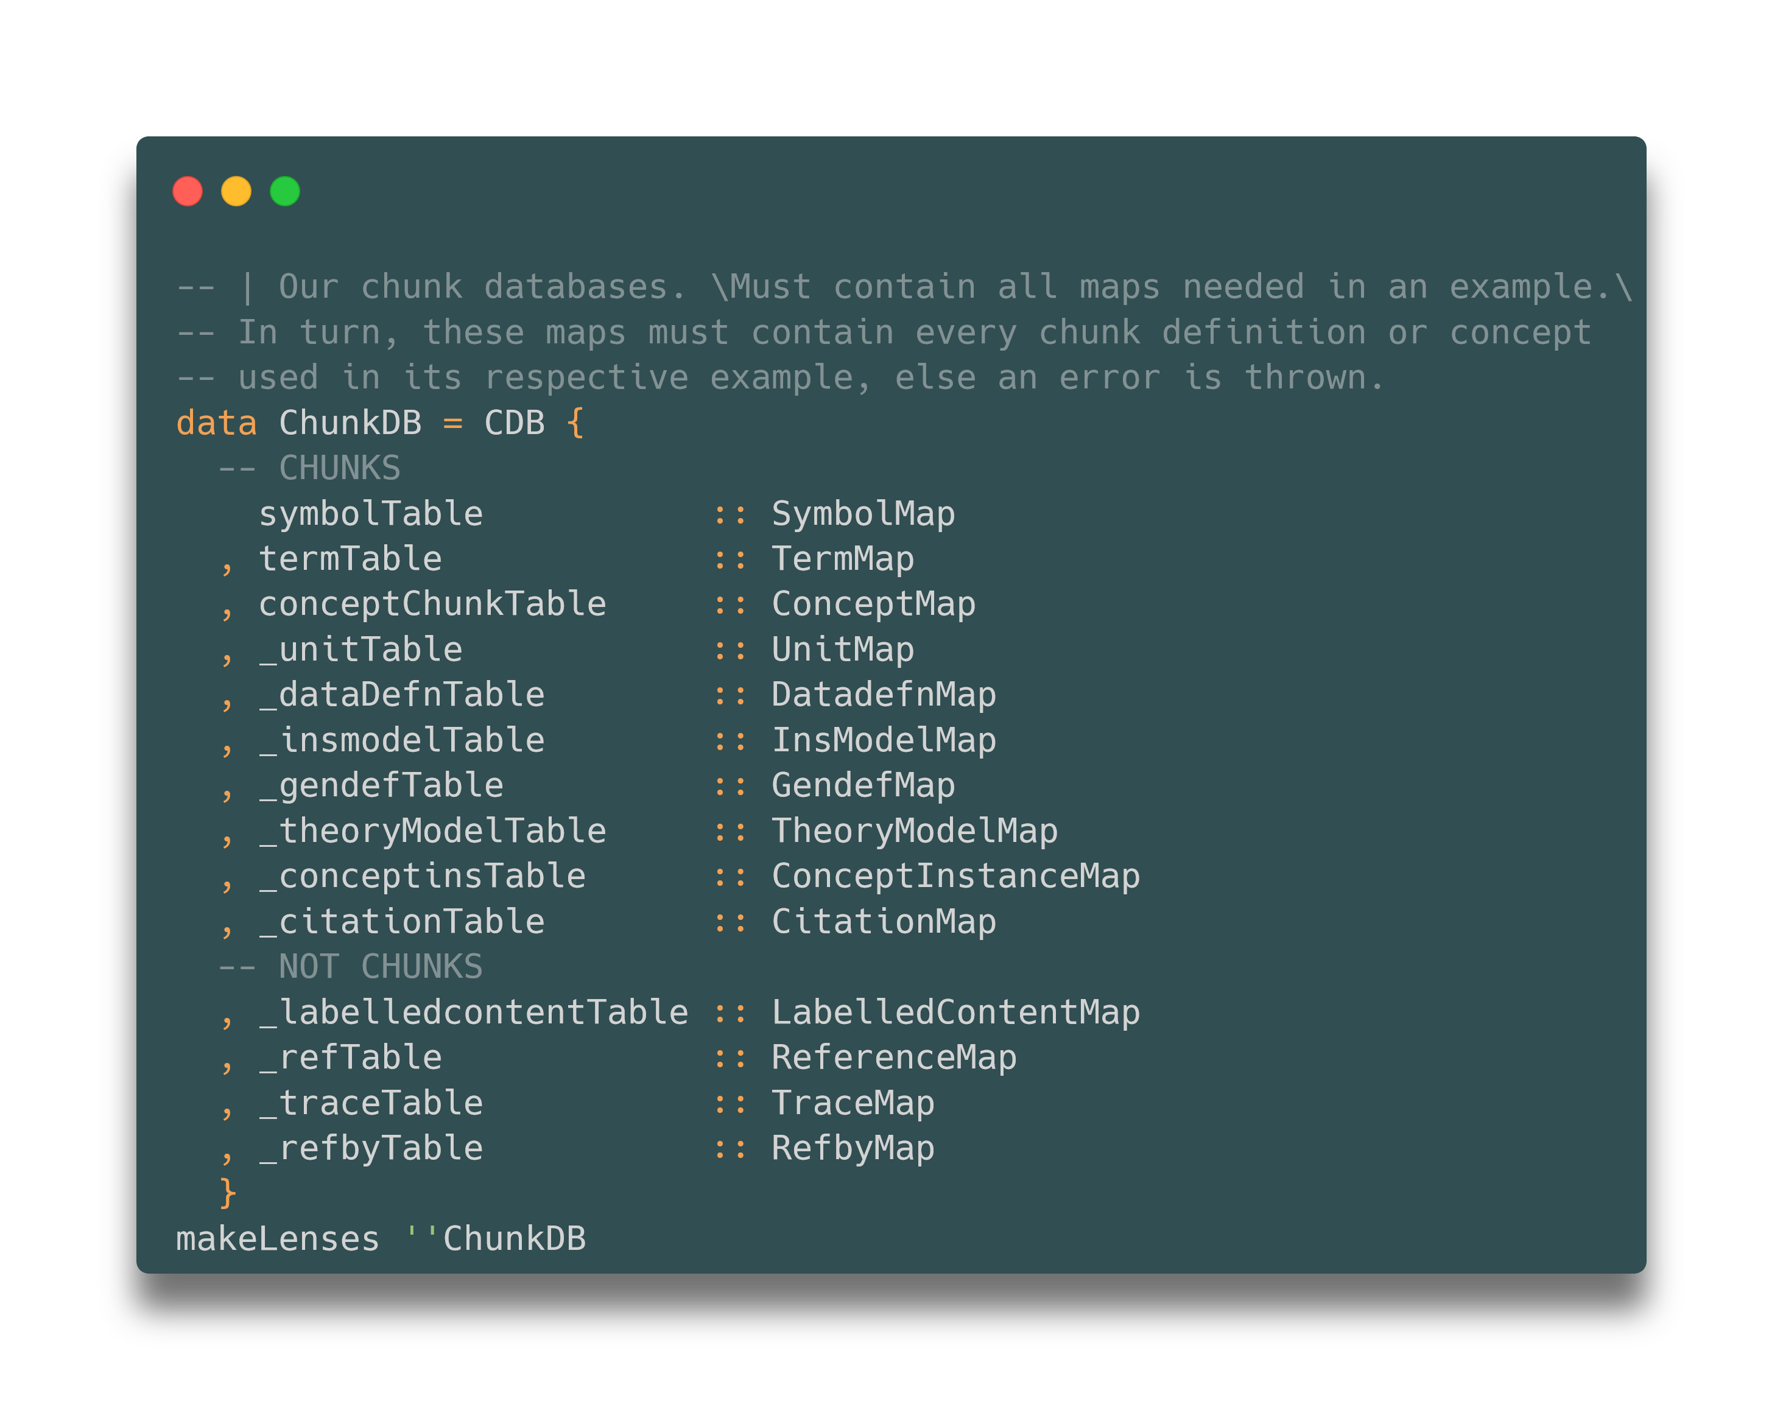
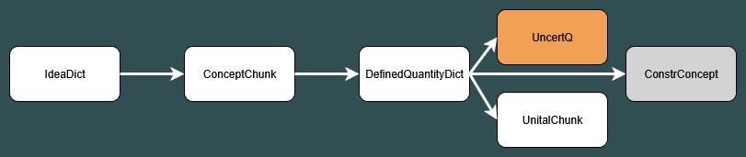
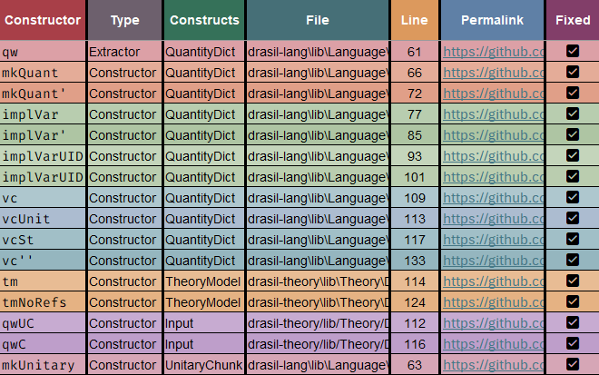
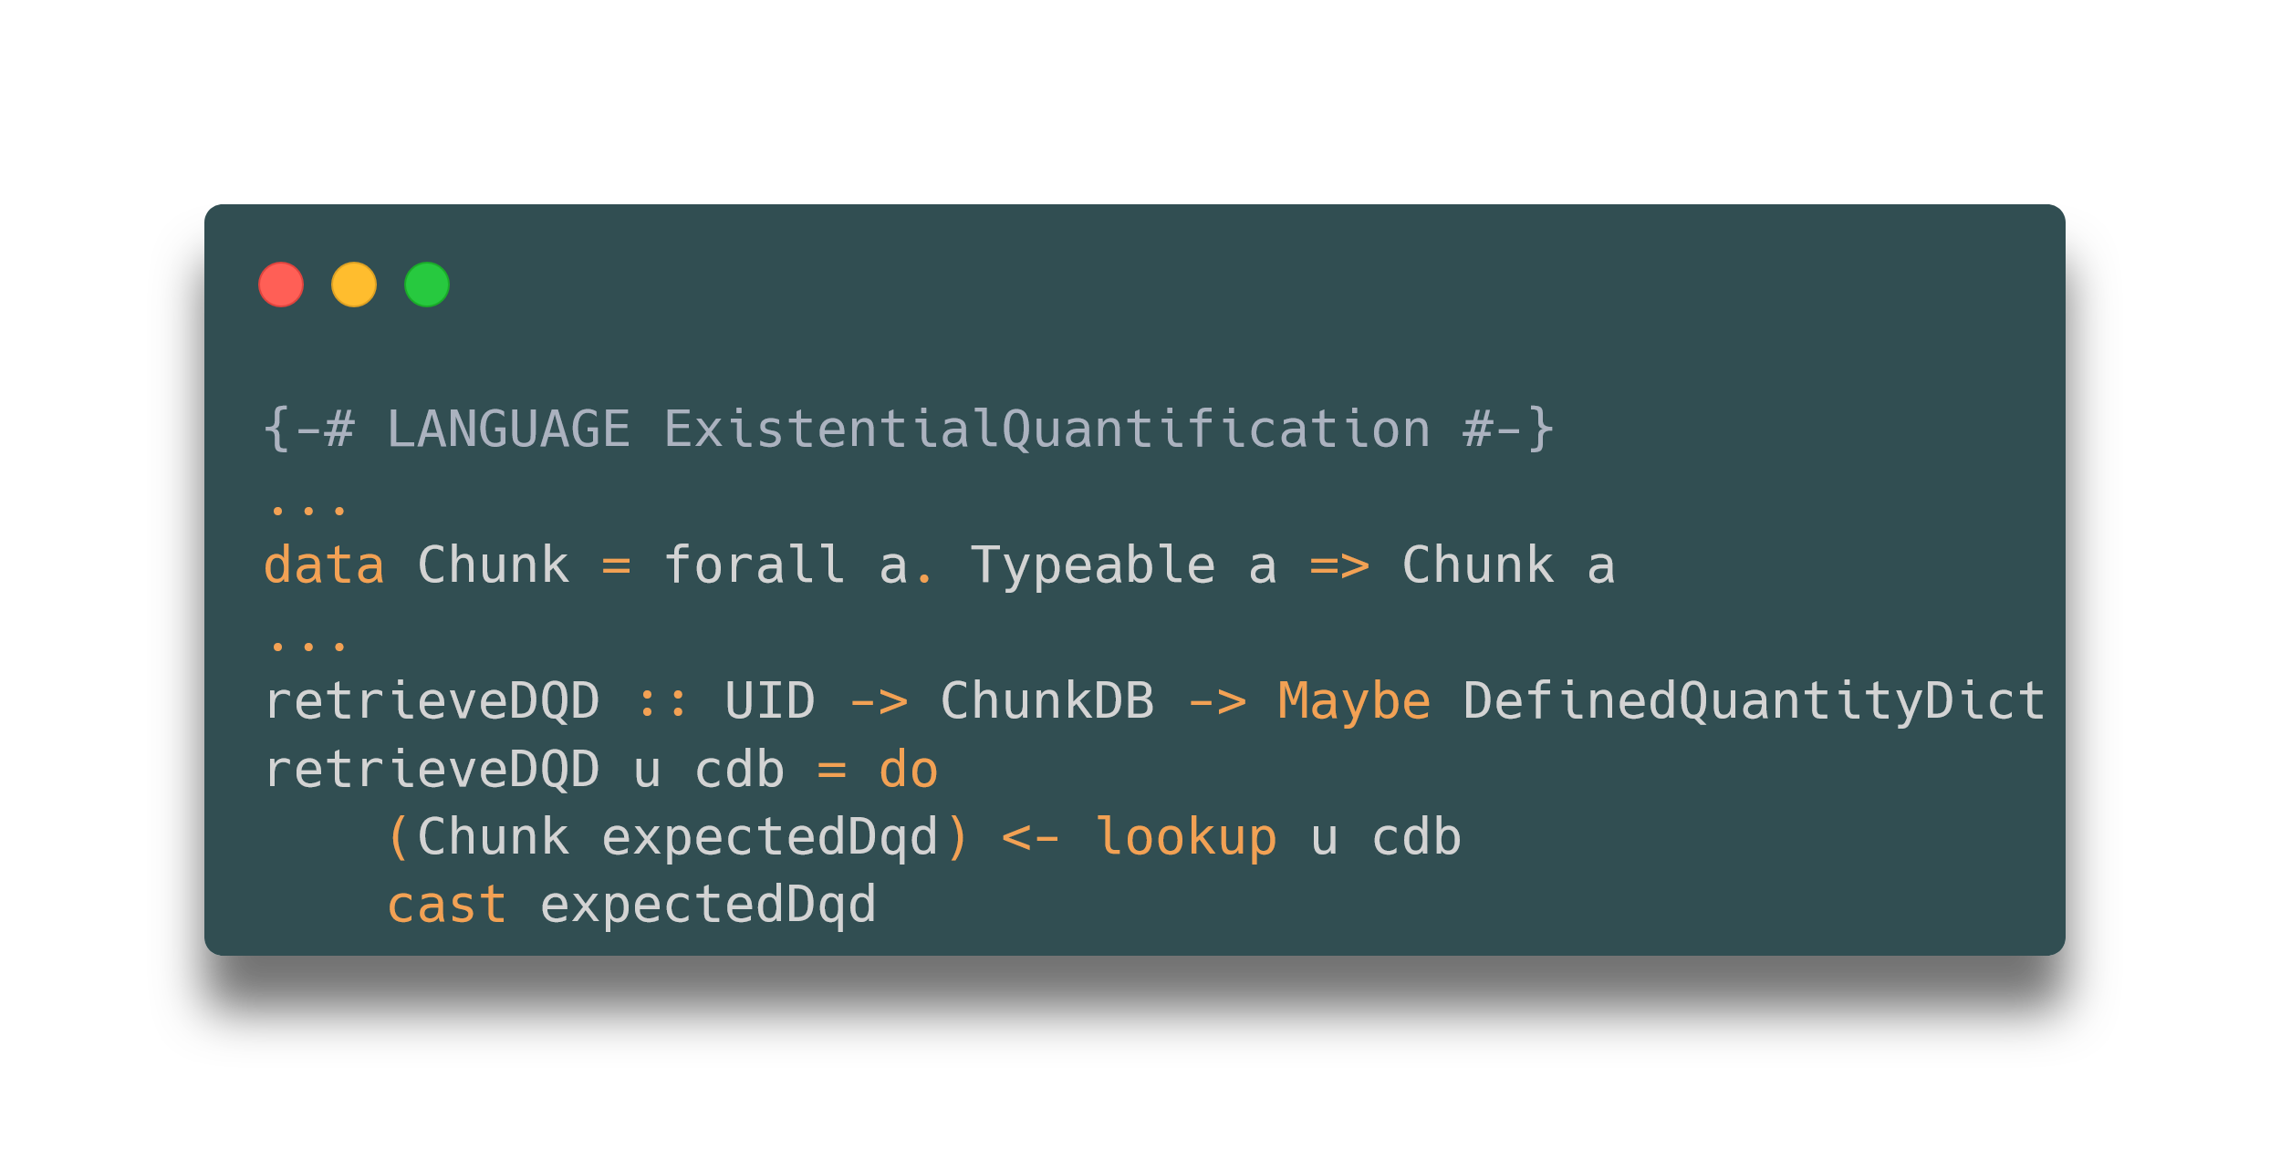

Addressing Knowledge Database Scalability Issues for Software Generation
Drasil – Generate All the Things!
Email: wyandj@mcmaster.ca
Jack Wyand, Dr. Jacques Carette, Dr. Spencer Smith, Jason Balaci
Department of Computing and Software, McMaster University, Hamilton, ON, Canada
LinkedIn: linkedin.com/in/jack-wyand
Background
Issues
Results
What is Drasil?
A framework for generating scientific computing software (SCS) from a stable knowledge base^{[1]}
Captures and reuses domain knowledge as structured, modular “chunks” to improve traceability, understandability, and to prevent duplication^{[1]}
Developed mainly in Haskell, with multiple embedded domain-specific-languages (DSLs)^{[1]}
Chunk UID duplicates
Duplicates occurred both within and across chunk tables. Across-table duplicates directly block the new implementation because of the following:
1425 UID duplicates fixed overall
QuantityDict type replaced by DefinedQuantityDict, eliminating all symbol-concept extraction duplicates
Work revealed many problems and insights within Drasil, significantly contributing to future improvements
Old implementation
New implementation
acceleration :: QuantityDict
ChunkDB
UID | Type
“acceleration” | QuantityDict
“acceleration" | ConceptChunk
Purpose
acceleration :: ConceptChunk
Improve the scalability of Drasil’s Chunk Database through deduplication of chunk UIDs within and across chunk tables and the implementation of a new database that does not restrict chunk types
Figure 3: Searching for the ConceptChunk with the UID “acceleration” will return Nothing since the QuantityDict appears first
Methods
Fixing UID duplicates – within tables
Determine where each instance is inserted
Analyze type of duplicate problem
Resolve issue
Figure 6: The previous chunk structure
Same UID, different data
Chunk extraction
Exact duplicate
Figure 7: The new, simplified chunk structure
Conclusions
Figure 4: The general method of fixing within-table duplicates
With the improved chunk database implementation, the scalability of future case studies generated with Drasil has been vastly improved. Furthermore, the overall quality of Drasil has been setup to be greatly enhanced through the many issues that my work has uncovered.
Fixing UID duplicates – across tables
Figure 1: Previous implementation of the Chunk Database, where every chunk type needed its own map
Figure 5: Tracking the use cases of all the QuantityDict constructors
References
Figure 2: Refined implementation, masking individual chunk types allowing for a single map^{[2]}
[1] D. Szymczak, S. Smith, and J. Carette, ‘Position paper: A knowledge-based approach to scientific software development’, in Proceedings of the International Workshop on Software Engineering for Science, Austin, Texas, 2016, pp. 23–26.
[2] J. Balaci, “Adding types and theory kinds to Drasil”, M.Sc. Thesis, Dept. Computing and Software, McMaster Univ., Hamilton, ON, Canada, 2022. [Online] . Available: http://hdl.handle.net/11375/29574
View the project here!
https://github.com/JacquesCarette/Drasil
Notes:
Background:
Drasil is a framework for generating scientific computing software, documentation, and test cases from a stable knowledge base. It does this by capturing domain knowledge to be reused across the generated artifacts using structured, modular “chunks.” A chunk is a unit of knowledge, ranging from things like a concept (e.g., temperature) to symbols, to even equations. This improves traceability, understandability, and prevents duplication in generated artifacts
Purpose:
- Due to Haskell being a statically typed language, lists can only have 1 type. Therefore, adding a new chunk type to the database requires creating a new chunk table. At a large scale, this becomes very unsustainable if we want to have many chunk types.

