Slide 1


Influence of inherent anisotropy of soil strength on limit equilibrium slope stability analysis
Problem Definition
Anisotropic Models
Search Routine
Numerical Examples
Future Work
References
Authors:
Brandon Karchewski*
Peijun Guo
Dieter Stolle
Department of Civil Engineering
McMaster University
Prepared for:
CGS Geotechnical Conference 2012
GeoManitoba
September 30 – October 3, 2012
B. Karchewski*, P. Guo, D. Stolle
Influence of inherent anisotropy of soil strength on limit equilibrium slope stability analysis

Slide 2
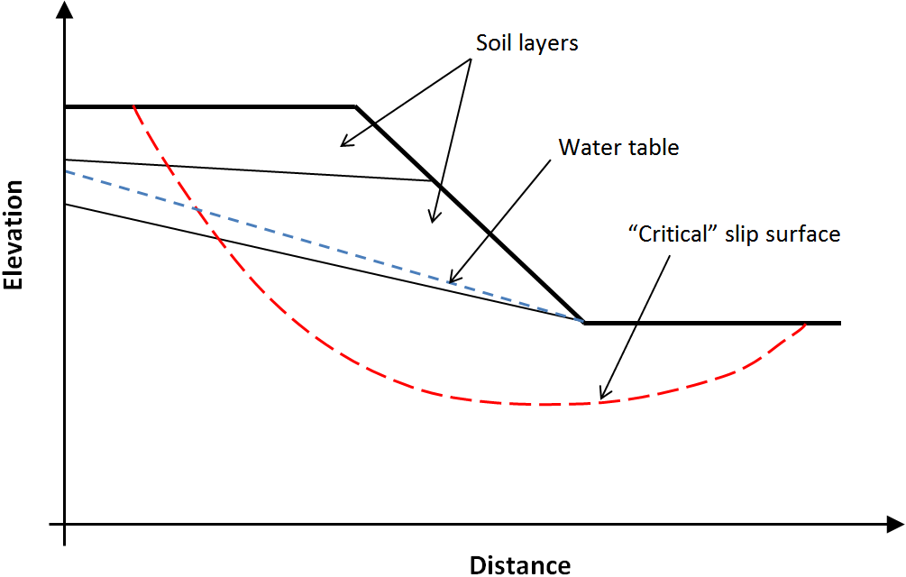
Two-dimensional slope with complex layering and water table
Problem Definition
Anisotropic Models
Search Routine
Numerical Examples
Future Work
References
B. Karchewski*, P. Guo, D. Stolle
Influence of inherent anisotropy of soil strength on limit equilibrium slope stability analysis
Notes:
Slope consisting of multiple soil layers of varying material properties
Bedding plane angle relative to failure surface angle influences available shear strength
Limit equilibrium analysis: must locate failure surface giving lowest factor of safety, “critical” failure surface
Analyse non-circular slip surface by dividing into series of slices and applying Morgenstern-Price analysis

Slide 3
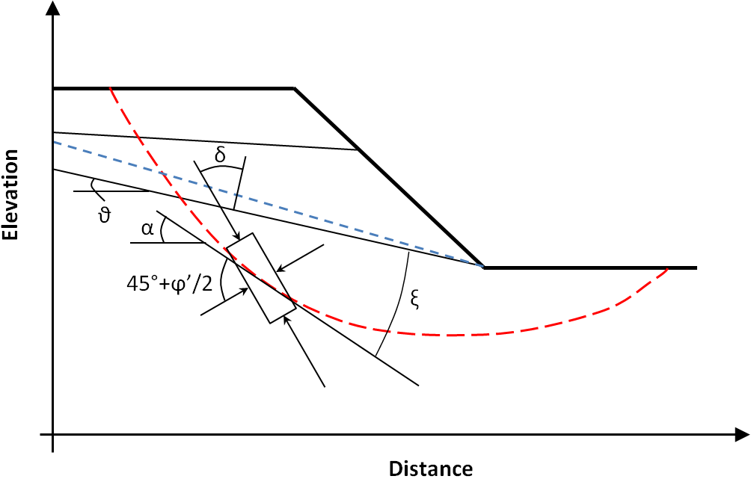
Definition of important angles in anisotropic models
Problem Definition
Anisotropic Models
Search Routine
Numerical Examples
Future Work
References
Angle of 45°+ϕ’/2 assumed for drained analysis (long-term stability)
  For undrained analysis should use value determined experimentally, for example Lo (1965)
B. Karchewski*, P. Guo, D. Stolle
Influence of inherent anisotropy of soil strength on limit equilibrium slope stability analysis
Notes:
Delta = angle between major principal stress and normal to bedding plane
Theta = angle between bedding plane and horizontal
Alpha = angle between failure plane and horizontal
Ksi = alpha – theta = angle between bedding plane and sliding plane
45+Phi/2; an assumed value for drained analysis (long-term stability); for undrained analysis should use a value determined experimentally, for example Lo (1965) and Law (1978)

Slide 4
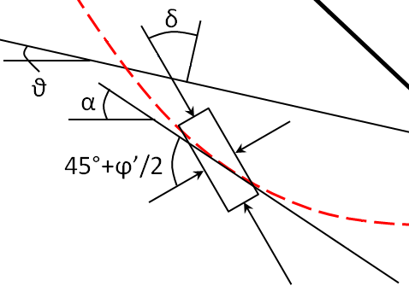
Anisotropic model for cohesive strength
c_{i} ʹ = c₌ʹ + (c┴ʹ – c₌ʹ) cos² δ
Problem Definition
Anisotropic Models
Search Routine
Numerical Examples
Future Work
References
OR
c_{i} ʹ = c┴ʹ [k_{c} + (1 – k_{c}) cos² δ]
k_{c} = c₌ʹ / c┴ʹ
Initially proposed by Casagrande and Carillo (1944)
Used by Law (1978) in embankment stability analysis and by Al-Karni and Al-Shamrani (2000) in analysis of circular slip surfaces for cohesive soils
B. Karchewski*, P. Guo, D. Stolle
Influence of inherent anisotropy of soil strength on limit equilibrium slope stability analysis
Notes:
c_i = cohesive strength for slice i
c_parallel = cohesive strength when major principal stress is parallel to bedding plane, delta = 90deg
c_perpendicular = cohesive strength when major principal stress is perp. to bedding plane, delta = 0deg
delta = angle between major principal stress and failure plane, as defined in previous diagram
k_c = degree of anisotropy

Slide 5
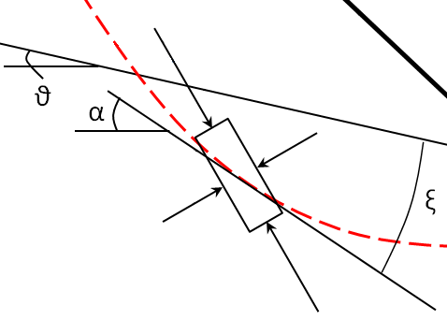
Anisotropic model for frictional strength
tan ϕ_{i}ʹ = μ₀ [1 – ϖ cos (2ξ)]
Problem Definition
Anisotropic Models
Search Routine
Numerical Examples
Future Work
References
with
μ₀ = ½ (tan ϕ┴ʹ + tan ϕ₌ʹ)
ϖ = (tan ϕ┴ʹ – tan ϕ₌ʹ) / (tan ϕ┴ʹ + tan ϕ₌ʹ)
Simplified model derived from micromechanical analysis by Guo and Stolle (2005)
Good agreement with experimental results by Tatsuoka and Park (1994)
B. Karchewski*, P. Guo, D. Stolle
Influence of inherent anisotropy of soil strength on limit equilibrium slope stability analysis
Notes:
tan(phi_i) = friction coefficient for slice i
phi_parallel = friction angle when sliding plane is parallel to bedding plane
phi_perpendicular = friction angle when sliding plane is perp. to bedding plane
ksi = angle between sliding plane and bedding plane, as defined in previous diagram
mu_0 = average friction coefficient
omega_bar = ratio between difference and sum of max and min friction coefficients

Slide 6
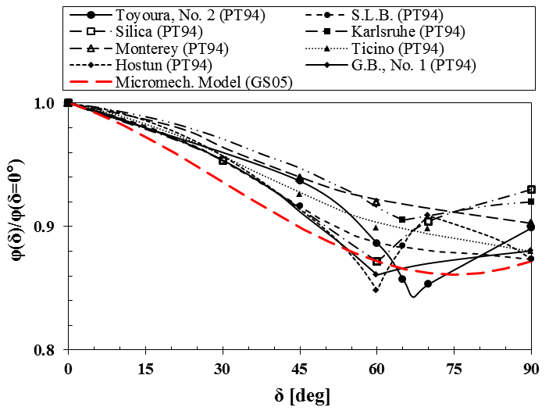
Anisotropic model for frictional strength
Problem Definition
Anisotropic Models
Search Routine
Numerical Examples
Future Work
References
Experimental data after Park and Tatsuoka (1994)
Reasonable frictional strength envelope using micromechanical model for ϕ₌ /ϕ┴ = 0.85
B. Karchewski*, P. Guo, D. Stolle
Influence of inherent anisotropy of soil strength on limit equilibrium slope stability analysis
Notes:
Model provides a reasonable frictional strength envelope when using phi_pll/phi_prp = 0.85
Values of friction angle for different orientations may be determined using standard tests with modified sample preparation, e.g. Guo (2008)

Slide 7
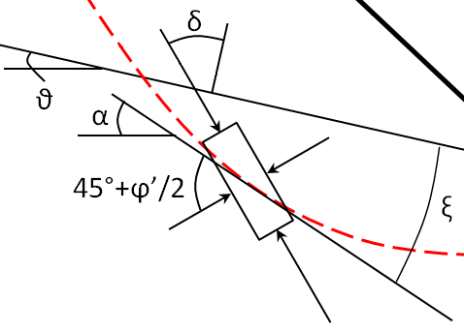
Note regarding the angles δ and ξ
Problem Definition
Anisotropic Models
Search Routine
Numerical Examples
Future Work
References
Both angles can be expressed through geometry and material properties; δ and ξ are not independent
Forms of anisotropic models are for computational convenience
ξ = |α – ϑ|
δ = 45° + ϕʹ/2 – |α| + ϑ sgn(α)
δ = 45° + ½ tan⁻¹ (μ₀ [1 – ϖ cos (2ξ)]) – |α| + ϑ sgn(α)
B. Karchewski*, P. Guo, D. Stolle
Influence of inherent anisotropy of soil strength on limit equilibrium slope stability analysis
Notes:
ksi is determined directly from angle of sliding plane and angle of bedding plane
delta is a function of friction angle and geometry
Substituting frictional model, delta is a function of geometry, material properties, and ksi
The variables are dependent allowing comparison of the two models
Only for drained analysis given the 45deg + phi/2 assumption

Slide 8
Locate “critical” slip surface using genetic algorithm search routine
Problem Definition
Anisotropic Models
Search Routine
Numerical Examples
Future Work
References
Direct search technique that seeks the surface yielding the minimum factor of safety
  Algorithm for non-circular surfaces after Li et al. (2010)
  Iteratively improve location of vertices that define the slip surface
Minimize objective function for factor of safety
  Method of slices for slip surfaces of general shape (Morgenstern and Price, 1965)
  Efficient algorithm as proposed by Zhu et al. (2005)
  Modified to account for interslice water pressure forces explicitly
B. Karchewski*, P. Guo, D. Stolle
Influence of inherent anisotropy of soil strength on limit equilibrium slope stability analysis

Slide 9
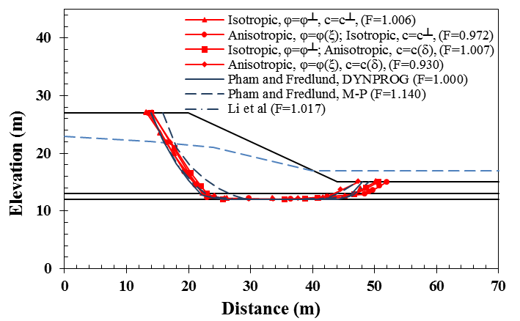
Horizontal bedding with weak layer and water table
Layer 1: φ┴=30°, c┴=20 kPa, γ= γ_{sat}=15 kN/m³
Layer 2: φ┴=10°, c┴=0 kPa, , γ= γ_{sat}=18 kN/m³
Layer 3: φ┴= 30°, c┴=100 kPa , γ= γ_{sat}=20 kN/m³
All layers have k_{φ}= k_{c} = 0.85
Problem Definition
Anisotropic Models
Search Routine
Numerical Examples
Future Work
References
B. Karchewski*, P. Guo, D. Stolle
Influence of inherent anisotropy of soil strength on limit equilibrium slope stability analysis
Notes:
Results consistent with those obtained using dynamic programming based on stress field obtained from finite element analysis (Pham and Fredlund, 2003)
In this particular case, accounting for anisotropy results in factor of safety changing from above to below unity
This may have implications for probabilistic analyses where strength properties become “random” variables
May result in significantly higher probability of failure / probability of unsatisfactory performance

Slide 10
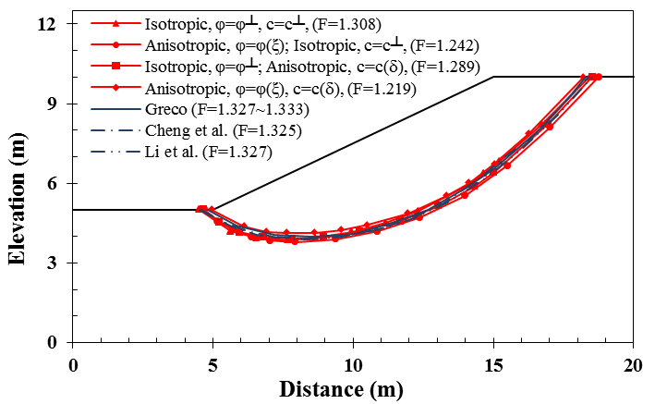
Homogeneous slope
φ┴=10°, φ═=8.5°, c┴=9.8kPa, c═=8.33kPa,
γ=17.64kN/m³, θ=0°
Problem Definition
Anisotropic Models
Search Routine
Numerical Examples
Future Work
References
B. Karchewski*, P. Guo, D. Stolle
Influence of inherent anisotropy of soil strength on limit equilibrium slope stability analysis
Notes:
Predicted shape and location in good agreement with other researchers
Results of multiple search algorithms: Monte Carlo (Greco, 1996), particle swarm (Cheng et al., 2007), genetic algorithm (Li et al., 2010)
Shape and location not affected by inherent strength anisotropy
In agreement with findings of Al-Karni and Al-Shamrani (2000) for circular surfaces, but also accounting for arbitrary shape
Allows search for critical surface and anisotropic analysis to be uncoupled, if desired
Says nothing of spatial anisotropy due to variable ground conditions or seasonal variations
Accounting for anisotropy, 7% reduction in F_{s} for 15% degree of anisotropy

Slide 11
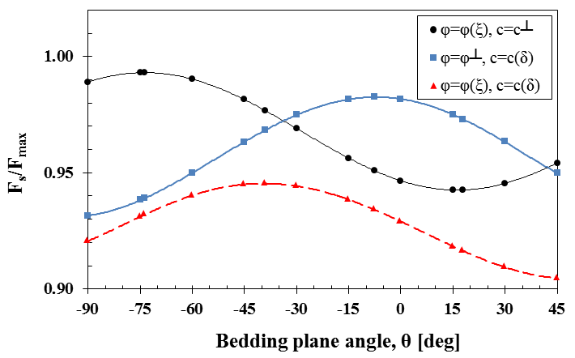
Homogeneous slope
φ┴=10°, φ═=8.5°, c┴=9.8kPa, c═=8.33kPa,
γ=17.64kN/m³, θ = variable
Problem Definition
Anisotropic Models
Search Routine
Numerical Examples
Future Work
References
B. Karchewski*, P. Guo, D. Stolle
Influence of inherent anisotropy of soil strength on limit equilibrium slope stability analysis
Notes:
Variation in bedding angle also plays a role
Note that frictional and cohesive components do not have the same variation with bedding angle
Makes interaction of these components non-intuitive; more research needed to examine this aspect
For frictional component
Minimum strength occurs when theta = mean(alpha) for a given surface
Maximum strength occurs when theta ≈ perpendicular to mean slope of failure surface

Slide 12
Future goals for anisotropic slope stability analysis
Incorporate inherent anisotropic analysis into more comprehensive simulation accounting for variation of material properties in space and time
  See, for example, Monte Carlo analysis by El-Ramly, Morgenstern, and Cruden (2002)
  Allows one to properly account for unsaturated component of strength since seasonal variation of properties is important
More detailed analysis on interaction between cohesive and friction strength with regard to bedding angle
  Should involve experimental analysis in addition to numerical modelling
  Build on past work by Duncan and Seed (1966), Mayne (1985), Park and Tatsuoka (1994), and others
Problem Definition
Anisotropic Models
Search Routine
Numerical Examples
Future Work
References
B. Karchewski*, P. Guo, D. Stolle
Influence of inherent anisotropy of soil strength on limit equilibrium slope stability analysis

Slide 13
Thank you for your time and attention.
Problem Definition
Anisotropic Models
Search Routine
Numerical Examples
Future Work
References
The funding provided by NSERC for this research is acknowledged and greatly appreciated.
Feedback in the form of questions, comments, or suggestions is welcomed.
B. Karchewski*, P. Guo, D. Stolle
Influence of inherent anisotropy of soil strength on limit equilibrium slope stability analysis

Slide 14
Al-Karni, A.A. and Al-Shamrani, M.A. (2000). Study of the effect of soil anisotropy on slope stability using method of slices. Computers and Geotechnics, 26(2), 83-103.
Casagrande, A. and Carillo, N. (1944). Shear failure of anisotropic materials. Journal of the Boston Society of Civil Engineers, Contributions to Soil Mechanics 1941-1953, 122- 135.
Cheng, Y., Li, L., Chi, S., and Wei, W. (2007). Particle swarm optimization algorithm for the location of the critical non-circular failure surface in two-dimensional slope stability analysis. Computers and Geotechnics, 32(2), 92-103.
Duncan, J.M. and Seed, H.B. (1966). Anisotropy and stress reorientation in clay. Journal of the Soil Mechanics and Foundation Division, ASCE, 92(SM5), 21-50.
El-Ramly, H., Morgenstern, N., and Cruden, D. (2002). Probabilistic slope stability analysis for practice. Canadian Geotechnical Journal, 39(3), 665-683.
Greco, V. (1996). Efficient Monte Carlo technique for locating critical slip surface. Journal of Geotechnical Engineering, ASCE, 122(7), 517-525.
Guo, P. (2008). Modified direct shear test for anisotropic strength of sand. Journal of Geotechnical and Geoenvironmental Engineering, 134(9), 1311-1318.
Guo, P. and Stolle, D. (2005). On the failure of granular materials with fabric effects. Soils and Foundations, 45(4), 1-12.
Law, K. (1978). Undrained strength anisotropy in embankment stability. Canadian Geotechnical Journal, 15(2), 306-309.
Problem Definition
Anisotropic Models
Search Routine
Numerical Examples
Future Work
References
B. Karchewski*, P. Guo, D. Stolle
Influence of inherent anisotropy of soil strength on limit equilibrium slope stability analysis

Slide 15
Li, Y., Chen, Y., Zhan, T., Ling, D., and Cleall, P. (2010). An efficient approach for locating the critical slip surface in slope stability analyses using a real-coded genetic algorithm. Canadian Geotechnical Journal, 47(7), 806-820.
Lo, K.Y. (1965). Stability of slopes in anisotropic soils. Journal of the Soil Mechanics and Foundations Division, ASCE, 91(SM4), 85-106.
Mayne, P.W. (1985). Stress anisotropy effects on clay strength. Journal of Geotechnical Engineering, ASCE, 111, 356-66.
Morgenstern, N. and Price, V. (1965). The analysis of the stability of general slip surfaces. Géotechnique, 15(1), 79-93.
Park, C. and Tatsuoka, F. (1994). Anisotropic strength and deformations of sands in plane strain compression. Proceedings of the Thirteenth International Conference on Soil Mechanics and Foundation Engineering, 1, 1-4.
Pham, H. and Fredlund, D. (2003). The application of dynamic programming to slope stability analysis. Canadian Geotechnical Journal, 40(4), 830-847.
Zhu, D., Lee, C., Qian, Q., and Chen, G. (2005). A concise algorithm for computing the factor of safety using the Morgenstern-Price method. Canadian Geotechnical Journal, 42(1), 272-278.
Zolfaghari, A., Heath, A., and McCombie, P. (2005). Simple genetic algorithm search for critical non-circular failure surface in slope stability analysis. Computers and Geotechnics, 32(3), 139-152.
Problem Definition
Anisotropic Models
Search Routine
Numerical Examples
Future Work
References
B. Karchewski*, P. Guo, D. Stolle
Influence of inherent anisotropy of soil strength on limit equilibrium slope stability analysis

