Slide 1


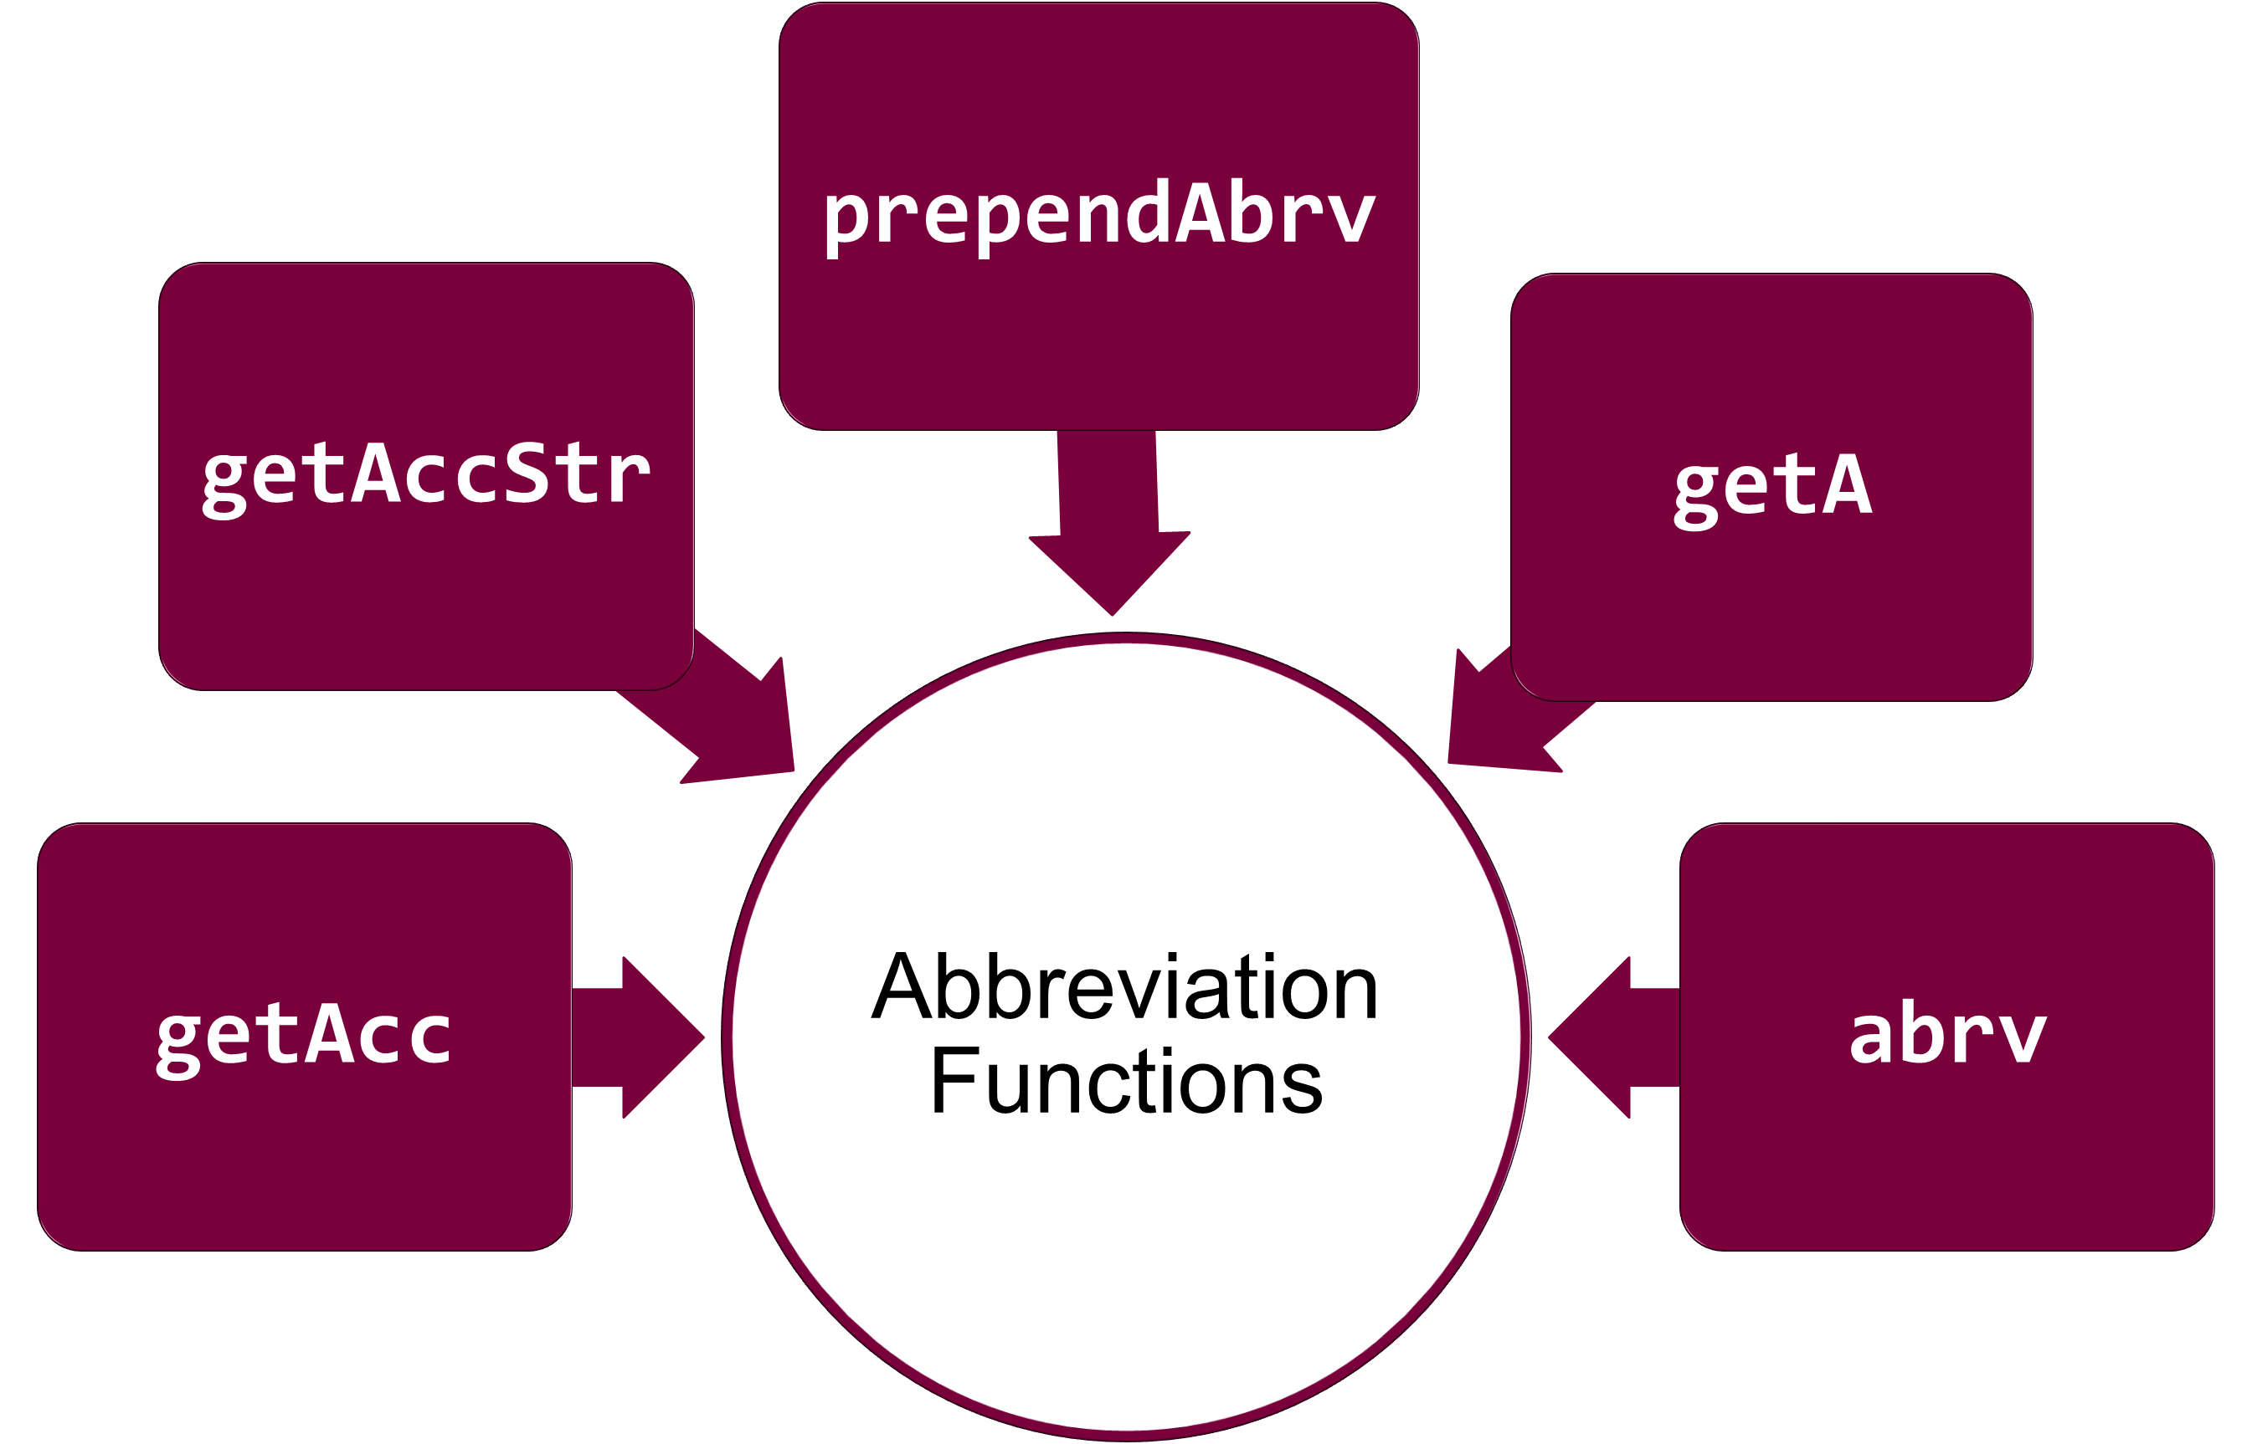

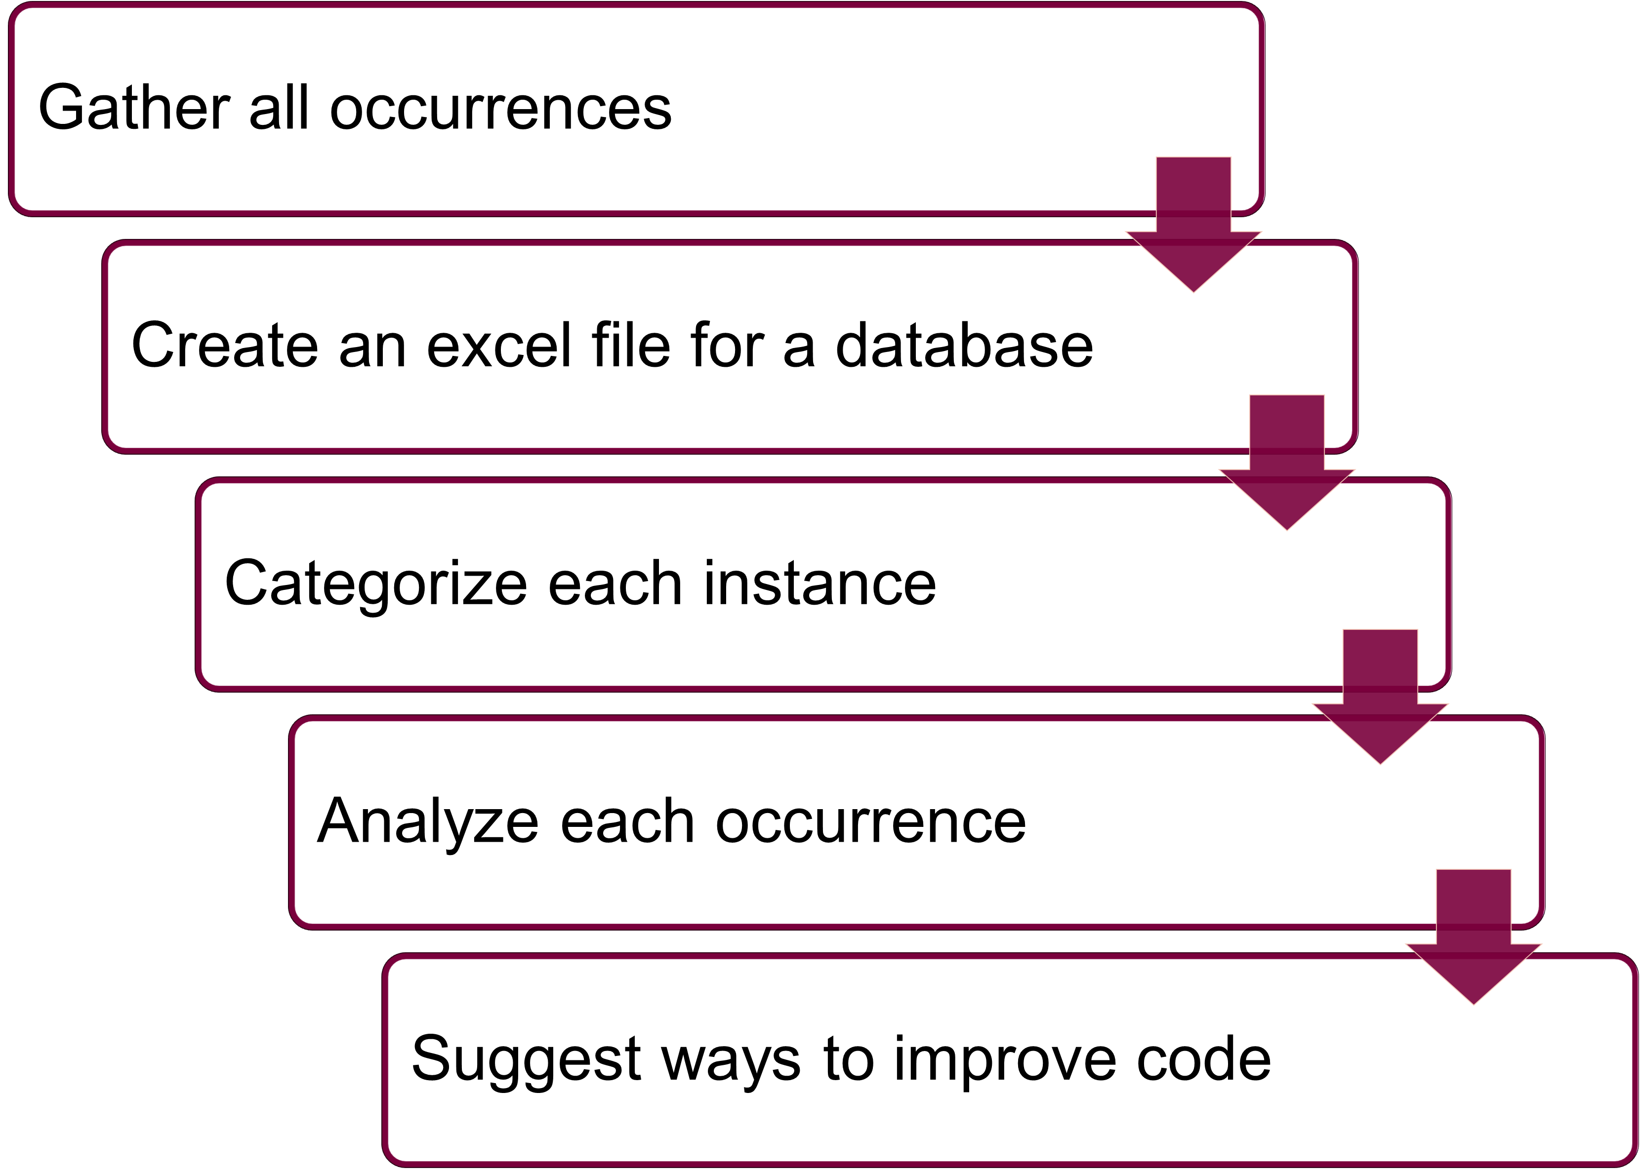

Investigation of Abbreviation Functions
Drasil – Generate All the Things!
Harmanpreet Singh Sagar, Dr. Jacques Carette, Dr. Spencer Smith
Department of Computing and Software, McMaster University, Hamilton, ON, Canada
Introduction
Methods Continued
The Problem of Information Duplication:
Prone to errors. ^{[1]}
Hard to achieve traceability. ^{[1]}
Reduces maintainability of software. ^{[1]}
The Solution:
A software framework (Drasil) that captures data once and duplicates it as needed to generate all software artifacts, including code, requirements documentation, build scripts, etc. ^{[1]}
What is Drasil?
A framework to generate all the software artifacts from a stable knowledge base. ^{[1]}
Currently focuses on Scientific Software. ^{[1]}
Common knowledge recipes are written in Domain Specific Languages (DSLs) embedded in Haskell. ^{[1]}
Drasil has grown organically for almost 10 years and is now in need of refactoring.
Short Name | Long Name | Description
F | Fundamental | An acronym is required and cannot be replaced with the full word in the SRS
I | Incidental | The sentence would still make sense if the full phrase was used instead in SRS
U | Unknown | Unsure of the classification or of its purpose
T | Text | Used to form text
OI | Obtain Idea | Finds the Idea contained in x used to make y, and later is used to obtain acronym out of that idea.
OA | Obtain Acronym | Obtains the acronym from an Idea of a type
DF/RF | Domain / Reference Formation | Used in a function that is used to make a domain or a reference
OR | Obtain Reference | Used in a function that is used to obtain a reference.
NF | Name Formation | Used in a function that is used to make names
Figure 3: Table showcasing the various classifications. (Source: Author’s Own Creation)
Results
Abbreviation functions used in 146 lines of code
No changes suggested for getA and getAcc.
getAccStr was replaced with abrv due to same functionality.
abrv replaced with programName in 19 different instances.
Improved file naming by replacing spaces with underscores
PD Controller → PD_Controller.
prependAbrv forms labels for GenDefn, DataDefinitions, InstanceModel, and TheoryModel. Further investigations are ongoing.
Abbreviation functions misused as a side-effect of de-embedding the Drasil framework.
Refactored code to improve traceability and documented findings in the Drasil wiki.
Purpose / Objectives
Analyze and resolve abbreviation function abuses in Drasil.
Reduce duplication to prevent errors in Drasil.
Improve traceability within the Drasil framework.
The functions being analyzed are as follows:
Figure 1: A mind map showing the various abbreviation functions in Drasil. (Source: Author’s Own Creation)
Figure 4: A code block showcasing an example of a change made to the code base. (Source: Author’s Own Creation)
Methods
Function | Location | Word | Classification
getAcc | drasil-docLang/lib/Drasil/Sections/Introduction.hs | Doc.SRS | F
getAcc | drasil-example/dblpendulum/lib/Drasil/DblPendulum/Assumptions.hs | twoD | F
Figure 5: A table showcasing different usages and classification of the getAcc function. (Source: Author’s Own Creation)
Conclusion
This investigation highlighted the uses and abuses of abbreviation functions within Drasil. A lot of these abuses were a result of the de-embedding of Drasil. The misuse of these functions has been fixed to improve readability and traceability. Refactoring the code has also helped in following file naming conventions and has thus improved the quality of the artifacts that are generated by Drasil.
Next Steps
Continue the investigation into the prependAbrv function to determine how it is used in reference formation.
Refactor the code for the Drasil framework to effectively and efficiently utilize the prependAbrv function.
Investigate functions that could be merged as a result of carrying out the same task.
Figure 2: A flowchart showcasing the various steps taken to investigate the use of abbreviations within the Drasil framework. (Source: Author’s Own Creation)
Reference
Acknowledgements
[1] Daniel Szymczak, W. Spencer Smith, and Jacques Carette. Position paper: A knowledge-based approach to scientific software development. In Proceedings of SE4Science’16 in conjunction with the International Conference on Software Engineering (ICSE), Austin, Texas, United States, May 2016. In conjunction with ICSE 2016. 4 pp.
I would like to thank the McMaster Engineering Research Experience Award committee for funding this position and paper. I would also like to thank Dr. Spencer Smith and Dr. Jacques Carette for providing me with this valuable opportunity to learn and contribute to this project. Finally, I would like to thank Jason Balaci and Samuel Crawford for their support throughout the summer.
HARMANPREET SINGH SAGAR
Email: sagarh@mcmaster.ca
LinkedIn: harmanpreetssagar
View Our Work
https://jacquescarette.github.io/Drasil

