Slide 1
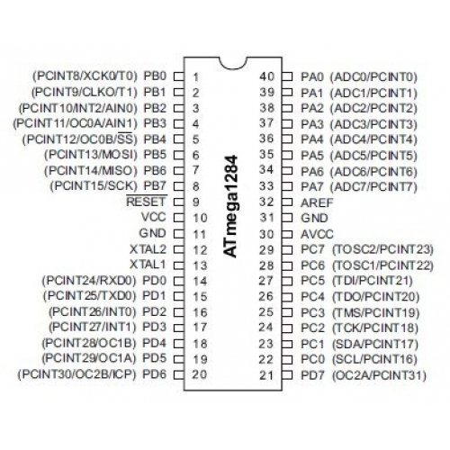

Joystick
LED Matrix
LCD
2 Buttons
LED Matrix
LCD Display
LCD

