Slide 1
Meridian Savings — Churn Ranking & Friction-Gate Handover
Course prototype · Scenario stakeholder roles
Ops cut t≈0.701 · Model card 1.1.0-sprint3-serving
Solo build · AI assisted · Reconciled 2 November 2026

Slide 2
Part 1: The Product & The ML Solution

Slide 3
Historical balances motivate a capacity-limited retention review prototype.
• Problem: silent churn erodes AUM — Sprint 1 validated ~$7.3M at risk
• Constraints: finite agent capacity; Responsible AI, explainability, risk mitigation
• Tier 1 — Predictive Engine: XGBoost (deterministic, verifiable, explainable)
• Tier 2 — GenAI Extension: Azure OpenAI + Pydantic + PII filtering

Slide 4
We eliminated threshold-calibration leakage by training on the past and predicting the future.
• Churn: Running_Balance_Rounded == 0 AND no active transactions that month
• Excluded high-balance dormant accounts (e.g. $10k inactive — still hold AUM)
• Temporal split (no shuffle): Train ≤ 2016-08 · Val · Test 2017-09 → 2020-04
• Observation window = features through month t; label = month t+1 (ADR 004)

Slide 5
We let tree models partition messy balances natively instead of destroying signal with heavy imputation.
• Nulls: imputed missing opening balances with $0
• Kept extreme balance outliers (±1e10) and NaNs in early-tenure lag features
• Filtered $0 system-generated placeholder transactions (false-active signals)
• Cohort: two-month inactivity streaks correlate with churn; geo/age slices flagged for fairness

Slide 6
We chose XGBoost because it natively handles our extreme balance outliers, missing lagged features, and Glass-Box explainability mandates.
• 1. Requirement constraints: ML Fundamentals forbade zero-shot GenAI for core prediction
• 2. Tree ensembles fit tabular churn — shipped model is XGBoost (LightGBM considered in-family)
• 3. Native NaNs + outlier robustness (±1e10) without destructive scaling
• 4. SHAP for Jamie's Glass-Box / RAI mandate (dtreeviz attempted, skipped: Lag3 NaNs)

Slide 7
MLflow tracks every training run, and the portable Ops artifact freezes the business-optimized cut at t≈0.701.
• MLflow logs hyperparameters, temporal CV folds, and ranking metrics (PR-AUC / ROC-AUC)
• Ops artifact in Models/ops/ freezes the contact policy — not a re-tune on demo day
• Business cut t≈0.701 is a RAISE from max-F1 t=0.475 → 12× fewer false positives
• Serving loads that frozen threshold so FastAPI / Streamlit stay aligned

Slide 8
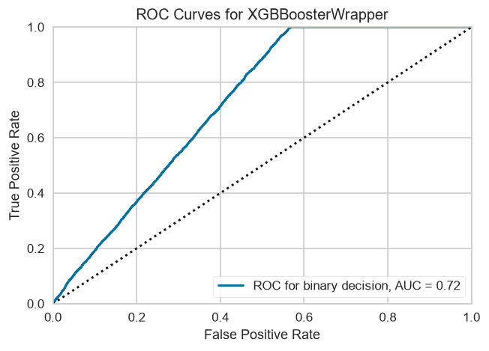
Our model beats the historical heuristic on PR-AUC and ROC-AUC — not on misleading accuracy.
• Always-negative: PR-AUC 0.132 (accuracy ≈ 0.869 — useless)
• gone_this_month heuristic: PR-AUC 0.151 · ROC-AUC 0.551
• XGBoost: PR-AUC 0.219 · ROC-AUC 0.723
• Ranking DoD = PR-AUC / ROC-AUC — threshold accuracy is not the bar

Slide 9
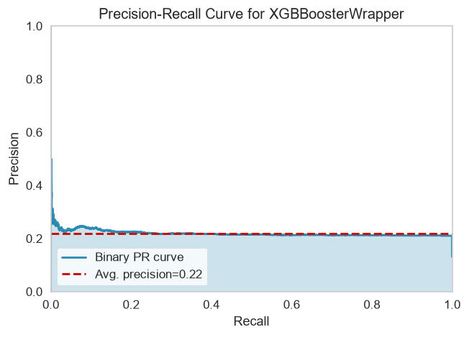
We prioritize ranked operational queues over calibrated actuarial probabilities.
• Scores support ordering; they are not percentiles or verified probabilities
• Platt scaling explicitly skipped — scale_pos_weight skews calibration
• Increasing Platt scaling preserves order; isotonic can introduce ties
• Validation top-5% cut sets no group quota or future queue guarantee

Slide 10
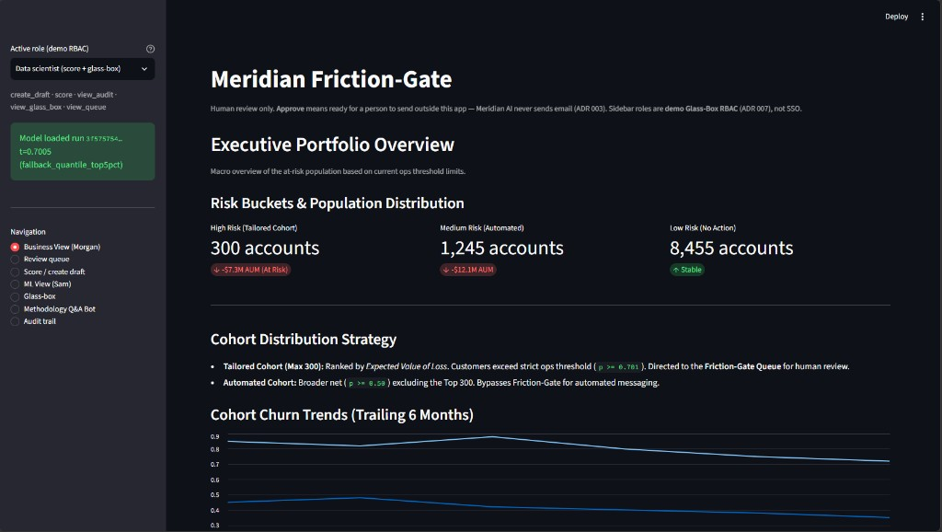
We restrict the retention queue to the top 5% of risk scores to keep false positives manageable.
• Max-F1 (t=0.475): precision 0.211 · 248,778 FP (~62% of test rows flagged)
• Ops RAISE to top-5% (t≈0.701): precision 0.229 · 20,127 FP (12× reduction)
• PR-AUC 0.219 / ROC-AUC 0.723 unchanged — decision policy, not ranking
• North Star ~$7.3M AUM: business-optimized capacity over max-F1 flood

Slide 11
We can rank better than the heuristic, but we cannot promise a 40% hit rate from raw scores.
• Top 50% ≈ 0.21 · Top 10% ≈ 0.23 · Top 5% ≈ 0.23 · Top 1% ≈ 0.24 val precision
• 40% never appears — scores are ranks, not calibrated probabilities
• Modest PR-AUC (0.219) limits precision at the top of the queue
• Base rate ~12% — 40% would require 3× richer than chance; needs new signal, not threshold hunt

Slide 12
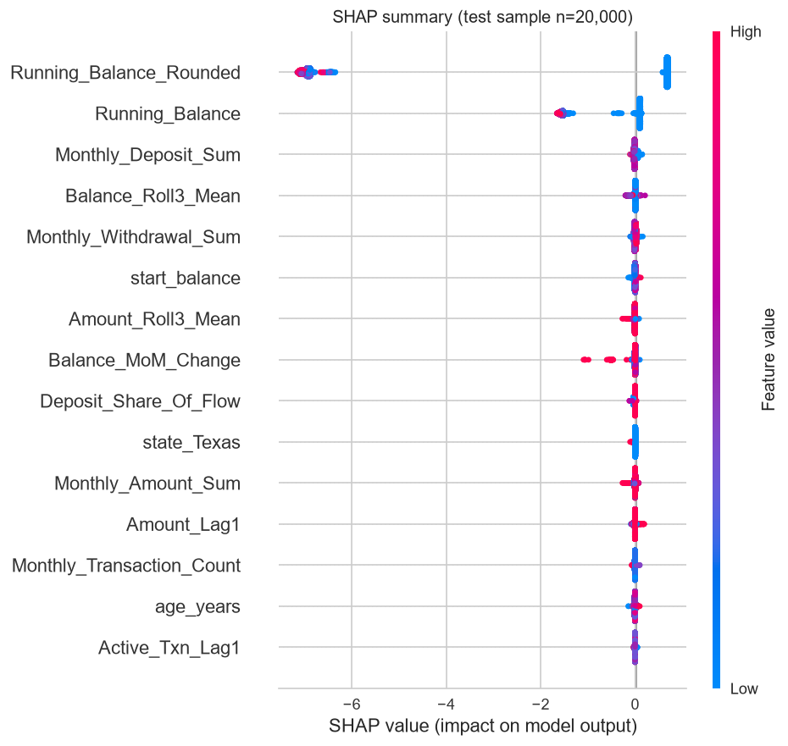
SHAP explains model output; measured age and state disparities remain.
• Balance features dominate; age and state are also model inputs
• Fairlearn Equalized Odds on age + state at ops t≈0.701
• Groups n ≥ 500 only; 38/55 state groups kept; detailed CSV absent
• Disclosed on model card: Age EOD ≈ 0.16 · State EOD ≈ 0.32

Slide 13
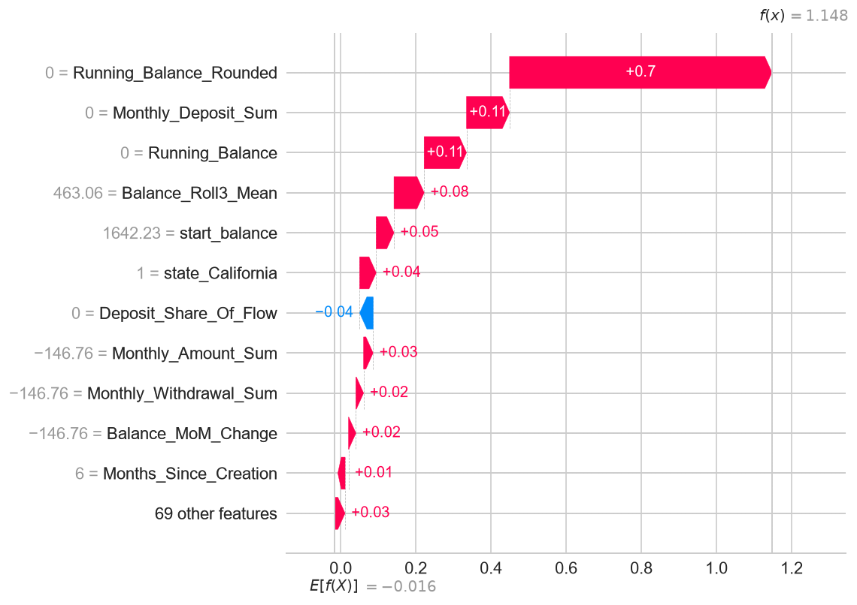
Local SHAP waterfall plots explain exactly why each individual customer was flagged.
• Friction-Gate UI displays exact push/pull features per customer
• Red: increases churn risk · Blue: decreases risk
• Agents see behaviour-led drivers — not opaque demographic scores
• Builds trust with retention agents reviewing the queue

Slide 14
Drafts use prompts and validation; methodology Q&A uses retrieved evidence.
• PII filtering: keys and patterns; no complete de-identification guarantee
• Pydantic checks structured fields and numeric rates; prose still needs review
• Prompt-as-code: versioned .prompty assets + Azure OpenAI (not hardcoded strings)
• Only Q&A retrieves documents; drafts use prompt constraints and drivers

Slide 15
Versioned prompts and fixtures support a repeatable local demonstration.
• retention_draft.prompty v1.0.0 — prompt-as-code (logic + params separated from Python)
• Demo path: Sprint 4 fixtures (below_threshold / flagged JSON) — no emails, no real customers
• PII filtering before prompts and on output; patterns can miss names
• No provider data-retention guarantee is established by these filters

Slide 16
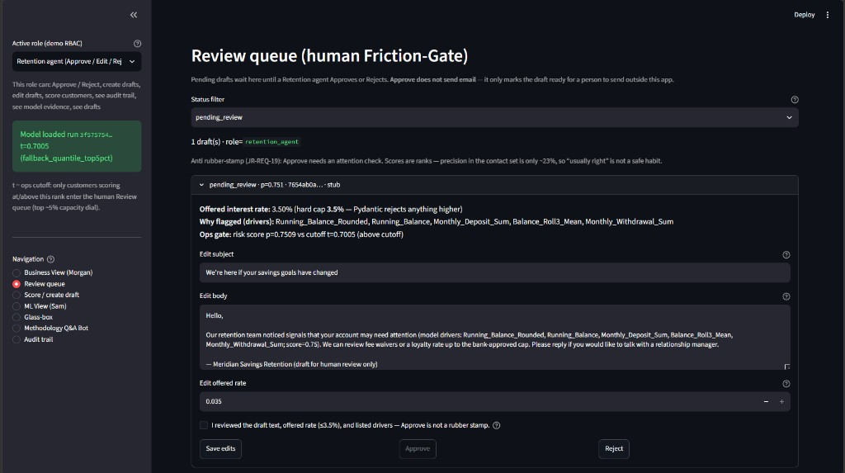
The Friction-Gate UI guarantees no email reaches a customer without active human approval.
• AI drafts locked in Pending Review — never autonomous dispatch
• Approve ≠ Sent — no /send route exists in architecture
• Approve marks draft ready; outbound mail lives outside this system
• Demo RBAC: Compliance can view, cannot Approve (ADR 007)

Slide 17
We treat Friction as a Feature so Streamlit Approves cannot become rubber stamps.
• Attention Ack required before Approve (attention_ack=true · JR-REQ-19)
• High-stakes visual banner when score is well above ops cut
• Fast-decide soft warn + audit if Approve in < ~8s (seconds_open logged)
• Queue copy: ranks only — contact-set precision ~23%

Slide 18
Prototype controls cover PII filtering, output checks and human review.
• Privacy / I/O: PII filters · Pydantic rate ≤ 3.5% · versioned .prompty + fixture demos
• Retrieval: ChromaDB rejected → pure-Python in-memory RAG (portable, zero native vector DB)
• HITL: Pending Review · Approve ≠ Sent · no /send · attention_ack · ~8s soft-warn · audit trail
• Access / fairness: Glass-Box RBAC (X-Demo-Role) · SHAP · Fairlearn EOD · ops cut t≈0.701

Slide 19
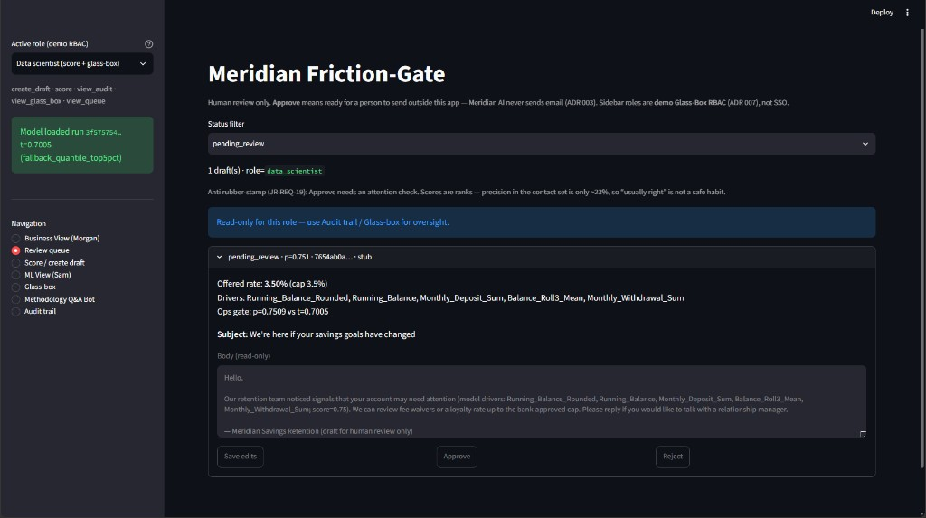
Data scientists can inspect the Review queue but cannot Save, Approve, or Reject drafts.
• Pending drafts, drivers, and 3.5% rate cap stay visible
• Read-only banner on the Review card
• Save / Approve / Reject disabled — not just relabeled
• Proves Glass-Box RBAC is enforced, not decorative

Slide 20
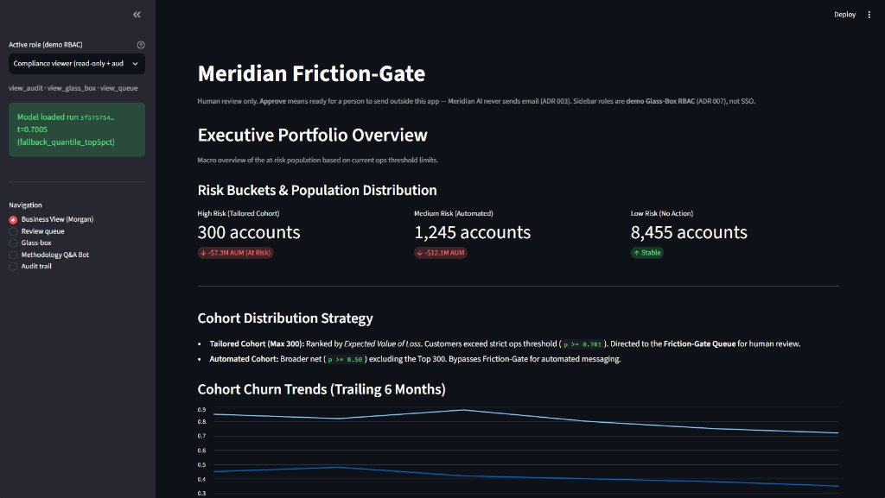
Compliance can oversee the $7.3M high-risk cohort on Business View but still cannot Approve.
• Capacity cohorts remain visible for Risk oversight
• High-risk slice tied to ~$7.3M historical AUM
• Approve path locked — Compliance views, does not decide
• Demo RBAC: pedagogical role picker, not production SSO

Slide 21
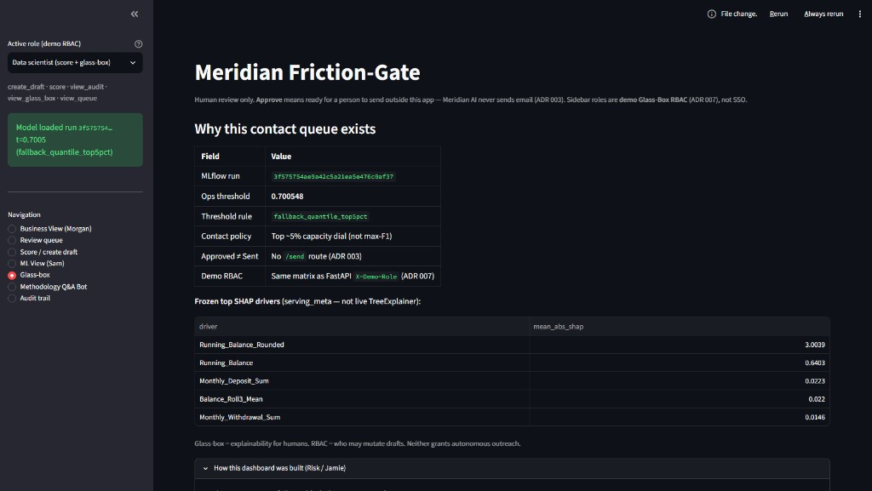
Glass-box evidence pins the ops cutoff, frozen SHAP drivers, and Approve ≠ Sent for Jamie.
• Ops threshold locked in Models/ops/ (top ~5% dial · t≈0.701)
• Frozen SHAP drivers — not live TreeExplainer on the request path
• Demo RBAC: Compliance can audit; cannot Approve (ADR 007)
• Approve never sends email — outbound lives outside the system

Slide 22
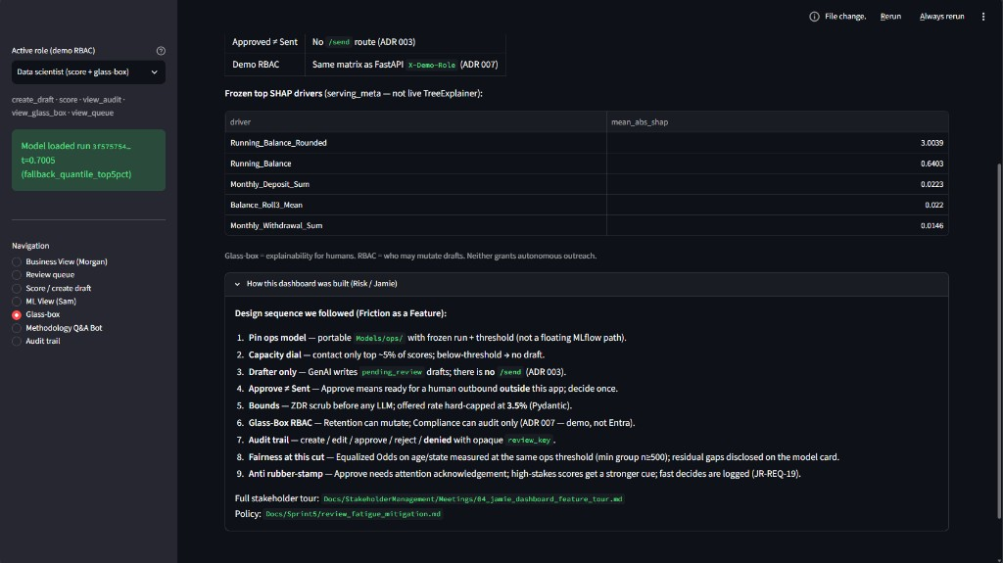
Jamie's Glass-box design sequence makes Friction-as-Feature auditable in nine explicit steps.
• Expanded “How this dashboard was built (Risk / Jamie)”
• Capacity dial → Attention Ack → high-stakes / fast-decide
• Approve ≠ Sent called out in the design chain
• Anti rubber-stamp controls mapped to JR-REQ-19

Slide 23
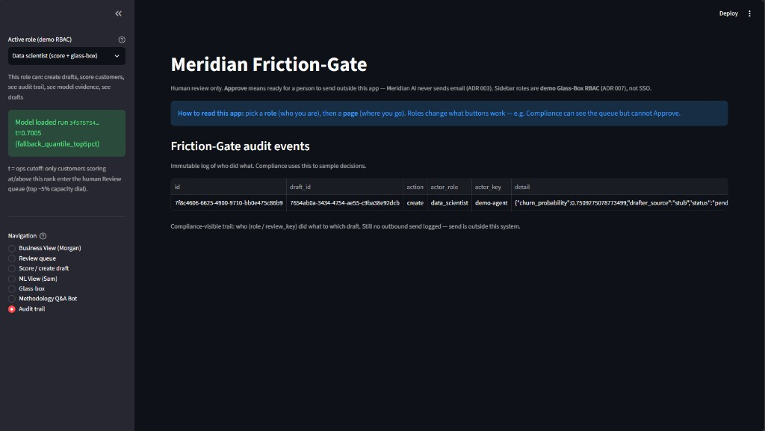
Every create, edit, approve, and reject is written to an immutable audit trail.
• Approves log attention_ack, high_stakes, seconds_open
• Compliance can sample haste / rubber-stamp patterns
• Still no outbound send — send lives outside this system
• Audit closes the anti-fatigue loop for Risk sampling

Slide 24
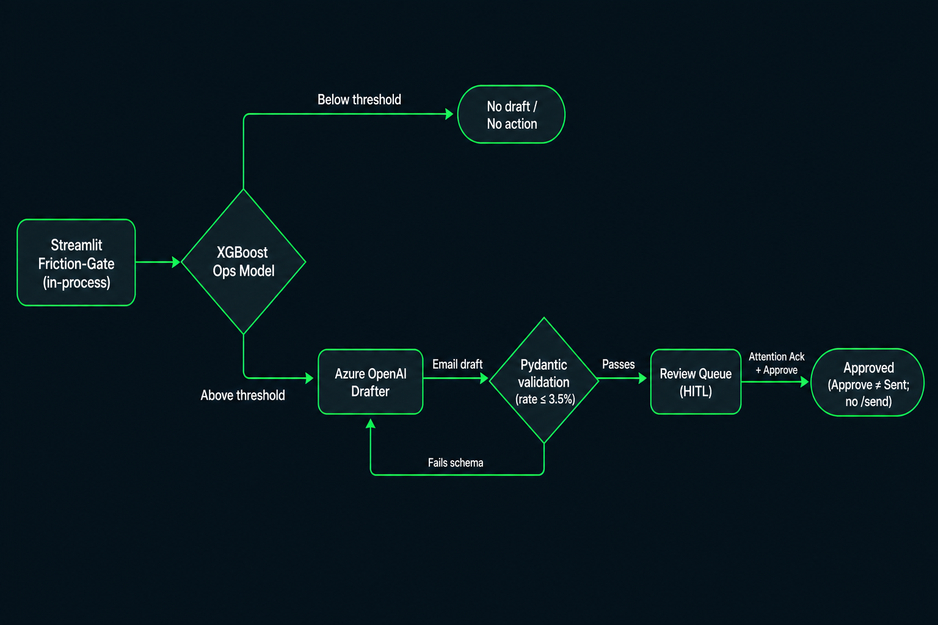
System architecture commits to HITL drafts, bounded GenAI I/O, and Compliance oversight without Approve rights.
• FastAPI: /health · /score · /drafts (+ PATCH) · X-Demo-Role RBAC · no /send
• Streamlit Friction-Gate UI; ADR 006 in-process demo path also valid
• ADR 003 HITL · ADR 002 rate ≤ 3.5% · ADR 007 Compliance audits, cannot Approve
• Guardrails stack: PII filters · .prompty fixtures · pure-Python RAG · attention_ack · audit

Slide 25
Part 2: The Meta-Project — How It Was Built

Slide 26
As a solo builder I prioritized AI engineering and orchestration over hand-writing every line.
• One person · Sprints 0–5 · ML + GenAI + UI + RAI + portable execution
• Role shift: Syntax Writer → Systems Orchestrator
• Agents execute scoped tasks; I own strategy, critique, and diffs
• Living MEMORY.md + project rules keep context across sessions

Slide 27
We established a rigid governance structure before a single line of code was written.
• PRD: locked ~$7.3M AUM target and Sam / Morgan / Jamie personas
• ADRs: permanent logs — e.g. ADR 008 why-not PostgreSQL · ADR 004 churn definition
• Model Card (1.1.0-sprint3-serving): lineage, ethics, EOD fairness metrics
• Governance is the playbook agents must follow — not optional polish

Slide 28
We managed a solo project with enterprise Agile rituals and aggressive stakeholder mapping.
• Morgan: speed / conversion / queue capacity · Jamie: explainability / fairness / HITL (DORA · EU AI Act framing)
• Sam: MLflow rigor · Sprint 0–5: sprint_plan at start · debrief + retrospective at close (not interchangeable)
• Repo layout: notebooks = explore · src/ = serving prototype · Docs/SprintN = rationale
• Execution convention: py -3.13 -m … + pyproject/uv — portable, enterprise-safe module runs

Slide 29
Living MEMORY.md and agent skills keep a solo builder coherent across sessions.
• .agents/MEMORY.md = living save-state — read/update before every major agent turn
• Skills: docs-before-code · red-team · skillify — critique before code, then cascade
• Project rules (.cursorrules / AGENTS.md) lock hybrid ML + GenAI + RAI constraints
• Orchestration > syntax: agents execute scoped tasks; I own merge judgment

Slide 30
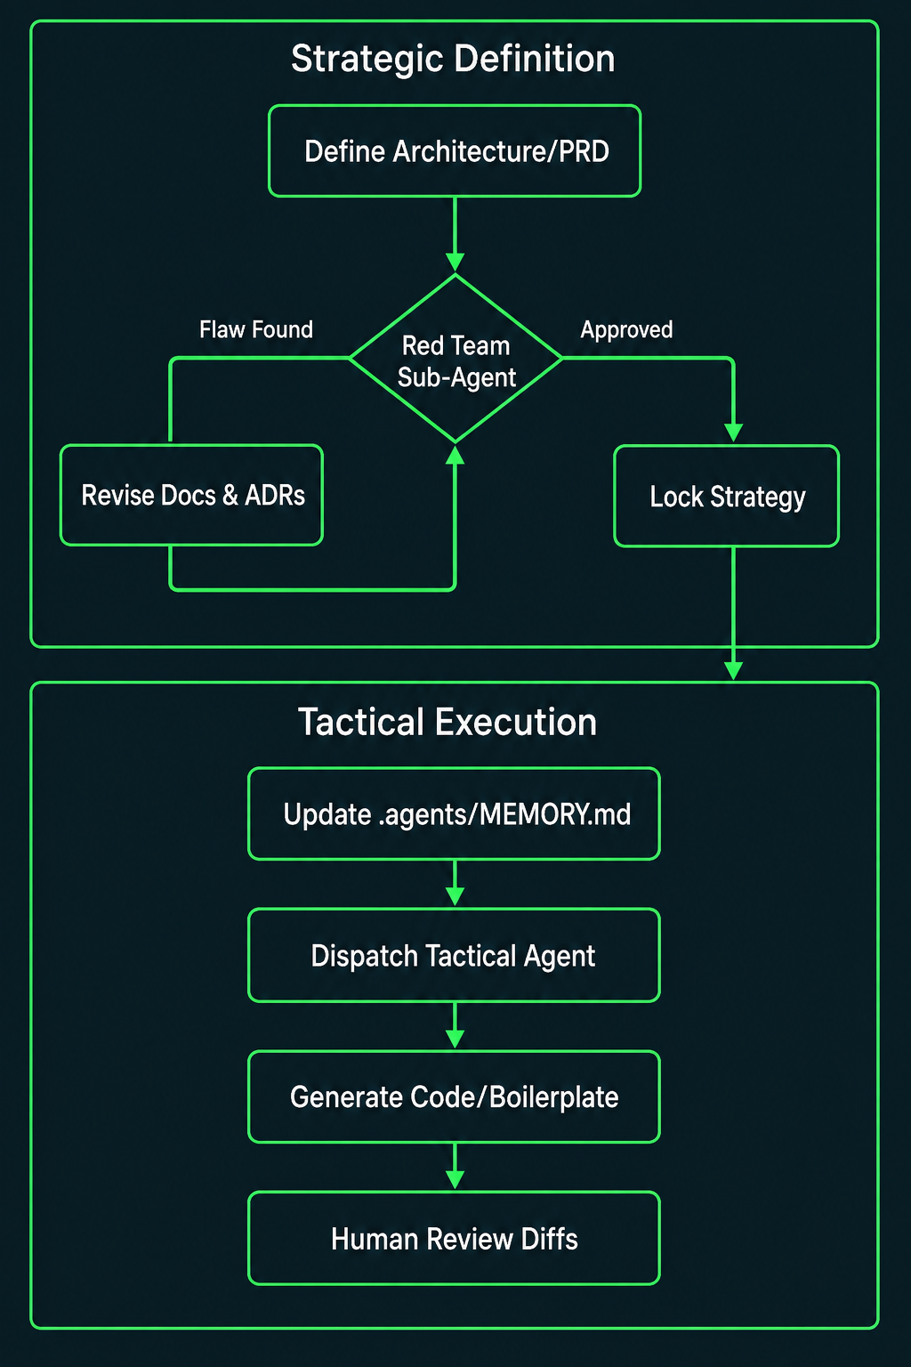
We utilized a Split-Executor workflow to prevent AI agents from developing tunnel vision.
• Strategic: Define Architecture/PRD → Red Team loop → Lock Strategy
• Flaw found → Revise Docs & ADRs, then re-enter Red Team until Approved
• Tactical: Update MEMORY.md → Dispatch Tactical Agent → Generate Code
• Human Review Diffs closes the loop — I own merge judgment, not the agent

Slide 31
We enforced an ironclad Docs-Before-Code circuit breaker to prevent AI from writing flawed logic.
• Red Team sub-agents attacked architecture before implementation
• The cascade: Attack Note → Revision Checklist → Update Docs → THEN code
• Solo builder cannot afford silent wrong turns across six sprints
• Critique first — code second

Slide 32
Red Team caught four critical modeling flaws before we wrote a single training script.
• Threshold leakage: ops threshold must calibrate on Val, freeze for Test
• Probability skew: scale_pos_weight → treat outputs as rankings, not probabilities
• Memory-efficient training: tree_method="hist" for 2.2M-row histograms
• Test no-skill PR-AUC ≈0.132; training base rate ≈0.118

Slide 33
Pure-Python retrieval avoids a separate vector database.
• Rejected: ChromaDB / local native vector DB stacks (extra native deps + local services)
• Shipped (ADR 015): BM25 offline; optional dense fusion and LLM reranking
• Why: portability, zero native install footprint, no separate vector-DB process for demos
• SQLite: one writer; local named volume; ephemeral cloud disk (ADR 016)

Slide 34
Retrieval and answer quality need evaluation before production use.
• Current: BM25 + optional dense RRF fusion and LLM reranking (ADR 015)
• Future options: dedicated cross-encoder, query rewriting, managed index
• Measure retrieval quality (chunk precision/recall) before trusting LLM answers
• Managed search is an option; infrastructure alone does not establish quality

Slide 35
Sprint 5 expanded our stack with containerization, multi-page UIs, and a grounded RAG bot.
• Docker Compose: FastAPI only; Streamlit runs on the host
• Multi-page dashboards: Business View (Morgan) · ML / What-If View (Sam)
• Azure API checked 24 Sep 2026, then removed; later key gate tested locally only
• Anti-rubber-stamp: attention_ack + seconds_open auditing (JR-REQ-19)

Slide 36
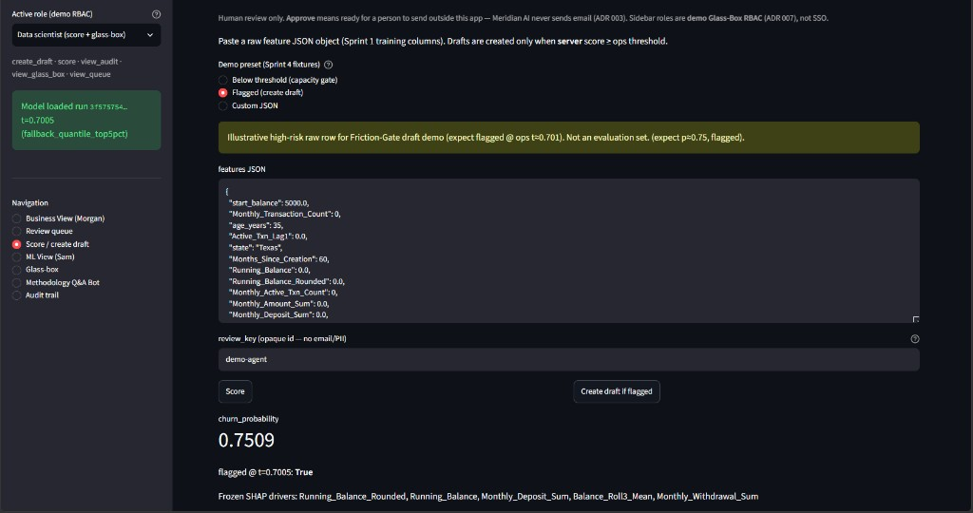
Local checks cover scoring, draft review and audit; no live cloud URL remains.
• 1. GET /health — run id + threshold + azure_configured
• 2. Below threshold (~0.21) → no draft (capacity discipline)
• 3. Flagged (~0.75) → create draft → Approve / Edit / Reject
• 4. Approval records a decision; there is no send route. Q&A is separate.

