Slide 1
Meridian Savings — Churn Ranking & Friction-Gate Handover
Audience: Sam (Data Science) · Morgan (Ops) · Jamie (Risk) · Assessors
Ops cut t≈0.701 · Model card 1.1.0-sprint3-serving
Solo build · AI engineering focus
Notes:
Welcome everyone. Today we hand over the Meridian Churn ranking model and GenAI Friction-Gate. Our dual mandate: capture the ~$7.3M of historical AUM at risk while satisfying strict compliance constraints. I built this solo — Part 2 covers how AI engineering and orchestration made that breadth possible. Ops contact policy ships at t≈0.701 (top ~5%). Model card version 1.1.0-sprint3-serving is the governed serving artifact.

Slide 2
Part 1: The Product & The ML Solution
Notes:
Let's dive into the core product we built and the ML engine powering it.

Slide 3
Meridian is bleeding ~$7.3M in historical AUM, and we must rank churners within finite retention capacity and strict RAI constraints.
• Problem: silent churn erodes AUM — Sprint 1 validated ~$7.3M at risk
• Constraints: finite agent capacity; Responsible AI, explainability, risk mitigation
• Tier 1 — Predictive Engine: XGBoost (deterministic, verifiable, explainable)
• Tier 2 — GenAI Extension: Azure OpenAI + Pydantic + Zero Data Retention
Notes:
Morgan — the business case is ~$7.3M historical AUM at risk from silent churn. Retention capacity is finite and we operate under heavy regulation. We rejected zero-shot foundation models for core prediction to guarantee deterministic, mathematically verifiable rankings regulators can audit. Tier 2 GenAI drafts retention outreach under Pydantic bounds and ZDR — never autonomous send.

Slide 4
We eliminated threshold-calibration leakage by training on the past and predicting the future.
• Churn: Running_Balance_Rounded == 0 AND no active transactions that month
• Excluded high-balance dormant accounts (e.g. $10k inactive — still hold AUM)
• Temporal split (no shuffle): Train ≤ 2016-08 · Val · Test 2017-09 → 2020-04
• Observation window = features through month t; label = month t+1 (ADR 004)
Notes:
Sam — we did not have a simple account-closed flag. We excluded high-balance dormant accounts because they still hold AUM. Churn is zero balance plus no activity. Training grain is customer × month. Features are left-looking through month t; the label is month t+1. We trained on the past, validated in the middle, and tested on the future to avoid threshold-calibration leakage.

Slide 5
We let tree models partition messy balances natively instead of destroying signal with heavy imputation.
• Nulls: imputed missing opening balances with $0
• Kept extreme balance outliers (±1e10) and NaNs in early-tenure lag features
• Filtered $0 system-generated placeholder transactions (false-active signals)
• Cohort: two-month inactivity streaks correlate with churn; geo/age slices flagged for fairness
Notes:
Sam — preprocessing was deliberate. We imputed $0 opening balances but kept extreme outliers and NaNs so XGBoost could partition them natively. We filtered $0 system placeholders that would look like activity. EDA confirmed two-month inactivity streaks drive risk. Geography and age bands became high-variance slices for later Fairlearn scrutiny.

Slide 6
We chose XGBoost because it natively handles our extreme balance outliers, missing lagged features, and Glass-Box explainability mandates.
• 1. Requirement constraints: ML Fundamentals forbade zero-shot GenAI for core prediction
• 2. Tree ensembles fit tabular churn — shipped model is XGBoost (LightGBM considered in-family)
• 3. Native NaNs + outlier robustness (±1e10) without destructive scaling
• 4. SHAP for Jamie's Glass-Box / RAI mandate (dtreeviz attempted, skipped: Lag3 NaNs)
Notes:
Sam and Jamie — four reasons for XGBoost over deep learning or linear models: bootcamp requirement for traditional ML; tree ensembles are the right family for tabular churn data (LightGBM was in the consideration set; the shipped ops model is XGBoost); native NaN and outlier handling; and SHAP/dtreeviz for explainability. We explicitly rejected zero-shot foundation models for the prediction engine.

Slide 7
MLflow tracks every training run, and the portable Ops artifact freezes the business-optimized cut at t≈0.701.
• MLflow logs hyperparameters, temporal CV folds, and ranking metrics (PR-AUC / ROC-AUC)
• Ops artifact in Models/ops/ freezes the contact policy — not a re-tune on demo day
• Business cut t≈0.701 is a RAISE from max-F1 t=0.475 → 12× fewer false positives
• Serving loads that frozen threshold so FastAPI / Streamlit stay aligned
Notes:
Sam — MLOps is not optional polish. MLflow is the experiment ledger. The portable Ops artifact ships the capacity-constrained threshold: we RAISED the cut from max-F1 0.475 to ≈0.701 to shrink the queue, not lower it to flood agents with more false positives. Cost of a miss still matters — that is why ranking quality stays the DoD — but the operating point is deliberate capacity discipline.

Slide 8
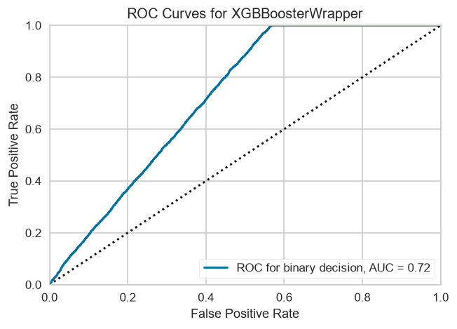
Our model beats the historical heuristic on PR-AUC and ROC-AUC — not on misleading accuracy.
• Always-negative: PR-AUC 0.132 (accuracy ≈ 0.869 — useless)
• gone_this_month heuristic: PR-AUC 0.151 · ROC-AUC 0.551
• XGBoost: PR-AUC 0.219 · ROC-AUC 0.723
• Ranking DoD = PR-AUC / ROC-AUC — threshold accuracy is not the bar
Notes:
Sam — do not lead with accuracy. Always-negative is ~86.9% accurate and useless. We cleared the real ranking bar: PR-AUC 0.219 vs heuristic 0.151, ROC-AUC 0.723 vs 0.551. Threshold-dependent accuracy is not the Definition of Done.

Slide 9
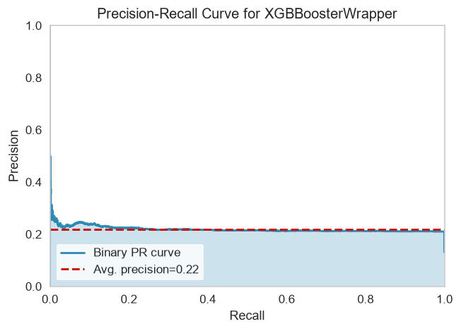
We prioritize ranked operational queues over calibrated actuarial probabilities.
• Scores represent ranking percentile, not true probability
• Platt scaling explicitly skipped — scale_pos_weight skews calibration
• Monotonic ranking preserves the Friction-Gate contact queue
• Decision policy (top 5%) is separate from ranking quality
Notes:
The PR curve shows we identify risk, but probabilities are uncalibrated due to class imbalance handling. We deliberately skipped Platt scaling because Morgan's team needs a ranked operational queue, not actuarial probabilities. Monotonic ranking is what matters for the Friction-Gate — this connects to Red Team finding on probability skew in Part 2.

Slide 10
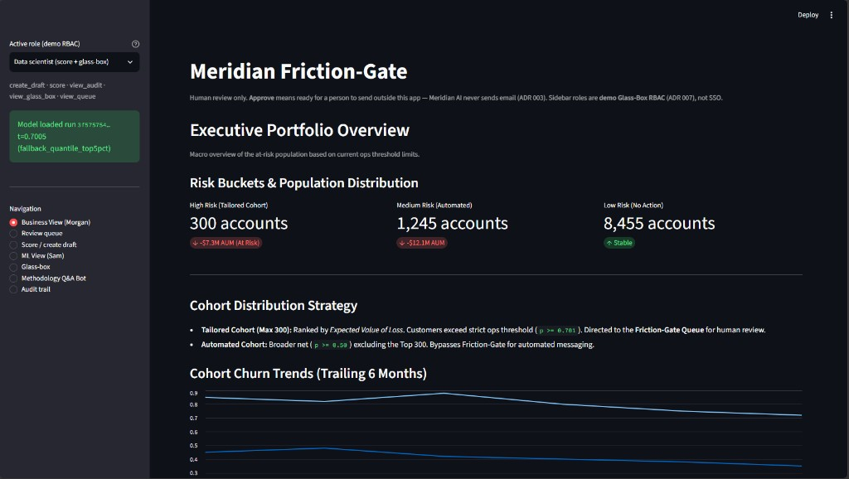
We restrict the retention queue to the top 5% of risk scores to keep false positives manageable.
• Max-F1 (t=0.475): precision 0.211 · 248,778 FP (~62% of test rows flagged)
• Ops RAISE to top-5% (t≈0.701): precision 0.229 · 20,127 FP (12× reduction)
• PR-AUC 0.219 / ROC-AUC 0.723 unchanged — decision policy, not ranking
• North Star ~$7.3M AUM: business-optimized capacity over max-F1 flood
Notes:
Morgan — max-F1 at t=0.475 would flood Friction-Gate with ~248k false positives. We RAISED the threshold to capacity-constrained top-5% at t≈0.701: precision 0.229, only 20,127 FP — a 12× reduction. This is not lowering the bar to capture more false positives. Ranking metrics are identical; we changed decision policy for the ~$7.3M North Star queue. Business View shows the high-risk cohort feeding the gate.

Slide 11
We can rank better than the heuristic, but we cannot promise a 40% hit rate from raw scores.
• Top 50% ≈ 0.21 · Top 10% ≈ 0.23 · Top 5% ≈ 0.23 · Top 1% ≈ 0.24 val precision
• 40% never appears — scores are ranks, not calibrated probabilities
• Modest PR-AUC (0.219) limits precision at the top of the queue
• Base rate ~12% — 40% would require 3× richer than chance; needs new signal, not threshold hunt
Notes:
Jury one-liner: we can rank better than the heuristic, but we can't promise 40% from raw scores — we dialed capacity (top 5%) instead. Three reasons: scale_pos_weight makes scores ranks; PR-AUC 0.219 is a real win but precision stays low-mid 20%s; ~12% base rate makes 40% mathematically unrealistic. If stakeholders demand >23% precision, that is calibration or new features — not another threshold search.

Slide 12
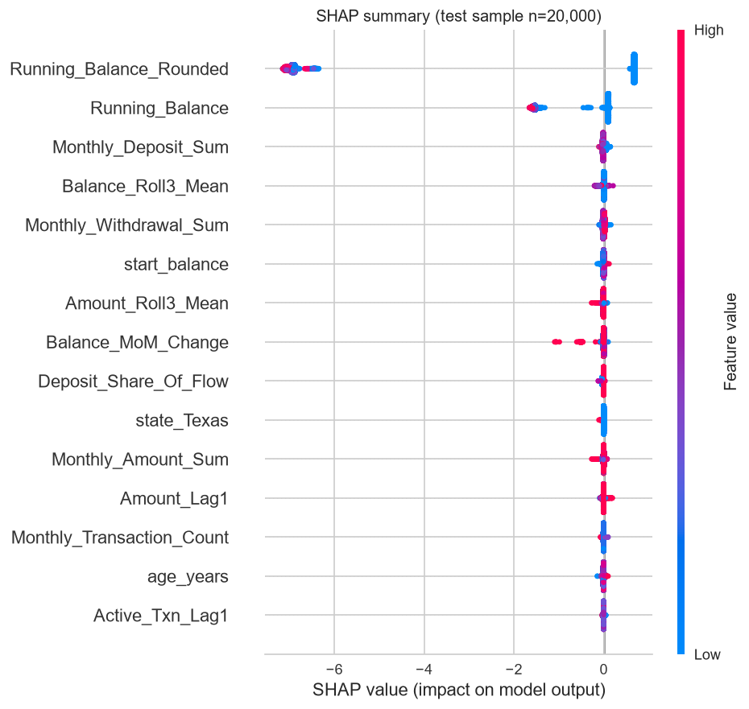
SHAP confirms financial behaviour drives risk, and we disclose Equalized Odds on age and state at the ops cut.
• Top drivers: Running_Balance_Rounded · Running_Balance · Monthly_Deposit_Sum
• Fairlearn Equalized Odds on age + state at ops t≈0.701
• Honest slices only: groups with n ≥ 500 (reject sparse noise)
• Disclosed on model card: Age EOD ≈ 0.16 · State EOD ≈ 0.32
Notes:
Jamie — SHAP confirms logical financial behaviours drive predictions, not demographics directly. Top three: Running_Balance_Rounded, Running_Balance, Monthly_Deposit_Sum. Fairlearn EOD on age and state at t≈0.701 with n≥500 filtering. Model card discloses Age EOD ≈ 0.16 and State EOD ≈ 0.32. Contact capacity limited to top 5% as an additional fairness control.

Slide 13
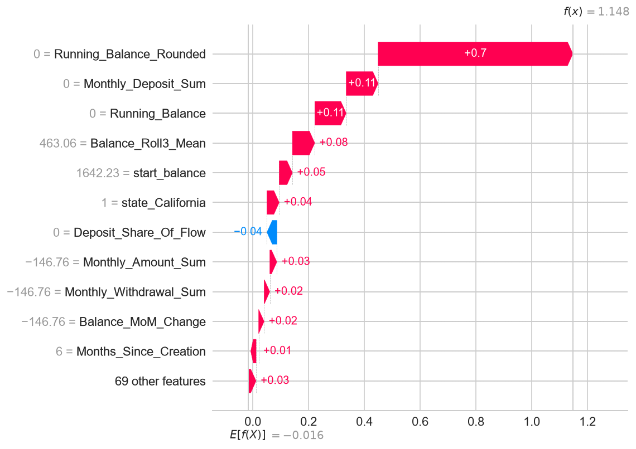
Local SHAP waterfall plots explain exactly why each individual customer was flagged.
• Friction-Gate UI displays exact push/pull features per customer
• Red: increases churn risk · Blue: decreases risk
• Agents see behaviour-led drivers — not opaque demographic scores
• Builds trust with retention agents reviewing the queue
Notes:
While global drivers show overall trends, operations needs to know why a specific customer was flagged. SHAP waterfall plots provide local explanations — exactly which behaviours push a customer toward churn. This is the per-account Glass-Box surface inside the Friction-Gate UI.

Slide 14
All Generative AI outreach is strictly bound by Zero Data Retention, Pydantic validation, and RAG context injection.
• Zero Data Retention (ZDR): no raw PII to LLMs — scrub via middleware first
• Pydantic determinism: every output structured; offered rate hard-capped ≤ 3.5%
• Prompt-as-code: versioned .prompty assets + Azure OpenAI (not hardcoded strings)
• RAG context injection: ground drafts / Q&A — Tier 2 never replaces Tier 1 ranking
Notes:
Jamie — Tier 2 GenAI operates under the Meridian Framework. ZDR means no raw PII hits Azure endpoints. Pydantic hard-fails if the LLM hallucinates above 3.5% interest. Prompts live as versioned .prompty files. RAG injects semantic context — we do not rely on zero-shot LLM knowledge for retention copy or methodology answers.

Slide 15
We version prompts as code and demo only on scrubbed fixture customers — never live PII.
• retention_draft.prompty v1.0.0 — prompt-as-code (logic + params separated from Python)
• Demo path: Sprint 4 fixtures (below_threshold / flagged JSON) — no emails, no real customers
• ZDR: scrub_mapping / scrub_text before prompty.prepare and again on LLM subject/body
• Why: governance, replayable demos, and zero real-customer PII in assessor walkthroughs
Notes:
GenAIOps proof: prompts are versioned assets under src/genai/prompts/, loaded by drafter.py via prompty.load / prepare. Streamlit demo presets load Docs/Sprint4/fixtures/*.json — synthetic feature rows for Below-threshold and Flagged paths, explicitly without PII. Before any Azure call we scrub context keys; after the LLM we scrub subject and body. That is how we get prompt replayability and Jamie's ZDR bar on the same demo path Morgan uses to show Friction-Gate.

Slide 16
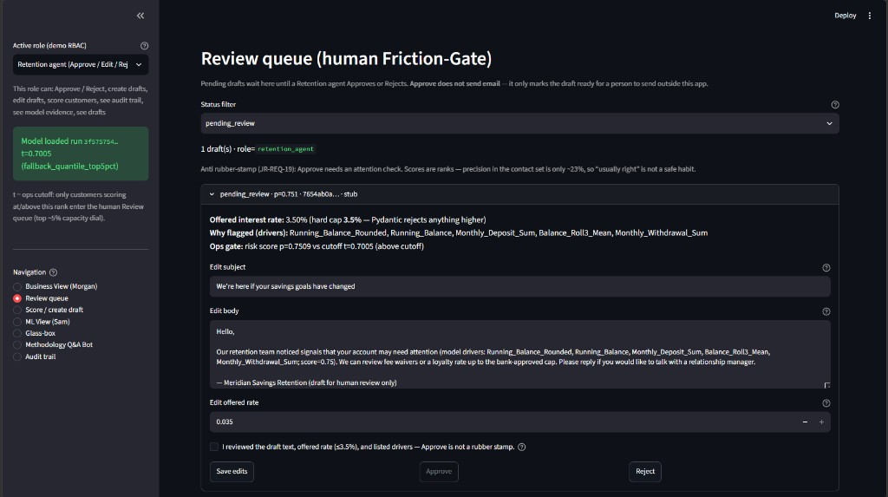
The Friction-Gate UI guarantees no email reaches a customer without active human approval.
• AI drafts locked in Pending Review — never autonomous dispatch
• Approve ≠ Sent — no /send route exists in architecture
• Approve marks draft ready; outbound mail lives outside this system
• Demo RBAC: Compliance can view, cannot Approve (ADR 007)
Notes:
Morgan and Jamie — the biggest GenAI risk is rubber-stamping. Every draft stays Pending Review until a retention agent decides. Approve does NOT send email — there is no /send endpoint. Architecture cannot dispatch even if UI is misused. Next slides show role enforcement and anti-fatigue controls in the Streamlit demo.

Slide 17
We treat Friction as a Feature so Streamlit Approves cannot become rubber stamps.
• Attention Ack required before Approve (attention_ack=true · JR-REQ-19)
• High-stakes visual banner when score is well above ops cut
• Fast-decide soft warn + audit if Approve in < ~8s (seconds_open logged)
• Queue copy: ranks only — contact-set precision ~23%
Notes:
Jamie and Morgan — HITL fails if agents Approve by habit. Anti-fatigue controls: (1) capacity dial already cut volume; (2) Approve disabled until Attention Ack checkbox; (3) high-stakes banner; (4) approving under ~8s soft-warns and logs seconds_open — no hard block to avoid rage-clicks; (5) UI states ~23% precision so 'usually right' is not a safe habit. Retention agent owns the live Approve path.

Slide 18
Meridian ships an explicit guardrail stack — privacy, bounded GenAI I/O, HITL friction, and Glass-Box access.
• Privacy / I/O: ZDR scrub · Pydantic rate ≤ 3.5% · versioned .prompty + fixture demos
• Retrieval: ChromaDB rejected → pure-Python in-memory RAG (portable, zero native vector DB)
• HITL: Pending Review · Approve ≠ Sent · no /send · attention_ack · ~8s soft-warn · audit trail
• Access / fairness: Glass-Box RBAC (X-Demo-Role) · SHAP · Fairlearn EOD · ops cut t≈0.701
Notes:
This is the one-slide guardrail map for Jamie and assessors. GenAI never sees raw PII; outputs are schema-bound; prompts are versioned code exercised on dummy fixtures. We rejected ChromaDB and shipped in-memory pure-Python retrieval for portability. Friction-as-Feature means Pending Review, Approve does not send, Attention Ack, high-stakes cues, seconds_open soft-warn at ~8s, and an immutable audit trail. Glass-Box demo RBAC lets Compliance audit without Approve. SHAP + Fairlearn EOD disclosure plus the raised top-5% ops cut complete the fairness posture.

Slide 19
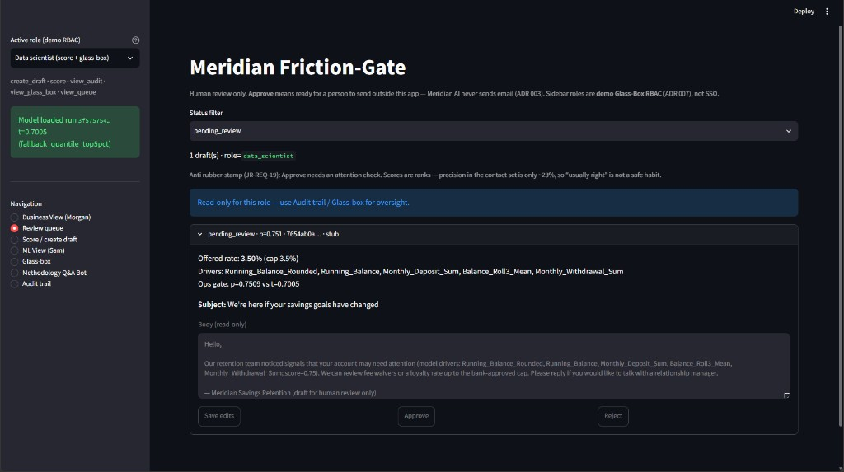
Data scientists can inspect the Review queue but cannot Save, Approve, or Reject drafts.
• Pending drafts, drivers, and 3.5% rate cap stay visible
• Read-only banner on the Review card
• Save / Approve / Reject disabled — not just relabeled
• Proves Glass-Box RBAC is enforced, not decorative
Notes:
Sam and Jamie — flip to Data scientist on the Review queue. Inspect pending drafts, SHAP drivers, and the 3.5% cap — but Save, Approve, and Reject stay disabled behind a read-only banner. Glass-Box RBAC is not sidebar labels: the action surface actually changes. Only Retention agents get the live Approve path.

Slide 20
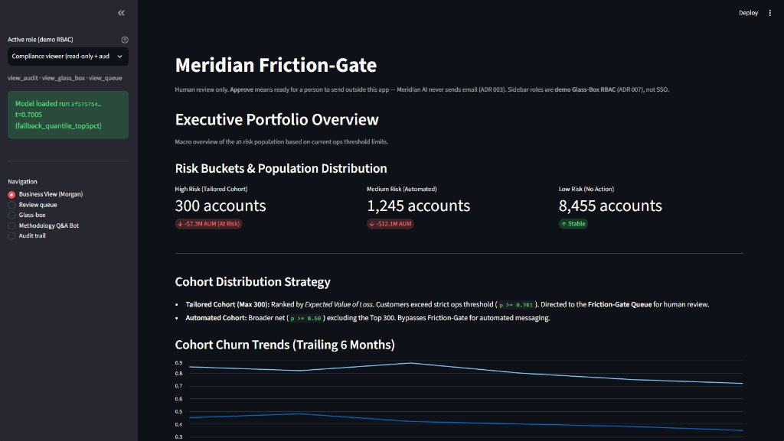
Compliance can oversee the $7.3M high-risk cohort on Business View but still cannot Approve.
• Capacity cohorts remain visible for Risk oversight
• High-risk slice tied to ~$7.3M historical AUM
• Approve path locked — Compliance views, does not decide
• Demo RBAC: pedagogical role picker, not production SSO
Notes:
Jamie — switch to Compliance on Business View. Portfolio overview and capacity cohorts — including the high-risk slice tied to ~$7.3M historical AUM — stay visible for oversight. There is still no Approve for this role. Demo RBAC only — not SSO.

Slide 21
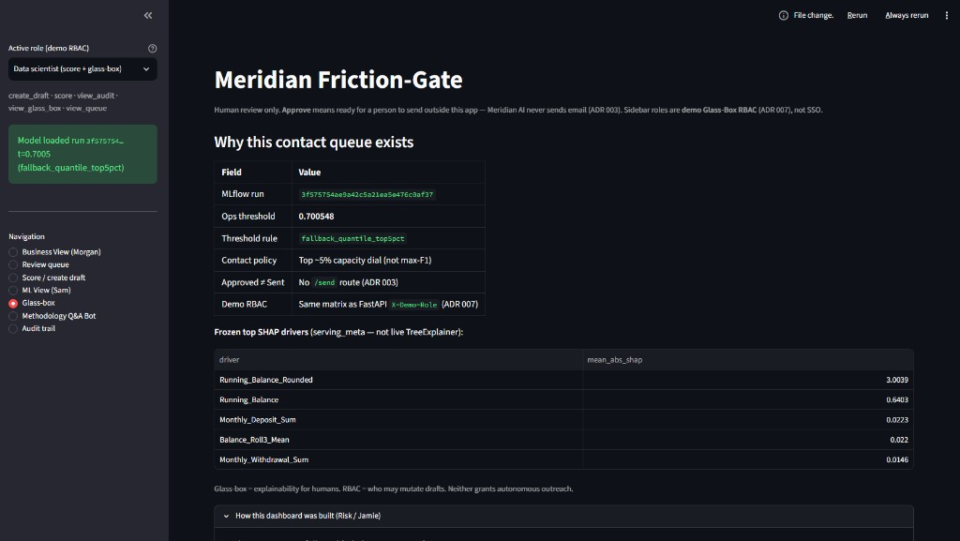
Glass-box evidence pins the ops cutoff, frozen SHAP drivers, and Approve ≠ Sent for Jamie.
• Ops threshold locked in Models/ops/ (top ~5% dial · t≈0.701)
• Frozen SHAP drivers — not live TreeExplainer on the request path
• Demo RBAC: Compliance can audit; cannot Approve (ADR 007)
• Approve never sends email — outbound lives outside the system
Notes:
Jamie — the Glass-box tab is the compliance surface: MLflow run and threshold that created this contact queue, frozen SHAP drivers, and the hard rule that Approve never sends email. Sidebar roles are pedagogical demo RBAC. Next slide expands the full Friction-as-Feature design sequence.

Slide 22
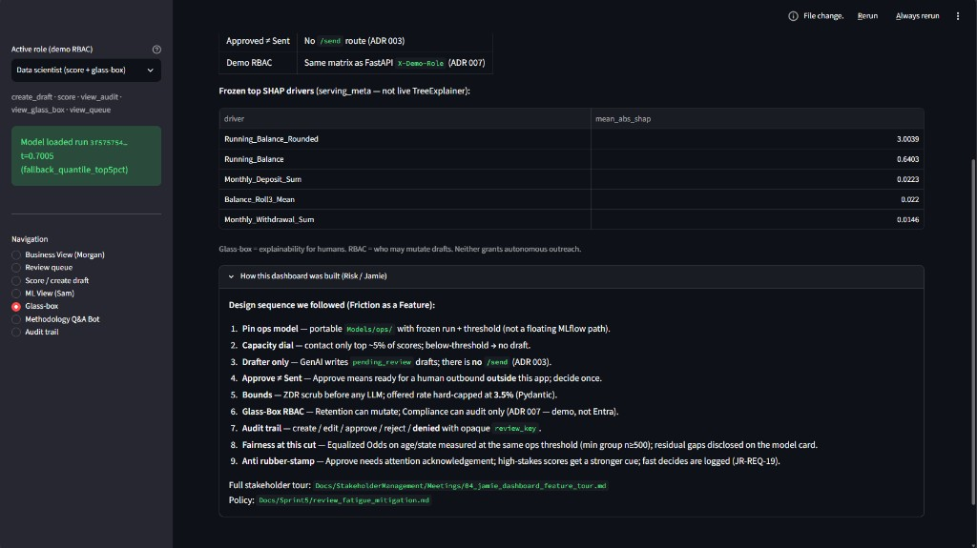
Jamie's Glass-box design sequence makes Friction-as-Feature auditable in nine explicit steps.
• Expanded “How this dashboard was built (Risk / Jamie)”
• Capacity dial → Attention Ack → high-stakes / fast-decide
• Approve ≠ Sent called out in the design chain
• Anti rubber-stamp controls mapped to JR-REQ-19
Notes:
Jamie — expand Glass-box to the Risk design sequence. Nine steps document Friction-as-Feature: capacity dial first, Attention Ack, high-stakes banners, fast-decide soft-warn, immutable audit fields, and Approve never sends mail — including JR-REQ-19 anti rubber-stamp.

Slide 23
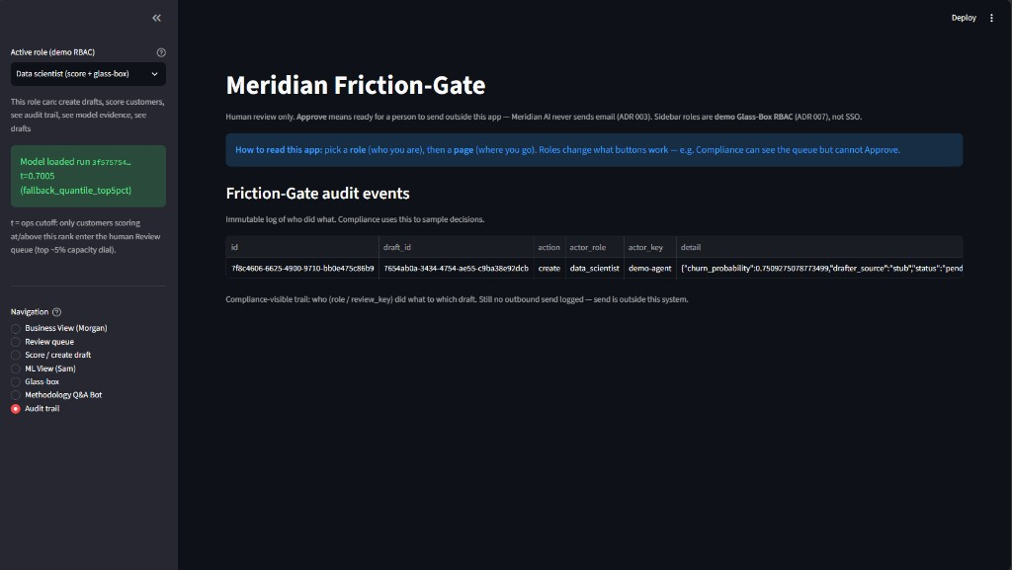
Every create, edit, approve, and reject is written to an immutable audit trail.
• Approves log attention_ack, high_stakes, seconds_open
• Compliance can sample haste / rubber-stamp patterns
• Still no outbound send — send lives outside this system
• Audit closes the anti-fatigue loop for Risk sampling
Notes:
Jamie — Audit trail closes the anti-fatigue loop. Approve events record attention checkbox usage, high-stakes flag, and seconds_open. Compliance can spot rubber-stamp patterns after the demo — without logging PII or inventing a send pipeline.

Slide 24
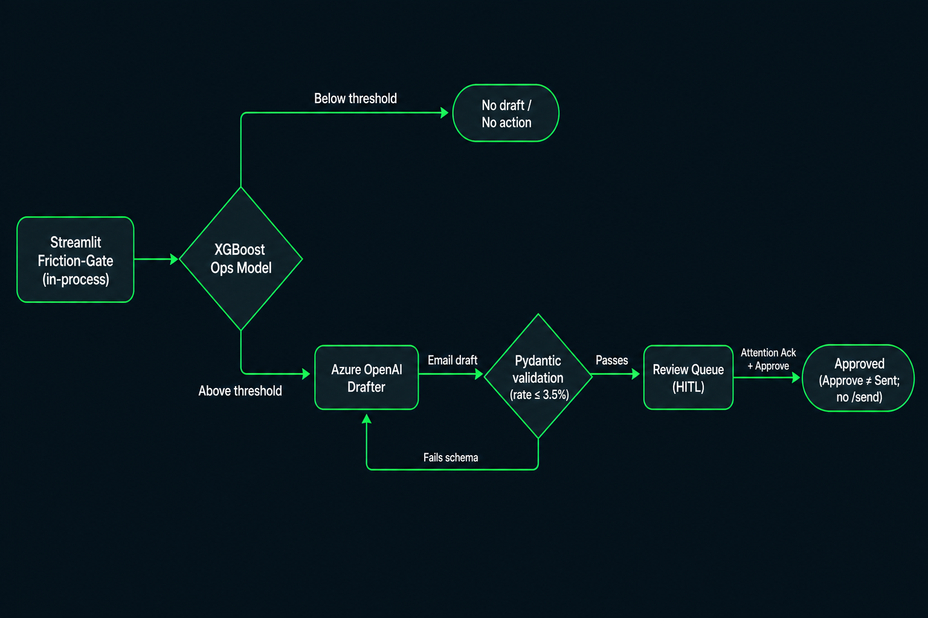
System architecture commits to HITL drafts, bounded GenAI I/O, and Compliance oversight without Approve rights.
• FastAPI: /health · /score · /drafts (+ PATCH) · X-Demo-Role RBAC · no /send
• Streamlit Friction-Gate UI; ADR 006 in-process demo path also valid
• ADR 003 HITL · ADR 002 rate ≤ 3.5% · ADR 007 Compliance audits, cannot Approve
• Guardrails stack: ZDR · .prompty fixtures · pure-Python RAG · attention_ack · audit
Notes:
Jamie — walk the system flow left to right. FastAPI exposes /health, /score, and /drafts with required X-Demo-Role (ADR 007). There is no /send route. Streamlit is the Friction-Gate surface; ADR 006 also documents an in-process demo path. ADR 003 locks HITL and Approve ≠ Sent. ADR 002 caps GenAI at 3.5%. Hybrid architecture: verifiable ML for who to contact, guarded GenAI for what to say.

Slide 25
Part 2: The Meta-Project — How It Was Built
Notes:
Now we pivot to the meta-project. I was a solo builder covering ML, GenAI, Streamlit, compliance, and portable enterprise-safe execution. Subtitle: Professional setup, AI Orchestration, and System Architecture. The scarce skill was not typing code — it was AI engineering and orchestration.

Slide 26
As a solo builder I prioritized AI engineering and orchestration over hand-writing every line.
• One person · Sprints 0–5 · ML + GenAI + UI + RAI + portable execution
• Role shift: Syntax Writer → Systems Orchestrator
• Agents execute scoped tasks; I own strategy, critique, and diffs
• Living MEMORY.md + project rules keep context across sessions
Notes:
Honest constraint: one person, product surface spanning temporal XGBoost, Friction-Gate, Azure RAG, Glass-Box RBAC, ADRs, stakeholder demos. I invested in AI engineering: lock strategy first, dispatch tactical agents, force MEMORY.md hand-offs, review diffs. Next slides show governance, Split-Executor, and Red Team.

Slide 27
We established a rigid governance structure before a single line of code was written.
• PRD: locked ~$7.3M AUM target and Sam / Morgan / Jamie personas
• ADRs: permanent logs — e.g. ADR 008 why-not PostgreSQL · ADR 004 churn definition
• Model Card (1.1.0-sprint3-serving): lineage, ethics, EOD fairness metrics
• Governance is the playbook agents must follow — not optional polish
Notes:
Solo orchestration starts with governance. PRDs locked the $7.3M AUM target and personas. ADR 008 documents why we chose SQLite over PostgreSQL for prototype portability. ADR 004 codifies 30-day forward-looking churn. Model Card treats the ML model as a governed enterprise asset with disclosed EOD metrics.

Slide 28
We managed a solo project with enterprise Agile rituals and aggressive stakeholder mapping.
• Morgan: speed / conversion / queue capacity · Jamie: explainability / fairness / HITL (DORA · EU AI Act framing)
• Sam: MLflow rigor · Sprint 0–5: sprint_plan at start · debrief + retrospective at close (not interchangeable)
• Repo layout: notebooks = explore · src/ = production · Docs/SprintN = rationale
• Execution convention: py -3.13 -m … + pyproject/uv — portable, enterprise-safe module runs
Notes:
Stakeholder tension is the product. Morgan wants actionable queues and conversion; Jamie wants Glass-Box explainability, fairness disclosure, and HITL under DORA / EU AI Act-style accountability framing. Sam wants MLflow rigor. Debrief = what we shipped; retrospective = how we work next — both mandatory. Notebooks stay exploratory; src/ is the serving path; Docs/SprintN holds the why. We run tools via py -3.13 -m for a portable enterprise-safe convention.

Slide 29
Living MEMORY.md and agent skills keep a solo builder coherent across sessions.
• .agents/MEMORY.md = living save-state — read/update before every major agent turn
• Skills: docs-before-code · red-team · skillify — critique before code, then cascade
• Project rules (.cursorrules / AGENTS.md) lock hybrid ML + GenAI + RAI constraints
• Orchestration > syntax: agents execute scoped tasks; I own merge judgment
Notes:
Module 2 AI engineering: MEMORY.md is the hand-off file so a new session does not reinvent the mission. docs-before-code forces attack note → checklist → docs → code. Red-team skills critique plans before implementation. skillify captures repeatable friction into reusable skills. Rules encode the hybrid architecture and guardrails so agents cannot quietly swap in foundation-model prediction.

Slide 30
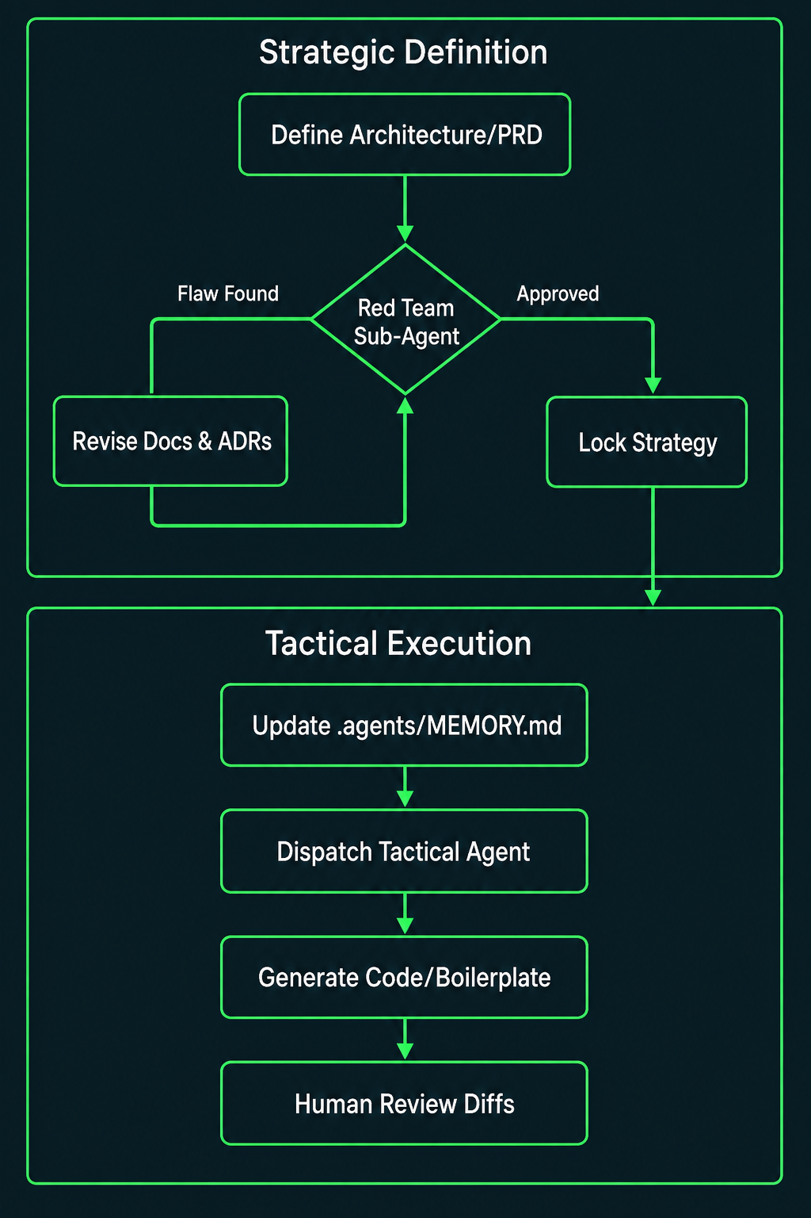
We utilized a Split-Executor workflow to prevent AI agents from developing tunnel vision.
• Strategic: Define Architecture/PRD → Red Team loop → Lock Strategy
• Flaw found → Revise Docs & ADRs, then re-enter Red Team until Approved
• Tactical: Update MEMORY.md → Dispatch Tactical Agent → Generate Code
• Human Review Diffs closes the loop — I own merge judgment, not the agent
Notes:
Assessors — this chart is the solo AI-engineering operating system. Top: Strategic Definition with Red Team attack loop until strategy is locked. Bottom: Tactical Execution — update MEMORY.md, dispatch agent, generate code, human review diffs. That split stops an agent rewriting the whole stack when asked to fix one bug.

Slide 31
We enforced an ironclad Docs-Before-Code circuit breaker to prevent AI from writing flawed logic.
• Red Team sub-agents attacked architecture before implementation
• The cascade: Attack Note → Revision Checklist → Update Docs → THEN code
• Solo builder cannot afford silent wrong turns across six sprints
• Critique first — code second
Notes:
Agents eagerly write wrong code if you let them. Red Team sits before Lock Strategy. When a flaw is found: attack note, signed revision checklist, update docs and ADRs, then code. That cascade keeps AI engineering accountable when there is no second human reviewer.

Slide 32
Red Team caught four critical modeling flaws before we wrote a single training script.
• Threshold leakage: ops threshold must calibrate on Val, freeze for Test
• Probability skew: scale_pos_weight → treat outputs as rankings, not probabilities
• Memory-efficient training: tree_method="hist" for 2.2M-row histograms
• Baseline reality: hardcode baseline PR-AUC ~0.117 so stakeholders don't misread naive baseline
Notes:
Sprint 2 Red Team attack on the XGBoost plan caught four flaws: test-set threshold calibration leakage; scale_pos_weight destroying probability calibration (led to ranking policy earlier in Part 1); memory pressure on 2.2M rows requiring tree_method=hist; and forcing an honest baseline PR-AUC ~0.117 so the heuristic win reads correctly.

Slide 33
We rejected ChromaDB and shipped pure-Python in-memory RAG for a portable, zero-native-deps prototype.
• Rejected: ChromaDB / local native vector DB stacks (extra native deps + local services)
• Shipped (ADR 010): Azure embeds + pure-Python cosine over ≤1200-char chunks; TF-IDF offline
• Why: portability, zero native install footprint, no separate vector-DB process for demos
• ADR 008 — SQLite shared volume over PostgreSQL; busy_timeout + exponential backoff
Notes:
Sam and Jamie — industry default is Chroma or FAISS. We explicitly rejected those for the prototype: they pull native C++/DLL install paths and a local vector-DB service we did not want as a demo dependency. ADR 010 ships Azure text-embedding-3-large with pure-Python cosine ranking over bounded markdown chunks — no Chroma, no FAISS. Tradeoff: lighter semantic polish vs 100% portable deployability. ADR 008 keeps SQLite on a shared volume with busy_timeout and backoff instead of standing up PostgreSQL for the prototype.

Slide 34
Production scale requires migrating to managed hybrid search with measured retrieval quality.
• Current: no Chroma — Azure embeddings + pure-Python in-memory rank (ADR 010)
• Target: Hybrid Search (keyword + vector) + Cross-Encoder reranking + query rewrite
• Measure retrieval quality (chunk precision/recall) before trusting LLM answers
• Infrastructure: Azure AI Search — managed vectors without a local vector-DB service
Notes:
Prototype RAG is deliberately pure-Python and portable. Production needs hybrid search with cross-encoder reranking and query rewriting on a managed store such as Azure AI Search. We must rigorously measure retrieval quality independently before trusting the LLM to generate answers.

Slide 35
Sprint 5 expanded our stack with containerization, multi-page UIs, and a grounded RAG bot.
• Docker Compose: FastAPI + Streamlit portable containers
• Multi-page dashboards: Business View (Morgan) · ML / What-If View (Sam)
• RAG Q&A bot grounded in Final_Report_Official.md (bounded chunks + Azure embeds)
• Anti-rubber-stamp: attention_ack + seconds_open auditing (JR-REQ-19)
Notes:
Sprint 5 GenAIOps phase: Docker Compose for portability, persona-tailored multi-page Streamlit, RAG chatbot grounded in Final_Report_Official.md (bounded chunks + Azure embeds — no ChromaDB), and Jamie's JR-REQ-19 anti-rubber-stamp controls. When you open the Methodology Q&A bot live, ask one of these — they retrieve well: DEMO Q: “What ops threshold did we ship, and why not max-F1?” DEMO Q (alt): “Does Approve send the retention email?”

Slide 36
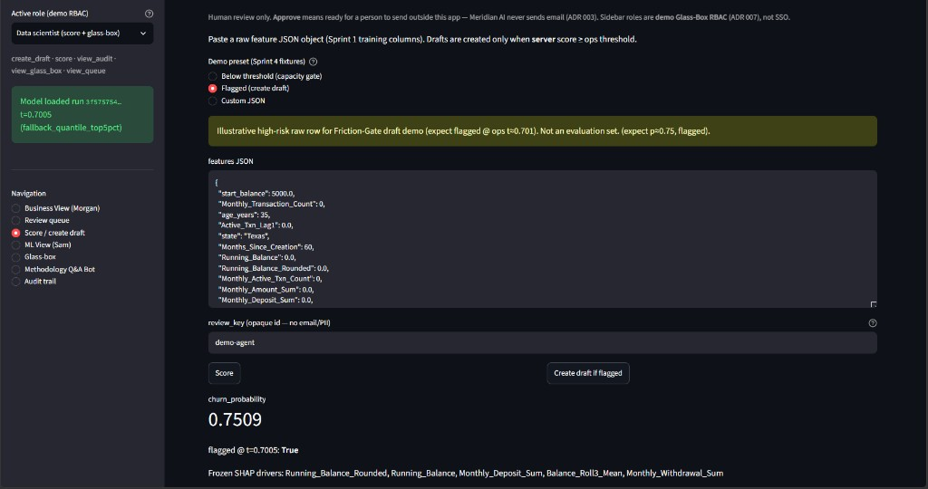
We are ready to demo the handover path — health check, capacity discipline, and human-gated drafts.
• 1. GET /health — run id + threshold + azure_configured
• 2. Below threshold (~0.21) → no draft (capacity discipline)
• 3. Flagged (~0.75) → create draft → Approve / Edit / Reject
• 4. Say explicitly: “Approved is not sent.” · Then Methodology RAG Q&A
Notes:
Live demo walkthrough. GET /health shows run id and threshold. Below-threshold preset ~0.21 produces no draft — capacity discipline. Flagged ~0.75 flows through draft, Approve/Edit/Reject. Say out loud: Approved is not sent. Then open Methodology Q&A (RAG on Final_Report_Official.md). Ready-to-read: DEMO Q: “What ops threshold did we ship, and why not max-F1?” DEMO Q (alt): “Does Approve send the retention email?” Optional third if time: “What is the ~$7.3M AUM figure?” Methodology: sprint_methodology_report.md. Demo commands: Sprint4/demo_runbook.md. Model card: Model_Card_Template.md 1.1.0-sprint3-serving. Closing: we rank better than a strong heuristic, contact only the top 5%, and every GenAI draft stops at a human — by design.

