Slide 1
PREDICTING 30-DAY HOSPITAL READMISSION FOR DIABETIC PATIENTS
Jiaqing Li
• Project: Predict whether a diabetic patient will be readmitted within 30 days after discharge
• Why it matters:
- 30-day readmission is a key healthcare quality indicator
- Early risk prediction may support discharge planning and follow-up care
• Real-world value:
- Helps identify high-risk patients earlier
- May support more efficient use of hospital resources
Notes:
Hello everyone. My project is about predicting whether a diabetic patient will be readmitted to the hospital within 30 days after discharge.
This is an important and interesting healthcare problem because 30-day readmission is widely used as an indicator of care quality, and it is also associated with substantial hospital cost.
If high-risk patients can be identified earlier, hospitals may be able to improve discharge planning, follow-up care, and post-discharge support.
So the main goal of this project is to build a machine learning model that can help identify patients at elevated risk of early readmission.

Slide 2
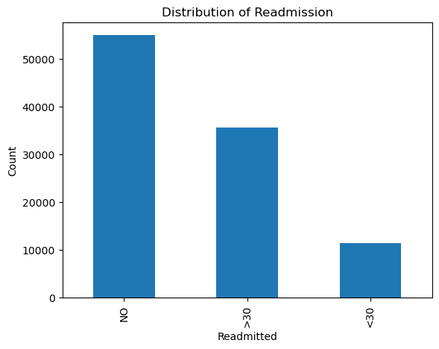
Dataset and Key Challenges
• Dataset: UCI Diabetes dataset (~101k encounters, ~50 features)
• Features: demographics, diagnoses, medications, utilization
• Key challenges:
- Severe class imbalance (~11% positive)
- High-dimensional mixed-type features
- Missing values and sparse categories
• Preprocessing:
- Cleaning, feature engineering, encoding, scaling, oversampling
Notes:
I used the UCI diabetes readmission dataset, which contains about 101,000 hospital encounters from 130 US hospitals. The dataset includes around 50 variables covering demographics, diagnoses, medications, laboratory procedures, and prior healthcare utilization.
The graph here shows the distribution of the original readmission categories. We can see that the group readmitted within 30 days, which is the target of greatest clinical interest, is much smaller than the other groups. This shows that class imbalance would be one of the main difficulties in the project.
To make the problem more clinically meaningful, I converted the original three-class target into a binary classification task, where the positive class is readmission within 30 days, and the negative class includes all other cases.
Another important challenge was missing data. For example, max_glu_serum, A1Cresult, and weight each had more than 80% missing values, so I removed these columns rather than trying to impute such incomplete information.
For the remaining features, I handled missing values within the preprocessing pipeline: I used median imputation for numerical variables and most-frequent imputation for categorical variables. After that, I applied feature engineering, one-hot encoding, and scaling, and used oversampling during training to address class imbalance.

Slide 3
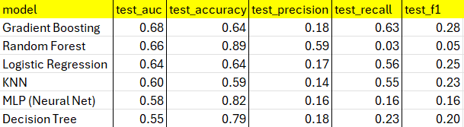
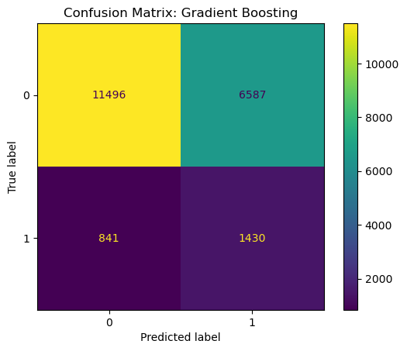
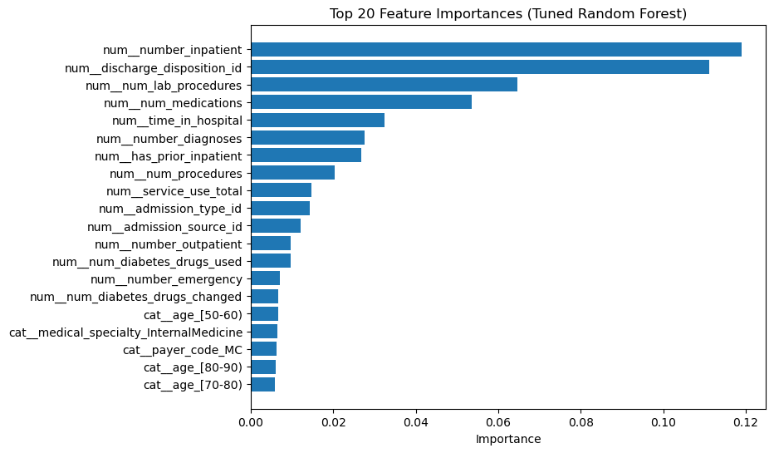
Model Comparison and Results
Compared 6 models
Best: Gradient Boosting
AUC: 0.678 | Recall: 0.630 | F1: 0.278
RF: high accuracy but very low recall
Accuracy is misleading
Notes:
I compared six baseline models: Logistic Regression, KNN, Decision Tree, Random Forest, Gradient Boosting, and MLP.
Among them Gradient Boosting achieved the best overall performance on the holdout test set. It reached the highest AUC, about 0.68, and also the highest recall, about 0.63. In this project, recall is especially important because the practical goal is to identify as many high-risk patients as possible.
A useful contrast is Random Forest. At first glance, Random Forest looks very strong because it achieved a very high accuracy of about 0.89. However, its recall was only 0.03, which means it missed almost all of the actual positive cases. So although the accuracy looks impressive, the model is not very useful for the real screening objective of this task.
This comparison shows why accuracy can be misleading in imbalanced healthcare prediction problems. Gradient Boosting performed better because it was much more sensitive to the minority class, even though that came at the cost of lower precision, as you also see that reflected in the confusion matrix for gradient bossting. In other words, it generated more false positives, but it was much better at catching truly high-risk patients.
I also examined feature importance. The most influential variables included prior inpatient visits, discharge disposition, number of medications, number of laboratory procedures, and time in hospital. These features are clinically plausible because they reflect disease burden, prior utilization, and care complexity.

Slide 4
Conclusion and Future Work
GB gives best balance
Clinically meaningful features identified
Limitations: low precision
Future: XGBoost, threshold tuning, fairness
Notes:
In conclusion, this project shows that predicting 30-day readmission for diabetic patients is feasible, but still challenging. The combination of class imbalance, noisy tabular features, and moderate signal in the data limits overall performance.
Among the models we tested, ensemble methods performed best, especially Gradient Boosting, which provided the strongest overall tradeoff between discrimination and sensitivity to the positive class. At the same time, the model is not perfect. Its precision is still low, meaning that many flagged patients would not actually be readmitted within 30 days.
I also found that the interpretation results were meaningful. Variables related to prior hospital use, discharge conditions, and treatment complexity appeared to be the most important predictors, which aligns well with clinical intuition and with findings from prior work.
For future work, the most natural next steps would be to add stronger tabular models such as XGBoost or LightGBM, tune the prediction threshold to better balance precision and recall, and perform fairness analysis across different patient groups.
Overall, I think this model is a useful screening tool for prioritizing follow-up attention, rather than as a final decision-making system.

