Slide 1

CS252: Systems Programming
Ninghui Li
Based on Slides by Prof. Gustavo Rodriguez-Rivera
Topic 8: Opening Files and Starting Processes
Notes:
<number>

Slide 2
System Calls
A system call is a controlled entry point into the kernel, allowing a process to request that the kernel do something for the process (API provided by kernels)
The set of system calls in an OS is fixed
Each system call has a set of arguments that specify information to be transferred to kernel
From programmer’s view, a system call looks like a function call.
In C, one issues a system call by calling a wrapper function for the call in C library
Notes:
<number>

Slide 3
File Descriptor
All system calls refer to open files using a file descriptor, a (usually small) nonnegative integer.
Usually 0 refers to standard input, 1 refer to standard output, and 2 to standard error
The scope of file descriptors is per process
File descriptor can be viewed as index into an array of opened files
The maximum number of files descriptor per process is 32 by default but but it can be changed with the command ulimit up to 1024
Notes:
<number>

Slide 4
Some System Calls for File I/O
Open a file
fd=open(pathname, flags, mode);
Read from a file
numread = read(fd, buffer, count);
Write to a file
numread = write(fd, buffer, count);
Close a file
status = close(fd);
Notes:
<number>

Slide 5
The Open File Table
Each process has a File Descriptor Table (maintained by the OS kernel) with all the files that are opened by that process.
Process can only affect it using system calls
Each entry in the File Descriptor Table contains a pointer to an open file object that contains all the information about the open file.
The kernel maintains a Open File Table, which includes Open File Objects for the whole system (shared by all processes).
Notes:
<number>

Slide 6
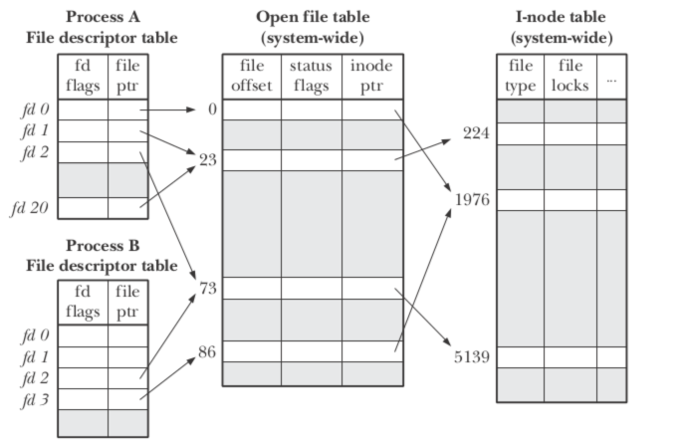
The System View (from http://www.programering.com/a/MzN0gDNwATg.html)
Notes:
<number>

Slide 7
Facts About The Open File Table
One file (i-node) can have multiple entries in the Open File Table
One entry in the Open File Table can be pointed by multiple file descriptors
When dup(), dup2(), and fork() are used, entries in Open File Table are shared.
When open() is used, another entry in Open File Table is created.
File descriptors sharing the same Open File Table entry will share the same offset, which will be updated by read/write.
Notes:
<number>

Slide 8
The Open File Table
A Process’ Open File Table
Open File Object
0
I-NODE
1
Open Mode
2
Offset
3
Reference Count
4
.
.
31
Notes:
<number>

Slide 9
Open File Object (or Open File Handle)
An Open File Object contains the state of an open file.
I-Node –
It uniquely identifies a file in the computer. An I-nodes is made of two parts:
Major number – Determines the devices
Minor number –It determines what file it refers to inside the device.
Open Mode – How the file was opened:
Read Only
Read Write
Append
Notes:
<number>

Slide 10
Open File Object (or Open File Handle)
Offset –
The next read or write operation will start at this offset in the file.
Each read/write operation increases the offset by the number of bytes read/written.
Reference Count –
It is increased by the number of file descriptors that point to this Open File Object.
When the reference count reaches 0 the Open File Object is removed.
The reference count is initially 1 and it is increased after fork() or calls like dup and dup2.
Notes:
<number>

Slide 11
Default Open Files
When a process is created, there are three files opened by default:
0 – Default Standard Input
1 – Default Standard Output
2 – Default Standard Error
write(1, “Hello”, 5) Sends Hello to stdout
write(2, “Hello”, 5) Sends Hello to stderr
Stdin, stdout, and stderr are inherited from the parent process.
Notes:
<number>

Slide 12
The open() system call
int open(filename, mode, [permissions]),
It opens the file in filename using the permissions in mode.
Mode:
O_RDONLY, O_WRONLY, O_RDWR, O_CREAT, O_APPEND, O_TRUNC
O_CREAT If the file does not exist, the file is created. Use the permissions argument for initial permissions. Bits: rwx(user) rwx(group) rwx (others) Example: 0555 – Read and execute by user, group and others. (101B==5Octal)
O_APPEND. Append at the end of the file.
O_TRUNC. Truncate file to length 0.
See “man open”
Notes:
<number>

Slide 13
The close() System call
void close(int fd)
Decrements the count of the open file object pointed by fd
If the reference count of the open file object reaches 0, the open file object is removed.
Notes:
<number>

Slide 14
The fork() system call
int fork()
It is the only way to create a new process in UNIX
The OS creates a new child process that is a copy of the parent.
ret = fork() returns:
ret == 0 in the child process
ret == pid > 0 in the parent process.
ret < 0 error
The memory in the child process is a copy of the parent process’s memory.
We will see later that this is optimized by using VM copy-on-write.
Notes:
<number>

Slide 15
The fork() system call
The File Descriptor table of the parent is also copied in the child.
The Open File Objects of the parent are shared with the child.
The reference counters of the Open File Objects are increased.
Notes:
<number>

Slide 16
The fork() system call
Before:
Open File Object
Open FileTable (parent)_
Ref count=1
0 1 2 3
Ref count=1
Ref count=1
Notes:
<number>

Slide 17
The fork() system call
After:
Open File Object
Open FileTable (parent)
Ref count=2
Open FileTable (child)
0 1 2 3
0 1 2 3
Ref count=2
Ref count=2
Notes:
<number>

Slide 18
The fork() system call
Implication of parent and child sharing file objects:
By sharing the same open file objects, parent and child or multiple children can communicate with each other.
They share the same offset, that is, after one reads it, the offset will be updated
We will use this property to be able to make the commands in a pipe line communicate with each other.
Notes:
<number>

Slide 19
The execvp() system call
int execvp(progname, argv[])
Loads a program in the current process.
The old program is overwritten.
progname is the name of the executable to load.
argv is the array with the arguments. argv[0] is the progname itself.
The entry after the last argument should be a NULL so execvp() can determine where the argument list ends.
If successful, execvp() will not return.
Notes:
<number>

Slide 20
The execvp() system call
Example: Run “ls –al” from a program.
void main() {
// Create a new process
int ret = fork();
if (ret == 0) {
// Child process.
// Execute “ls –al”
const char *argv[3];
argv[0]=“ls”;
argv[1]=“-al”;
argv[2] = NULL;
execvp(argv[0], argv);
// There was an error
perror(“execvp”);
_exit(1);
}
Notes:
<number>

Slide 21
The dup2() system call
int dup2(fd1, fd2)
After dup2(fd1, fd2), fd2 will refer to the same open file object that fd1 refers to.
The open file object that fd2 refered to before is closed.
The reference counter of the open file object that fd1 refers to is increased.
dup2() will be useful to redirect stdin, stdout, and also stderr.
Notes:
<number>

Slide 22
The dup2() system call
Example: redirecting stdout to file “myfile” previously created.
Before:
Open File Object
Shell Console
Ref count=3
What should we use to redirect stdout to file “myout”?
0 1 2 3
File “myout”
Ref count=1
Notes:
<number>

Slide 23
The dup2() system call
After dup2(3,1);
Open File Object
Shell Console
Ref count=2
0 1 2 3
File “myout”
Ref count=2
Now every printf will go to file “myout”.
Notes:
<number>

Slide 24
Example: Redirecting stdout
A program that redirects stdout to a file myoutput.txt
int main(int argc,char**argv)
{
// Create a new file
int fd = open(“myoutput.txt”,
O_CREAT|O_WRONLY|O_TRUNC,
0664);
if (fd < 0) {
perror(“open”);
exit(1);
}
// Redirect stdout to file
dup2(fd,1);
// Now printf that prints
// to stdout, will write to
// myoutput.txt
printf(“Hello world\n”);
}
Notes:
<number>

Slide 25
The dup() system call
fd2=dup(fd1)
dup(fd1) will return a new file descriptor that will point to the same file object that fd1 is pointing to.
The reference counter of the open file object that fd1 refers to is increased.
This will be useful to “save” the stdin, stdout, stderr, so the shell process can restore it after doing the redirection.
Notes:
<number>

Slide 26
The dup() system call
Before:
Open File Object
Shell Console
Ref count=3
0 1 2 3
Notes:
<number>

Slide 27
The dup() system call
After fd2 = dup(1)
Open File Object
Shell Console
Ref count=4
0 1 2 3
fd2 == 3
Notes:
<number>

Slide 28
The pipe system call
int pipe(fdpipe[2])
fdpipe[2] is an array of int with two elements.
After calling pipe, fdpipe will contain two file descriptors that point to two open file objects that are interconnected.
What is written into fdpipe[1] can be read from fdpipe[0].
In some Unix systems like Solaris pipes are bidirectional but in Linux they are unidirectional.
Notes:
<number>

Slide 29
The pipe system call
Before:
Open File Objects
Shell Console
Ref count=3
0 1 2 3
Notes:
<number>

Slide 30
The pipe system call
After running:
int fdpipe[2];
pipe(fdpipe);
Open File Objects
Shell Console
Ref count=3
0 1 2 3 4
fdpipe[0]==3
fdpipe[1]==4
What is written in fdpipe[1] can be read from fdpipe[0].
pipe0
Ref count=1
Pipe1
Ref count=1
Notes:
<number>

Slide 31
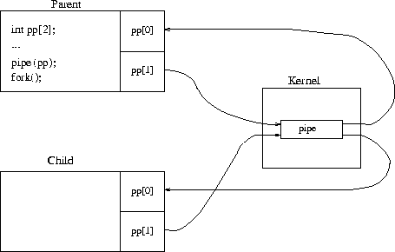
After pipe() and fork() (from http://www.cim.mcgill.ca/~franco/OpSys-304-427/lecture-notes/node28.html)
Notes:
<number>

Slide 32
Example of pipes and redirection
A program “lsgrep” that runs “ls –al | grep arg1 > arg2”.
Example: “lsgrep aa myout” lists all files that contain “aa” and puts output in file myout.
int main(int argc,char**argv)
{
if (argc < 3) {
fprintf(stderr, "usage:”
“lsgrep arg1 arg2\n");
exit(1);
}
// Strategy: parent does the
// redirection before fork()
//save stdin/stdout
int tempin = dup(0);
int tempout = dup(1);
//create pipe
int fdpipe[2];
pipe(fdpipe);
//redirect stdout for "ls“
dup2(fdpipe[1],1);
close(fdpipe[1]);
Notes:
<number>

Slide 33
Example of pipes and redirection
// fork for "ls”
int ret= fork();
if(ret==0) {
// close file descriptors
// as soon as are not
// needed
close(fdpipe[0]);
char * args[3];
args[0]="ls";
args[1]=“-al";
args[2]=NULL;
execvp(args[0], args); // error in execvp
perror("execvp");
_exit(1);
}
//redirection for "grep“
//redirect stdin
dup2(fdpipe[0], 0);
close(fdpipe[0]);
//create outfile
int fd=open(argv[2], O_WRONLY|O_CREAT|O_TRUNC, 0600);
if (fd < 0){
perror("open");
exit(1);
} //redirect stdout
dup2(fd,1);
close(fd);
Notes:
<number>

Slide 34
Example of pipes and redirection
// fork for “grep”
ret= fork();
if(ret==0) {
char * args[3];
args[0]=“grep";
args[1]=argv[1];
args[2]=NULL;
execvp(args[0], args); // error in execvp
perror("execvp");
_exit(1);
}
// Restore stdin/stdout
dup2(tempin,0);
dup2(tempout,1);
// Parent waits for grep
// process
waitpid(ret,NULL);
printf(“All done!!\n”);
} // main
Notes:
<number>

Slide 35
Two Implementations of lsgrep
Read the first implementation at
Parent process does redirection
And the second implementation at
Child process does redirection
Notes:
<number>

Slide 36
Closing Unused Pipes
Must close unused write end of the pipe, otherwise processes keep waiting for more to be written to the pipe, and won’t exit.
Only when all write ends are closed to the pipe, is EOF sent to the readers.
Good practice to close unused read end of the pipe as well, so writer process gets an error signal when writing to the pipe
Otherwise a writer process may keep writing, until pipe is full and process is blocked
Notes:
<number>

Slide 37
Review:
What is an open file object? What information does it include?
What is the semantics for pipe, dup, dup2, especially how they affect the creation/deletion and reference count of open file object?
How to implement pipe and redirection using pipe, dup, dup2? (Not required for mid-term 1)
Notes:
<number>

