Slide 1
Teensy Audio Platform
Looking at the Teensy Audio platform with an
eye towards sound synthesis
Presented By:
Marshall Taylor
Byron Jacquot
SparkFun Electronics
Niwot, Colorado

Slide 2
Outline
Part 1: Background
Part 2: Using Teensy Audio
Part 3: Our Projects
Part 4: Under The Hood
Notes:
Part 1: Background
What's a Teensy?
What's Teensy Audio
Part 2: Using Teensy Audio
A quick demonstration
Part 3: Our Projects
Proto-8 & the Bendevelope
TeensyBoom
Part 4: Under The Hood
Implementing new modules
Fast integer math tricks

Slide 3
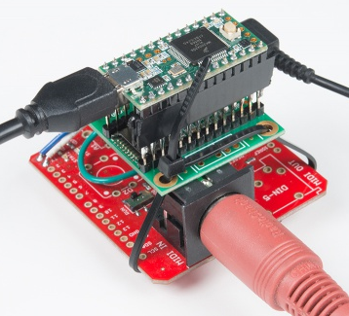
Part 1: Background
The Teensy, from PJRC.com
Improved Arduino-compatible microcontroller
1.0 Atmel AVR Mega328P
2.0 Atmel ATMEGA32U4 – native USB port.
3.1/3.2 Freescale Kinetis MK20DX256 (ARM Cortex M4)
LC (Low Cost) Cortex M0+
Programming environment is FOSS – GCC for ARM,
Arduino IDE.
Notes:
What Is Teensy?
Small, inexpensive, Arduino-compatible microcontroller boards.
[photos]
From PJRC.com
Three Generations:
1.0 Atmel AVR Mega328P
2.0 Atmel ATMEGA32U4 – native USB port.
3.1/3.2 Freescale Kinetis MK20DX256 (ARM Cortex M4)
LC (Low Cost) Cortex M0+
Programming environment is FOSS – GCC for ARM, Arduino IDE.

Slide 4
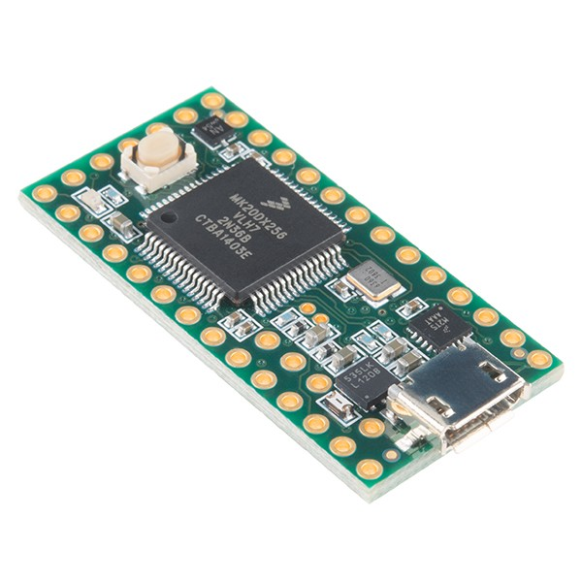
Teensy 3.2
32-bit ARM Cortex M4 core
72 MHz
256 kB flash memory
64 kB RAM
34 I/O pins
21 Analog-to-digital channels
DMA (direct memory access)
I2S Peripheral
Integer DSP instructions
Best of all, it's $20!

Slide 5
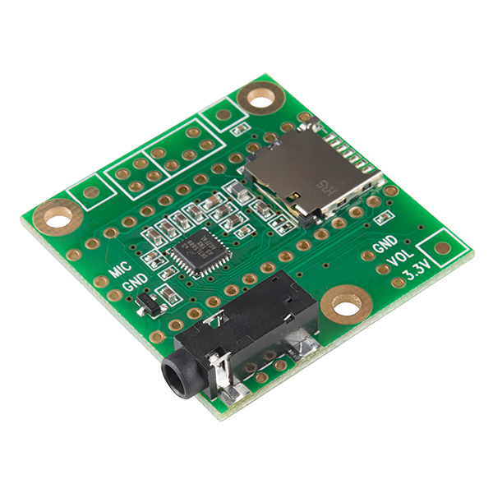
Teensy Audio Adapter
Codec – 2 channel audio in / 2 out
16-bit audio conversion
SD slot / memory expansion
Headphone amp
Built-in filter, gain, etc.
$15 price tag
Audio board not required for Teensy Audio – Teensy has 12-bit analog I/O but without physical interface
Notes:
[pic]
[block diagram from datasheet]
Shield board with stereo audio codec and micro-SD card slot.
$15 retail price.
Codec - “coder/decoder” combines audio-type analog-to-digial and digital-to-analog converters.
The codec on the shield is capable of 2 channels 16-bit audio conversion.
It's not required, but it adds high quality stereo conversion. You can also use the Teensy's onboard ADC and DAC for 12-bit conversion.
It also provides some audio utility functions – input and output gain control, EQ, bass enhancement, limiting, and a headphone amplifier.

Slide 6
Part 2: Using Teensy Audio
Build audio systems graphically, then export code.
Browser interface built on Node Red framework
Drag and drop DSP functions
Wired with virtual patch cords
Can run locally w/o internet connection.
Functions as the reference manual for the DSP nodes.
Exported Code is built & loaded using Arduino IDE.
Notes:
Browser based block interface built on Node Red framework. Can run locally w/o internet connection.
Drag and drop DSP functions, wire them together with virtual patch cords.
It also functions as the reference manual for the DSP nodes.
-demo part 1-
Show off types of nodes

Slide 7
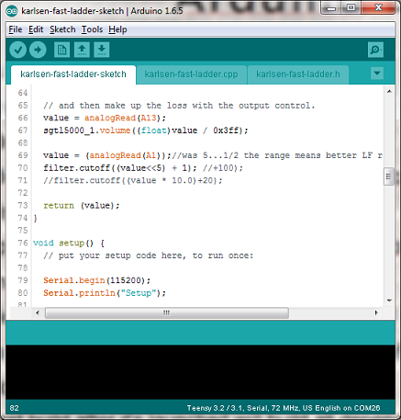
Arduino Details
“Arduino” is several things:
Simplified C++ development environment
Embedded microcontroller boards
Embedded runtime libraries – device drivers, etc.
A program is called a “sketch,” *.ino files.
Arduino supports Teensy with PJRC's “Teensyduino” package.
Arduino is not a terribly rich environment.
The code editor is garbage, select “use external editor”
It's not a debugger. But there is a serial window!
The build process is really coarse –
  The first build after it's launched will build all dependencies. Subsequent builds don't rebuild everything.
  Dependencies are determined through a set of paths.
Notes:
Supports Teensy when the “Teensyduino” package is loaded, and Teensy is selected as the target.
It's not a terribly rich environment.
The code editor is minimal but functional.
It's not a debugger. But there is a serial window.
The build process is really coarse –
The first build after it's launched will build all dependencies. Subsequent builds don't rebuild everything.
Dependencies are determined through a set of paths.

Slide 8
To Load A Patch
Hit the “export” button in GUI, and copy the code listing to the clipboard.
Paste that code into the local declarations of an Arduino Sketch.
Typically, you'll need to add some initialization code to the setup() function.

Slide 9
How Others are Using Teensy Audio
Two types of project seem to be most common:
Sample playback from SD cards.
Realtime analysis – can do 1024 point FFT.
Plenty of example projects can be found on Youtube.

Slide 10
Part 3: How We're using Teensy Audio
Synthesis and effects!
Teensy has many channels of onboard utilitarian (non-Audio) ADC, so we can add knobs for realtime control.
Also has serial ports for MIDI.
I2C and SPI for low-level hardware interfaces.

Slide 11
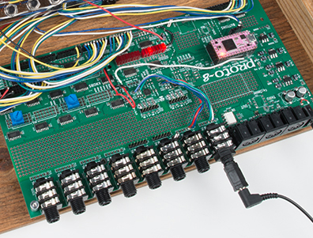
Proto-8 “Teensy Audio Adapter”
64 knobs
64 switches or buttons
64 LEDs
MIDI/TRS interfaces
2 Teensy audio adapters (4 I/O)

Slide 12
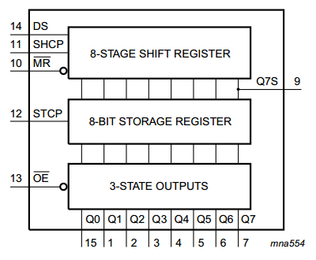
Expanding Hardware: LEDs
Cheap 74HC595 shift registers
Simple active-high with limiting resistor
High speed
SPI bus compatible

Slide 13
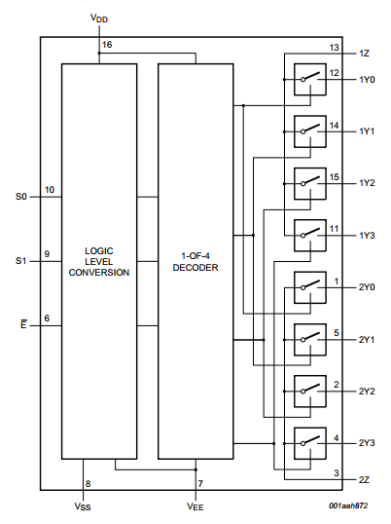
Expanding Hardware: Knobs
Cheap 4052 analog dual 4:1 muxes
Can multiplex multiplexors
<10us response time
Read values with analog in

Slide 14
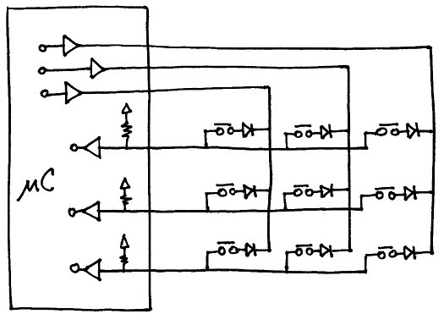
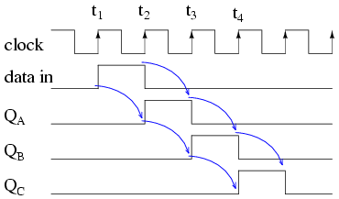
Expanding Hardware: Switches
Contacts are matrixed
Diodes are installed by the contacts
Driven by 74HC595 shift register
Rows minimized, read by GPIO
Serial interface on GPIO:
Send one bit down the serial chain to scan, latch on falling clock

Slide 15
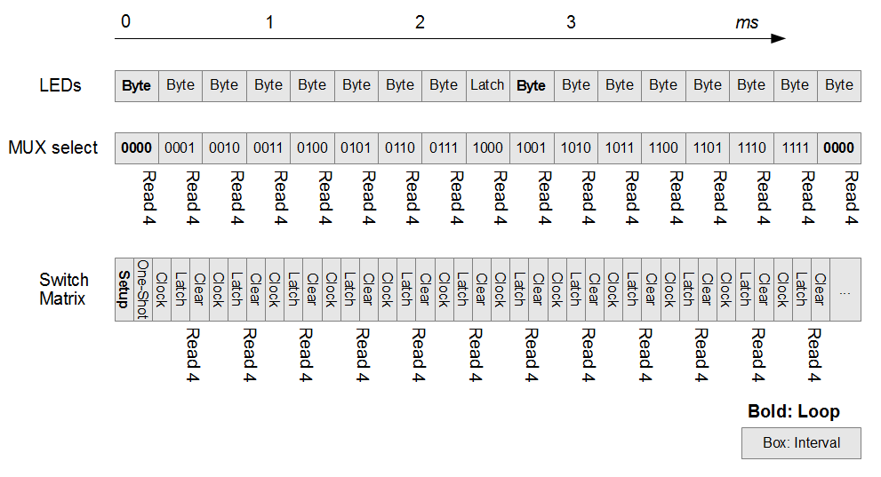
Operating the human-machine interface
Mini state machines
Periodically called
Watch out for SPI-LED bus contention

Slide 16
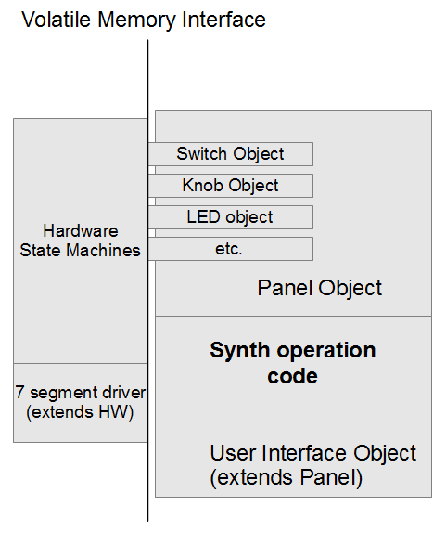
Building the panel
Hardware periodically called and ignored
Panel object is containment
Panel elements accessed through edge, de-bounce, and hysteresis functions

Slide 17
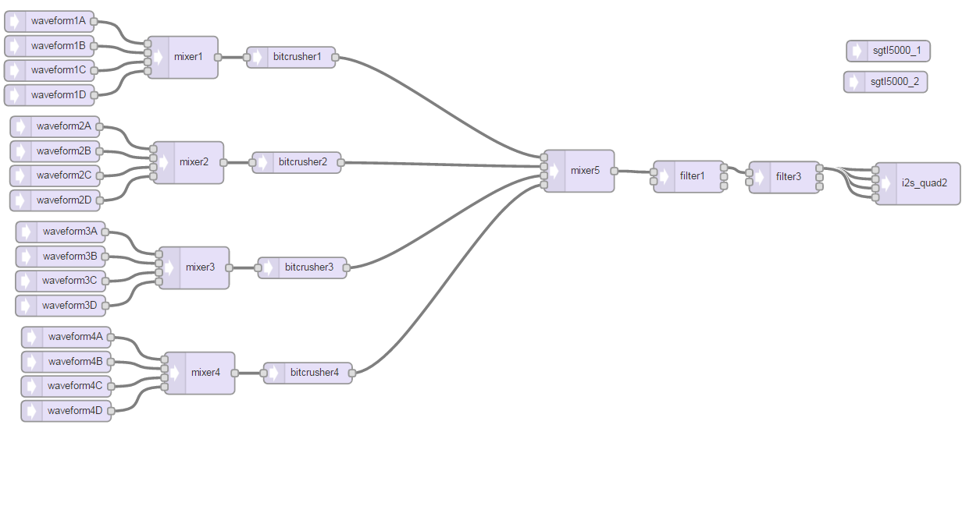
Bendvelope Example Project
4 voices, 4 oscillators each
1 bendvelope per voice
Very heavy system (83%)
“bitcrusher” used as placeholder

Slide 18
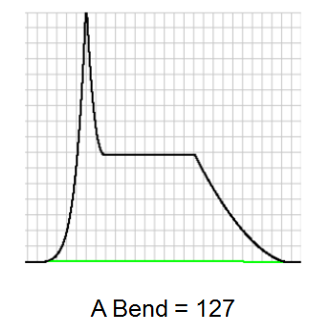
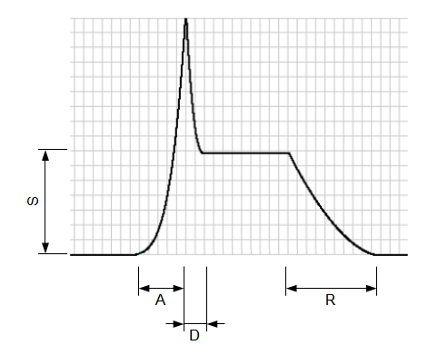
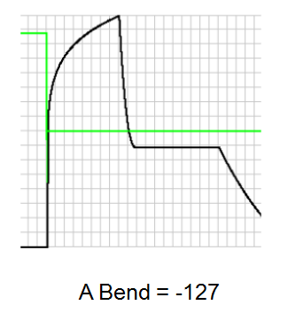
Bendvelope
A modified ADSR gain block
1 input, 1 output
Sketch-level functions
noteOn()
noteOff()
attack(length, bend)
decay(length, bend)
sustain(level)
release(length, bend)

Slide 19
The Bend Table
The yield of playing around with coefficients
amplitude out = f(t, P, Q, G)
time = t
timescale = P
power scale = Q
target amp = G
f(t, P, Q, G) = G*(t/P)^(e^(2Q/127))
Too much maths!

Slide 20
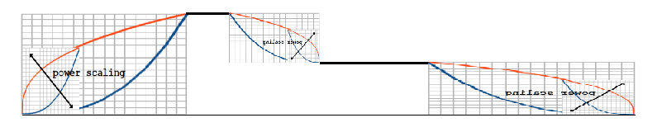
Constructing a bendvelope
Use look up tables to calculate while running
Calculate tables when input changes
Gate changes within table require seeking time by value, so the table goes in an object that:
Has binary search function
Has table generation math function
Other helper functions
Notes:
Demo here?

Slide 21
Teensy-boom
Classic-style drum machine with (eventual) step sequencer.
Drums are based on analog emulation.
Drum voices are using direct-digital-synthesis (DDS) waveform generation for damped sine waves.
Cymbal voices use an emulation of the TR-808/606 cymbal circuit, generating and combining six square waves
Shaker and clap are simply pulses of filtered white noise

Slide 22
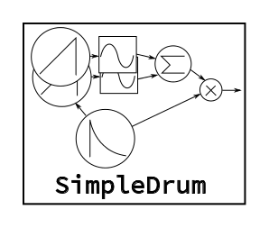
SimpleDrum Class
Uses a phase accumlulator oscillator to index a sine wave table, with interpolation between points.
A second phase accumulator is easy to calculate, for a second harmonized waveform.
Also contains a decay-only envelope – uses a phase accumulator to generate a ramp, then squares it, as n^2 on the interval [0..1] is an inexpensive quasi-exponential decay.
The envelope is applied to amplitude and pitch inside the module.
This one is “simple” as there are drum sounds at the output. It has a cousin with outputs for the oscillator and envelope, which can be used with other modules for more complex sounds, like adding white noise to a snare drum.

Slide 23
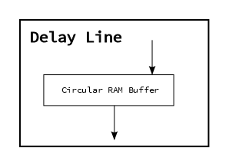
Effects
Modulated delay line.
Fixed size buffer is filled with incoming data.
Data is extracted from an offset off the insertion point. Offset can be changed at runtime.
The core of a tape-delay emulation, chorus, and pitch shift.

Slide 24
The more we learn about the platform, the more ideas we dream up...

Slide 25



Quick Commercial Break
Protos shown tonight were made with CNC tools.
Acrylic was worked with an Epilog laser cutter.
Wooden end caps were made using Shapeoko CNC router.

Slide 26
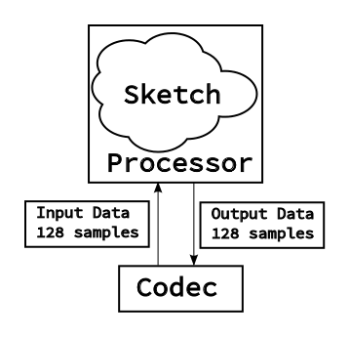
Part 4: Lifting The Hood
Teensy Audio architecture
Codec uses I2S bus, which delivers samples into processor memory using direct-memory-access (DMA). Blocks of 128 samples arrive without any software intervention, generating an interrput when complete.
Output processing is expected to deliver 128 sample blocks to the output, fed out by I2S & DMA hardware.

Slide 27
Software Architecture
A lot of pieces are generic, and hidden behind the scenes.
DMA and I2S drivers.
Graph analysis of the patch represented by the nodes and connectors. The connectors correspond to the runtime RAM usage, but it appears to be reasonably optimal. The memory for the connectors has to be allocated by the sketch using AudioMemory(n) call.
Execution model can be considered as two threads.
  The Arduino sketch is a lower priority thread that can control the processing.
  The processing is done by the nodes in an interrupt (IE. higher priority thread).
The processing work is done by the nodes.
  Each note is a C++ class, derived from a common AudioStream ancestor.
  Each uses the parent class for sample buffer management
  Each must implement the update() function.
  Other functions are more dependent on the use & behavior of the block.
Notes:
You don't have to know the details of the guts just to be able to use it.

Slide 28
The update() Function
Writing a new node is mainly about writing it's update() function. Update does the realtime processing of blocks of PCM data.
A data block is 128 samples, or about 2.9 mSec of audio.
Called automatically by framework when audio sample data is required.
Can generate, consume or pass through.
Nodes can have [0..many] inputs, and [0..many] outputs.
Needs to be somewhat lightweight, and shouldn't use blocking resources.
If the node needs to receive data from the sketch, that's usually done by adding accessor functions. Compound accesses should guarantee atomicity.

Slide 29
Comparison to VST Plugin Architecture
Both are frameworks for handling DSP routines.
VST uses variable sized sample blocks. So far Teensy uses fixed size blocks.
VST uses floats on range [0..1.0] for control parameters. Teensy has no limitation.
VST uses floats in range [-1.0..1.0] for audio data. Teensy uses 16-bit signed integers.
Notes:
In case you've written VSP plugins...

Slide 30
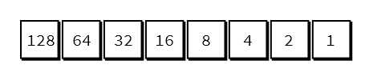
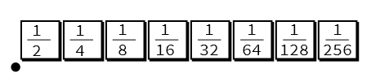
Fixed Point Math
The thing that makes all this possible is fast multiplication hardware in the CPU. It can handle 16 and 32 bit integer multiplication quickly. Floating point is considerably slower.
Rather than thinking about the audio data as being 2's complement signed integers [-32768..32767], it's easier to reframe it as being fractional data from [-1..0.999999]. A byte then breaks down as shown below.
Longer integer types can use the same format, with progressively smaller fractional bits.
Conversion between lengths means left-justifying the data, and adding or discarding LSBs.
This is sometimes called “Q” format, with numbers indicating the number of fractional bits. Q15 is 15 fractional bits, usually with a sign bit to make 16 total. There are times that the decimal needs to be somewhere else: Q4.4 would be 4 fractional bits, and 4 integer bits.

Slide 31
Fixed Point Math, Page 2
The trick to using fixed point math is a reexamination of the multiplicative identity.
We know that multiplying x by 1 results in x.
X * 1 = X
If we multiply two fixed point numbers, we get similar behavior
0xff x 0xff = 0xfe01
If we discard the eight fractional bits that were added (just as we might limit the number of digits of precision in a decimal calculation), we nearly return to the multiplicative identity.
0xFe01 >>= 8 -> 0xfe.
(Nearly because 0xff isn't a complete 1, it's 255/256, or 0.99605. 1/256 is 0.003906)
This also works for twos-complement signed numbers, but every multiplication adds two sign bits, so we need to shift by fewer bits to discard LSBs.
0x7f * 0x7f = 0x3f01
3f01 >>= 7 -> 0x7e
We can expand this to longer data types by adding on more fractional LSBs, and shifting to realign the decimal (binary) point.

Slide 32
Using the fast multiplies
Most legible: Can simply use C-style math operators. The compiler generates reasonable code, inserting the DSP instructions when possible.
More optimized: Dspinst.h contains explicit wrappers around useful DSP instructions, such as:
q31*q31>>32
Arm_math.h has a lot of useful, Q type-specific functions, but they're not as fast as the DSP instructions.

Slide 33
Useful Development Tricks
Clone & Mutate existing classes...
...or at least use the existing classes for reference.
You can print diagnostic information from the update() function, but it's easy to overwhelm the system if you do it for every sample or block. Set a flag periodically, or add an inspect() method to look inside the object.
You can use the onboard 12-bit DAC to extract signals for debugging. It's also DC coupled, making it useful for looking at control paths.
Periodically measure system load for CPU % and buffer consumption.
Turn off audio interrupts if you need to guarantee atomicity of class accessors (ie: trigger envelope and reset oscillator phase).
If it seems to be locking up, make sure that your update() function isn't looping forever.
Reserve buffer memory; be sure to enable the I2S devices; turn up the output volume parameter!
Notes:
Some obvious and not-so-obvious things we've experienced.

Slide 34
What's Next?
Get some of our classes matured & contributed back to the mainline!
More sketches built with existing blocks
  Vocoder should be easy.
More & better processing classes, mainly for Teensy-Boom.
  Handclap generator.
  4-pole lowpass (Karlsen fast ladder).
  Porting some other algorithms found at MusicDSP.org.
  Reverb & pitch shift are desired.
  Optimized multi-tone generator
  Tube overdrive emulation
More complete hardware prototypes

Slide 35
Resources
PJRC.com
http://www.pjrc.com/teensy/gui/
https://github.com/PaulStoffregen/Audio
https://github.com/Jacquot-SFE/Teensy-synth-platform - this presentation is in there.
https://github.com/marshalltaylorSFE/Proto-8 Proto-8 design files, hardware layer, and projects
MusicDSP.org
Hal Chamberlin's Musical Applications Of Microprocessors, 2nd Ed.

