Slide 1
Merge Sort
Divide And Conquer Algorithm

Slide 2
Applications of Merge Sort
Merge Sort is pretty interesting algorithm and have a very basic example of how to approach divide and conquer algorithms.
Most implementations produce a stable sort , which means that the order of equal elements is same in the input and output.
Time complexity of Merge Sort is O(nlogn) in all 3 cases(worst , average , best).
Auxiliary Space Complexity is O(n).

Slide 3
Algorithm of Merge Sort
It divides the input array in two halves , call itself for the two halves and then merges the two sorted halves .
The Merge() function is used for merging two halves .
The Merge(arr, l, m, r) is the key process that assumes that arr[l,...m] and arr[m+1,..r] are sorted and merges the two sorted subarrays into one.

Slide 4
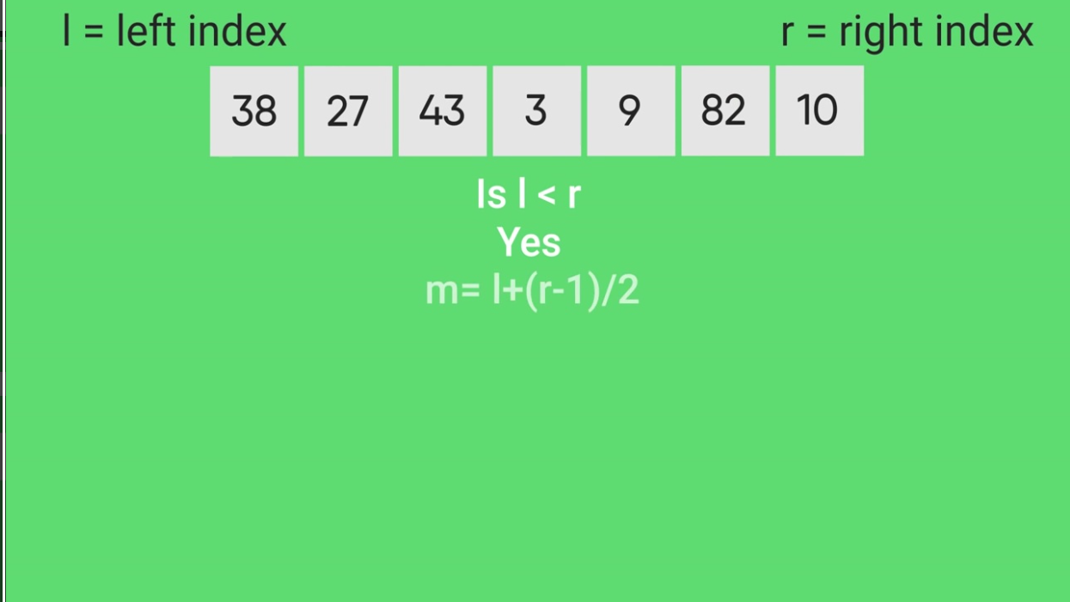
Steps to Algorithm

Slide 5
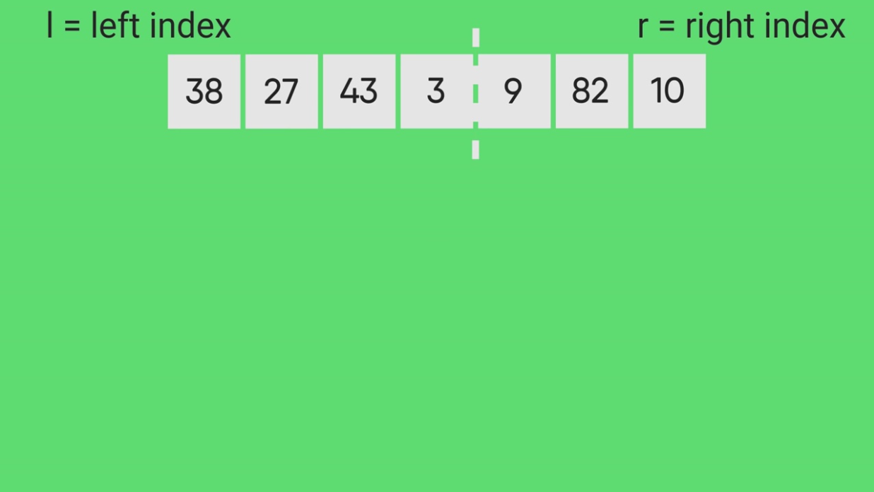
Divide the array from the point ‘m’ if l<r

Slide 6
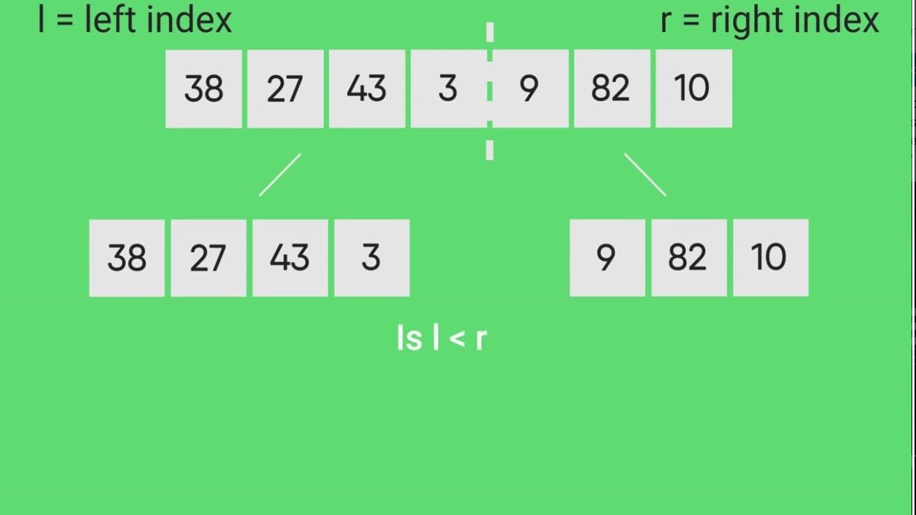
Divide the array in two halves

Slide 7
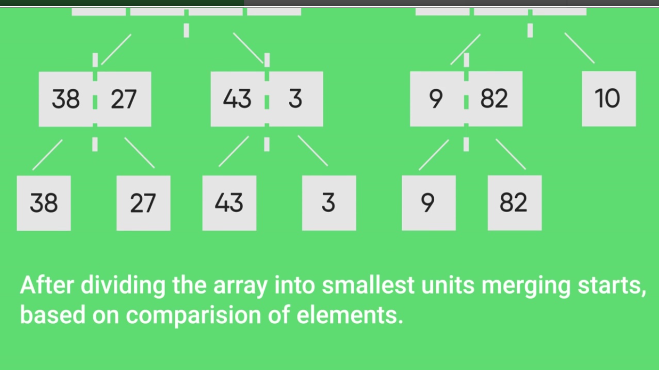
Split the divide array into more subarrays with a new value of ‘m’

Slide 8
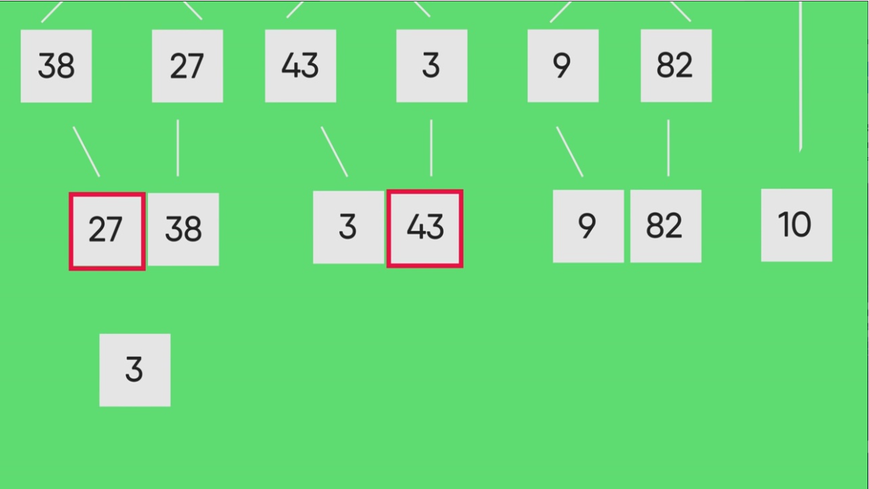
Now starts Merging smaller units

Slide 9
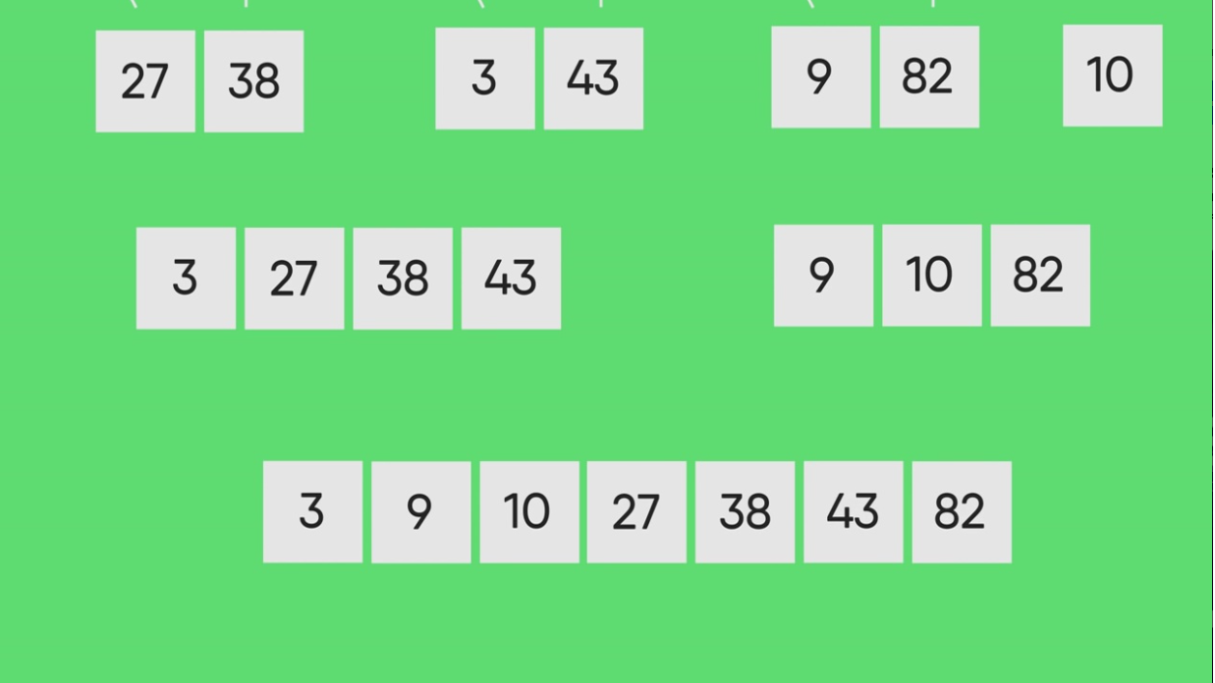
Smaller subarrays will merge and sorted array will be formed

