Slide 1
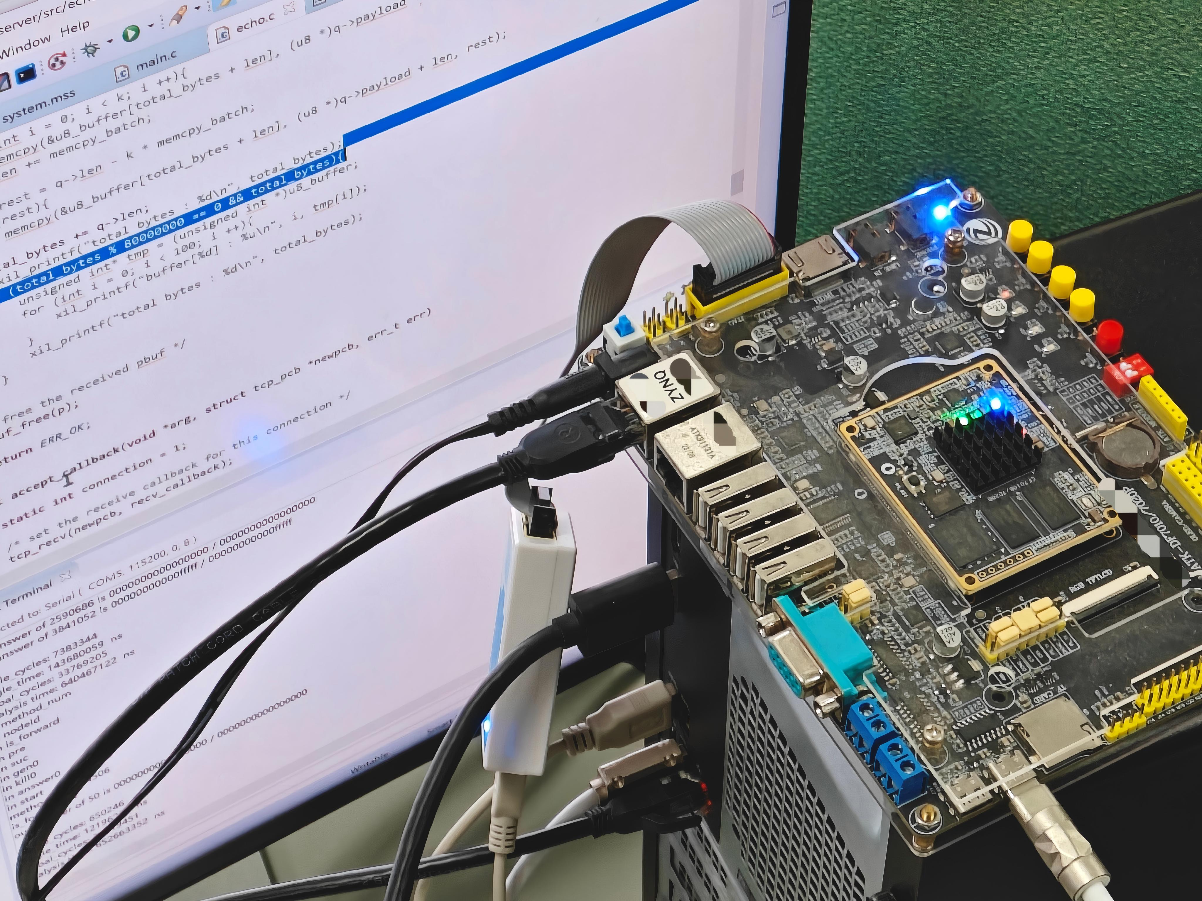




When FPGA Meets Dataflow Analysis
(An Explorative Step)
Fang Wei, Qinlin Chen, Nairen Zhang, Jiacai Cui,
Tian Tan*, Zhiqiang Zuo, and Yue Li*
Notes:
Hello, everyone. My name is Jiacai Cui.
I am a third-year Ph.D. student at Nanjing University, advised by Yue Li, who co-runs the PASCAL Research Group with Tian Tan.
Today, I will talk about our paper titled “When FPGA Meets Dataflow Analysis: An Explorative Step.”
Let’s first have a recap of (-) dataflow analysis.

Slide 2






Dataflow Analysis
entry
$$∅$$
a := 0
Concept
  Propagates information along a program’s control-flow graph
  to determine the data fact at each program point.
Importance
  Fundamental in revealing general-purpose program information
    e.g., live variables, reaching definitions, available expressions, etc.
  Useful for many software engineering tasks
    e.g., bug detection, security analysis, code optimization, program understanding, etc.
$$\left\{a\right\}$$
b := 1
$$\left\{a, b\right\}$$
c := a + b
$$\left\{c\right\}$$
a := 2
$$\left\{a, c\right\}$$
d := c + a
$$∅$$
exit
Notes:
Dataflow analysis is about (-) propagating information along a program’s control-flow graph to determine the data fact at each program point.
>
For example, (-) here is the control-flow graph of a simple sequential program, where the blue dots denote program points and the green sets next to them are data facts.
>
Dataflow analysis is (-) fundamental for revealing general-purpose program information like live variables, reaching definitions, and available expressions.
>
For example, the data facts in the right case shows the live variables at each program point. They tell us which variables have values that will be used later.
>
This kind of fundamental information is (-) useful for many software engineering tasks, such as bug detection, security analysis, code optimization, and program understanding.
>
For example, live variables can be used to optimize dead-code and register allocation, while reaching definitions can be used to detect use-before-initialization bugs.
>
Due to its importance, there has been a lot of effort to

Slide 3

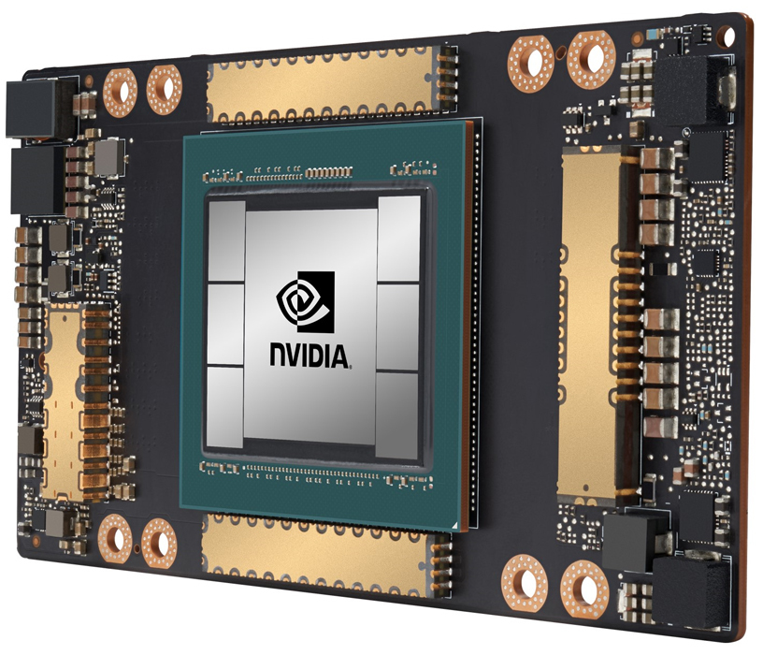

Analysis-Acceleration
Software
Dataflow Analysis
CC’21
CC’19
FSE’23
PLDI’21
POPL’11
IPDPS’19
Adapting
analysis algorithms
to
hardware architectures
... ...
... ...
... ...
multi-core scheduling
SIMD/SIMT parallelism
partitioning & communication
CPUs
GPUs
Distributed Systems
Hardware
General-purpose Computing Platforms
Notes:
accelerate dataflow analysis, (-) by leveraging many general-purpose computing platforms, such as CPUs, GPUs, and distributed systems.
>
They follow a common paradigm (-) --- adapting analysis algorithms to hardware architectures.
>
For example, they design specific (-) multi-core scheduling to better utilize modern CPUs,
>
specific (-) SIMD or SIMT parallelism to better utilize high-performance GPUs,
>
or specific (-) workload partitioning and service communication to better leverage the computing power of distributed systems.

Slide 4
Research Question
Analysis-Acceleration
Software
Hardware
Adapting
Hardware
Software
What about the other way round?
Designing specialized hardware for dataflow analysis remains unexplored.
Notes:
With this software-to-hardware paradigm in mind, we started to wonder, out of pure research curiosity, that: (-) “What about the other way around?”
>
What about (-) designing specialized hardware that directly accelerates dataflow analysis?
>
This direction remains unexplored.

Slide 5
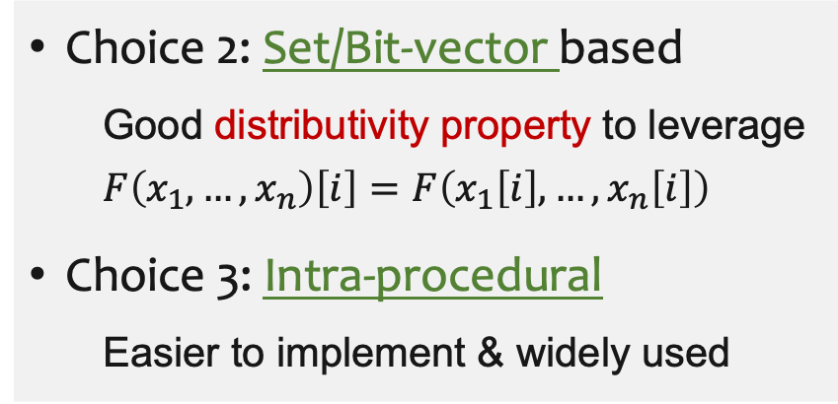
Research Question: An Explorative Step
Designing specialized hardware for dataflow analysis remains unexplored.
An FPGA
(Field-Programmable Gate Array)
Set-based Intra-procedural
Dataflow Analysis
Choice 1: FPGA
  Highly customizable and well-suited for rapidly prototyping specialized hardware
  Too expensive to tape out an ASIC
Choice 2: Set/Bit-vector based
  Good distributivity property to leverage
  $$F\left(x_{1},…,x_{n}\right)\left[i\right]=F\left(x_{1}\left[i\right],…,x_{n}\left[i\right]\right)$$
Choice 3: Intra-procedural
  Easier to implement & widely used
Starting-point Choices
Notes:
And this work takes an explorative step in this direction.
>
As a starting point, we make a few choices (-) to make life easier.
>
(-) We choose an FPGA for rapidly prototyping the specialized hardware, as it’s too expensive to tape out an ASIC.
>
(-) And we start with set-based intra-procedural dataflow analysis, because the set-based, also known as bit-vector based, formulation has a good distributivity property to leverage, while the intra-procedural setting is easier to implement and already widely used.

Slide 6



An Explorative Step
Initial Try
Challenges
Final Design
reveal
overcome
Notes:
To present our exploration more intuitively,
>
(-) I’ll first introduce a straightforward initial try, then
>
(-) the challenges revealed by this initial design, and finally
>
(-) how we overcome these challenges and achieve our final design.

Slide 7
An Explorative Step
Initial Try
Challenges
Final Design
reveal
overcome
Notes:
Let’s start with an initial try.

Slide 8






Initial Try: A Straightforward Accelerator
Algorithm 1: Classic Worklist Algorithm
1
2
3
4
5
6
7-
8-
9-
$W←$ {all the-entry nodes of the-CFG}
repeat
Retrieve node k from $W$
$IN\left[k\right]←\text{⊗} p∈pred(k)OUT[p]$
$TMP ←(IN[k]\backslash KILL[k])∪GEN[k]$
if$TMP≠OUT\left[k\right]$then
$OUT[k]←TMP$
$W←W∪succ\left(k\right)$
until $W is empty$
worklist unit
$$N0$$
$$N1$$
$$N2$$
$$N3$$
$$N4$$
……
merge
unit
pred
bram
bram-controller
out
cfg
transfer
unit
gen
fact
kill
gen/
kill
update
unit
succ
MUX
straightforward = simply rewrite the-algorithm using an HDL (e.g., Verilog)
Notes:
This is a classic worklist algorithm for dataflow analysis that you can find in almost every compiler textbook.
>
It basically computes the fixed point of the transfer functions shown in lines 4 and 5, which compute the dataflow facts, IN and OUT, associated with the program points before and after each CFG node.
>
Our initial try at turning this into a hardware accelerator is very straightforward: (-) simply rewrite the algorithm using an HDL such as Verilog.
>
More specifically, we (-) store the program data required for the analysis in high-speed on-chip memory, which is a BRAM here, and design hardware units (-) that directly correspond to the algorithmic steps on the left.
>
For the sake of time, I’ll skip the details of these units here, as they are actually quite straightforward.
>
This design makes intuitive sense, but when we experimented with it,

Slide 9
An Explorative Step
Initial Try
Challenges
Final-Design
reveal
overcome
Notes:
we observed two challenges.

Slide 10

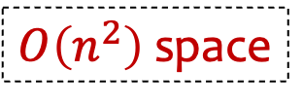
Challenges Revealed by the Straightforward Design
Spatial Infeasibility
  fails to analyze large procedures due to limited high-speed on-chip memory
Temporal Inefficiency
  fails to outperform high-end CPUs due to the FPGA’s lower clock frequency
bram
bram
$O\left(n^{2}\right)$ space
in proportion to #cfg-nodes ($=n$)
cfg
data fact
0 | 1 | 1 | 0 | 1 | 0 | ... | ... | 0 | 1
fact
for each cfg node
gen info
0 | 1 | 0 | 0 | 1 | 0 | ... | ... | 0 | 1
gen/
kill
0 | 1 | 0 | 0 | 1 | 0 | ... | ... | 1 | 1
kill info
Notes:
The first challenge is (-) spatial infeasibility: the straightforward hardware design fails to analyze large procedures due to limited high-speed on-chip memory.
>
To be specific, (-) let’s look at the internal structure of this BRAM in the initial try.
(-) For each CFG node, we store its associated dataflow fact and other semantic information in the BRAM. These are all bit vectors.
>
For example, if we’re analyzing reaching definitions, each bit in the datafact indicates whether a definition is reachable, so we need as many bits as the number of statements; if we’re analyzing live variables, each bit indicates whether a variable is live, so we need as many bits as the number of variables.
>
Therefore, (-) the length of these bit vectors is in proportion to the number of CFG nodes, also the size of the procedure.
In summary, the space complexity of the straightforward design grows (-) quadratically with the procedure size, quickly exhausting the FPGA’s limited high-speed on-chip memory when analyzing large procedures.
>
(-) The second challenge is temporal inefficiency: the straightforward design fails to outperform high-end CPUs because of the FPGA’s lower clock frequency.
The Xilinx FPGA we use for prototyping operates at the megahertz level, while an Intel CPU operates at the gigahertz level.
So, the straightforward design is not enough to make a modest FPGA outperform a commercial CPU.

Slide 11
An Explorative Step
Initial Try
Challenges
Final Design
reveal
overcome
Notes:
Our final design overcomes these two challenges.

Slide 12
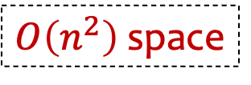

Overcome Spatial Infeasibility via Distributivity
$$F\left(x_{1},…,x_{n}\right)\left[i\right]=F\left(x_{1}\left[i\right],…,x_{n}\left[i\right]\right)$$
bram
$O\left(n^{2}\right)$ space
in proportion to #cfg-nodes ($=n$)
data fact
0 | 1 | 1 | 0 | 1 | 0 | ... | ... | 0 | 1
for each cfg node
gen info
0 | 1 | 0 | 0 | 1 | 0 | ... | ... | 0 | 1
kill info
0 | 1 | 0 | 0 | 1 | 0 | ... | ... | 1 | 1
Notes:
For the spatial infeasibility challenge, we overcome it by leveraging the distributivity of set-based dataflow analysis to divide and conquer the problem.
>
This property, expressed by this formula, ensures that each bit in the resulting bit vector can be computed independently from the corresponding bits in the original bit vectors during the analysis.
This is a standard property of set-based, also known as bit-vector-based, dataflow analysis, so I won’t go into its theoretical details here.
>
With this property, we can choose

Slide 13
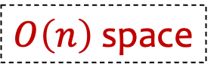

Overcome Spatial Infeasibility via Distributivity
$$F\left(x_{1},…,x_{n}\right)\left[i\right]=F\left(x_{1}\left[i\right],…,x_{n}\left[i\right]\right)$$
$O\left(n\right)$ space
in proportion to #cfg-nodes ($=n$)
data fact
0 | 1 | 1 | 0 | 1 | 0 | ... | ... | 0 | 1
for each cfg node
gen info
0 | 1 | 0 | 0 | 1 | 0 | ... | ... | 0 | 1
kill info
0 | 1 | 0 | 0 | 1 | 0 | ... | ... | 1 | 1
bram
a fixed $k$
Notes:
a fixed number as the subproblem size and iteratively solve each subproblem using only linear space.

Slide 14

Overcome Spatial Infeasibility via Distributivity
$$F\left(x_{1},…,x_{n}\right)\left[i\right]=F\left(x_{1}\left[i\right],…,x_{n}\left[i\right]\right)$$
$O\left(n\right)$ space
in proportion to #cfg-nodes ($=n$)
data fact
0 | 1 | 1 | 0 | 1 | 0 | ... | ... | 0 | 1
for each cfg node
gen info
0 | 1 | 0 | 0 | 1 | 0 | ... | ... | 0 | 1
kill info
0 | 1 | 0 | 0 | 1 | 0 | ... | ... | 1 | 1
bram
a fixed $k$
Notes:
a fixed number as the subproblem size and iteratively solve each subproblem using only linear space.

Slide 15

Overcome Spatial Infeasibility via Distributivity
$$F\left(x_{1},…,x_{n}\right)\left[i\right]=F\left(x_{1}\left[i\right],…,x_{n}\left[i\right]\right)$$
$O\left(n\right)$ space
in proportion to #cfg-nodes ($=n$)
data fact
0 | 1 | 1 | 0 | 1 | 0 | ... | ... | 0 | 1
for each cfg node
gen info
0 | 1 | 0 | 0 | 1 | 0 | ... | ... | 0 | 1
kill info
0 | 1 | 0 | 0 | 1 | 0 | ... | ... | 1 | 1
bram
a fixed $k$
Notes:
a fixed number as the subproblem size and iteratively solve each subproblem using only linear space.
>
And of course, there’s no free lunch.

Slide 16

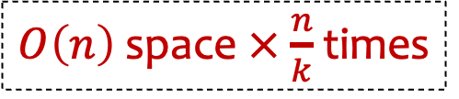
Overcome Spatial Infeasibility via Distributivity
$$F\left(x_{1},…,x_{n}\right)\left[i\right]=F\left(x_{1}\left[i\right],…,x_{n}\left[i\right]\right)$$
$O\left(n\right)$ space $×$ $\frac{n}{k}$ times
in proportion to #cfg-nodes ($=n$)
data fact
0 | 1 | 1 | 0 | 1 | 0 | ... | ... | 0 | 1
for each cfg node
gen info
0 | 1 | 0 | 0 | 1 | 0 | ... | ... | 0 | 1
kill info
0 | 1 | 0 | 0 | 1 | 0 | ... | ... | 1 | 1
bram
a fixed $k$
Notes:
The reduction in space comes at the cost of increased time, since we need to iteratively invoke the FPGA accelerator.
>
But at least, we make it spatially feasible through this way.

Slide 17





Improve Temporal Efficiency via Hardware Parallelism
worklist unit
$$N0$$
$$N1$$
$$N2$$
$$N3$$
$$N4$$
……
merge
unit
pred
bram
bram-controller
out
cfg
transfer
unit
gen
fact
kill
gen/
kill
update
unit
succ
MUX
Notes:
After overcoming the spatial infeasibility, we then improve temporal efficiency via hardware parallelism and arrive at our final design (-) like this.

Slide 18






Improve Temporal Efficiency via Hardware Parallelism
worklist unit
Task Retrieval
Stage
$$N0$$
$$N1$$
$$N2$$
$$N3$$
$$N4$$
……
bram
merge
unit
pred_controller
pred
pred
Data Merging
Stage
out
out_controller
fact0
fact1
data forwarding
unit
transfer
unit
fact2
gen
genkill_controller
kill
gen/kill
Fact Computation
Stage
succ_controller
succ
update
unit
succ
……
State Update
Stage
MUX
Notes:
Here, the leveraged hardware parallelism techniques include

Slide 19
Improve Temporal Efficiency via Hardware Parallelism
worklist unit
unlocks
Task Retrieval
Stage
$$N0$$
$$N1$$
$$N2$$
$$N3$$
$$N4$$
……
bram
Pipelining
Hardware
Software
merge
unit
pred_controller
pred
pred
Data Merging
Stage
out
out_controller
fact0
fact1
data forwarding
unit
transfer
unit
fact2
gen
genkill_controller
gen/kill
BRAM
Partitioning & Replication
Fact Computation
Stage
kill
Data Forwarding
succ_controller
succ
update
unit
succ
……
State Update
Stage
MUX
Notes:
pipelining with (-) data forwarding and (-) BRAM partitioning and replication.
>
Due to the time limit, I’ll leave these hardware-specific techniques to the paper. They are actually quite common in hardware design.
>
The main point to take away here is that it is the (-) switching to a new hardware-to-software paradigm that unlocks the potential of hardware-level optimizations for dataflow analysis.
>
Our final design is named (-) FPGAFlow.

Slide 20
FPGAFlow
(Implementation of our design)
Xilinx Zynq-7020 FPGA (55 MHz)
Notes:
It is implemented on a Xilinx FPGA with a maximum clock frequency of 55 megahertz.

Slide 21

Evaluation - Setup
vs.
FPGAFlow
(Implementation of our design)
Tai-e
(A state-of-the-art Java static analyzer)
Xilinx Zynq-7020 FPGA (55 MHz)
Intel Xeon Silver 4114 CPU (2.20–3.00 GHz)
Notes:
We compare it with a state-of-the-art Java static analyzer, Tai-e, running on a server-grade Intel CPU with a maximum clock frequency of 3 gigahertz, to evaluate the potential of FPGA-accelerated dataflow analysis.

Slide 22












Evaluation - Programs Under Analysis
Real-world Java Projects (Averaged 32.5K Github Stars)
Notes:
The programs under analysis in our evaluation consist of many real-world Java projects, averaging tens of thousands of GitHub stars, and spanning diverse domains such as programming language implementations, distributed middleware, development tools, and business applications.

Slide 23
Evaluation - Results
FPGAFlow on a Xilinx Zynq-7020 FPGA (55 MHz)
vs.
Tai-e on an Intel Xeon Silver 4114 CPU (2.20–3.00 GHz)
Dataflow Analyses: Live Variables & Reaching Definitions
Correctness
  Produces exactly the same analysis results, amounting to 75 billion bits.
Performance
  A modest FPGA outperforms a server-grade CPU with an averaged
  15.45x speedup for live variables and 12.32x speedup for reaching definitions.
Notes:
We compare two representative dataflow analyses: live variables and reaching definitions.
>
For correctness, (-) FPGAFlow produces exactly the same analysis results as Tai-e for both analyses, on those real-world projects, amounting to 75 billion bits of dataflow facts.
So we’re very confident in the correctness of FPGAFlow.
>
For performance, (-) FPGAFlow running on a modest FPGA outperforms Tai-e running on a server-grade CPU, achieving an average speedup of 15 times for live variables and 12 times for reaching definitions over those real-world projects.
This showcases the acceleration potential of FPGAFlow.

Slide 24
Conclusion
Exploration
  Design the first specialized hardware for static analysis.
    We start with FPGA and dataflow analysis.
Vision
  Accelerate static analyses by plugging an accelerator card into the host machine.
    Success of such a paradigm has already been demonstrated in many other fields,
    e.g., graphics, deep learning, simulation, bioinformatics, image processing, etc.
Notes:
In conclusion, this work is about exploration and vision.
It explores (-) the first specialized hardware design for static analysis, starting with FPGA and dataflow analysis.
>
We envision that, in the future, (-) developers could accelerate their static analyses simply by plugging an accelerator card into the host machine.
>
The success of this paradigm has already been demonstrated in many other fields, such as graphics, deep learning, bioinformatics, and so on.
>
We hope that in the future, such a paradigm could also make more sophisticated static analyses, such as context-sensitive analyses, practical for daily use.

Slide 25
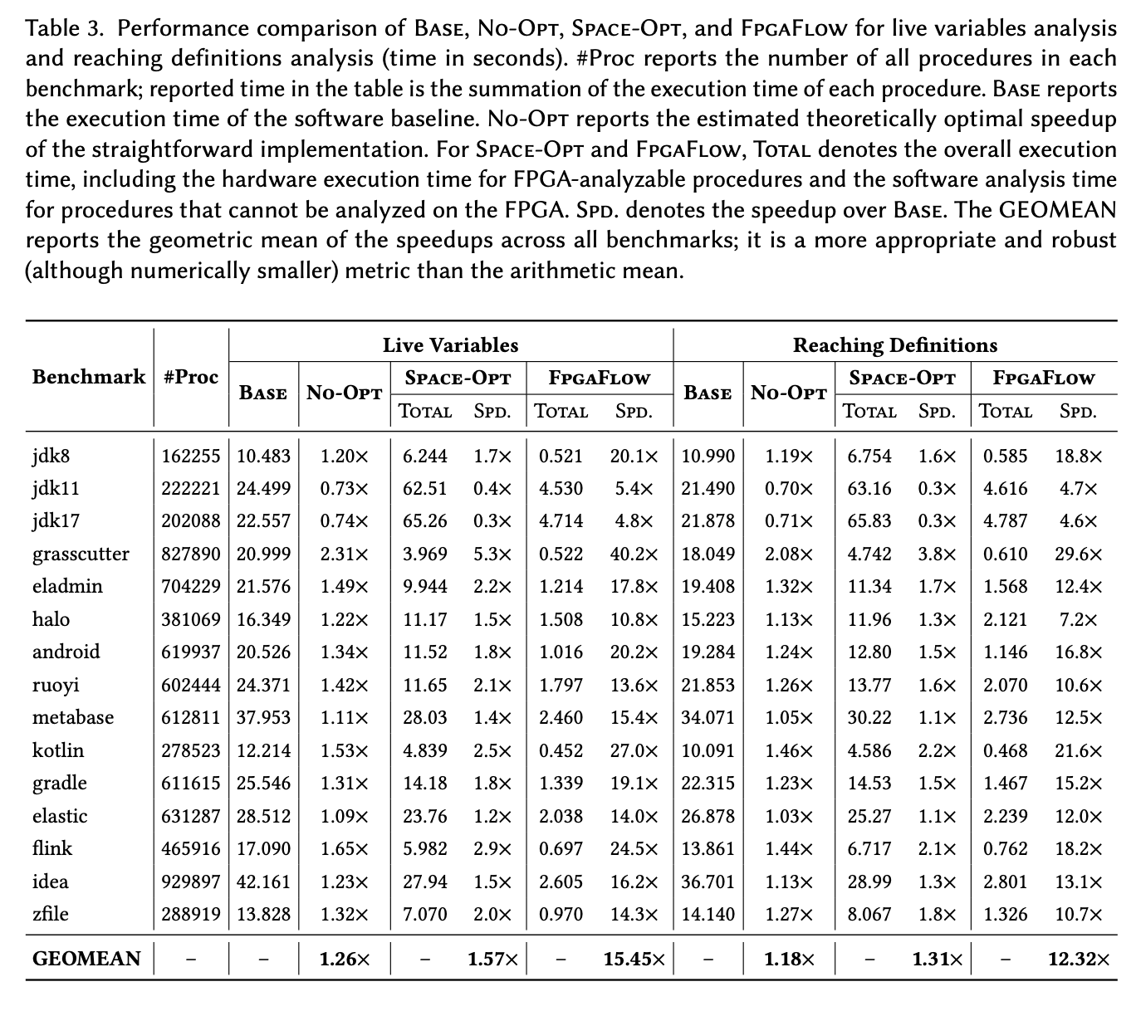
Backup

Slide 26
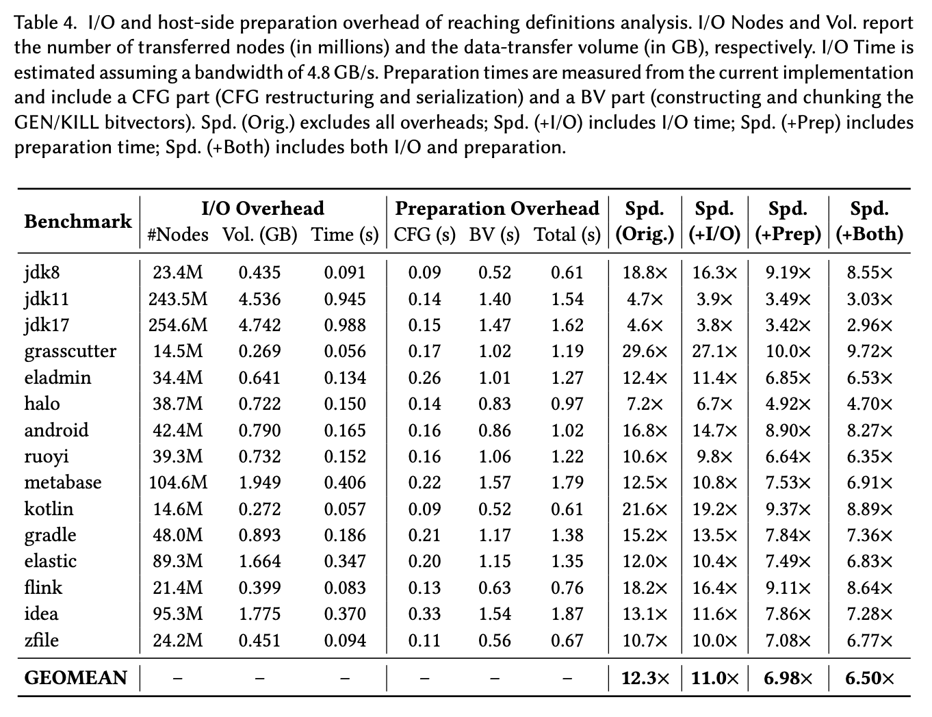
Backup

Slide 27
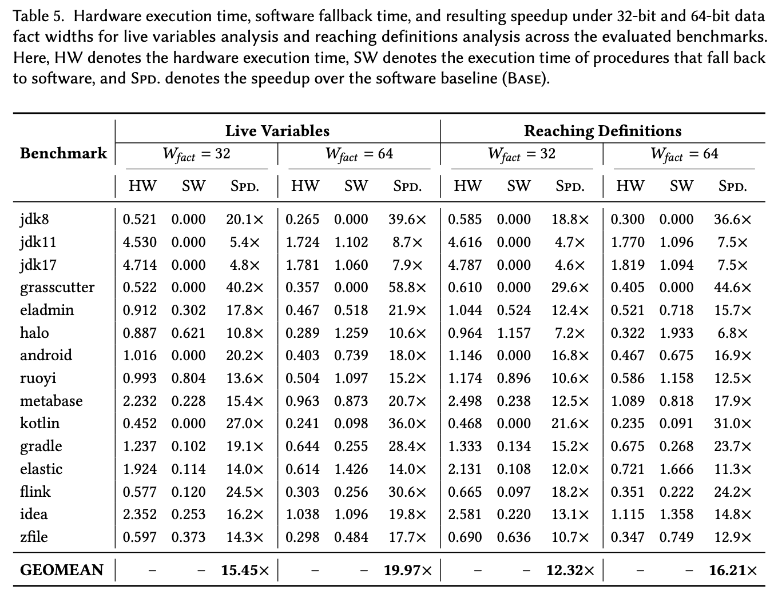
Backup

