Slide 1




Exploiting Sophisticated Static Analysis for Verilog
Qinlin Chen, Nairen Zhang, Jinpeng Wang, Jiacai Cui,
Tian Tan*, Xiaoxing Ma, Chang Xu, Jian Lu, and Yue Li*
PASCAL @ Institute of Computer Software
State Key Laboratory for Novel Software Technology, Nanjing University
Notes:
Hello everyone. I‘m Jiacai Cui from Nanjing University.
I’m a second-year Ph.D. student advised by Yue Li who co-runs the PASCAL research group with Tian Tan.
Today, I’ll try my best to present this work on behalf of the first author, Qinlin Chen, who was unfortunately unable to attend due to visa issues.
Our paper is titled Exploiting Sophisticated Static Analysis for Verilog, the dominant hardware description language.

Slide 2
Outline
The Untapped Potential of Hardware Static Analysis
Qihe: A General-Purpose Static Analysis Framework for Verilog
What Hardware Static Analysis Looks Like
​​Preliminary Results in Hardware Bug Detection, Security, Understanding, and Optimization
Notes:
In this talk, I’ll first discuss the untapped potential of hardware static analysis.
And then, I will introduce Qihe, the first general-purpose static analysis framework for Verilog.
After that, I will show what hardware static analysis looks like in practice.
Finally, I will present our preliminary results on applying hardware static analysis across diverse application domains.
Let’s start by talking about why we want to do static analysis for hardware.

Slide 3
The Untapped Potential of Hardware Static Analysis
Software
Programming (C, Java)
Testing + Formal Verification
Increasing Software
Diversity and Complexity
Software Static Analysis
Thousands of analyses for bug detection, security, program understanding…
2000
——
2026
Basic Syntactic Checks
Sophisticated Semantic Analysis
Naming, Style, Pattern, ...
Logic, Property, Intention, ...
Hardware
Programming (Verilog)
Simulation + Formal Verification
Increasing Hardware
Diversity and Complexity
Hardware Static Analysis?
Underexplored
2026
——
Notes:
If we look back at how static analysis has greatly evolved in the software world, we can observe a large amount of untapped potential of static analysis in the hardware world.
In many ways, hardware development resembles software development.
Hardware is “programmed” in languages like Verilog, and its quality is ensured through techniques such as simulation-based testing and formal verification.
These approaches are also widely used in software.
However, as of 2026, static analysis in hardware is still underutilized.
The overwhelmingly dominant hardware static analyzers are linters.
They provide basic syntactic checks, such as naming conventions, style rules, and simple pattern matching.
This is similar to software in the early 2000s. At that time, standalone software static analyzers largely meant linters as well.
However, over time, as software became more complex and diverse, static analysis has evolved significantly.
Thousands of analyses emerged for bug detection, security assessment, and program understanding.
These are sophisticated semantic analyses beyond linting that reason about program logic, properties, and intention.
They have led to widely used tools such as the Clang Static Analyzer, Coverity, and many others.
Now, if we turn back to hardware, we’re seeing a similar inflection point.
Hardware designs are also becoming more diverse and more complex, with hardware accelerators emerging for many domains like AI, graphics, bioinformatics, and so on.
We believe static analysis in the hardware world can likewise evolve into sophisticated semantic analyses that help detect hardware bugs, improve hardware security, and deepen our understanding of hardware designs.
And today, this area is still underexplored.

Slide 4
The Untapped Potential of Hardware Static Analysis
Software
Programming (C, Java)
Testing + Formal Verification
Increasing Software
Diversity and Complexity
Software Static Analysis
Thousands of analyses for bug detection, security, program understanding…
2000
——
2026
Hardware
Programming (Verilog)
Simulation + Formal Verification
Increasing Hardware
Diversity and Complexity
Hardware Static Analysis?
Underexplored
2026
——
Exploit
Qihe: The First General-Purpose Static Analysis Framework for Verilog
100K+ LoC, Open-Source
Notes:
Therefore, to support the exploration and exploitation of hardware static analysis, we developed Qihe, the first general-purpose static analysis framework for Verilog.
Qihe was a challenging effort.
We spent four years building it from scratch, drawing on our sustained communication with industrial hardware practitioners, in-depth understanding of Verilog formal semantics, and decade-long experience in fundamental static analysis research.
Now, it has grown to over one hundred thousand lines of open-source code and I’ll introduce it for you.

Slide 5
Qihe Overview
Frontend
Verilog IR
Fundamental Analysis
Application-Specific Analysis
IR
Generator
Three-Address
Code
Control
CFG Builder
Call Graph Builder
Branch Analysis
Concurrency
Thread Model Builder
Thread Analysis
Data
Def-Use Analysis
Def-Chain Analysis
Constant Propagation
Reaching Defs Analysis
Flow-insensitive VFG Builder
Flow-sensitive VFG builder
Bug Detection
Missing Reset Analysis
Deadlock Analysis
...... (5 more)
Security
Taint Analysis
X Propagation
Understanding
Clock Inference
Latch Inference
...... (5 more)
Optimization
Dead Code Analysis
...... (2 more)
Common
Hierarchy Analysis
Assignability Checker
Expr Reduction Analysis
Assign Reduction Analysis
Bit-Ref Analysis
Synchronization
Guard Analysis
Reachable Guards Analysis
Reaching Guards Analysis
Guarded Inputs Analysis
Guarded Outputs Analysis
Computation Model Builder
Bug Detection
Missing Reset Analysis
Deadlock Analysis
...... (5 more)
Security
Taint Analysis
X Propagation
Understanding
Clock Inference
Latch Inference
...... (5 more)
Optimization
Dead Signal Analysis
...... (2 more)
Attribute System
Simplification
Passes
Support
Analysis Manager
Elaborator
Analysis Context
Parser
Analysis Engine
In: Verilog Design
Out: Analysis Results
Add: New Analyses
Analysis Users
Analysis Developers
Notes:
This is an overview of Qihe.
It summarizes its main components: the frontend, the IR, the analysis manager, the fundamental analyses, and the application-specific analyses.

Slide 6
Bug Detection
Missing Reset Analysis
Deadlock Analysis
...... (5 more)
Security
Taint Analysis
X Propagation
Understanding
Clock Inference
Latch Inference
...... (5 more)
Optimization
Dead Code Analysis
...... (2 more)
Qihe Overview
Bug Detection
Missing Reset Analysis
Deadlock Analysis
Invalid Use Analysis
......
Security
Taint Analysis
X Propagation
Understanding
Clock Inference
Latch Inference
FSM Extraction
......
Optimization
Dead Signal Analysis
Redundant Assign Analysis
Unreachable Code Analysis
......
Frontend
Verilog IR
Fundamental Analysis
Application-Specific Analysis
IR
Generator
Three-Address
Code
Control
CFG Builder
Call Graph Builder
Branch Analysis
Concurrency
Thread Model Builder
Thread Analysis
Data
Def-Use Analysis
Def-Chain Analysis
Constant Propagation
Reaching Defs Analysis
Flow-insensitive VFG Builder
Flow-sensitive VFG builder
Bug Detection
Missing Reset Analysis
Deadlock Analysis
...... (5 more)
Security
Taint Analysis
X Propagation
Understanding
Clock Inference
Latch Inference
...... (5 more)
Optimization
Dead Code Analysis
...... (2 more)
Common
Hierarchy Analysis
Assignability Checker
Expr Reduction Analysis
Assign Reduction Analysis
Bit-Ref Analysis
Synchronization
Guard Analysis
Reachable Guards Analysis
Reaching Guards Analysis
Guarded Inputs Analysis
Guarded Outputs Analysis
Computation Model Builder
Bug Detection
Missing Reset Analysis
Deadlock Analysis
...... (5 more)
Security
Taint Analysis
X Propagation
Understanding
Clock Inference
Latch Inference
...... (5 more)
Optimization
Dead Signal Analysis
...... (2 more)
Attribute System
Simplification
Passes
Support
Analysis Manager
Elaborator
Analysis Context
Parser
Analysis Engine
In: Verilog Design
Out: Analysis Results
Add: New Analyses
Analysis Users
Analysis Developers
Notes:
Although Qihe is a static analysis framework, our goal is to enable real-world adoption of sophisticated hardware static analysis beyond linting.
Therefore, Qihe comes with a set of out-of-the-box built-in application clients as demos of its capabilities.
These analyses are motivated by needs we gathered from both the literature and discussions with industrial practitioners, and they span diverse areas as visioned before.

Slide 7
Qihe Overview
Frontend
Verilog IR
Fundamental Analysis
Application-Specific Analysis
IR
Generator
Three-Address
Code
Control
CFG Builder
Call Graph Builder
Branch Analysis
Concurrency
Thread Model Builder
Thread Analysis
Data
Def-Use Analysis
Def-Chain Analysis
Constant Propagation
Reaching Defs Analysis
Flow-insensitive VFG Builder
Flow-sensitive VFG builder
Bug Detection
Missing Reset Analysis
Deadlock Analysis
...... (5 more)
Security
Taint Analysis
X Propagation
Understanding
Clock Inference
Latch Inference
...... (5 more)
Optimization
Dead Code Analysis
...... (2 more)
Common
Hierarchy Analysis
Assignability Checker
Expr Reduction Analysis
Assign Reduction Analysis
Bit-Ref Analysis
Synchronization
Guard Analysis
Reachable Guards Analysis
Reaching Guards Analysis
Guarded Inputs Analysis
Guarded Outputs Analysis
Computation Model Builder
Bug Detection
Missing Reset Analysis
Deadlock Analysis
...... (5 more)
Security
Taint Analysis
X Propagation
Understanding
Clock Inference
Latch Inference
...... (5 more)
Optimization
Dead Signal Analysis
...... (2 more)
Attribute System
Each fundamental analysis is reused by about 10 application-specific analyses
Simplification
Passes
Support
Analysis Manager
Elaborator
Analysis Context
Parser
Analysis Engine
In: Verilog Design
Out: Analysis Results
Add: New Analyses
Analysis Users
Analysis Developers
Notes:
As a framework, Qihe’s most important component is a suite of more than twenty `fundamental` analyses.
These analyses are designed to be `reusable building blocks` for diverse application-specific analyses.
On average, each fundamental analysis is already reused by about ten built-in application-specific analyses in Qihe.
These fundamental analyses address essential hardware characteristics.
They handle Verilog’s four-valued bit-vector semantics, capture how synchronization and concurrency work in Verilog.
They also support analyzing complex hardware control and data flows.

Slide 8
Qihe Overview
Frontend
Verilog IR
Fundamental Analysis
Application-Specific Analysis
IR
Generator
Three-Address
Code
Control
CFG Builder
Call Graph Builder
Branch Analysis
Concurrency
Thread Model Builder
Thread Analysis
Data
Def-Use Analysis
Def-Chain Analysis
Constant Propagation
Reaching Defs Analysis
Flow-insensitive VFG Builder
Flow-sensitive VFG builder
Bug Detection
Missing Reset Analysis
Deadlock Analysis
...... (5 more)
Security
Taint Analysis
X Propagation
Understanding
Clock Inference
Latch Inference
...... (5 more)
Optimization
Dead Code Analysis
...... (2 more)
Common
Hierarchy Analysis
Assignability Checker
Expr Reduction Analysis
Assign Reduction Analysis
Bit-Ref Analysis
Synchronization
Guard Analysis
Reachable Guards Analysis
Reaching Guards Analysis
Guarded Inputs Analysis
Guarded Outputs Analysis
Computation Model Builder
Bug Detection
Missing Reset Analysis
Deadlock Analysis
...... (5 more)
Security
Taint Analysis
X Propagation
Understanding
Clock Inference
Latch Inference
...... (5 more)
Optimization
Dead Signal Analysis
...... (2 more)
  Analysis-oriented Verilog frontend and IR
    Support Verilog + synthesizable SystemVerilog
    Support incomplete hardware analysis (e.g., due to IP cores)
Attribute System
Simplification
Passes
Support
  A ​​user-friendly analysis manager
  Analysis integration, configuration, execution
Analysis Manager
Elaborator
Analysis Context
Parser
Analysis Engine
In: Verilog Design
Out: Analysis Results
Add: New Analyses
Analysis Users
Analysis Developers
Notes:
The remaining part of Qihe is its infrastructure.
We provide an analysis-oriented frontend and IR for Verilog.
It also supports analyses of incomplete hardware programs because in hardware practice, encrypted IP cores are common and their Verilog code is typically not available.
In addition, we provide a user-friendly analysis manager that simplifies analysis development.

Slide 9
Qihe Overview
Frontend
Verilog IR
Fundamental Analysis
Application-Specific Analysis
IR
Generator
Three-Address
Code
Control
CFG Builder
Call Graph Builder
Branch Analysis
Concurrency
Thread Model Builder
Thread Analysis
Data
Def-Use Analysis
Def-Chain Analysis
Constant Propagation
Reaching Defs Analysis
Flow-insensitive VFG Builder
Flow-sensitive VFG builder
Bug Detection
Missing Reset Analysis
Deadlock Analysis
...... (5 more)
Security
Taint Analysis
X Propagation
Understanding
Clock Inference
Latch Inference
...... (5 more)
Optimization
Dead Code Analysis
...... (2 more)
Common
Hierarchy Analysis
Assignability Checker
Expr Reduction Analysis
Assign Reduction Analysis
Bit-Ref Analysis
Synchronization
Guard Analysis
Reachable Guards Analysis
Reaching Guards Analysis
Guarded Inputs Analysis
Guarded Outputs Analysis
Computation Model Builder
Bug Detection
Missing Reset Analysis
Deadlock Analysis
...... (5 more)
Security
Taint Analysis
X Propagation
Understanding
Clock Inference
Latch Inference
...... (5 more)
Optimization
Dead Signal Analysis
...... (2 more)
Attribute System
Simplification
Passes
Support
Analysis Manager
Elaborator
Analysis Context
Parser
Analysis Engine
In: Verilog Design
Out: Analysis Results
Add: New Analyses
Analysis Users
Analysis Developers
Notes:
We hope our framework could make life easier for both Verilog analysis users and future Verilog analysis developers.

Slide 10
Questions on Developing Hardware Static Analysis
Q1: What kinds of hardware problems can static analysis handle, and how do they differ from software analysis problems?
Q2: How to design sophisticated hardware static analyses that leverage hardware-specific insights to address these problems?
Q3: What challenges arise in building sophisticated hardware static analyses and how can Qihe help address it?
Next, Motivating Example: Missing-Reset Analysis
Software Analogue: Use-Before-Initialization (UBI)
Both lead to serious consequence due to undefined value
Notes:
If you’re interested in developing hardware static analysis, you might wonder these questions about hardware analysis problems, insights and challenges.
To concretely answer them within a short timeframe, I’ll use a motivating example: missing-reset analysis.
It has a close software analogue: use-before-initialization.
In both cases, an undefined value can propagate and cause serious consequences.

Slide 11
Background: Registers and Verilog
Registers: store values representing the circuit state and updates on clock edges (i.e., when the clock signal changes).
reg acc;
input wire in, clock;
always @(posedge clock)
acc <= acc + in;
1
2
3
4
Notes:
Since you may not be familiar with Verilog, I will briefly give some background.
Let’s start with how Verilog code models hardware registers.
Registers are a common hardware concept: they store values that represent the circuit state and update on clock edges.
Here’s a simple example of a register that accumulates input values on each clock edge.
The first line declares a register acc.
Line 2 declares two wires: in, which carries external input values, and clock, the clock signal that toggles between 0 and 1.
Lines 3 and 4 specify an always block, which says whenever the clock transitions from 0 to 1, which is called a positive edge, as specified by this posedge keyword, acc is updated to its current value plus the input value.

Slide 12
Background: Registers and Verilog
Reset: Since registers power up in an undefined state, hardware developers design a reset signal which users can pull up to activate reset logic forcing registers into a predefined known state.
reg acc;
input wire in, clock;
always @(posedge clock)
acc <= acc + in;
1
2
3
4
Notes:
However, when a circuit powers up, registers start in an undefined state.
To address this, hardware designers typically include

Slide 13
Background: Registers and Verilog
Reset: Since registers power up in an undefined state, hardware developers design a reset signal which users can pull up to activate reset logic forcing registers into a predefined known state.
reg acc;
input wire in, clock;
input wire reset;
always @(posedge clock)
if (reset)
acc <= 0;
else
acc <= acc + in;
12
3
4
5
6
7
8
Notes:
a reset signal that users can assert to trigger reset logic, forcing registers into a predefined, known state.
in this example, a new input wire, reset, is added in line 3.
Inside the always block, a reset case is included: if reset is asserted, acc is set to zero as its initial value. Otherwise, the accumulation update is performed as before.

Slide 14
Background: Runtime
reg acc;
input wire in, clock;
input wire reset;
always @(posedge clock)
if (reset)
acc <= 0;
else
acc <= acc + in;
Cycle | Input |  | State
 | reset | in | acc
0 | 1 | 1
1 | 0 | 2
2 | 0 | 3
3 | ... | ...
12
3
4
5
6
7
8
undef
power-up
0
2
5
1
clock
0
Cycle
0
1
2
3
Notes:
The table on the right shows how the value of acc changes over time.
The first column shows clock cycles. Each line corresponds to a clock cycle where the clock toggles between 0 and 1.
The second column shows how the input values change at each clock cycle.
In cycle 0, acc is undefined because the circuit has just powered up.
Then line 5 is executed.
Since reset is 1, line 6 executes and sets acc to 0 for cycle 1.
In cycle 1, reset is 0, so line 8 executes. Because in is 2, acc will take the value 2 in the next cycle.
Similarly, in cycle 2, we can compute that acc becomes 5 in cycle 3.

Slide 15
Missing-Reset Problem
Definition: A register has the missing-reset problem if its undefined value is infinitely-often used after reset
Finitely-often is OK: propagating defined value needs time (e.g. pipelined circuit)
x
y
z
Cycle | Input | State
 | reset | x | y | z
0 | 1 | undef | undef | undef
1 | 0
2 | 0
3 | ...
always @(posedge clock)
if (reset)
x <= 1;
else begin
y <= x;
z <= y;
end
12
3
4
5
6
7
1
undef
undef
1
1
undef
1
1
1
Notes:
With this background, we define the missing-reset problem.
A register has the missing-reset problem if its undefined value is used infinitely often after reset.
The key here is infinitely often. In contrast, undefined values being used only finitely often is typically acceptable, because in hardware—unlike in software—defined values can take time to propagate through the circuit, especially in pipelined designs.
Here is a simplified pipeline that propagates values from register x to y, and then to z.
During its execution, we can see that after reset, x starts with an initial value of 1, and this value is propagated to y and z cycle by cycle.
So these registers are eventually defined, which is good.

Slide 16
Missing-Reset Problem
Definition: A register has the missing-reset problem if its undefined value is infinitely-often used after reset
always @(posedge clock)
if (reset)
x <= 1;
else begin
x <= y;
y <= x ? in : 0;
end
Cycle | Input |  | State
 | reset | in | x | y
0 | 1 | 0 | undef | undef
1 | 0 | 1
2 | 0 | 2
3 | 0 | 1
4 | ... | ...
12
3
4
5
6
7
1
undef
undef
1
1
undef
undef
1
Notes:
Here is an example of the “infinitely often” case.
Even though x is reset to 1 initially, in subsequent cycles the undefined value in y propagates to x, and then feeds back to y. This happens repeatedly, so the undefined value keeps circulating infinitely, which is a bad case.

Slide 17
Missing-Reset vs. Use-Before-Initialization
Seem similar, but:
UBI: a variable whose undefined value is once used in any possible software execution
Missing-Reset: a register whose undefined value is infinitely often used after reset
Naturally, addressing the missing-reset problem needs some hardware-specific insights, rather than simply copying approaches designed for UBI
Notes:
The missing-reset problem may look similar to the use-before-initialization (UBI) problem in software.
However, they are fundamentally different.
UBI flags a variable if its undefined value can be used even once in any possible software execution.
In contrast, missing-reset occurs when a register’s undefined value is infinitely often used after reset.
Therefore, addressing missing-reset requires hardware-specific insights, rather than directly reusing approaches designed for UBI.

Slide 18
Insight of Our Missing-Reset Analysis
Our Insight: only non-reset registers involved in circular dependencies can have missing-reset problems.
reset
always @(posedge clock)
if (reset)
x <= 1;
else begin
x <= y;
y <= x ? in : 0;
end
Dependency
Edges
12
3
4
5
6
7
x
1
Graph
sync
reset
clock
data
y
in
control
0
See our paper for details on the soundness
Notes:
To solve this problem with static analysis, our key insight is that only non-reset registers involved in circular dependencies can have missing-reset problems.
Here is the previous problematic example.
This is its hardware dependency graph, which encodes all dependencies in the design—synchronization, reset, data, and control.
From the graph, we can see that x and y form a circular data-control dependency.
However, register y is not reset, so it has the missing-reset problem according to our insight.
For the sake of time, I will leave the soundness argument of this example analysis to the paper.

Slide 19
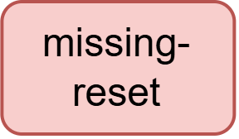
Challenges in Building Missing-Reset Analysis
Notes:
After getting a sense of the missing-reset problem and analysis, we can now talk about the challenges.
What challenges arise in building a missing-reset analysis?

Slide 20
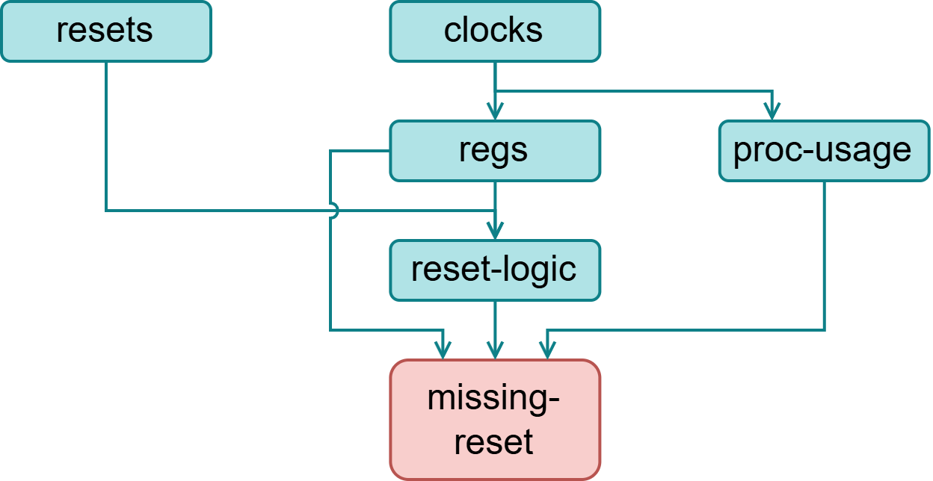
Challenges in Building Missing-Reset Analysis
Need to understand the synthesis process, i.e., how Verilog variables are mapped to physical registers, clocks, and resets
invoking a synthesizer for such information requires > 1h for a design of 1.8M LoC
Qihe provides such analyses finishing in 3 seconds
Notes:
First, we need to understand how Verilog variables map to physical registers, clocks, and resets since the problem is defined on top of these concepts.
Traditionally, this information is not available until after the lengthy hardware synthesis process.
Invoking a synthesizer to obtain it can take over an hour for a one-million-line design.
In contrast, Qihe provides analyses that approximates these post-synthesis information in just three seconds for the same Verilog design.

Slide 21
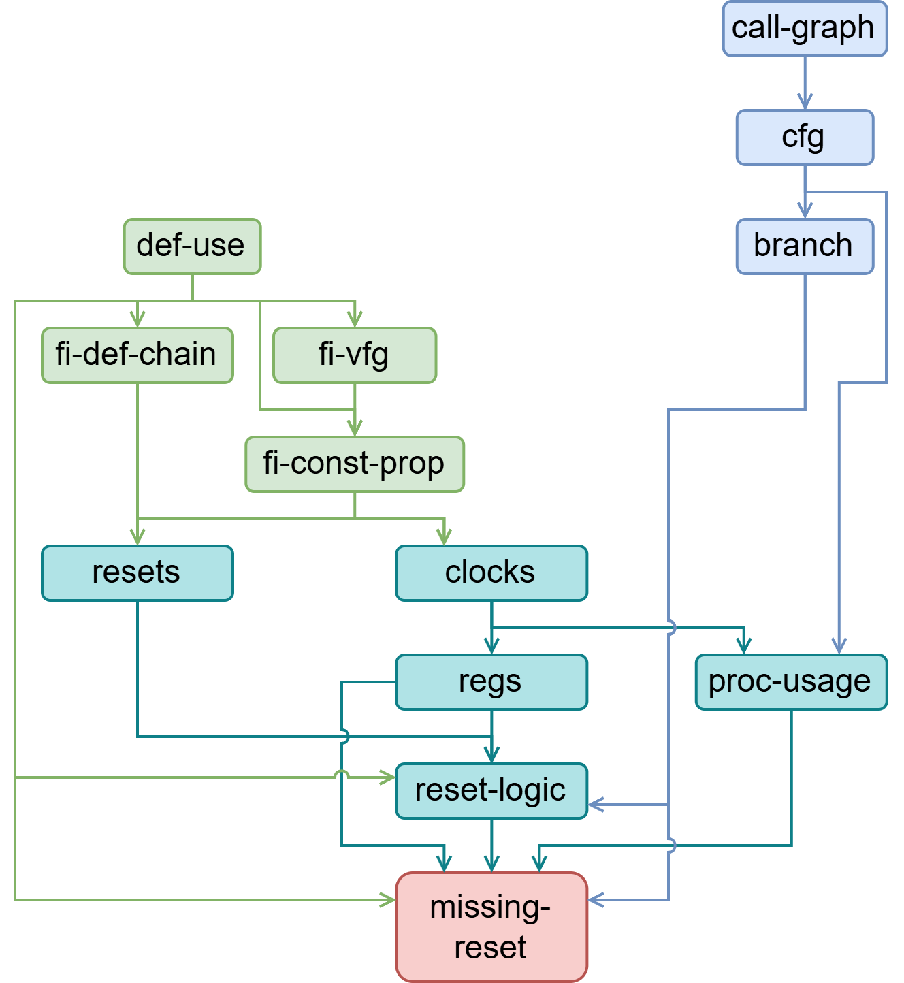
Challenges in Building Missing-Reset Analysis
Need hardware data-flow and control-flow analyses for constructing the graph structures
Notes:
In addition, we need hardware data-flow and control-flow analyses to construct the graph structures we need for the missing-reset analysis.

Slide 22
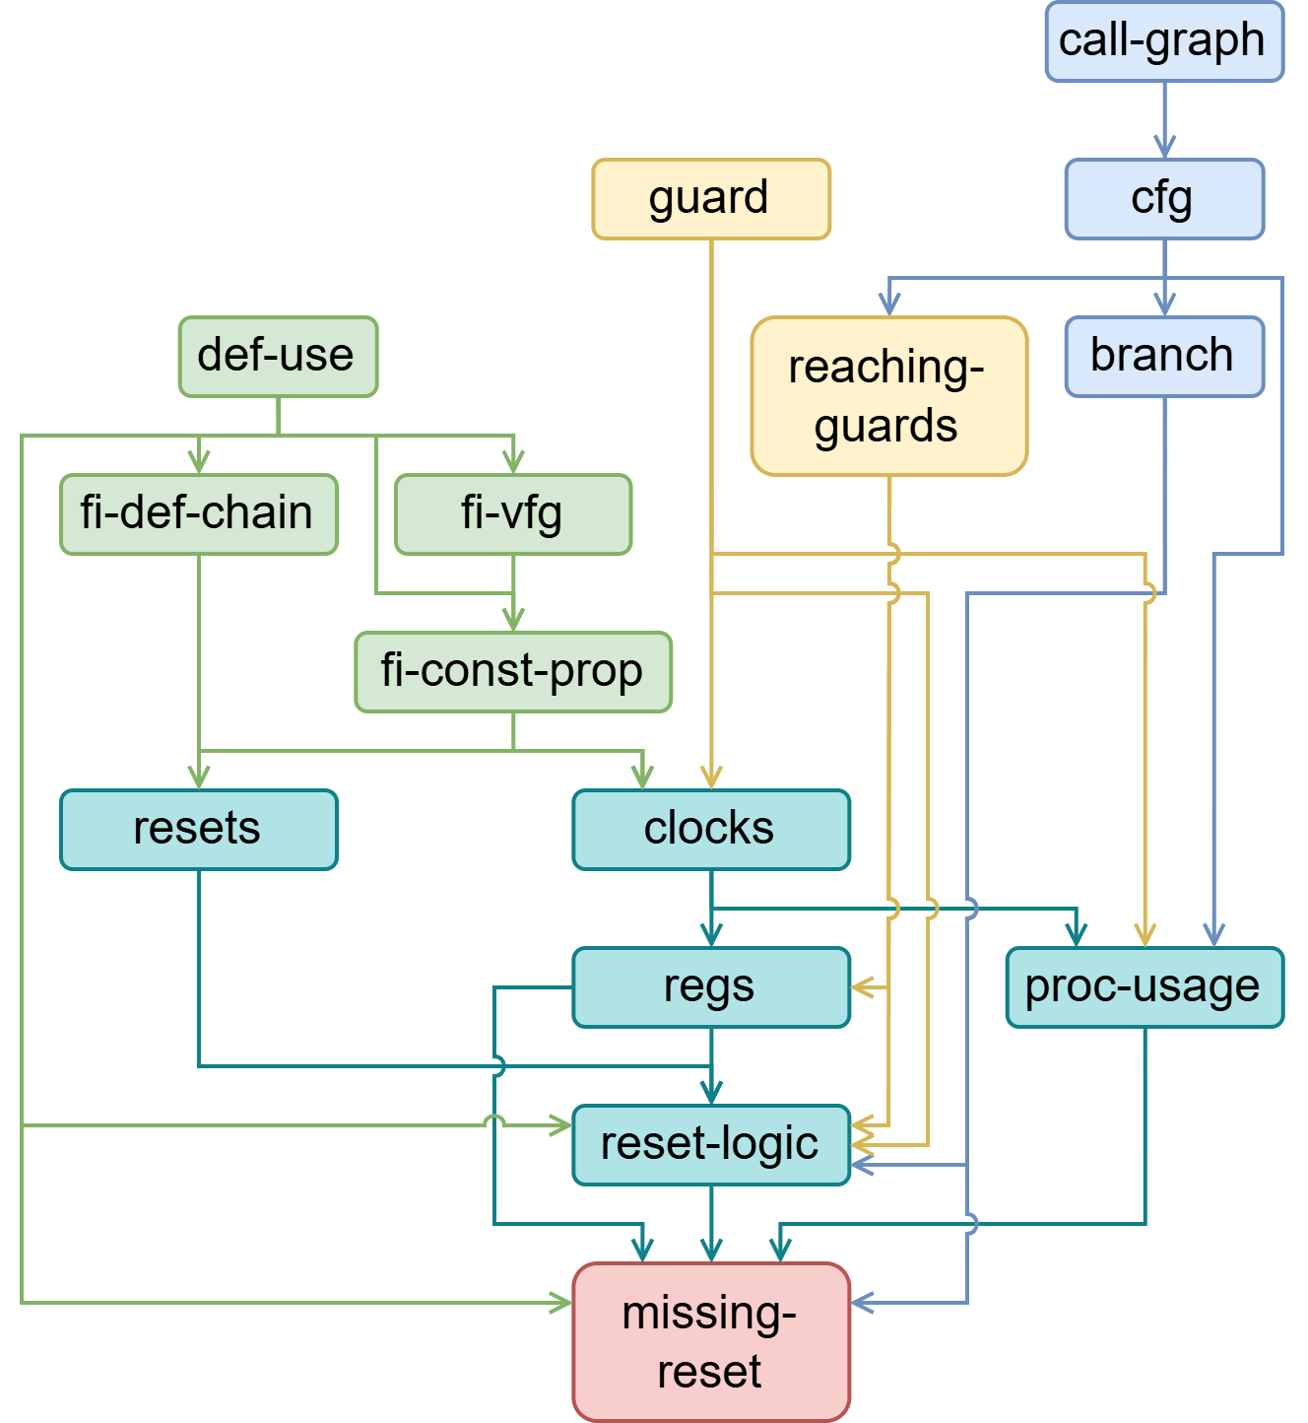
Challenges in Building Missing-Reset Analysis
Need hardware data-flow and control-flow analyses for constructing the graph structures
Need analyses for capturing Verilog’s synchronization characteristics, which are essential for reasoning about behavioral semantics in hardware understanding
Notes:
To understand how variables are mapped to registers and clocks, we also need analyses for capturing Verilog’s synchronization characteristics.

Slide 23
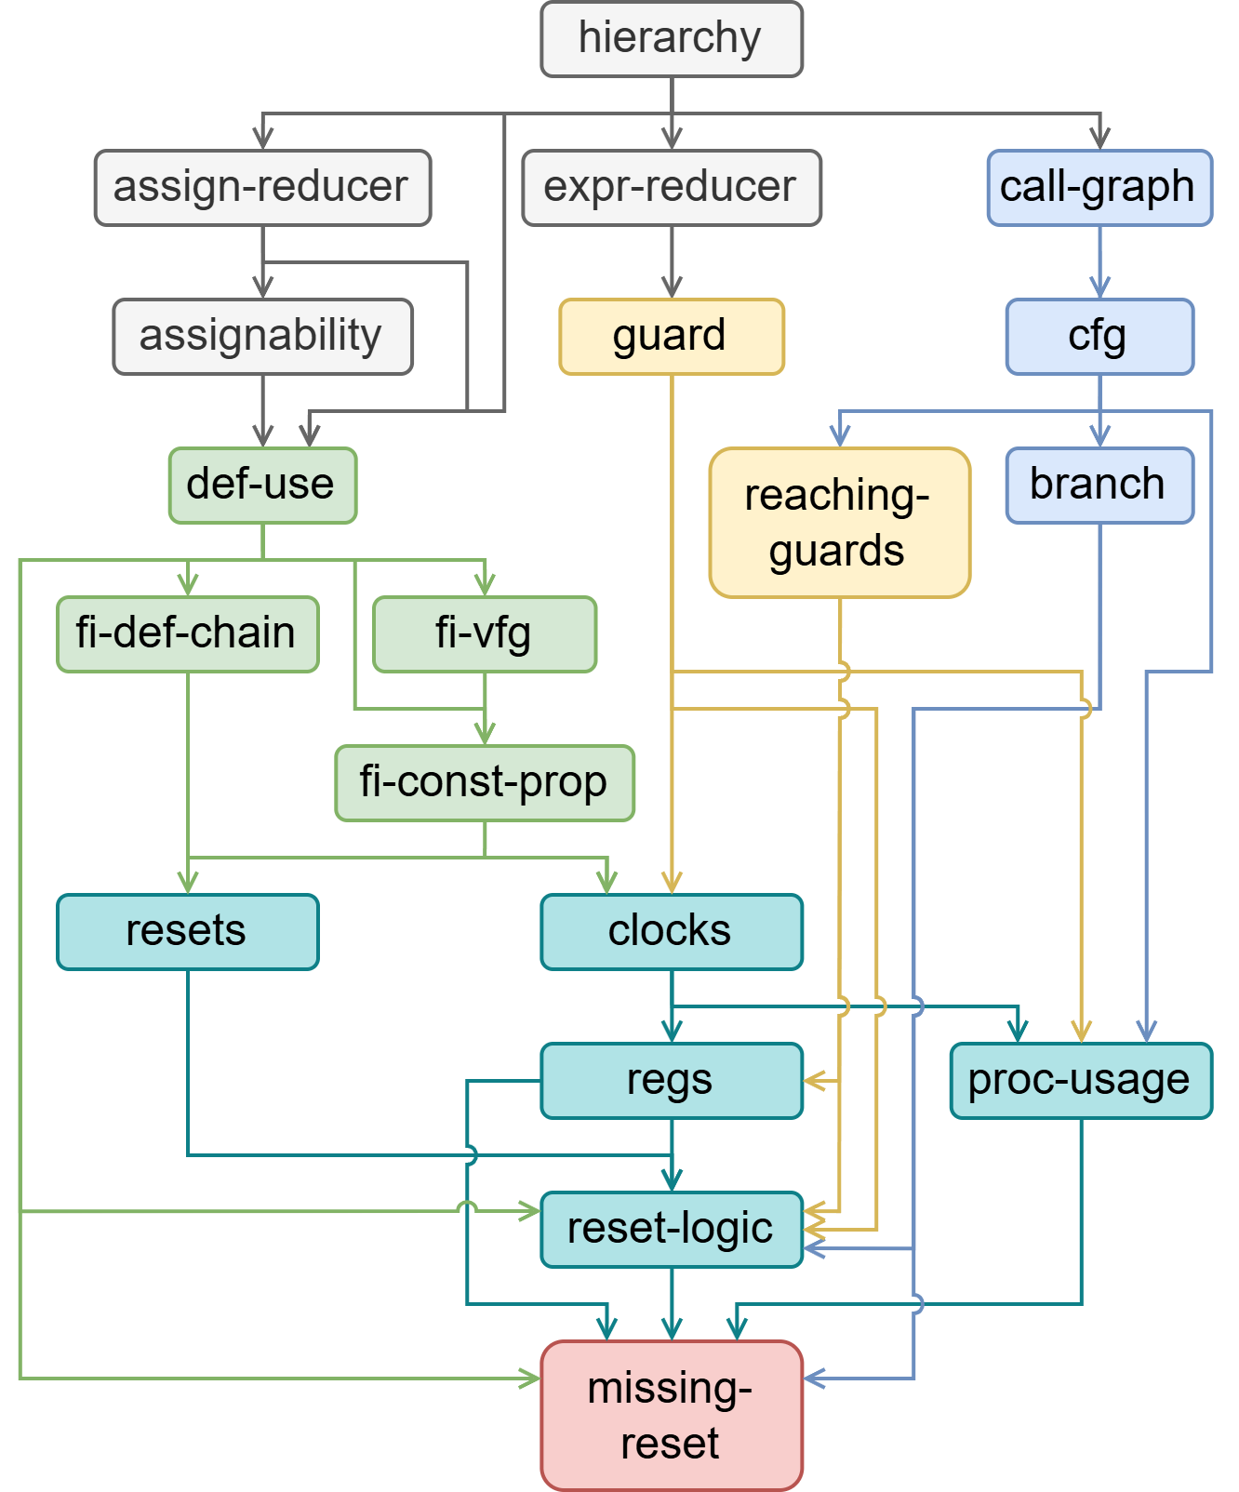
Challenges in Building Missing-Reset Analysis
Need hardware data-flow and control-flow analyses for constructing the graph structures
Need analyses for capturing hardware’s synchronization characteristics, which are essential for reasoning about behavioral semantics in hardware understanding
Need module hierarchy analysis for inter-module reasoning and more ...
Qihe comes with all of these analyses and more, ready to be reused across a wide range of clients.
Notes:
To enable more precise inter-module reasoning, we also need module hierarchy analysis and other supporting analyses.
In summary, building a sophisticated Verilog analysis beyond linting does require a substantial foundation, which is exactly why we develop Qihe.
Qihe provides all of these supporting analyses—and even more to be reused across a wide range of clients.

Slide 24
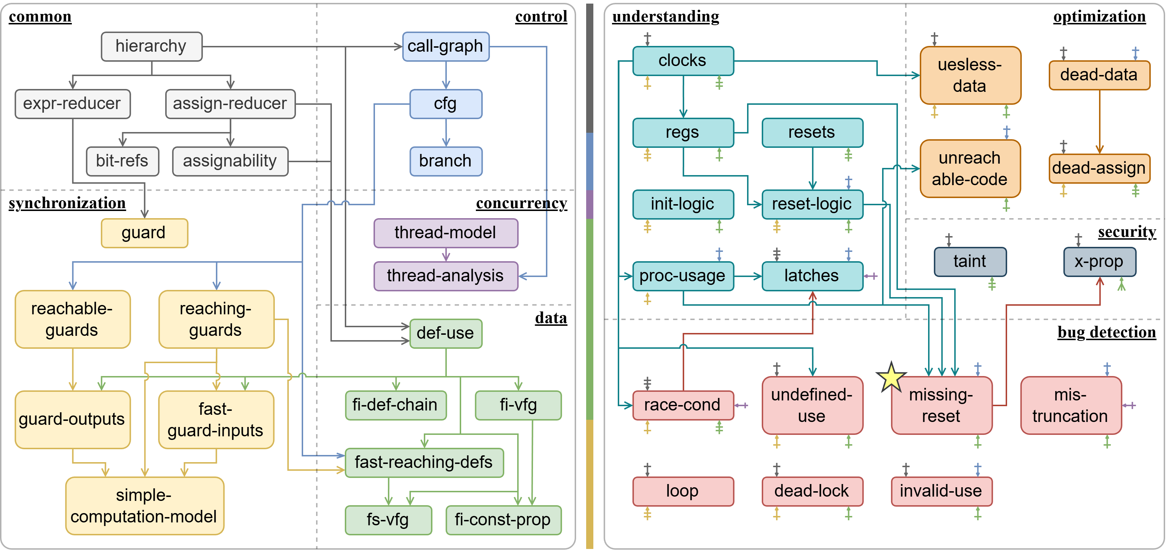
Each fundamental analysis is reused by about 10 application-specific analyses
Qihe’s Analysis Suite
Fundamental Analyses
Application-Specific Analyses
Notes:
This is a whole picture of Qihe’s analysis suite.
Missing-reset is just one small bug detection client.
The nodes on the left are the fundamental analyses, and the nodes on the right are application-specific analyses.
The edges indicate dependency relationships.
We omit the edges between fundamental and application-specific analyses because the diagram would otherwise become cluttered; as mentioned, each fundamental analysis is reused by about ten application-specific analyses.

Slide 25
Preliminary Results
1. Hardware Bug Detection (11 analyses)
  Unlike software, hardware tends to contain fewer but harder-to-detect bugs
  Detected 18 bugs across 8 categories from 11 popular open-source hardware projects
    Projects: avg. 1.5K+ GitHub stars — CPU, AXI Protocol, SHA512 Encryption, ...
    Bugs: Missing-Reset Regs, Unreachable States, Deadlocks, Invalid Use, ...
  9/18 bugs were previously unknown, all confirmed by developers
  Beyond the capabilities of existing Verilog static analyses (i.e., linters)
2. Hardware Security Analysis (2 analyses)
  15 information leaks found in 19 hardware designs from TrustHub
    e.g. encryption keys to leakage points, such as capacitance, antenna, and shift reg
  A Hardware Trojan exploiting Verilog’s X-value
Notes:
Finally, let’s look at some preliminary experimental results of Qihe’s application-specific analyses.
On hardware bug detection:
Unlike software, hardware tends to contain fewer but harder-to-detect bugs.
That’s because hardware designs typically undergo extensive simulation and rigorous verification, as hardware defects are too expensive to fix if escaped into production.
Even so, our analyses detected 18 bugs in 8 categories across hardware projects averaging 1.5 thousand Github stars.
Half of these bugs were previously unknown and all of them have been confirmed by the developers.
Moreover, all of these bugs are beyond the capabilities of exiting Verilog static analysis tools, which are linters.
On hardware security analysis,
our Verilog taint analysis can find 15 information leaks in from the well-known TrustHub benchmark.
Qihe can also detect a class of hardware Trojans that exploit Verilog’s special X-value semantics to hide their malicious behavior.

Slide 26
Preliminary Results
3. Hardware Program Understanding (7 analyses)
  Representative understanding tasks: inferring clock signals, reset signals, and registers
  On 13 real hardware programs (averaging 146K lines)
    97.1% precision and 96.9% recall on average;
    62% (=24/39) cases can achieve both 100% precision and recall
4. Hardware Code Optimization (4 analyses)
  Optimize 7000+ useless signal on the same 13 real programs as above
Notes:
On hardware program understanding, we evaluate Qihe on three representative tasks: inferring clock signals, reset signals, and registers, and achieve 97% precision and recall on average.
On hardware code optimization, we identify a lot of useless signals that can be safely removed.
Overall, these preliminary results demonstrate strong potential of hardware static analysis.

Slide 27
Preliminary Results
3. Hardware Program Understanding (7 analyses)
  Representative understanding tasks: inferring clock signals, reset signals, and registers
  On 13 real hardware programs (averaging 146K lines)
    97.1% precision and 96.9% recall on average;
    62% (=24/39) cases can achieve both 100% precision and recall
Low Development Cost
~300 LoC for each of the client analyses
vs. ~5000 LoC from scratch
Lightweight Runtime Cost
40+ analyses, on a 1.8M LoC code base, 6 minutes
4. Hardware Code Optimization (4 analyses)
  Optimize 7000+ useless signal on the same 13 real programs as above
Notes:
With Qihe’s underlying framework support, the implementation effort of these application-specific analyses is also modest: each client takes just about 300 lines of code on average.
However, without Qihe, building an application-specific analysis would require re-implementing all the prerequisite analyses from scratch.
Our estimate is that this would take roughly 5,000 lines of code.
In addition, our static analyses are lightweight: even on a real-world codebase with over one million lines of code, running all of our more than 40 analyses takes only about six minutes in total.

Slide 28














Preliminary Impact
Since its release 4 months ago, Qihe has received registrations for use from nearly 50 institutions worldwide
Peking University
Tsinghua University
Georgia Institute of Technology
University of California, Los Angeles
Fudan University
Zhejiang University
Johns Hopkins University
The Ohio State University
University of Science and Technology of China
Chinese Academy of Science (all its related institutes)
The University of Hong Kong
Max Planck Institute for Security and Privacy
Taiwan Cheng Kung University
Ivannikov Institute for System Programming of
Russian Academy of Sciences
... ...
Notes:
One more thing I’d like to share is that, since its release four months ago, Qihe has attracted registered users from nearly 50 institutions across the world.

Slide 29

Where to Go?
Homepage (qihe.pascal-lab.net)
Obtain Qihe’s source code (100K+ LoC)
Documentation (qihe-docs.pascal-lab.net)
Learn how to use Qihe
Try developing new analyses in Qihe!
Javadoc (qihe-docs.pascal-lab.net/javadoc/)
Detailed API Reference
qihe.pascal-lab.net
Questions or Discussions?
Feel free to contact us!
qinlinchen@smail.nju.edu.cn
jiacaicui@smail.nju.edu.cn
tiantan@nju.edu.cn
yueli@nju.edu.cn
Thank You!
Q&A
Notes:
We welcome everyone to visit our website to access the full source code of Qihe.
We also provide extensive documentation to help you get started with Qihe and develop new analyses.
In addition, we offer detailed API references.
If you have any questions or would like to discuss ideas, feel free to contact us.
Thank you for your attention.

