Slide 1
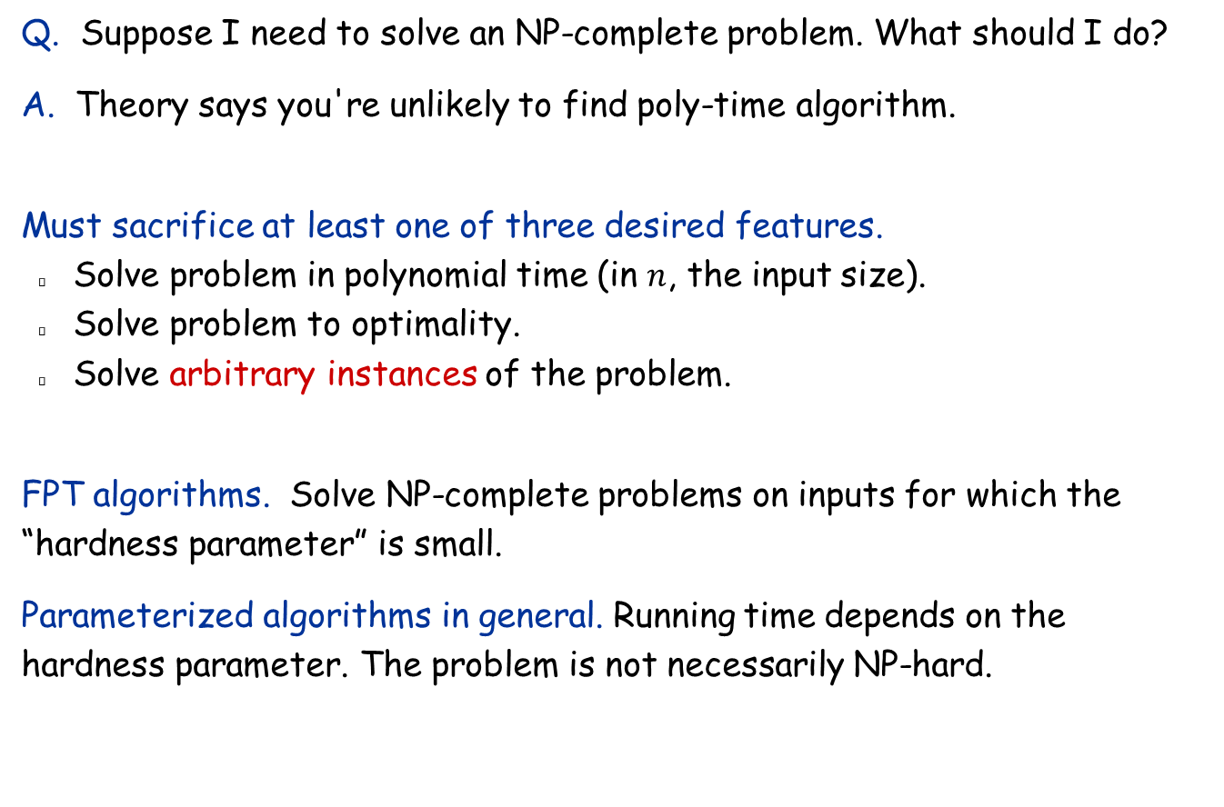
Coping With NP-Completeness
Q. Suppose I need to solve an NP-complete problem. What should I do?
A. Theory says you're unlikely to find poly-time algorithm.
Must sacrifice at least one of three desired features.
Solve problem in polynomial time (in $n$, the input size).
Solve problem to optimality.
Solve arbitrary instances of the problem.
FPT algorithms. Solve NP-complete problems on inputs for which the “hardness parameter” is small.
Parameterized algorithms in general. Running time depends on the hardness parameter. The problem is not necessarily NP-hard.

Slide 2
10.1 Finding Small Vertex Covers

Slide 3

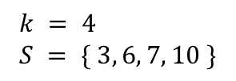
Vertex Cover
Problem definition: Given a graph $G=(V, E)$ and an integer $k$, is there a subset of vertices $S⊆V$ such that $\left|S\right|≤k$, and for each edge $\left(u, v\right)$, either $u∈S$, or $v∈S$, or both.
1
6
2
7
$$k = 4 \\ S = \{ 3, 6, 7, 10 \}$$
3
8
4
9
5
10

Slide 4
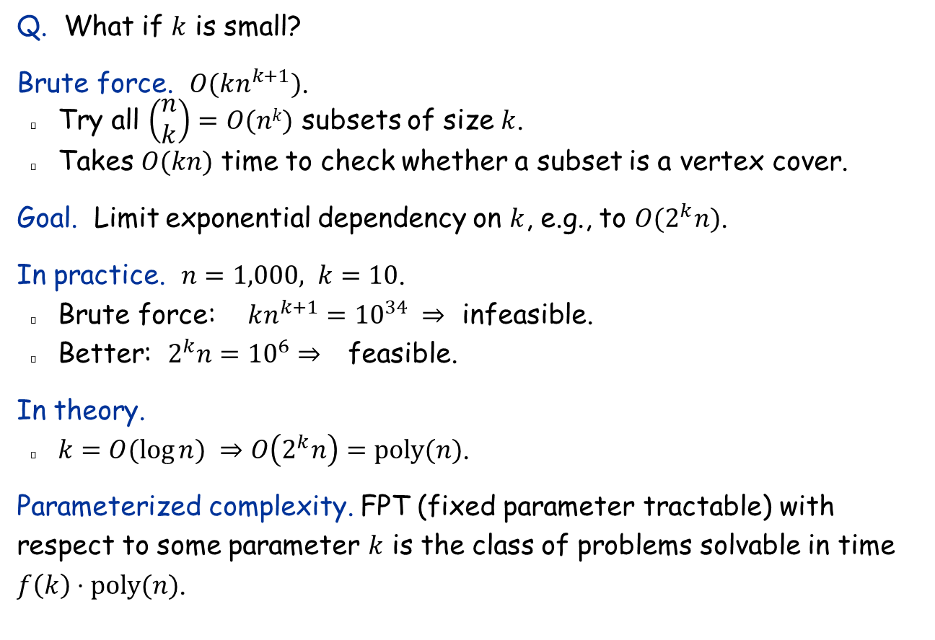
Finding Small Vertex Covers
Q. What if $k$ is small?
Brute force. $O(kn^{k+1})$.
Try all $\left(\begin{matrix}n \\ k\end{matrix}\right)=O(nk)$ subsets of size $k$.
Takes $O(kn)$ time to check whether a subset is a vertex cover.
Goal. Limit exponential dependency on $k$, e.g., to $O(2^{k}n)$.
In practice. $n=1,000, k=10$.
Brute force: $kn^{k+1}={10}^{34} ⇒$ infeasible.
Better: $2^{k}n={10}^{6}⇒$ feasible.
In theory.
$k=O(\log{n}) ⇒$ $O\left(2^{k}n\right)=poly(n)$.
Parameterized complexity. FPT (fixed parameter tractable) with respect to some parameter $k$ is the class of problems solvable in time $f\left(k\right)⋅poly(n)$.

Slide 5
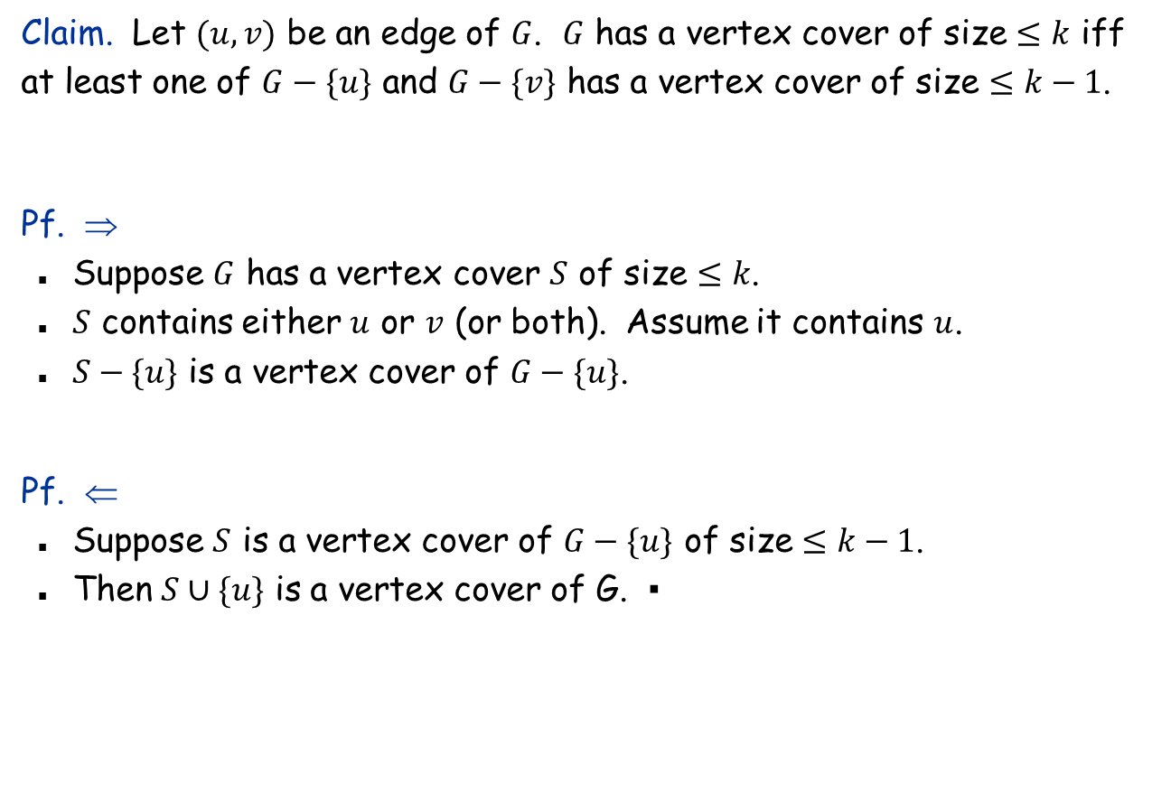
Finding Small Vertex Covers
Claim. Let $(u,v)$ be an edge of $G$. $G$ has a vertex cover of size $≤k$ iff at least one of $G−\{u\}$ and $G−\{v\}$ has a vertex cover of size $≤k−1$.
Pf. ⇒
Suppose $G$ has a vertex cover $S$ of size $≤k$.
$S$ contains either $u$ or $v$ (or both). Assume it contains $u$.
$S−\{u\}$ is a vertex cover of $G−\{u\}$.
Pf. ⇐
Suppose $S$ is a vertex cover of $G−\{u\}$ of size $≤k−1$.
Then $S∪\{u\}$ is a vertex cover of G. ▪
delete v and all incident edges

Slide 6
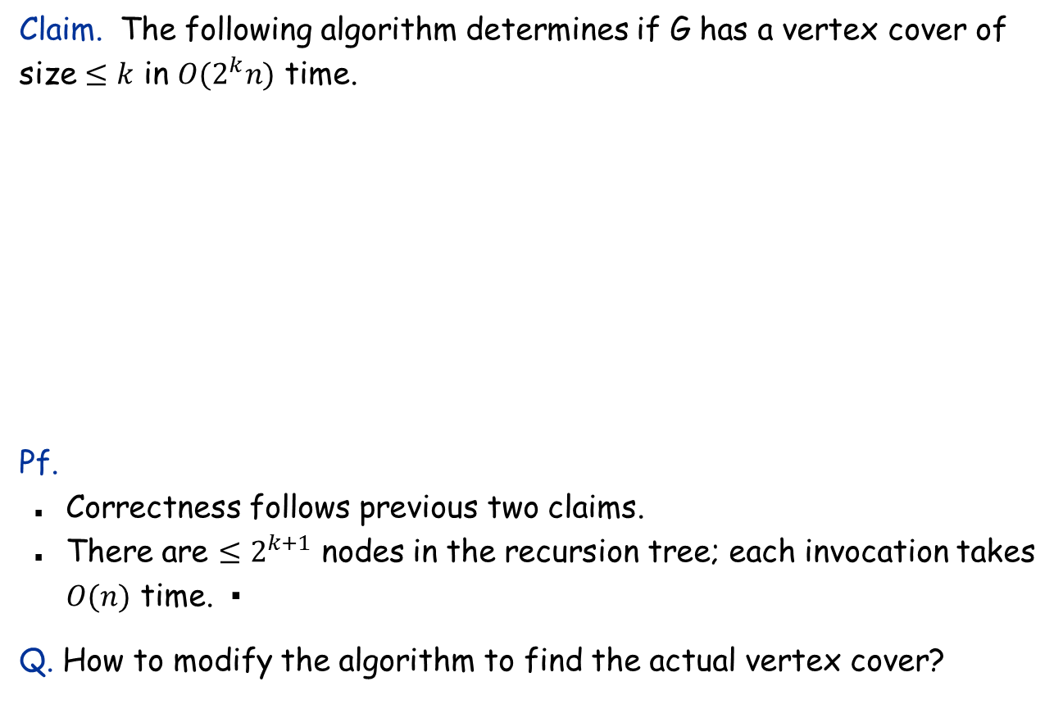

Finding Small Vertex Covers: Algorithm
Claim. The following algorithm determines if G has a vertex cover of size $≤k$ in $O(2^{k}n)$ time.
Pf.
Correctness follows previous two claims.
There are $≤2^{k+1}$ nodes in the recursion tree; each invocation takes $O(n)$ time. ▪
Q. How to modify the algorithm to find the actual vertex cover?
Vertex-Cover($G, k$):
if $G$ contains no edges return true
if $k=0$ return false
let $(u, v)$ be any edge of $G$
$a←$Vertex-Cover($G−\{u\}, k−1$)
$b←$Vertex-Cover($G−\{v\}, k−1$)
return $a$ or $b$

Slide 7







Finding Small Vertex Covers: Recursion Tree
$$T\left(n,k\right)≤\left\{\begin{matrix}1, & if k=0, \\ 2T\left(n,k−1\right)+cn, & if k>0.\end{matrix}\right. ⇒ T\left(n,k\right)≤2^{k+1}cn$$
$$k$$
$$k−1$$
$$k−1$$
$$k−2$$
$$k−2$$
$$k−2$$
$$k−2$$
$$k−i$$
0
0
0
0
0
0
0
0

Slide 8
10.3 Circular Arc Coloring

Slide 9


Wavelength-Division Multiplexing
Background. More than one communication links can share the same portion of a fiber optic cable, provided they are transmitted using different wavelengths.
Problem definition. Given a graph $G=(V,E)$, and $m$ paths $p_{1},p_{2},…, p_{m}$, assign each path a color so that any two paths that share an edge must have different colors. The goal is to use as few colors as possible.
Ring topology. Consider the special case is when graph is a cycle on $n$ nodes.
Bad news. NP-complete, even on rings.
Brute force. Can determine if $k$ colors suffice in $O\left(k^{m}\right)⋅poly\left(m, n\right)$ time by trying all k-colorings.
Goal. $f\left(k\right)⋅poly(m, n)$ time.
c
b
1
a
4
2
e
f
d
3
$$n=4, m=6$$

Slide 10
Review: Interval Coloring
Interval coloring. Greedy algorithm finds coloring such that number of colors equals depth of schedule.
Circular arc coloring.
Number of colors ≥ depth.
But the two may not be equal.
maximum number of intervals at one location
c
d
f
j
b
g
i
a
e
h
max depth = 2 min colors = 3

Slide 11
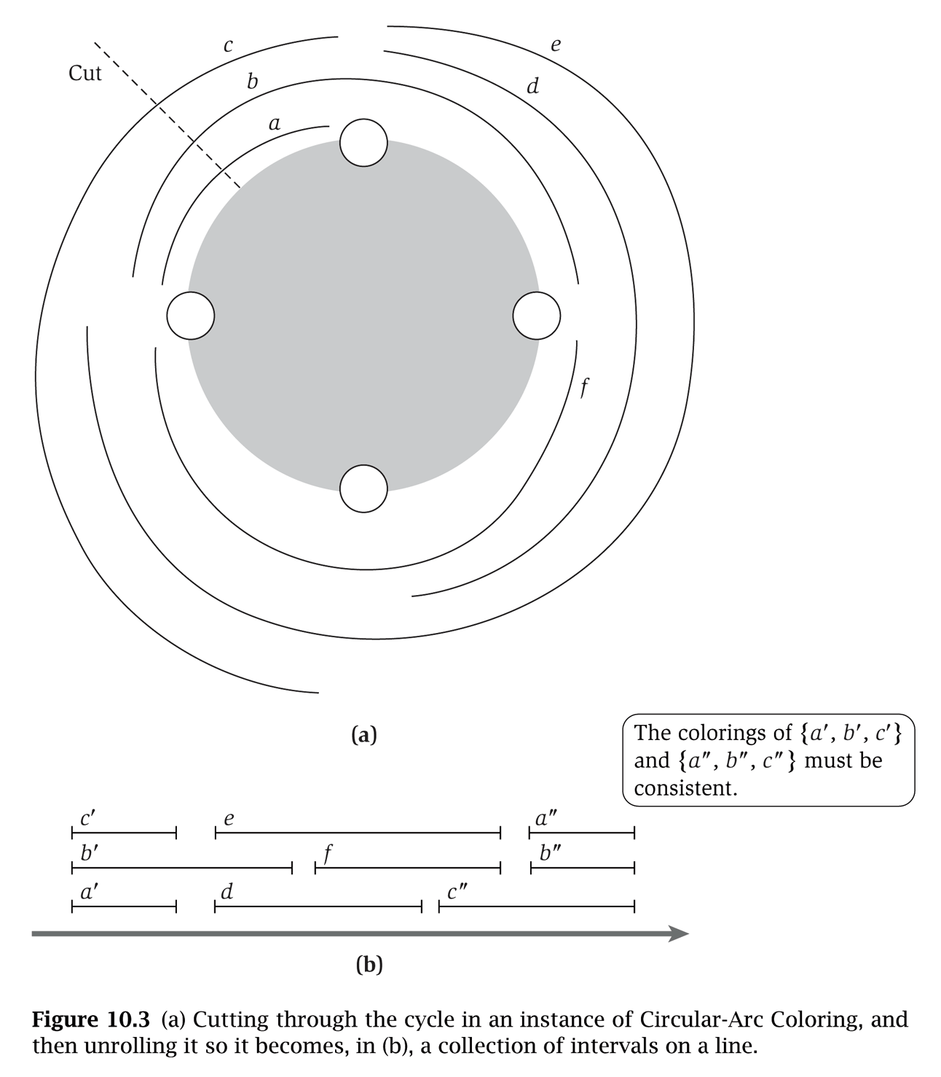

(Almost) Transforming Circular Arc Coloring to Interval Coloring
Circular arc coloring. Given a set of $m$ arcs with depth $d≤k$, can the arcs be colored with $k$ colors?
Equivalent problem. Cut the ring between nodes $v_{1}$ and $v_{n}$. The arcs can be colored with $k$ colors iff the intervals can be colored with $k$ colors in such a way that those “sliced” arcs have the same color.
colors of a', b', and c' must correspond to colors of a", b", and c"
v₁
v₀
v₄
v₂
v₀
v₁
v₂
v₃
v₄
v₀
v₃

Slide 12
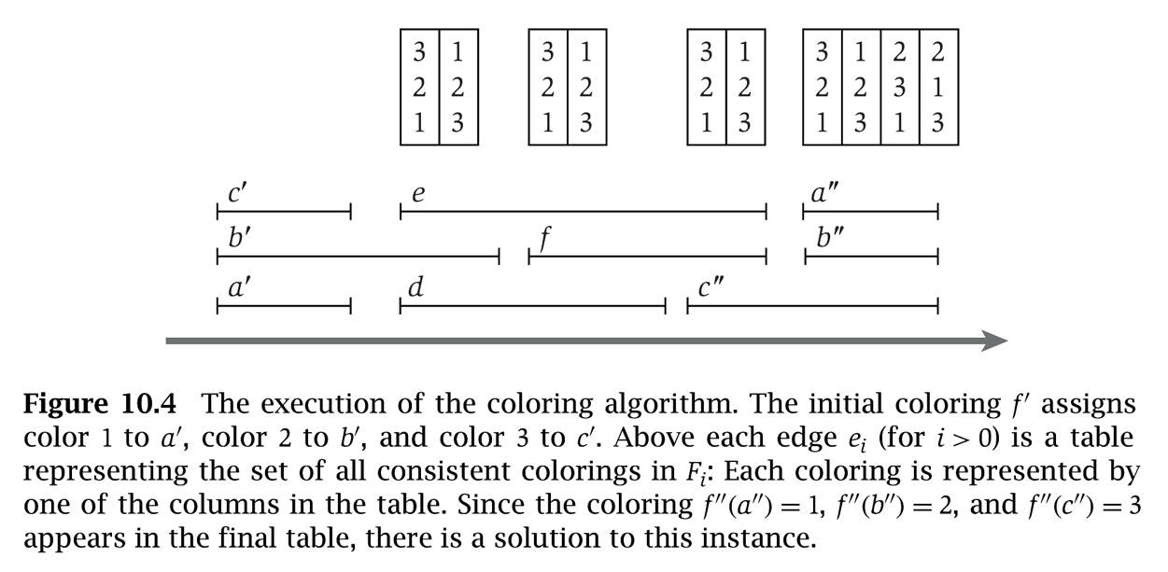

Circular Arc Coloring: Dynamic Programming Algorithm
Dynamic programming algorithm.
Assign distinct color to each interval which begins at cut node v₀.
At each node $v_{i}$, some intervals may finish, and others may begin.
Enumerate all $k$-colorings of the intervals through $v_{i}$ that are consistent with the colorings of the intervals through $v_{i−1}$.
The arcs are $k$-colorable iff some coloring of intervals ending at cut node $v0$ is consistent with original coloring of the same intervals.
yes
c'
3
e
3
1
e
3
1
e
3
1
a"
3
2
1
2
b'
2
b'
2
2
f
2
2
f
2
2
b"
2
3
2
1
a'
1
d
1
3
d
1
3
c"
1
3
c"
1
1
3
3
v₀
v₁
v₂
v₃
v₄
v₀

Slide 13
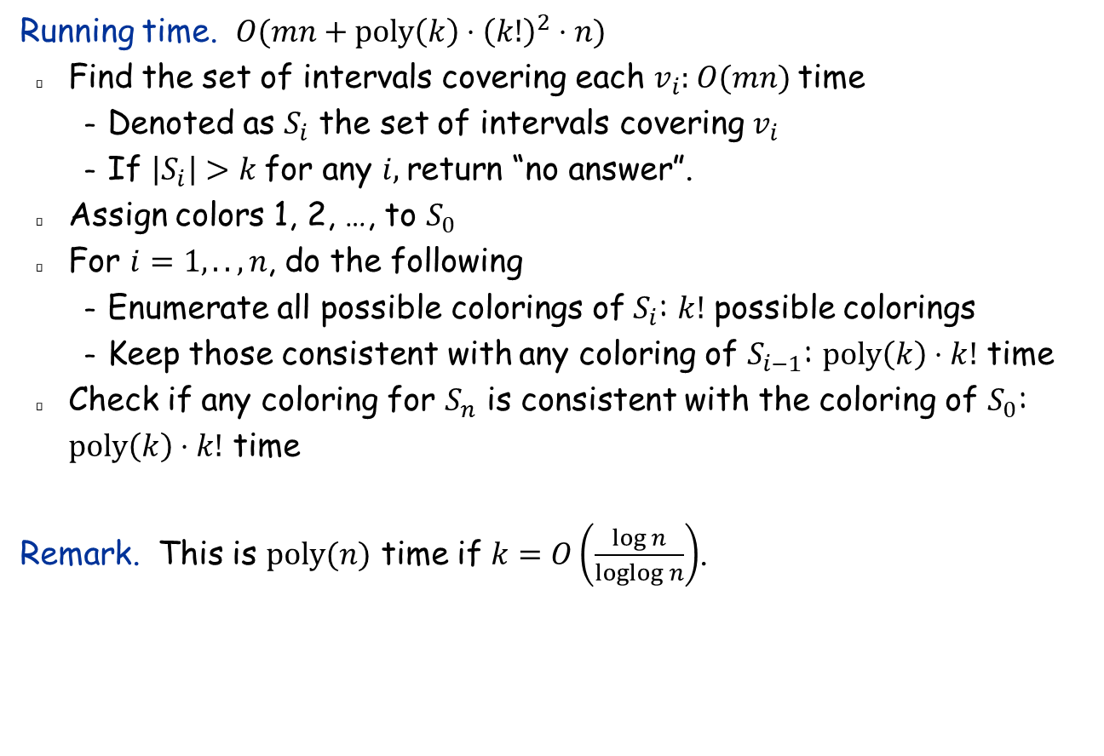
Circular Arc Coloring: Running Time
Running time. $O(mn+poly\left(k\right)⋅{\left(k!\right)}^{2}⋅n)$
Find the set of intervals covering each $v_{i}$: $O(mn)$ time
Denoted as $S_{i}$ the set of intervals covering $v_{i}$
If $\left|S_{i}\right|>k$ for any $i$, return “no answer”.
Assign colors 1, 2, …, to $S_{0}$
For $i=1,..,n$, do the following
Enumerate all possible colorings of $S_{i}$: $k!$ possible colorings
Keep those consistent with any coloring of $S_{i−1}$: $poly\left(k\right)⋅k!$ time
Check if any coloring for $S_{n}$ is consistent with the coloring of $S_{0}$: $poly\left(k\right)⋅k!$ time
Remark. This is $poly(n)$ time if $k=O\left(\frac{\log{n}}{loglog n}\right)$.

Slide 14
10.2 Solving NP-Hard Problems on Trees

Slide 15
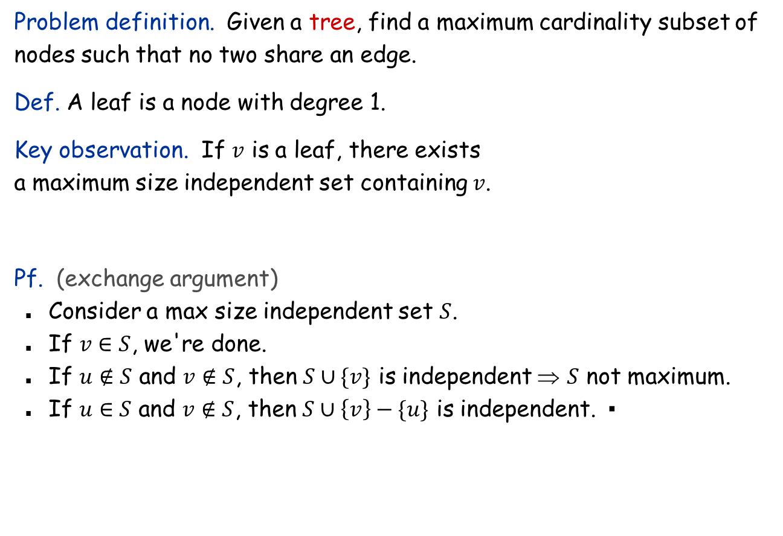


Independent Set on Trees
Problem definition. Given a tree, find a maximum cardinality subset of nodes such that no two share an edge.
Def. A leaf is a node with degree 1.
Key observation. If $v$ is a leaf, there exists a maximum size independent set containing $v$.
Pf. (exchange argument)
Consider a max size independent set $S$.
If $v∈S$, we're done.
If $u∉S$ and $v∉S$, then $S∪\{v\}$ is independent ⇒ $S$ not maximum.
If $u∈S$ and $v∉S$, then $S∪\left\{v\right\}−\{u\}$ is independent. ▪
$$u$$
$$v$$
Notes:
Is independent set in FPT?

Slide 16

Independent Set on Trees: Greedy Algorithm
Theorem. The following greedy algorithm finds a maximum cardinality independent set in forests (and hence trees).
Pf. Correctness follows from the previous key observation. ▪
Remark. Can implement in O(n) time by considering nodes in postorder.
Independent-Set-In-A-Forest($F$):
$S←∅$
while $F$ has at least one edge do
Let $e=(u, v)$ be an edge such that $v$ is a leaf
Add $v$ to $S$
Delete nodes $u$ and $v$ from $F$, and all edges
incident to them.
Add all remaining vertices to $S$
return $S$

Slide 17
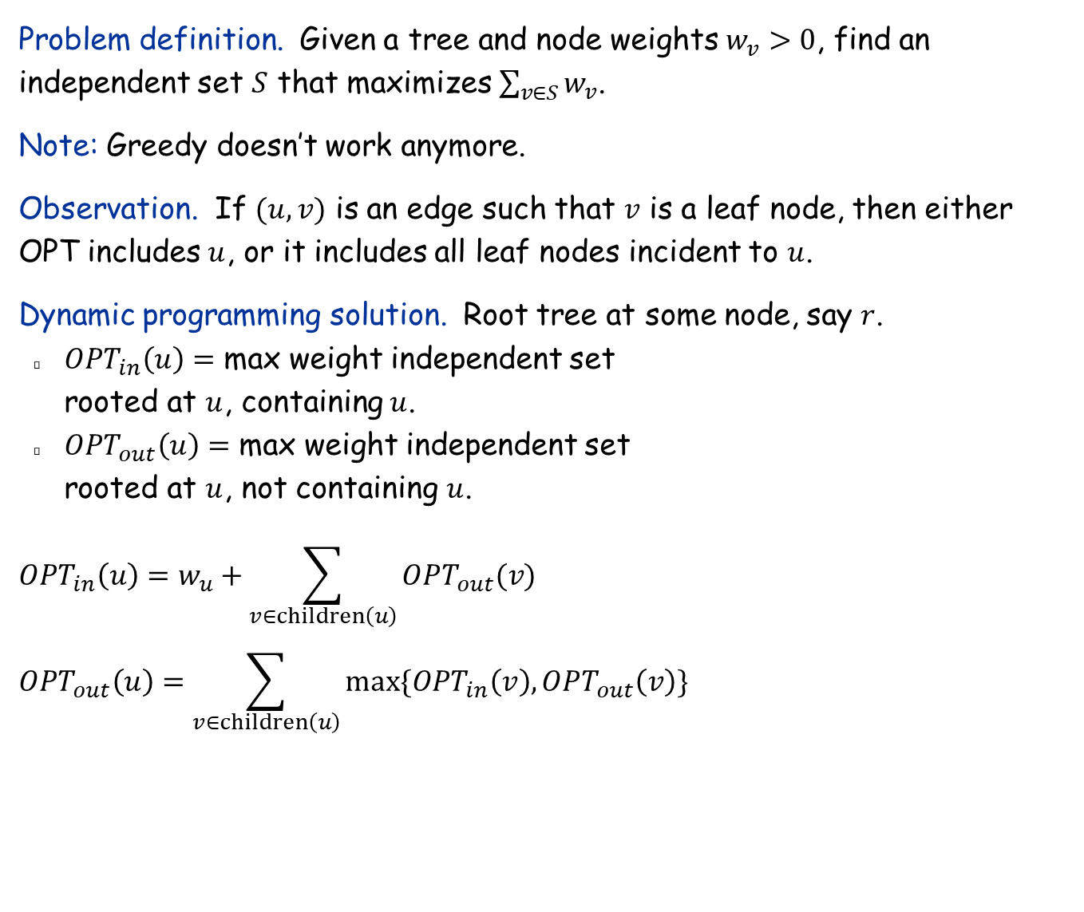
Weighted Independent Set on Trees
Problem definition. Given a tree and node weights $w_{v}>0$, find an independent set $S$ that maximizes $\sum_{v∈S}{w_{v}}$.
Note: Greedy doesn’t work anymore.
Observation. If $(u, v)$ is an edge such that $v$ is a leaf node, then either OPT includes $u$, or it includes all leaf nodes incident to $u$.
Dynamic programming solution. Root tree at some node, say $r$.
$OPT_{in}\left(u\right)=$ max weight independent set rooted at $u$, containing $u$.
$OPT_{out}\left(u\right)=$ max weight independent set rooted at $u$, not containing $u$.
$$OPT_{in}\left(u\right)=w_{u}+\sum_{v∈children\left(u\right)}{OPT_{out}(v)}$$
$$OPT_{out}\left(u\right)=\sum_{v∈children\left(u\right)}{max⁡\{OPT_{in}\left(v\right),OPT_{out}\left(v\right)\}}$$
r
u
v
w
x
children(u) = { v, w, x }

Slide 18

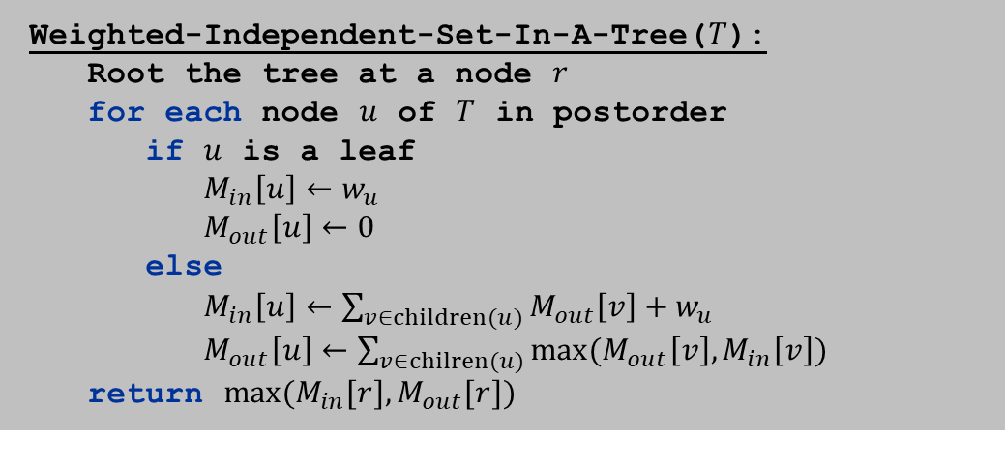
Independent Set on Trees: Dynamic Programming
Theorem. The dynamic programming algorithm find a maximum weighted independent set in trees in $O(n)$ time.
Weighted-Independent-Set-In-A-Tree($T$):
Root the tree at a node $r$
for each node $u$ of $T$ in postorder
if $u$ is a leaf
$M_{in}\left[u\right]←w_{u}$
$M_{out}\left[u\right]←0$
else
$M_{in}\left[u\right]←\sum_{v∈children(u)}{M_{out}\left[v\right]+w_{u}}$
$M_{out}\left[u\right]←\sum_{v∈chilren(u)}{max⁡(M_{out}\left[v\right],M_{in}\left[v\right])}$
return $max⁡(M_{in}[r], M_{out}[r])$
ensures a node is visited after all its children

Slide 19
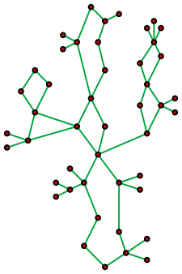
10.4 Tree Decompositions and Treewidth

Slide 20
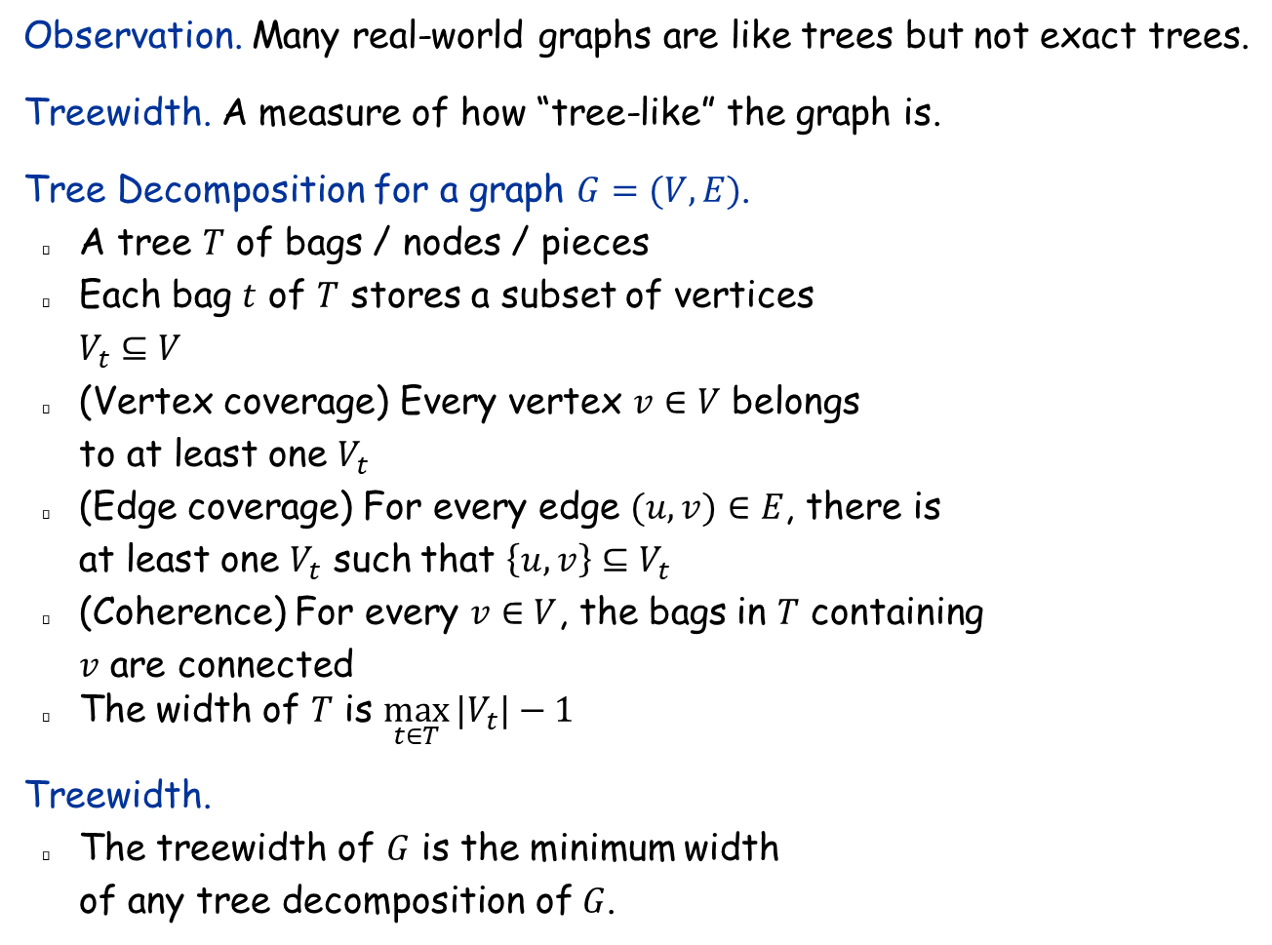
Tree Decompositions and Treewidth
Observation. Many real-world graphs are like trees but not exact trees.
Treewidth. A measure of how “tree-like” the graph is.
Tree Decomposition for a graph $G=(V, E)$.
A tree $T$ of bags / nodes / pieces
Each bag $t$ of $T$ stores a subset of vertices $V_{t}⊆V$
(Vertex coverage) Every vertex $v∈V$ belongs to at least one $V_{t}$
(Edge coverage) For every edge $(u,v)∈E$, there is at least one $V_{t}$ such that $\left\{u,v\right\}⊆V_{t}$
(Coherence) For every $v∈V$, the bags in $T$ containing $v$ are connected
The width of $T$ is $\max_{t∈T}{|V_{t}|}−1$
Treewidth.
The treewidth of $G$ is the minimum width of any tree decomposition of $G$.
Notes:
Is independent set in FPT?

Slide 21
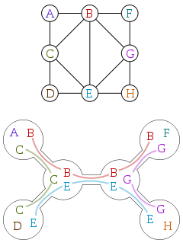
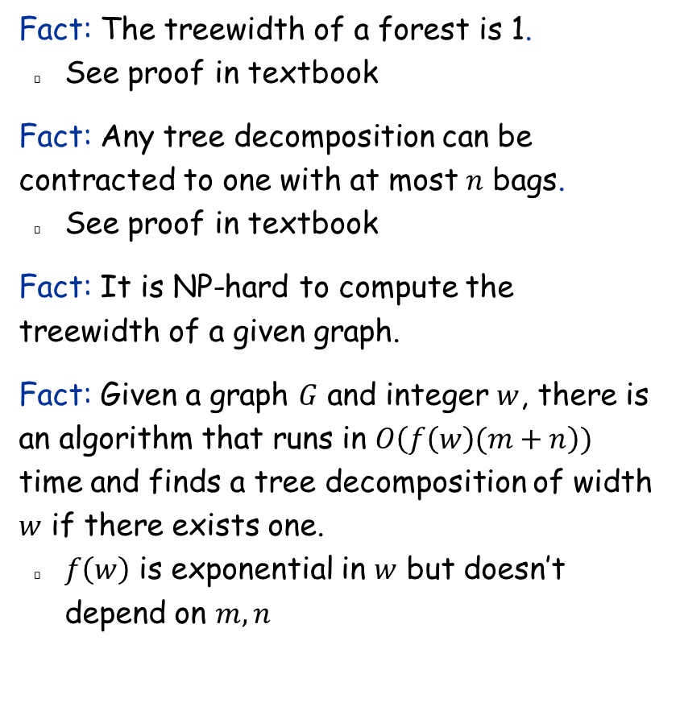
Tree Decompositions and Treewidth
Fact: The treewidth of a forest is 1.
See proof in textbook
Fact: Any tree decomposition can be contracted to one with at most $n$ bags.
See proof in textbook
Fact: It is NP-hard to compute the treewidth of a given graph.
Fact: Given a graph $G$ and integer $w$, there is an algorithm that runs in $O\left(f\left(w\right)(m+n\right))$ time and finds a tree decomposition of width $w$ if there exists one.
$f\left(w\right)$ is exponential in $w$ but doesn’t depend on $m,n$

Slide 22
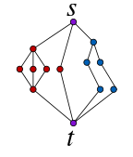
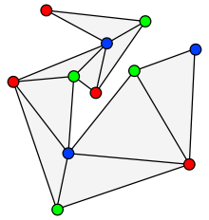
Graphs with bounded treewidth
Cactus graph
Series-parallel graph
Outerplanar graph

Slide 23
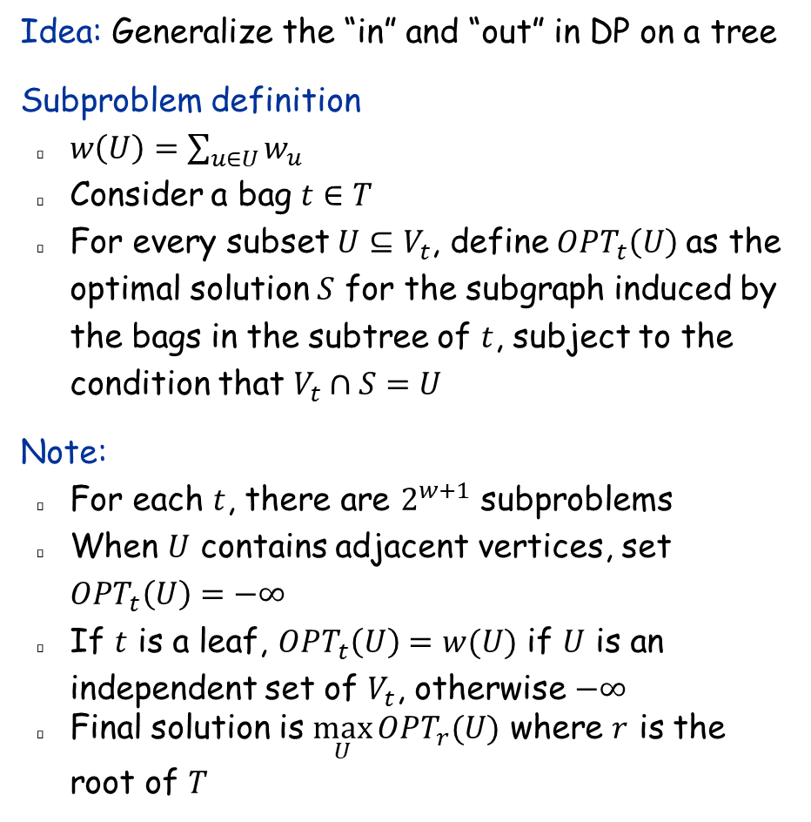
Weighted Independent Set on Tree Decompositions
Idea: Generalize the “in” and “out” in DP on a tree
Subproblem definition
$w\left(U\right)=\sum_{u∈U}{w_{u}}$
Consider a bag $t∈T$
For every subset $U⊆V_{t}$, define$OPT_{t}\left(U\right)$ as the optimal solution $S$ for the subgraph induced by the bags in the subtree of $t$, subject to the condition that $V_{t}∩S=U$
Note:
For each $t$, there are $2^{w+1}$ subproblems
When $U$ contains adjacent vertices, set $OPT_{t}\left(U\right)=−∞$
If $t$ is a leaf, $OPT_{t}\left(U\right)=w(U)$ if $U$ is an independent set of $V_{t}$, otherwise $−∞$
Final solution is $\max_{U}{OPT_{r}(U)}$ where $r$ is the root of $T$

Slide 24
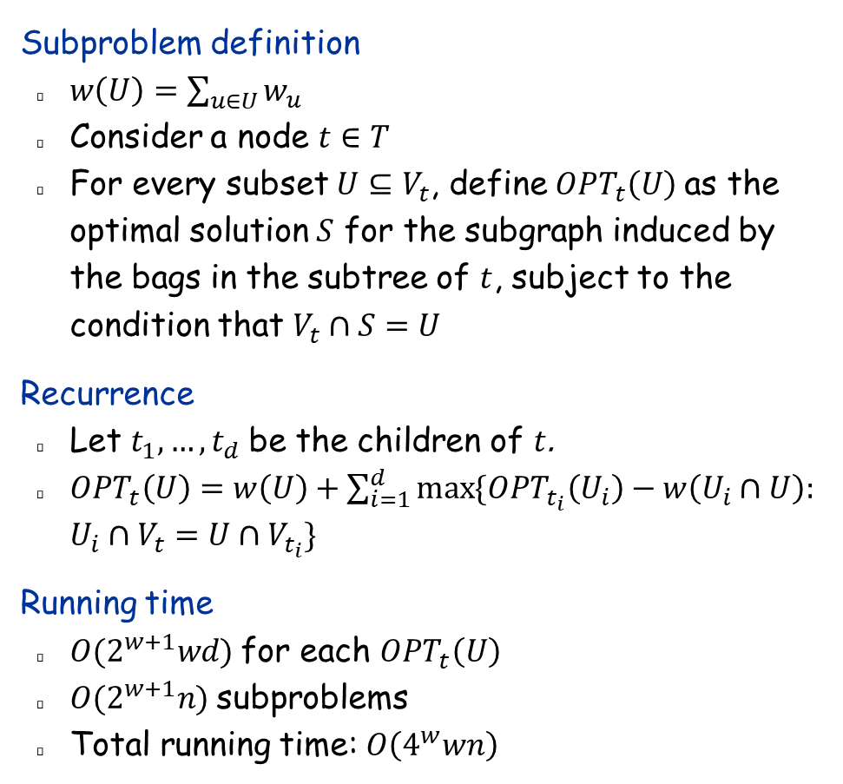
The Dynamic Programming Algorithm
Subproblem definition
$w\left(U\right)=\sum_{u∈U}{w_{u}}$
Consider a node $t∈T$
For every subset $U⊆V_{t}$, define$OPT_{t}\left(U\right)$ as the optimal solution $S$ for the subgraph induced by the bags in the subtree of $t$, subject to the condition that $V_{t}∩S=U$
Recurrence
Let $t_{1},…, t_{d}$ be the children of $t$.
$OPT_{t}\left(U\right)=w\left(U\right)+\sum_{i=1}^{d}{\max{\{OPT_{t_{i}}\left(U_{i}\right)−w\left(U_{i}∩U\right):}}$ $U_{i}∩V_{t}=U∩V_{t_{i}}\}$
Running time
$O(2^{w+1}wd)$ for each $OPT_{t}\left(U\right)$
$O(2^{w+1}n)$ subproblems
Total running time: $O\left(4^{w}wn\right)$

Slide 25
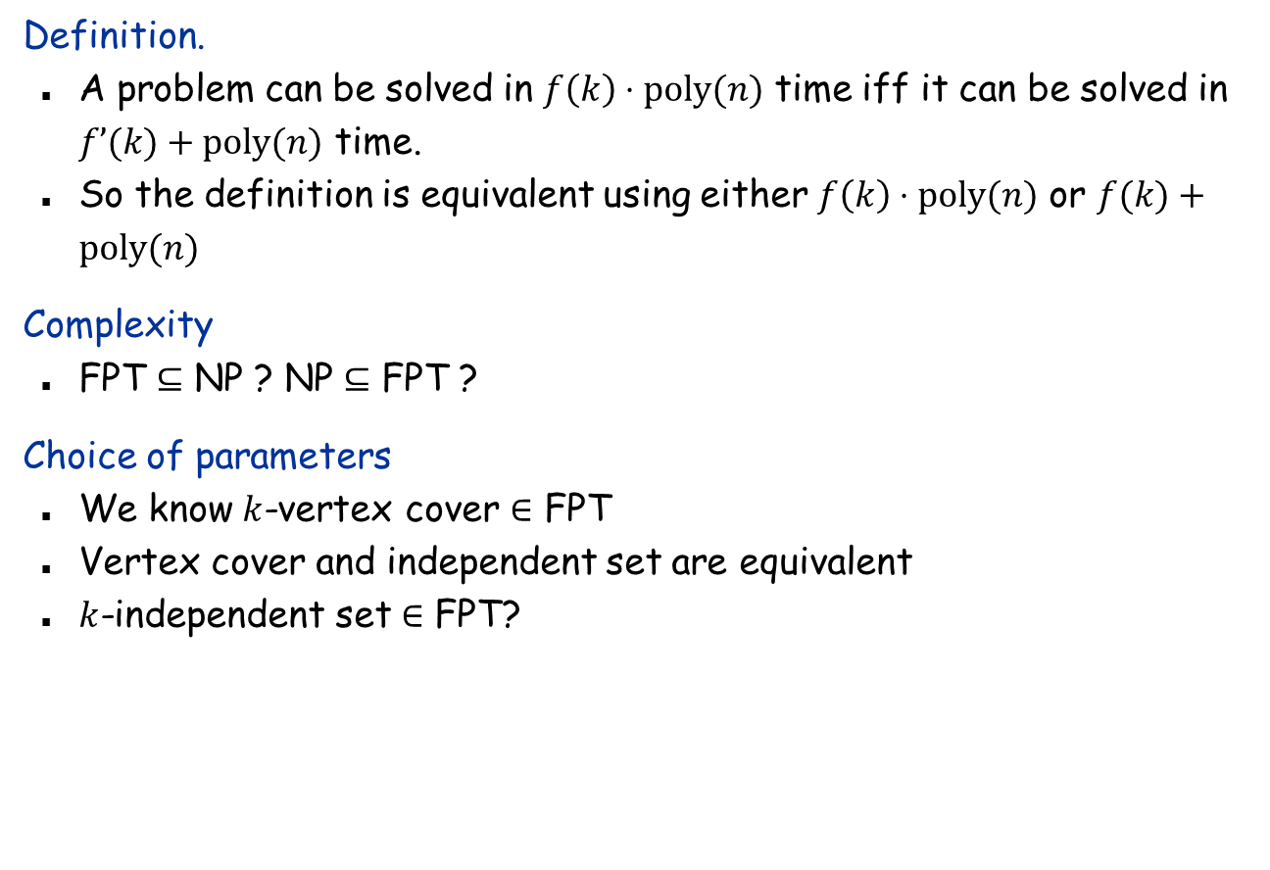
A Few Issues about FPT
Definition.
A problem can be solved in $f\left(k\right)⋅poly(n)$ time iff it can be solved in $f’(k)+poly(n)$ time.
So the definition is equivalent using either $f\left(k\right)⋅poly(n)$ or $f(k)+poly(n)$
Complexity
FPT $⊆$ NP ? NP $⊆$ FPT ?
Choice of parameters
We know $k$-vertex cover $∈$ FPT
Vertex cover and independent set are equivalent
$k$-independent set $∈$ FPT?

