Slide 1
Approximation Algorithms
Q. Suppose I need to solve an NP-hard problem. What should I do?
A. Theory says you're unlikely to find a poly-time algorithm.
Must sacrifice one of three desired features.
Solve problem to optimality.
Solve problem in poly-time.
Solve arbitrary instances of the problem.
Approximation algorithms.
Guaranteed to run in poly-time.
Guaranteed to solve arbitrary instance of the problem
Guaranteed to find solution within a certain ratio of true optimum.
Challenge. Need to prove a solution's value is close to optimum, without even knowing what optimum value is!

Slide 2
11.1 Load Balancing

Slide 3
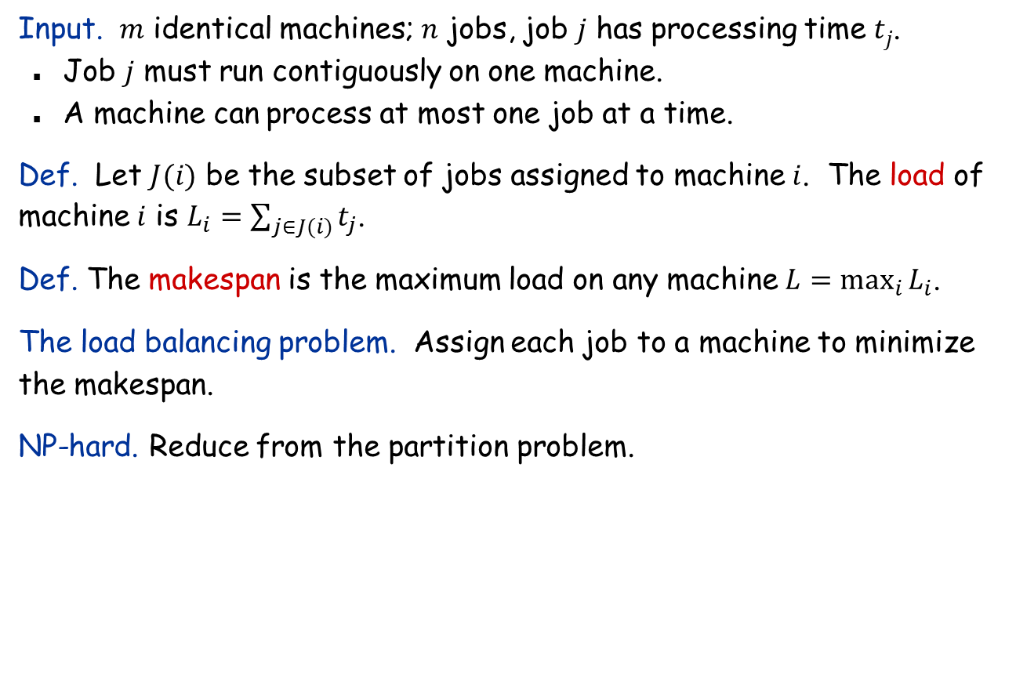
Load Balancing
Input. $m$ identical machines; $n$ jobs, job $j$ has processing time $tj$.
Job $j$ must run contiguously on one machine.
A machine can process at most one job at a time.
Def. Let $J(i)$ be the subset of jobs assigned to machine $i$. The load of machine $i$ is $L_{i}=\sum_{j∈J(i)}{t_{j}}$.
Def. The makespan is the maximum load on any machine $L=\max_{i}{L_{i}}$.
The load balancing problem. Assign each job to a machine to minimize the makespan.
NP-hard. Reduce from the partition problem.

Slide 4


Load Balancing: Greedy
A natural greedy algorithm.
Consider $n$ jobs in some arbitrary order.
Assign job $j$ to machine whose load is smallest so far.
Implementation. $O(n log⁡n)$ time using a priority queue.
Greedy($m, n, t1,t2,…,tn$):
for $i←1$ to $m$
$L_{i}←0$
$J\left(i\right)←∅$
for $j←1$ to $n$
$i←\arg{\min_{k}{L_{k}}}$
$J\left(i\right)←J\left(i\right)∪\{j\}$
$L_{i}←L_{i}+t_{j}$
Notes:
Remark. This is an "on-line" algorithm.

Slide 5
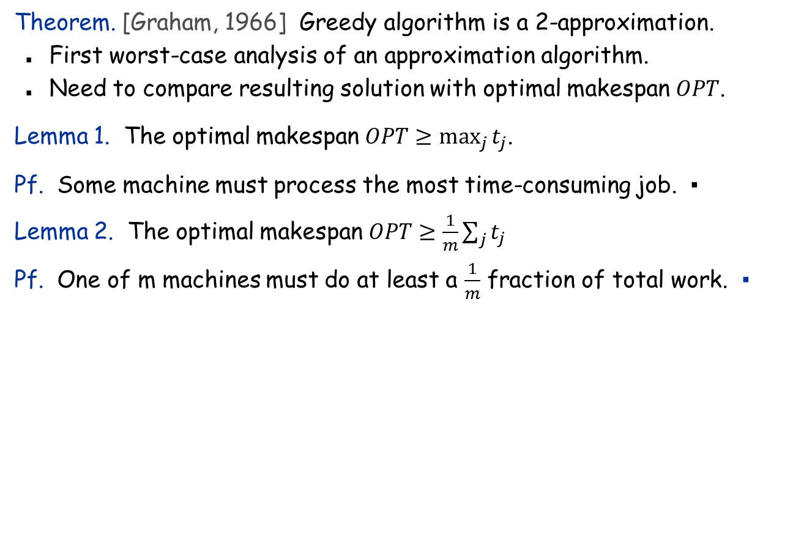
Load Balancing: Greedy Analysis
Theorem. [Graham, 1966] Greedy algorithm is a 2-approximation.
First worst-case analysis of an approximation algorithm.
Need to compare resulting solution with optimal makespan $OPT$.
Lemma 1. The optimal makespan $OPT≥\max_{j}{t_{j}}$.
Pf. Some machine must process the most time-consuming job. ▪
Lemma 2. The optimal makespan $OPT≥\frac{1}{m}\sum_{j}{t_{j}}$
Pf. One of m machines must do at least a $\frac{1}{m}$ fraction of total work. ▪
Notes:
Need to compare greedy solution with optimal makespan. Need good lower bounds on the optimal value.
Lower bound too weak in following case: one job is extremely long relative to sum of all processing times. If sufficiently extreme, optimal solution will place long job on a machine all by itself and it will be last to finish. In this case, greedy will do well, but first lower bound will not establish this.

Slide 6





Load Balancing: Greedy Analysis
Theorem. Greedy algorithm is a 2-approximation.
Pf.
Consider load $L_{i}$ of the bottleneck machine $i$.
Let $j$ be last job scheduled on machine $i$.
When job $j$ was assigned to machine $i$, $i$ had smallest load. Its load before assignment is $L_{i}−t_{j}$
By the greedy nature, $L_{i}−t_{j}≤L_{k}$ for all $k$.
blue jobs scheduled before $j$
machine $i$
$$j$$
0
$$L_{i}−t_{j}$$
$$L=L_{i}$$

Slide 7
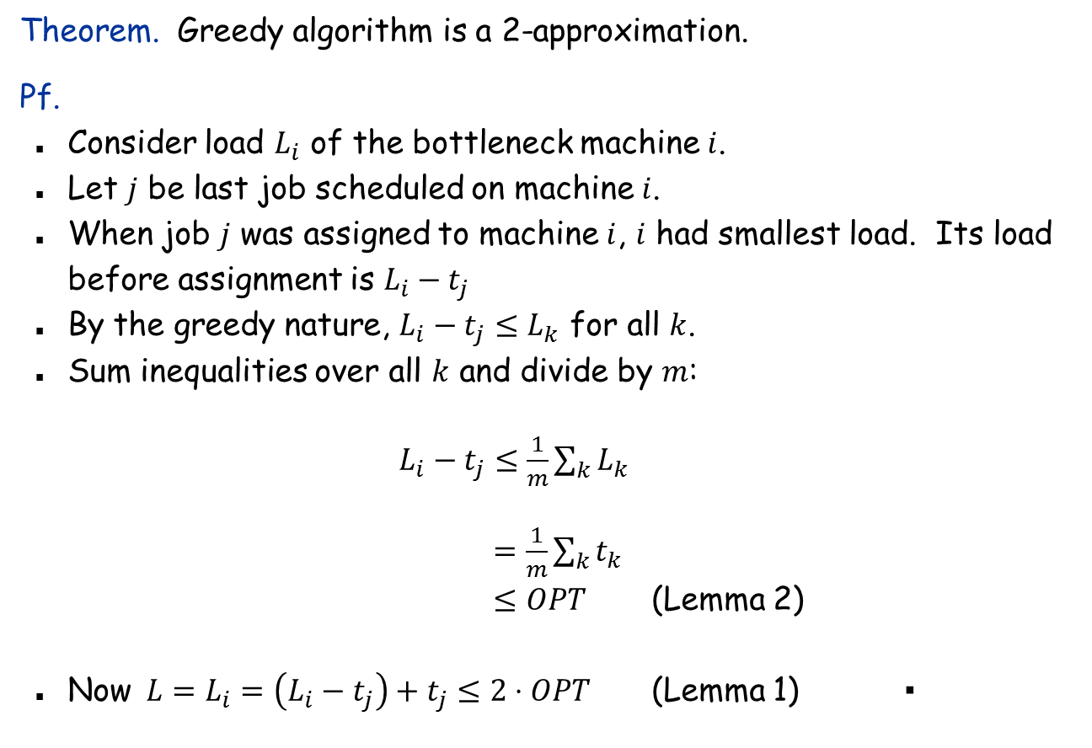
Load Balancing: Greedy Analysis
Theorem. Greedy algorithm is a 2-approximation.
Pf.
Consider load $L_{i}$ of the bottleneck machine $i$.
Let $j$ be last job scheduled on machine $i$.
When job $j$ was assigned to machine $i$, $i$ had smallest load. Its load before assignment is $L_{i}−t_{j}$
By the greedy nature, $L_{i}−t_{j}≤L_{k}$ for all $k$.
Sum inequalities over all $k$ and divide by $m$:
$L_{i}−t_{j}≤\frac{1}{m}\sum_{k}{L_{k}}$ $=\frac{1}{m}\sum_{k}{t_{k}}$
$≤OPT$ (Lemma 2)
Now $L=L_{i}=\left(L_{i}−t_{j}\right)+t_{j}≤2⋅OPT$ (Lemma 1) ▪

Slide 8


Load Balancing: Greedy Analysis
Q. Is our analysis tight?
A. Essentially yes.
Ex: $m$ machines, $m(m−1)$ length-1 jobs, one job of length $m$
machine 2 idle
machine 3 idle
machine 4 idle
$$m=10$$
machine 5 idle
machine 6 idle
machine 7 idle
machine 8 idle
machine 9 idle
machine 10 idle
list scheduling makespan = 19

Slide 9

Load Balancing: Greedy Analysis
Q. Is our analysis tight?
A. Essentially yes.
Ex: $m$ machines, $m(m−1)$ length-1 jobs, one job of length $m$
$$m=10$$
optimal makespan = 10

Slide 10

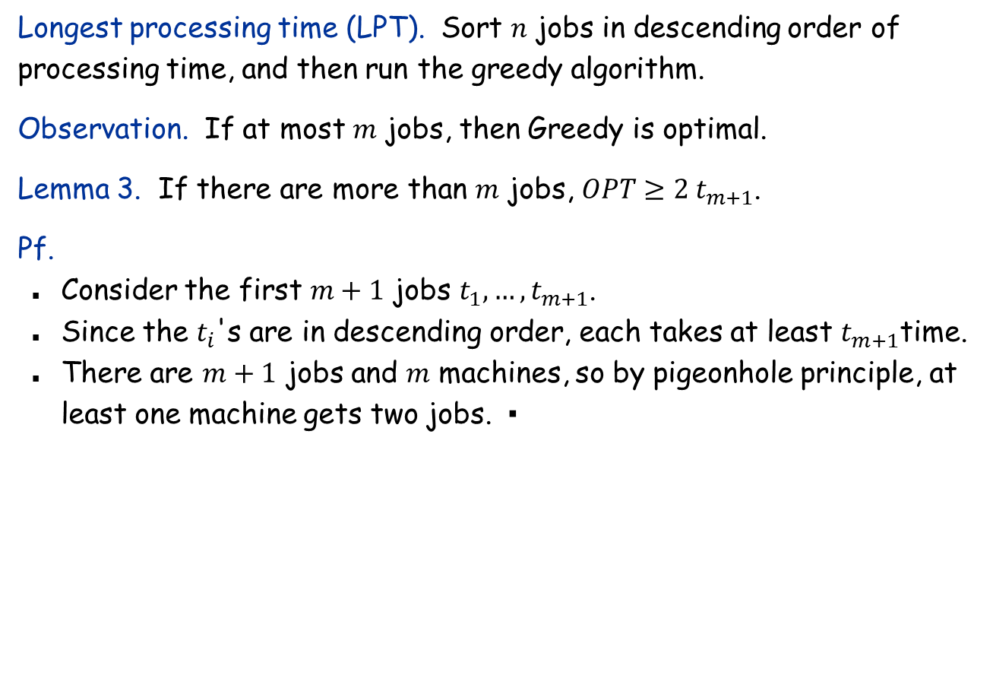




Load Balancing: LPT Rule
Longest processing time (LPT). Sort $n$ jobs in descending order of processing time, and then run the greedy algorithm.
Observation. If at most $m$ jobs, then Greedy is optimal.
Lemma 3. If there are more than $m$ jobs, $OPT≥2 t_{m+1}$.
Pf.
Consider the first $m+1$ jobs $t_{1}, …, t_{m+1}$.
Since the $t_{i}$'s are in descending order, each takes at least $t_{m+1}$time.
There are $m+1$ jobs and $m$ machines, so by pigeonhole principle, at least one machine gets two jobs. ▪
machine $i$
$$j$$
$$m+1$$
0
$$L_{i}−t_{j}$$
$$L=L_{i}$$
Notes:
j = last job scheduled on bottleneck machine.

Slide 11

Load Balancing: LPT Rule
Longest processing time (LPT). Sort $n$ jobs in descending order of processing time, and then run the greedy algorithm.
Observation. If at most $m$ jobs, then Greedy is optimal.
Lemma 3. If there are more than $m$ jobs, $OPT≥2 t_{m+1}$.
Theorem. LPT rules gives a 3/2-approximation.
Pf: $L_{i}=\left(L_{i}−t_{j}\right)+t_{j}≤OPT+t_{m+1}≤OPT+\frac{1}{2}OPT=\frac{3}{2}OPT$.
machine $i$
$$j$$
$$m+1$$
0
$$L_{i}−t_{j}$$
$$L=L_{i}$$
Notes:
j = last job scheduled on bottleneck machine.

Slide 12
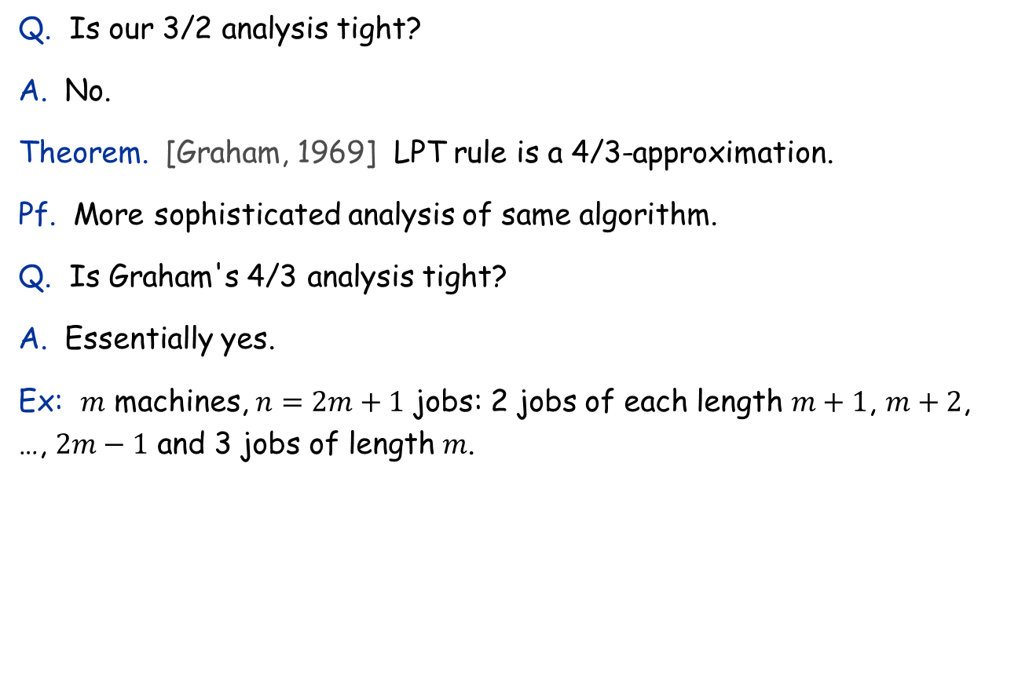
Load Balancing: LPT Rule
Q. Is our 3/2 analysis tight?
A. No.
Theorem. [Graham, 1969] LPT rule is a 4/3-approximation.
Pf. More sophisticated analysis of same algorithm.
Q. Is Graham's 4/3 analysis tight?
A. Essentially yes.
Ex: $m$ machines, $n=2m+1$ jobs: 2 jobs of each length $m+1$, $m+2$, …, $2m−1$ and 3 jobs of length $m$.
Notes:
Best known: PTAS, 4/3-analysis not too hard

Slide 13
11.2 The k-Center problem

Slide 14



The k-Center Problem
Input. Set of $n$ sites $s_{1}$, …, $s_{n}$ in the plane.
The k-center problem. Select $k$ centers $C$ so that maximum distance from a site to nearest center is minimized.
$$k=4$$
$$r(C)$$
center
site

Slide 15
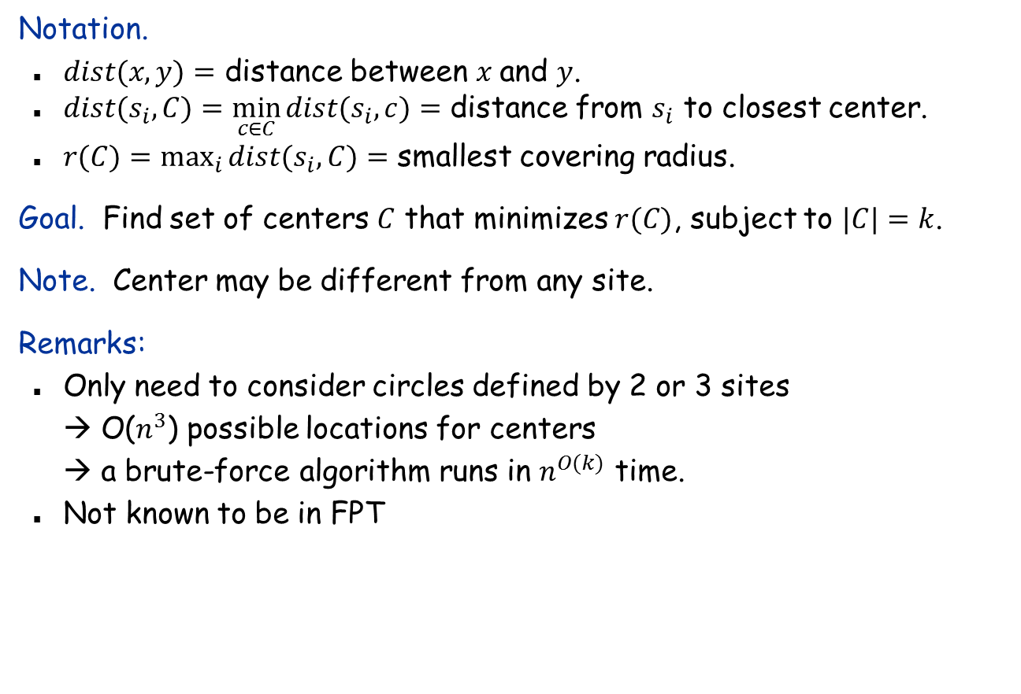
The k-Center Problem
Notation.
$dist(x, y)=$ distance between $x$ and $y$.
$dist(s_{i}, C)=\min_{c∈C}⁡dist(s_{i}, c)=$ distance from $s_{i}$ to closest center.
$r(C)=\max_{i}{dist(s_{i},C)}=$ smallest covering radius.
Goal. Find set of centers $C$ that minimizes $r(C)$, subject to $|C|=k$.
Note. Center may be different from any site.
Remarks:
Only need to consider circles defined by 2 or 3 sites → O($n^{3}$) possible locations for centers → a brute-force algorithm runs in $n^{O(k)}$ time.
Not known to be in FPT

Slide 16
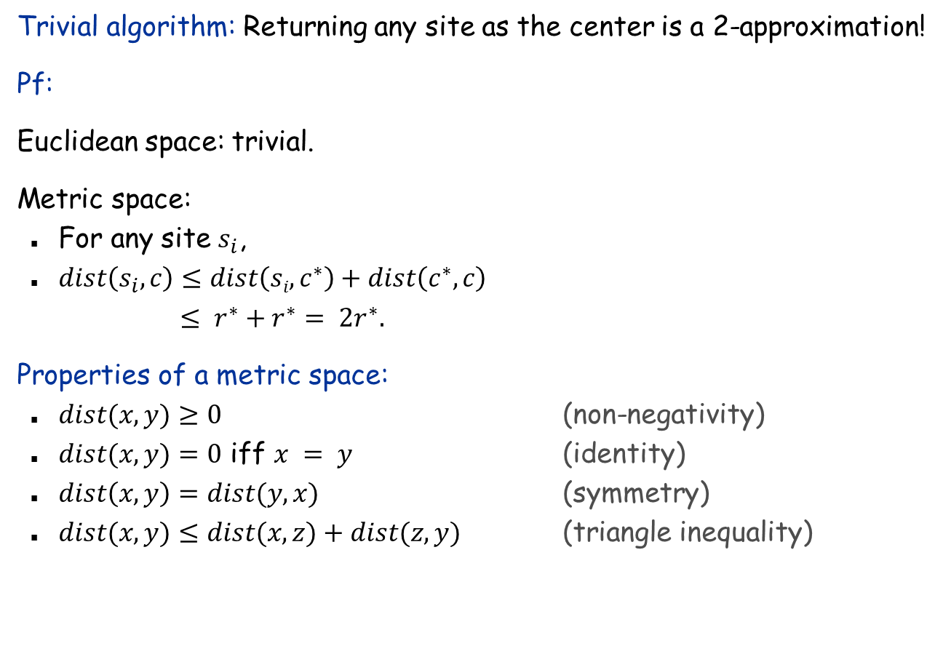
1-Center
Trivial algorithm: Returning any site as the center is a 2-approximation!
Pf:
Euclidean space: trivial.
Metric space:
For any site $s_{i}$,
$dist\left(s_{i}, c\right)≤dist\left(si, c^{∗}\right)+dist\left(c^{∗}, c\right)$ $≤ r^{∗}+r^{∗}= 2r^{∗}.$
Properties of a metric space:
$dist(x, y)≥0$ (non-negativity)
$dist(x, y)=0$ iff $x = y$ (identity)
$dist\left(x, y\right)=dist(y, x)$ (symmetry)
$dist(x, y)≤dist(x, z)+dist(z, y)$ (triangle inequality)
r*
c*
c
2r*
Notes:
1-center can be solved optimally in O(n) time in constant dimensions.

Slide 17
Greedy Algorithm for k-Center: A False Start
Greedy algorithm. Put the first center at the best possible location for a single center, and then keep adding centers so as to reduce the covering radius each time by as much as possible.
Remark: arbitrarily bad!
greedy center 1
center
k = 2 centers
site

Slide 18
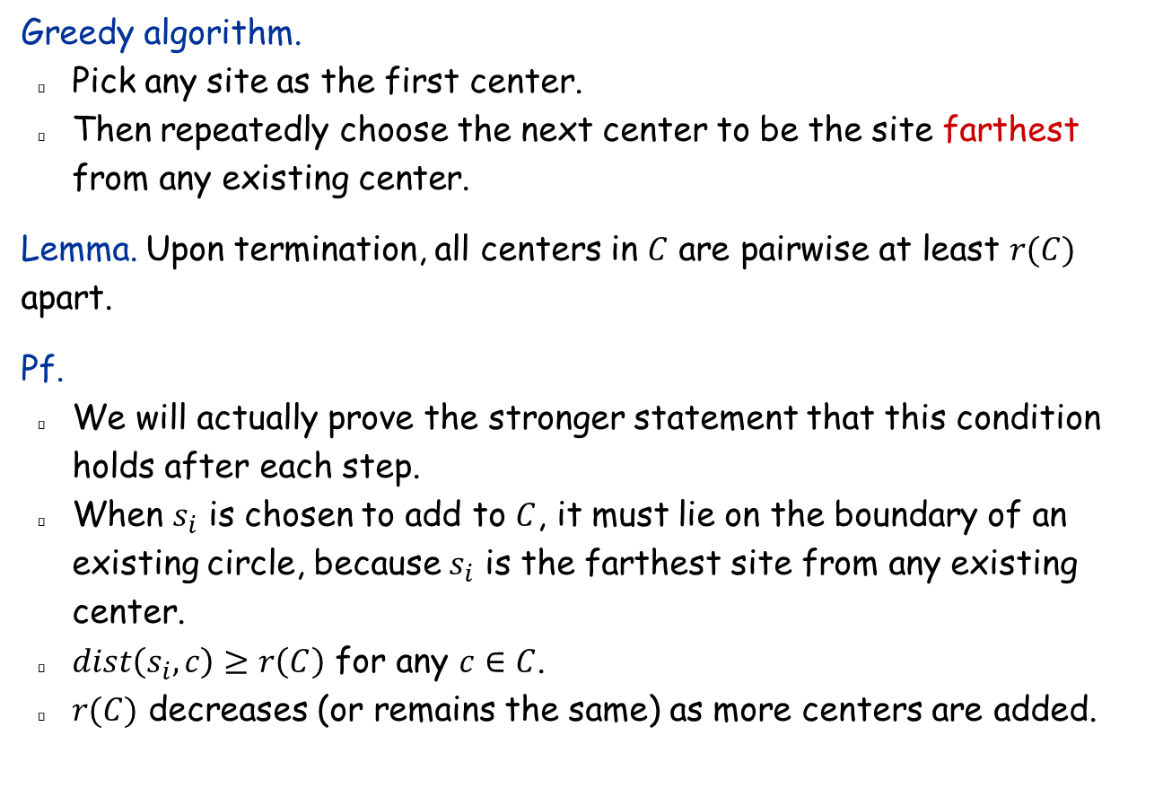
k-Center: Greedy Algorithm
Greedy algorithm.
Pick any site as the first center.
Then repeatedly choose the next center to be the site farthest from any existing center.
Lemma. Upon termination, all centers in $C$ are pairwise at least $r(C)$ apart.
Pf.
We will actually prove the stronger statement that this condition holds after each step.
When $s_{i}$ is chosen to add to $C$, it must lie on the boundary of an existing circle, because $s_{i}$ is the farthest site from any existing center.
$dist\left(s_{i},c\right)≥r\left(C\right)$ for any $c∈C$.
$r(C)$ decreases (or remains the same) as more centers are added.
Notes:
Note: in first iteration, can choose any site s

Slide 19
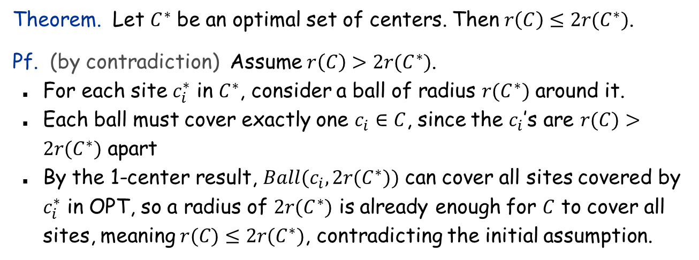
k-Center: Analysis of Greedy Algorithm
Theorem. Let $C^{∗}$ be an optimal set of centers. Then $r\left(C\right)≤2r(C^{∗})$.
Pf. (by contradiction) Assume $r\left(C\right)>2r(C^{∗})$.
For each site $c_{i}^{∗}$ in $C^{∗}$, consider a ball of radius $r(C^{∗})$ around it.
Each ball must cover exactly one $c_{i}∈C$, since the $c_{i}$’s are $r(C)>2r(C^{∗})$ apart
By the 1-center result, $Ball(c_{i}, 2r(C^{∗}))$ can cover all sites covered by $c_{i}^{∗}$ in OPT, so a radius of $2r(C^{∗})$ is already enough for $C$ to cover all sites, meaning $r(C)≤2r(C^{∗})$, contradicting the initial assumption.
r(C*)
r(C*)
c_{i}*
r(C*)
r(C*)
C
C*
c_{i}

Slide 20
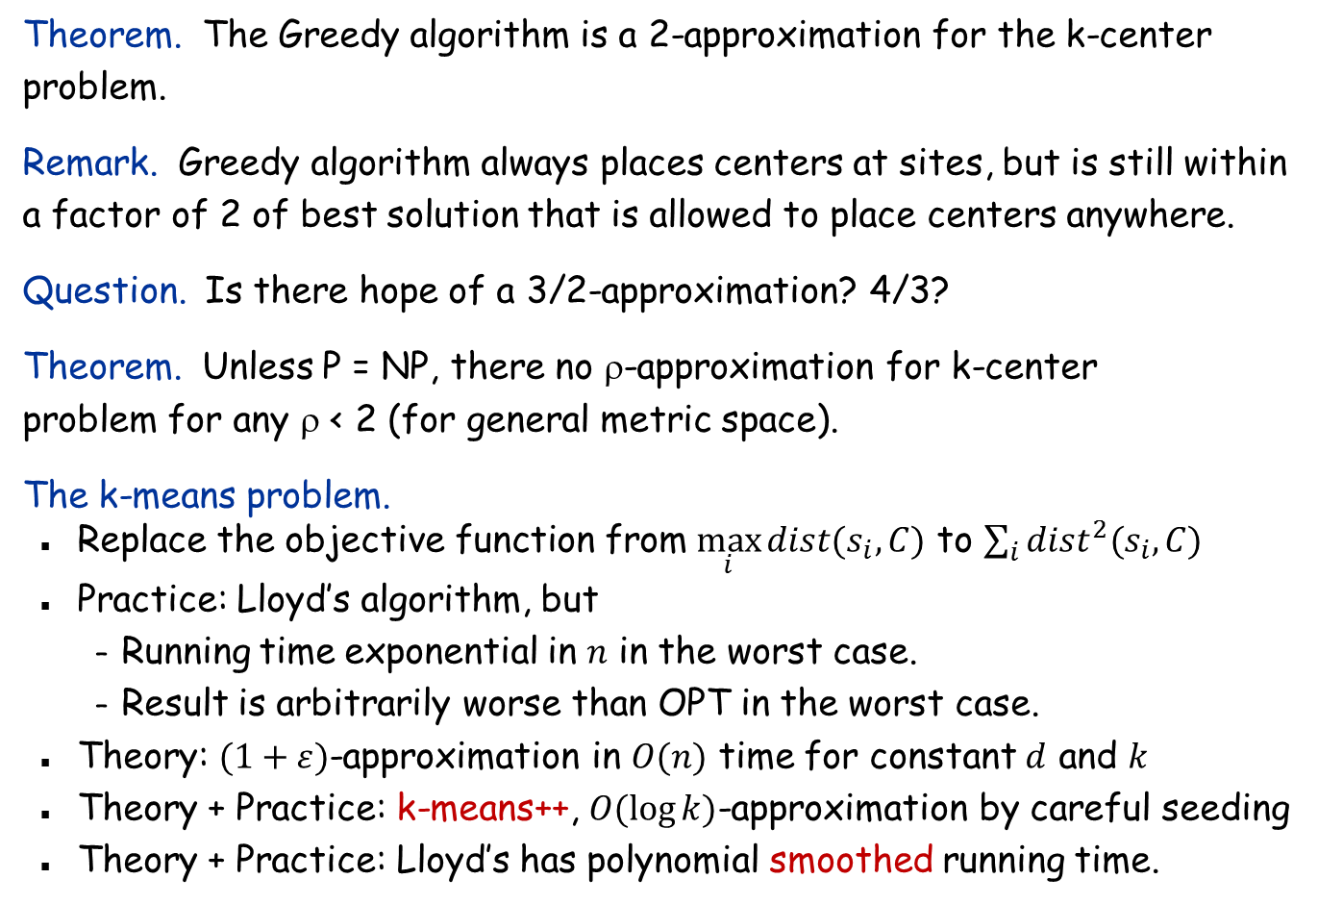
The k-Center Problem
Theorem. The Greedy algorithm is a 2-approximation for the k-center problem.
Remark. Greedy algorithm always places centers at sites, but is still within a factor of 2 of best solution that is allowed to place centers anywhere.
Question. Is there hope of a 3/2-approximation? 4/3?
Theorem. Unless P = NP, there no ρ-approximation for k-center problem for any ρ < 2 (for general metric space).
The k-means problem.
Replace the objective function from $\max_{i}{dist(s_{i},C)}$ to $\sum_{i}{dist^{2}(s_{i},C)}$
Practice: Lloyd’s algorithm, but
Running time exponential in $n$ in the worst case.
Result is arbitrarily worse than OPT in the worst case.
Theory: $(1+ε)$-approximation in $O(n)$ time for constant $d$ and $k$
Theory + Practice: k-means++, $O(\log{k)}$-approximation by careful seeding
Theory + Practice: Lloyd’s has polynomial smoothed running time.
Notes:
PTAS for Euclidean space

Slide 21
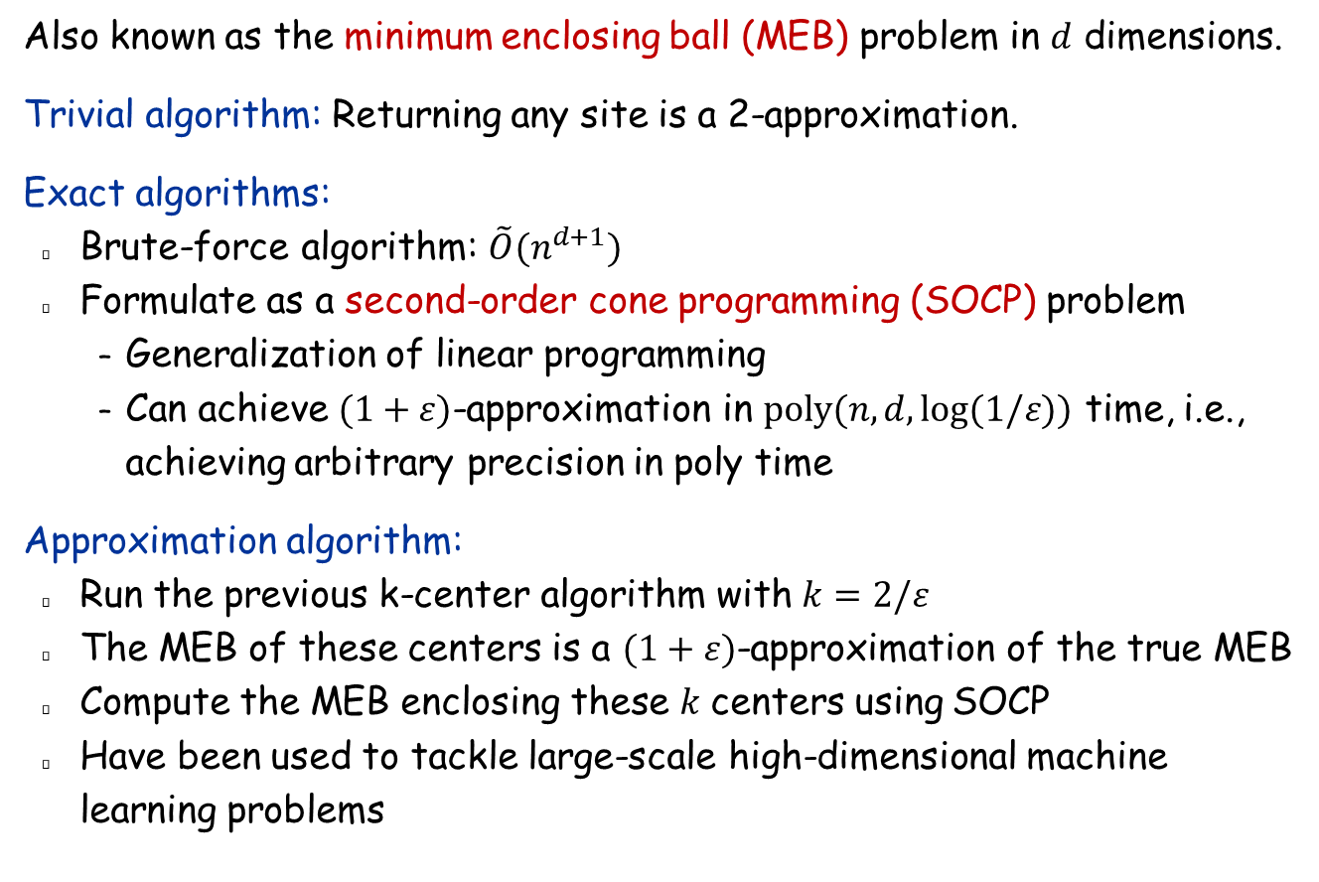
1-Center Revisited
Also known as the minimum enclosing ball (MEB) problem in $d$ dimensions.
Trivial algorithm: Returning any site is a 2-approximation.
Exact algorithms:
Brute-force algorithm: $\tilde{O}(n^{d+1})$
Formulate as a second-order cone programming (SOCP) problem
Generalization of linear programming
Can achieve $(1+ε)$-approximation in $poly(n,d,\log{(1/ε)})$ time, i.e., achieving arbitrary precision in poly time
Approximation algorithm:
Run the previous k-center algorithm with $k=2/ε$
The MEB of these centers is a $(1+ε)$-approximation of the true MEB
Compute the MEB enclosing these $k$ centers using SOCP
Have been used to tackle large-scale high-dimensional machine learning problems

Slide 22
11.3 Set Cover

Slide 23
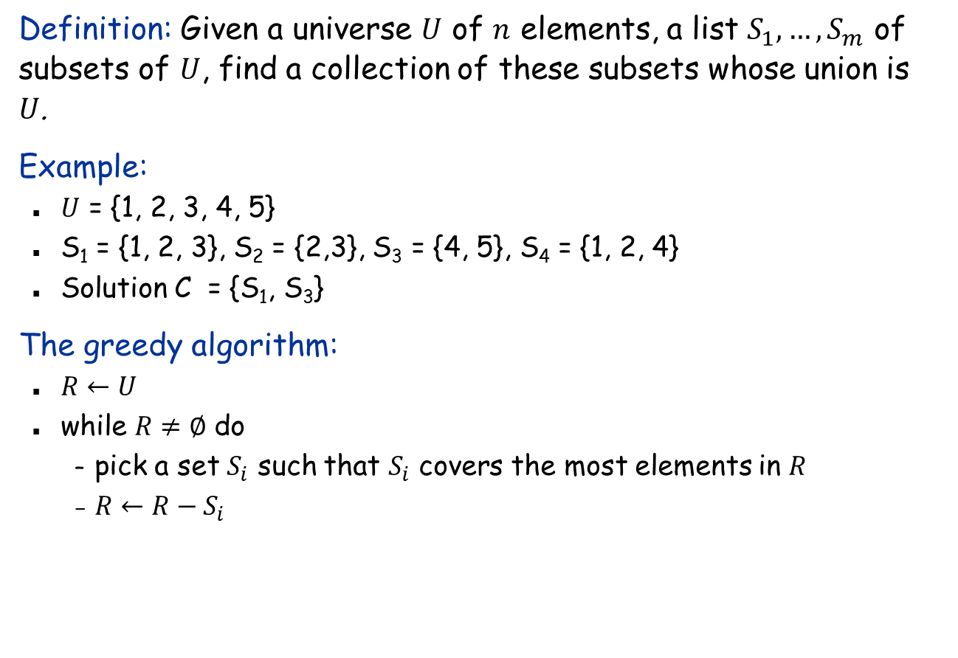
Set Cover
Definition: Given a universe $U$ of $n$ elements, a list $S_{1}, …, S_{m}$ of subsets of $U$, find a collection of these subsets whose union is $U$.
Example:
$U$ = {1, 2, 3, 4, 5}
S₁ = {1, 2, 3}, S₂ = {2,3}, S₃ = {4, 5}, S₄ = {1, 2, 4}
Solution C = {S₁, S₃}
The greedy algorithm:
$R←U$
while $R≠∅$ do
pick a set $S_{i}$ such that $S_{i}$ covers the most elements in $R$
$R←R−S_{i}$

Slide 24
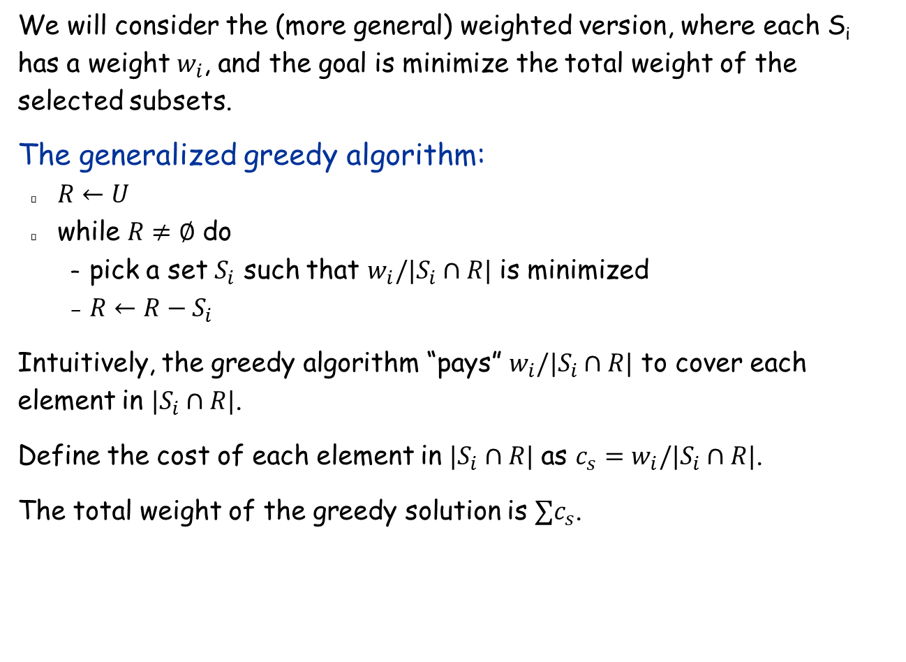
Weighted Set Cover
We will consider the (more general) weighted version, where each S_{i} has a weight $w_{i}$, and the goal is minimize the total weight of the selected subsets.
The generalized greedy algorithm:
$R←U$
while $R≠∅$ do
pick a set $S_{i}$ such that $w_{i}/|S_{i}∩R|$ is minimized
$R←R−S_{i}$
Intuitively, the greedy algorithm “pays” $w_{i}/|S_{i}∩R|$ to cover each element in $|S_{i}∩R|$.
Define the cost of each element in $|S_{i}∩R|$ as $c_{s}=w_{i}/|S_{i}∩R|$.
The total weight of the greedy solution is $∑c_{s}$.

Slide 25
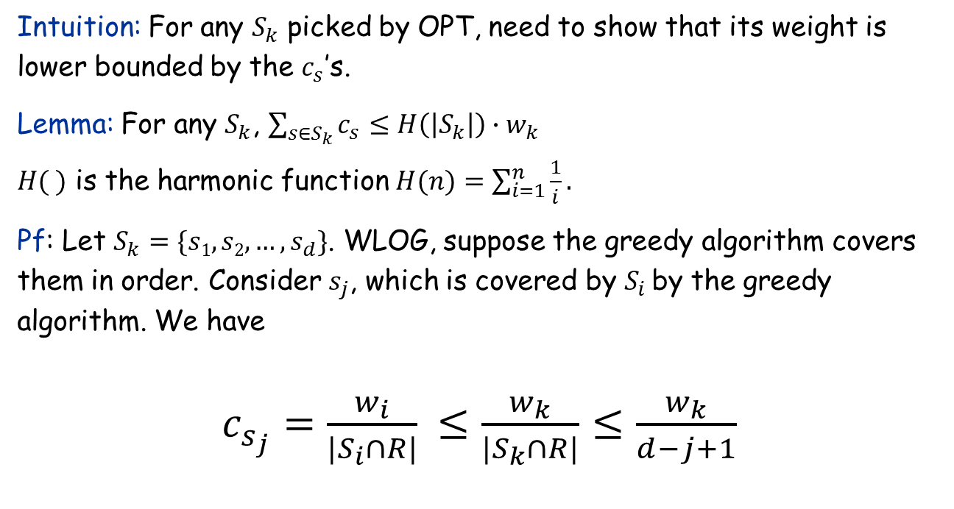

Relating $∑cs$ with OPT
Intuition: For any $S_{k}$ picked by OPT, need to show that its weight is lower bounded by the $c_{s}$’s.
Lemma: For any $S_{k}$, $\sum_{{s∈S}_{k}}{c_{s}}≤H\left(\left|S_{k}\right|\right)∙w_{k}$
$H( )$ is the harmonic function $H(n)=\sum_{i=1}^{n}{\frac{1}{i}}.$
Pf: Let $S_{k}=\{s1, s2, …, s_{d}\}$. WLOG, suppose the greedy algorithm covers them in order. Consider $s_{j}$, which is covered by $S_{i}$ by the greedy algorithm. We have
$c_{s_{j}}=\frac{w_{i}}{|S_{i}∩R|}$ $≤\frac{w_{k}}{|S_{k}∩R|}$ $≤\frac{w_{k}}{d−j+1}$
greedy choice
$s_{j}, s_{j+1}, …, s_{d}$are not covered

Slide 26
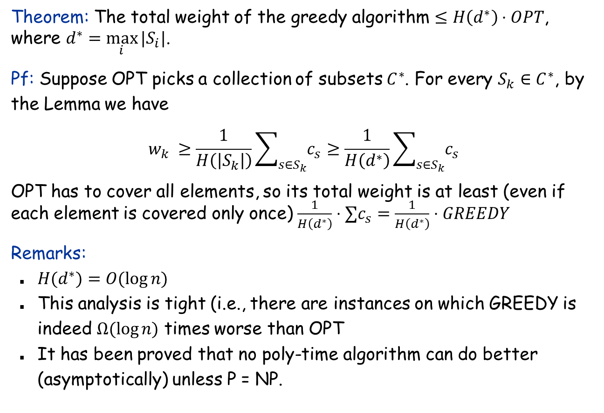
Approximation Ratio of the Greedy Algorithm
Theorem: The total weight of the greedy algorithm $≤H\left(d^{∗}\right)⋅OPT$, where $d^{∗}=\max_{i}⁡|S_{i}|$.
Pf: Suppose OPT picks a collection of subsets $C^{∗}$. For every $S_{k}∈C^{∗}$, by the Lemma we have
$$w_{k} ≥\frac{1}{H\left(\left|S_{k}\right|\right)}\sum_{{s∈S}_{k}}{c_{s}}≥\frac{1}{H\left(d^{∗}\right)}\sum_{{s∈S}_{k}}{c_{s}}$$
OPT has to cover all elements, so its total weight is at least (even if each element is covered only once) $\frac{1}{H\left(d^{∗}\right)}⋅∑c_{s}=\frac{1}{H\left(d^{∗}\right)}⋅GREEDY$
Remarks:
$H(d^{∗})=O(log⁡n)$
This analysis is tight (i.e., there are instances on which GREEDY is indeed $Ω(log⁡n)$ times worse than OPT
It has been proved that no poly-time algorithm can do better (asymptotically) unless P = NP.

Slide 27
11.4 The Pricing Method: Vertex Cover

Slide 28

Weighted Vertex Cover
Weighted vertex cover. Given a graph G with vertex weights, find a vertex cover of minimum weight.
It’s a special case of the set cover problem, so the $H(d^{∗})$ approximation ratio can be achieved by the greedy algorithm, where $d^{∗}=$ max degree.
2
4
2
4
2
9
2
9
weight = 2 + 2 + 4 = 8
weight = 2 + 9 = 11

Slide 29
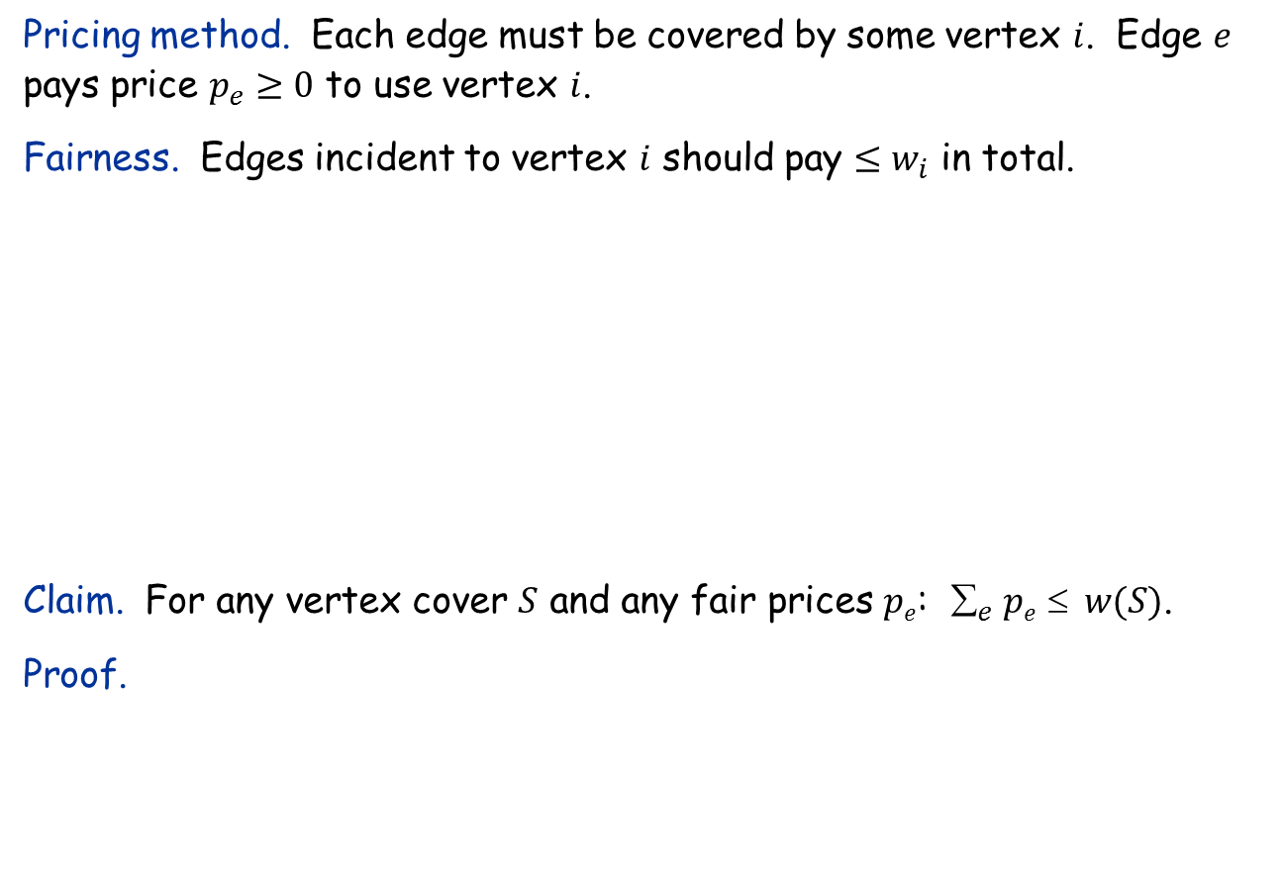
Weighted Vertex Cover
Pricing method. Each edge must be covered by some vertex $i$. Edge $e$ pays price $p_{e}≥0$ to use vertex $i$.
Fairness. Edges incident to vertex $i$ should pay $≤w_{i}$ in total.
Claim. For any vertex cover $S$ and any fair prices $pe$: $_{e} pe  w(S)$.
Proof.
2
4
2
9
each edge e covered by at least one node in S
sum fairness inequalities for each node in S

Slide 30
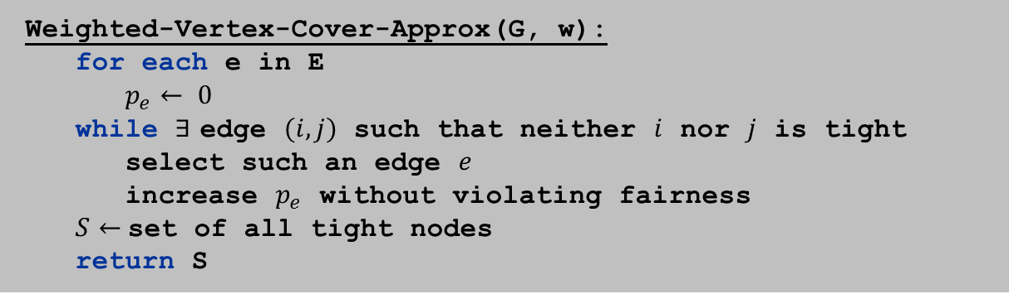
Pricing Method
Pricing method. Set prices and find vertex cover simultaneously.
Weighted-Vertex-Cover-Approx(G, w):
for each e in E
$p_{e}← 0$
while $∃$ edge $(i,j)$ such that neither $i$ nor $j$ is tight
select such an edge $e$
increase $p_{e}$ without violating fairness
$S←$set of all tight nodes
return S

Slide 31
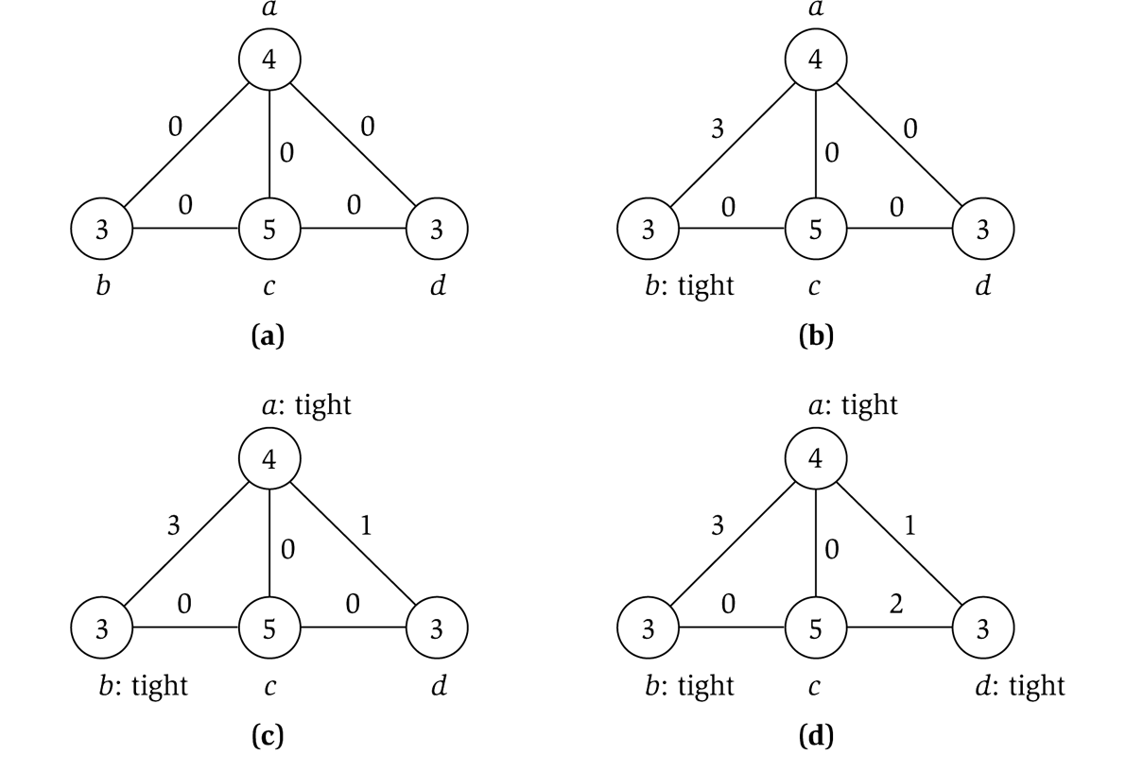
Pricing Method: Example
price of edge a-b
vertex weight

Slide 32

Pricing Method: Analysis
Theorem. Pricing method is a 2-approximation.
Pf.
Algorithm terminates in $O(n)$ iterations, since at least one new node becomes tight after each iteration of while loop.
Let $S=$ set of all tight nodes upon termination of algorithm.
$S$ is a vertex cover: if some edge $(i,j)$ is uncovered, then neither $i$ nor $j$ is tight. But then the while loop would not terminate.
Let $S^{∗}$ be optimal vertex cover. We will show $w\left(S\right)≤2w(S^{∗})$.
all nodes in S are tight
S ⊆ V, prices ≥ 0
each edge counted twice
fairness lemma

Slide 33
11.6 LP Rounding: Vertex Cover

Slide 34
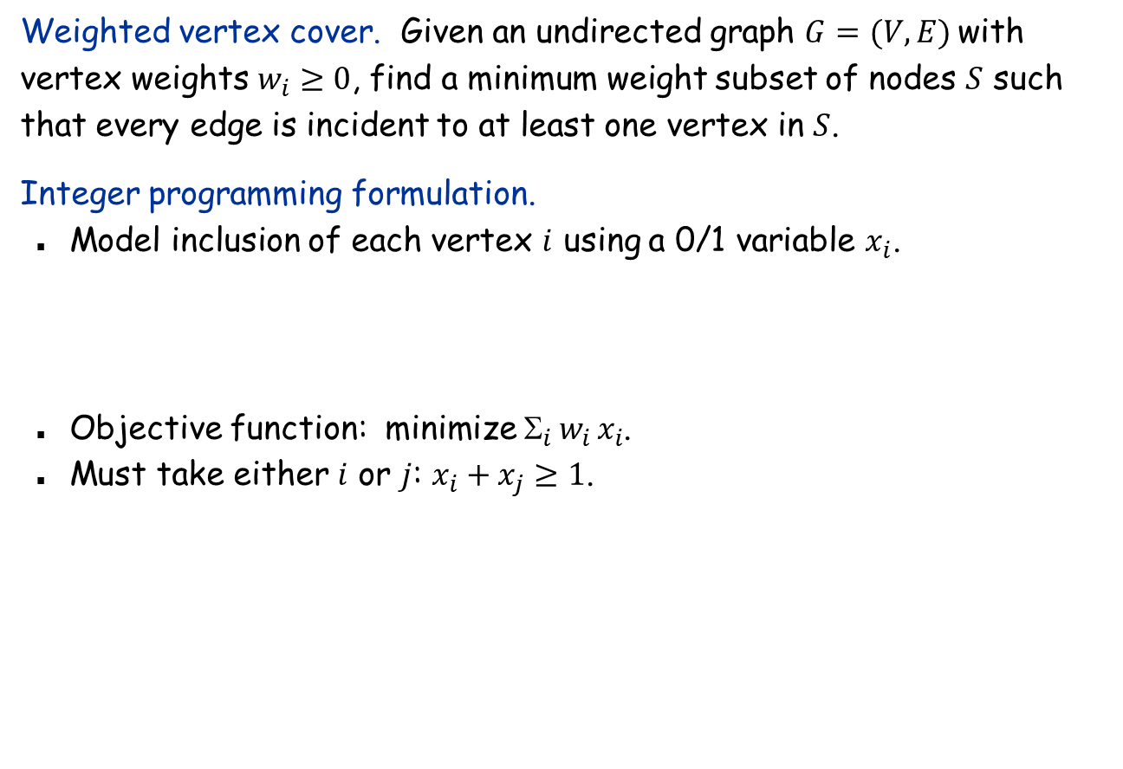
Weighted Vertex Cover: Integer Linear Programming Formulation
Weighted vertex cover. Given an undirected graph $G=(V, E)$with vertex weights $w_{i}≥0$, find a minimum weight subset of nodes $S$ such that every edge is incident to at least one vertex in $S$.
Integer programming formulation.
Model inclusion of each vertex $i$ using a 0/1 variable $x_{i}$.
Objective function: minimize $_{i} w_{i} x_{i}$.
Must take either $i$ or $j$: $x_{i}+x_{j}≥1$.

Slide 35
Integer Linear Programming
ILP. Given integers a_{ij} and b_{i}, find integers x_{j} that satisfy:
Observation. Vertex cover formulation proves that ILP is NP-hard.

Slide 36
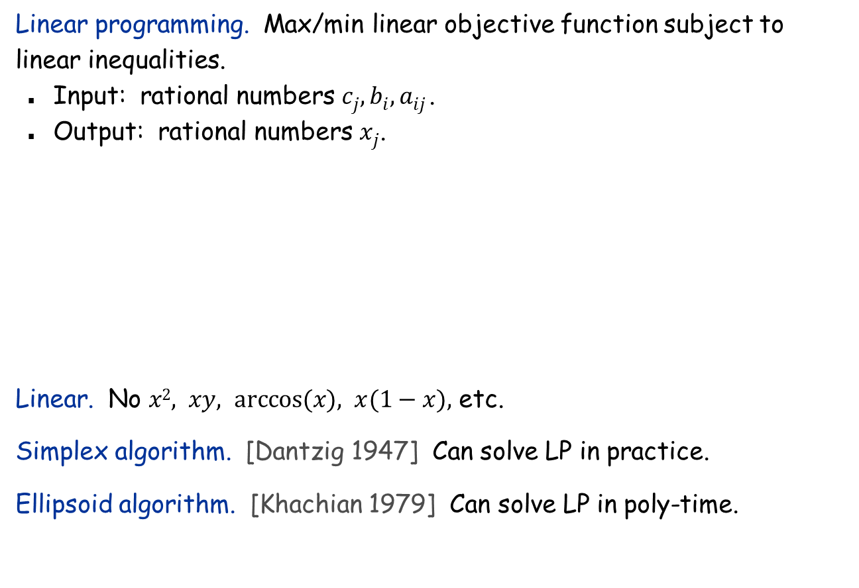
Linear Programming
Linear programming. Max/min linear objective function subject to linear inequalities.
Input: rational numbers $cj, bi, aij$.
Output: rational numbers $xj$.
Linear. No $x2, xy, arccos⁡(x), x(1−x),$ etc.
Simplex algorithm. [Dantzig 1947] Can solve LP in practice.
Ellipsoid algorithm. [Khachian 1979] Can solve LP in poly-time.

Slide 37
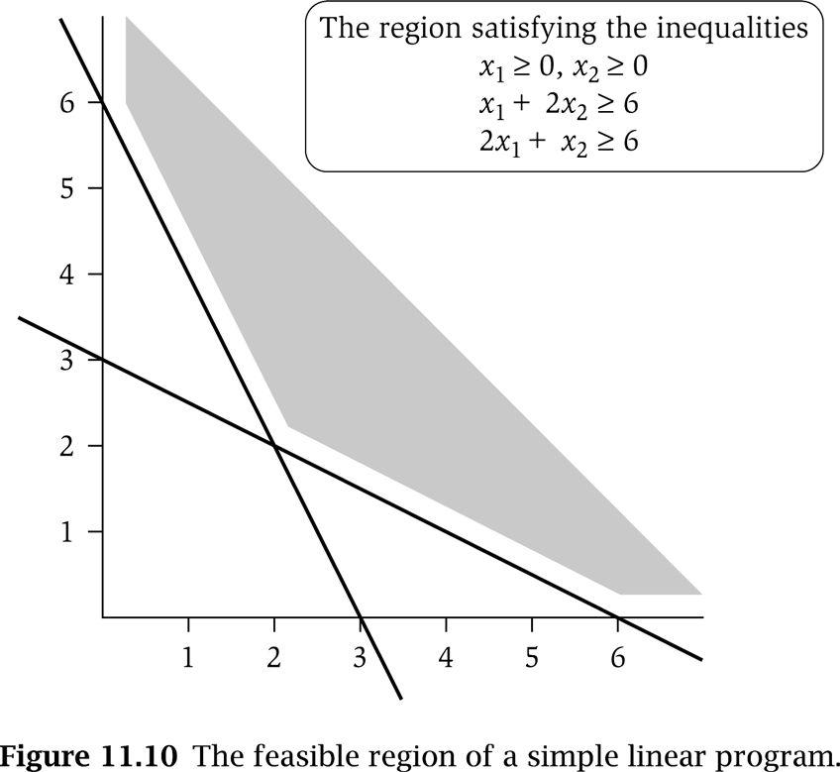




LP Feasible Region
LP geometry in 2D.
$$x1=0$$
$$x2=0$$
$$x1+2x2=6$$
$$2x1+x2=6$$

Slide 38
Weighted Vertex Cover: LP Relaxation
Weighted vertex cover. Linear programming formulation.
Observation. Optimal value of (LP) ≤ optimal value of (ILP).
Pf. LP has fewer constraints.
Note. LP is not equivalent to vertex cover.
Q. How can solving LP help us find a small vertex cover?
A. Solve LP and round fractional values.
½
½
½
Notes:
LP relaxation is a useful lower bound for designing approximation algorithms.

Slide 39

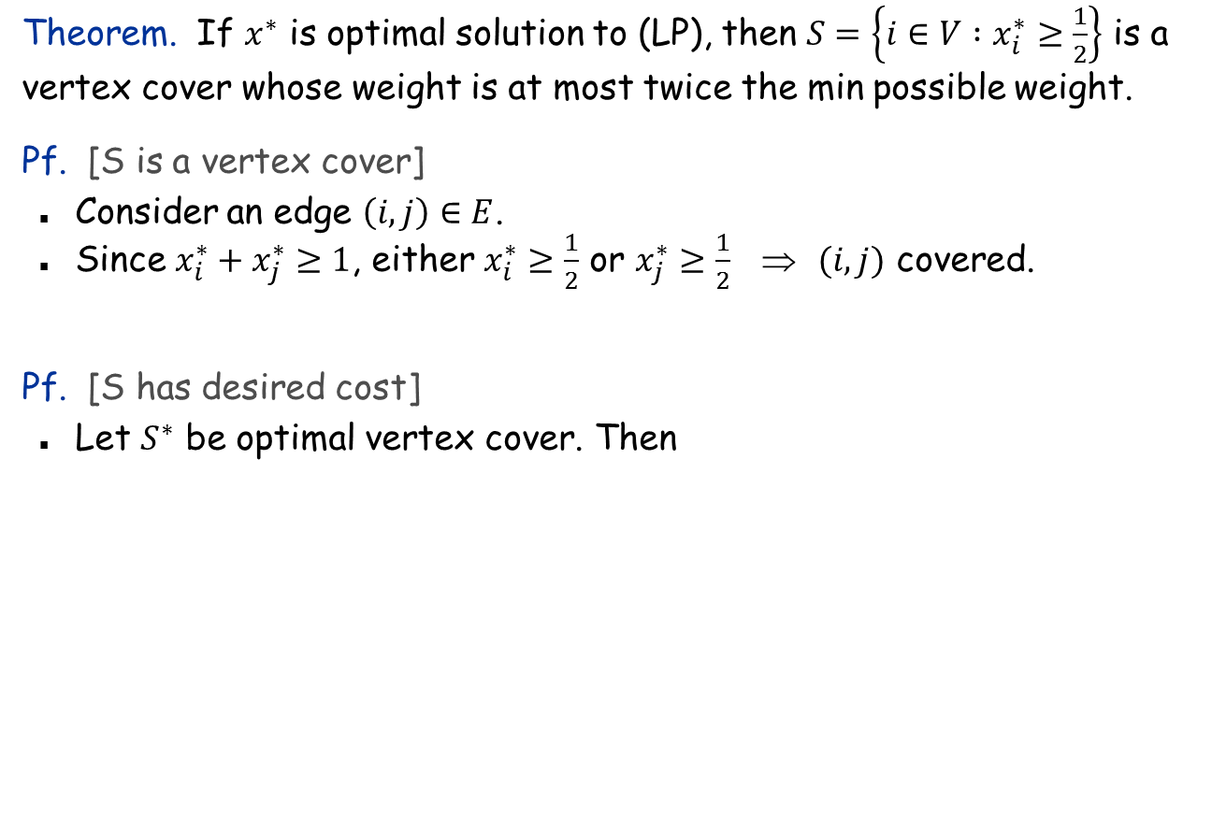
Weighted Vertex Cover
Theorem. If $x^{∗}$ is optimal solution to (LP), then $S=\left\{i∈V :x_{i}^{∗}≥\frac{1}{2}\right\}$ is a vertex cover whose weight is at most twice the min possible weight.
Pf. [S is a vertex cover]
Consider an edge $\left(i, j\right)∈E$.
Since $x_{i}^{∗}+x_{j}^{∗}≥1$, either $x_{i}^{∗}≥\frac{1}{2}$ or $x_{j}^{∗}≥\frac{1}{2}$ ⇒ $(i, j)$ covered.
Pf. [S has desired cost]
Let $S^{∗}$ be optimal vertex cover. Then
LP is a relaxation
$$x_{i}^{∗}≥\frac{1}{2}$$

Slide 40
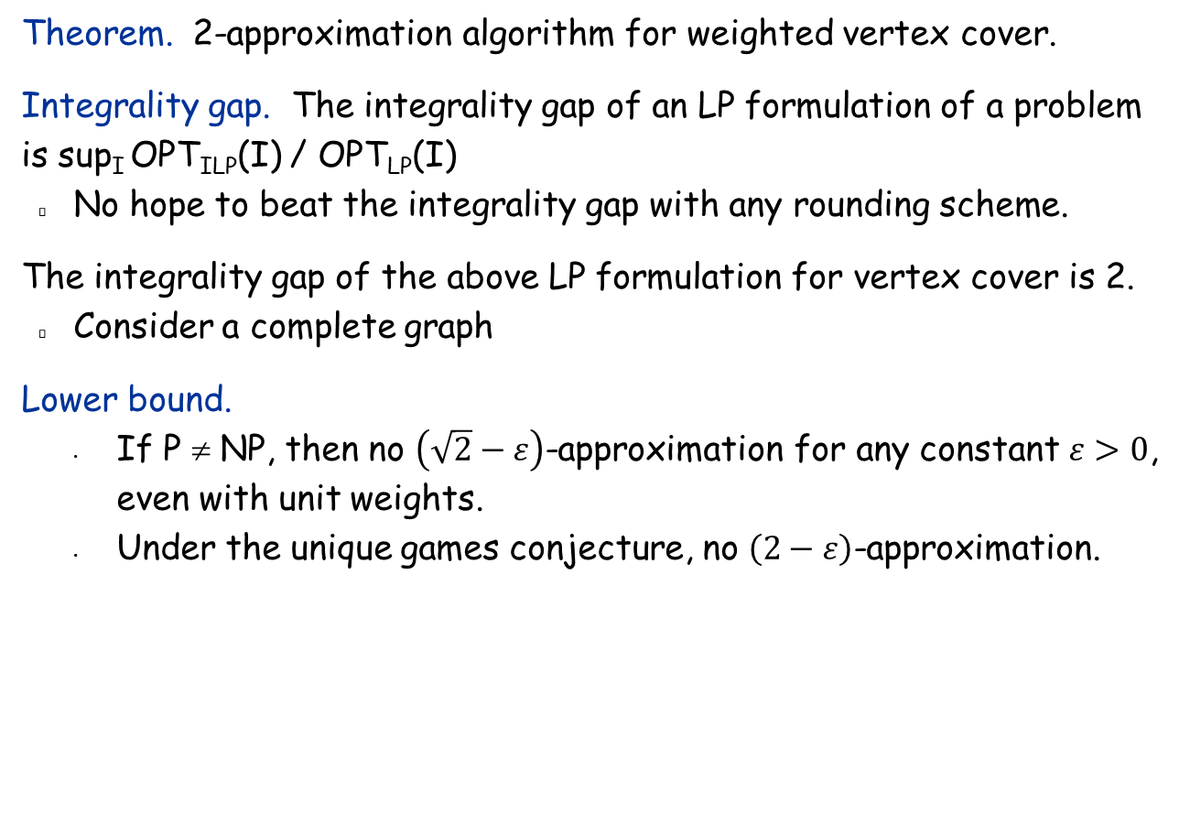
Weighted Vertex Cover
Theorem. 2-approximation algorithm for weighted vertex cover.
Integrality gap. The integrality gap of an LP formulation of a problem is sup_{I} OPT_{ILP}(I) / OPT_{LP}(I)
No hope to beat the integrality gap with any rounding scheme.
The integrality gap of the above LP formulation for vertex cover is 2.
Consider a complete graph
Lower bound.
If P ≠ NP, then no $\left(\sqrt{2}−ε\right)$-approximation for any constant $ε>0$, even with unit weights.
Under the unique games conjecture, no $\left(2−ε\right)$-approximation.
Notes:
NP-hard even on 3-regular planar graphs with unit weights.

Slide 41
LP Rounding: Set Cover

Slide 42

ILP Formulation of Set Cover
Problem Definition: Given a universe $U$ of n elements, a list $S_{1}, …, S_{m}$ of subsets of $U$, find a collection of these subsets whose union is $U$.
Weighted version: $S_{i}$ has weight $w_{i}$. Want to minimize total weight of the subsets selected in the set cover.
ILP formulation:
$x_{i}=1$ if $S_{i}$ is selected, $0$ otherwise.

Slide 43
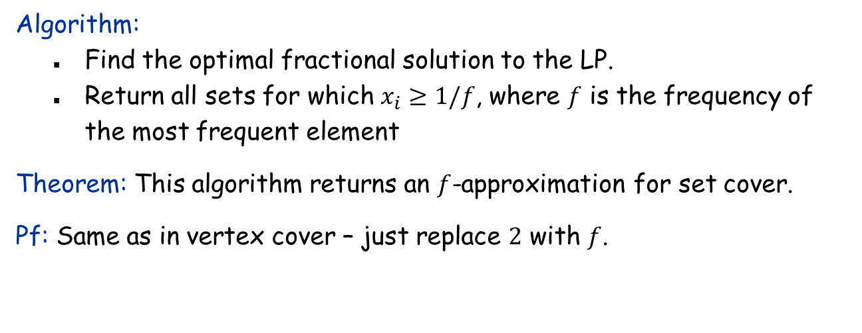
LP Relaxation for Set Cover and Rounding
Algorithm:
Find the optimal fractional solution to the LP.
Return all sets for which $x_{i}≥1/f$, where $f$ is the frequency of the most frequent element
Theorem: This algorithm returns an $f$-approximation for set cover.
Pf: Same as in vertex cover – just replace $2$ with $f$.

Slide 44
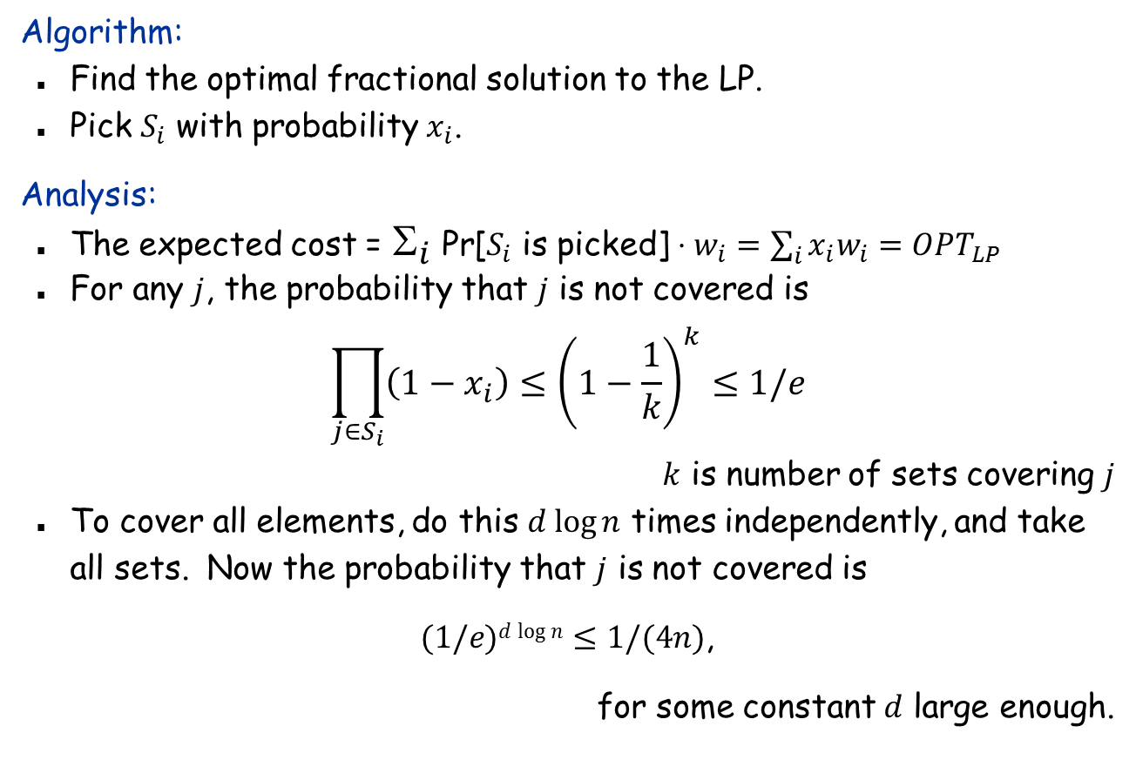
Randomized Rounding
Algorithm:
Find the optimal fractional solution to the LP.
Pick $S_{i}$ with probability $x_{i}$.
Analysis:
The expected cost = $_{i}$ Pr[$S_{i}$ is picked] $⋅w_{i}=\sum_{i}{x_{i}w_{i}}=OPT_{LP}$
For any $j$, the probability that $j$ is not covered is
$$\prod_{j∈S_{i}}{\left(1−x_{i}\right)}≤{\left(1−\frac{1}{k}\right)}^{k}≤1/e$$
$k$ is number of sets covering $j$
To cover all elements, do this $d log⁡n$ times independently, and take all sets. Now the probability that $j$ is not covered is
$(1/e)d log⁡n≤1/(4n)$,
for some constant $d$ large enough.

Slide 45
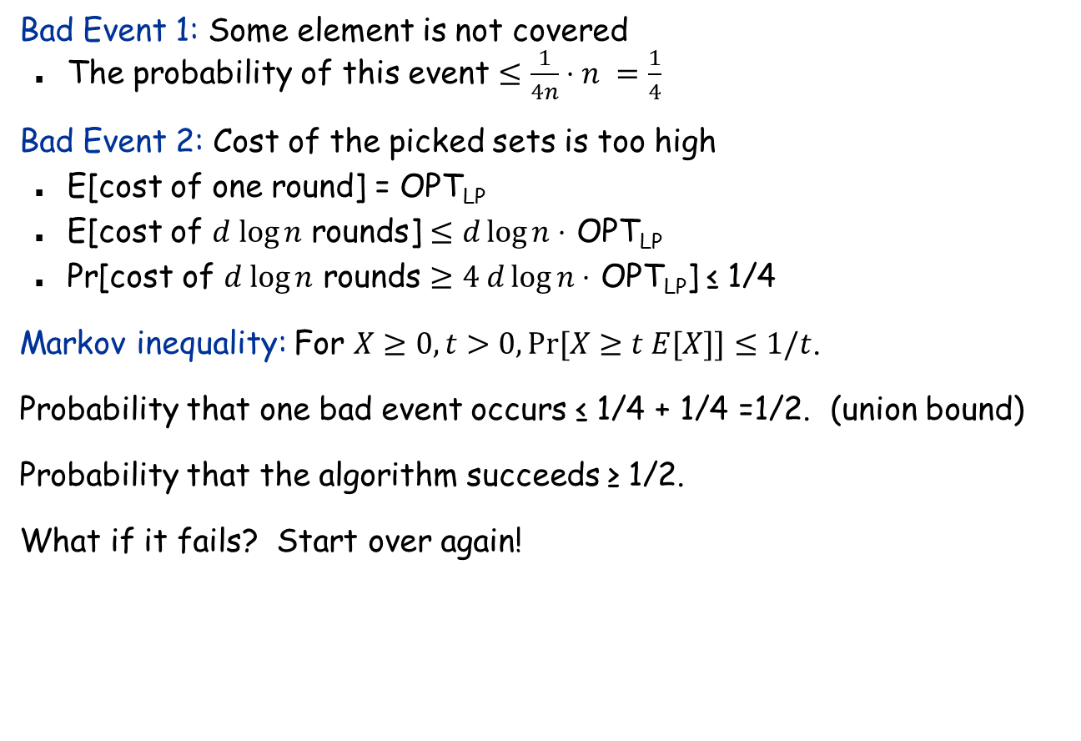
$O(log⁡n)$-Approximation
Bad Event 1: Some element is not covered
The probability of this event $≤\frac{1}{4n}⋅n =\frac{1}{4}$
Bad Event 2: Cost of the picked sets is too high
E[cost of one round] = OPT_{LP}
E[cost of $d log⁡n$ rounds] $≤d\log{n⋅}$ OPT_{LP}
Pr[cost of $d log⁡n$ rounds $≥4 d\log{n}⋅$ OPT_{LP}] ≤ 1/4
Markov inequality: For $X≥0, t>0, Pr⁡[X≥t E[X]]≤1/t$.
Probability that one bad event occurs ≤ 1/4 + 1/4 =1/2. (union bound)
Probability that the algorithm succeeds ≥ 1/2.
What if it fails? Start over again!

Slide 46

11.8 FPTAS: The Knapsack Problem
Using $1/ε$ as the parameter

Slide 47
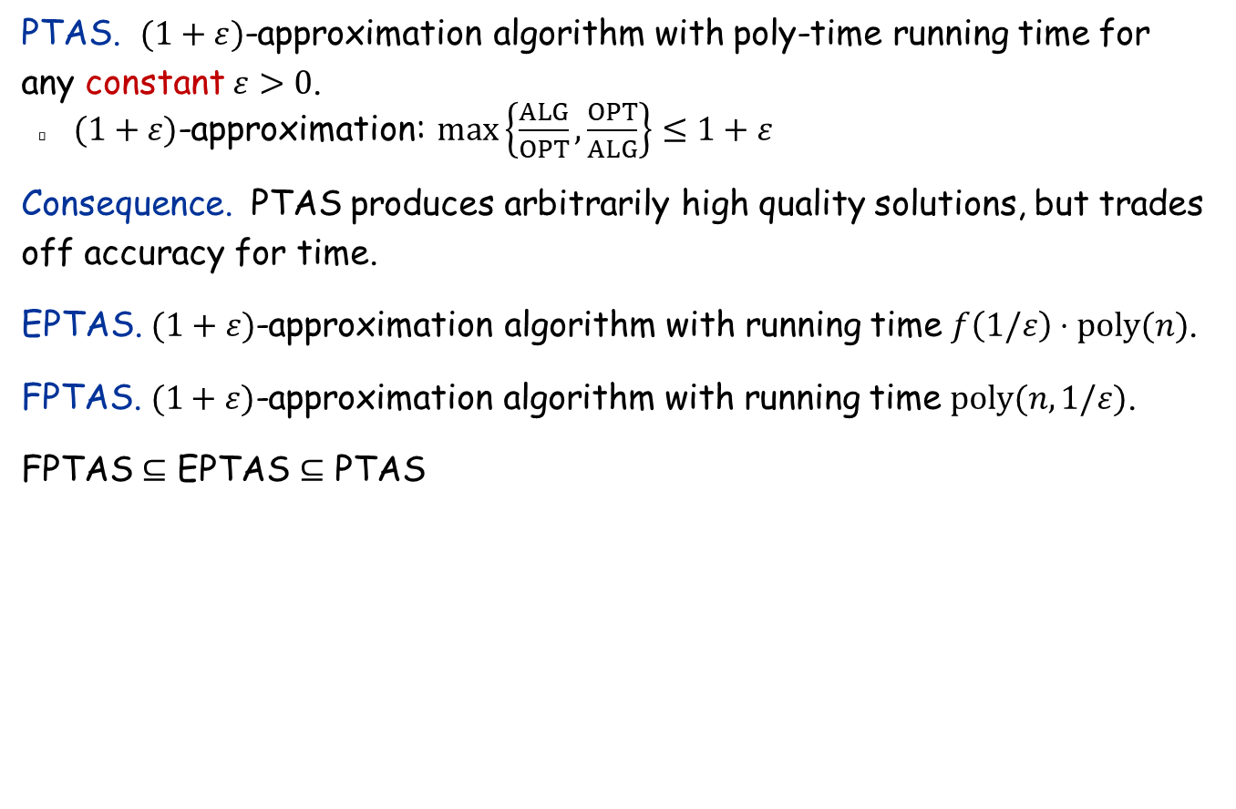
Polynomial Time Approximation Scheme
PTAS. $(1+ε)$-approximation algorithm with poly-time running time for any constant $ε>0$.
$(1+ε)$-approximation: $\max\left\{\frac{ALG}{OPT},\frac{OPT}{ALG}\right\}≤1+ε$
Consequence. PTAS produces arbitrarily high quality solutions, but trades off accuracy for time.
EPTAS. $(1+ε)$-approximation algorithm with running time $f\left(1/ε\right)⋅poly(n)$.
FPTAS. $(1+ε)$-approximation algorithm with running time $poly(n, 1/ε)$.
FPTAS $⊆$ EPTAS $⊆$ PTAS

Slide 48
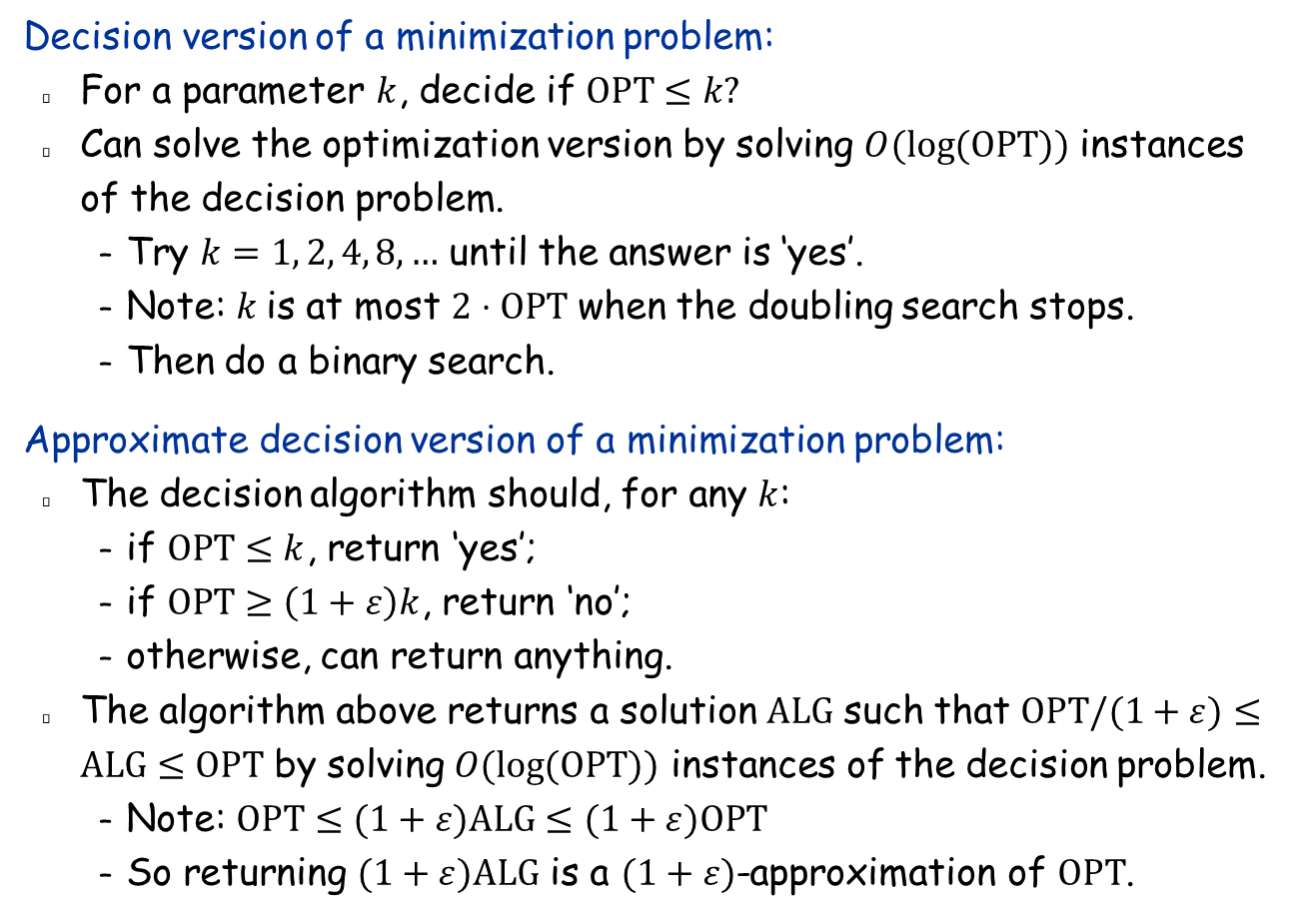
Decision Problems and Optimization Problems
Decision version of a minimization problem:
For a parameter $k$, decide if $OPT≤k?$
Can solve the optimization version by solving $O(\log{(OPT}))$ instances of the decision problem.
Try $k=1, 2, 4, 8,…$ until the answer is ‘yes’.
Note: $k$is at most $2⋅OPT$ when the doubling search stops.
Then do a binary search.
Approximate decision version of a minimization problem:
The decision algorithm should, for any $k$:
if $OPT≤k$, return ‘yes’;
if $OPT≥\left(1+ε\right)k$, return ‘no’;
otherwise, can return anything.
The algorithm above returns a solution $ALG$ such that $OPT/(1+ε)≤ALG≤OPT$ by solving $O(\log{(OPT}))$ instances of the decision problem.
Note: $OPT≤(1+ε)ALG≤(1+ε)OPT$
So returning $(1+ε)ALG$ is a $(1+ε)$-approximation of $OPT$.

Slide 49
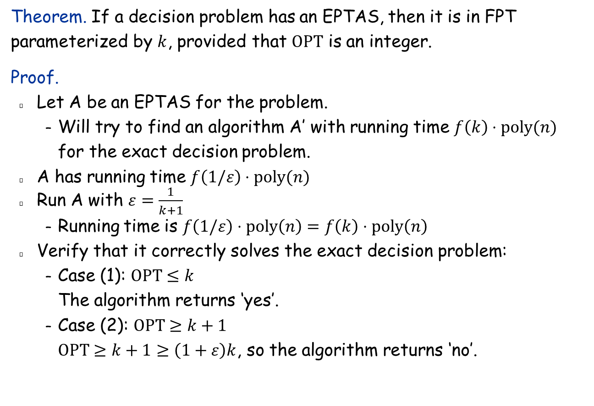
EPTAS and FPT
Theorem. If a decision problem has an EPTAS, then it is in FPT parameterized by $k$, provided that $OPT$ is an integer.
Proof.
Let A be an EPTAS for the problem.
Will try to find an algorithm A’ with running time $f\left(k\right)⋅poly(n)$ for the exact decision problem.
A has running time $f\left(1/ε\right)⋅poly(n)$
Run A with $ε=\frac{1}{k+1}$
Running time is $f\left(1/ε\right)⋅poly\left(n\right)=f\left(k\right)⋅poly\left(n\right)$
Verify that it correctly solves the exact decision problem:
Case (1): $OPT≤k$ The algorithm returns ‘yes’.
Case (2): $OPT≥k+1$ $OPT≥k+1≥\left(1+ε\right)k$, so the algorithm returns ‘no’.

Slide 50

Knapsack Problem
Knapsack problem.
Given $n$ objects and a “knapsack”.
Item $i$ has value $v_{i}>0$ and weighs $w_{i}>0$.
Knapsack can carry weight up to W. (We assume $w_{i}≤W$)
Goal: fill knapsack so as to maximize total value.
Ex: { 3, 4 } has value 40.
Item
Value
Weight
1
1
1
2
6
2
W = 11
3
18
5
4
22
6
5
28
7
Notes:
Fractional version can be solved optimally by Greedy

Slide 51
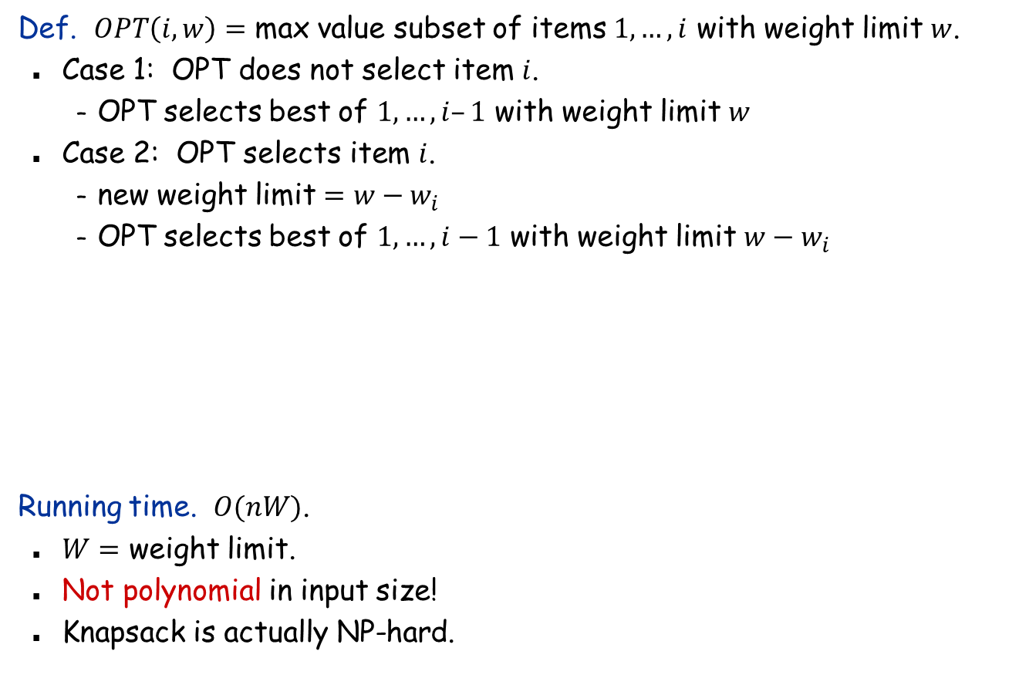
Knapsack Problem: Dynamic Programming I
Def. $OPT\left(i, w\right)=$ max value subset of items $1,…, i$ with weight limit $w$.
Case 1: OPT does not select item $i$.
OPT selects best of $1, …, i–1$ with weight limit $w$
Case 2: OPT selects item $i$.
new weight limit $=w−w_{i}$
OPT selects best of $1, …, i−1$ with weight limit $w−w_{i}$
Running time. $O(nW)$.
$W=$ weight limit.
Not polynomial in input size!
Knapsack is actually NP-hard.

Slide 52
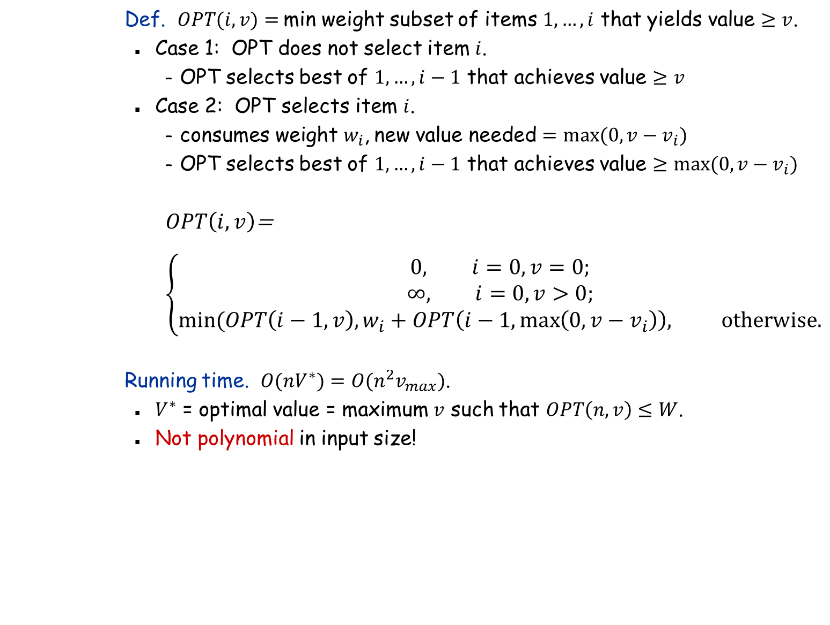
Knapsack Problem: Dynamic Programming II
Def. $OPT(i, v)=$min weight subset of items $1, …, i$ that yields value $≥v$.
Case 1: OPT does not select item $i$.
OPT selects best of $1, …, i−1$ that achieves value $≥v$
Case 2: OPT selects item $i$.
consumes weight $w_{i}$, new value needed $=max⁡(0, v−v_{i})$
OPT selects best of $1, …, i−1$ that achieves value $≥max⁡(0, v−v_{i})$
$OPT\left(i, v\right)$=
$$\left\{\begin{aligned}0, i=0,v=0; \\ ∞, i=0, v>0; \\ min⁡(OPT\left(i−1,v\right), w_{i}+OPT\left(i−1,\max\left(0,v−v_{i}\right)\right), \text{otherwise}\text{.}\end{aligned}\right.$$
Running time. $O(nV^{∗})=O(n^{2}v_{max})$.
$V^{∗}$ = optimal value = maximum $v$ such that $OPT\left(n, v\right)≤W$.
Not polynomial in input size!

Slide 53
Knapsack: FPTAS
Intuition for approximation algorithm.
Round all values up to lie in smaller range.
Run dynamic programming algorithm on rounded instance.
Return optimal items in rounded instance.
Item
Value
Weight
Item
Value
Weight
1
2,134,221
1
1
3
1
2
6,656,342
2
2
7
2
3
18,810,013
5
3
19
5
4
22,217,800
6
4
23
6
5
28,343,199
7
5
29
7
W = 11
W = 11
original instance
rounded instance

Slide 54
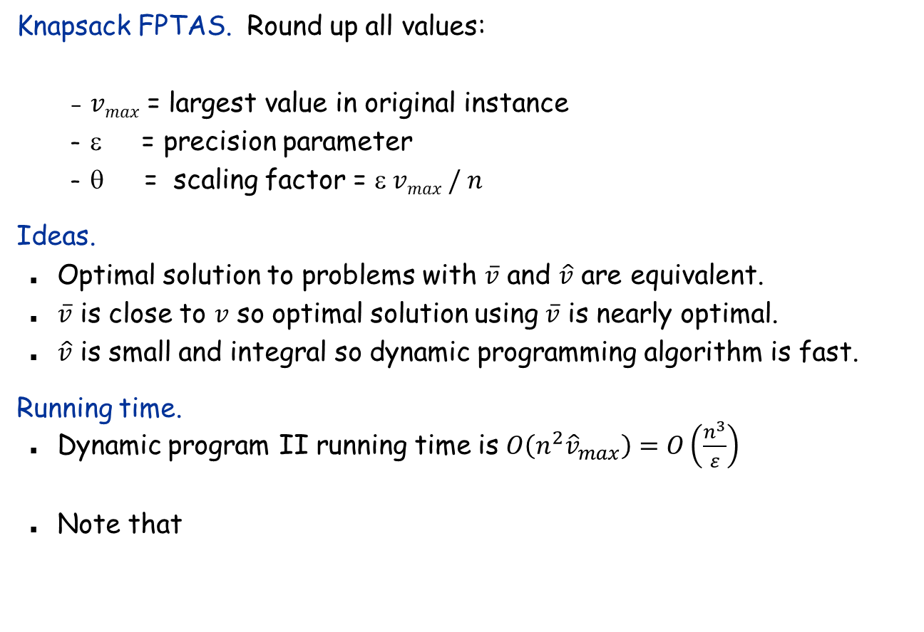
Knapsack: FPTAS
Knapsack FPTAS. Round up all values:
$vmax$ = largest value in original instance
ε = precision parameter
θ = scaling factor = $ vmax / n$
Ideas.
Optimal solution to problems with $\overline{v}$ and $\hat{v}$ are equivalent.
$\overline{v}$ is close to $v$ so optimal solution using $\overline{v}$ is nearly optimal.
$\hat{v}$ is small and integral so dynamic programming algorithm is fast.
Running time.
Dynamic program II running time is $O\left(n^{2}{\hat{v}}_{max}\right)=O\left(\frac{n^{3}}{ε}\right)$
Note that

Slide 55

Knapsack: FPTAS
Theorem. If $S$ is solution found by our algorithm and $S^{∗}$ is the optimal solution, then
Pf. $\sum_{i∈S}{v_{i}}≥\sum_{i∈S}{({\overline{v}}_{i}}−θ)$
$≥\sum_{i∈S}{{\overline{v}}_{i}}−nθ$
$≥\sum_{i∈S^{∗}}{{\overline{v}}_{i}}−nθ$
$≥\sum_{i∈S^{∗}}{{\overline{v}}_{i}}−ε\sum_{i∈S^{∗}}{v_{i}}$
$≥(1−ε)\sum_{i∈S^{∗}}{v_{i}}$
never round up by more than θ
|S| ≤ n
solve rounded instance optimally
always round up
n θ = ε v_{max}, v_{max} ≤ Σ_{i∈S*} v_{i}
Note: ALG > (1 – ε) OPT is actually as good as
ALG > OPT /(1 + ε), since 1 – ε > 1/(1 + 2ε), for ε small enough. Replacing ε with ε/2 makes the former a (1+ε)-approximation.
Q: Can we use Dynamic Programming I and round up the weights?

