Slide 1
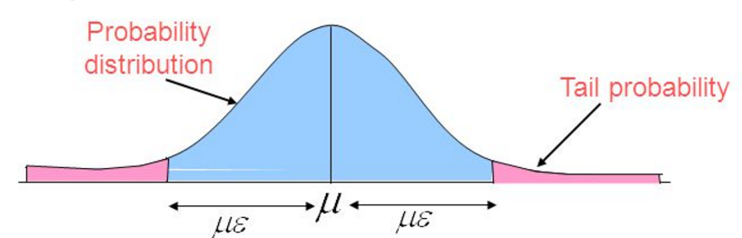
13.9 Tail Inequalities
KT 13.9
MR 3.2, 4.1

Slide 2
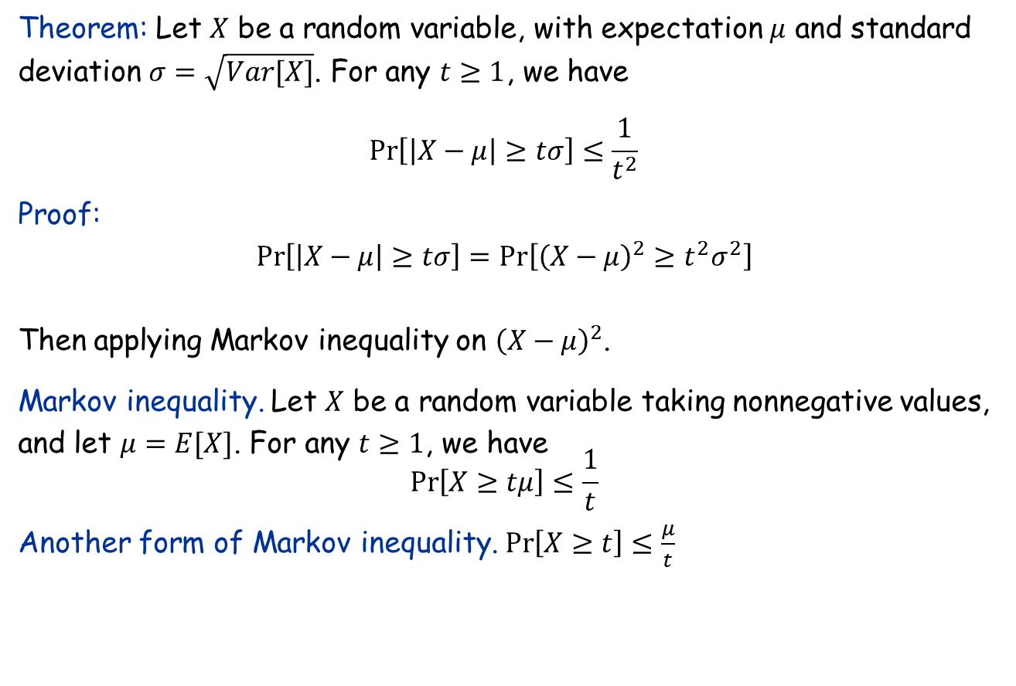
Chebyshev inequality
Theorem: Let $X$ be a random variable, with expectation $μ$ and standard deviation $σ=\sqrt{Var[X]}$. For any $t≥1$, we have $$\operatorname{Pr}\left[\left|X−μ\right|≥tσ\right]≤\frac{1}{t^{2}}$$
Proof: $$\operatorname{Pr}\left[\left|X−μ\right|≥tσ\right]=Pr\left[{\left(X−μ\right)}^{2}≥t^{2}σ^{2}\right]$$ Then applying Markov inequality on ${\left(X−μ\right)}^{2}$.
Markov inequality. Let $X$ be a random variable taking nonnegative values, and let $μ=E[X]$. For any $t≥1$, we have $$\operatorname{Pr}\left[X≥tμ\right]≤\frac{1}{t}$$
Another form of Markov inequality. $\operatorname{Pr}\left[X≥t\right]≤\frac{μ}{t}$

Slide 3
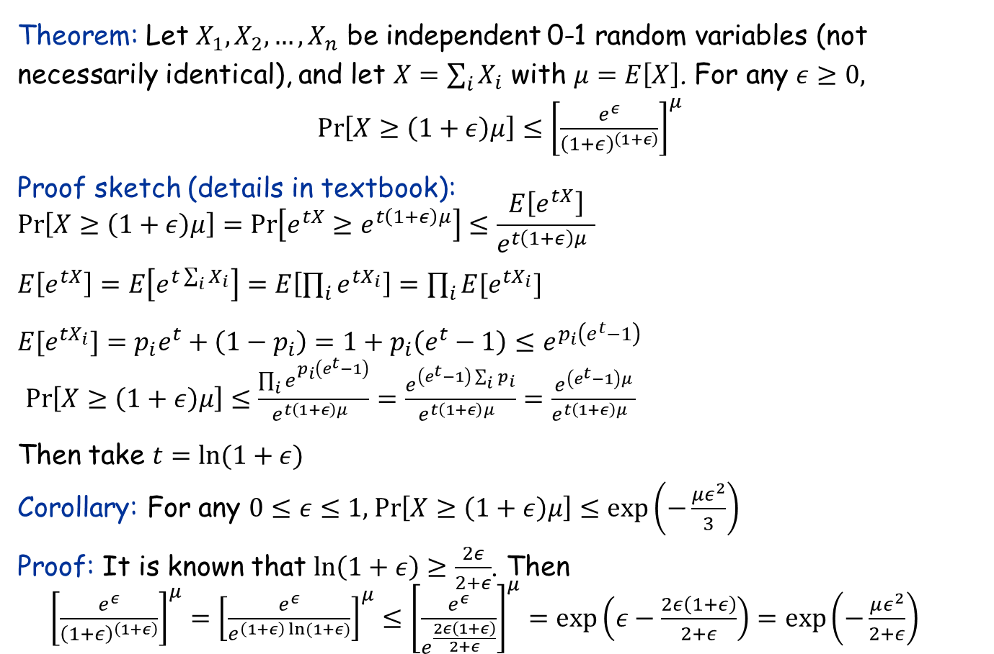
Chernoff inequality
Theorem: Let $X_{1},X_{2},…, X_{n}$ be independent 0-1 random variables (not necessarily identical), and let $X=\sum_{i}{X_{i}}$ with $μ=E\left[X\right]$. For any $ε≥0,$
$\operatorname{Pr}\left[X≥\left(1+ε\right)μ\right]≤{\left[\frac{e^{ε}}{{\left(1+ε\right)}^{\left(1+ε\right)}}\right]}^{μ}$
Proof sketch (details in textbook):
$$\operatorname{Pr}\left[X≥\left(1+ε\right)μ\right]=\operatorname{Pr}\left[e^{tX}≥e^{t\left(1+ε\right)μ}\right]≤\frac{E\left[e^{tX}\right]}{e^{t\left(1+ε\right)μ} }$$
$E\left[e^{tX}\right]=E\left[e^{t\sum_{i}{X_{i}}}\right]=E\left[\prod_{i}{e^{tX_{i}}}\right]=\prod_{i}{{E[e}^{tX_{i}}]}$
${E[e}^{tX_{i}}]=p_{i}e^{t}+\left(1−p_{i}\right)=1+p_{i}\left(e^{t}−1\right)≤e^{p_{i}\left(e^{t}−1\right)}$
$\operatorname{Pr}\left[X≥\left(1+ε\right)μ\right]≤\frac{\prod_{i}{e_{}^{p_{i}\left(e^{t}−1\right)}}}{e^{t\left(1+ε\right)μ} }=\frac{e^{\left(e^{t}−1\right)\sum_{i}{p_{i}}}}{e^{t\left(1+ε\right)μ} }=\frac{e^{\left(e^{t}−1\right)μ}}{e^{t\left(1+ε\right)μ} }$
Then take $t=\ln{(1+ε)}$
Corollary: For any $0≤ε≤1,$ $\operatorname{Pr}\left[X≥\left(1+ε\right)μ\right]≤\exp\left(−\frac{με^{2}}{3}\right)$
Proof: It is known that $ln\left(1+ε\right)≥\frac{2ε}{2+ε}$. Then
${\left[\frac{e^{ε}}{{\left(1+ε\right)}^{\left(1+ε\right)}}\right]}^{μ}={\left[\frac{e^{ε}}{e^{\left(1+ε\right)\ln{(1+ε)}}}\right]}^{μ}≤{\left[\frac{e^{ε}}{e^{\frac{2ε\left(1+ε\right)}{2+ε}}}\right]}^{μ}=\exp\left(ε−\frac{2ε\left(1+ε\right)}{2+ε}\right)=\exp\left(−\frac{με^{2}}{2+ε}\right)⁡$

Slide 4
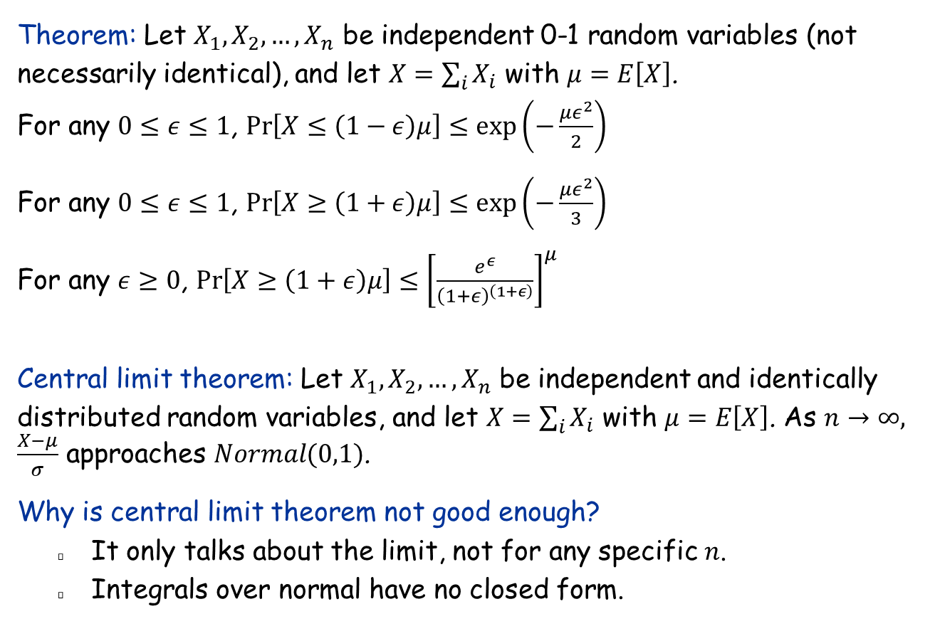
Chernoff inequality
Theorem: Let $X_{1},X_{2},…, X_{n}$ be independent 0-1 random variables (not necessarily identical), and let $X=\sum_{i}{X_{i}}$ with $μ=E\left[X\right]$.
For any $0≤ε≤1$, $\operatorname{Pr}\left[X≤\left(1−ε\right)μ\right]≤\exp\left(−\frac{με^{2}}{2}\right)$ For any $0≤ε≤1$, $\operatorname{Pr}\left[X≥\left(1+ε\right)μ\right]≤\exp\left(−\frac{με^{2}}{3}\right)$ For any $ε≥0$, $\operatorname{Pr}\left[X≥\left(1+ε\right)μ\right]≤{\left[\frac{e^{ε}}{{\left(1+ε\right)}^{\left(1+ε\right)}}\right]}^{μ}$
Central limit theorem: Let $X_{1},X_{2},…, X_{n}$ be independent and identically distributed random variables, and let $X=\sum_{i}{X_{i}}$ with $μ=E\left[X\right]$. As $n→∞, \frac{X−μ}{σ}$ approaches $Normal(0,1)$.
Why is central limit theorem not good enough?
It only talks about the limit, not for any specific $n$.
Integrals over normal have no closed form.

Slide 5
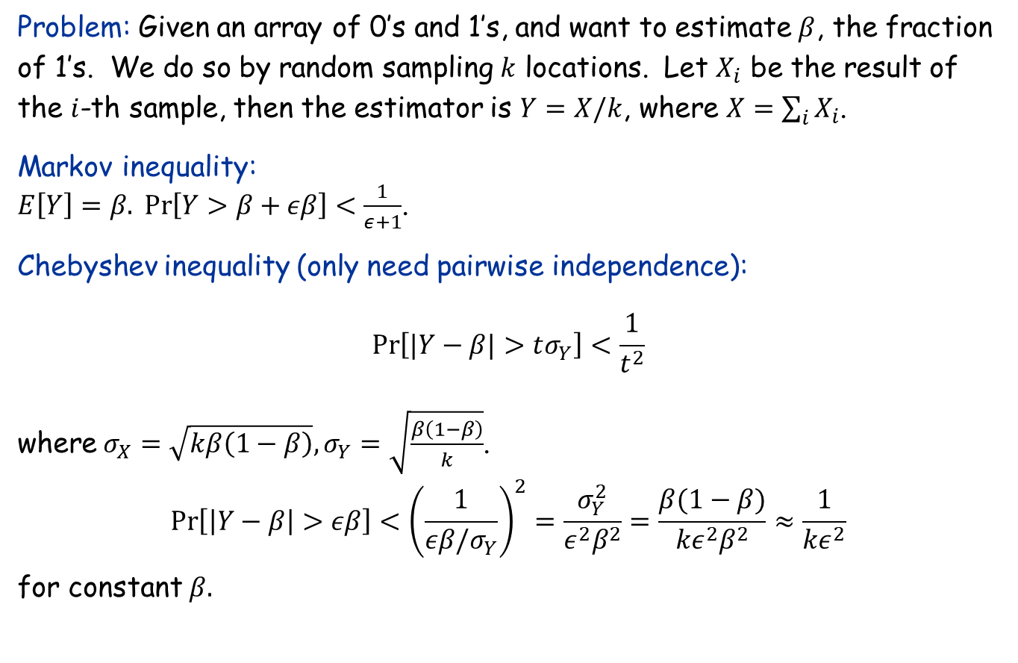
Application to Random Sampling
Problem: Given an array of 0’s and 1’s, and want to estimate $β$, the fraction of 1’s. We do so by random sampling $k$ locations. Let $X_{i}$ be the result of the $i$-th sample, then the estimator is $Y=X/k$, where $X=\sum_{i}{X_{i}}$.
Markov inequality: $E\left[Y\right]=β. \operatorname{Pr}\left[Y>β+εβ\right]<\frac{1}{ε+1}$.
Chebyshev inequality (only need pairwise independence):
$$\operatorname{Pr}\left[|Y−β|>tσ_{Y}\right]<\frac{1}{t^{2}}$$
where $σ_{X}=\sqrt{kβ\left(1−β\right)}, σ_{Y}=\sqrt{\frac{β\left(1−β\right)}{k}}$.
$$\operatorname{Pr}\left[\left|Y−β\right|>εβ\right]<{\left(\frac{1}{εβ/σ_{Y}}\right)}^{2}=\frac{σ_{Y}^{2}}{ε^{2}β^{2}}=\frac{β(1−β)}{{kε}^{2}β^{2}}≈\frac{1}{kε^{2}}$$
for constant $β.$

Slide 6
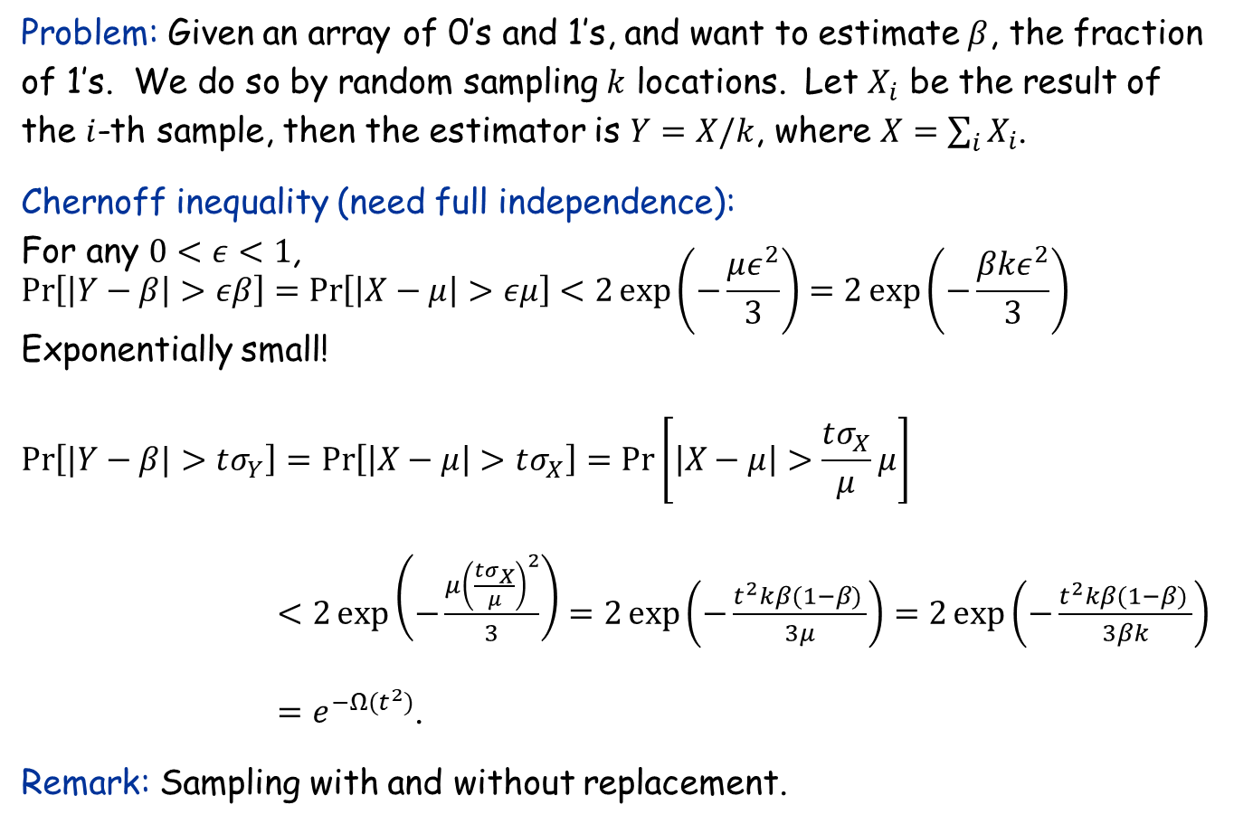
Application to Random Sampling
Problem: Given an array of 0’s and 1’s, and want to estimate $β$, the fraction of 1’s. We do so by random sampling $k$ locations. Let $X_{i}$ be the result of the $i$-th sample, then the estimator is $Y=X/k$, where $X=\sum_{i}{X_{i}}$.
Chernoff inequality (need full independence): For any $0<ε<1$, $$\operatorname{Pr}\left[\left|Y−β\right|>εβ\right]=\operatorname{Pr}\left[\left|X−μ\right|>εμ\right]<2\exp\left(−\frac{με^{2}}{3}\right)=2\exp\left(−\frac{βkε^{2}}{3}\right)$$ Exponentially small!
$$\operatorname{Pr}\left[|Y−β|>tσ_{Y}\right]=\operatorname{Pr}\left[\left|X−μ\right|>tσ_{X}\right]=\operatorname{Pr}\left[\left|X−μ\right|>\frac{tσ_{X}}{μ}μ\right]$$
$<2\exp\left(−\frac{μ{\left(\frac{tσ_{X}}{μ}\right)}^{2}}{3}\right)=2\exp\left(−\frac{t^{2}kβ(1−β) }{3μ}\right)=2\exp\left(−\frac{t^{2}kβ(1−β) }{3βk}\right)$ $=e^{−Ω(t^{2})}$.
Remark: Sampling with and without replacement.

Slide 7
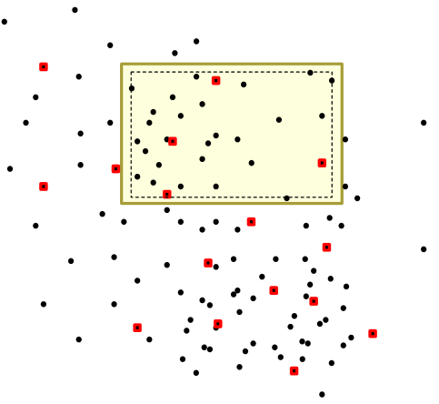
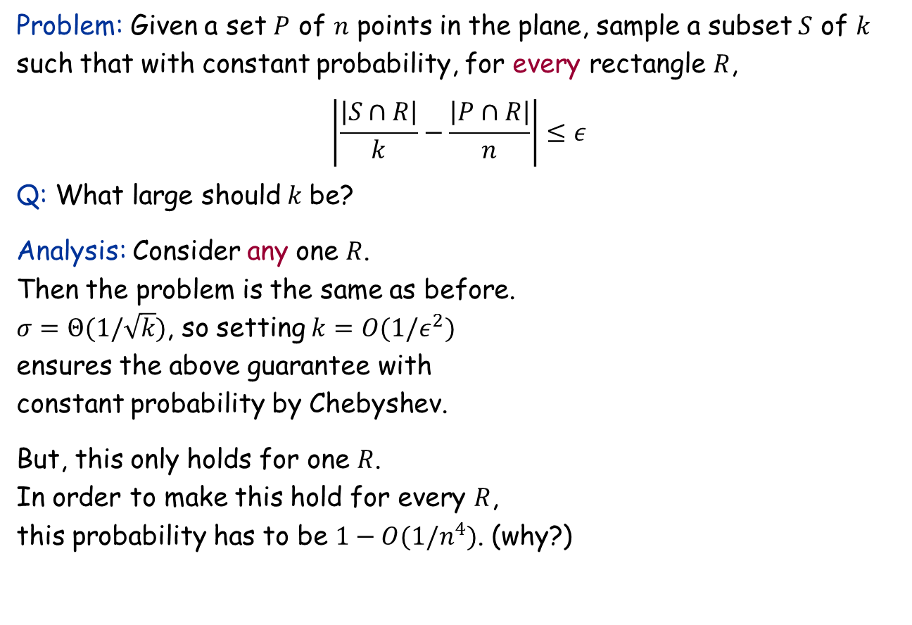
Random Sampling for Density Approximation
Problem: Given a set $P$ of $n$ points in the plane, sample a subset $S$ of $k$ such that with constant probability, for every rectangle $R$, $$\left|\frac{\left|S∩R\right|}{k}−\frac{\left|P∩R\right|}{n}\right|≤ε$$
Q: What large should$k$ be?
Analysis: Consider any one $R$. Then the problem is the same as before. $σ=Θ(1/\sqrt{k})$, so setting $k=O(1/ε^{2})$ ensures the above guarantee with constant probability by Chebyshev.
But, this only holds for one $R$. In order to make this hold for every $R$, this probability has to be $1−O(1/n^{4})$. (why?)

Slide 8
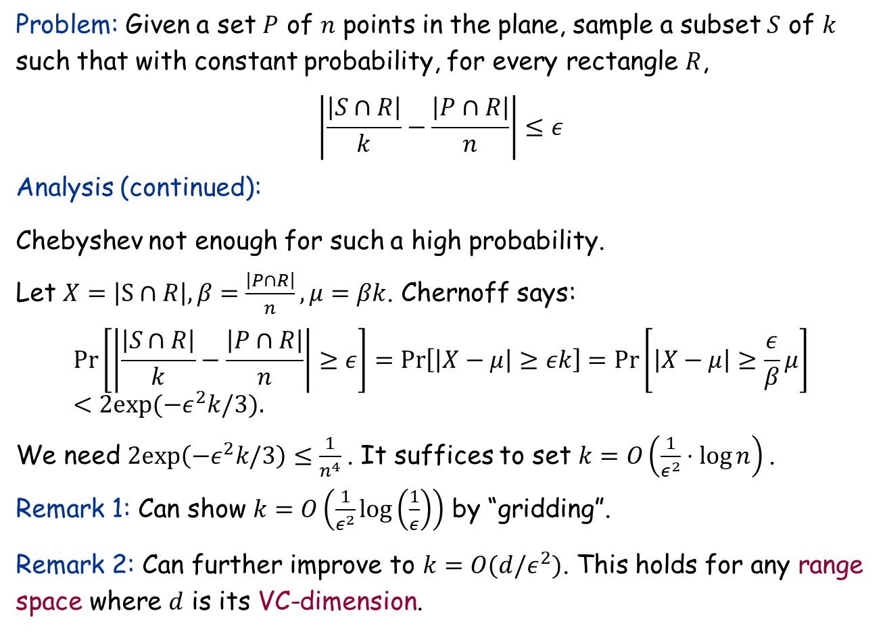
Random Sampling for Density Approximation
Problem: Given a set $P$ of $n$ points in the plane, sample a subset $S$ of $k$ such that with constant probability, for every rectangle $R$, $$\left|\frac{\left|S∩R\right|}{k}−\frac{\left|P∩R\right|}{n}\right|≤ε$$
Analysis (continued):
Chebyshev not enough for such a high probability.
Let $X=\left|S∩R\right|, β=\frac{\left|P∩R\right|}{n},μ=βk$. Chernoff says: $$Pr\left[\left|\frac{\left|S∩R\right|}{k}−\frac{\left|P∩R\right|}{n}\right|≥ε\right]=\operatorname{Pr}\left[\left|X−μ\right|≥εk\right]=\operatorname{Pr}\left[\left|X−μ\right|≥\frac{ε}{β}μ\right] \\ <2exp({−ε}^{2}k/3).$$
We need $2exp\left(−ε^{2}k/3\right)≤\frac{1}{n^{4}}$. It suffices to set $k=O\left(\frac{1}{ε^{2}}⋅log{n}\right)$.
Remark 1: Can show $k=O\left(\frac{1}{ε^{2}}\log\left(\frac{1}{ε}\right)\right)$ by “gridding”.
Remark 2: Can further improve to $k=O(d/ε^{2})$. This holds for any range space where $d$ is its VC-dimension.

Slide 9
13.10 Balls and Bins

Slide 10
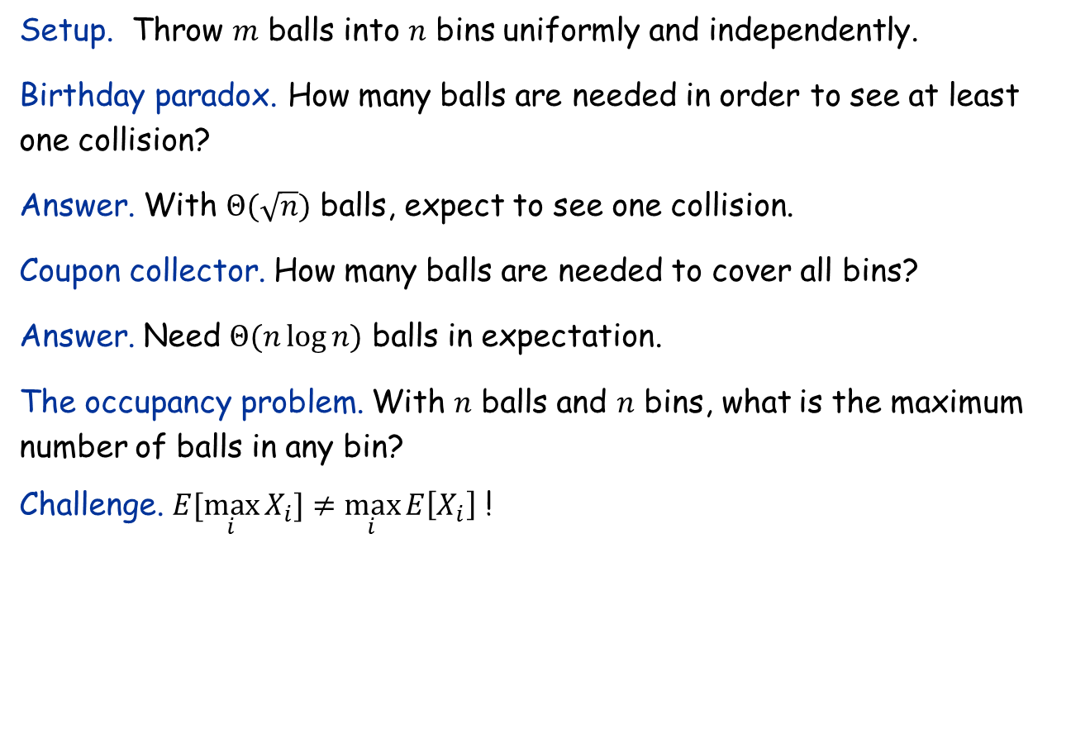
Balls and Bins
Setup. Throw $m$ balls into $n$ bins uniformly and independently.
Birthday paradox. How many balls are needed in order to see at least one collision?
Answer. With $Θ(\sqrt{n})$ balls, expect to see one collision.
Coupon collector. How many balls are needed to cover all bins?
Answer. Need $Θ(n\log{n)}$ balls in expectation.
The occupancy problem. With $n$ balls and $n$ bins, what is the maximum number of balls in any bin?
Challenge. $E[\max_{i}{X_{i}]≠\max_{i}{E\left[X_{i}\right]}}$ !

Slide 11
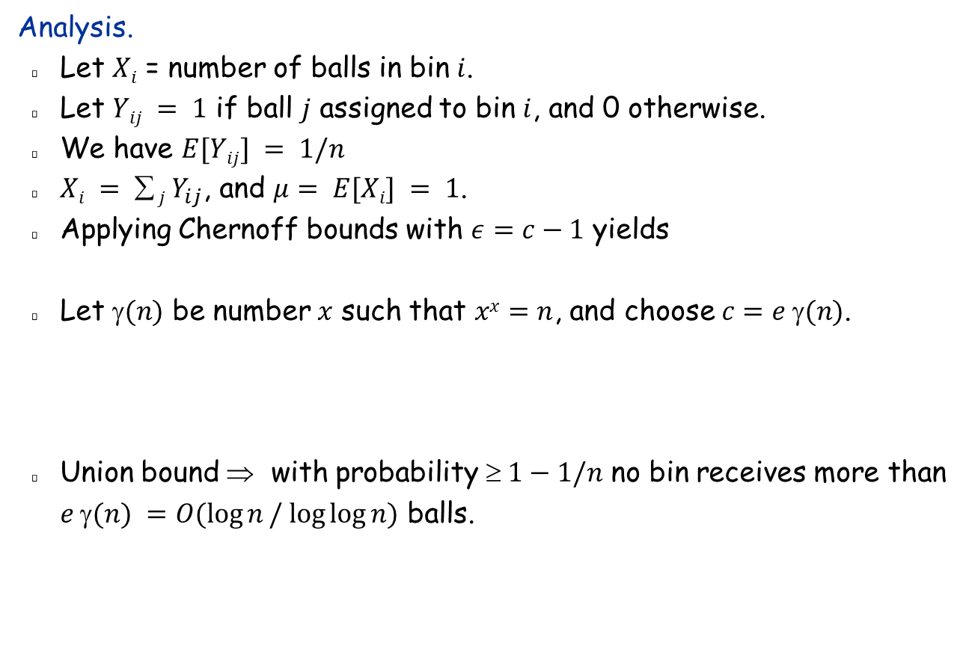

The Occupancy Problem
Analysis.
Let $Xi$ = number of balls in bin $i$.
Let $Yij = 1$ if ball $j$ assigned to bin $i$, and 0 otherwise.
We have $E[Yij] = 1/n$
$Xi =  j Y_{ij}$, and $μ= E[Xi] = 1$.
Applying Chernoff bounds with $ε=c−1$ yields
Let $(n)$ be number $x$ such that $xx=n$, and choose $c=e (n)$.
Union bound ⇒ with probability $ 1−1/n$ no bin receives more than $e γ(n) =O(\log{n}/ log⁡log⁡n)$ balls.
Fact: this bound is asymptotically tight: with high probability, some bin receives $Ω(\log{n}/ log⁡log⁡n)$

Slide 12
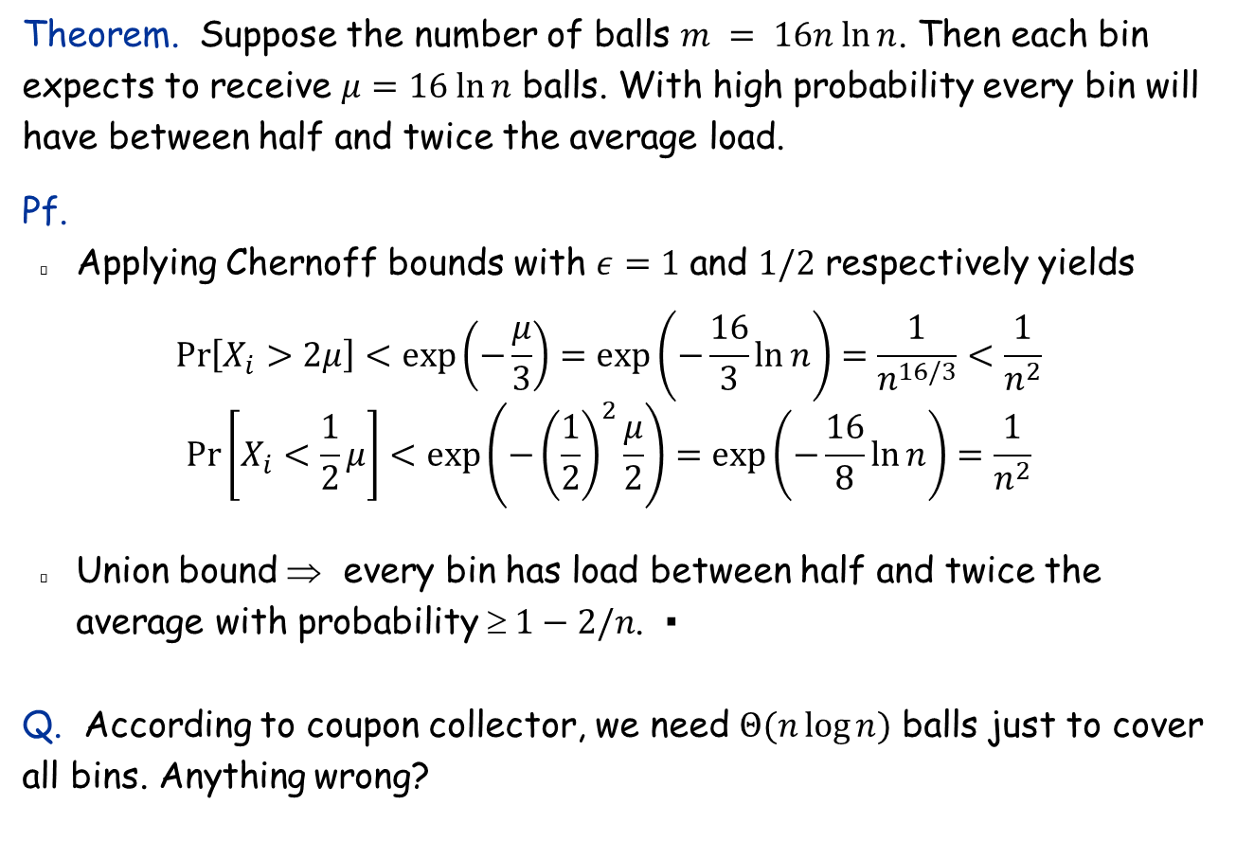
Even more balls
Theorem. Suppose the number of balls $m = 16n ln⁡n$. Then each bin expects to receive $μ=16 ln⁡n$ balls. With high probability every bin will have between half and twice the average load.
Pf.
Applying Chernoff bounds with $ε=1$ and $1/2$ respectively yields
$$\operatorname{Pr}\left[X_{i}>2μ\right]<\exp\left(−\frac{μ}{3}\right)=\exp\left(−\frac{16}{3}\ln{n}\right)=\frac{1}{n^{16/3}}<\frac{1}{n^{2}}$$
$$\operatorname{Pr}\left[X_{i}<\frac{1}{2}μ\right]<\exp\left(−{\left(\frac{1}{2}\right)}^{2}\frac{μ}{2}\right)=\exp\left(−\frac{16}{8}\ln{n}\right)=\frac{1}{n^{2}}$$
Union bound ⇒ every bin has load between half and twice the average with probability $ 1−2/n$. ▪
Q. According to coupon collector, we need $Θ(n\log{n)}$ balls just to cover all bins. Anything wrong?

Slide 13
More Applications with Chernoff

Slide 14
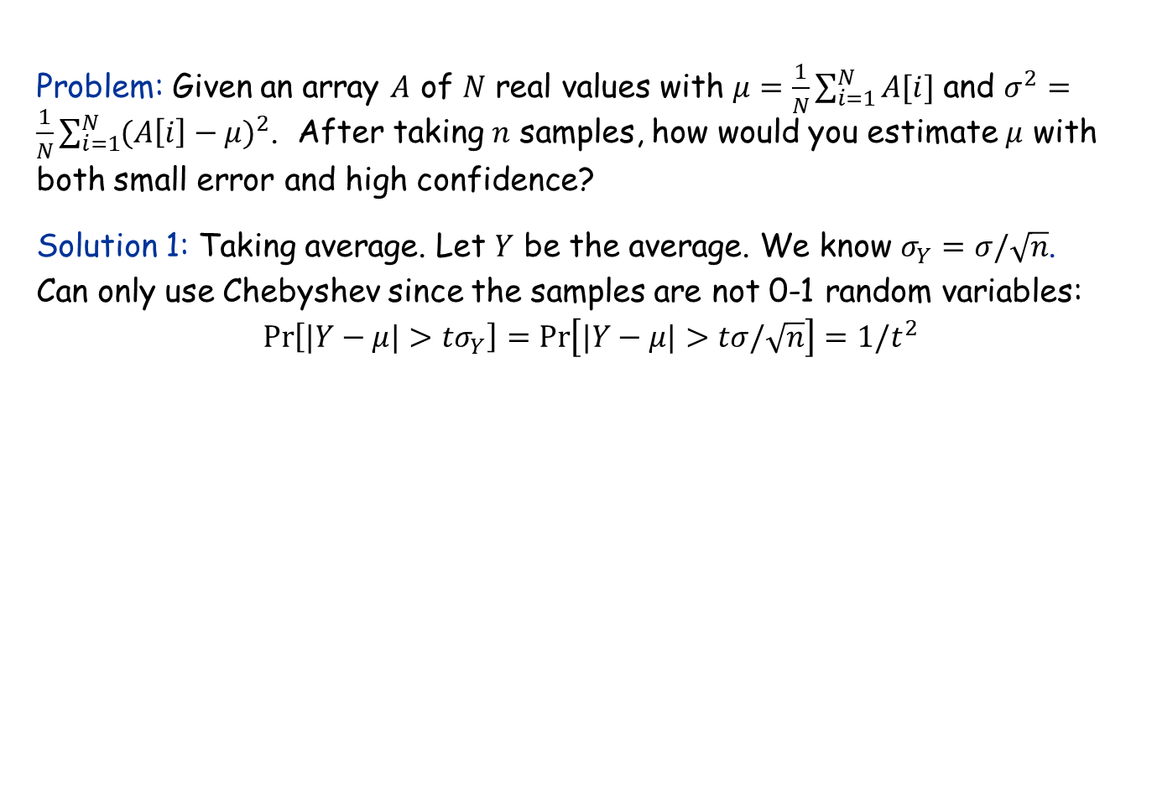
Sampling from a general distribution
Problem: Given an array $A$ of $N$ real values with $μ=\frac{1}{N}\sum_{i=1}^{N}{A[i]}$ and $σ^{2}=\frac{1}{N}\sum_{i=1}^{N}{(A{\left[i\right]−μ)}^{2}}$. After taking $n$ samples, how would you estimate $μ$ with both small error and high confidence?
Solution 1: Taking average. Let $Y$ be the average. We know $σ_{Y}=σ/\sqrt{n}$. Can only use Chebyshev since the samples are not 0-1 random variables: $$\operatorname{Pr}\left[|Y−μ|>tσ_{Y}\right]=\operatorname{Pr}\left[|Y−μ|>tσ/\sqrt{n}\right]=1/t^{2}$$

Slide 15
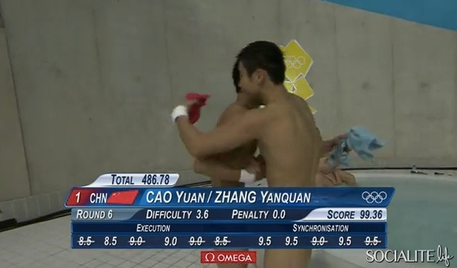
Score computation in Olympics: Truncated Mean

Slide 16
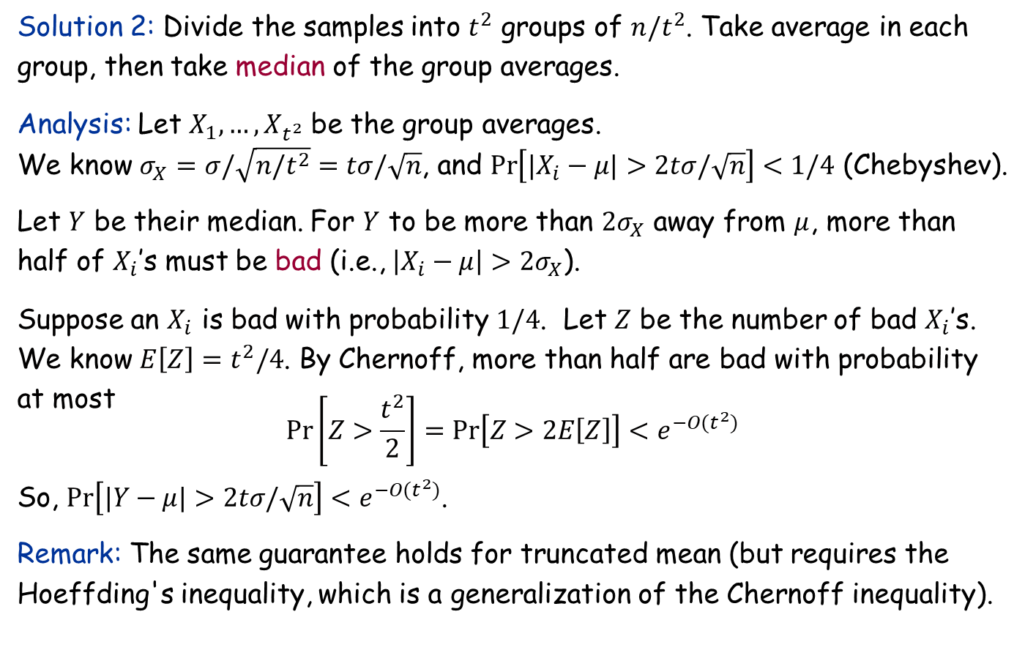
“Median of averages” technique
Solution 2: Divide the samples into $t^{2}$ groups of $n/t^{2}$. Take average in each group, then take median of the group averages.
Analysis: Let $X_{1},…,X_{t^{2}}$ be the group averages. We know $σ_{X}=σ/\sqrt{n/t^{2}}=tσ/\sqrt{n}$, and $\operatorname{Pr}\left[|X_{i}−μ|>2tσ/\sqrt{n}\right]<1/4$ (Chebyshev).
Let $Y$ be their median. For $Y$ to be more than $2σ_{X}$ away from $μ$, more than half of $X_{i}$’s must be bad (i.e., $\left|X_{i}−μ\right|>2σ_{X}$).
Suppose an $X_{i}$ is bad with probability $1/4$. Let $Z$ be the number of bad $X_{i}$’s. We know $E\left[Z\right]=t^{2}/4$. By Chernoff, more than half are bad with probability at most $$Pr\left[Z>\frac{t^{2}}{2}\right]=Pr\left[Z>2E\left[Z\right]\right]<e^{−O(t^{2})}$$
So, $Pr\left[|Y−μ|>2tσ/\sqrt{n}\right]<e^{−O(t^{2})}$.
Remark: The same guarantee holds for truncated mean (but requires the Hoeffding's inequality, which is a generalization of the Chernoff inequality).

Slide 17
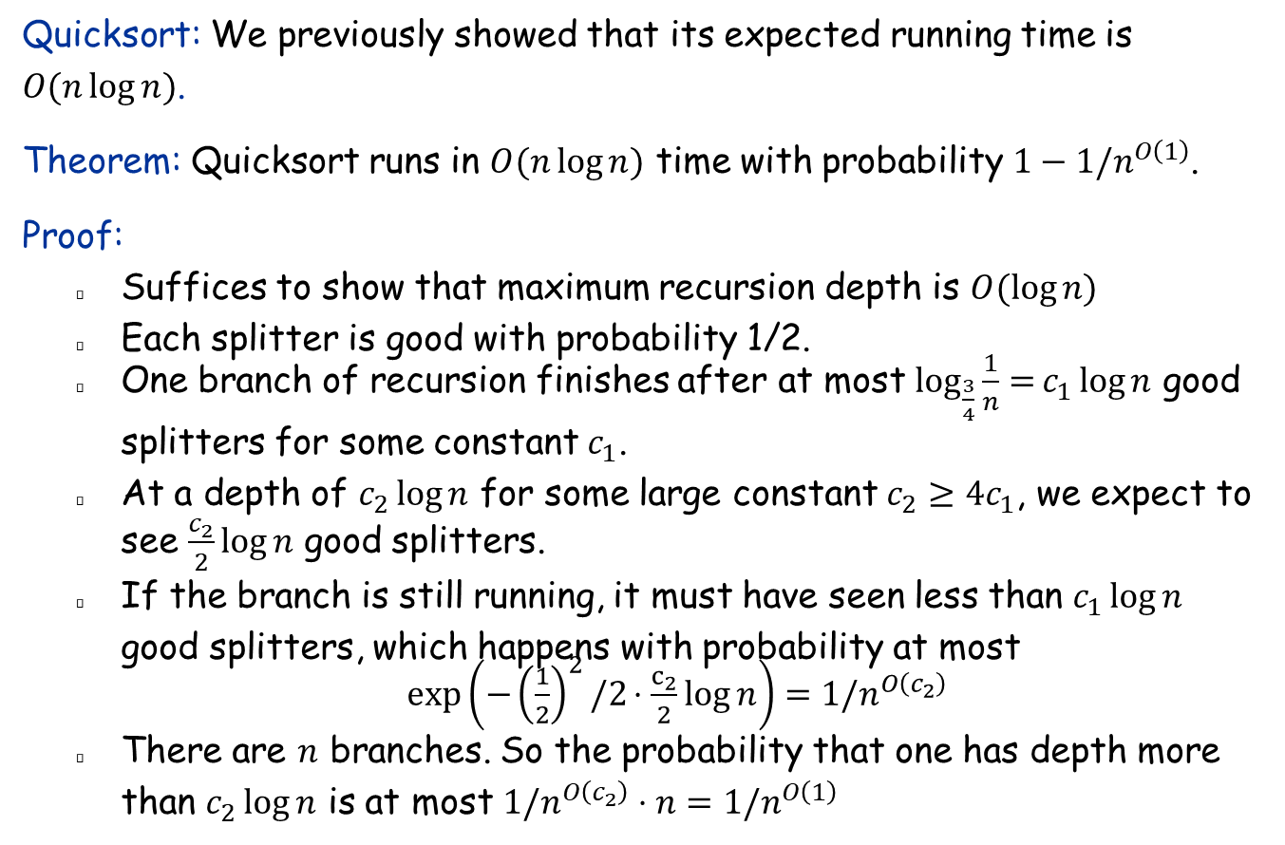
High probability bound on running time
Quicksort: We previously showed that its expected running time is $O(n\log{n})$.
Theorem: Quicksort runs in $O(n\log{n})$ time with probability $1−1/n^{O\left(1\right)}$.
Proof:
Suffices to show that maximum recursion depth is $O(\log{n)}$
Each splitter is good with probability 1/2.
One branch of recursion finishes after at most $\log_{\frac{3}{4}}\frac{1}{n}{=}c_{1}\log{n}$ good splitters for some constant $c_{1}$.
At a depth of $c_{2}\log{n}$ for some large constant $c_{2}≥4c_{1}$, we expect to see $\frac{c_{2}}{2}\log{n}$ good splitters.
If the branch is still running, it must have seen less than $c_{1}\log{n}$ good splitters, which happens with probability at most
$\exp\left(−{\left(\frac{1}{2}\right)}^{2}/2⋅\frac{c_{2}}{2}log{n}\right)=1/n^{O\left(c_{2}\right)}$
There are $n$ branches. So the probability that one has depth more than $c_{2}\log{n}$ is at most $1/n^{O\left(c_{2}\right)}⋅n=1/n^{O\left(1\right)}$

Slide 18
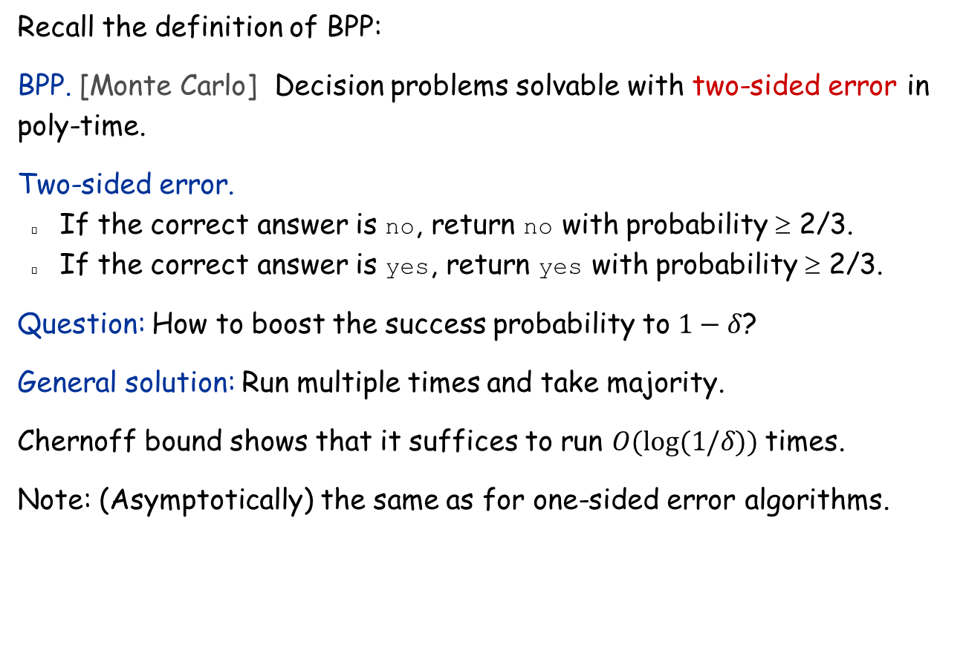
Chernoff Bound: Probability Boosting
Recall the definition of BPP:
BPP. [Monte Carlo] Decision problems solvable with two-sided error in poly-time.
Two-sided error.
If the correct answer is no, return no with probability ≥ 2/3.
If the correct answer is yes, return yes with probability ≥ 2/3.
Question: How to boost the success probability to $1−δ$?
General solution: Run multiple times and take majority.
Chernoff bound shows that it suffices to run $O(log⁡(1/δ))$times.
Note: (Asymptotically) the same as for one-sided error algorithms.

