Slide 1
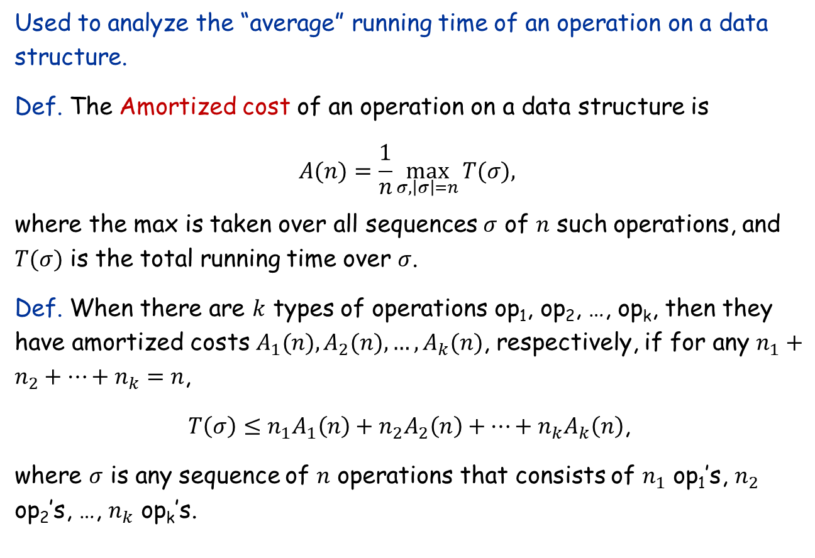
Amortized Analysis
Used to analyze the “average” running time of an operation on a data structure.
Def. The Amortized cost of an operation on a data structure is $$A(n)=\frac{1}{n}\max_{σ,\left|σ\right|=n}⁡T(σ),$$
where the max is taken over all sequences $σ$ of $n$ such operations, and $T(σ)$ is the total running time over $σ$.
Def. When there are $k$ types of operations op₁, op₂, …, op_{k}, then they have amortized costs $A_{1}(n), A_{2}(n), …, A_{k}(n)$, respectively, if for any $n_{1}+n_{2}+…+n_{k}=n$,
$T\left(σ\right)≤n_{1}A_{1}\left(n\right)+n_{2}A_{2}\left(n\right)+…+n_{k}A_{k}\left(n\right)$,
where $σ$ is any sequence of $n$ operations that consists of $n_{1}$ op₁’s, $n_{2}$ op₂’s, …, $n_{k}$ op_{k}’s.

Slide 2
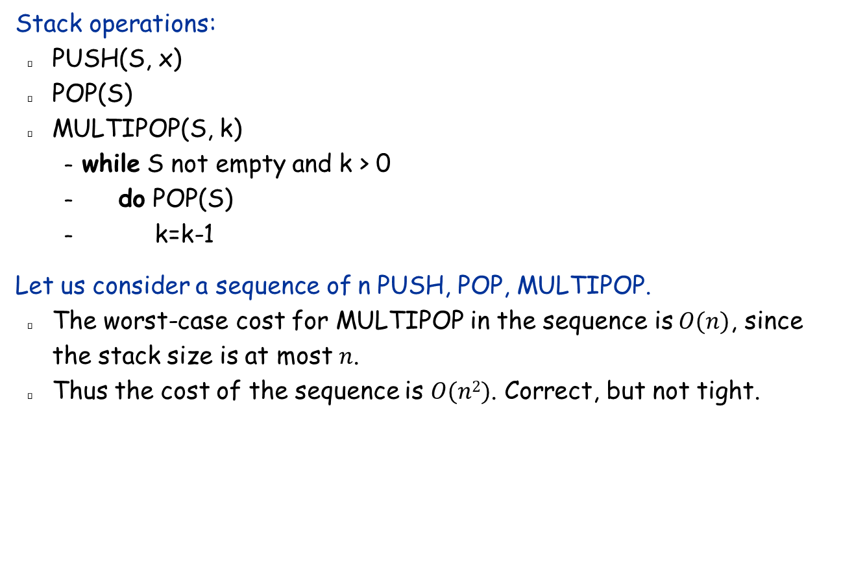
Example for amortized analysis
Stack operations:
PUSH(S, x)
POP(S)
MULTIPOP(S, k)
while S not empty and k > 0
do POP(S)
k=k-1
Let us consider a sequence of n PUSH, POP, MULTIPOP.
The worst-case cost for MULTIPOP in the sequence is $O(n)$, since the stack size is at most $n$.
Thus the cost of the sequence is $O(n2)$. Correct, but not tight.

Slide 3

Aggregate Analysis
In fact, a sequence of $n$ operations on an initially empty stack cost at most $O(n)$.
An object can be POPed only once (including in MULTIPOP) after it has been PUSHed.
#POPs is at most #PUSHs, which is at most $n$.
Thus the amortized cost of any operation is $O(n)/n=O(1)$.

Slide 4
Amortized Analysis
Contrast with:
Average-case analysis: Average running time of one execution of a deterministic algorithm an input randomly chosen from a distribution.
Expected-case analysis: Average running time of one execution of a randomized algorithm with internal random numbers on the worst input.
Amortized analysis:
No probability.
Average performance on a sequence of operations on a data structure, even some operation is expensive.
Guaranteed average performance per operation among a sequence of such operations in the worst case.

Slide 5
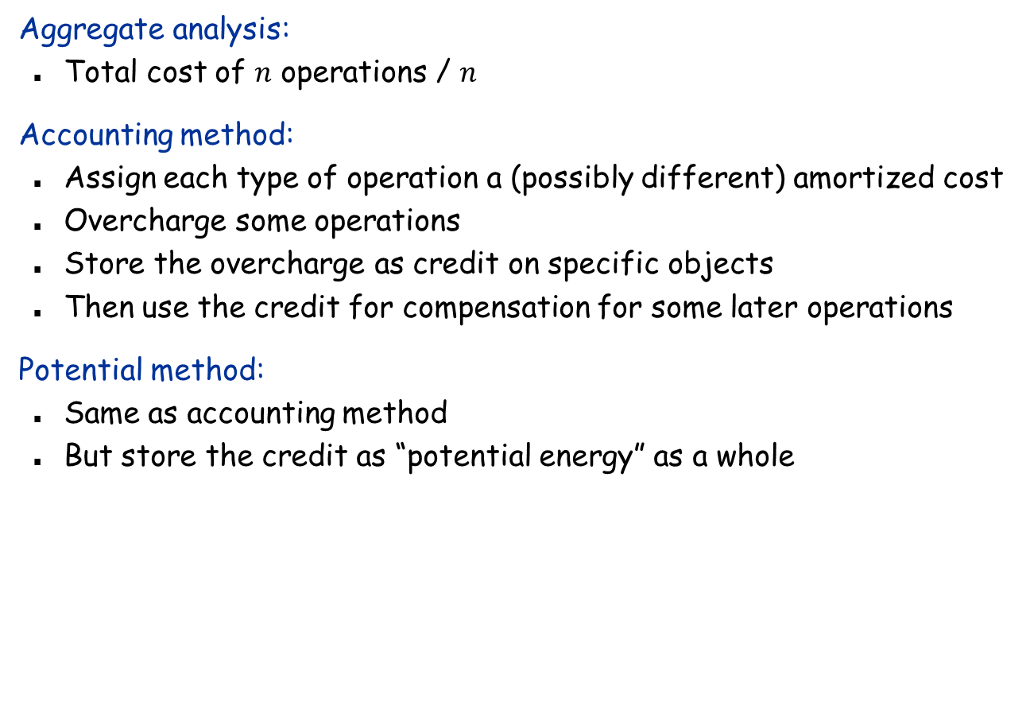
Three Methods of Amortized Analysis
Aggregate analysis:
Total cost of $n$ operations / $n$
Accounting method:
Assign each type of operation a (possibly different) amortized cost
Overcharge some operations
Store the overcharge as credit on specific objects
Then use the credit for compensation for some later operations
Potential method:
Same as accounting method
But store the credit as “potential energy” as a whole

Slide 6
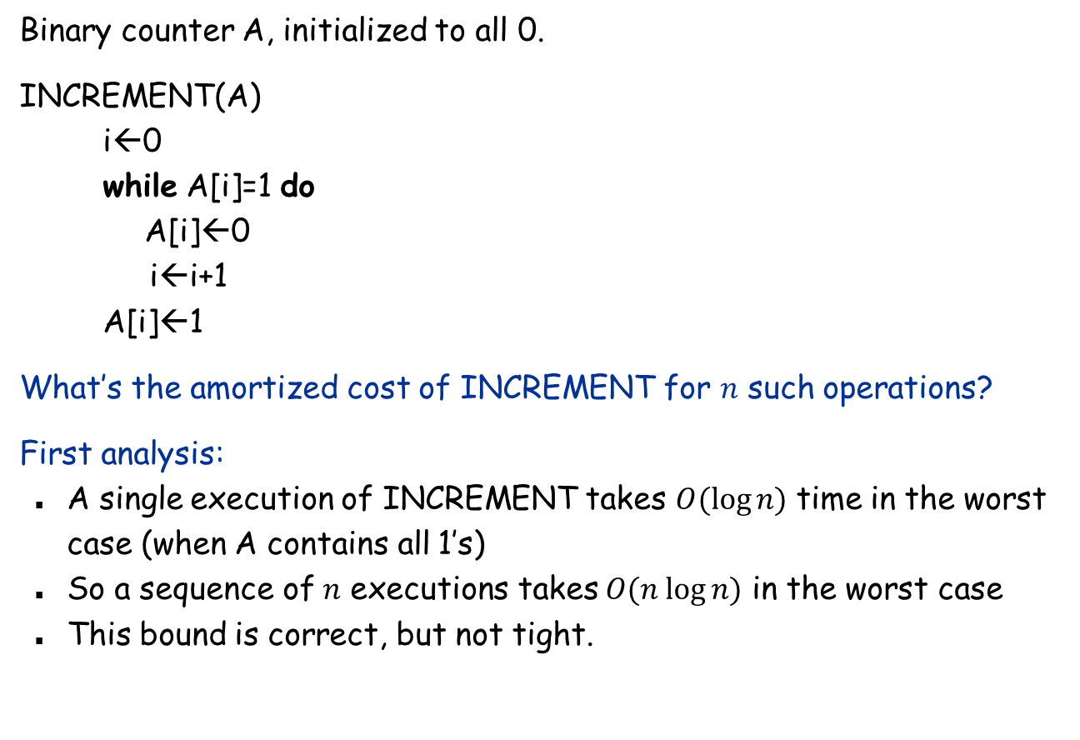
Another example: incrementing a binary counter
Binary counter A, initialized to all 0.
INCREMENT(A) i←0 while A[i]=1 do A[i]←0 i←i+1 A[i]←1
What’s the amortized cost of INCREMENT for $n$ such operations?
First analysis:
A single execution of INCREMENT takes $O(log⁡n)$ time in the worst case (when A contains all 1’s)
So a sequence of $n$ executions takes $O(n log⁡n)$ in the worst case
This bound is correct, but not tight.

Slide 7
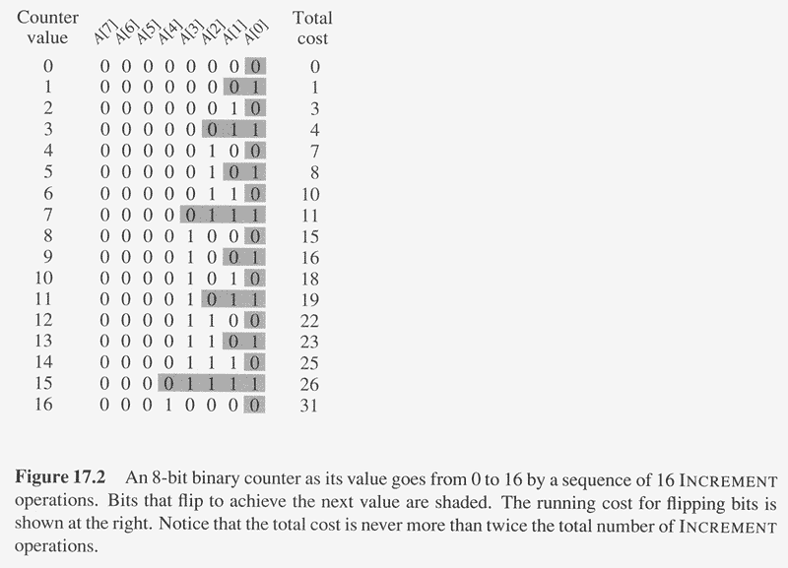

Amortized Analysis of INCREMENT(A)
Observation: The running time determined by #flips, but not all bits flip each time INCREMENT is called.
A[0] flips every time, total $n$ times.
A[1] flips every other time, $n/2$ times.
A[2] flips every forth time, $n/4$ times.
…
A[i] flips $n/2^{i}$ times.
Thus total #flips is $\sum_{i=0}^{\log{n−1}}{\frac{n}{2^{i}}=}O(n)$.
Amortized cost = O(1).

Slide 8
Amortized Analysis: Accounting Method
Idea:
Assign an amortized cost to each type of operation.
The amortized cost may be more or less than the actual cost.
When amortized cost > actual cost, the difference is saved in specific objects in the data structure as credits.
The credits can be used by later operations whose amortized cost < actual cost.

Slide 9
Accounting method: binary counter
We will show that the amortized cost of each INCREMENT is $2.
Let $1 represent each unit of cost (i.e., the flip of one bit).
Whenever a bit flips from 0 to 1, we will spend $2: $1 for the actual cost, and store another $1 on the 1-bit as credit.
When a bit is set to 0, the stored $1 pays the cost.
At most one bit flips from 0 to 1 in each INCREMENT operation, so the amortized cost of $2 is enough to cover all its flips.

Slide 10
Accounting Method: Stack Operations
Actual costs:
PUSH :1, POP :1, MULTIPOP: k.
Let’s assign the following amortized costs:
PUSH:2, POP: 0, MULTIPOP: 0.
Similar to a stack of plates in a cafeteria.
Suppose $1 represents a unit cost.
When pushing a plate, use one dollar to pay the actual cost of the PUSH and leave one dollar on the plate as credit.
When POPing a plate, the one dollar on the plate is used to pay the actual cost of the POP. (Same for MULTIPOP).
By charging PUSH a little more, we do not charge POP or MULTIPOP.
So the amortized cost is 2 for PUSH, and 0 for POP and MULTIPOP,

Slide 11
The Potential Method
Same as accounting method: something prepaid is used later.
Difference from accounting method:
The prepaid work is not stored as credit, but as “potential energy”, or “potential”.
The potential is associated with the data structure as a whole rather than with specific objects within the data structure.
Initial data structure D₀; n operations, resulting in D₀, D₁,…, D_{n} with costs c₁, c₂,…, c_{n}.
A potential function Φ: {D_{i}} → real numbers
Φ(D_{i}) is called the potential of D_{i}.
Amortized cost c_{i}' of the i-th operation is:
c_{i}' = c_{i} + Φ(D_{i}) - Φ(D_{i-1}). (actual cost + potential change)
∑_{i=1}^{n} c_{i}' = ∑_{i=1}^{n} (c_{i} + Φ(D_{i}) - Φ(D_{i-1})) = ∑_{i=1}^{n}c_{i} + Φ(D_{n}) - Φ(D₀)
It’s required that Φ(D_{n}) ≥ Φ(D₀).

Slide 12
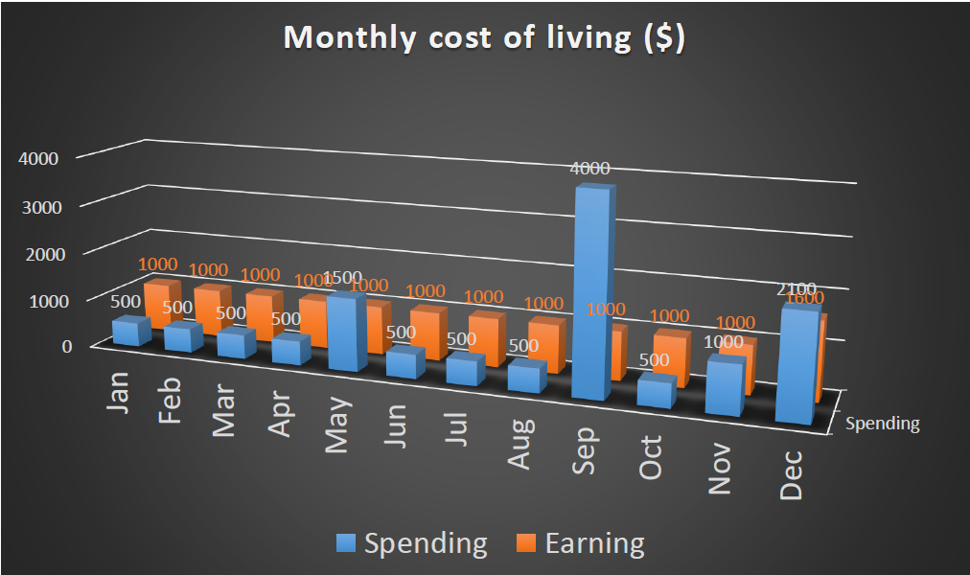
The Potential Method
Amortized cost = earning (uniform across all operations)
Actual cost = spending (small most of the time with a few exceptions)
Potential = savings (key is to relate to some measure on the data structure)

Slide 13
Potential method: stack operation
Potential for a stack := the number of objects in the stack.
So Φ(D₀)=0, and Φ(D_{i}) ≥0
Amortized cost of stack operations:
PUSH:
Potential change: Φ(D_{i}) - Φ(D_{i-1}) = 1.
Amortized cost: c_{i}' = c_{i} + Φ(D_{i}) - Φ(D_{i-1}) = 1 + 1 = 2.
POP:
Potential change: Φ(D_{i}) - Φ(D_{i-1}) = -1.
Amortized cost: c_{i}' = c_{i} + Φ(D_{i}) - Φ(D_{i-1})= 1 + (-1) = 0.
MULTIPOP(S, k):
Potential change: Φ(D_{i}) - Φ(D_{i-1}) = –k.
Amortized cost: c_{i}' = c_{i} + Φ(D_{i}) - Φ(D_{i-1}) = k + (-k) = 0.
So amortized cost of each operation is O(1).

Slide 14
Potential method: binary counter
Define the potential of the counter := the number of 1’s.
Clearly, Φ(D_{i}) ≥ 0.
The amortized cost of an operation
Suppose the ith operation sets t_{i} bits to 0 and one bit to 1.
Actual cost c_{i} of the operation is t_{i} +1.
Potential change is Φ(D_{i}) - Φ(D_{i-1}) = 1 - t_{i.}
Amortized cost is: c_{i}' = c_{i} + Φ(D_{i}) - Φ(D_{i-1}) = t_{i} + 1 + 1 – t_{i} = 2.

Slide 15
Amortized analysis: Dynamic table
Scenario:
A table (e.g., an array)
Do not know how large in advance
Insertion at the end: O(1) time if there is space
Deletion at the end: O(1) time
Rebuilding the table takes time linear to the table size
Goal:
O(1) amortized cost.
Load factor α ≥ constant fraction.

Slide 16
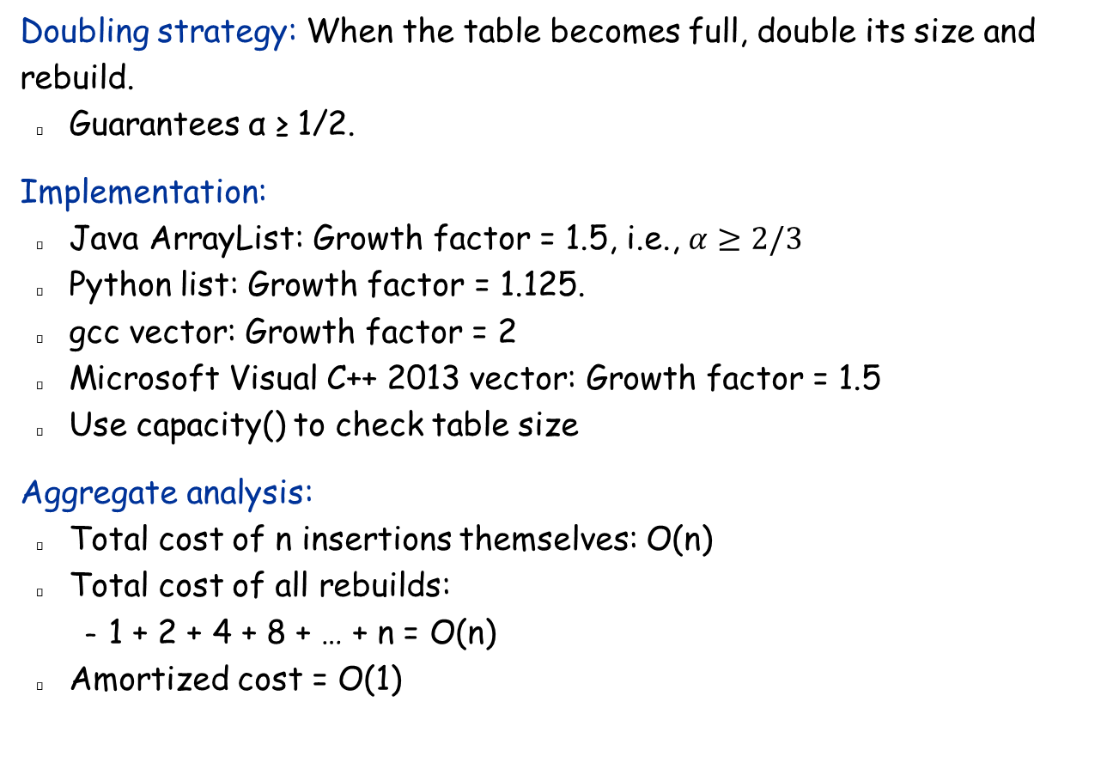
Dynamic table: expansion with insertion only
Doubling strategy: When the table becomes full, double its size and rebuild.
Guarantees α ≥ 1/2.
Implementation:
Java ArrayList: Growth factor = 1.5, i.e., $α≥2/3$
Python list: Growth factor = 1.125.
gcc vector: Growth factor = 2
Microsoft Visual C++ 2013 vector: Growth factor = 1.5
Use capacity() to check table size
Aggregate analysis:
Total cost of n insertions themselves: O(n)
Total cost of all rebuilds:
1 + 2 + 4 + 8 + … + n = O(n)
Amortized cost = O(1)

Slide 17
Accounting analysis
Charge $3 per insertion of x.
$1 pays for x’s insertion
$1 is stored as credit with x
$1 is stored as credit with some other element in the table currently having no credit
Analysis.
Suppose we’ve just expanded, with size = m.
Will expand again after another m insertions.
Each insertion will put $1 on one of the m items that were in the table just after expansion and will put $1 on the item inserted.
Have $2m credits by next expansion: Just enough to pay for the expansion, with no credit left over!

Slide 18
Dynamic table: Supporting both insertions and deletions
One natural strategy
Double the size when inserting to a full table.
Halve the size when less than half full.
Then always have 1/2 ≤ α ≤ 1.
However, consider the following sequence of operations:
Fill table first, then
insert ⇒ double
2 deletes ⇒ halve
2 inserts ⇒ double
2 deletes ⇒ halve
・ ・ ・
Cost of each expansion or contraction is Θ(n), so n operations will cost Θ(n²).
Problem: Not performing enough operations after expansion or contraction to pay for the next one.

Slide 19
Correct Solution
Double as before: when inserting with α = 1 ⇒ after doubling, α = 1/2.
Halve size when deleting with α = 1/4 ⇒ after halving, α = 1/2.
Thus, immediately after either expansion or contraction, have α = 1/2.
Always have 1/4 ≤ α ≤ 1.
Intuition: Want to make sure that we perform enough operations between consecutive expansions/contractions to pay for next expansion/extraction.
Aggregate analysis is very difficult.

Slide 20
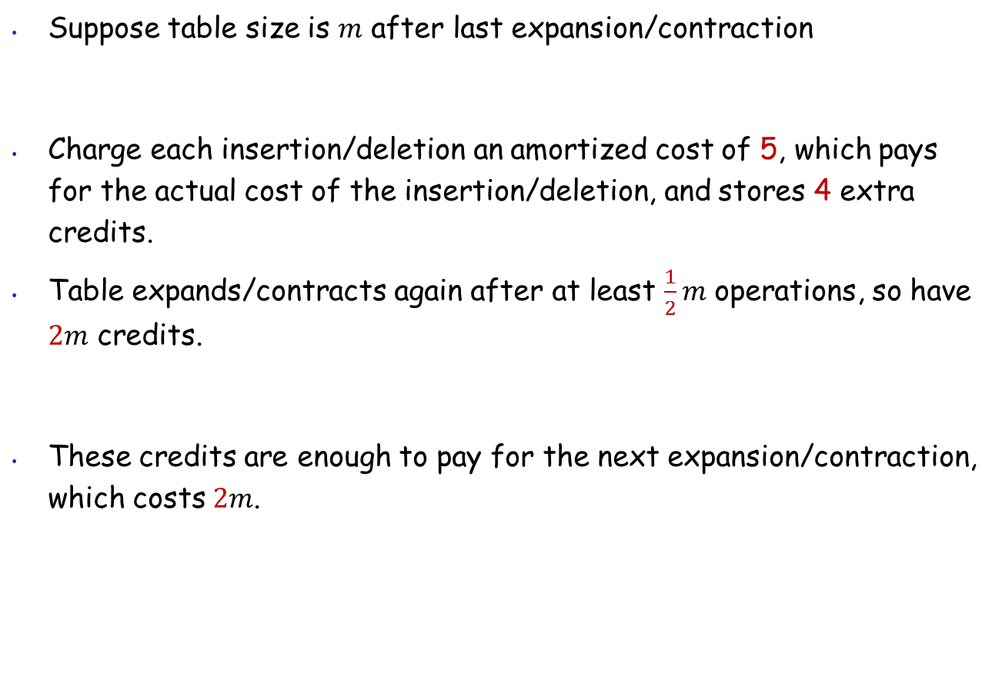
Accounting method
Suppose table size is $m$ after last expansion/contraction
Charge each insertion/deletion an amortized cost of 5, which pays for the actual cost of the insertion/deletion, and stores 4 extra credits.
Table expands/contracts again after at least $\frac{1}{2}m$ operations, so have $2m$ credits.
These credits are enough to pay for the next expansion/contraction, which costs $2m$.

Slide 21
Accounting method
Suppose table size is m after last expansion/contraction
Charge each insertion/deletion an amortized cost of O(1), which pays for the actual cost of the insertion/deletion, and stores O(1) as credits.
Table expands/contracts again after at least Ω(m) operations, so have Ω(m) credits.
These credits are enough to pay for the next expansion/contraction, which costs O(m).
sufficiently large
sufficiently large
some given constant
sufficiently large
some given constant

Slide 22
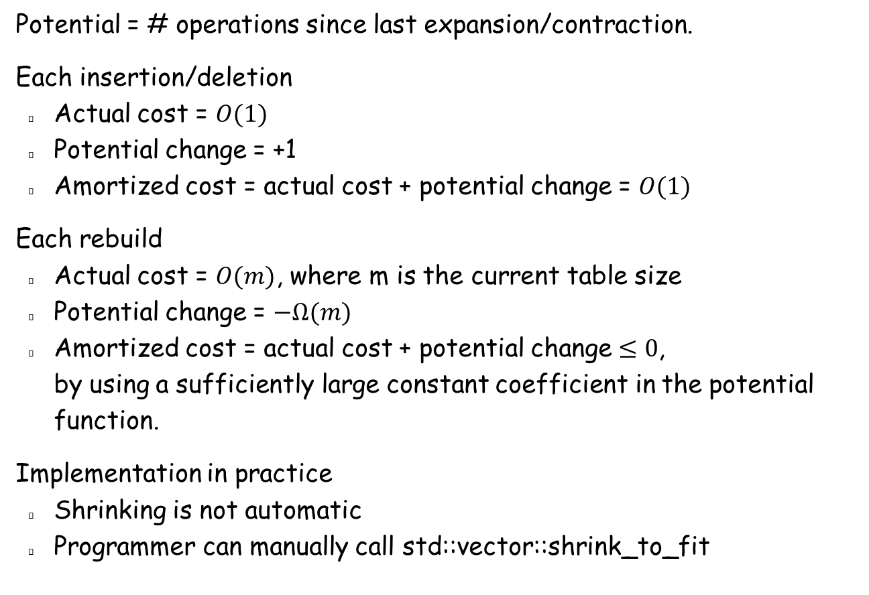
Potential method
Potential = # operations since last expansion/contraction.
Each insertion/deletion
Actual cost = $O(1)$
Potential change = +1
Amortized cost = actual cost + potential change = $O(1)$
Each rebuild
Actual cost = $O(m)$, where m is the current table size
Potential change = $−Ω(m)$
Amortized cost = actual cost + potential change $≤0$, by using a sufficiently large constant coefficient in the potential function.
Implementation in practice
Shrinking is not automatic
Programmer can manually call std::vector::shrink_to_fit

Slide 23
The Splay Tree
The dictionary problem (the fundamental data structure problem):
Store a set S of elements in a data structure that supports the following operations:
Insert x into S
Delete x from S
Find x

Slide 24
Splay Trees
Problems with AVL Trees
Extra storage/complexity for height fields
Hard to implement
Doesn’t adapt to skewed workload
Solution: splay trees
Blind adjusting version of AVL trees
The good:
Simple implementation
Self-adjusting: good for skewed workload
Dynamic optimality conjecture
The bad:
Amortized time for each operation is O(log n)
Worst case time is O(n) for one operation
The ugly:
Structure changed even for queries – bad for concurrency control

Slide 25
Splay Tree Idea
10
You’re forced to make
a really deep access:
17
Since you’re down there anyway,
fix up a lot of deep nodes!
5
2
9
3

Slide 26
Splaying
After accessing a node, splay it to the top via a series of rotations.
Rotations are the same as in AVL/red-black tree, but no need for extra fields to decide on whether to rotate or not.

Slide 27
Access root: Do nothing
root
root
a
a
X
Y
X
Y

Slide 28
Access child of root: Single rotation
root
root
p
a
a
Z
X
p
X
Y
Y
Z

Slide 29
Access (LR, RL) grandchild: Zig-Zag (double rotation)
g
a
X
p
g
p
a
W
X
Y
Z
W
Y
Z

Slide 30
Access (LL, RR) grandchild: Zig-Zig (double rotation)
g
a
W
p
p
Z
X
a
g
Y
Y
Z
W
X

Slide 31
Splaying Example: Find(6)
1
1
2
2
zig-zig
3
3
Find(6)
4
6
5
5
6
4

Slide 32
… still splaying …
1
1
2
6
zig-zig
3
3
6
2
5
5
4
4

Slide 33
… 6 splayed out!
1
6
6
1
zig
3
3
2
5
2
5
4
4

Slide 34
Splay it Again! Find (4)
6
6
1
1
zig-zag
3
4
Find(4)
2
5
3
5
4
2

Slide 35
… 4 splayed out!
6
4
1
1
6
zig-zag
4
3
5
3
5
2
2

Slide 36
Splay Operations
Find:
Find the node as in normal BST
Splay the node to the root
Insert
Insert the new node as in normal BST
Splay the new node to top
Notes:
So, on find we just splay the sought-after node to the root.

Slide 37
Splay Operations: Delete
x
find(x)
delete x
L
R
L
R
< x
> x
Now what?
Notes:
OK, we’ll do something similar for delete.
We know x is in the tree.
Find it and bring it to the root.
Remove it.
Now, we have two split subtrees.
How do we put them back together?

Slide 38
Join
Join(L, R): given two trees such that L < R, merge them
Splay on the maximum element in L, then attach R
L
L
R
splay
R
Notes:
The join operation puts two subtrees together as long as one has smaller keys to begin with.
First, splay the max element of L to the root.
Now, that’s gauranteed to have no right child, right?
Just snap R onto that NULL right side of the max.

Slide 39
Delete Completed
x
T
find(x)
delete x
L
R
L
R
< x
> x
Join(L,R)
T - x
Notes:
So, we just join the two subtrees for delete.

Slide 40
Delete Example
4
6
6
1
6
1
9
1
9
find(4)
2
9
2
7
4
7
Find max
7
2
2
2
1
6
1
6
Delete(4)
9
9
7
7

Slide 41
Amortized Analysis: Potential Method
Recall that, after an operation T -> T’
Amortized cost = actual cost + Φ(T’) - Φ(T)
= # rotations + Φ(T’) - Φ(T)
Define:
size(x): number of nodes below x (including x)
r(x) = log(size(x))
Potential function Φ(T) = ∑_{x∈T} r(x)
It’s obvious that Φ = 0 initially, and Φ ≥ 0

Slide 42
Potential change for one rotation
We will show that, for any double rotation on a,
Potential change ≤ c(r’(a) – r(a)) − c’;
and for any single rotation on a,
Potential change ≤ c(r’(a) – r(a)), for some constants c, c’.
Then consider any operation that involves a series of rotations. We add up the above inequalities over all rotations (there is at most one single rotation), we have
Φ(T’) - Φ(T) ≤ c(r’(a) – r(a)) – c’(# rotations - 1),
so
amortized cost = actual cost + Φ(T’) - Φ(T)
≤ # rotations + c(r’(a) – r(a)) - c'(# rotations - 1)
≤ O(log n)
a: the node being splayed to top
A technical lemma:
For positive a, b, c, if a + b <= c, then log a + log b <= 2 log c – 2.

Slide 43
Potential change for single rotation
root
root
p
a
a
Z
X
p
X
Y
Y
Z
Φ(T’) - Φ(T) = r’(a) – r(a) + r’(p) – r(p)
≤ r’(a) – r(a)
≤ 3(r’(a) – r(a))

Slide 44
Potential change for zig-zag rotation
g
a
X
p
g
p
a
W
X
Y
Z
W
Y
Z
Φ(T’) - Φ(T) = r’(a) – r(a) + r’(p) – r(p) + r’(g) – r(g)
= – r(a) + r’(p) – r(p) + r’(g)
= - r(a) – r(p) + r’(p) + r’(g)
≤ – 2r(a) + 2r’(a) – 2
≤ 3(r’(a) - r(a)) – 2

Slide 45
Potential change for zig-zig rotation
g
a
W
p
p
Z
X
a
g
Y
Y
Z
W
X
Φ(T’) - Φ(T) = r’(a) – r(a) + r’(p) – r(p) + r’(g) – r(g)
= – r(a) + r’(p) – r(p) + r’(g)
≤ –2r(a) + r’(a) – r(a) + r’(g) + r(a)
≤ –3r(a) + r’(a) + 2r’(a) – 2
= 3(r’(a) - r(a)) – 2

Slide 46
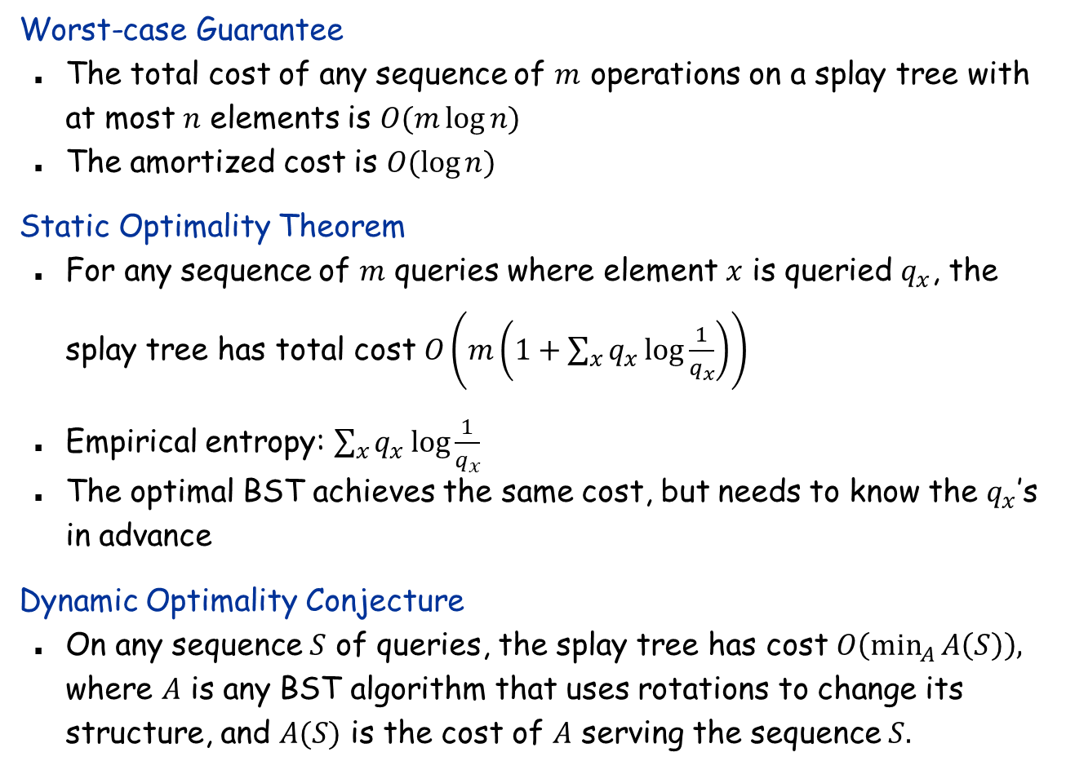
Splay Tree: Performance Guarantees
Worst-case Guarantee
The total cost of any sequence of $m$ operations on a splay tree with at most $n$ elements is $O(m\log{n)}$
The amortized cost is $O(\log{n)}$
Static Optimality Theorem
For any sequence of $m$ queries where element $x$ is queried $q_{x}$, the splay tree has total cost $O\left(m\left(1+\sum_{x}{q_{x}\log{\frac{1}{q_{x}}}}\right)\right)$
Empirical entropy: $\sum_{x}{q_{x}\log{\frac{1}{q_{x}}}}$
The optimal BST achieves the same cost, but needs to know the $q_{x}$’s in advance
Dynamic Optimality Conjecture
On any sequence $S$ of queries, the splay tree has cost $O\left(\min_{A}{A\left(S\right)}\right),$ where $A$ is any BST algorithm that uses rotations to change its structure, and $A(S)$ is the cost of $A$ serving the sequence $S.$

Slide 47
Fibonacci Heaps
A classical example where the improvement in the amortized cost of a data structure leads to the improvement in an algorithm.

Slide 48
Priority Queues Performance Cost Summary
Hopeless challenge. O(1) insert and delete-min. Why?
Operation
Linked List
Binary Heap
Binomial Heap
Fibonacci Heap †
Relaxed Heap
make-heap
1
1
1
1
1
is-empty
1
1
1
1
1
insert
1
log n
log n
1
1
delete-min
n
log n
log n
log n
log n
decrease-key
n
log n
log n
1
1
delete
n
log n
log n
log n
log n
union
1
n
log n
1
1
find-min
n
1
log n
1
1
n = max number of elements in priority queue
† amortized
A weaker statement: insert has amortized cost O(log n) and delete-min
has amortized cost O(1).
Notes:
Q. If O(1) insert and delete-min then O(n) sort.
can only access the keys through pairwise comparisons

Slide 49
Fibonacci Heaps
History. [Fredman and Tarjan, 1986]
Ingenious data structure and analysis.
Motivation: improve Dijkstra's shortest path algorithm from O(E log V ) to O(E + V log V ).
Also for Prim’s MST algorithm.
V insert, V delete-min, E decrease-key

Slide 50
Fibonacci Heaps: Structure
each parent smaller than its children
Fibonacci heap.
A forest of heap-ordered trees; store the roots in a list.
Maintain pointer to minimum element.
Set of marked nodes.
Each node stores an up pointer to its parent,
a “down” pointer to one of its children.
Siblings are stored in a doubly linked list
roots
heap-ordered tree
17
24
23
7
3
30
26
46
18
52
41
Heap H
35
44
39
Notes:
set -> unordered

Slide 51
Fibonacci Heaps: Structure
Fibonacci heap.
A forest of heap-ordered trees; store the roots in a list.
Maintain pointer to minimum element.
Set of marked nodes.
find-min takes O(1) time
min
17
24
23
7
3
30
26
46
18
52
41
Heap H
35
44
39
Notes:
set -> unordered

Slide 52
Fibonacci Heaps: Structure
Fibonacci heap.
A forest of heap-ordered trees; store the roots in a list.
Maintain pointer to minimum element.
Set of marked nodes.
used to bound maximum degree (will explain later);
roots are never marked
min
17
24
23
7
3
30
26
46
18
52
41
Heap H
35
marked
44
39
Notes:
set -> unordered

Slide 53
Fibonacci Heaps: Notation
Notation.
n = number of nodes in heap.
d(x) = number of children of node x (degree).
D(n) = max degree of any node in a heap of size n. Will guarantee D(n) = O(log n)
trees(H) = number of trees in heap H.
marks(H) = number of marked nodes in heap H.
trees(H) = 5
marks(H) = 3
n = 14
d = 3
min
17
24
23
7
3
30
26
46
18
52
41
Heap H
35
marked
44
39
Notes:
recall: with binomial heap, at most one tree of rank 0, 1, 2, 3, 4, …
nodes only change mark in Decrease-Key Can basically ignore marks until then.
marks are used to ensure size of heap is exponential in rank

Slide 54
Fibonacci Heaps: Potential Function
may be scaled up by some constant sufficiently large
Φ(H) = trees(H) + 2 ⋅ marks(H)
potential of heap H
trees(H) = 5
marks(H) = 3
Φ(H) = 5 + 2⋅3 = 11
min
17
24
23
7
3
30
26
46
18
52
41
Heap H
35
marked
44
39

Slide 55
Fibonacci Heaps: Insert
Insert.
Create a new singleton tree.
Add to root list; update min pointer (if necessary).
insert 21
21
min
17
24
23
7
3
30
26
46
18
52
41
Heap H
35
44
39

Slide 56
Fibonacci Heaps: Insert
Insert.
Create a new singleton tree.
Add to root list; update min pointer (if necessary).
insert 21
min
17
24
23
7
21
3
30
26
46
18
52
41
Heap H
35
44
39
Notes:
lazy insert - don't consolidate trees when inserting into Fibonacci heap. If k consecutive inserts, the k 1-node trees are created.

Slide 57
Fibonacci Heaps: Insert Analysis
Actual cost. O(1)
Change in potential. +1
Amortized cost. O(1)
Φ(H) = trees(H) + 2 ⋅ marks(H)
potential of heap H
min
17
24
23
7
21
3
30
26
46
18
52
41
Heap H
35
44
39

Slide 58
Linking Operation
Linking operation. Make larger root a child of smaller root.
larger root
smaller root
still heap-ordered
15
3
3
56
24
18
52
41
15
18
52
41
77
39
44
56
24
39
44
tree T₁
tree T₂
77
tree T'

Slide 59
Fibonacci Heaps: Delete Min
Delete min.
Delete min; meld its children into root list; set unmarked; update min.
Consolidate trees so that no two roots have same degree.
min
7
24
23
17
3
30
26
46
18
52
41
35
39
44

Slide 60
Fibonacci Heaps: Delete Min
Delete min.
Delete min; meld its children into root list; set unmarked; update min.
Consolidate trees so that no two roots have same degree.
min
7
24
23
17
18
52
41
30
26
46
39
44
35

Slide 61
Fibonacci Heaps: Delete Min
Delete min.
Delete min; meld its children into root list; set unmarked; update min.
Consolidate trees so that no two roots have same degree.
min
current
7
24
23
17
18
52
41
30
26
46
39
44
35

Slide 62
Fibonacci Heaps: Delete Min
Delete min.
Delete min; meld its children into root list; set unmarked; update min.
Consolidate trees so that no two roots have same degree.
degree
0
1
2
3
min
current
7
24
23
17
18
52
41
30
26
46
39
44
35

Slide 63
Fibonacci Heaps: Delete Min
Delete min.
Delete min; meld its children into root list; set unmarked; update min.
Consolidate trees so that no two roots have same degree.
degree
0
1
2
3
min
current
7
24
23
17
18
52
41
30
26
46
39
44
35

Slide 64
Fibonacci Heaps: Delete Min
Delete min.
Delete min; meld its children into root list; set unmarked; update min.
Consolidate trees so that no two roots have same degree.
degree
0
1
2
3
min
7
24
23
17
18
52
41
30
26
46
current
39
44
35

Slide 65
Fibonacci Heaps: Delete Min
Delete min.
Delete min; meld its children into root list; set unmarked; update min.
Consolidate trees so that no two roots have same degree.
degree
0
1
2
3
min
7
24
23
17
18
52
41
30
26
46
current
39
44
35
link 23 into 17

Slide 66
Fibonacci Heaps: Delete Min
Delete min.
Delete min; meld its children into root list; set unmarked; update min.
Consolidate trees so that no two roots have same degree.
degree
0
1
2
3
min
7
24
17
18
52
41
30
26
46
current
23
39
44
35
link 17 into 7

Slide 67
Fibonacci Heaps: Delete Min
Delete min.
Delete min; meld its children into root list; set unmarked; update min.
Consolidate trees so that no two roots have same degree.
degree
0
1
2
3
current
min
24
7
18
52
41
26
46
17
30
39
44
35
23
link 24 into 7

Slide 68
Fibonacci Heaps: Delete Min
Delete min.
Delete min; meld its children into root list; set unmarked; update min.
Consolidate trees so that no two roots have same degree.
degree
0
1
2
3
current
min
7
18
52
41
24
17
30
39
44
26
46
23
35

Slide 69
Fibonacci Heaps: Delete Min
Delete min.
Delete min; meld its children into root list; set unmarked; update min.
Consolidate trees so that no two roots have same degree.
degree
0
1
2
3
current
min
7
18
52
41
24
17
30
39
44
26
46
23
35

Slide 70
Fibonacci Heaps: Delete Min
Delete min.
Delete min; meld its children into root list; set unmarked; update min.
Consolidate trees so that no two roots have same degree.
degree
0
1
2
3
current
min
7
18
52
41
24
17
30
39
44
26
46
23
35

Slide 71
Fibonacci Heaps: Delete Min
Delete min.
Delete min; meld its children into root list; set unmarked; update min.
Consolidate trees so that no two roots have same degree.
degree
0
1
2
3
current
min
7
18
52
41
24
17
30
39
44
26
46
23
link 41 into 18
35

Slide 72
Fibonacci Heaps: Delete Min
Delete min.
Delete min; meld its children into root list; set unmarked; update min.
Consolidate trees so that no two roots have same degree.
degree
0
1
2
3
current
min
7
52
18
24
17
30
41
39
26
46
23
44
35

Slide 73
Fibonacci Heaps: Delete Min
Delete min.
Delete min; meld its children into root list; set unmarked; update min.
Consolidate trees so that no two roots have same degree.
degree
0
1
2
3
current
min
7
52
18
24
17
30
41
39
26
46
23
44
35

Slide 74
Fibonacci Heaps: Delete Min
Delete min.
Delete min; meld its children into root list; set unmarked; update min.
Consolidate trees so that no two roots have same degree.
min
7
52
18
24
17
30
41
39
26
46
23
44
stop
35

Slide 75
Fibonacci Heaps: Delete Min Analysis
Delete min.
Actual cost. O(D(n)) + O(trees(H)) = O(log n) + O(trees(H))
O(D(n)) to meld min's children into root list.
O(D(n)) + O(trees(H)) to update min.
O(D(n)) + O(trees(H)) to consolidate trees.
Change in potential. D(n) + 1 - trees(H) = O(log n) – trees(H)
trees(H') ≤ D(n) + 1 since no two trees have same degree.
marks(H) does not increase.
ΔΦ(H) ≤ D(n) + 1 - trees(H).
Amortized cost. O(log n)
Φ(H) = trees(H) + 2 ⋅ marks(H)
potential function

Slide 76
Fibonacci Heaps: Delete Min Analysis
Q. How to show D(n) = O(log n)?
A. If only insert and delete-min operations…
In this case, all trees are binomial trees.
This implies D(n) = O(log n).
A. Yes, we'll implement decrease-key so that D(n) = O(log n) still.
we only link trees of equal degree
B₀
B₁
B₂
B₃

Slide 77
Fibonacci Heaps: Decrease Key
Intuition for deceasing the key of node x.
If heap-order is not violated, just decrease the key of x.
Otherwise, cut tree rooted at x, meld into root list, and unmark it.
Look at p, the parent of x
If p is a root, stop
If it’s unmarked, mark it
If it’s marked, cut it off, meld into root list, and unmark it, and check the parent of p recursively.
min
7
18
38
marked node: one child already cut
24
17
23
21
39
41
26
46
30
52
35
88
72
Notes:
If decreasing the key of node i makes it violate heap order property, we can cutout subtree rooted at i and meld it into heap.
To keep trees bushy, we limit the number of cuts among the children of any vertex to 2.
Use the mark of a node to designate whether or not it has had one child cut off

Slide 78
Fibonacci Heaps: Decrease Key
Case 1. [heap order not violated]
Decrease key of x.
Change heap min pointer (if necessary).
min
7
18
38
24
17
23
21
39
41
26
46
29
30
52
x
35
88
72
decrease-key of x from 46 to 29

Slide 79
Fibonacci Heaps: Decrease Key
Case 2a. [heap order violated]
Decrease key of x.
Cut tree rooted at x, meld into root list, and unmark.
If parent p of x is unmarked (hasn't yet lost a child), mark it; Otherwise, cut p, meld into root list, and unmark (and do so recursively for all ancestors that lose a second child).
min
7
18
38
24
17
23
21
39
41
p
26
29
30
52
15
x
35
88
72
decrease-key of x from 29 to 15

Slide 80
Fibonacci Heaps: Decrease Key
Case 2a. [heap order violated]
Decrease key of x.
Cut tree rooted at x, meld into root list, and unmark.
If parent p of x is unmarked (hasn't yet lost a child), mark it; Otherwise, cut p, meld into root list, and unmark (and do so recursively for all ancestors that lose a second child).
min
7
18
38
24
17
23
21
39
41
p
26
15
30
52
x
35
88
72
decrease-key of x from 29 to 15

Slide 81
Fibonacci Heaps: Decrease Key
Case 2a. [heap order violated]
Decrease key of x.
Cut tree rooted at x, meld into root list, and unmark.
If parent p of x is unmarked (hasn't yet lost a child), mark it; Otherwise, cut p, meld into root list, and unmark (and do so recursively for all ancestors that lose a second child).
x
min
15
7
18
38
72
24
17
23
21
39
41
p
26
30
52
35
88
decrease-key of x from 29 to 15

Slide 82
Fibonacci Heaps: Decrease Key
Case 2a. [heap order violated]
Decrease key of x.
Cut tree rooted at x, meld into root list, and unmark.
If parent p of x is unmarked (hasn't yet lost a child), mark it; Otherwise, cut p, meld into root list, and unmark (and do so recursively for all ancestors that lose a second child).
x
min
15
7
18
38
72
24
24
17
23
21
39
41
mark parent
p
26
30
52
35
88
decrease-key of x from 29 to 15

Slide 83
Fibonacci Heaps: Decrease Key
Case 2b. [heap order violated]
Decrease key of x.
Cut tree rooted at x, meld into root list, and unmark.
If parent p of x is unmarked (hasn't yet lost a child), mark it; Otherwise, cut p, meld into root list, and unmark (and do so recursively for all ancestors that lose a second child).
min
15
7
18
38
72
24
24
17
23
21
39
41
p
26
30
52
35
88
decrease-key of x from 35 to 5
x
5

Slide 84
Fibonacci Heaps: Decrease Key
Case 2b. [heap order violated]
Decrease key of x.
Cut tree rooted at x, meld into root list, and unmark.
If parent p of x is unmarked (hasn't yet lost a child), mark it; Otherwise, cut p, meld into root list, and unmark (and do so recursively for all ancestors that lose a second child).
min
15
7
18
38
72
24
24
17
23
21
39
41
p
26
30
52
x
5
88
decrease-key of x from 35 to 5

Slide 85
Fibonacci Heaps: Decrease Key
Case 2b. [heap order violated]
Decrease key of x.
Cut tree rooted at x, meld into root list, and unmark.
If parent p of x is unmarked (hasn't yet lost a child), mark it; Otherwise, cut p, meld into root list, and unmark (and do so recursively for all ancestors that lose a second child).
min
x
15
5
7
18
38
72
24
24
17
23
21
39
41
p
26
30
52
88
decrease-key of x from 35 to 5

Slide 86
Fibonacci Heaps: Decrease Key
Case 2b. [heap order violated]
Decrease key of x.
Cut tree rooted at x, meld into root list, and unmark.
If parent p of x is unmarked (hasn't yet lost a child), mark it; Otherwise, cut p, meld into root list, and unmark (and do so recursively for all ancestors that lose a second child).
min
x
15
5
7
18
38
72
24
24
17
23
21
39
41
second child cut
p
26
30
52
88
decrease-key of x from 35 to 5

Slide 87
Fibonacci Heaps: Decrease Key
Case 2b. [heap order violated]
Decrease key of x.
Cut tree rooted at x, meld into root list, and unmark.
If parent p of x is unmarked (hasn't yet lost a child), mark it; Otherwise, cut p, meld into root list, and unmark (and do so recursively for all ancestors that lose a second child).
min
x
p
15
5
26
7
18
38
88
24
72
24
17
23
21
39
41
30
52
decrease-key of x from 35 to 5

Slide 88
Fibonacci Heaps: Decrease Key
Case 2b. [heap order violated]
Decrease key of x.
Cut tree rooted at x, meld into root list, and unmark.
If parent p of x is unmarked (hasn't yet lost a child), mark it; Otherwise, cut p, meld into root list, and unmark (and do so recursively for all ancestors that lose a second child).
min
x
p
15
5
26
7
18
38
88
24
72
p'
24
17
23
21
39
41
30
52
second child cut
decrease-key of x from 35 to 5

Slide 89
Fibonacci Heaps: Decrease Key
Case 2b. [heap order violated]
Decrease key of x.
Cut tree rooted at x, meld into root list, and unmark.
If parent p of x is unmarked (hasn't yet lost a child), mark it; Otherwise, cut p, meld into root list, and unmark (and do so recursively for all ancestors that lose a second child).
min
x
p
p'
p''
15
5
26
24
7
18
38
72
88
don't mark parent if it's a root
17
23
21
39
41
30
52
decrease-key of x from 35 to 5

Slide 90
Fibonacci Heaps: Decrease Key Analysis
Decrease-key.
Actual cost. O(c)
O(1) time for changing the key.
O(1) time for each of c cuts, plus melding into root list.
Change in potential. O(1) - c
trees(H') = trees(H) + c.
marks(H') ≤ marks(H) - c + 2.
ΔΦ ≤ c + 2 ⋅ (-c + 2) = 4 - c.
Amortized cost. O(1)
Φ(H) = trees(H) + 2 ⋅ marks(H)
potential function
Notes:
When marked node y is cut by cascading cut, its mark bit is cleared (2 units of potential).
One unit pays for cut, the other for unit increase in potential due to y becoming a root.
marks(H') <= marks(H) - c + 2: each cut (except first) unmarks a node; last cut may or may not mark a node
Can scale units of potential to dominate cost hidden in O(c) term

Slide 91
Analysis Summary
Insert. O(1)
Delete-min. O(D(n))
Decrease-key. O(1)
Key lemma. D(n) = O(log n).
number of nodes is exponential in degree

Slide 92
Fibonacci Heaps: Bounding the Degree
Lemma. Fix a point in time. Let x be a node, and let y₁, …, y_{k} denote its children in the order in which they were linked to x. Then:
Pf.
When y_{i} was linked into x, x had at least i -1 children y₁, …, y_{i-1}.
Since only trees of equal degree are linked, at that time d(y_{i}) = d(x) ≥ i - 1.
Since then, y_{i} has lost at most one child.
Thus, right now d(y_{i}) ≥ i - 2.
x
y₁
y₂
…
y_{k}
or y_{i} would have been cut
Notes:
when yi was linked into x, x could have had more than i-1 children since some of them may have since been cut

Slide 93
Fibonacci Heaps: Bounding the Degree
Lemma. Fix a point in time. Let x be a node, and let y₁, …, y_{k} denote its children in the order in which they were linked to x. Then:
Def. Let F_{k} be smallest possible tree of degree k satisfying property.
x
y₁
y₂
…
y_{k}
F₀
F₁
F₂
F₃
F₄
F₅
1
2
3
5
8
13
Notes:
slightly non-standard definition of fibonacci with f0 = 1, f1 = 2

Slide 94
Fibonacci Heaps: Bounding the Degree
Lemma. Fix a point in time. Let x be a node, and let y₁, …, y_{k} denote its children in the order in which they were linked to x. Then:
Def. Let F_{k} be smallest possible tree of degree k satisfying property.
x
y₁
y₂
…
y_{k}
F₄
F₅
F₆
8
13
8 + 13 = 21
Notes:
slightly non-standard definition of fibonacci with f0 = 1, f1 = 2

Slide 95
Fibonacci Heaps: Bounding the Degree
Lemma. Fix a point in time. Let x be a node, and let y₁, …, y_{k} denote its children in the order in which they were linked to x. Then:
Def. Let F_{k} be smallest possible tree of degree k satisfying property.
Fibonacci numbers. F_{k} = F_{k-1} + F_{k-2}
Fibonacci fact. F_{k} ≥ φ^{k}, where φ = (1 + √5) / 2 ≈ 1.618.
Corollary. D(n) ≤ log_{φ} n .
x
y₁
y₂
…
y_{k}
golden ratio

Slide 96
Fibonacci Heaps: Union
Union. Combine two Fibonacci heaps.
Representation. Root lists are circular, doubly linked lists.
min
min
23
24
17
7
3
21
30
26
46
18
52
41
Heap H'
35
Heap H''
44
39

Slide 97
Fibonacci Heaps: Union
Union. Combine two Fibonacci heaps.
Representation. Root lists are circular, doubly linked lists.
min
23
24
17
7
3
21
30
26
46
18
52
41
35
Heap H
44
39

Slide 98
Fibonacci Heaps: Union
Actual cost. O(1)
Change in potential. 0
Amortized cost. O(1)
Φ(H) = trees(H) + 2 ⋅ marks(H)
potential function
min
23
24
17
7
3
21
30
26
46
18
52
41
35
Heap H
44
39

Slide 99
Fibonacci Heaps: Delete
Delete node x.
decrease-key of x to -∞.
delete-min element in heap.
Amortized cost. O(D(n))
O(1) amortized for decrease-key.
O(D(n)) amortized for delete-min.
Φ(H) = trees(H) + 2 ⋅ marks(H)
potential function

Slide 100
The Union-Find Data Structure
The amortized cost per operation of the union-find structure using link-by-height and path compression is α(n), where α(n) is the inverse Ackermann function, an extremely slow-growing function. (See CLRS 21 for proof)

