Slide 1
13.6 Hashing and Hash Tables
A data structure problem for which the randomized algorithm is conjectured to be strictly better than any deterministic algorithm.
See CLRS 11, KT 13.6 and MR 8.4-8.5

Slide 2
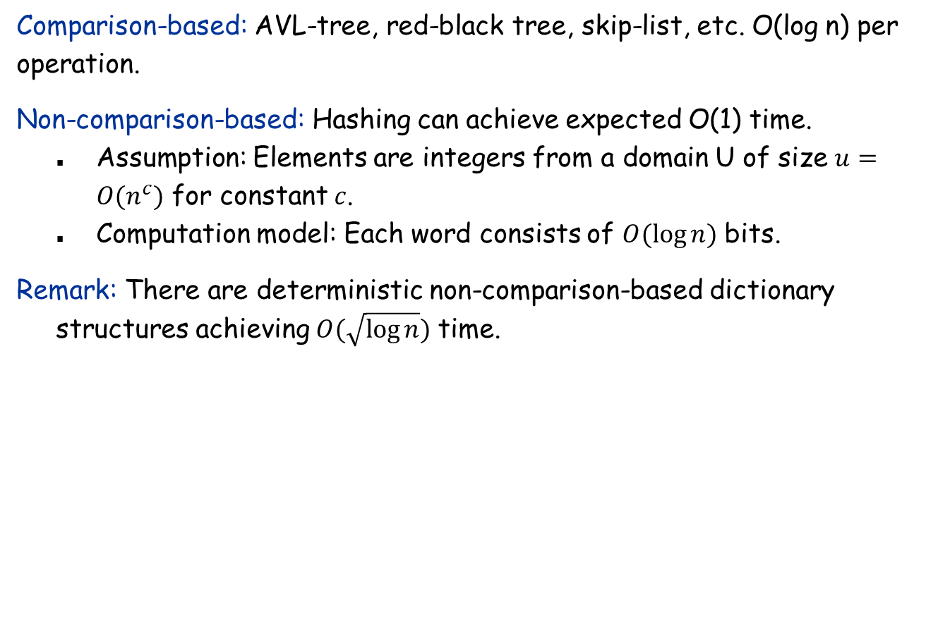
The Dictionary Problem
Comparison-based: AVL-tree, red-black tree, skip-list, etc. O(log n) per operation.
Non-comparison-based: Hashing can achieve expected O(1) time.
Assumption: Elements are integers from a domain U of size $u=O(n^{c})$ for constant $c$.
Computation model: Each word consists of $O(log{n})$ bits.
Remark: There are deterministic non-comparison-based dictionary structures achieving $O(\sqrt{\log{n}})$ time.

Slide 3

Hash Table
Hash function. $h :U→[m]$, where $\left[m\right]=\{0,1,2,…,m−1\}$
Hash table. Create an array H of size m. When processing element x, access array element H[h(x)].
Collision. When h(x) = h(y) but x ≠ y.
Separate chaining: H[i] stores linked list of elements x with h(x) = i.
H[0]
51230
12350
H[1]
null
H[2]
12352
562
122
H[9]
969

Slide 4
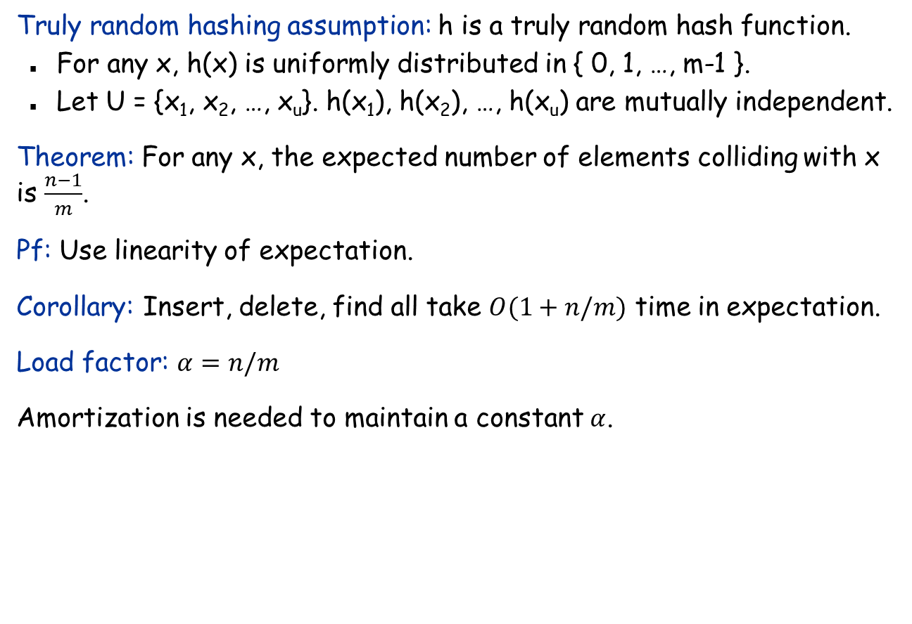
Analysis of Chaining under Truly Random Hashing Assumption
Truly random hashing assumption: h is a truly random hash function.
For any x, h(x) is uniformly distributed in { 0, 1, …, m-1 }.
Let U = {x₁, x₂, …, x_{u}}. h(x₁), h(x₂), …, h(x_{u}) are mutually independent.
Theorem: For any x, the expected number of elements colliding with x is $\frac{n−1}{m}$.
Pf: Use linearity of expectation.
Corollary: Insert, delete, find all take $O(1+n/m)$ time in expectation.
Load factor: $α=n/m$
Amortization is needed to maintain a constant $α$.

Slide 5
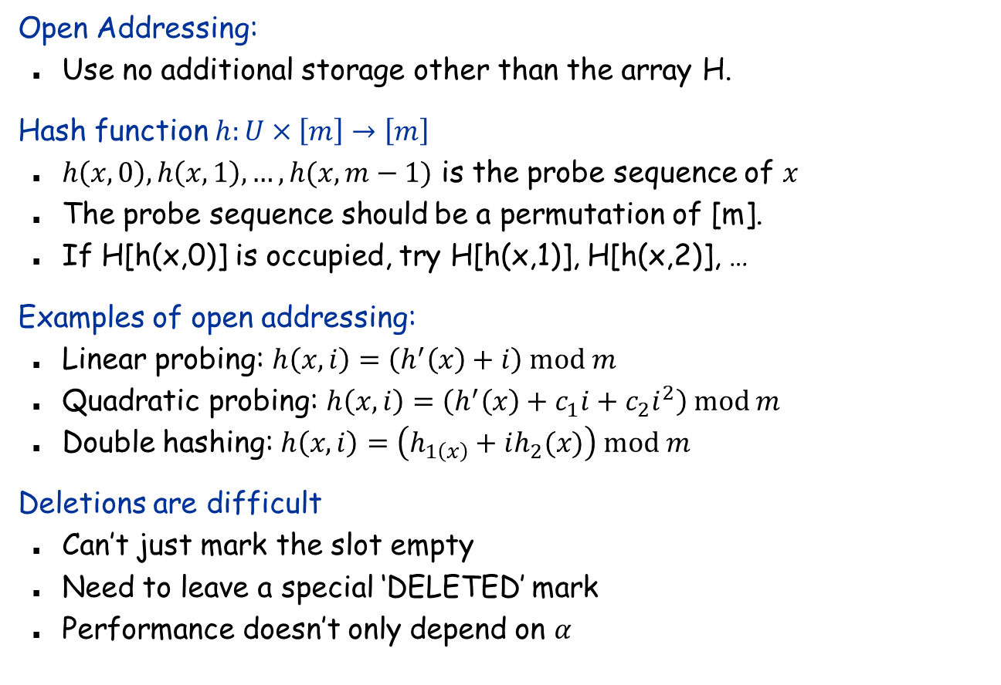
Open Addressing
Open Addressing:
Use no additional storage other than the array H.
Hash function $h:U×\left[m\right]→\left[m\right]$
$h\left(x,0\right),h\left(x,1\right),…,h(x,m−1)$ is the probe sequence of $x$
The probe sequence should be a permutation of [m].
If H[h(x,0)] is occupied, try H[h(x,1)], H[h(x,2)], …
Examples of open addressing:
Linear probing: $h\left(x,i\right)=\left(h^{′}\left(x\right)+i\right) mod m$
Quadratic probing: $h\left(x,i\right)=\left(h^{′}\left(x\right)+c_{1}i+c_{2}i^{2}\right) mod m$
Double hashing: $h\left(x,i\right)=\left(h_{1\left(x\right)}+ih_{2}(x)\right) mod m$
Deletions are difficult
Can’t just mark the slot empty
Need to leave a special ‘DELETED’ mark
Performance doesn’t only depend on $α$

Slide 6
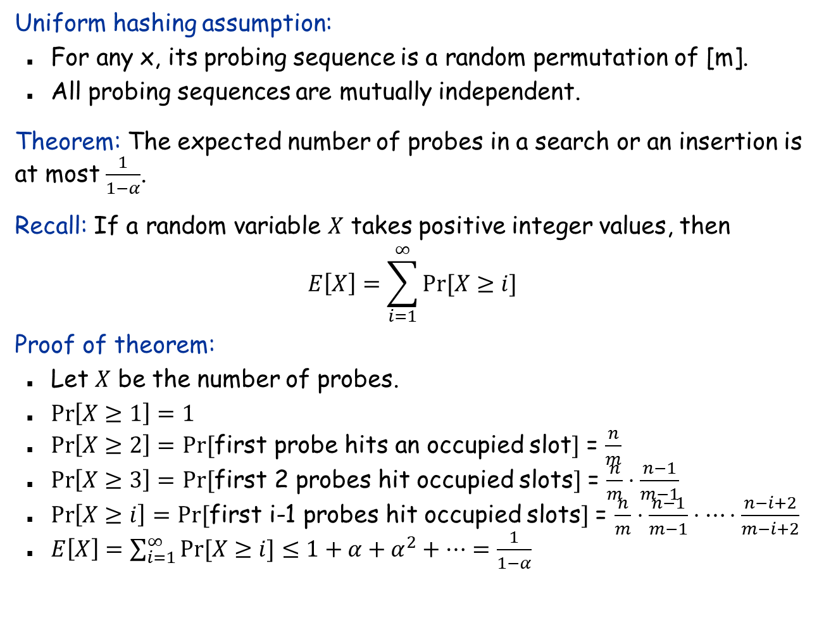
Analysis of Open Addressing under Uniform Hashing Assumption
Uniform hashing assumption:
For any x, its probing sequence is a random permutation of [m].
All probing sequences are mutually independent.
Theorem: The expected number of probes in a search or an insertion is at most $\frac{1}{1−α}$.
Recall: If a random variable $X$ takes positive integer values, then $$E\left[X\right]=\sum_{i=1}^{∞}{Pr⁡[X≥i]}$$
Proof of theorem:
Let $X$ be the number of probes.
$\operatorname{Pr}\left[X≥1\right]=1$
$\operatorname{Pr}\left[X≥2\right]=$ $Pr⁡[$first probe hits an occupied slot$]$ = $\frac{n}{m}$
$\operatorname{Pr}\left[X≥3\right]=$ $Pr⁡[$first 2 probes hit occupied slots$]$ = $\frac{n}{m}⋅\frac{n−1}{m−1}$
$\operatorname{Pr}\left[X≥i\right]=$ $Pr⁡[$first i-1 probes hit occupied slots$]$ = $\frac{n}{m}⋅\frac{n−1}{m−1}⋅⋯⋅\frac{n−i+2}{m−i+2}$
$E\left[X\right]=\sum_{i=1}^{∞}{Pr⁡[X≥i]}≤1+α+α^{2}+⋯=\frac{1}{1−α}$

Slide 7
Ad Hoc Hash Function
Unfortunately, truly random hash functions don’t exist. (More precisely, such a function requires O(u log n) bits to represent.)
Ad hoc hash function.
Deterministic hashing. If u ≥ n², then for any fixed hash function h, there is a subset S ⊆ U of n elements that all hash to same slot. Thus, Θ(n) time per search in the worst case.
Q. Is ad hoc hash function good enough in practice?
hash function ala Java string library
int h(String s, int n) {
int hash = 0;
for (int i = 0; i < s.length(); i++)
hash = (31 * hash) + s[i];
return hash % n;
}

Slide 8
Algorithmic Complexity Attacks
When can't we live with ad hoc hash functions?
Obvious situations: aircraft control, nuclear reactors.
Denial-of-service attacks.
Q: How about using cryptographic hash functions like MD5, SHA-x?
A: Performance Cryptographic guarantees vs probabilistic guarantees
malicious adversary learns your ad hoc hash function (e.g., by reading Java API) and causes a big pile-up in a single slot that grinds performance to a halt

Slide 9
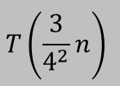
Universal Hashing
Universal class of hash functions. [Carter-Wegman 1980s]
For any pair of elements x, y $∈$ U, Pr_{h∈H}[h(x)=h(y)] ≤ 1/n
Can select random h efficiently.
Can compute h(x) efficiently.
Ex. U = { a, b, c, d, e, f }, n = 2.
chosen uniformly at random
a
b
c
d
e
f
H = {h₁, h₂}
Pr _{h ∈ H} [h(a) = h(b)] = 1/2
Pr _{h ∈ H} [h(a) = h(c)] = 1 Pr _{h ∈ H} [h(a) = h(d)] = 0 . . .
h₁(x)
0
1
0
1
0
1
not universal
h₂(x)
0
0
0
1
1
1
a
b
c
d
e
f
H = {h₁, h₂ , h₃ , h₄}
Pr _{h ∈ H} [h(a) = h(b)] = 1/2 Pr _{h ∈ H} [h(a) = h(c)] = 1/2
Pr _{h ∈ H} [h(a) = h(d)] = 1/2
Pr _{h ∈ H} [h(a) = h(e)] = 1/2
Pr _{h ∈ H} [h(a) = h(f)] = 0
. . .
h₁(x)
0
1
0
1
0
1
h₂(x)
0
0
0
1
1
1
universal
h₃(x)
0
0
1
0
1
1
h₄(x)
1
0
0
1
1
0

Slide 10

Universal Hashing
Universal hashing property. Let $H$ be a universal class of hash functions, let $h∈H$ be chosen uniformly at random from $H$, and let $x∈U$. For any subset $S⊆U$ of size at most $n$, the expected number of items in $S$ that collide with $x$ is at most $1$.
Pf. For any element $s∈S$, define indicator random variable $X_{s}=1$ if $h(s)=h(x)$ and $0$ otherwise. Let $X$ be a random variable counting the total number of collisions with $u$.
linearity of expectation
X_{s} is a 0-1 random variable
universal (assumes u ∉ S)

Slide 11

Designing a Universal Family of Hash Functions
Bertrand’s Postulate (actually a theorem): There exists a prime between $n$ and $2n$.
Choose a prime number $u ≤ p ≤ 2u$.
Hash function. $h_{a,b}(x) = ((ax + b) mod p) mod n$
Hash function family. $H = \{h_{a,b}: a, b∈[p], a ≠ 0\}$, where $[p] = \{0, 1, 2, …, p−1\}$.
no need for randomness here

Slide 12
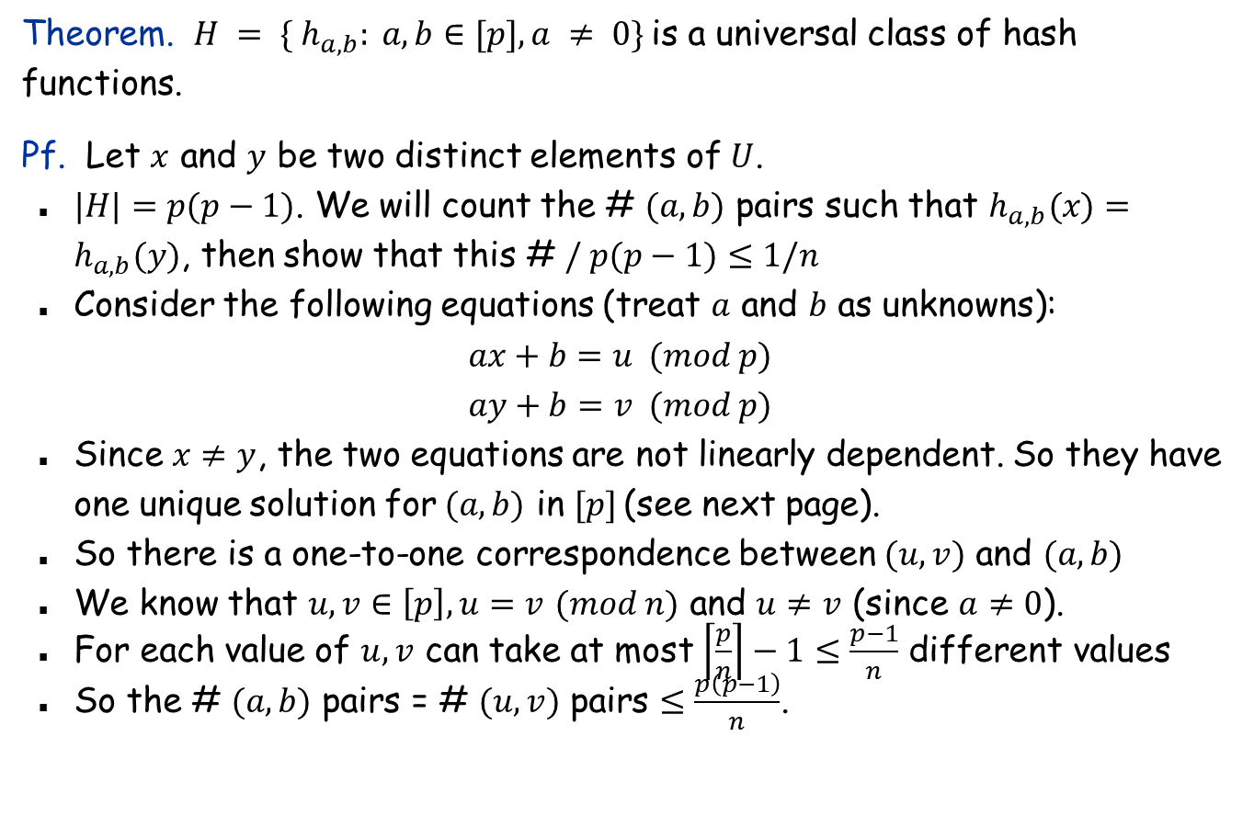
Designing a Universal Class of Hash Functions
Theorem. $H = \{ h_{a,b}: a, b∈[p], a ≠ 0\}$is a universal class of hash functions.
Pf. Let $x$ and $y$ be two distinct elements of $U$.
$|H|=p(p−1)$. We will count the # $(a, b)$ pairs such that $h_{a,b}(x)=h_{a,b}(y)$, then show that this # $/ p(p−1)≤1/n$
Consider the following equations (treat $a$ and $b$ as unknowns):
$$ax+b=u (mod p)$$
$$ay+b=v (mod p)$$
Since $x≠y$, the two equations are not linearly dependent. So they have one unique solution for$(a, b)$ in $[p]$ (see next page).
So there is a one-to-one correspondence between $(u,v)$ and $(a, b)$
We know that $u,v∈\left[p\right],u=v$ $(mod n)$ and $u≠v$ (since $a≠0$).
For each value of $u, v$ can take at most $\left\lceil \frac{p}{n}\right\rceil −1≤\frac{p−1}{n}$ different values
So the # $(a, b)$ pairs = # $(u, v)$ pairs $≤\frac{p\left(p−1\right)}{n}$.

Slide 13
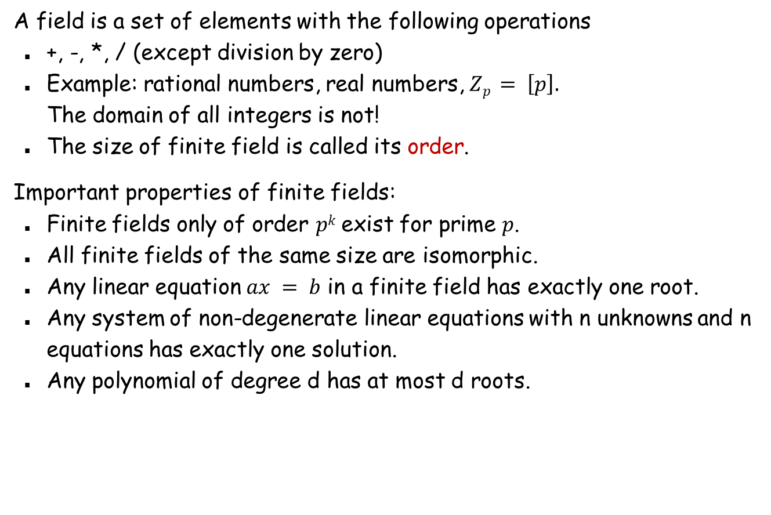
Finite Field Basics
A field is a set of elements with the following operations
+, -, *, / (except division by zero)
Example: rational numbers, real numbers, $Zp = \left[p\right].$ The domain of all integers is not!
The size of finite field is called its order.
Important properties of finite fields:
Finite fields only of order $pk$ exist for prime $p$.
All finite fields of the same size are isomorphic.
Any linear equation $ax = b$ in a finite field has exactly one root.
Any system of non-degenerate linear equations with n unknowns and n equations has exactly one solution.
Any polynomial of degree d has at most d roots.

Slide 14
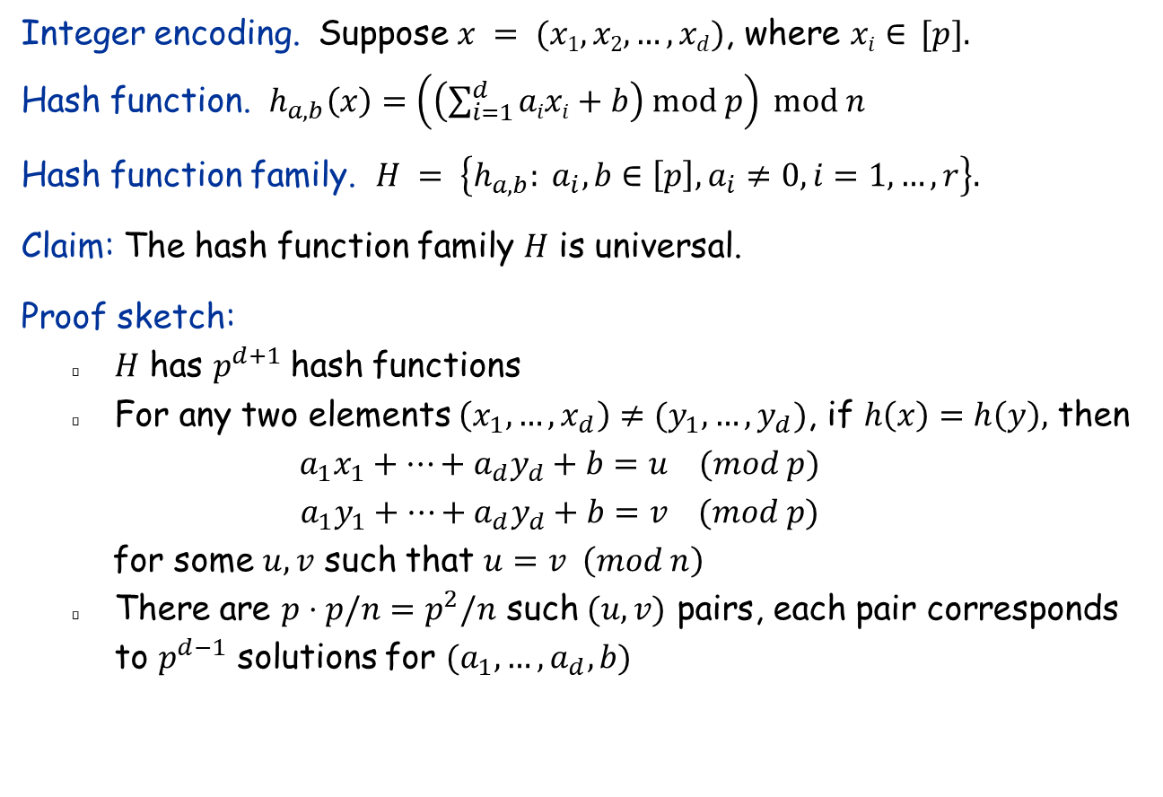
Hashing Vectors
Integer encoding. Suppose $x = (x1, x2, …, xd)$, where $xi∈ [p].$
Hash function. $h_{a,b}\left(x\right)=\left(\left(\sum_{i=1}^{d}{aixi}+b\right) mod p\right) mod n$
Hash function family. $H = \left\{h_{a,b}: a_{i}, b∈\left[p\right], a_{i}≠0,i=1,…,r\right\}.$
Claim: The hash function family $H$ is universal.
Proof sketch:
$H$ has $p^{d+1}$hash functions
For any two elements $\left(x_{1},…,x_{d}\right)≠(y_{1},…,y_{d})$, if $h\left(x\right)=h\left(y\right),$ then
$$a_{1}x_{1}+…+a_{d}y_{d}+b=u (mod p)$$
$$a_{1}y_{1}+…+a_{d}y_{d}+b=v (mod p)$$
for some $u,v$ such that $u=v \left(mod n\right)$
There are $p⋅p/n=p^{2}/n$ such $(u,v)$ pairs, each pair corresponds to $p^{d−1}$ solutions for $(a_{1},…,a_{d}, b)$

Slide 15
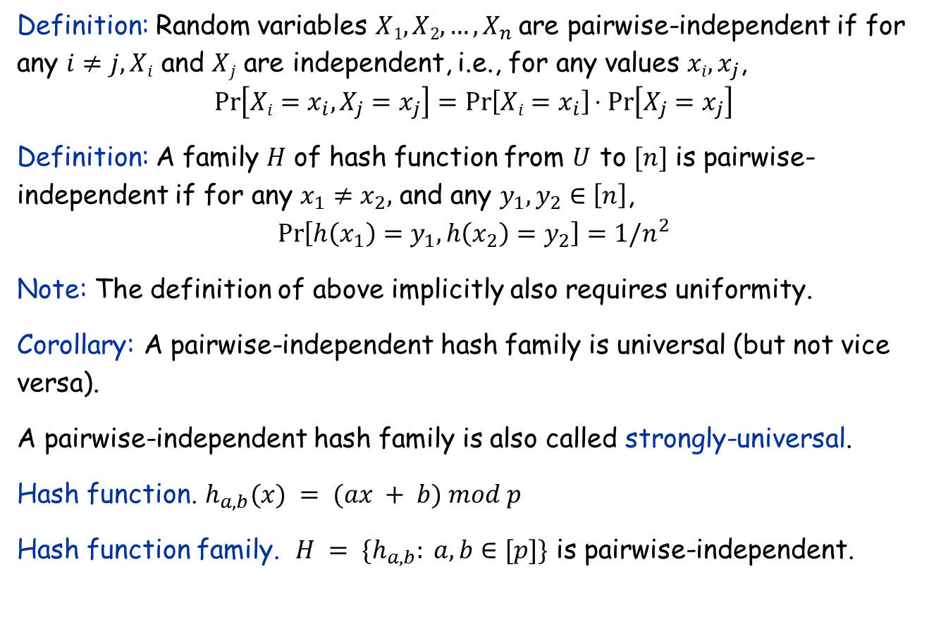
Pairwise-Independent Hash Functions
Definition: Random variables $X1, X2, …, X_{n}$are pairwise-independent if for any $i≠j, Xi$ and $Xj$ are independent, i.e., for any values $xi, x_{j}$,
$$\operatorname{Pr}\left[Xi=x_{i},X_{j}=x_{j}\right]=\operatorname{Pr}\left[Xi=x_{i}\right]⋅Pr\left[X_{j}=x_{j}\right]$$
Definition: A family $H$ of hash function from $U$ to $[n]$ is pairwise-independent if for any $x_{1}≠x_{2},$ and any $y_{1},y_{2}∈\left[n\right]$,
$$\operatorname{Pr}\left[h\left(x_{1}\right)=y_{1},h\left(x_{2}\right)=y_{2}\right]=1/n^{2}$$
Note: The definition of above implicitly also requires uniformity.
Corollary: A pairwise-independent hash family is universal (but not vice versa).
A pairwise-independent hash family is also called strongly-universal.
Hash function. $h_{a,b}(x) = (ax + b) mod p$
Hash function family. $H = \{h_{a,b}: a, b∈[p]\}$ is pairwise-independent.

Slide 16
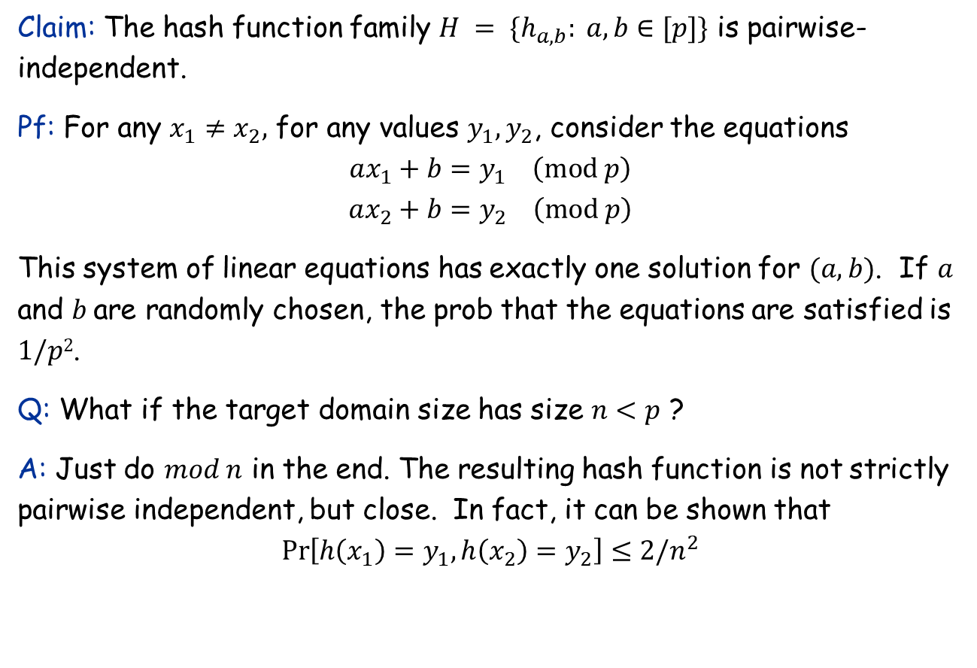
Pairwise-Independent Hash Functions
Claim: The hash function family $H = \{h_{a,b}: a, b∈[p]\}$ is pairwise-independent.
Pf: For any $x_{1}≠x_{2},$ for any values $y_{1},y_{2}$, consider the equations
$$ax_{1}+b=y_{1} \left(mod p\right)$$
$$ax_{2}+b=y_{2} \left(mod p\right)$$
This system of linear equations has exactly one solution for $(a, b)$. If $a$ and $b$are randomly chosen, the prob that the equations are satisfied is $1/p2$.
Q: What if the target domain size has size $n<p$ ?
A: Just do $mod n$ in the end. The resulting hash function is not strictly pairwise independent, but close. In fact, it can be shown that
$$\operatorname{Pr}\left[h\left(x_{1}\right)=y_{1},h\left(x_{2}\right)=y_{2}\right]≤2/n^{2}$$

Slide 17
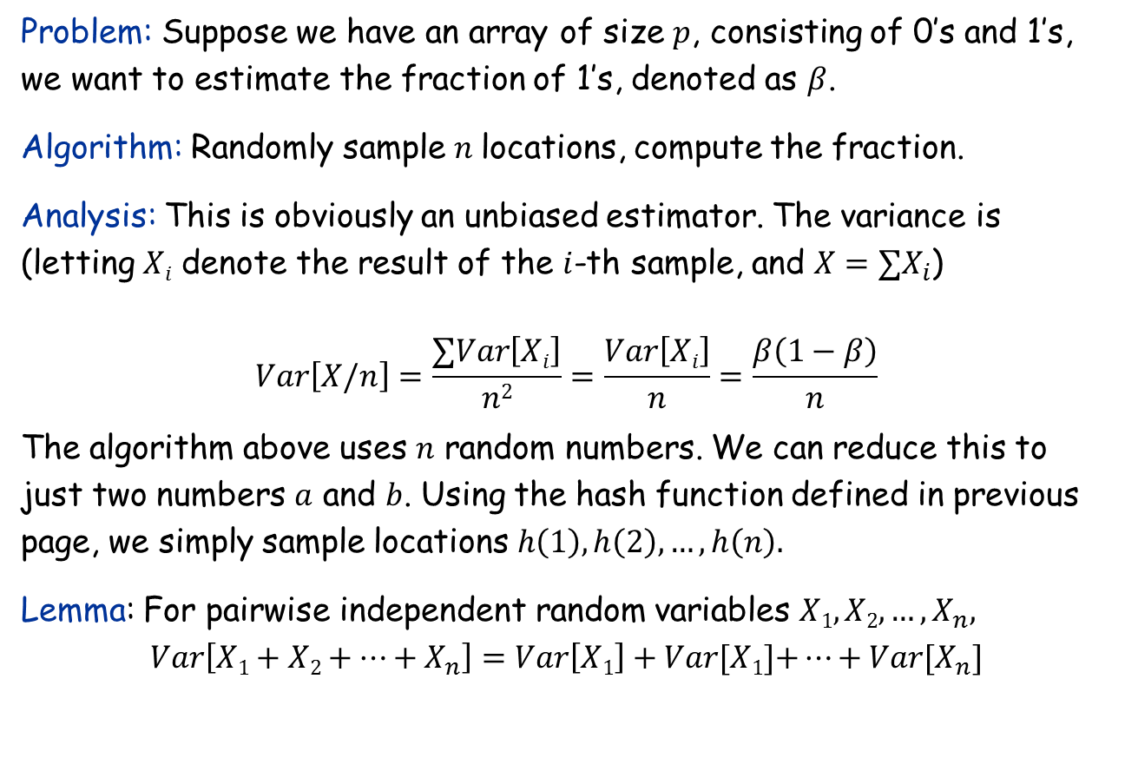
Application of Pairwise Independence: Randomness Reduction
Problem: Suppose we have an array of size $p$, consisting of 0’s and 1’s, we want to estimate the fraction of 1’s, denoted as $β$.
Algorithm: Randomly sample $n$locations, compute the fraction.
Analysis: This is obviously an unbiased estimator. The variance is (letting $Xi$ denote the result of the $i$-th sample, and $X=∑X_{i}$)
$$Var\left[X/n\right]=\frac{∑Var\left[Xi\right]}{n2}=\frac{Var\left[Xi\right]}{n}=\frac{β\left(1−β\right)}{n}$$
The algorithm above uses $n$ random numbers. We can reduce this to just two numbers $a$ and $b$. Using the hash function defined in previous page, we simply sample locations $h\left(1\right), h\left(2\right),…,h\left(n\right).$
Lemma: For pairwise independent random variables $X1, X2, …, X_{n},$
$$Var\left[X1+X2+…+X_{n}\right]=Var\left[X1\right]+Var[X1]\text{+}…+Var[X_{n}]$$

Slide 18
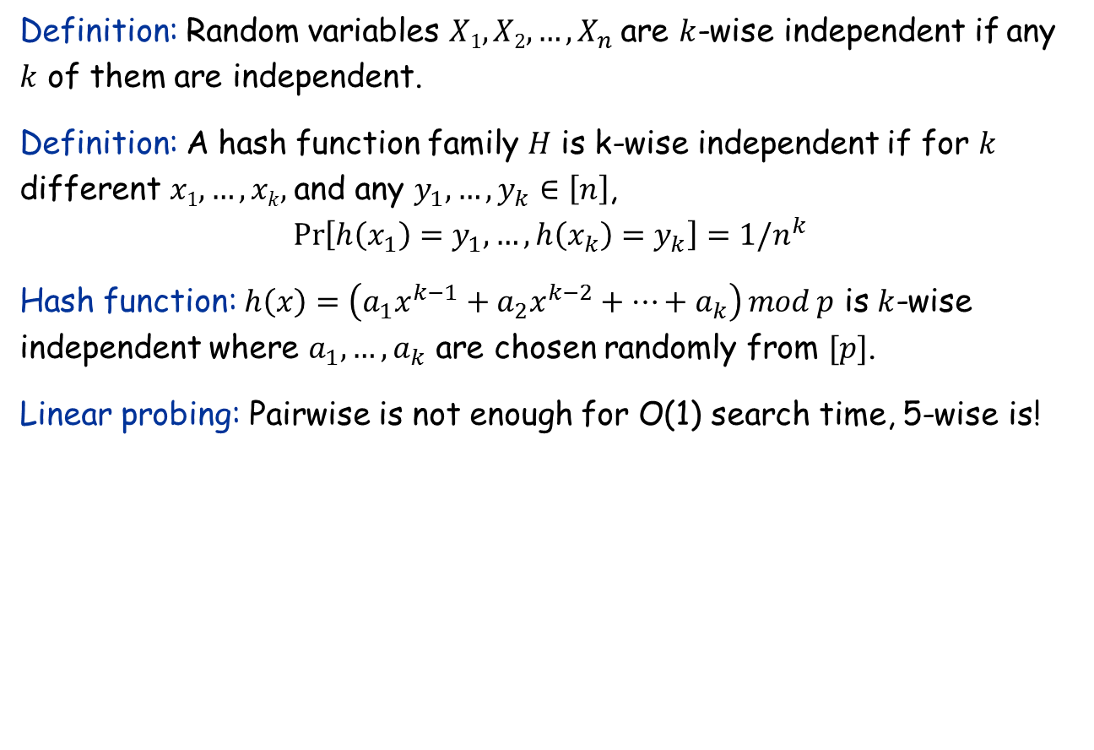
Generalization to k-wise independence
Definition: Random variables $X1, X2, …, X_{n}$are $k$-wise independent if any $k$ of them are independent.
Definition: A hash function family $H$ is k-wise independent if for $k$ different $x1,…,xk,$and any $y_{1},{…,y}_{k}∈\left[n\right]$,
$$\operatorname{Pr}\left[h\left(x_{1}\right)=y_{1},…,h\left(x_{k}\right)=y_{k}\right]=1/n^{k}$$
Hash function: $h\left(x\right)=\left(a_{1}x^{k−1}+a_{2}x^{k−2}+…+a_{k}\right) mod p$ is $k$-wise independent where $a_{1},…, a_{k}$ are chosen randomly from $[p]$.
Linear probing: Pairwise is not enough for O(1) search time, 5-wise is!

Slide 19
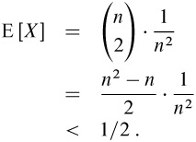
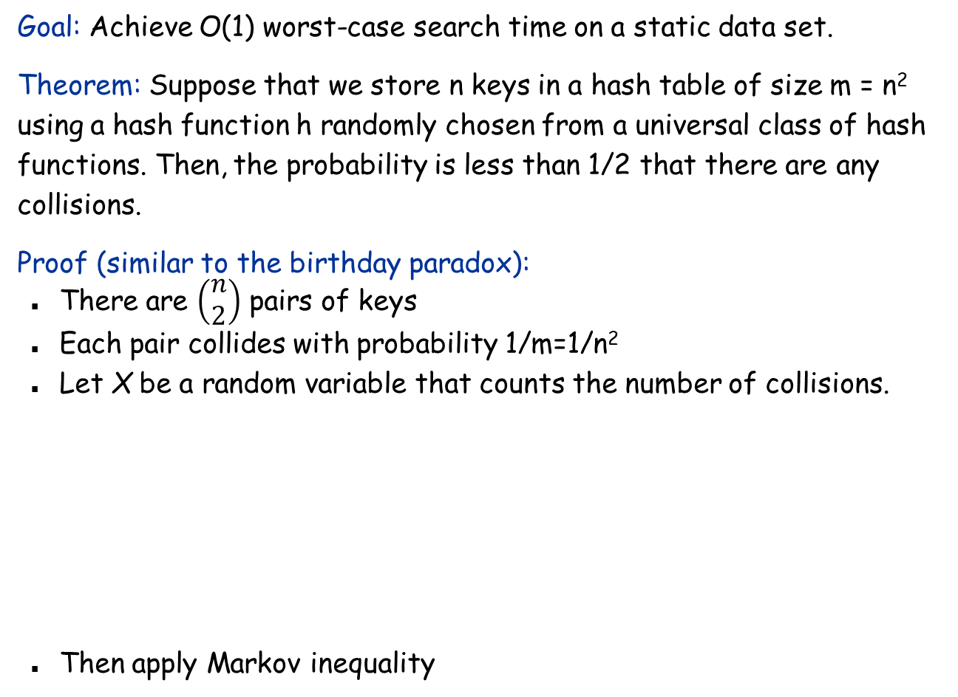
Perfect Hashing
Goal: Achieve O(1) worst-case search time on a static data set.
Theorem: Suppose that we store n keys in a hash table of size m = n² using a hash function h randomly chosen from a universal class of hash functions. Then, the probability is less than 1/2 that there are any collisions.
Proof (similar to the birthday paradox):
There are $\left(\begin{matrix}n \\ 2\end{matrix}\right)$ pairs of keys
Each pair collides with probability 1/m=1/n²
Let X be a random variable that counts the number of collisions.
Then apply Markov inequality

Slide 20
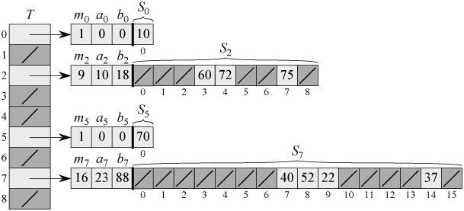
Perfect Hashing
Two-level hashing:
Using perfect hashing to store the set K = {10, 22, 37, 40, 52, 60, 70, 72, 75}. The outer hash function is h(k) = ((ak + b) mod p) mod m, where a = 3, b = 42, p = 101, and m = 9. A secondary hash table S_{j} stores all the n_{j} keys hashing to slot j. The size of hash table S_{j} is m_{j}=n_{j}² and the associated hash function is h_{j}(k) = ((a_{j}k + b_{j}) mod p) mod m_{j}. No collisions occur in any of the secondary hash tables.

Slide 21

Perfect Hashing: Analysis
Theorem: When m=n,
Proof: See textbook.
Corollary: With probability at least ½, the total size of all secondary hash tables is at most 4n.
Algorithm:
Pick a primary hash function h
Compute total size of all secondary hash tables. If greater than 4n, pick a new h.
For each secondary hash table j
Pick a hash function h_{j}
If it causes any collision, pick a new h_{j}
Running time: O(n)
Open question: Can we achieve O(1) worst-case search time and O(1) worst-case insertion time simultaneously?
Notes:
There is a purported proof in the following paper:
R. Sundar. A lower bound for the dictionary problem under a hashing model. In Proc. IEEE Symposium on Foundations of Computer Science,
pages 612–621, 1991.
But no one understands the proof and the author cannot be reached for explanation.

Slide 22
13.7 Finding the Closest Pair of Points
One of the first problems studied in computational geometry. The randomized algorithm is faster than the best known deterministic algorithm.

Slide 23
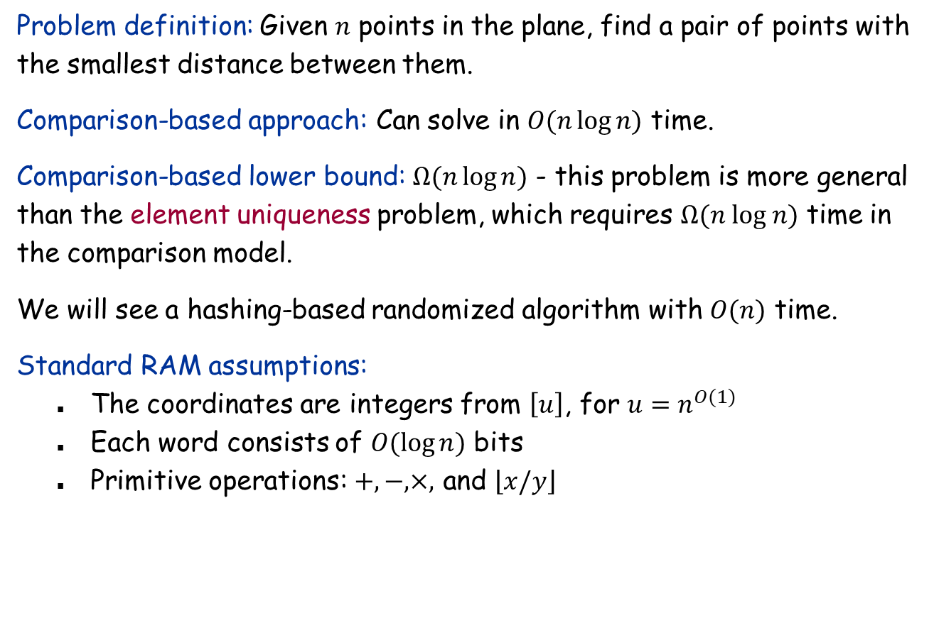
The Closest Pair of Points Problem
Problem definition: Given $n$ points in the plane, find a pair of points with the smallest distance between them.
Comparison-based approach: Can solve in $O(n\log{n)}$ time.
Comparison-based lower bound: $Ω(n\log{n)}$ - this problem is more general than the element uniqueness problem, which requires $Ω(n log n)$ time in the comparison model.
We will see a hashing-based randomized algorithm with $O(n)$ time.
Standard RAM assumptions:
The coordinates are integers from $\left[u\right]$, for $u=n^{O(1)}$
Each word consists of $O(\log{n)}$ bits
Primitive operations: $+,−, ×,$ and $\left\lfloor x/y\right\rfloor$

Slide 24
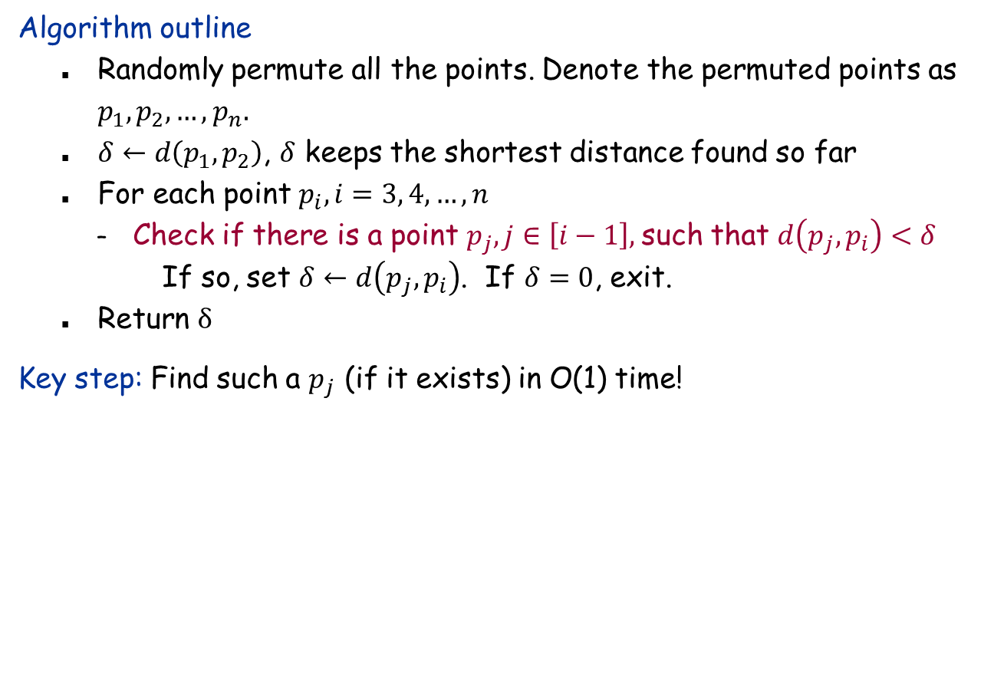
Algorithm Outline
Algorithm outline
Randomly permute all the points. Denote the permuted points as $p_{1},p_{2},…, p_{n}.$
$δ←d\left(p_{1},p_{2}\right)$, $δ$ keeps the shortest distance found so far
For each point $p_{i},i=3, 4,…,n$
Check if there is a point $p_{j}, j∈\left[i−1\right],$such that $d\left(p_{j},p_{i}\right)<δ$
If so, set $δ←d\left(p_{j},p_{i}\right)$. If $δ=0$, exit.
Return $δ$
Key step: Find such a $p_{j}$ (if it exists) in O(1) time!

Slide 25
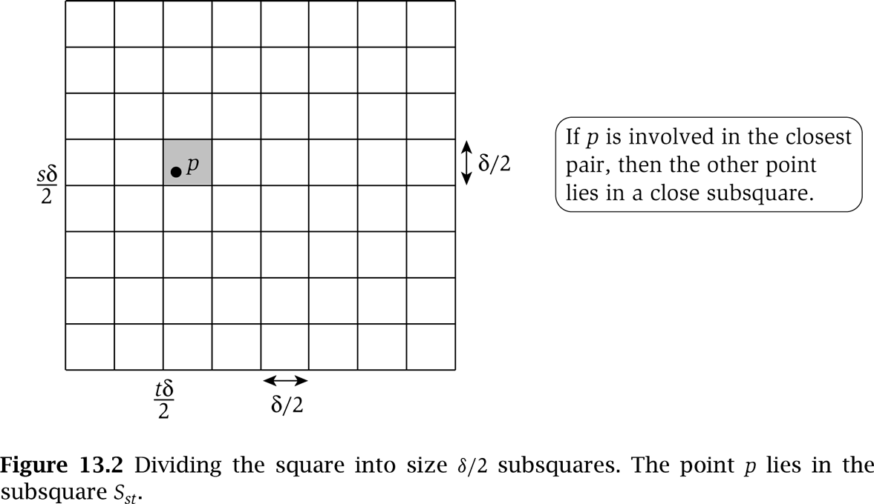
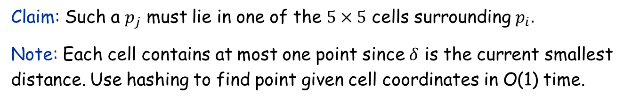
Gridding
Claim: Such a $p_{j}$ must lie in one of the $5×5$ cells surrounding $p_{i}.$
Note: Each cell contains at most one point since $δ$ is the current smallest distance. Use hashing to find point given cell coordinates in O(1) time.

Slide 26
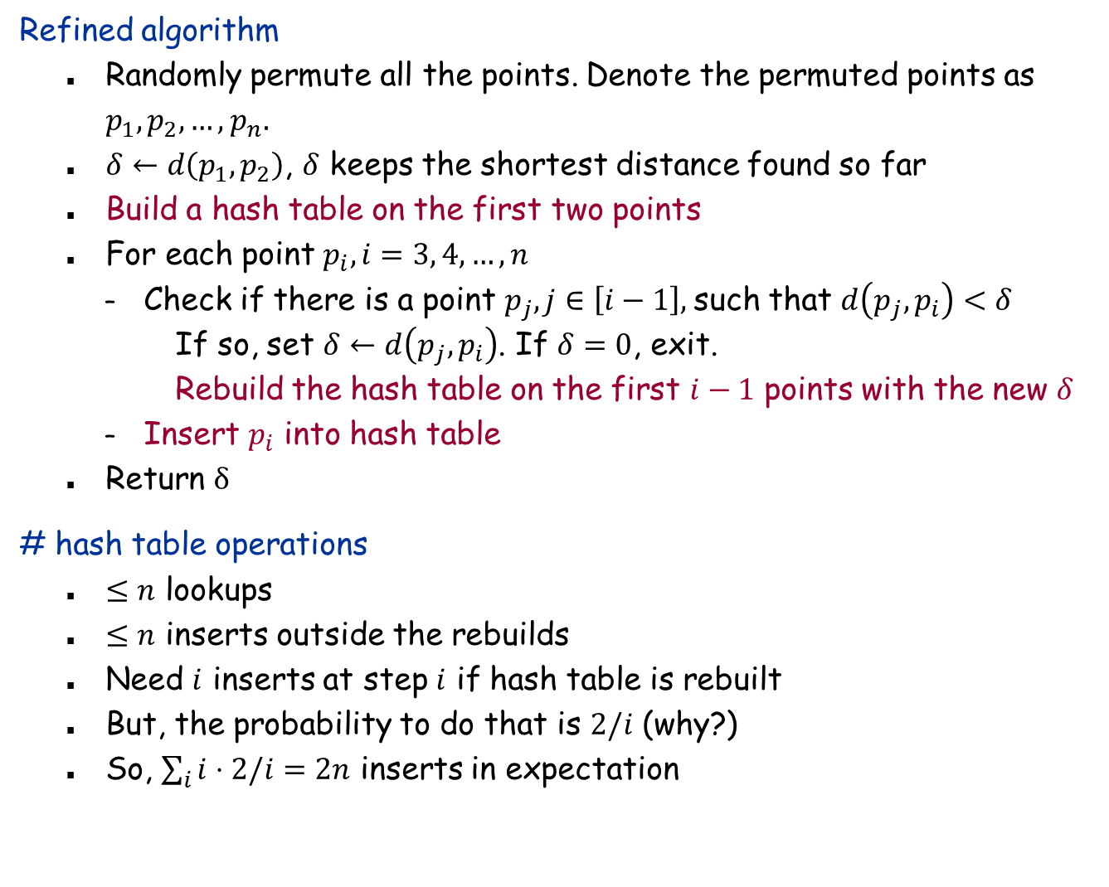
Refined Algorithm
Refined algorithm
Randomly permute all the points. Denote the permuted points as $p_{1},p_{2},…, p_{n}.$
$δ←d\left(p_{1},p_{2}\right)$, $δ$ keeps the shortest distance found so far
Build a hash table on the first two points
For each point $p_{i},i=3, 4,…,n$
Check if there is a point $p_{j}, j∈\left[i−1\right],$such that $d\left(p_{j},p_{i}\right)<δ$
If so, set $δ←d\left(p_{j},p_{i}\right)$. If $δ=0$, exit.
Rebuild the hash table on the first $i−1$ points with the new $δ$
Insert $p_{i}$ into hash table
Return $δ$
# hash table operations
$≤n$ lookups
$≤n$ inserts outside the rebuilds
Need $i$ inserts at step $i$ if hash table is rebuilt
But, the probability to do that is $2/i$ (why?)
So, $\sum_{i}{i⋅2/i}=2n$ inserts in expectation

Slide 27
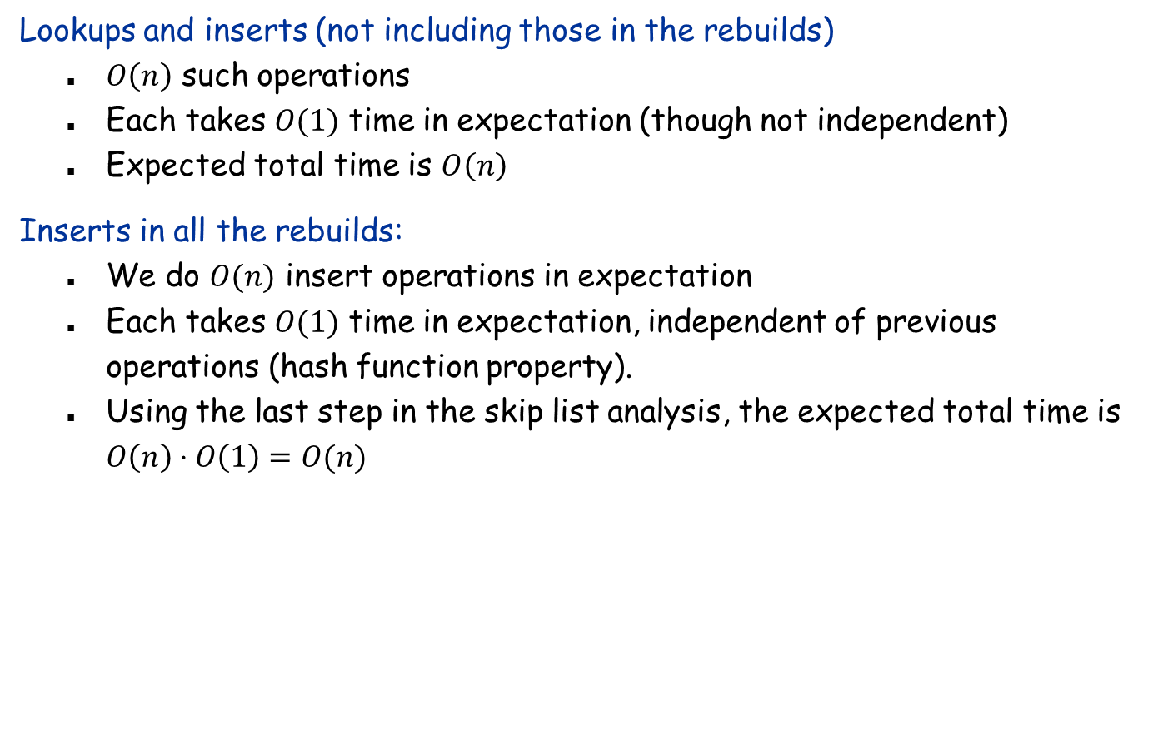
Cost Analysis
Lookups and inserts (not including those in the rebuilds)
$O\left(n\right)$ such operations
Each takes $O(1)$ time in expectation (though not independent)
Expected total time is $O\left(n\right)$
Inserts in all the rebuilds:
We do $O(n)$ insert operations in expectation
Each takes $O(1)$ time in expectation, independent of previous operations (hash function property).
Using the last step in the skip list analysis, the expected total time is $O\left(n\right)⋅O\left(1\right)=O(n)$

Slide 28
Randomized Incremental Construction
See MR 9.1-9.2

Slide 29
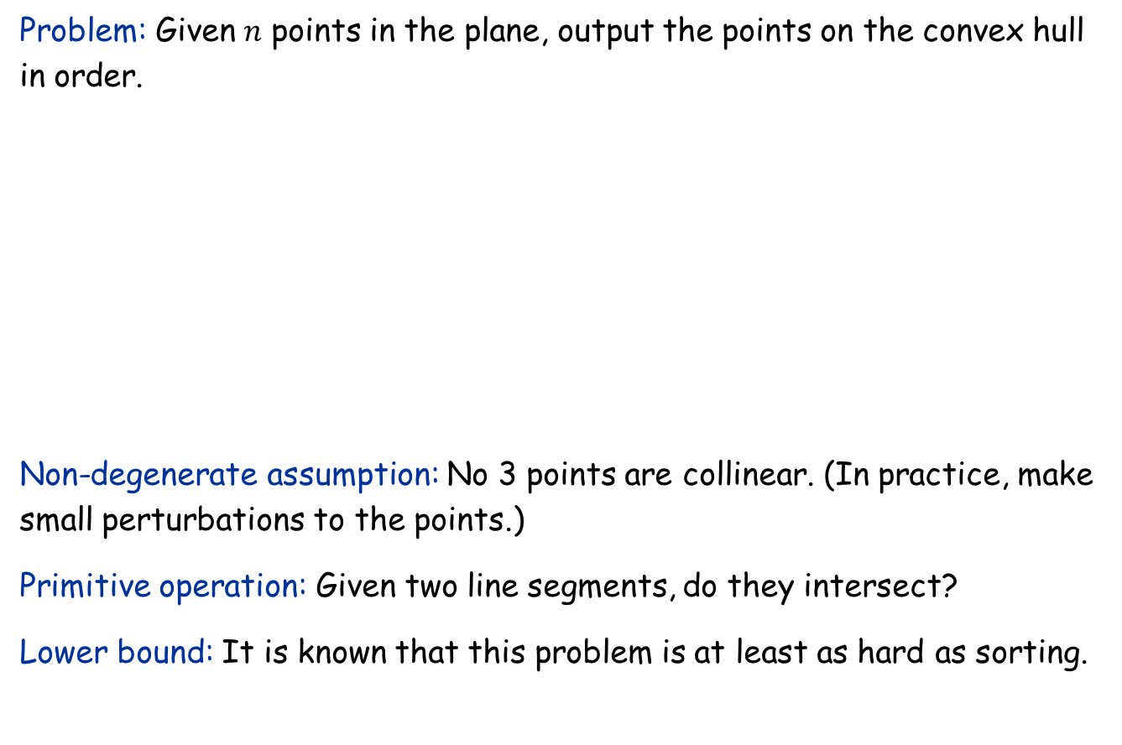
Convex Hulls
Problem: Given $n$ points in the plane, output the points on the convex hull in order.
Non-degenerate assumption: No 3 points are collinear. (In practice, make small perturbations to the points.)
Primitive operation: Given two line segments, do they intersect?
Lower bound: It is known that this problem is at least as hard as sorting.

Slide 30

Randomized Incremental Construction
Algorithm outline:
Randomly permute the points as $p_{1},p_{2},…,p_{n}$
Build the convex hull for $p_{1},p_{2},p_{3}$
Add the remaining points one by one, and update the convex hull after each step
Structural changes:
Each step adds at most one point to convex hull, but may delete many
Amortized # changes = O(1) (why?) Randomization not needed here

Slide 31

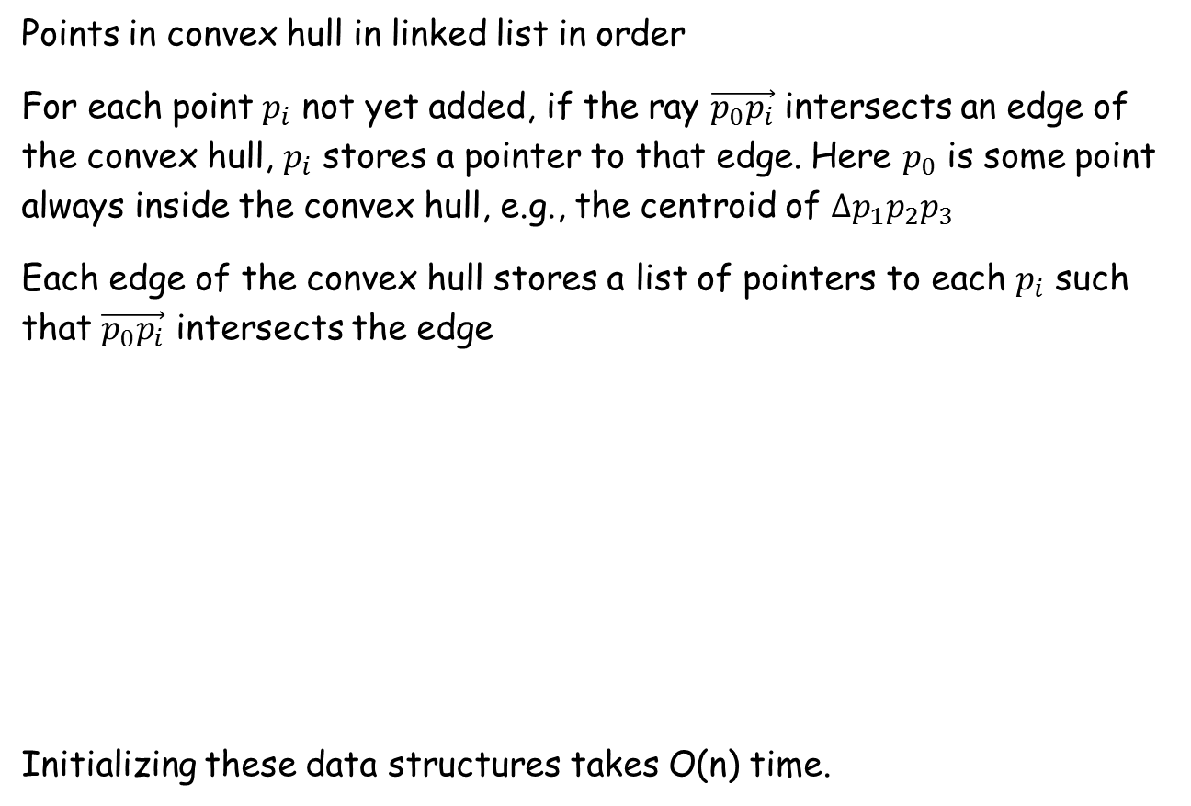
Data Structures
Points in convex hull in linked list in order
For each point $p_{i}$ not yet added, if the ray $\vec{p_{0}p_{i}}$ intersects an edge of the convex hull, $p_{i}$ stores a pointer to that edge. Here $p_{0}$ is some point always inside the convex hull, e.g., the centroid of $∆p_{1}p_{2}p_{3}$
Each edge of the convex hull stores a list of pointers to each $p_{i}$ such that $\vec{p_{0}p_{i}}$ intersects the edge
Initializing these data structures takes O(n) time.
$$p_{0}$$

Slide 32

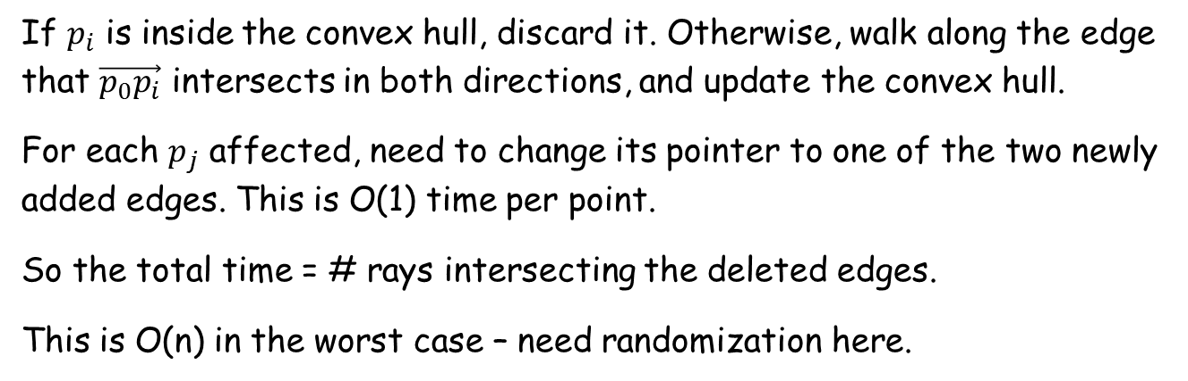


Add One Point
If $p_{i}$ is inside the convex hull, discard it. Otherwise, walk along the edge that $\vec{p_{0}p_{i}}$ intersects in both directions, and update the convex hull.
For each $p_{j}$ affected, need to change its pointer to one of the two newly added edges. This is O(1) time per point.
So the total time = # rays intersecting the deleted edges.
This is O(n) in the worst case – need randomization here.
$$p_{j}$$
$$p_{i}$$
$$p_{0}$$

Slide 33

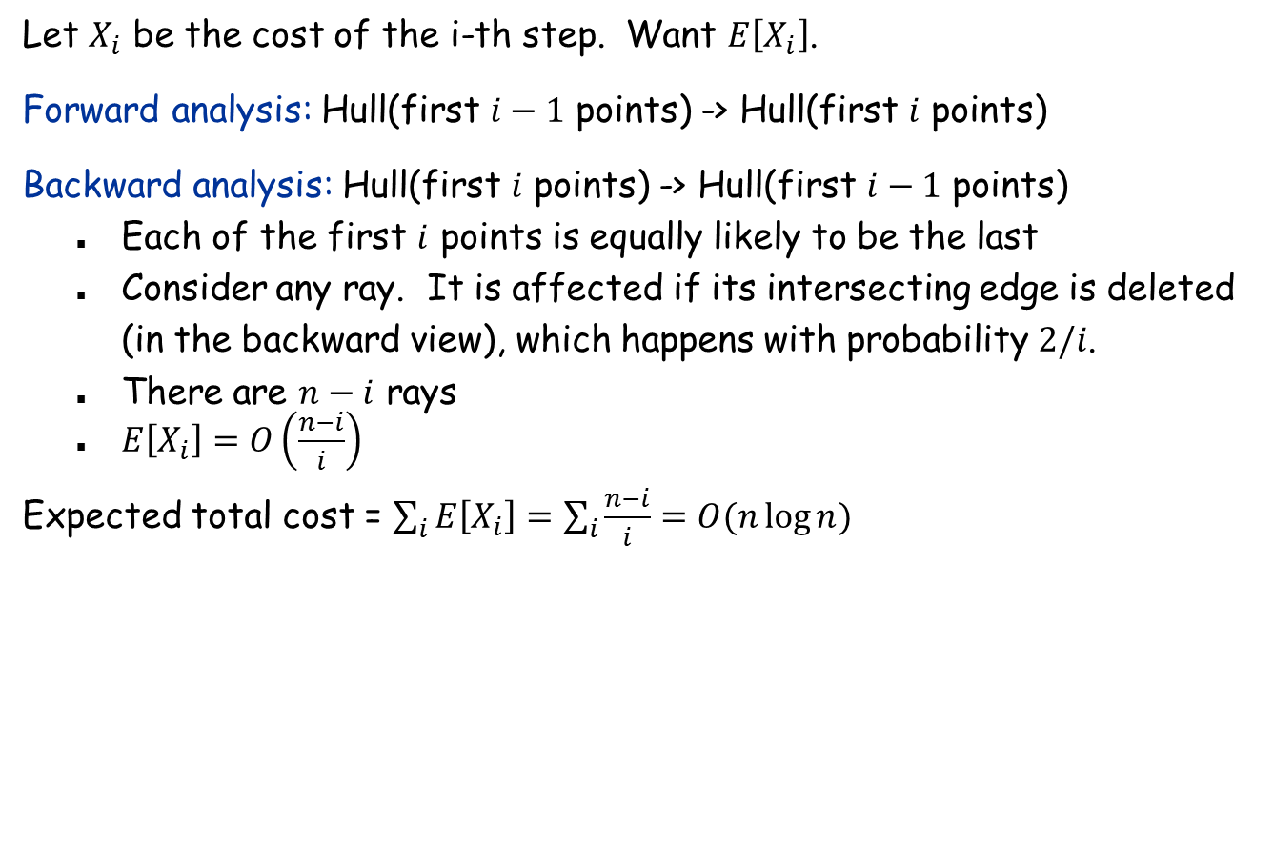
Analysis
Let $X_{i}$ be the cost of the i-th step. Want $E\left[X_{i}\right]$.
Forward analysis: Hull(first $i−1$ points) -> Hull(first $i$ points)
Backward analysis: Hull(first $i$ points) -> Hull(first $i−1$ points)
Each of the first $i$ points is equally likely to be the last
Consider any ray. It is affected if its intersecting edge is deleted (in the backward view), which happens with probability $2/i$.
There are $n−i$ rays
$E\left[X_{i}\right]=O\left(\frac{n−i}{i}\right)$
Expected total cost = $\sum_{i}{E\left[X_{i}\right]=\sum_{i}{\frac{n−i}{i}}=O(n\log{n})}$
$$p_{0}$$

Slide 34
Locality Sensitive Hashing
See CY 9.1

Slide 35
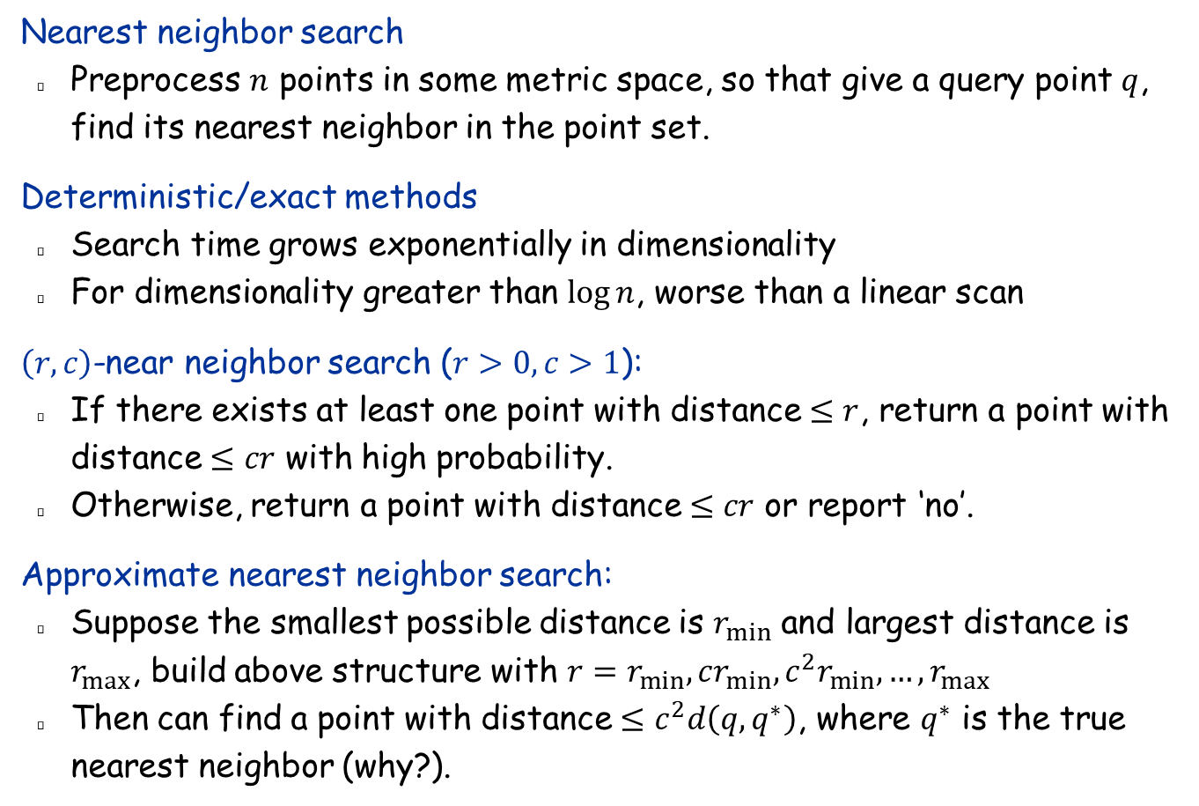
Nearest Neighbor Search
Nearest neighbor search
Preprocess $n$ points in some metric space, so that give a query point $q$, find its nearest neighbor in the point set.
Deterministic/exact methods
Search time grows exponentially in dimensionality
For dimensionality greater than $\log{n}$, worse than a linear scan
$\left(r,c\right)$-near neighbor search ($r>0, c>1$):
If there exists at least one point with distance $≤r$, return a point with distance $≤cr$ with high probability.
Otherwise, return a point with distance $≤cr$ or report ‘no’.
Approximate nearest neighbor search:
Suppose the smallest possible distance is $r_{min}$ and largest distance is $r_{max}$, build above structure with $r=r_{min},cr_{min},c^{2}r_{min},…,r_{max}$
Then can find a point with distance $≤c^{2}d\left(q,q^{∗}\right)$, where $q^{∗}$ is the true nearest neighbor (why?).

Slide 36

LSH Family
Def: Let $H$ be a family of functions defined over universe $U$, and let $d$ be a distance measure. Suppose the following holds for any $p,q∈U$ and $h∈H$ uniformly chosen at random:
If $d\left(p,q\right)≤r$, then $\operatorname{Pr}\left[h\left(p\right)=h\left(q\right)\right]≥p_{1}$
If $d\left(p,q\right)≥cr$, then $\operatorname{Pr}\left[h\left(p\right)=h\left(q\right)\right]≤p_{2}$ If $p_{1}>p_{2}$, then $H$ is called $(r,cr,p_{1},p_{2})$-sensitive.

Slide 37
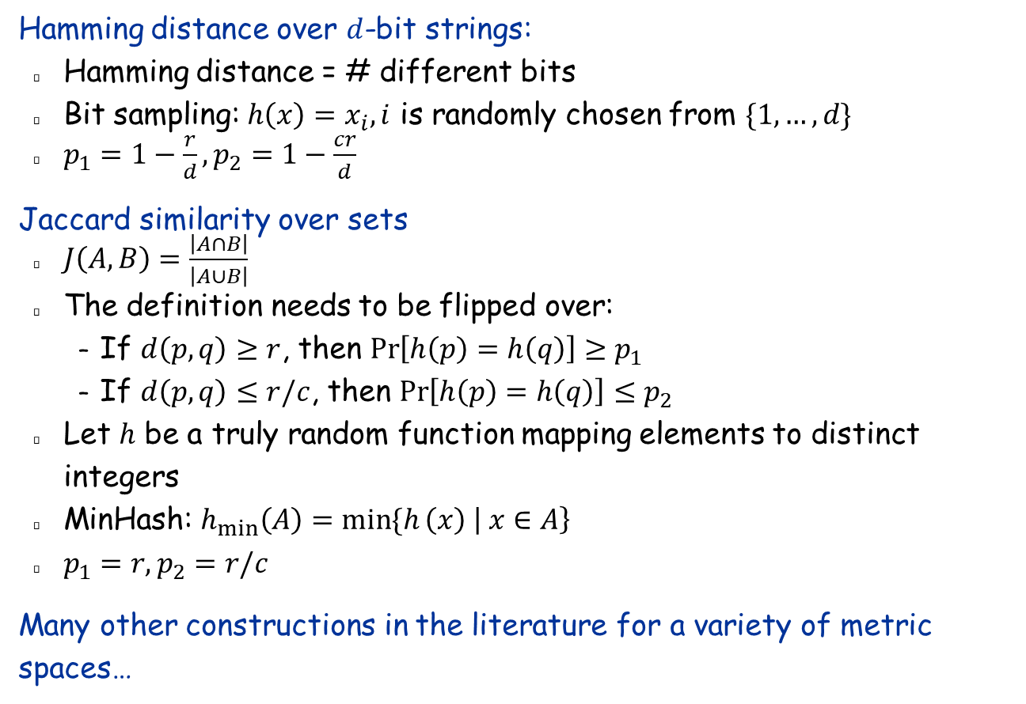
LSH Family Constructions
Hamming distance over $d$-bit strings:
Hamming distance = # different bits
Bit sampling: $h\left(x\right)=x_{i},i$ is randomly chosen from $\{1,…,d\}$
$p_{1}=1−\frac{r}{d}, p_{2}=1−\frac{cr}{d}$
Jaccard similarity over sets
$J\left(A,B\right)=\frac{\left|A∩B\right|}{\left|A∪B\right|}$
The definition needs to be flipped over:
If $d\left(p,q\right)≥r$, then $\operatorname{Pr}\left[h\left(p\right)=h\left(q\right)\right]≥p_{1}$
If $d\left(p,q\right)≤r/c$, then $\operatorname{Pr}\left[h\left(p\right)=h\left(q\right)\right]≤p_{2}$
Let $h$ be a truly random function mapping elements to distinct integers
MinHash: $h_{min}\left(A\right)=\min{\{h}\left(x\right) \left| x∈A\right\}$
$p_{1}=r,p_{2}=r/c$
Many other constructions in the literature for a variety of metric spaces…

Slide 38
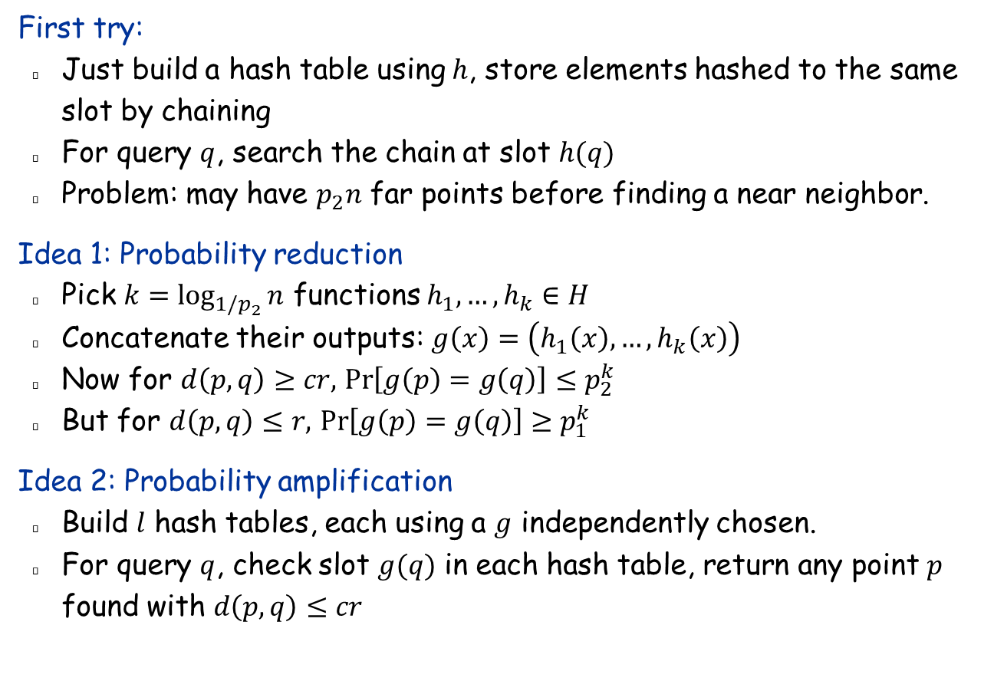
Hash Table Construction
First try:
Just build a hash table using $h$, store elements hashed to the same slot by chaining
For query $q$, search the chain at slot $h(q)$
Problem: may have $p_{2}n$ far points before finding a near neighbor.
Idea 1: Probability reduction
Pick $k=\log_{1/p_{2}}{n}$ functions $h_{1},…, h_{k}∈H$
Concatenate their outputs: $g\left(x\right)=\left(h_{1}\left(x\right),…, h_{k}\left(x\right)\right)$
Now for $d\left(p,q\right)≥cr,$ $\operatorname{Pr}\left[g\left(p\right)=g\left(q\right)\right]≤p_{2}^{k}$
But for $d\left(p,q\right)≤r,$ $\operatorname{Pr}\left[g\left(p\right)=g\left(q\right)\right]≥p_{1}^{k}$
Idea 2: Probability amplification
Build $l$ hash tables, each using a $g$ independently chosen.
For query $q$, check slot $g(q)$ in each hash table, return any point $p$ found with $d\left(p,q\right)≤cr$

Slide 39
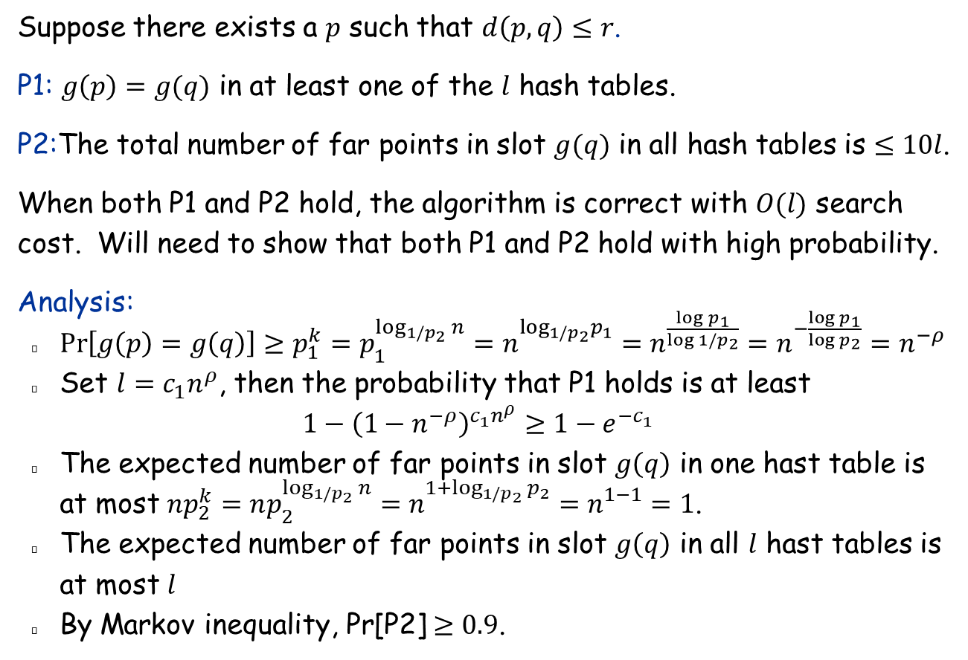
LSH Analysis
Suppose there exists a $p$ such that $d\left(p,q\right)≤r$.
P1: $g\left(p\right)=g(q)$ in at least one of the $l$ hash tables.
P2:The total number of far points in slot $g(q)$ in all hash tables is $≤10l$.
When both P1 and P2 hold, the algorithm is correct with $O(l)$ search cost. Will need to show that both P1 and P2 hold with high probability.
Analysis:
$\operatorname{Pr}\left[g\left(p\right)=g\left(q\right)\right]≥p_{1}^{k}=p_{1}^{\log_{1/p_{2}}{n}}=n_{}^{\log_{1/p_{2}}p_{1}}=n^{\frac{\log{p_{1}}}{\log{1/p_{2}}}}=n^{−\frac{\log{p_{1}}}{\log{p_{2}}}}=n^{−ρ}$
Set $l=c_{1}n^{ρ}$, then the probability that P1 holds is at least $1−{\left(1−n^{−ρ}\right)}^{c_{1}n^{ρ}}≥1−e^{−c_{1}}$
The expected number of far points in slot $g\left(q\right)$ in one hast table is at most ${np}_{2}^{k}=np_{2}^{\log_{1/p_{2}}{n}}=n_{}^{1+\log_{1/p_{2}}{p_{2}}}=n_{}^{1−1}=1$.
The expected number of far points in slot $g\left(q\right)$ in all $l$ hast tables is at most $l$
By Markov inequality, Pr[P2] $≥0.9$.

Slide 40
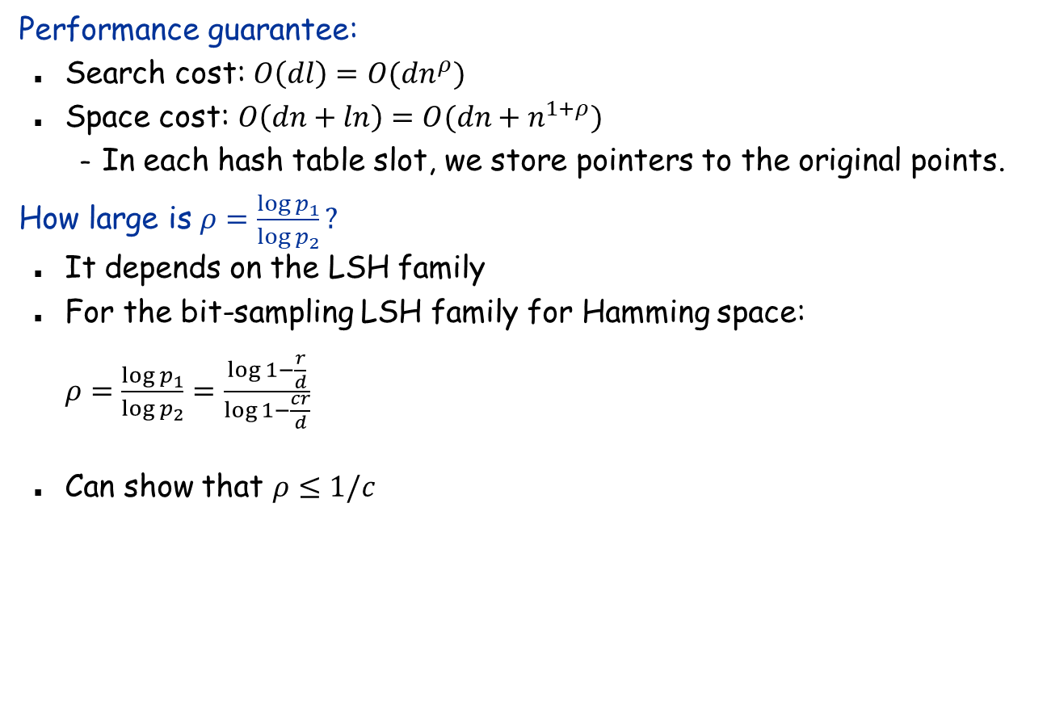
LSH Summary
Performance guarantee:
Search cost: $O\left(dl\right)=O(dn^{ρ})$
Space cost: $O\left(dn+ln\right)=O(dn+n^{1+ρ})$
In each hash table slot, we store pointers to the original points.
How large is $ρ=\frac{\log{p_{1}}}{\log{p_{2}}}?$
It depends on the LSH family
For the bit-sampling LSH family for Hamming space: $ρ=\frac{\log{p_{1}}}{\log{p_{2}}}=\frac{\log{1−\frac{r}{d}}}{\log{1−\frac{cr}{d}}}$
Can show that $ρ≤1/c$

