Slide 1
COMP 5711 Advanced Algorithms
Ke Yi
Dept CSE, HKUST

Slide 2
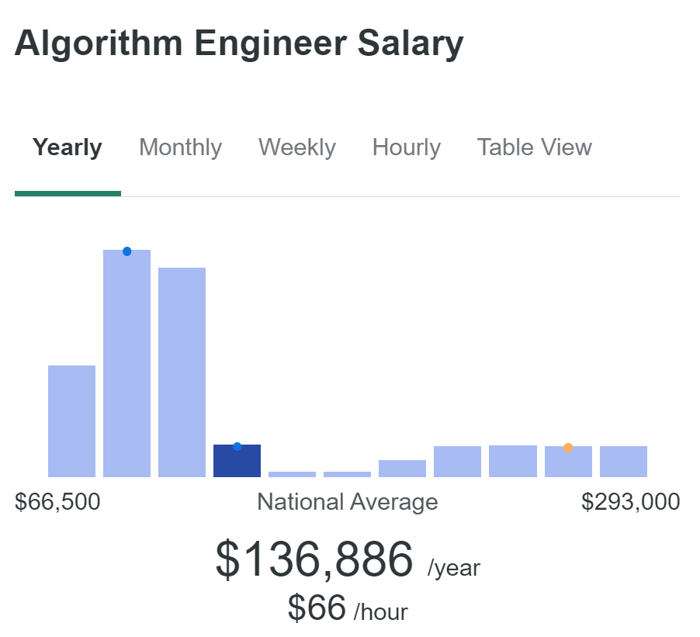
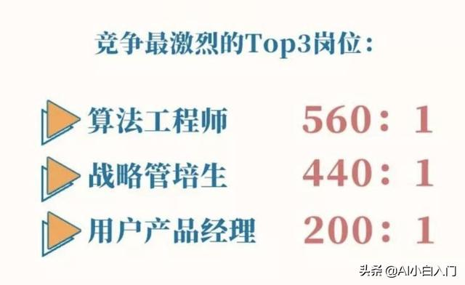

Slide 3
What This Course is NOT About
Want to design an algorithm to beat ChatGPT?
COMP 5211 - Advanced Artificial Intelligence
COMP 5212 - Machine Learning
COMP 5221 - Natural Language Processing
COMP 5214 - Advanced Deep Learning Architectures
Want to design an algorithm to predict tomorrow’s stock prices?
COMP 5212 - Machine Learning
COMP 5331 - Knowledge Discovery in Databases
Want to design an algorithm to drive cars automatically?
COMP 5421 - Computer Vision
COMP 5214 - Advanced Deep Learning Architectures
Want to design an algorithm to solve complicated optimization problems like linear programming, network flow, scheduling, covering, packing, constraint satisfaction (CSP)?
COMP 5712 - Introduction to Combinatorial Optimization
ELEC 5470 - Convex Optimization

Slide 4
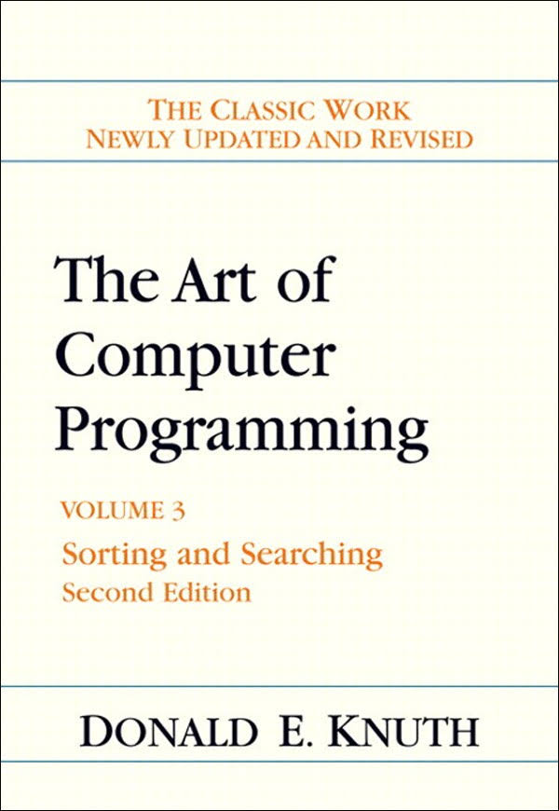
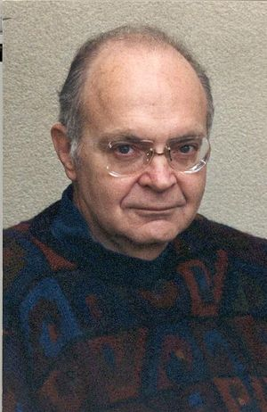
Algorithms: Broadly and Narrowly
Broadly
Everything (pretty much) in computer science
Narrowly (focus of this course):
Algorithms with provable guarantees
Fundamental algorithms and data structures
Amortized analysis.
Parameterized algorithms.
Randomized algorithms.
Hashing.
Tail inequalities and random sampling.
Online algorithms.
Advanced topics: streaming/parallel/distributed algorithms
More analysis than design
Mostly well understood and implemented in libraries

Slide 5
Who should take this course?
Yes: PhD students in the CSE department
Required to take core course in 4 different areas
One of them has to be theory
Must obtain B+ or above
Maybe:
MPhil students in CSE
UG students considering graduate studies in CS
PG students in other departments who do a lot of low-level programming (C++, Java)
What’s the difference between Python’s list and C++’s std::list?
Probably not:
UG students with no intention of graduate studies
PG students who do high-level programming mostly (MATLAB, R, TensorFlow, Python?)

Slide 6
Background Requirements
COMP3711 (Undergrad algorithms course)
Sorting and searching, divide & conquer, greedy, dynamic programming, graph algorithms (MST, shortest path, etc.),
Analysis of algorithms
Basic discrete math
Recurrences, logic and proofs, basic graph theory
Basic probability theory
Probability space, random variables, expectation, variance
NP-completeness
Not necessary but good to know

Slide 7
Background Check
See Canvas -> Quiz

Slide 8
Logistics
Grading
10% assignments
30% midterm exam (in class), possible dates: Oct 19 or 21
60% final exam
Exams will be open-book
Course website on Canvas
Reference books
[KT] Algorithm Design, by Jon Kleinberg and Eva Tardos.
[CLRS] Introduction to Algorithms, by T. Cormen, C. Leiserson, R. Rivest, and C. Stein.
[MR] Randomized Algorithms, by Rajeev Motwani and Prabhakar Raghavan.
[CY] Small Summaries for Big Data, by Graham Cormode and Ke Yi
This is PG-core course in the Theory area
COMP 5712 will be offered in Spring 2021.

Slide 9
A Few General Issues about Algorithm Design & Analysis

Slide 10
Models of Computation
All models are wrong,
But some are useful.
George E. P. Box

Slide 11
Models of Computation
Turing machine
Random Access Machine (RAM)
Space
Time

Slide 12
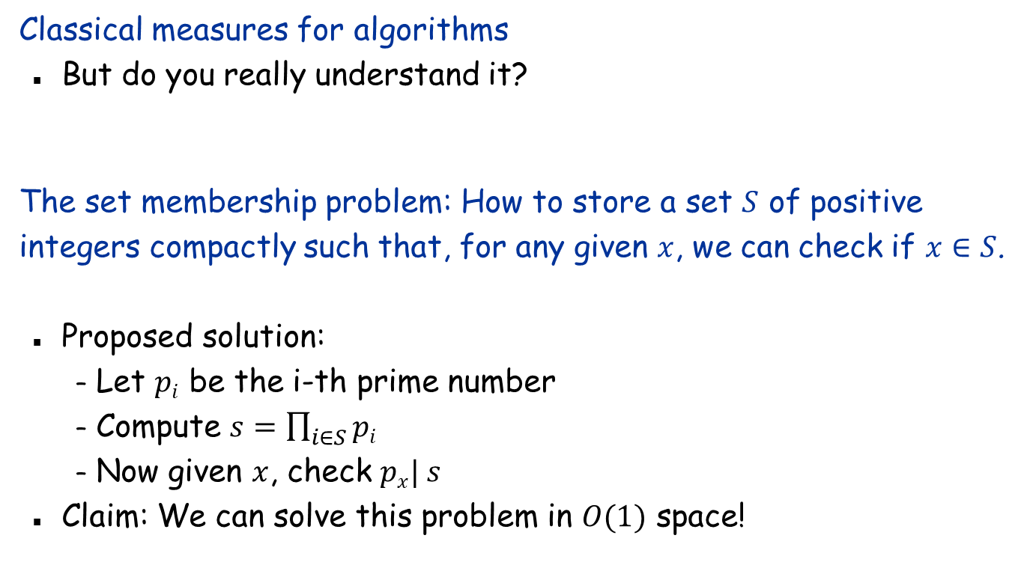
RAM
Classical measures for algorithms
But do you really understand it?
The set membership problem: How to store a set $S$ of positive integers compactly such that, for any given $x$, we can check if $x∈S$.
Proposed solution:
Let $pi$ be the i-th prime number
Compute $s=\prod_{i∈S}{pi}$
Now given $x$, check $px| s$
Claim: We can solve this problem in $O(1)$ space!

Slide 13
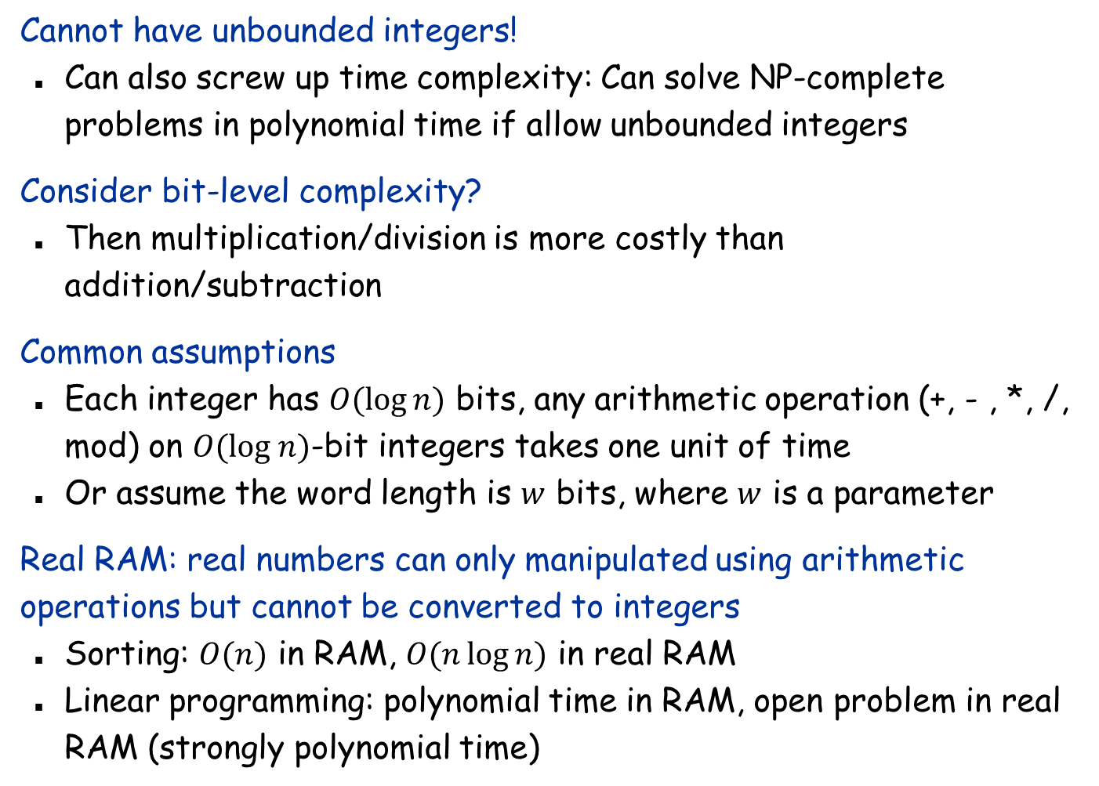
RAM
Cannot have unbounded integers!
Can also screw up time complexity: Can solve NP-complete problems in polynomial time if allow unbounded integers
Consider bit-level complexity?
Then multiplication/division is more costly than addition/subtraction
Common assumptions
Each integer has $O(log⁡n)$ bits, any arithmetic operation (+, - , *, /, mod) on $O(log n)$-bit integers takes one unit of time
Or assume the word length is $w$ bits, where $w$ is a parameter
Real RAM: real numbers can only manipulated using arithmetic operations but cannot be converted to integers
Sorting: $O(n)$ in RAM, $O(n\log{n)}$ in real RAM
Linear programming: polynomial time in RAM, open problem in real RAM (strongly polynomial time)

Slide 14
Models of Computation
Turing machine
Random Access Machine
Computation models for “Big data”
Data stream model
External memory model
Parallel models: PRAM, BSP, MapReduce
Distributed computing

Slide 15

Asymptotics
Asymptotics: $O, Ω, Θ$
Why?
Easier to analyze
Result independent of implementation
Focus on growth rate as $n→∞$
Worst-case analysis

Slide 16
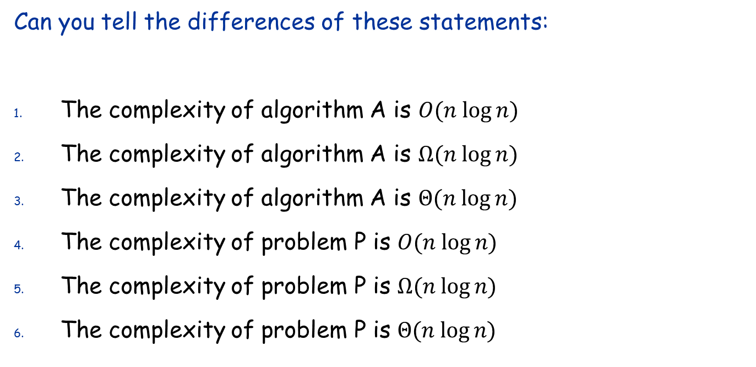
Upper and Lower Bounds
Can you tell the differences of these statements:
The complexity of algorithm A is $O(n log⁡n)$
The complexity of algorithm A is $Ω(n log⁡n)$
The complexity of algorithm A is $Θ(n log⁡n)$
The complexity of problem P is $O(n log⁡n)$
The complexity of problem P is $Ω(n log⁡n)$
The complexity of problem P is $Θ(n log⁡n)$

Slide 17
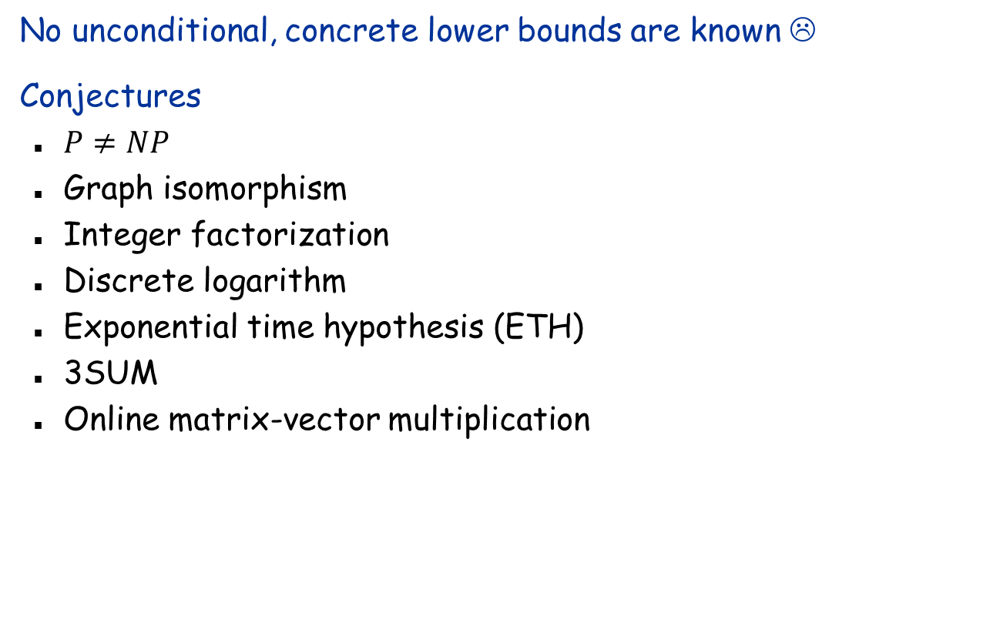
Lower Bounds
No unconditional, concrete lower bounds are known ☹
Conjectures
$P≠NP$
Graph isomorphism
Integer factorization
Discrete logarithm
Exponential time hypothesis (ETH)
3SUM
Online matrix-vector multiplication

Slide 18
Lower Bounds
Restricted computational models
Decision tree
Non-time lower bounds
Circuit complexity
Communication lower bounds
Space lower bounds
Data structure lower bounds
I/O lower bounds
Sample-accuracy lower bound

Slide 19
Beyond Worst-Case Analysis
Expected case (for randomized algorithms)
Also high-probability bound
Average-case analysis
Instance-optimality / Parameterized analysis
All possible inputs of size n

