Slide 1
Online Algorithms
KT 13.8

Slide 2
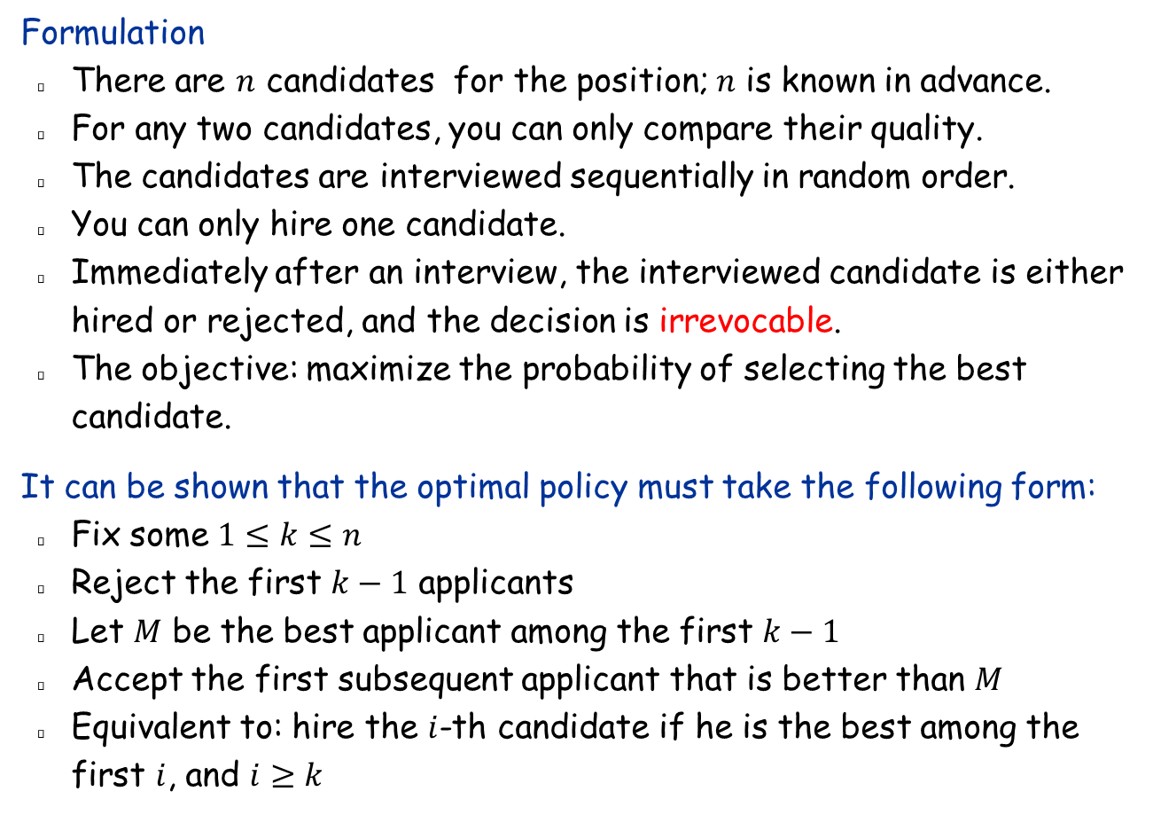
The Secretary Problem
Formulation
  There are $n$ candidates for the position; $n$ is known in advance.
  For any two candidates, you can only compare their quality.
  The candidates are interviewed sequentially in random order.
  You can only hire one candidate.
  Immediately after an interview, the interviewed candidate is either hired or rejected, and the decision is irrevocable.
  The objective: maximize the probability of selecting the best candidate.
It can be shown that the optimal policy must take the following form:
  Fix some $1≤k≤n$
  Reject the first $k−1$ applicants
  Let $M$ be the best applicant among the first $k−1$
  Accept the first subsequent applicant that is better than $M$
  Equivalent to: hire the $i$-th candidate if he is the best among the first $i$, and $i≥k$

Slide 3
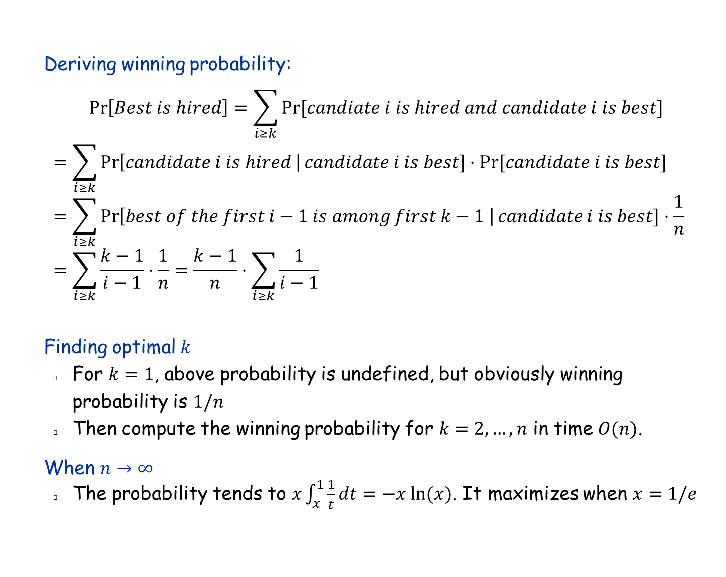
Determining optimal $k$
Deriving winning probability:
  $$\operatorname{Pr}\left[Best is hired\right]=\sum_{i≥k}{Pr⁡[candiate i is hired and candidate i is best]}$$
  $$=\sum_{i≥k}{\operatorname{Pr}\left[candidate i is hired \right|candidate i is best]⋅Pr⁡[candidate i is best]}$$
  $$=\sum_{i≥k}{\operatorname{Pr}\left[best of the first i−1 is among first k−1 \right|candidate i is best]⋅\frac{1}{n}}$$
  $$=\sum_{i≥k}{\frac{k−1}{i−1}⋅\frac{1}{n}}=\frac{k−1}{n}⋅\sum_{i≥k}{\frac{1}{i−1}}$$
Finding optimal $k$
  For $k=1$, above probability is undefined, but obviously winning probability is $1/n$
  Then compute the winning probability for $k=2,…,n$ in time $O(n)$.
When $n→∞$
  The probability tends to $x\int_{x}^{1}{\frac{1}{t}}dt=−x ln⁡(x)$. It maximizes when $x=1/e$

Slide 4
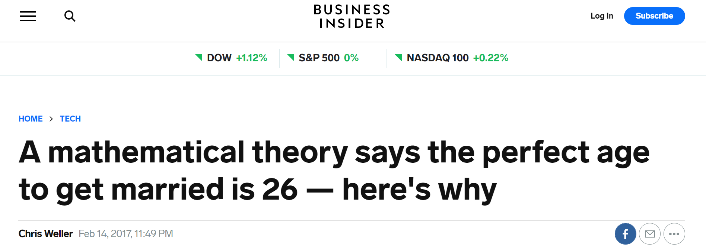
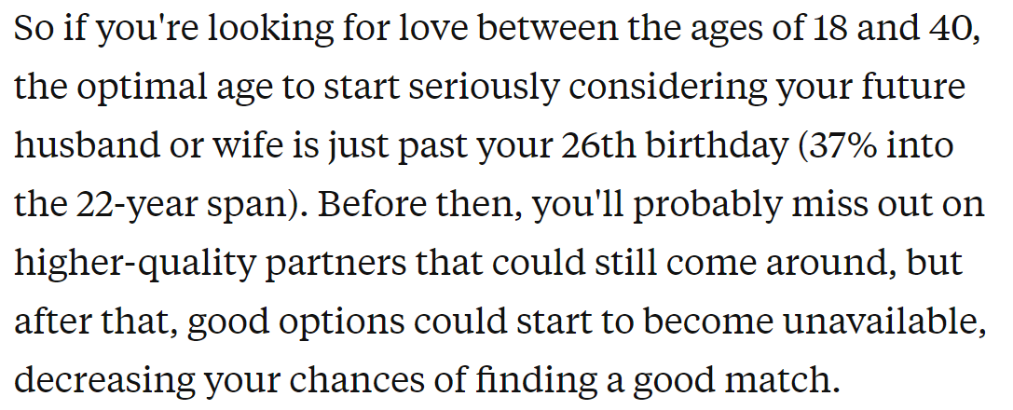

Slide 5
13.8 The Caching (Paging) Problem
See KT 13.8

Slide 6
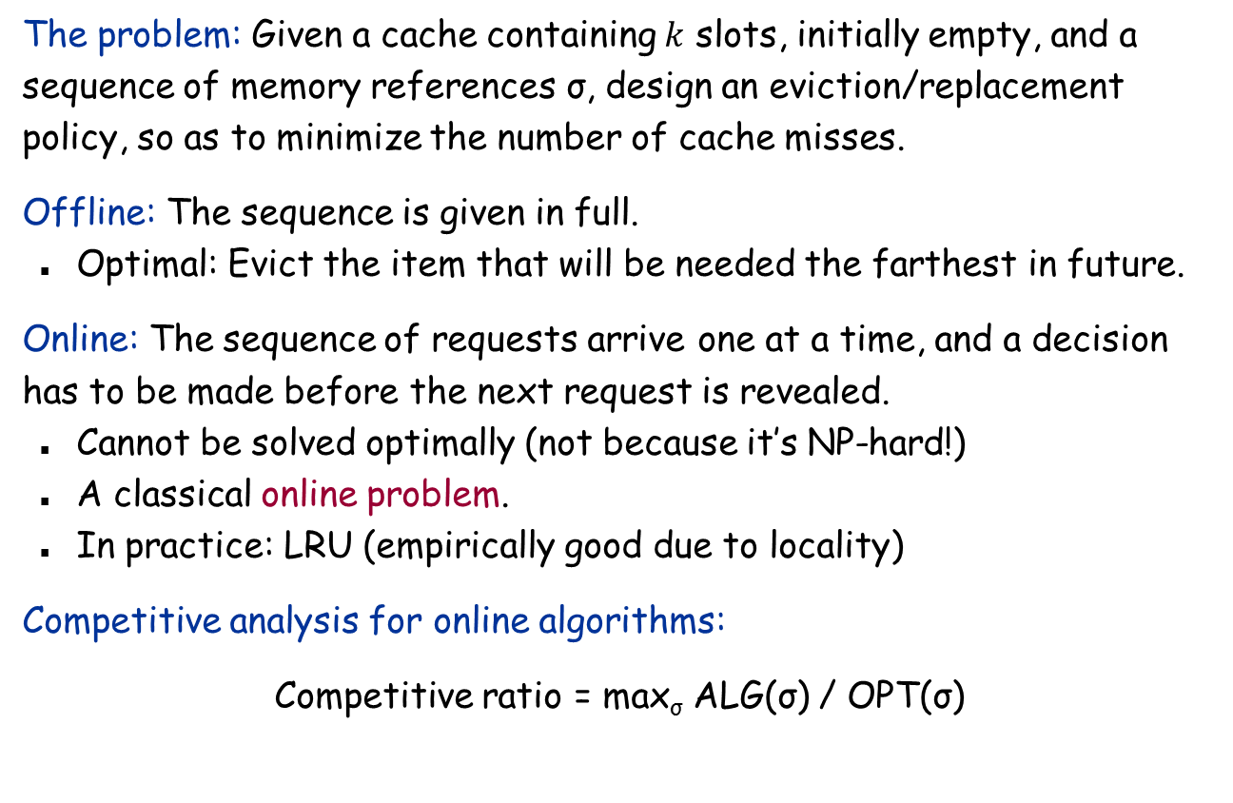
The Caching (Paging) Problem
The problem: Given a cache containing $k$ slots, initially empty, and a sequence of memory references σ, design an eviction/replacement policy, so as to minimize the number of cache misses.
Offline: The sequence is given in full.
  Optimal: Evict the item that will be needed the farthest in future.
Online: The sequence of requests arrive one at a time, and a decision has to be made before the next request is revealed.
  Cannot be solved optimally (not because it’s NP-hard!)
  A classical online problem.
  In practice: LRU (empirically good due to locality)
Competitive analysis for online algorithms:
Competitive ratio = max_{σ} ALG(σ) / OPT(σ)
# cache misses of the algorithm on input σ
Offline optimal on input σ

Slide 7
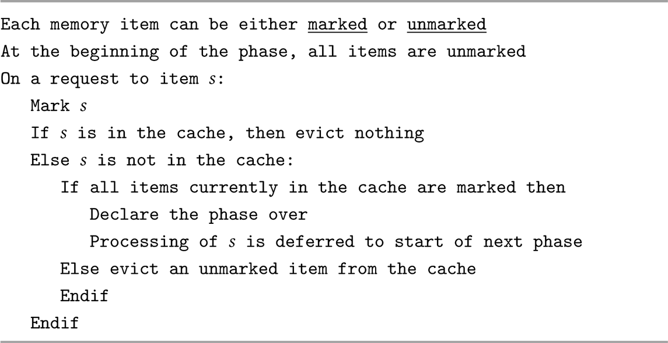
Marking Algorithms
NRU and LRU are both special cases of the marking algorithm.

Slide 8
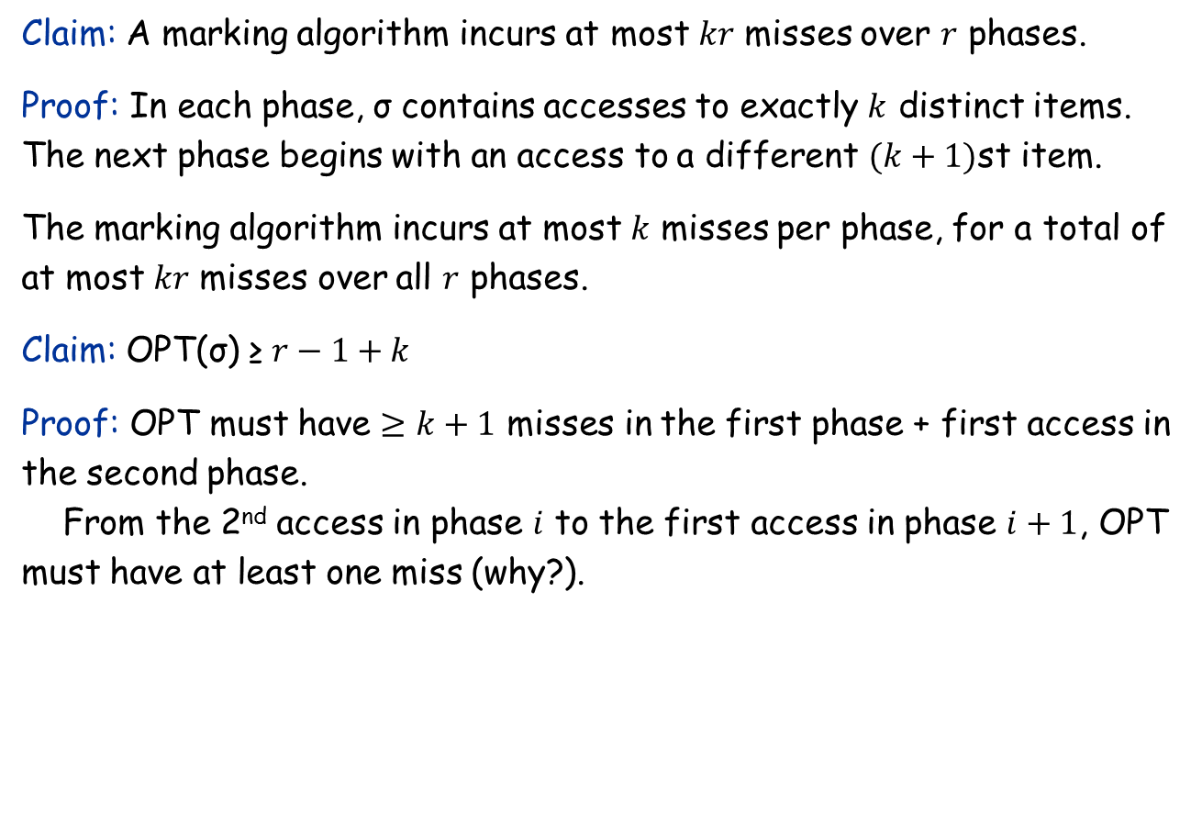
Analyzing Marking Algorithms
Claim: A marking algorithm incurs at most $kr$ misses over $r$ phases.
Proof: In each phase, σ contains accesses to exactly $k$ distinct items. The next phase begins with an access to a different $(k+1)$st item.
The marking algorithm incurs at most $k$ misses per phase, for a total of at most $kr$ misses over all $r$ phases.
Claim: OPT(σ) ≥ $r−1+k$
Proof: OPT must have $≥k+1$ misses in the first phase + first access in the second phase.
From the 2nd access in phase $i$ to the first access in phase $i+1$, OPT must have at least one miss (why?).

Slide 9
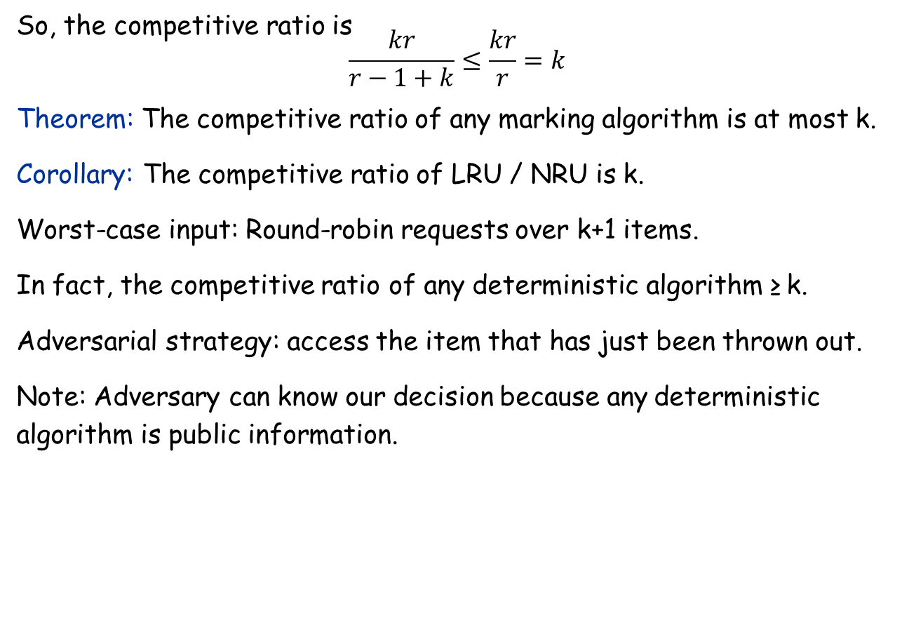
Competitive Ratio for a Marking Algorithm
So, the competitive ratio is
$$\frac{kr}{r−1+k}≤\frac{kr}{r}=k$$
Theorem: The competitive ratio of any marking algorithm is at most k.
Corollary: The competitive ratio of LRU / NRU is k.
Worst-case input: Round-robin requests over k+1 items.
In fact, the competitive ratio of any deterministic algorithm ≥ k.
Adversarial strategy: access the item that has just been thrown out.
Note: Adversary can know our decision because any deterministic algorithm is public information.

Slide 10
A Randomized Marking Algorithm
Chosen uniformly at random
Assumption: Adversary doesn’t know our random numbers.

Slide 11
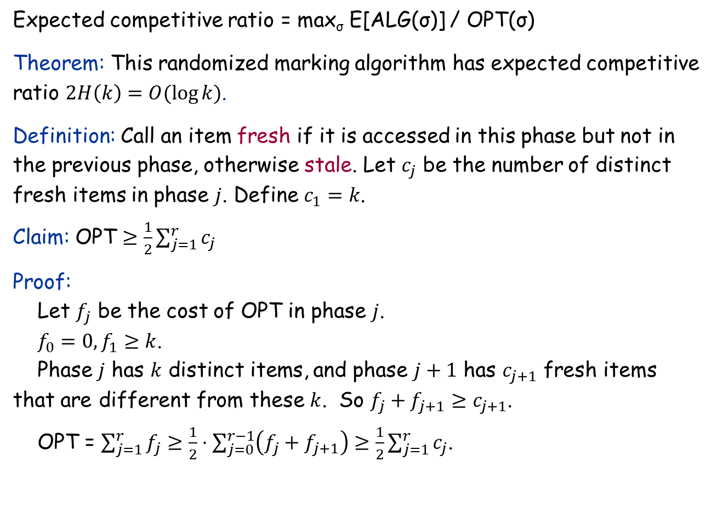
Analysis for the Randomized Marking Algorithm
Expected competitive ratio = max_{σ} E[ALG(σ)] / OPT(σ)
Theorem: This randomized marking algorithm has expected competitive ratio $2H\left(k\right)=O(\log{k)}$.
Definition: Call an item fresh if it is accessed in this phase but not in the previous phase, otherwise stale. Let $c_{j}$ be the number of distinct fresh items in phase $j$. Define $c_{1}=k$.
Claim: OPT $≥\frac{1}{2}\sum_{j=1}^{r}{c_{j}}$
Proof:
Let $f_{j}$ be the cost of OPT in phase $j$.
$f_{0}=0,f_{1}≥k$.
Phase $j$ has $k$ distinct items, and phase $j+1$ has $c_{j+1}$ fresh items that are different from these $k$. So $f_{j}+f_{j+1}≥c_{j+1}$.
OPT = $\sum_{j=1}^{r}{f_{j}}≥\frac{1}{2}⋅\sum_{j=0}^{r−1}{\left(f_{j}+f_{j+1}\right)≥\frac{1}{2}\sum_{j=1}^{r}{c_{j}}}$.

Slide 12
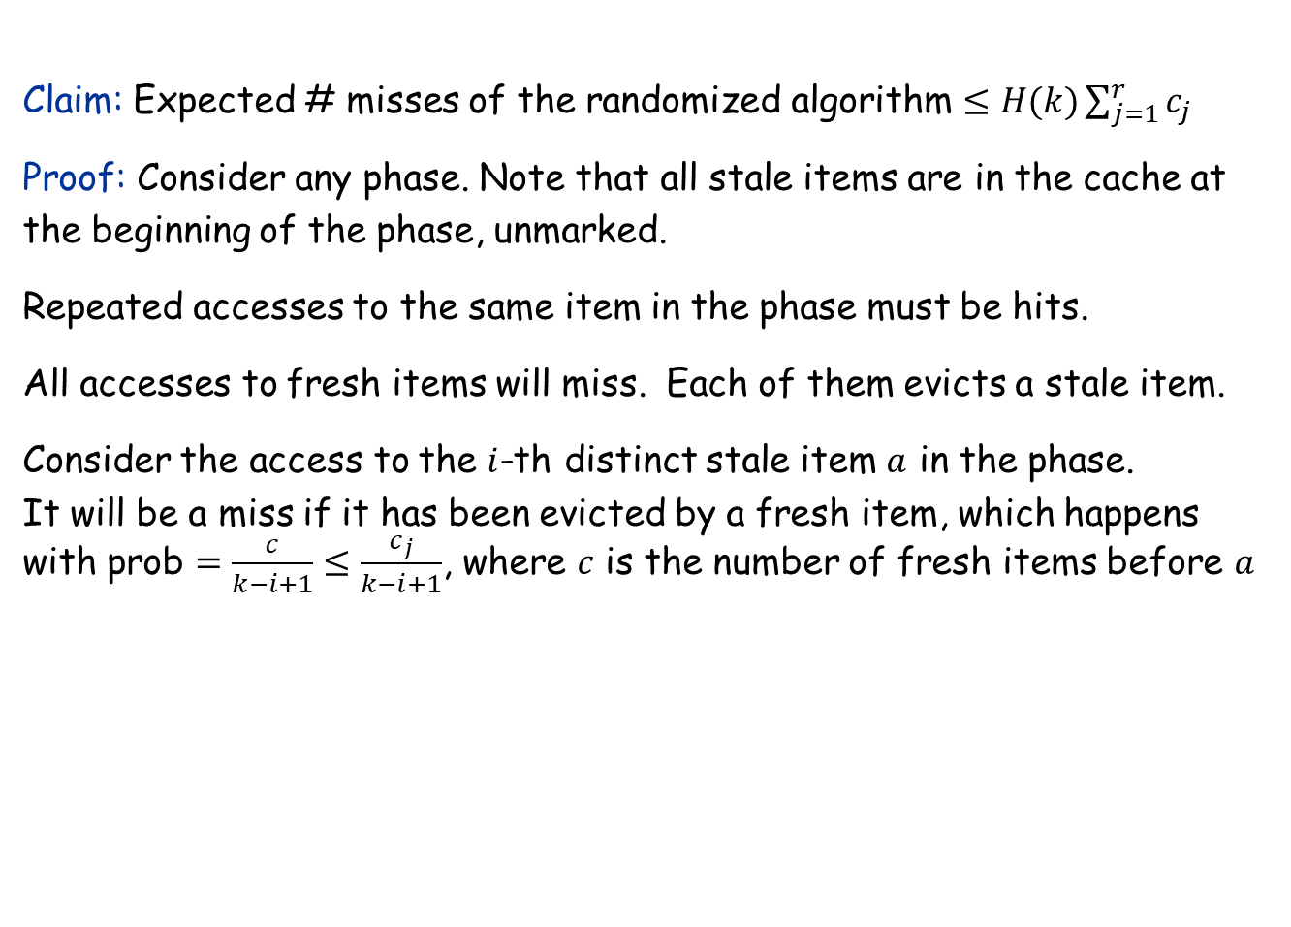


Analysis for the Randomized Marking Algorithm
Claim: Expected # misses of the randomized algorithm $≤H(k)\sum_{j=1}^{r}{c_{j}}$
Proof: Consider any phase. Note that all stale items are in the cache at the beginning of the phase, unmarked.
Repeated accesses to the same item in the phase must be hits.
All accesses to fresh items will miss. Each of them evicts a stale item.
Consider the access to the $i$-th distinct stale item $a$ in the phase.
It will be a miss if it has been evicted by a fresh item, which happens
with prob $=\frac{c}{k−i+1}≤\frac{c_{j}}{k−i+1}$, where $c$ is the number of fresh items before $a$
$c$ fresh items
$i−1$ stale items accesses so far

Slide 13
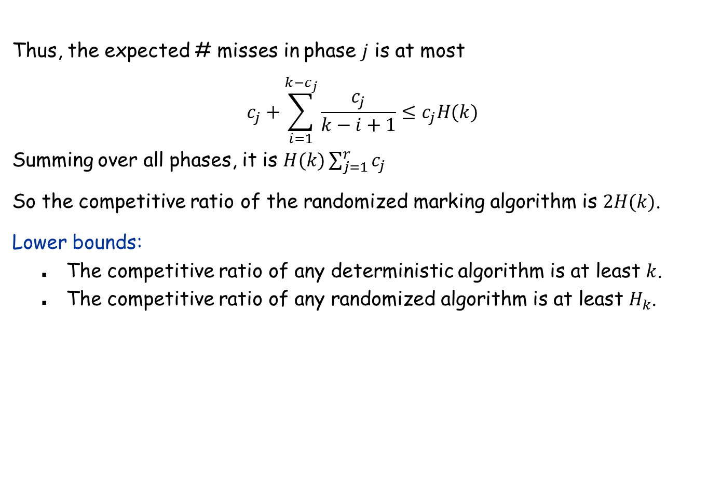
Analysis for the Randomized Marking Algorithm
Thus, the expected # misses in phase $j$ is at most
$$c_{j}+\sum_{i=1}^{k−c_{j}}{\frac{c_{j}}{k−i+1}}≤c_{j}H(k)$$
Summing over all phases, it is $H(k)\sum_{j=1}^{r}{c_{j}}$
So the competitive ratio of the randomized marking algorithm is $2H(k)$.
Lower bounds:
  The competitive ratio of any deterministic algorithm is at least $k$.
  The competitive ratio of any randomized algorithm is at least $H_{k}$.

