Slide 1
Parallel Algorithms
Circuits
PRAM
BSP/MapReduce

Slide 2
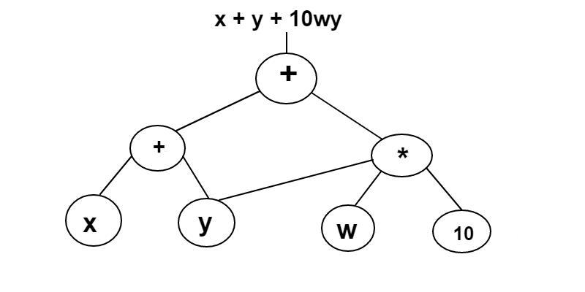
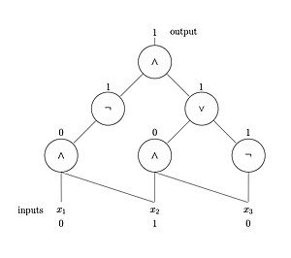
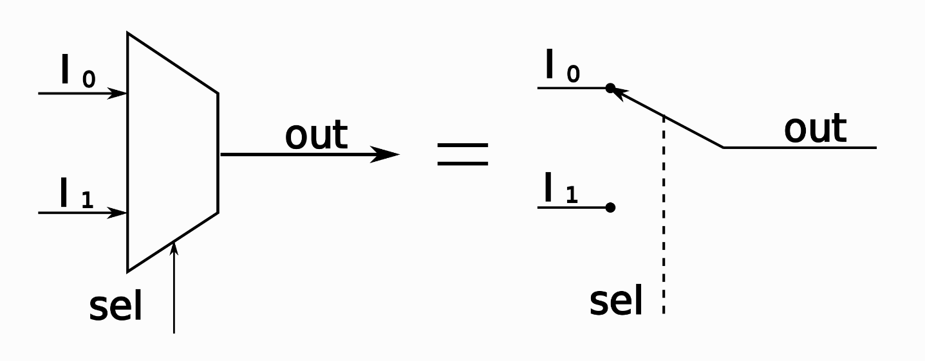
Boolean Circuits and Arithmetic Circuits
Multiplexer

Slide 3

Computing Sum by a Circuit
Given: Sequence a of n = 2^{k} elements
Given: Binary associative operator +
Compute: S = a₁ + ... + a_{n}
Size: $O(n)$
Depth: $O(\log{n})$

Slide 4
How to do prefix sums ?
Input: Sequence x of n = 2^{k} elements, binary associative operator +
Output: Sequence s of n = 2^{k} elements, with y_{k} = x₁ + ... + x_{k}
Example:
x = [1, 4, 3, 5, 6, 7, 0, 1]
y = [1, 5, 8, 13, 19, 26, 26, 27]

Slide 5
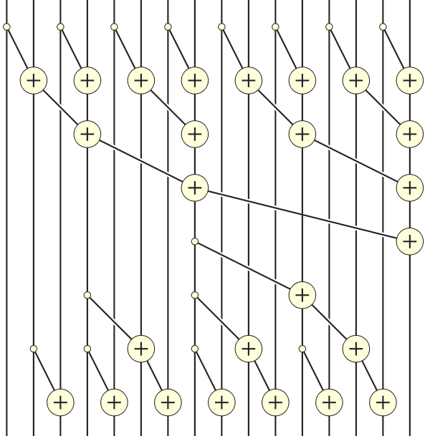
Prefix Sums by Circuits
Depth: O(log n)
Size: O(n)
Note: + can be any associative operator!
Application:
String comparison (lexicographically)

Slide 6

The Random Access Machine Model
RAM model of serial computers:
Memory is a sequence of words, each capable of containing an integer of $O(\log{n)}$ bits
Each memory access takes one unit of time
Basic operations (add, multiply, compare) take one unit time.

Slide 7

PRAM [Parallel Random Access Machine]
(Introduced by Fortune and Wyllie, 1978)
PRAM composed of:
p processors, each with its own program.
A single shared memory composed of a sequence of words, each capable of containing an integer of $O(\log{n)}$ bits
Shared memory

Slide 8
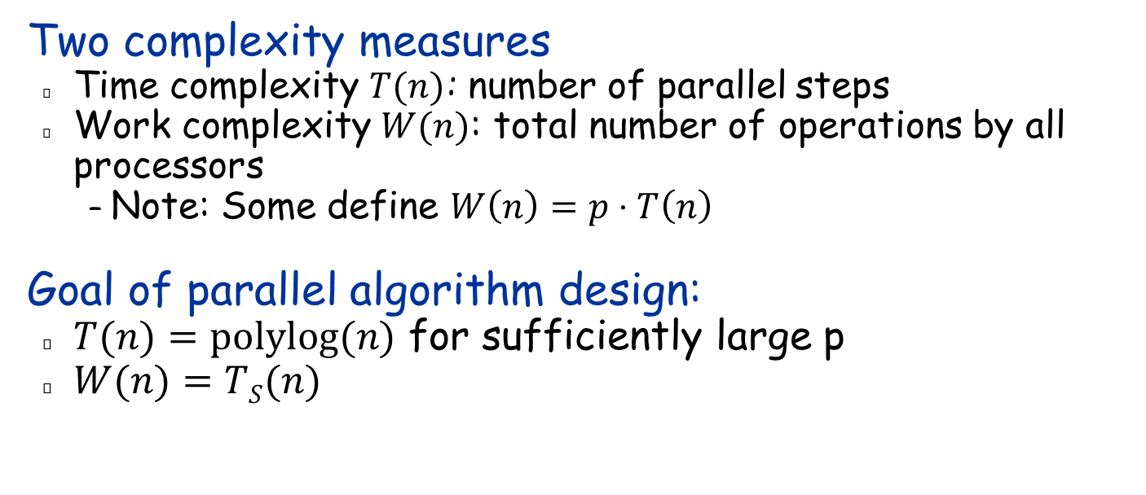
Complexity Measures
Two complexity measures
Time complexity $T(n)$: number of parallel steps
Work complexity $W(n)$: total number of operations by all processors
Note: Some define $W\left(n\right)=p⋅T\left(n\right)$
Goal of parallel algorithm design:
$T(n)=polylog(n)$ for sufficiently large p
$W(n)=TS(n)$
optimal sequential Algorithm

Slide 9
Variants of PRAM model
CW rule: The processor with the smallest index wins
There are other rules…

Slide 10
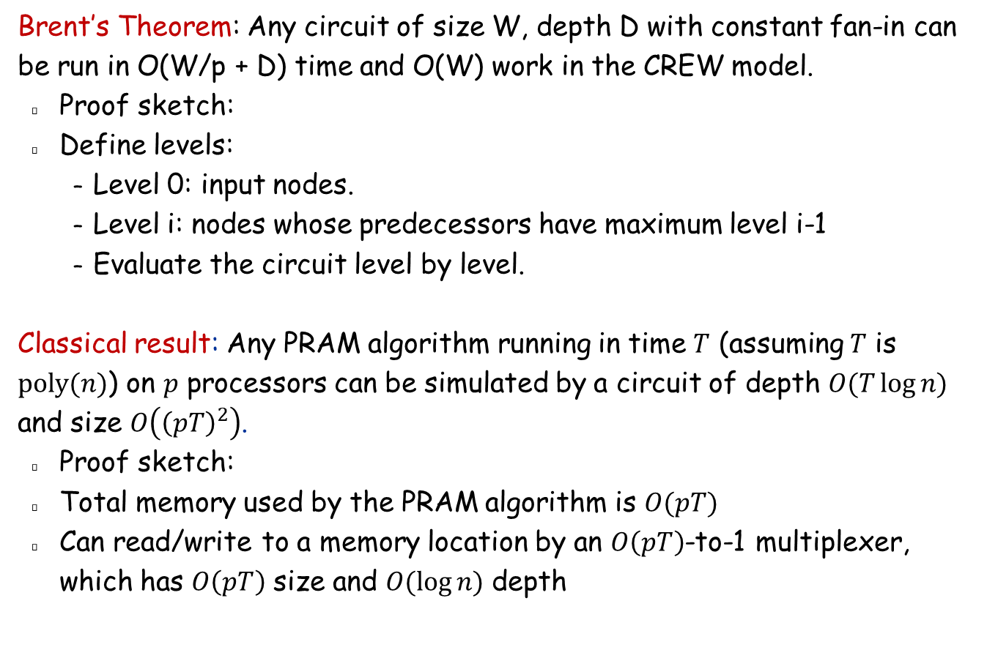
Circuits and PRAM
Brent’s Theorem: Any circuit of size W, depth D with constant fan-in can be run in O(W/p + D) time and O(W) work in the CREW model.
Proof sketch:
Define levels:
Level 0: input nodes.
Level i: nodes whose predecessors have maximum level i-1
Evaluate the circuit level by level.
Classical result: Any PRAM algorithm running in time $T$ (assuming $T$ is $poly(n)$) on $p$ processors can be simulated by a circuit of depth $O(T\log{n)}$ and size $O\left({\left(pT\right)}^{2}\right)$.
Proof sketch:
Total memory used by the PRAM algorithm is $O(pT)$
Can read/write to a memory location by an $O\left(pT\right)$-to-1 multiplexer, which has $O\left(pT\right)$ size and $O(\log{n)}$ depth

Slide 11
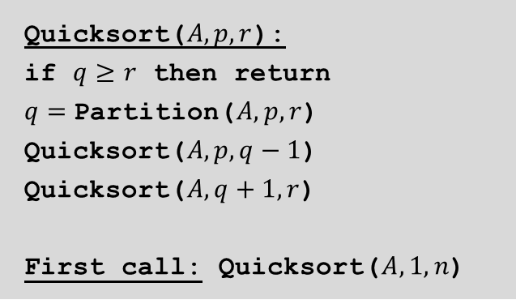
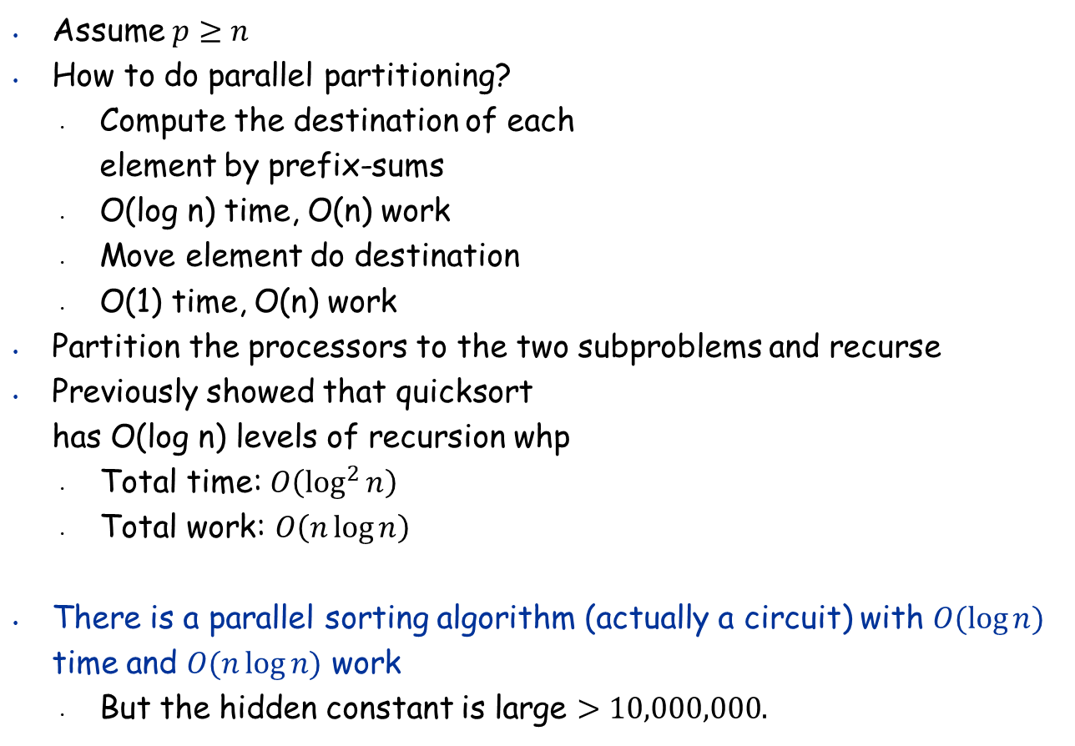
Parallel Quicksort
Assume $p≥n$
How to do parallel partitioning?
Compute the destination of each element by prefix-sums
O(log n) time, O(n) work
Move element do destination
O(1) time, O(n) work
Partition the processors to the two subproblems and recurse
Previously showed that quicksort has O(log n) levels of recursion whp
Total time: $O\left(\log^{2}{n}\right)$
Total work: $O\left(n{\log{n}}\right)$
There is a parallel sorting algorithm (actually a circuit) with $O(\log{n)}$ time and $O(n\log{n)}$ work
But the hidden constant is large $>10,000,000.$

Slide 12
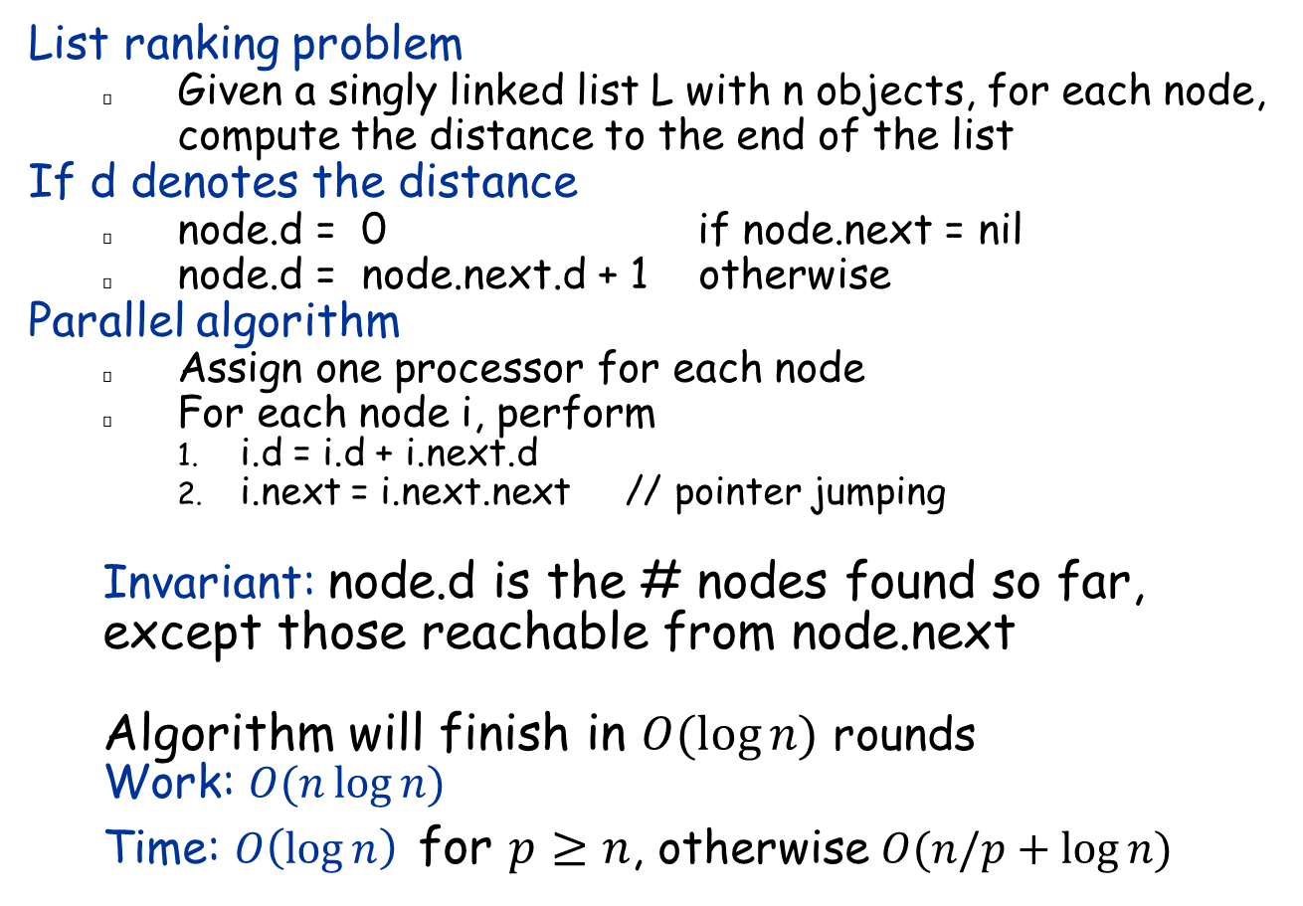
List Ranking in PRAM
List ranking problem
Given a singly linked list L with n objects, for each node, compute the distance to the end of the list
If d denotes the distance
node.d = 0 if node.next = nil
node.d = node.next.d + 1 otherwise
Parallel algorithm
Assign one processor for each node
For each node i, perform
i.d = i.d + i.next.d
i.next = i.next.next // pointer jumping
Invariant: node.d is the # nodes found so far, except those reachable from node.next
Algorithm will finish in $O(\log{n)}$ rounds
Work: $O(n\log{n})$
Time: $O\left(\log{n}\right)$ for $p≥n$, otherwise $O(n/p+\log{n)}$

Slide 13
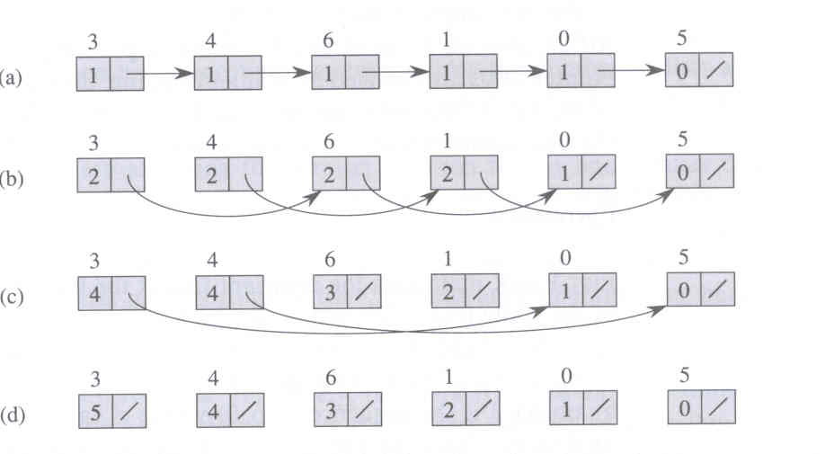
List Ranking - Example
Notes:
Fig. 30.2

Slide 14
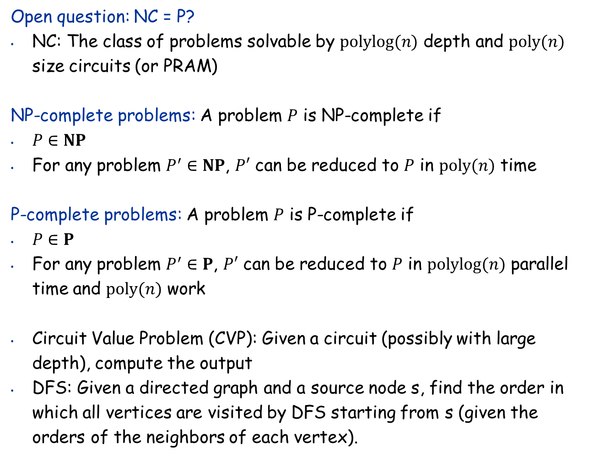
Class NC
Open question: NC = P?
NC: The class of problems solvable by $polylog(n)$ depth and $poly(n)$ size circuits (or PRAM)
NP-complete problems: A problem $P$ is NP-complete if
$P∈NP$
For any problem $P^{′}∈NP$, $P′$ can be reduced to $P$ in $poly(n)$ time
P-complete problems: A problem $P$ is P-complete if
$P∈P$
For any problem $P^{′}∈P$, $P′$ can be reduced to $P$ in $polylog(n)$ parallel time and $poly(n)$ work
Circuit Value Problem (CVP): Given a circuit (possibly with large depth), compute the output
DFS: Given a directed graph and a source node s, find the order in which all vertices are visited by DFS starting from s (given the orders of the neighbors of each vertex).

Slide 15
The Bulk Synchronous Parallel Model (BSP) Introduced by Leslie Valiant in 1990

Slide 16
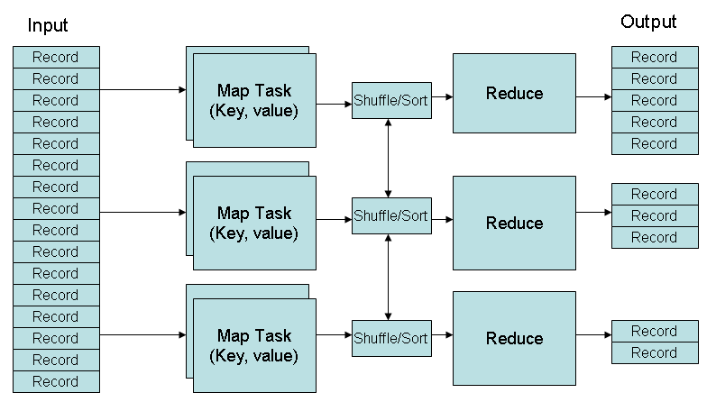
MapReduce
(key, value) pairs are used as the format for both data and intermediate results

Slide 17
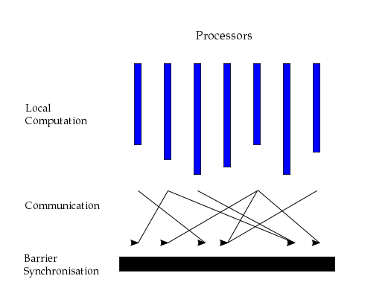
The BSP Model

Slide 18
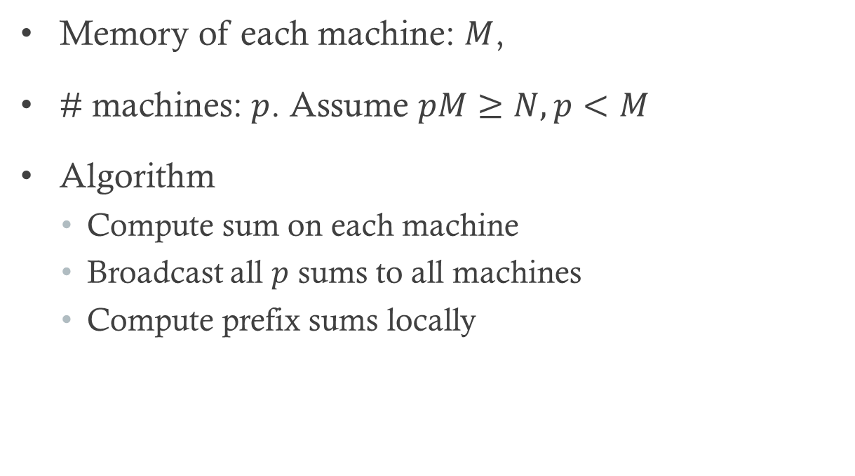
Prefix sums on BSP
Memory of each machine: $M$,
# machines: $p$. Assume $pM≥N,p<M$
Algorithm
Compute sum on each machine
Broadcast all $p$ sums to all machines
Compute prefix sums locally

Slide 19
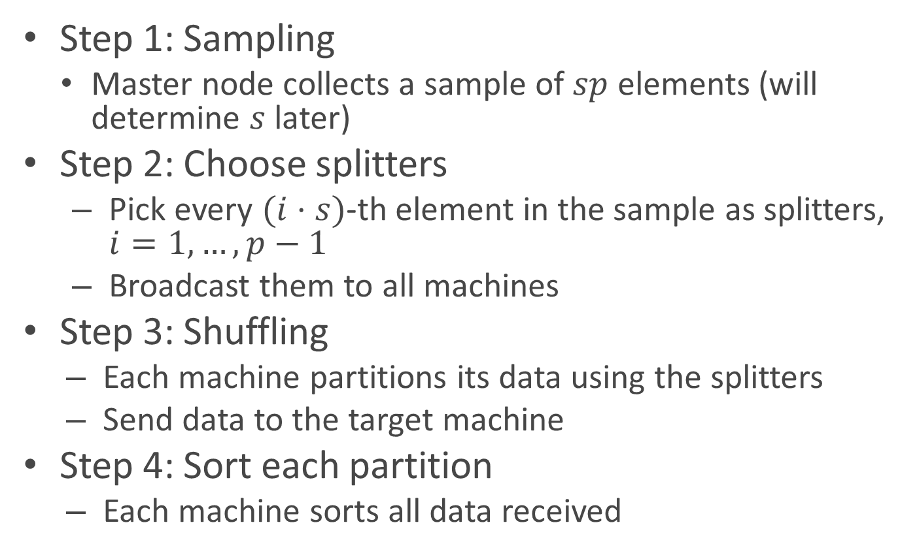
Sorting (Sample Sort)
Step 1: Sampling
Master node collects a sample of $sp$ elements (will determine $s$ later)
Step 2: Choose splitters
Pick every $(i⋅s)$-th element in the sample as splitters, $i=1,…, p−1$
Broadcast them to all machines
Step 3: Shuffling
Each machine partitions its data using the splitters
Send data to the target machine
Step 4: Sort each partition
Each machine sorts all data received

Slide 20
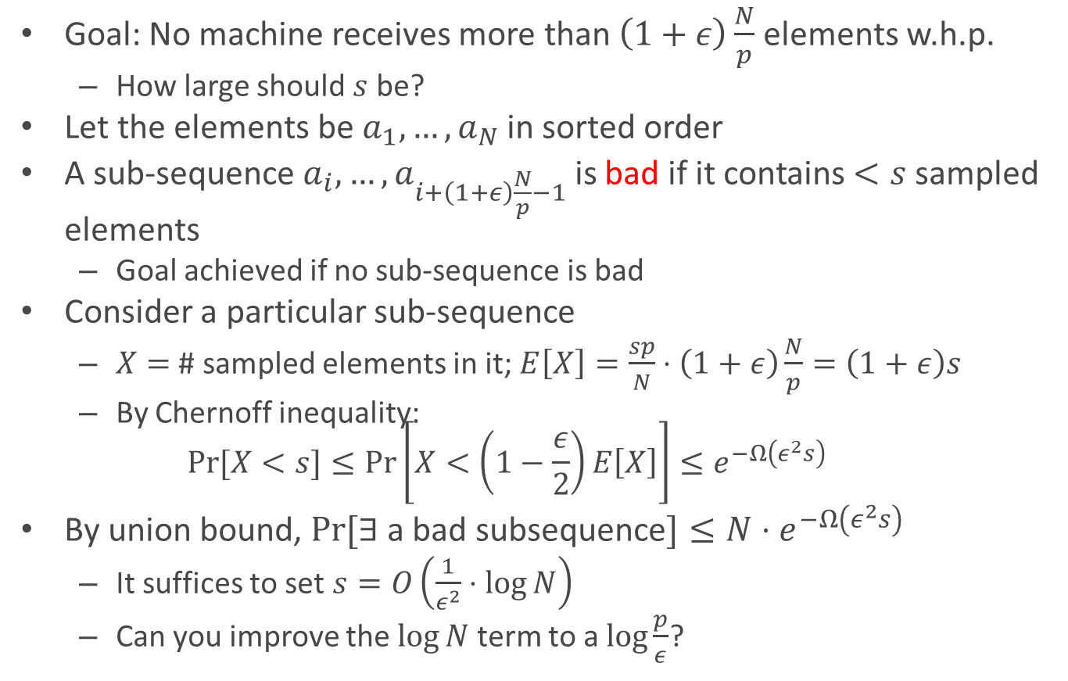
Determining Sample Size
Goal: No machine receives more than $\left(1+ε\right)\frac{N}{p}$ elements w.h.p.
How large should $s$ be?
Let the elements be $a_{1},…,a_{N}$ in sorted order
A sub-sequence $a_{i},…, a_{i+\left(1+ε\right)\frac{N}{p}−1}$ is bad if it contains $<s$ sampled elements
Goal achieved if no sub-sequence is bad
Consider a particular sub-sequence
$X=$ # sampled elements in it; $E\left[X\right]=\frac{sp}{N}⋅\left(1+ε\right)\frac{N}{p}=\left(1+ε\right)s$
By Chernoff inequality: $\operatorname{Pr}{[X<s]}≤\operatorname{Pr}\left[X<\left(1−\frac{ε}{2}\right)E\left[X\right]\right]≤e^{−Ω\left(ε^{2}s\right)}$
By union bound, $Pr⁡[∃$ a bad subsequence$]≤N{⋅e}^{−Ω\left(ε^{2}s\right)}$
It suffices to set $s=O\left(\frac{1}{ε^{2}}⋅log{N}\right)$
Can you improve the $\log{N}$ term to a $\log{\frac{p}{ε}}$?

Slide 21
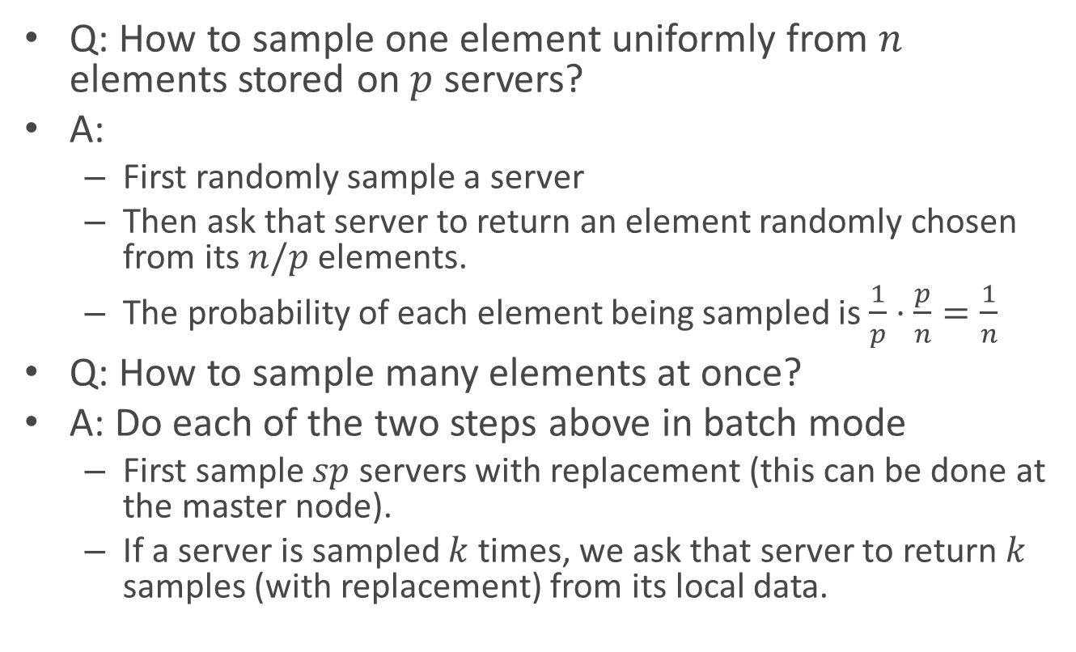
Distributed Sampling
Q: How to sample one element uniformly from $n$ elements stored on $p$ servers?
A:
First randomly sample a server
Then ask that server to return an element randomly chosen from its $n/p$ elements.
The probability of each element being sampled is$\frac{1}{p}⋅\frac{p}{n}=\frac{1}{n}$
Q: How to sample many elements at once?
A: Do each of the two steps above in batch mode
First sample $sp$ servers with replacement (this can be done at the master node).
If a server is sampled $k$ times, we ask that server to return $k$ samples (with replacement) from its local data.

Slide 22
Parallel Computation in Practice
Parallel architectures vary a lot
Multicore
GPU
Computer cluster
Supercomputer
Distributed computing
COMP 5112 - Parallel Programming

