Slide 1
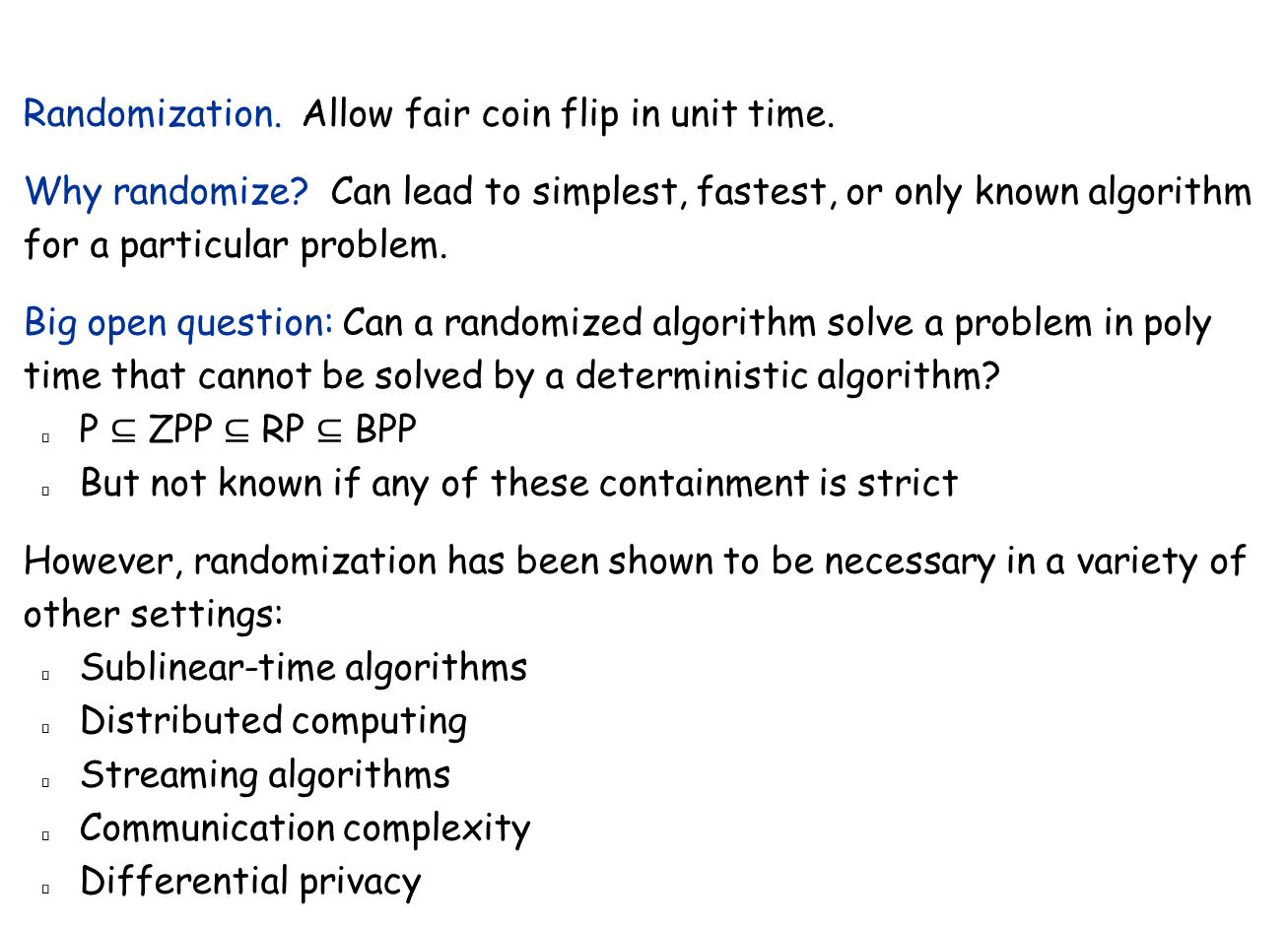
Randomization
Randomization. Allow fair coin flip in unit time.
Why randomize? Can lead to simplest, fastest, or only known algorithm for a particular problem.
Big open question: Can a randomized algorithm solve a problem in poly time that cannot be solved by a deterministic algorithm?
P $⊆$ ZPP $⊆$ RP $⊆$ BPP
But not known if any of these containment is strict
However, randomization has been shown to be necessary in a variety of other settings:
Sublinear-time algorithms
Distributed computing
Streaming algorithms
Communication complexity
Differential privacy
in practice, access to a pseudo-random number generator

Slide 2
13.1 Contention Resolution
A example in distributed computing where randomization is necessary.

Slide 3
Contention Resolution in a Distributed System
Contention resolution. Given n processes P₁, …, P_{n}, each competing for access to a shared channel. If two or more processes access the channel simultaneously, all processes are locked out. Devise protocol to ensure all processes get through on a regular basis.
Assumption. Time is divided into rounds.
Restriction. Processes can't communicate, and they don’t have id’s.
Challenge. Need symmetry-breaking paradigm.
No deterministic protocol can solve the problem.
P₁
P₂
. . .
P_{n}

Slide 4
Contention Resolution: Randomized Protocol
Protocol. Each process requests access to the channel at time t with probability p = 1/n.
Claim. Let S[i, t] = event that process i succeeds in accessing the database at time t. Then 1/(e ⋅ n) ≤ Pr[S(i, t)] ≤ 1/(2n).
Pf. By independence, Pr[S(i, t)] = p (1-p)^{n-1}.
Setting p = 1/n, we have Pr[S(i, t)] = 1/n (1 - 1/n) ^{n-1}. ▪
Useful facts from calculus.
1/4 < (1 - 1/n)^{n} < 1/e < (1 - 1/n)^{n-1} < 1/2
9/4 < (1 + 1/n)^{n} < e < (1 + 1/n)^{n+1-}< 27/8
process i requests access
none of remaining n-1 processes request access
between 1/e and 1/2

Slide 5
Contention Resolution: Randomized Protocol
Claim. The probability that process i fails to access the channel in e⋅n rounds is at most 1/e. After e⋅n⋅c ln n rounds, the probability is at most n^{-c}.
Pf. Let F[i, t] = event that process i fails to access database in rounds 1 through t. By independence and previous claim, we have Pr[F(i, t)] ≤ (1 - 1/(en))^{t}.
Choose t = e n:
Choose t = (e n) (c ln n):

Slide 6
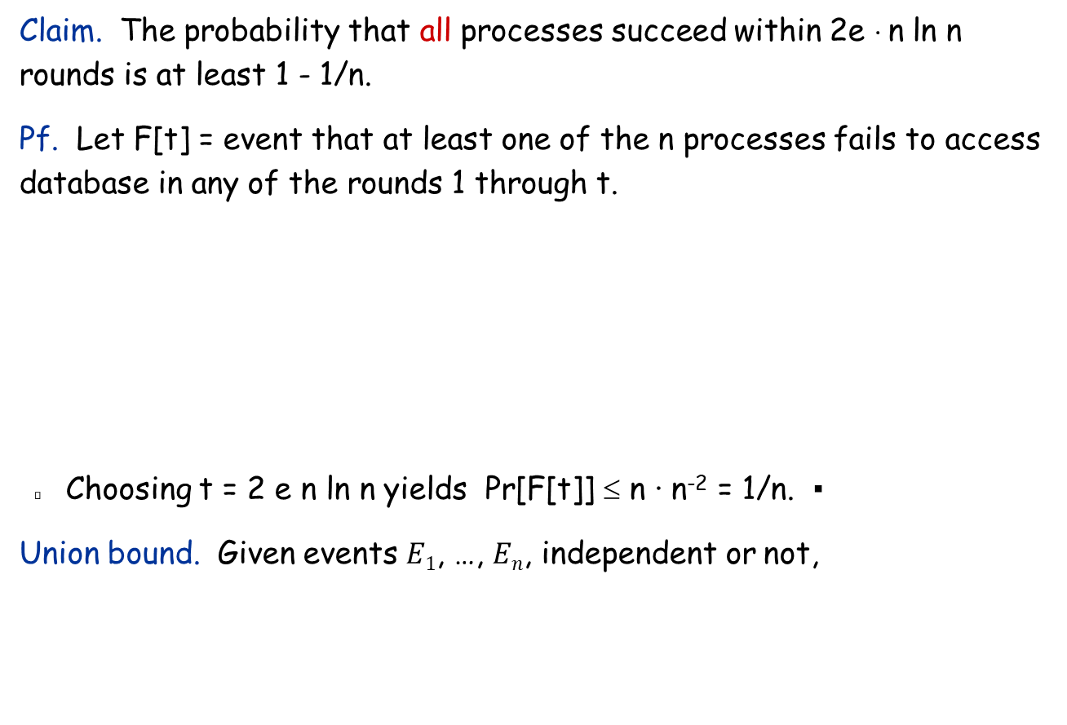
Contention Resolution: Randomized Protocol
Claim. The probability that all processes succeed within 2e ⋅ n ln n rounds is at least 1 - 1/n.
Pf. Let F[t] = event that at least one of the n processes fails to access database in any of the rounds 1 through t.
Choosing t = 2 e n ln n yields Pr[F[t]] ≤ n · n⁻² = 1/n. ▪
Union bound. Given events $E1$, …, $En$, independent or not,
union bound
previous slide

Slide 7
13.2 Global Minimum Cut
A problem for which the best known randomized algorithm is faster than the best known deterministic algorithm.

Slide 8
Global Minimum Cut
Global min cut. Given a connected, undirected graph G = (V, E), find a cut (A, B) of minimum cardinality.
Applications. Partitioning items in a database, identify clusters of related documents, network reliability, network design, circuit design, TSP solvers.
Network flow solution.
Replace every edge (u, v) with two antiparallel edges (u, v) and (v, u).
Pick some vertex s and compute min s-v cut separating s from each other vertex v ∈ V.
Min cut / max flow algorithms.
O(V E²), O(V² E), O(V³) (in textbook)
O(V E) (very complicated)
Total time: O(V² E)
False intuition. Global min-cut is harder than min s-t cut.

Slide 9
Contraction Algorithm
Contraction algorithm. [Karger 1995]
Pick an edge e = (u, v) uniformly at random.
Contract edge e.
replace u and v by a single new supernode w
preserve edges, updating endpoints of u and v to w
keep parallel edges, but delete self-loops
Repeat until graph has just two supernodes v₁ and v₂.
Return the cut (between the two supernodes).
a
b
c
⇒
a
b
c
u
d
v
contract u-v
w
e
f
f
O(E log V) time (we always merge the vertex with smaller degree into the other).

Slide 10
Contraction Algorithm
Claim. The contraction algorithm returns a min cut with prob ≥ 2/n².
Pf. Consider a global min-cut (A*, B*) of G. Let F* be edges with one endpoint in A* and the other in B*. Let k = |F*| = size of min cut.
In first step, algorithm contracts an edge in F* with prob k / |E|.
Every node has degree ≥ k since otherwise (A*, B*) would not be min-cut. ⇒ |E| ≥ ½kn.
Thus, algorithm contracts an edge in F* with probability ≤ 2/n.
A*
B*
F*

Slide 11
Contraction Algorithm
Claim. The contraction algorithm returns a min cut with prob ≥ 2/n².
Pf. Consider a global min-cut (A*, B*) of G. Let F* be edges with one endpoint in A* and the other in B*. Let k = |F*| = size of min cut.
Let G' be graph after j iterations. There are n' = n-j supernodes.
Suppose no edge in F* has been contracted. The min-cut in G' is still k.
Since value of min-cut is k, |E'| ≥ ½kn'.
Thus, algorithm contracts an edge in F* with probability ≤ 2/n'.
Let E_{j} = event that an edge in F* is not contracted in iteration j.

Slide 12
Contraction Algorithm
Amplification. To amplify the probability of success, run the contraction algorithm many times.
Claim. If we repeat the contraction algorithm n² times with independent random choices and return the best cut found, then the algorithm finds the min-cut with constant probability.
Pf. By independence, the probability of failure is at most
Convention: We are usually happy with a constant success probability; repeating the algorithm O(log(1/δ)) times will amplify it to 1 - δ.

Slide 13
Global Min Cut: Context
Remark. Overall running time is O(V² E log V), since we repeat the algorithm O(V²) times and each takes O(E log V) time.
Best known. [Karger 2000] O(E log³V).
Basic idea: contractions in the early stages are likely to be correct, so we don’t have to restart from the beginning every time.
Faster than best known deterministic global min cut algorithm
Notes:
Best known deterministic. [Nagamochi-Ibaraki 1992] O(mn + n² log n).

Slide 14
13.3 Random Variables and Expectations
See also [CLRS 5]

Slide 15
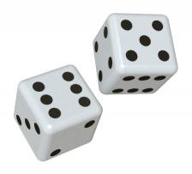
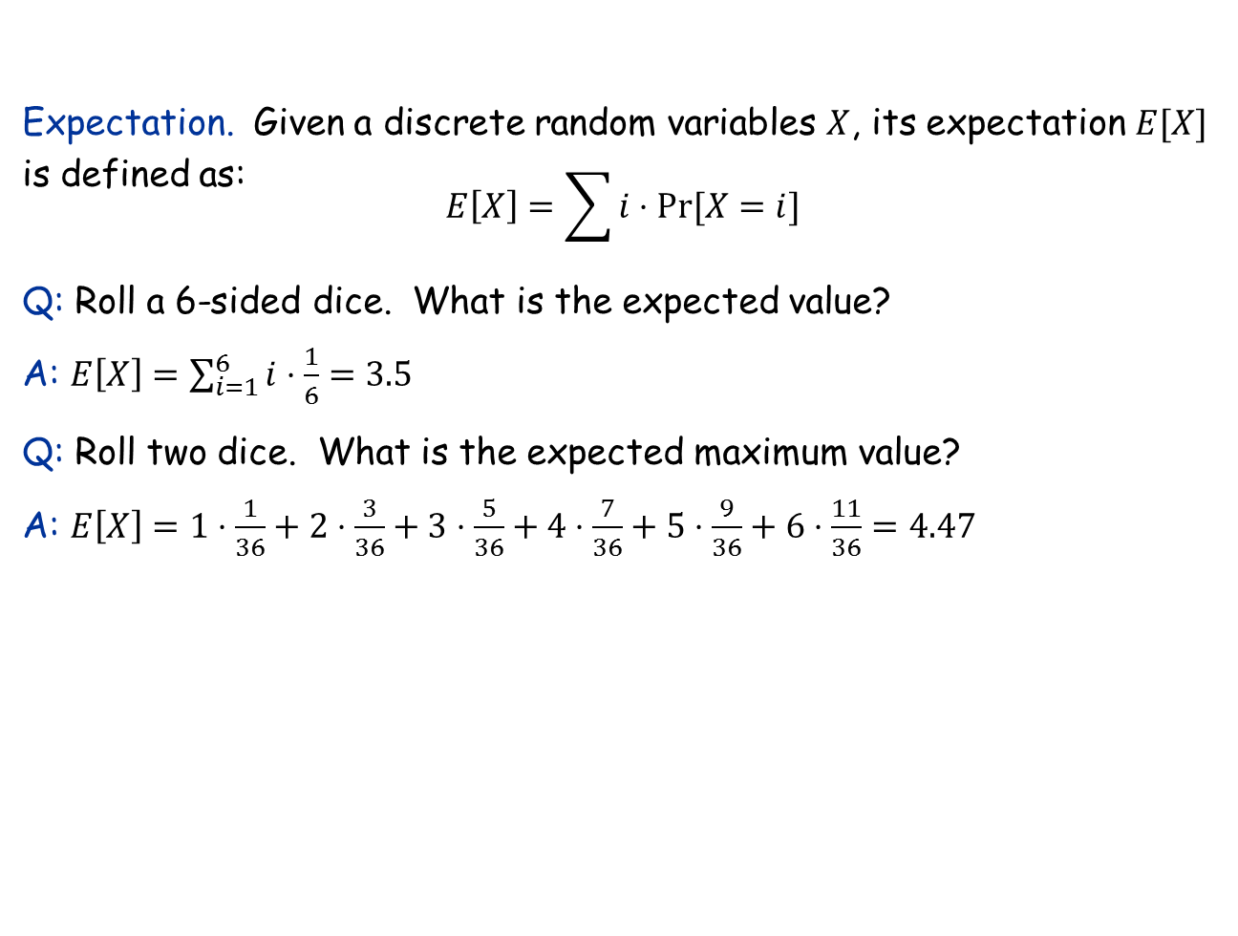
A quick review of probability theory
Expectation. Given a discrete random variables $X$, its expectation $E[X]$ is defined as:
$$E\left[X\right]=\sum{i⋅Pr⁡[X=i]}$$
Q: Roll a 6-sided dice. What is the expected value?
A: $E\left[X\right]=\sum_{i=1}^{6}{i⋅\frac{1}{6}}=3.5$
Q: Roll two dice. What is the expected maximum value?
A: $E\left[X\right]=1⋅\frac{1}{36}+2⋅\frac{3}{36}+3⋅\frac{5}{36}+4⋅\frac{7}{36}+5⋅\frac{9}{36}+6⋅\frac{11}{36}=4.47$

Slide 16
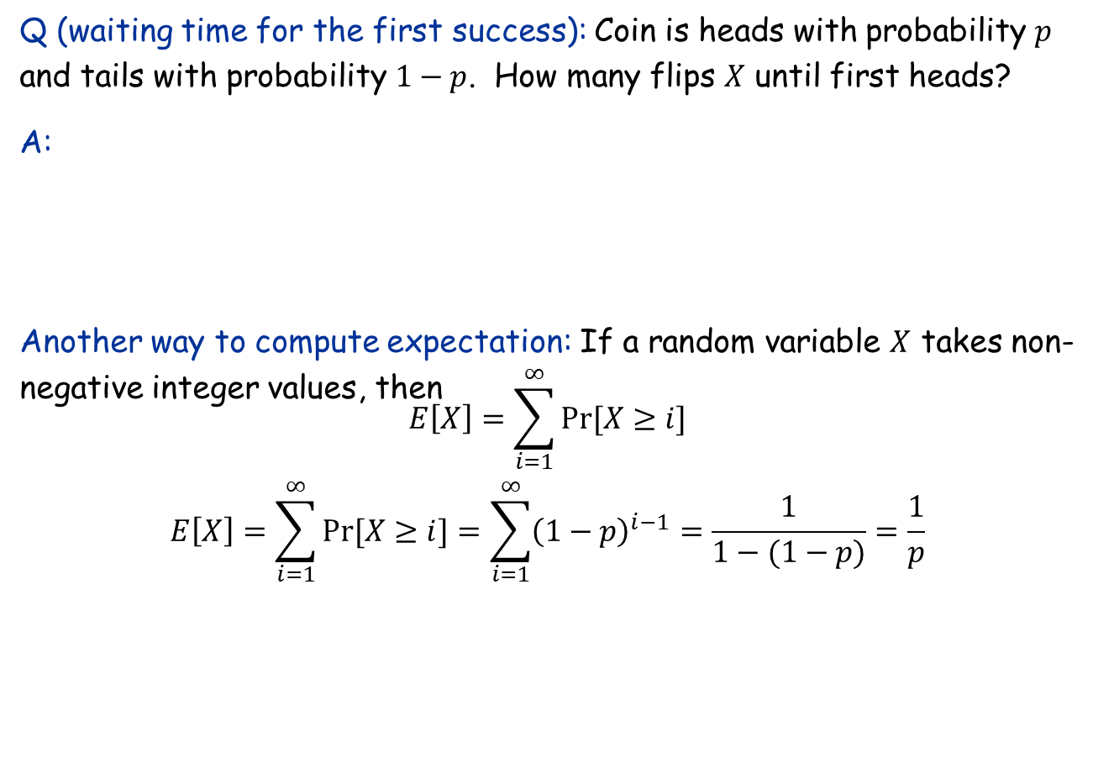
Waiting time for first success
Q (waiting time for the first success): Coin is heads with probability $p$ and tails with probability $1−p$. How many flips $X$ until first heads?
A:
Another way to compute expectation: If a random variable $X$ takes non-negative integer values, then
$$E\left[X\right]=\sum_{i=1}^{∞}{Pr⁡[X≥i]}$$
$$E\left[X\right]=\sum_{i=1}^{∞}{Pr⁡[X≥i]}=\sum_{i=1}^{∞}{{\left(1−p\right)}^{i−1}=\frac{1}{1−(1−p)}=\frac{1}{p}}$$
j-1 tails
1 head

Slide 17
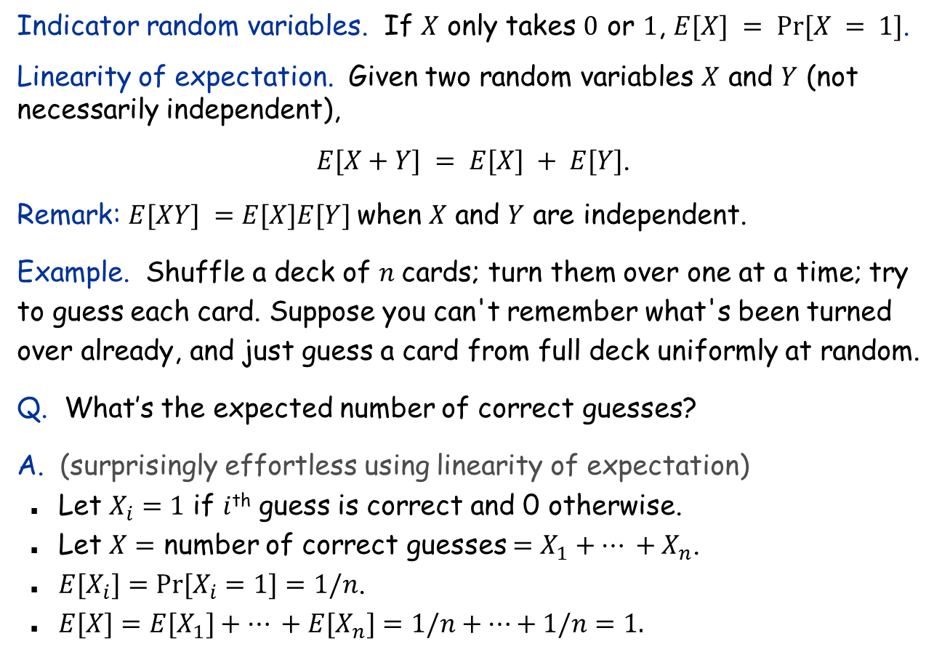
Expectation: Two Properties
Indicator random variables. If $X$ only takes $0$ or $1$, $E[X] = Pr⁡[X = 1]$.
Linearity of expectation. Given two random variables $X$ and $Y$ (not necessarily independent),
$E[X+Y] = E[X] + E[Y]$.
Remark: $E[XY] =E[X]E[Y]$when $X$ and $Y$ are independent.
Example. Shuffle a deck of $n$cards; turn them over one at a time; try to guess each card. Suppose you can't remember what's been turned over already, and just guess a card from full deck uniformly at random.
Q. What’s the expected number of correct guesses?
A. (surprisingly effortless using linearity of expectation)
Let $X_{i}=1$ if $i$^{th} guess is correct and 0 otherwise.
Let $X=$ number of correct guesses $=X_{1}+… +X_{n}$.
$E[X_{i}]=Pr⁡[X_{i}=1]=1/n$.
$E[X]=E[X_{1}]+… +E[X_{n}]=1/n+…+1/n=1.$

Slide 18
Guessing Cards with Memory
Guessing with memory. Guess a card uniformly at random from cards not yet seen.
Q. What’s the expected number of correct guesses?
A.
Let $X_{i}=1$ if $i$^{th} guess is correct and 0 otherwise.
Let $X=$ number of correct guesses $=X_{1}+… +X_{n}$.
$E[X_{i}]=Pr⁡[X_{i}=1]=1/(n−i+1).$
$E[X]=E[X_{1}]+…+E[X_{n}]=\frac{1}{n}+…+\frac{1}{2}+\frac{1}{1}=Θ(\log{n)}.$

Slide 19
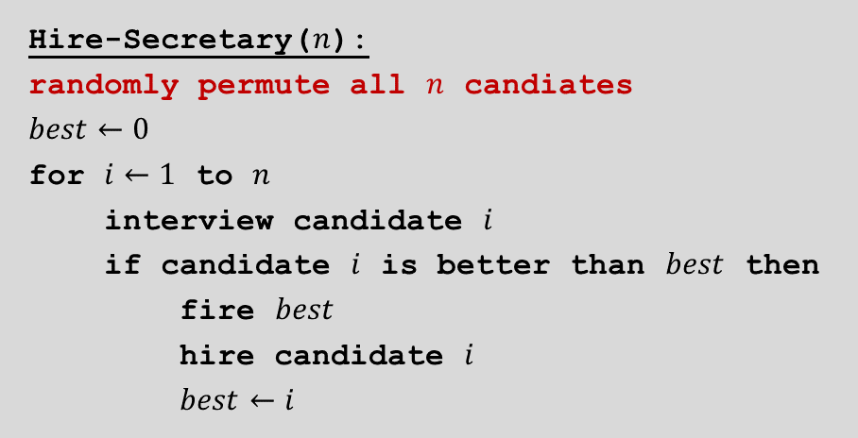
The Secretary Problem
Hire-Secretary($n$):
randomly permute all $n$ candiates
$$best←0$$
for $i←1$ to $n$
interview candidate $i$
if candidate $i$ is better than $best$ then
fire $best$
hire candidate $i$
$best←i$
Q: What’s the expected number of hires?
A:
Let $Xi=1$ if you hire candidate $i$ and 0 otherwise.
Let $X=$ number of hires $=X_{1}+… +X_{n}$.
$E[X_{i}]=Pr⁡[X_{i}=1]=1/i.$ (Among the first $i$ candidates, the best has probability $1/i$ to be placed at the last position.)
$E\left[X\right]=E\left[X_{1}\right]+…+E\left[X_{n}\right]=1+\frac{1}{2}+…+\frac{1}{n−1}+\frac{1}{n}=Θ(\log{n)}.$

Slide 20
How to Generate a Random Permutation
RandomPermute($A$):
$n←A.length$
for $i←1$ to $n$
swap $A[i]$ with $A[Random\left(1,i\right)]$
Note: This algorithm is slightly different from the one in textbook
Analysis
$O(n)$ time, $O(1)$ working space
Correctness:
Precise meaning of a “random permutation”: Each different permutation is the output with probability $1/n!$
We will show that after the $i$-th iteration, $A[1..i]$ has been randomly permuted, by induction on $i$.
Base case $i=1$: trivial
Assume the $A[1..i−1]$ has been randomly permuted after $i−1$ iterations of the algorithm.
Consider any permutation $(a_{1},…,a_{i})$ for $A\left[1..i\right]$. What’s the probability that $A\left[1..i\right]=(a_{1},…,a_{i})$ after the $i$-th iteration?
Generates a random number between $1$ and $i$ uniformly.

Slide 21
Random Permutation: Correctness
Proof of correctness (continued):
Label the initial elements as $1, 2,…,i$.
If after the $i$-th step, $A\left[1..i\right]=\left(a_{1},a_{2},…,a_{i}\right)$, then the $i$-th step must be like this ($i=10$ in the example):
$a_{i}$ $i$
So after the $(i−1)$-the step, $A\left[1..i−1\right]=$(2,8,7,3,4,1,5,6,9), which happens with probability $1/\left(i−1\right)!$ (by induction hypothesis)
The last swap must choose $a_{i}$ to swap, which happens with probability $1/i$
Thus, after the $i$-th step, $\operatorname{Pr}\left[A\left[1..i\right]=\left(a_{1},…,a_{i}\right)\right]=\frac{1}{\left(i−1\right)!}⋅\frac{1}{i}=\frac{1}{i!}$
2
8
7
3
4
1
5
6
9
10
2
8
10
3
4
1
5
6
9
7

Slide 22

How Humans Do Shuffling
Riffle shuffle
Analysis:
$\frac{3}{2}\log{n}$ riffle shuffles can shuffle a deck of $n$ cards to produce a distribution that is close to uniform [Bayer & Diaconis, 1992].
For $n=52$, $8$ shuffles are good, $7$ also OK.

Slide 23
The Birthday Paradox
Problem: Suppose there are $n=365$ days in a year, and in a room of $k$ people, each person’s birthday falls in any one of the $n$ days with equal probability. How large should $k$ be for us to expect two people with the same birthday?
Analysis:
Define $X_{ij}=1$ if person $i$ and person $j$ have the same birthday, and $0$ otherwise.
We know $E\left[X_{ij}\right]=\operatorname{Pr}\left[X_{ij}=1\right]=1/n$.
Let $X=\sum_{1≤i<j≤k}{X_{ij}}$ be the number of pairs of people having the same birthday.
We have
$$E\left[X\right]=E\left[\sum_{1≤i<j≤k}{X_{ij}}\right]=\left(\begin{matrix}k \\ 2\end{matrix}\right)\frac{1}{n}=\frac{k(k−1)}{2n}$$
So, when $\frac{k(k−1)}{2n}≥\frac{{\left(k−1\right)}^{2}}{2n}≥1$, or $k≥\sqrt{2n}+1≈28$, we expect to see at least one pair of people having the same birthday.

Slide 24

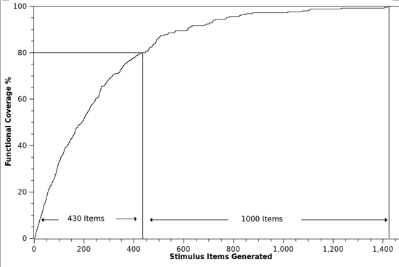
Coupon Collector
Coupon collector. Each box of cereal contains a coupon. There are n different types of coupons. Assuming a box contains each type of coupon equally likely, how many boxes do you need to open to have at least one coupon of each type?
Solution.
Stage $i=$ time between $i$ and $i+1$ distinct coupons.
Let $Xi =$ number of steps you spend in stage $i$.
Let $X=$ number of steps in total $=X0+X1+…+X_{n−1}$.
$$E\left[X\right]=\sum_{i=0}^{n−1}{E\left[X_{i}\right]=}\sum_{i=0}^{n−1}{\frac{n}{n−i}=}n\sum_{i=1}^{n}{\frac{1}{i}=Θ(n\log{n)}}$$
prob of success $=(n−i)/n$ ⇒ expected waiting time $=n/(n−i)$

Slide 25
13.4 MAX 3-SAT
An extremely simple randomized approximation algorithm.

Slide 26
Maximum 3-Satisfiability
MAX-3SAT. Given 3-SAT formula, find a truth assignment that satisfies as many clauses as possible.
Remark. NP-hard search problem.
Simple idea. Flip a coin, and set each variable true with probability ½, independently for each variable.
exactly 3 distinct literals per clause

Slide 27
Maximum 3-Satisfiability: Analysis
Claim. Given a 3-SAT formula with k clauses, the expected number of clauses satisfied by a random assignment is 7k/8.
Pf. Consider random variable
Let Z = total number of clauses satisfied.
linearity of expectation

Slide 28
The Probabilistic Method
Corollary. For any instance of 3-SAT, there exists a truth assignment that satisfies at least a 7/8 fraction of all clauses.
Pf. Random variable is at least its expectation some of the time. ▪
Probabilistic method. We showed the existence of a non-obvious property of 3-SAT by showing that a random construction produces it with positive probability!

Slide 29
Maximum 3-Satisfiability: Analysis
Q. Can we turn this idea into a 7/8-approximation algorithm?
Lemma. The probability that a random assignment satisfies ≥ 7k/8 clauses is at least 1/(8k).
Pf. Let p_{j} be probability that exactly j clauses are satisfied.
Rearranging terms yields ∑_{j≥7k/8} p_{j} ≥ 1 / (8k). ▪
Repetition. Repeating the algorithm O(k) times amplifies the success probability to a constant.

Slide 30
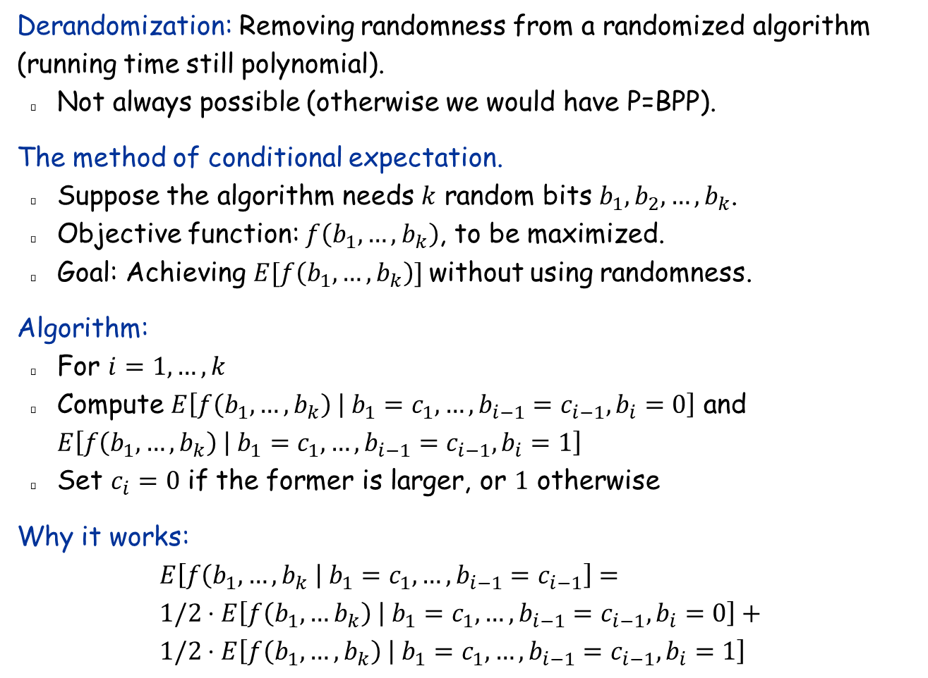
Derandomization
Derandomization: Removing randomness from a randomized algorithm (running time still polynomial).
Not always possible (otherwise we would have P=BPP).
The method of conditional expectation.
Suppose the algorithm needs $k$ random bits $b_{1},b_{2},…,b_{k}$.
Objective function: $f\left(b_{1},…,b_{k}\right)$, to be maximized.
Goal: Achieving $E[f\left(b_{1},…,b_{k}\right)]$ without using randomness.
Algorithm:
For $i=1,…,k$
Compute $E\left[f\left(b_{1},…,b_{k}\right) | {b_{1}=c_{1},…, b_{i−1}=c_{i−1},b}_{i}=0\right]$ and $E\left[f\left(b_{1},…,b_{k}\right) | {b_{1}=c_{1},…, b_{i−1}=c_{i−1},b}_{i}=1\right]$
Set $c_{i}=0$ if the former is larger, or $1$ otherwise
Why it works:
$$E\left[f\left(b_{1},…, b_{k} \right| b_{1}=c_{1},…, b_{i−1}=c_{i−1}\right]= \\ 1/2⋅E\left[f\left(b_{1},…b_{k}\right) | {b_{1}=c_{1},…, b_{i−1}=c_{i−1},b}_{i}=0\right]+ \\ 1/2⋅E\left[f\left(b_{1},…,b_{k}\right) | {b_{1}=c_{1},…, b_{i−1}=c_{i−1},b}_{i}=1\right]$$

Slide 31

More about MAX-3SAT
Approximation algorithm:
The randomized algorithm achieves ratio 7/8.
The best deterministic algorithm is its derandomized version.
Hardness of approximation.
Unless P=NP, MAX-3SAT cannot be approximated with a ratio better than $\frac{7}{8}+ε$, for any small constant $ε>0$.

Slide 32
13.5 Quicksort and Linear-Time Selection

Slide 33


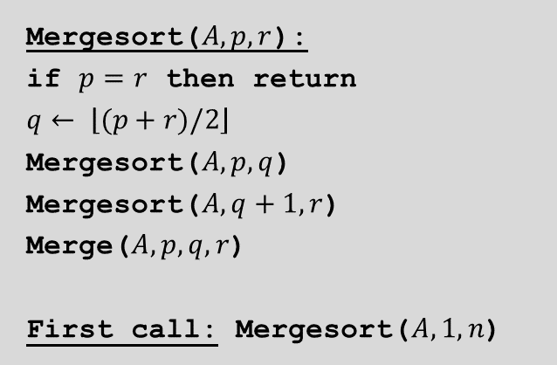

Quicksort: The “dual” of merge sort
Mergesort($A, p, r$):
if $p=r$ then return
$$q← \left\lfloor (p+r)/2\right\rfloor$$
Mergesort($A, p,q$)
Mergesort($A, q+1, r$)
Merge($A, p,q,r$)
First call: Mergesort($A,1,n$)
5
2
4
7
1
3
2
6
5
2
4
7
1
3
2
6
divide
$$Θ(1)$$
2
4
5
7
1
2
3
6
sort
$$2T(n/2)$$
1
2
2
3
4
5
6
7
merge
$$Θ(n)$$

Slide 34
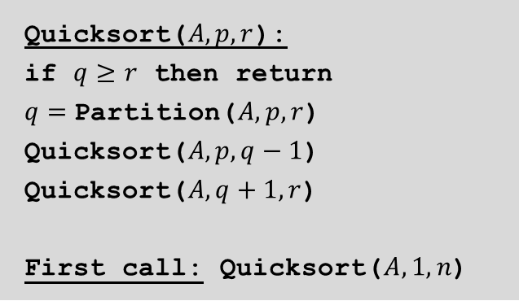



Quicksort: The “dual” of merge sort
Mergesort($A, p,r$):
if $p=r$ then return
$$q← \left\lfloor (p+r)/2\right\rfloor$$
Mergesort($A, p,q$)
Mergesort($A, q+1, r$)
Merge($A, p,q,r$)
First call: Mergesort($A,1,n$)
Quicksort($A, p, r$):
if $q≥r$ then return
$q=$Partition($A, p, r$) Quicksort($A, p, q−1$)
Quicksort($A, q+1, r$)
First call: Quicksort($A,1,n$)
5
2
4
7
1
3
2
6
2
1
3
2
5
4
7
6
partition
$$Θ(n)$$
1
2
2
3
4
5
6
7
sort
$$2T(n/2)$$
1
2
2
3
4
5
6
7
combine
$$0$$

Slide 35
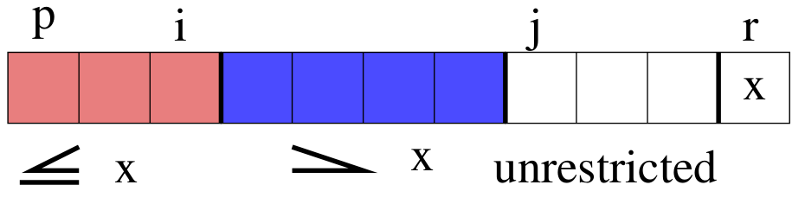
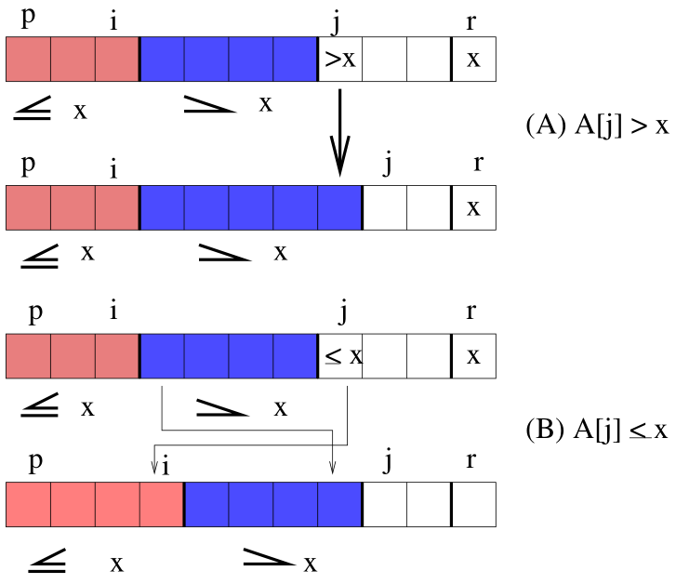
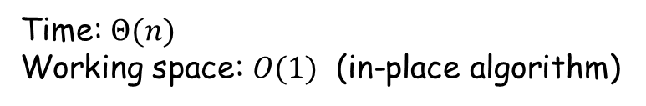

Partition with the last element as the pivot
Partition($A, p, r$):
$$x←A\left[r\right]$$
$$i←p−1$$
for $j←p$ to $r−1$
if $A\left[j\right]≤x$ then
$i←i+1$
swap $A[i]$ and $A\left[j\right]$
swap $A\left[i+1\right]$ and $A\left[r\right]$
return $i+1$
Time: $Θ(n)$
Working space: $O(1)$ (in-place algorithm)

Slide 36
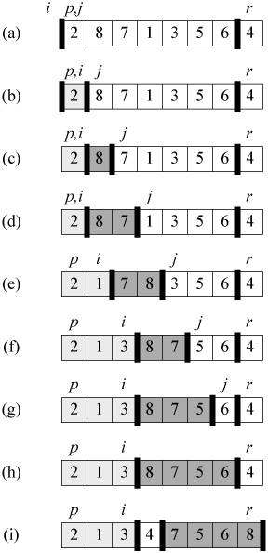
Partition: Example

Slide 37
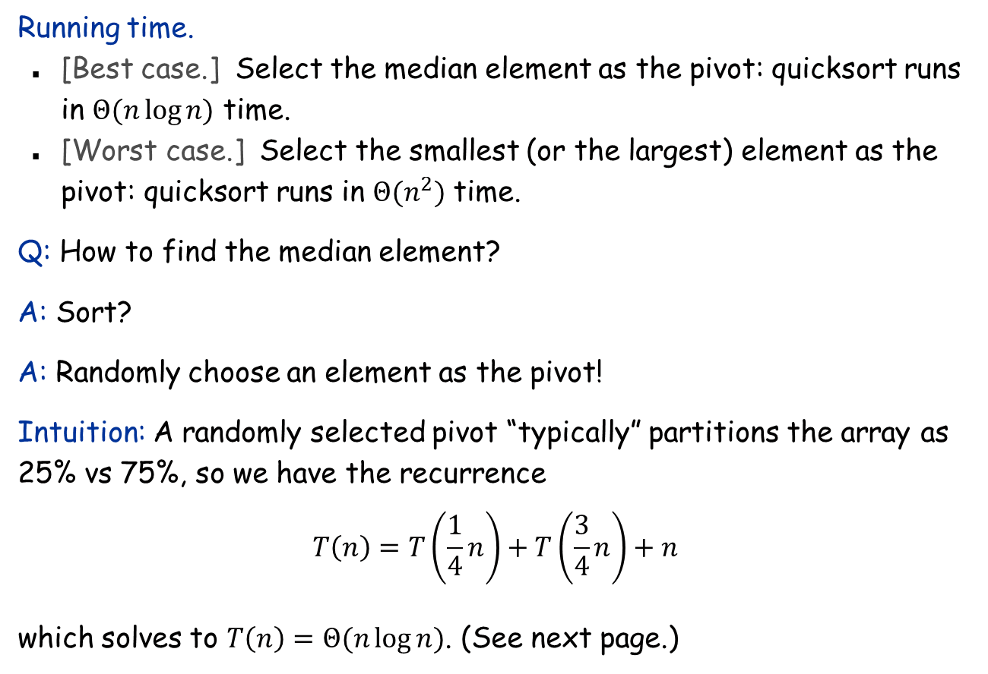
Pivot selection is crucial
Running time.
[Best case.] Select the median element as the pivot: quicksort runs in $Θ(n\log{n)}$ time.
[Worst case.] Select the smallest (or the largest) element as the pivot: quicksort runs in $Θ(n^{2})$ time.
Q: How to find the median element?
A: Sort?
A: Randomly choose an element as the pivot!
Intuition: A randomly selected pivot “typically” partitions the array as 25% vs 75%, so we have the recurrence $$T\left(n\right)=T\left(\frac{1}{4}n\right)+T\left(\frac{3}{4}n\right)+n$$ which solves to $T\left(n\right)=Θ(n\log{n})$. (See next page.)

Slide 38
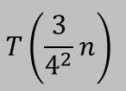

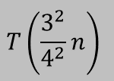


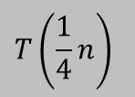

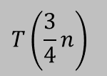




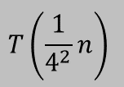

Solve the recurrence
$$T\left(n\right)=T\left(\frac{1}{4}n\right)+T\left(\frac{3}{4}n\right)+n$$
$$T(n)$$
$$n$$
$$T\left(\frac{1}{4}n\right)$$
$$T\left(\frac{3}{4}n\right)$$
$$n$$
$$\log_{4/3}{n} \sim \log_{4}{n}$$
$$T\left(\frac{1}{4^{2}}n\right)$$
$$T\left(\frac{3}{4^{2}}n\right)$$
$$T\left(\frac{3}{4^{2}}n\right)$$
$$T\left(\frac{3^{2}}{4^{2}}n\right)$$
$$n$$
. . .
$$≤n$$
$$Θ(n log n)$$

Slide 39

Analysis of quicksort: The binary tree representation
Assumption: All elements are distinct
Note: Running time = $Θ$(# comparisons)
Relabel the elements from small to large as z₁, z₂, …, z_{n}
z₇
z₆
z₁₂
z₃
z₁₁
z₈
z₇
z₁
z₁₅
z₁₃
z₁₇
z₁₀
z₁₆
z₁₄
z₉
z₄
z₅
first pivot, chosen randomly
z₁₀
z₅
z₁₃
z₃
z₉
z₁₁
z₁₆
z₂
z₄
z₇
z₁₂
z₁₅
z₁₇
z₁
z₆
z₈
z₁₄

Slide 40
Analysis of quicksort
Observation 1: Element only compared with its ancestors and descendants.
z₂ and z₇ are compared if their lowest common ancestor (lca) is z₂ or z₇.
z₂ and z₇ are not compared if their lca is z₃, z₄, z₅, or z₆.
Other elements cannot be the lca of z₂ and z₇
Observation 2: Every element in {z_{i}, …, z_{j}} is equally likely to be the lca of z_{i} and z_{j}
So, Pr[z_{i} and z_{j} are compared] = 2 / (j - i + 1).
z₁₀
z₅
z₁₃
z₃
z₉
z₁₁
z₁₆
z₂
z₄
z₇
z₁₂
z₁₅
z₁₇
z₁
z₆
z₈
z₁₄

Slide 41
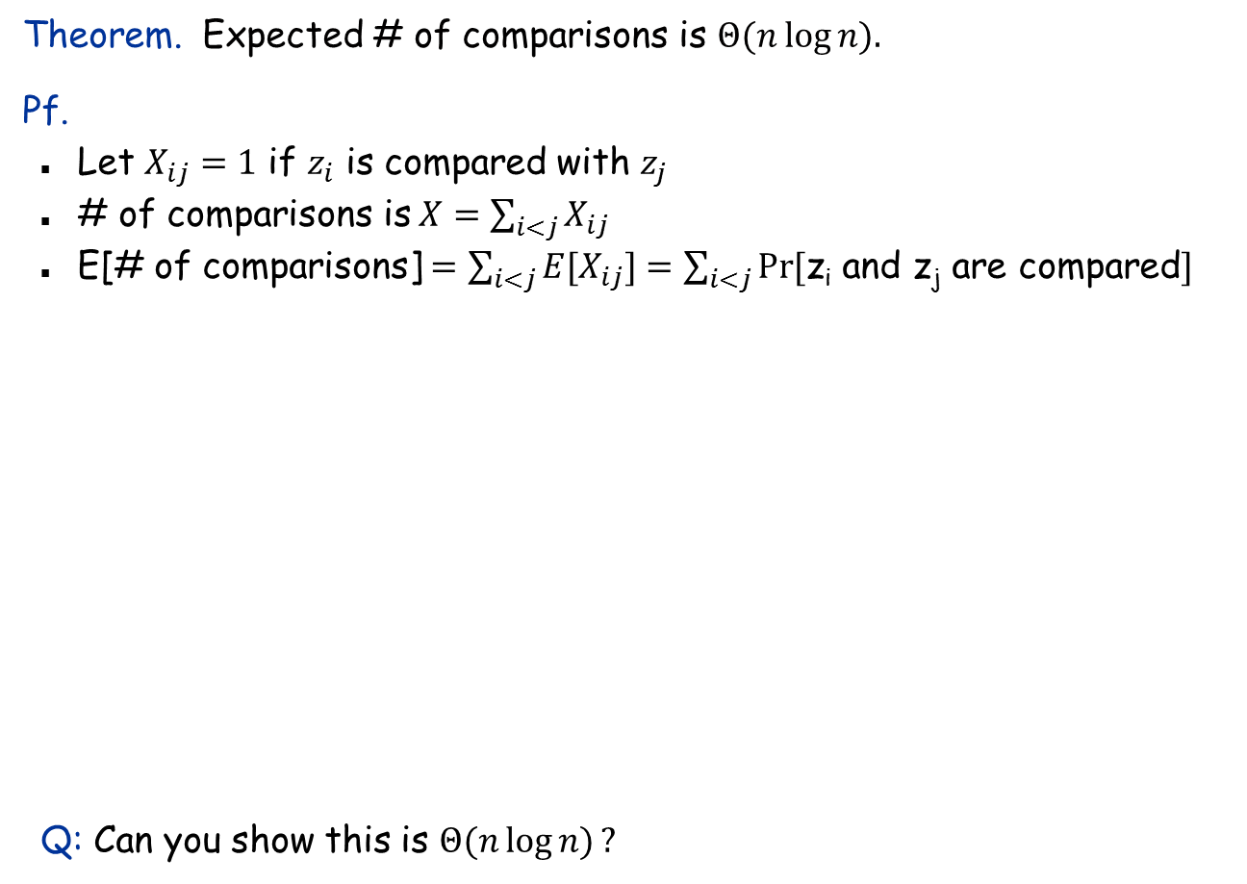
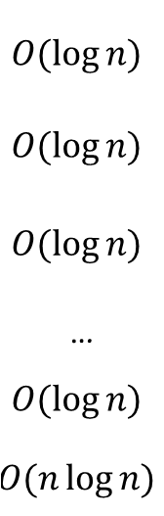
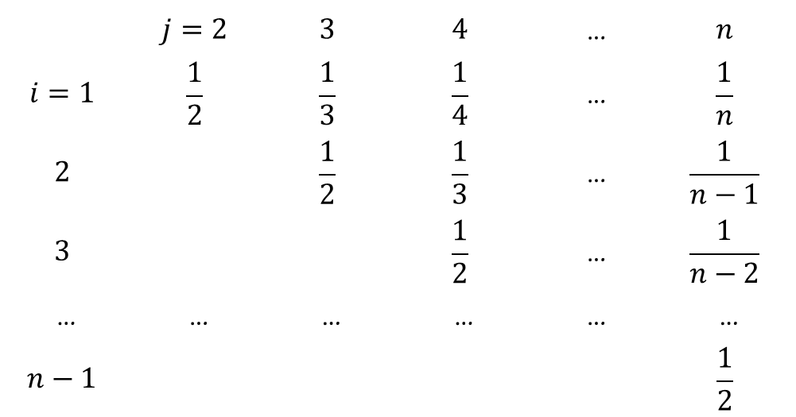
Analysis of quicksort (continued)
Theorem. Expected # of comparisons is $Θ(n log⁡n).$
Pf.
Let $X_{ij}=1$ if $z_{i}$ is compared with $z_{j}$
# of comparisons is $X=\sum_{i<j}{X_{ij}}$
E[# of comparisons] $=\sum_{i<j}{{E[X}_{ij}]}=\sum_{i<j}{\operatorname{Pr}{[}}$z_{i} and z_{j} are compared$]$
Q: Can you show this is $Θ(n\log{n)}?$
 | $$j=2$$ | $$3$$ | $$4$$ | … | $$n$$
$$i=1$$ | $$\frac{1}{2}$$ | $$\frac{1}{3}$$ | $$\frac{1}{4}$$ | … | $$\frac{1}{n}$$
$$2$$ |  | $$\frac{1}{2}$$ | $$\frac{1}{3}$$ | … | $$\frac{1}{n−1}$$
$$3$$ |  |  | $$\frac{1}{2}$$ | … | $$\frac{1}{n−2}$$
… | … | … | … | … | …
$$n−1$$ |  |  |  |  | $$\frac{1}{2}$$
$$O(\log{n)}$$
$$O(\log{n)}$$
$$O(\log{n)}$$
…
$$O(\log{n)}$$
$$O(n\log{n)}$$

Slide 42
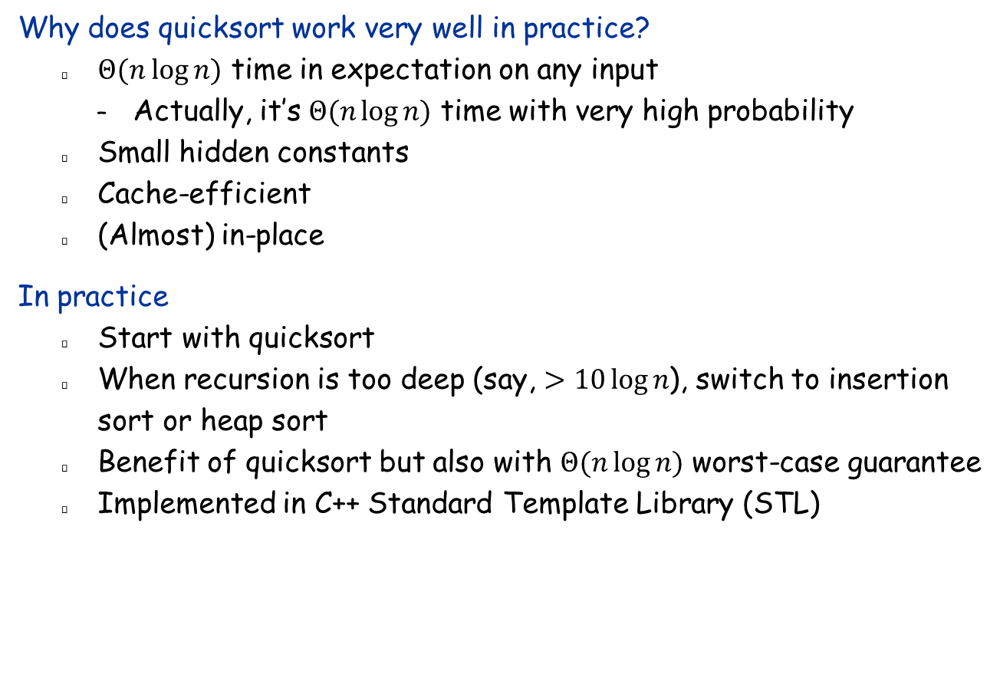
Quicksort in practice
Why does quicksort work very well in practice?
$Θ(n log⁡n)$ time in expectation on any input
Actually, it’s $Θ(n\log{n)}$ time with very high probability
Small hidden constants
Cache-efficient
(Almost) in-place
In practice
Start with quicksort
When recursion is too deep (say, $>10\log{n}$), switch to insertion sort or heap sort
Benefit of quicksort but also with $Θ(n\log{n)}$ worst-case guarantee
Implemented in C++ Standard Template Library (STL)

Slide 43


Randomized Selection
Selection. Given an array $A$ of $n$ distinct elements and an integer $i$, return the $i$-th smallest element of $A$.
Goal: Want to do better than sorting, i.e., linear time.
Select($A, p, r,i$):
if $p=r$ then return $A[p]$
$q←$Partition($A, p,r$)
$$k←q−p+1$$
if $i=k$ then return $A[q]$
else if $i<k$ then return Select($A,p,q−1,i$)
else return Select($A, q+1, r,i−k$)
First call: Select($A,1,n,i$)

Slide 44
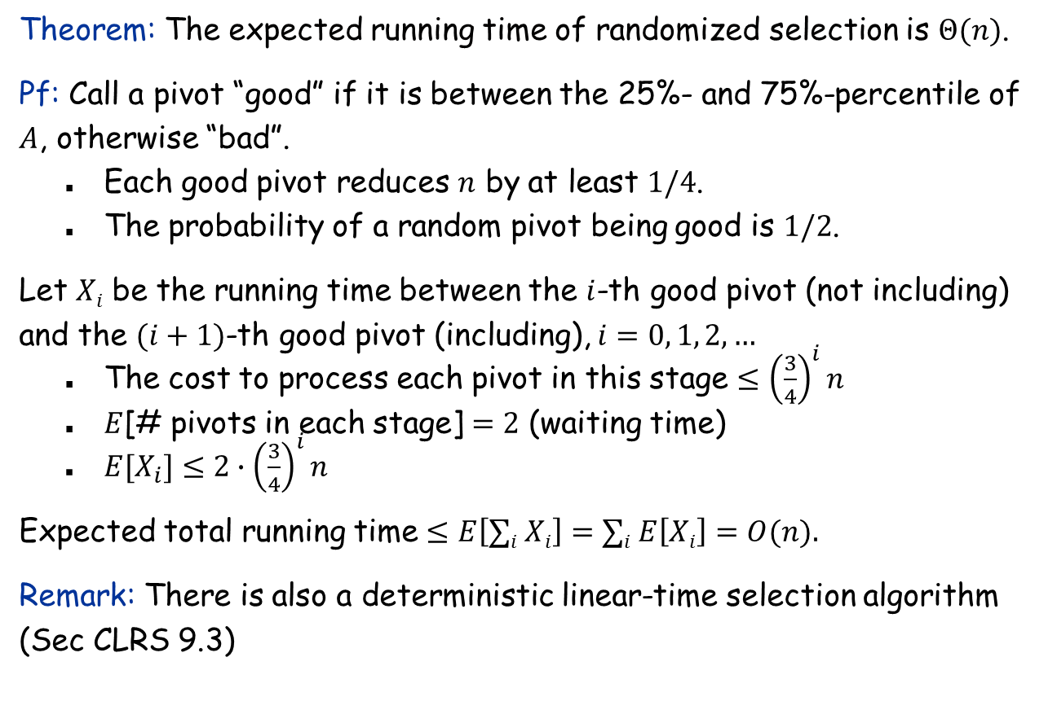
Analysis of randomized selection
Theorem: The expected running time of randomized selection is $Θ(n)$.
Pf: Call a pivot “good” if it is between the 25%- and 75%-percentile of $A$, otherwise “bad”.
Each good pivot reduces $n$ by at least $1/4$.
The probability of a random pivot being good is $1/2$.
Let $Xi$ be the running time between the $i$-th good pivot (not including) and the $(i+1)$-th good pivot (including), $i=0, 1, 2, …$
The cost to process each pivot in this stage $≤{\left(\frac{3}{4}\right)}^{i}n$
$E$[# pivots in each stage] $=2$ (waiting time)
$E[X_{i}]≤2∙{\left(\frac{3}{4}\right)}^{i}n$
Expected total running time $≤E\left[∑i Xi\right]=∑i E\left[Xi\right]=O(n).$
Remark: There is also a deterministic linear-time selection algorithm (Sec CLRS 9.3)

Slide 45
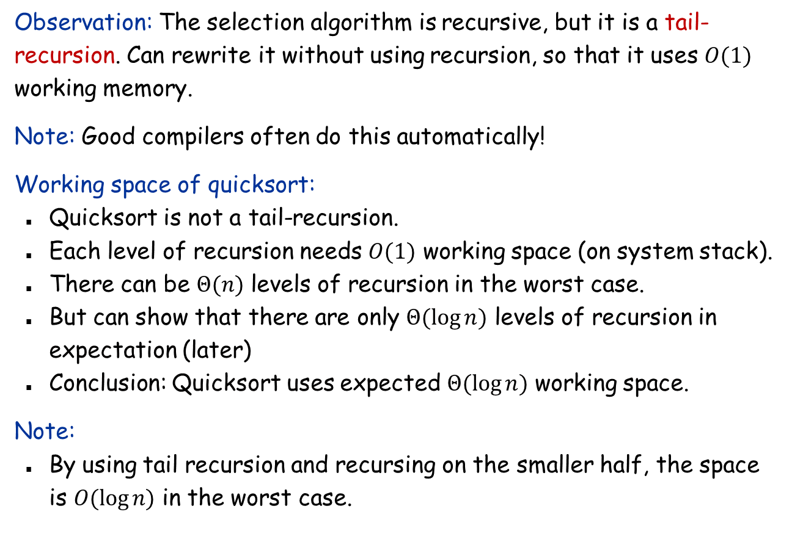
Space analysis
Observation: The selection algorithm is recursive, but it is a tail-recursion. Can rewrite it without using recursion, so that it uses $O(1)$ working memory.
Note: Good compilers often do this automatically!
Working space of quicksort:
Quicksort is not a tail-recursion.
Each level of recursion needs $O(1)$ working space (on system stack).
There can be $Θ(n)$ levels of recursion in the worst case.
But can show that there are only $Θ(\log{n})$ levels of recursion in expectation (later)
Conclusion: Quicksort uses expected $Θ(\log{n})$ working space.
Note:
By using tail recursion and recursing on the smaller half, the space is $O(\log{n)}$ in the worst case.

Slide 46
Skip List
A simple randomized comparison-based dictionary
The dictionary problem (the fundamental data structure problem):
Store a set S of n elements in a data structure that supports the following operations:
Insert x into S
Delete x from S
Find x
See MR 8.3

Slide 47
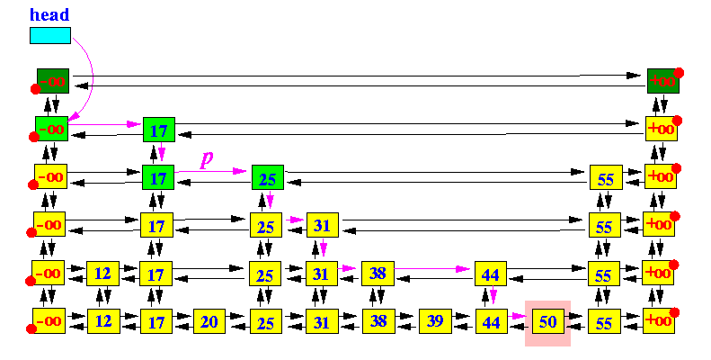
Skip List
Structure
Each key is promoted to the next higher level with probability 1/2.
All keys on each level are stored in a sorted linked list
Multiple copies of the same key are linked together
Find(x):
Start from the top level, search though the list until find the first key greater than or equal to x, or reaching the end
Then go one level down, and continue the same process
Insert/delete(x): O(1) expected time after Find.

Slide 48
Skip List: Benefits
Easy implementation: only need to use lists
No bookkeeping data as in AVL/red-black (similar to splay tree): smaller space
Faster range queries
Useful in distributed applications
Check Wikipedia page for usage in practice

Slide 49
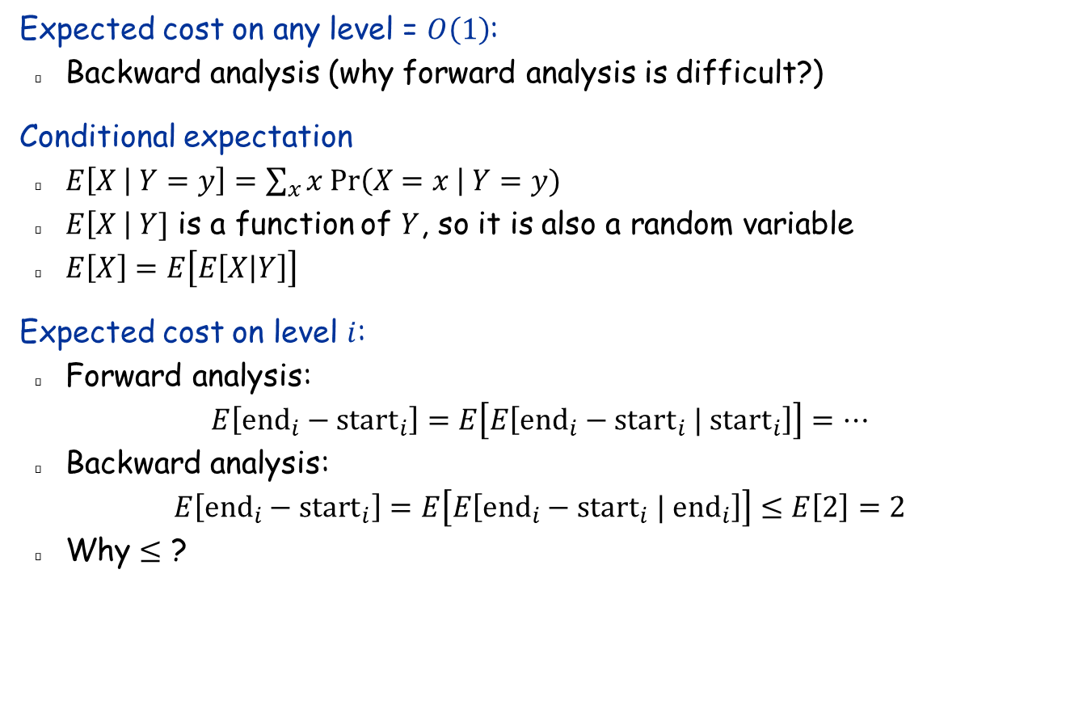
Skip List: Analysis
Expected cost on any level = $O\left(1\right)$:
Backward analysis (why forward analysis is difficult?)
Conditional expectation
$E\left[X | Y=y\right]=\sum_{x}{x Pr\left(X=x \right| Y=y)}$
$E\left[X \right| Y]$ is a function of $Y$, so it is also a random variable
$E\left[X\right]=E\left[E\left[X | Y\right]\right]$
Expected cost on level $i$:
Forward analysis: $E\left[{end}_{i}−{start}_{i}\right]=E\left[E\left[{end}_{i}−{start}_{i} | start_{i}\right]\right]=…$
Backward analysis: $E\left[{end}_{i}−{start}_{i}\right]=E\left[E\left[{end}_{i}−{start}_{i} | end_{i}\right]\right]≤E\left[2\right]=2$
Why $≤$ ?

Slide 50
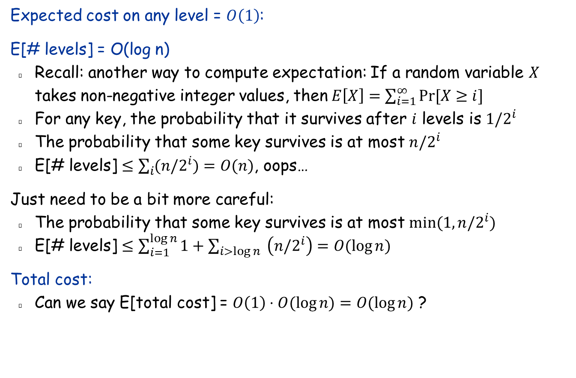
Skip List: Analysis
Expected cost on any level = $O\left(1\right)$:
E[# levels] = O(log n)
Recall: another way to compute expectation: If a random variable $X$ takes non-negative integer values, then$E\left[X\right]=\sum_{i=1}^{∞}{Pr⁡[X≥i]}$
For any key, the probability that it survives after $i$ levels is ${1/2}^{i}$
The probability that some key survives is at most $n/2^{i}$
E[# levels] $≤\sum_{i}{(n/2^{i})}=O(n)$, oops…
Just need to be a bit more careful:
The probability that some key survives is at most $min(1,n/2^{i})$
E[# levels] $≤\sum_{i=1}^{\log{n}}{1}+\sum_{i>\log{n}}{ \left(n/2^{i}\right)}=O(\log{n})$
Total cost:
Can we say E[total cost] = $O\left(1\right)⋅O(\log{n)=O(\log{n)}}$ ?

Slide 51
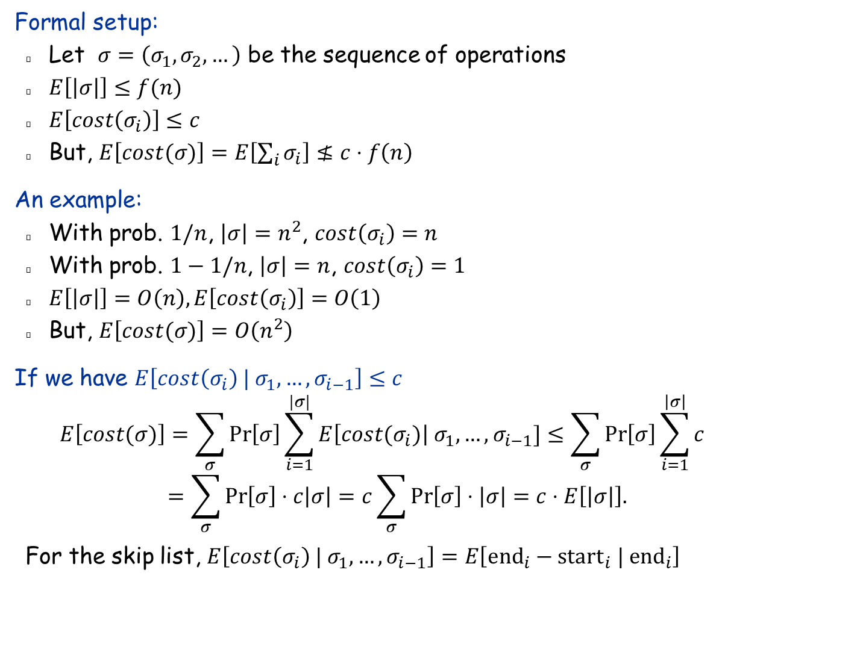
Skip List: Analysis
Formal setup:
Let $σ=\left(σ_{1},σ_{2},…\right)$ be the sequence of operations
$E\left[\left|σ\right|\right]≤f(n)$
$E\left[cost\left(σ_{i}\right)\right]≤c$
But, $E\left[cost(σ)\right]=E\left[\sum_{i}{σ_{i}}\right]≰c⋅f\left(n\right)$
An example:
With prob. $1/n$, $\left|σ\right|=n^{2}$, $cost\left(σ_{i}\right)=n$
With prob. $1−1/n$, $\left|σ\right|=n$, $cost\left(σ_{i}\right)=1$
$E\left[\left|σ\right|\right]=O\left(n\right), E\left[cost\left(σ_{i}\right)\right]=O\left(1\right)$
But, $E\left[cost(σ)\right]=O\left(n^{2}\right)$
If we have $E\left[cost\left(σ_{i}\right) | σ_{1},…, σ_{i−1}\right]≤c$
$$E\left[cost(σ)\right]=\sum_{σ}{\operatorname{Pr}\left[σ\right]\sum_{i=1}^{|σ|}{E\left[cost(σ_{i})\right| σ_{1},…,σ_{i−1}]}}≤\sum_{σ}{\operatorname{Pr}\left[σ\right]}\sum_{i=1}^{\left|σ\right|}{c}$$
$$=\sum_{σ}{\operatorname{Pr}\left[σ\right]}⋅c\left|σ\right|=c\sum_{σ}{\operatorname{Pr}\left[σ\right]}⋅\left|σ\right|=c⋅E\left[\left|σ\right|\right].$$
For the skip list, $E\left[cost\left(σ_{i}\right) | σ_{1},…, σ_{i−1}\right]=E\left[{end}_{i}−{start}_{i} | end_{i}\right]$

Slide 52
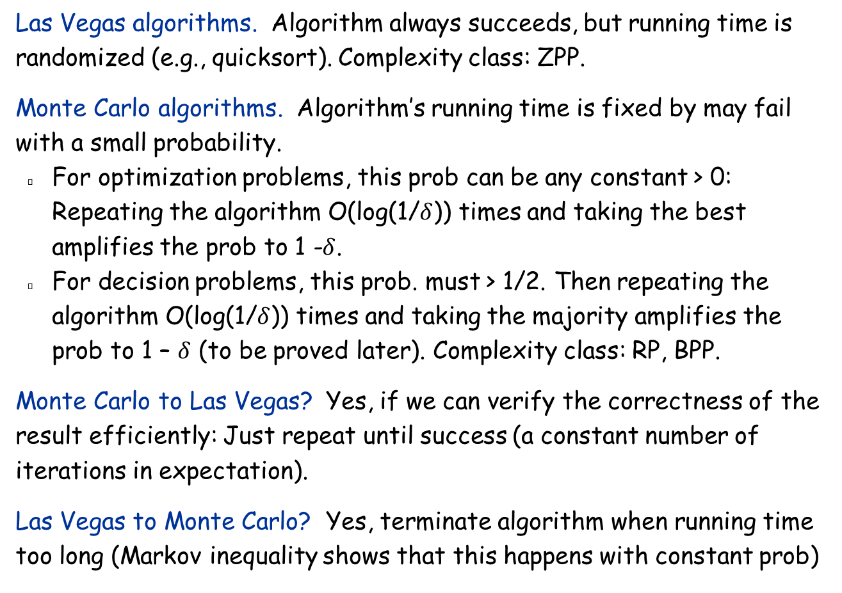
Types of Randomized Algorithms
Las Vegas algorithms. Algorithm always succeeds, but running time is randomized (e.g., quicksort). Complexity class: ZPP.
Monte Carlo algorithms. Algorithm’s running time is fixed by may fail with a small probability.
For optimization problems, this prob can be any constant > 0: Repeating the algorithm O(log(1/$δ$)) times and taking the best amplifies the prob to 1 -$δ$.
For decision problems, this prob. must > 1/2. Then repeating the algorithm O(log(1/$δ$)) times and taking the majority amplifies the prob to 1 – $δ$ (to be proved later). Complexity class: RP, BPP.
Monte Carlo to Las Vegas? Yes, if we can verify the correctness of the result efficiently: Just repeat until success (a constant number of iterations in expectation).
Las Vegas to Monte Carlo? Yes, terminate algorithm when running time too long (Markov inequality shows that this happens with constant prob)

Slide 53
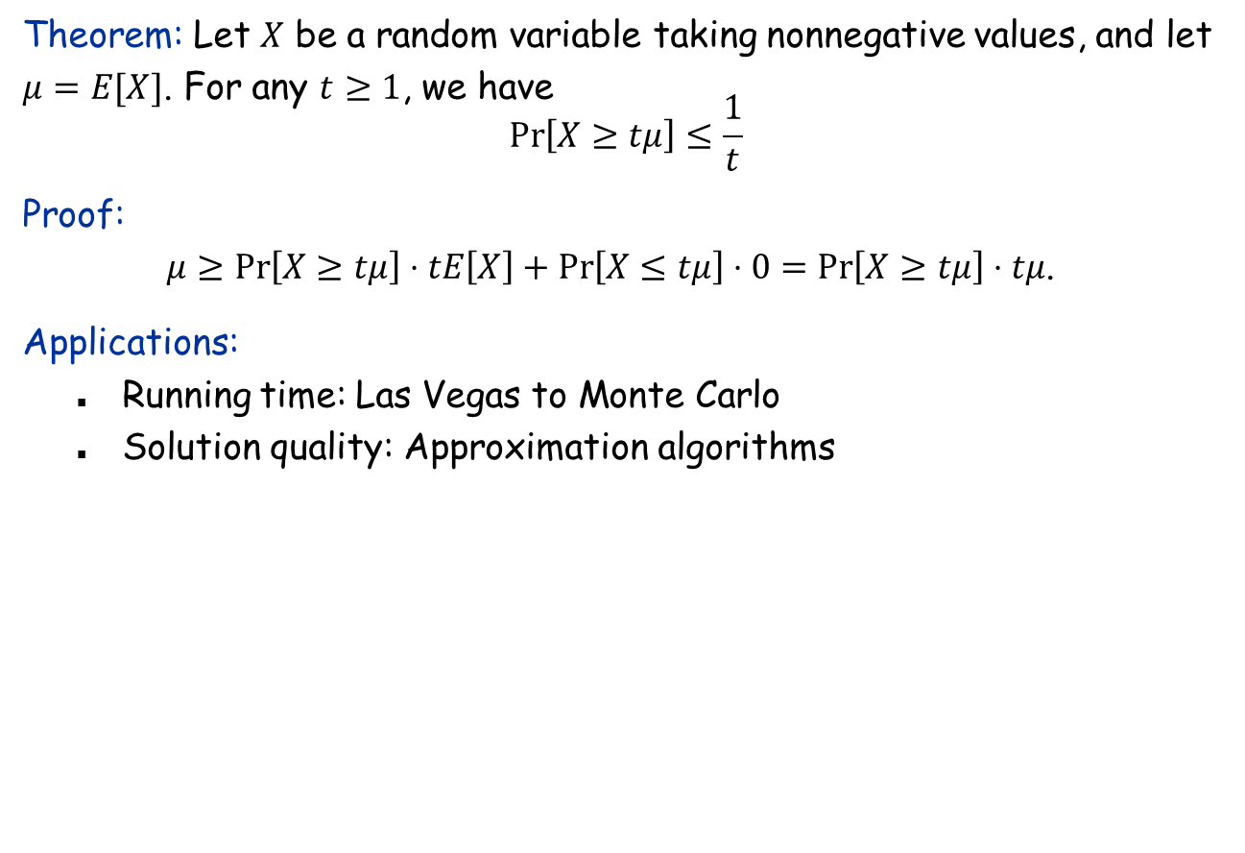
Markov inequality
Theorem: Let $X$ be a random variable taking nonnegative values, and let $μ=E[X]$. For any $t≥1$, we have $$\operatorname{Pr}\left[X≥tμ\right]≤\frac{1}{t}$$
Proof: $μ≥\operatorname{Pr}\left[X≥tμ\right]⋅tE\left[X\right]+\operatorname{Pr}\left[X≤tμ\right]⋅0=\operatorname{Pr}\left[X≥tμ\right]⋅tμ$.
Applications:
Running time: Las Vegas to Monte Carlo
Solution quality: Approximation algorithms

Slide 54
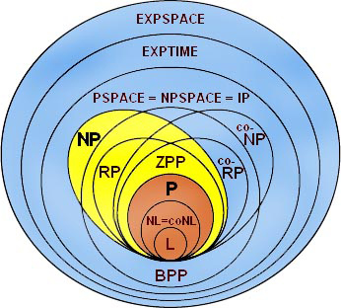

Slide 55
How does a computer generate a random number?
Pseudorandom numbers:
Computed by a deterministic algorithm from a “seed”.
If the “seed” is unknown, then it’s difficult to predict the next number to be generated.
Often use current machine time as the seed.
Higher difficulty needs more complicated algorithms.
rand: “linear generator” $x_{n}={(214013x}_{n−1}+2531011) mod 2^{32}$
ranlux48
knuth_b
http://en.cppreference.com/w/cpp/numeric/random
True random numbers:
Electronic noise, thermal noise, atmospheric noise, etc.
Expensive and slow
http://www.random.org

