Slide 1
Streaming Algorithms

Slide 2
Missing Card
I take one from a deck of 52 cards, and pass the rest to you. Suppose you only have a (very basic) calculator and bad memory, how can you find out which card is missing with just one pass over the 51 cards?
What if there are two missing cards?

Slide 3
A data stream algorithm …
Makes one pass over the input data
Uses a small amount of memory (much smaller than the input data)
Computes something

Slide 4


Slide 5
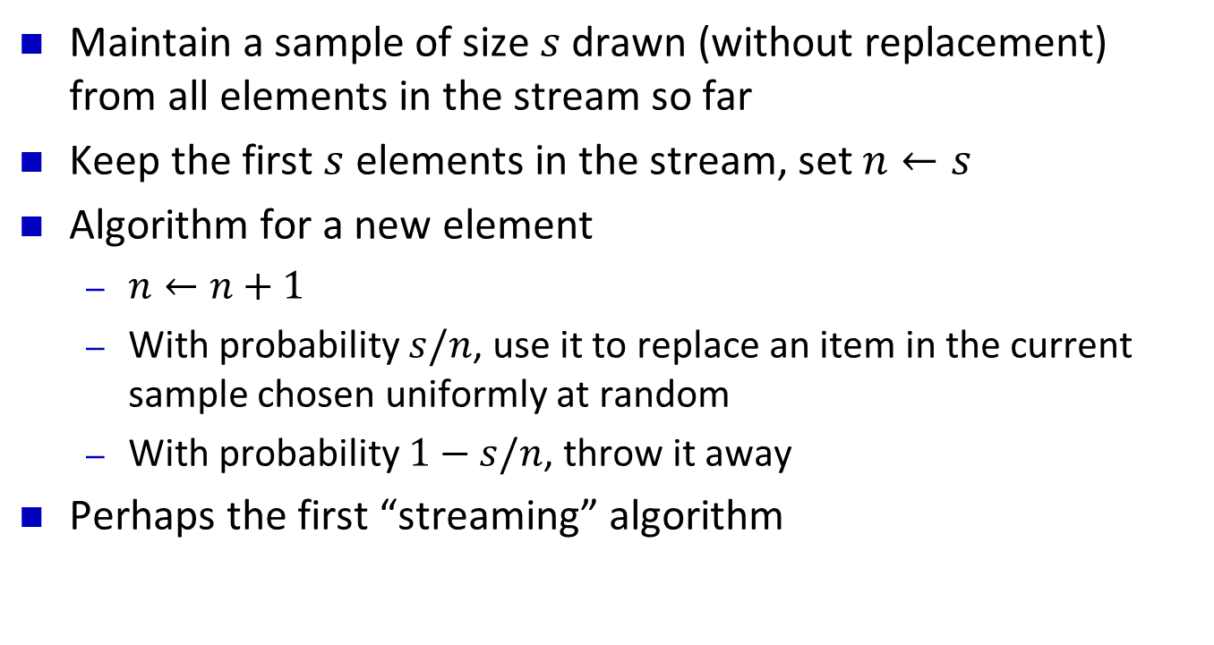
Reservoir Sampling
Maintain a sample of size $s$ drawn (without replacement) from all elements in the stream so far
Keep the first $s$ elements in the stream, set $n←s$
Algorithm for a new element
$n←n+1$
With probability $s/n$, use it to replace an item in the current sample chosen uniformly at random
With probability $1−s/n$, throw it away
Perhaps the first “streaming” algorithm
[Waterman ??; Knuth’s book]

Slide 6
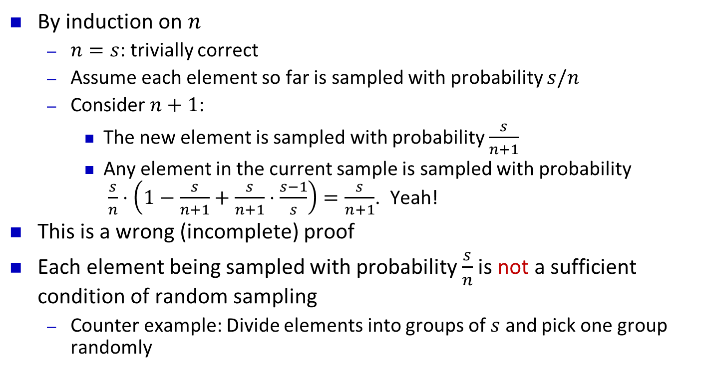
Correctness Proof
By induction on $n$
$n=s$: trivially correct
Assume each element so far is sampled with probability $s/n$
Consider $n+1$:
The new element is sampled with probability $\frac{s}{n+1}$
Any element in the current sample is sampled with probability $\frac{s}{n}⋅\left(1−\frac{s}{n+1}+\frac{s}{n+1}⋅\frac{s−1}{s}\right)=\frac{s}{n+1}$. Yeah!
This is a wrong (incomplete) proof
Each element being sampled with probability $\frac{s}{n}$ is not a sufficient condition of random sampling
Counter example: Divide elements into groups of $s$ and pick one group randomly

Slide 7



Slide 8
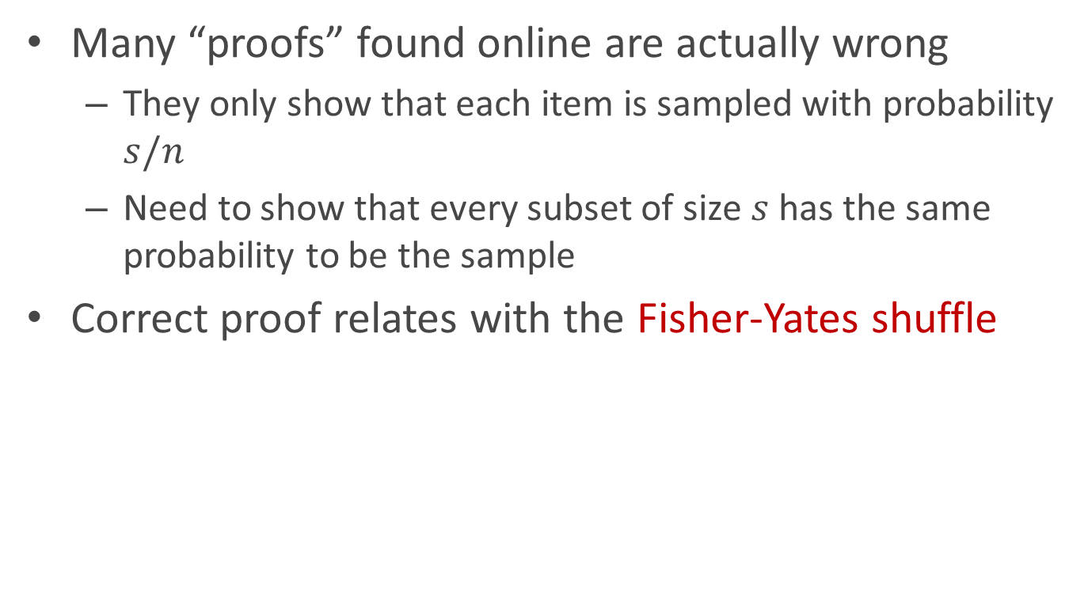
Reservoir Sampling Correctness Proof
Many “proofs” found online are actually wrong
They only show that each item is sampled with probability $s/n$
Need to show that every subset of size $s$ has the same probability to be the sample
Correct proof relates with the Fisher-Yates shuffle
s = 2
a
a
b
b
b
b
b
a
c
d
c
c
c
a
a
d
d
d
d
c

Slide 9
Majority
Given a sequence of items, find the majority if there is one
A A B C D B A A B B A A A A A A C C C D A B A A A
Answer: A
Trivial if we have O(n) memory
Can you do it with O(1) memory and two passes?
First pass: find the possible candidate
Second pass: compute its frequency and verify that it is > n/2
How about one pass?
Unfortunately, no

Slide 10
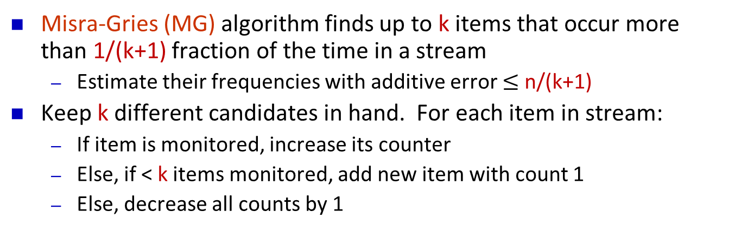
Heavy hitters
Misra-Gries (MG) algorithm finds up to k items that occur more than 1/(k+1) fraction of the time in a stream
Estimate their frequencies with additive error $≤$ n/(k+1)
Keep k different candidates in hand. For each item in stream:
If item is monitored, increase its counter
Else, if < k items monitored, add new item with count 1
Else, decrease all counts by 1
k=5
1 2 3 4 5 6 7 8 9

Slide 11
Heavy hitters
Misra-Gries (MG) algorithm finds up to k items that occur more than 1/(k+1) fraction of the time in a stream
Estimate their frequencies with additive error $≤$ n/(k+1)
Keep k different candidates in hand. For each item in stream:
If item is monitored, increase its counter
Else, if < k items monitored, add new item with count 1
Else, decrease all counts by 1
k=5
1 2 3 4 5 6 7 8 9

Slide 12
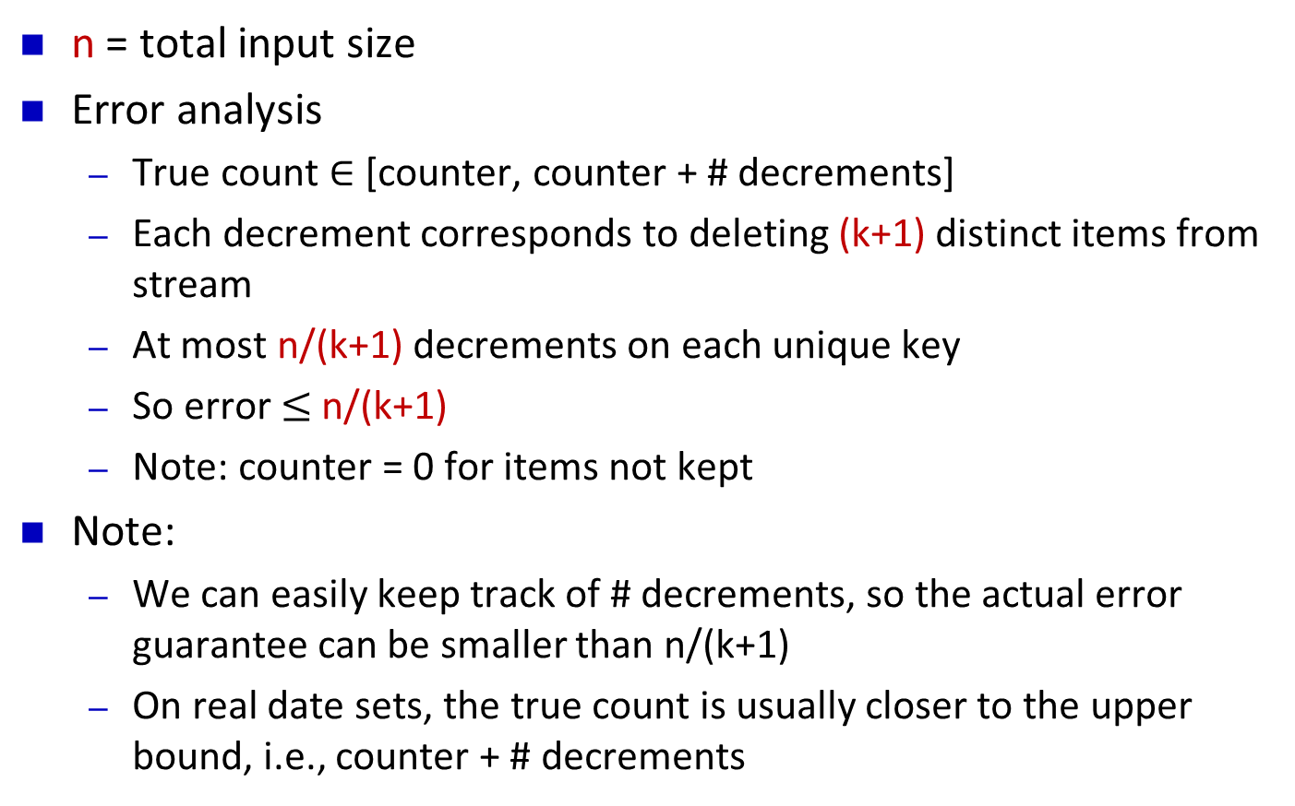
Streaming MG analysis
n = total input size
Error analysis
True count $∈$ [counter, counter + # decrements]
Each decrement corresponds to deleting (k+1) distinct items from stream
At most n/(k+1) decrements on each unique key
So error $≤$ n/(k+1)
Note: counter = 0 for items not kept
Note:
We can easily keep track of # decrements, so the actual error guarantee can be smaller than n/(k+1)
On real date sets, the true count is usually closer to the upper bound, i.e., counter + # decrements

Slide 13
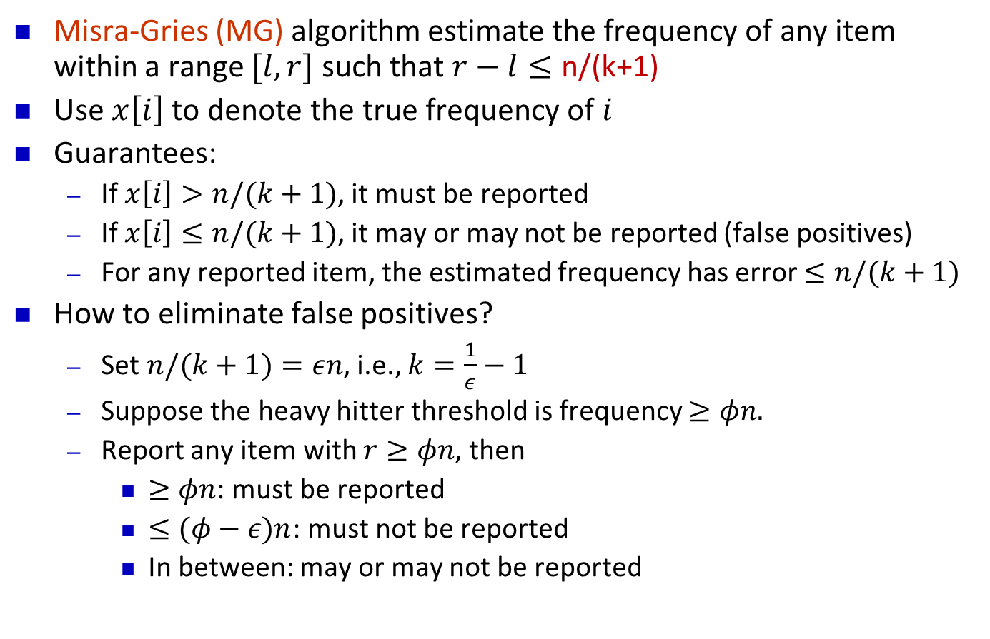
Heavy hitters guarantees
Misra-Gries (MG) algorithm estimate the frequency of any item within a range $[l, r]$ such that $r−l≤\text{n}\text{/(}\text{k}\text{+1)}$
Use $x\left[i\right]$ to denote the true frequency of $i$
Guarantees:
If $x\left[i\right]>n/(k+1)$, it must be reported
If $x\left[i\right]≤n/(k+1)$, it may or may not be reported (false positives)
For any reported item, the estimated frequency has error $≤n/(k+1)$
How to eliminate false positives?
Set $n/(k+1)=εn$, i.e., $k=\frac{1}{ε}−1$
Suppose the heavy hitter threshold is frequency $≥φn.$
Report any item with $r≥φn$, then
$≥φn$: must be reported
$≤(φ−ε)n$: must not be reported
In between: may or may not be reported

Slide 14
Data Models
We model data as a collection of simple tuples
Arrivals only model:
Example: (x, 3), (y, 2), (x, 2) encodes the arrival of 3 copies of item x, 2 copies of y, then 2 copies of x.
Could represent eg. packets on a network; power usage
Arrivals and departures:
Example: (x, 3), (y,2), (x, -2) encodes final state of (x, 1), (y, 2).
Can represent fluctuating quantities, or measure differences between two distributions
x
y
x
y

Slide 15
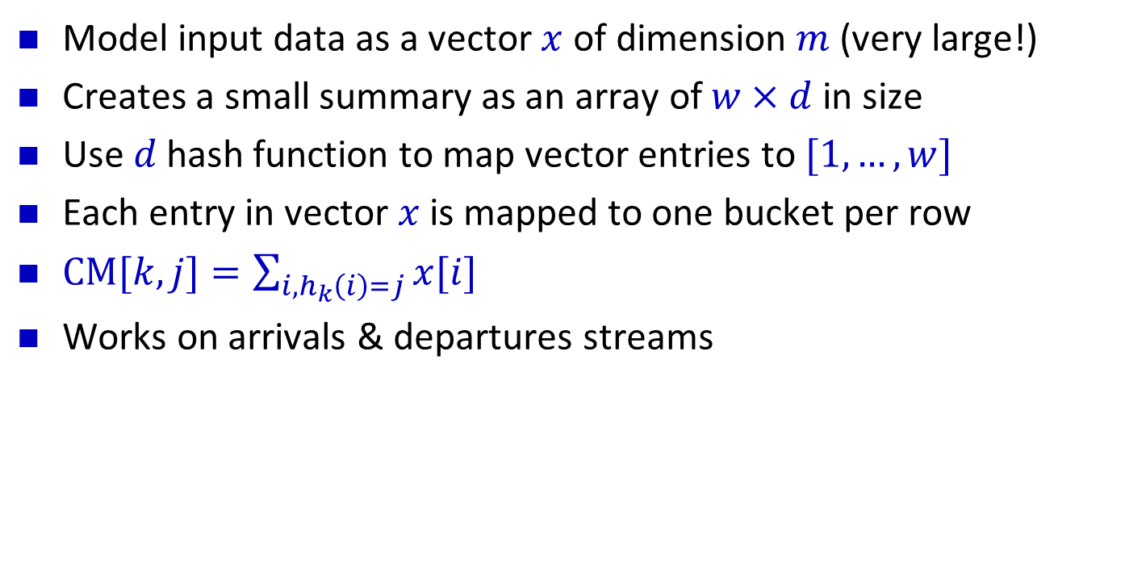
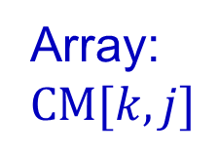


Count-Min Sketch
Model input data as a vector $x$ of dimension $m$ (very large!)
Creates a small summary as an array of $w×d$in size
Use $d$ hash function to map vector entries to $[1,…,w]$
Each entry in vector $x$ is mapped to one bucket per row
$CM[k,j]=\sum_{i,h_{k}\left(i\right)=j}{x[i]}$
Works on arrivals & departures streams
$$w$$
Array: $CM[k,j]$
$$d$$

Slide 16
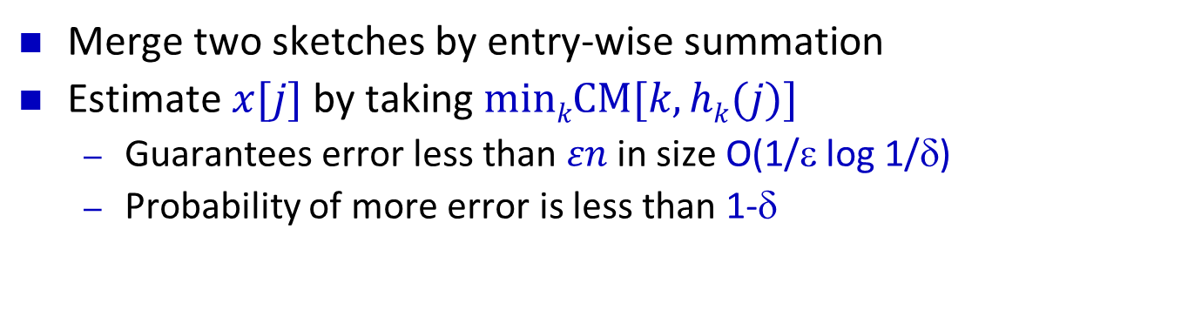
Count-Min Sketch Structure
+c
h₁(j)
j,+c
+c
d=log 1/δ
+c
h_{d}(j)
+c
w = 2/ε
Merge two sketches by entry-wise summation
Estimate $x[j]$ by taking $minkCM[k,hk(j)]$
Guarantees error less than $εn$ in size O(1/ε log 1/δ)
Probability of more error is less than 1-δ

Slide 17
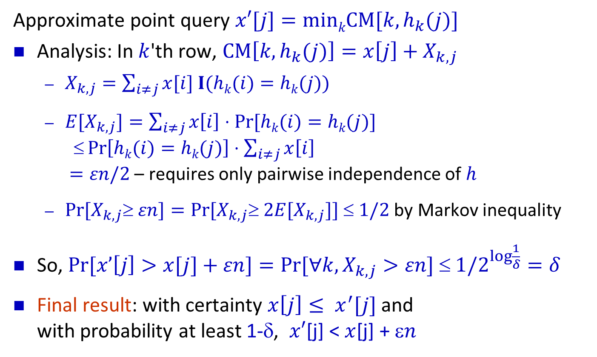
Approximation of Point Queries
Approximate point query $x′[j]=minkCM[k,h_{k}(j)]$
Analysis: In $k$'th row, $CM\left[k,h_{k}(j)\right]=x\left[j\right]+X_{k,j}$
$X_{k,j}=\sum_{i≠j}{x[i] I(hk(i)=hk(j))}$
$E[X_{k,j}]=\sum_{i≠j}{x\left[i\right]⋅Pr⁡[hk(i)=hk(j)]}$ $\operatorname{Pr}\left[hk(i)=hk(j)\right]⋅\sum_{i≠j}{x\left[i\right]}$ $=εn/2$ – requires only pairwise independence of $h$
$Pr⁡[X_{k,j} εn]=Pr⁡[X_{k,j} 2E[X_{k,j}]]  1/2$ by Markov inequality
So, $Pr⁡[x’\left[j\right]>x[j]+εn]=Pr[∀k, X_{k,j}>εn] ≤ 1/2^{log⁡\frac{1}{δ}}=δ$
Final result: with certainty $x\left[j\right]≤ x^{′}[j]$and with probability at least 1-δ, $x′$[j] < $x$[j] + ε$n$

Slide 18
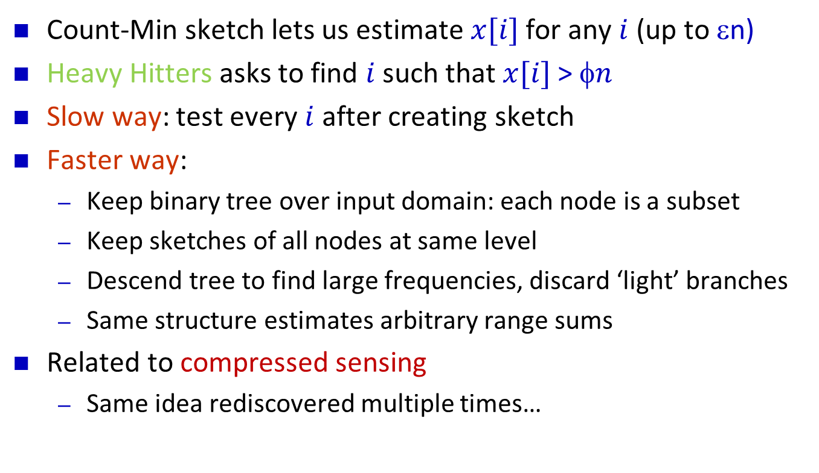
Applications of Count-Min to Heavy Hitters
Count-Min sketch lets us estimate $x[i]$ for any $i$ (up to εn)
Heavy Hitters asks to find $i$ such that $x[i]$> $n$
Slow way: test every $i$ after creating sketch
Faster way:
Keep binary tree over input domain: each node is a subset
Keep sketches of all nodes at same level
Descend tree to find large frequencies, discard ‘light’ branches
Same structure estimates arbitrary range sums
Related to compressed sensing
Same idea rediscovered multiple times…

Slide 19
Application to Large Scale Machine Learning
In machine learning, often have very large feature space
Many objects, each with huge, sparse feature vectors
Slow and costly to work in the full feature space
“Hash kernels”: work with a sketch of the features
Effective in practice! [Weinberger, Dasgupta, Langford, Smola, Attenberg ‘09]
Similar analysis explains why:
Essentially, not too much noise on the important features

Slide 20
Bloom Filters
Bloom filters compactly encode set membership
k hash functions map items to bit vector k times
Set all k entries to 1 to indicate item is present
Can store a set of size n in O(n) bits while supporting membership queries
Duplicate insertions do not change Bloom filters
Compare with the Count-Min sketch
item
1
1
1

Slide 21
Bloom Filter analysis
How to set k (number of hash functions), m (size of filter)?
Analysis below assumes truly random hash functions
No false negative
False positive: when all k locations for an item are set
Let ρ be the probability of a cell being empty
False positive probability is (1-ρ)^{k}
For n items, ρ = (1 - 1/m)^{kn} ≈ exp(-kn/m)
(1 - ρ)^{k} = exp(k ln(1 - ρ)) = exp(-m/n ln(ρ) ln(1-ρ))
For fixed n, m, minimized at ρ = ½
Half cells are occupied, half are empty
Gives k = (m/n)ln 2, false positive rate is ½^{k}
Choose m = cn to get constant FP rate, e.g. c=10 gives < 1% FP

Slide 22
Bloom Filters Applications
Bloom Filters widely used in “big data” applications
Many problems require storing a large set of items
Can generalize to allow deletions
Swap bits for counters: increment on insert, decrement on delete
Bloom Filters are an active research area
Several papers on topic in every networking conference…
item
1
1
1

Slide 23
F₀ Estimation
F₀ is the number of distinct items in the stream
a fundamental quantity with many applications
Early algorithms by Flajolet and Martin [1983] gave nice hashing-based solution
analysis assumed truly random hash functions
Will describe a generalized version of the FM algorithm due to Bar-Yossef et. al with only pairwise indendence
Known as the “k-Minimum values (KMV)” algorithm

Slide 24
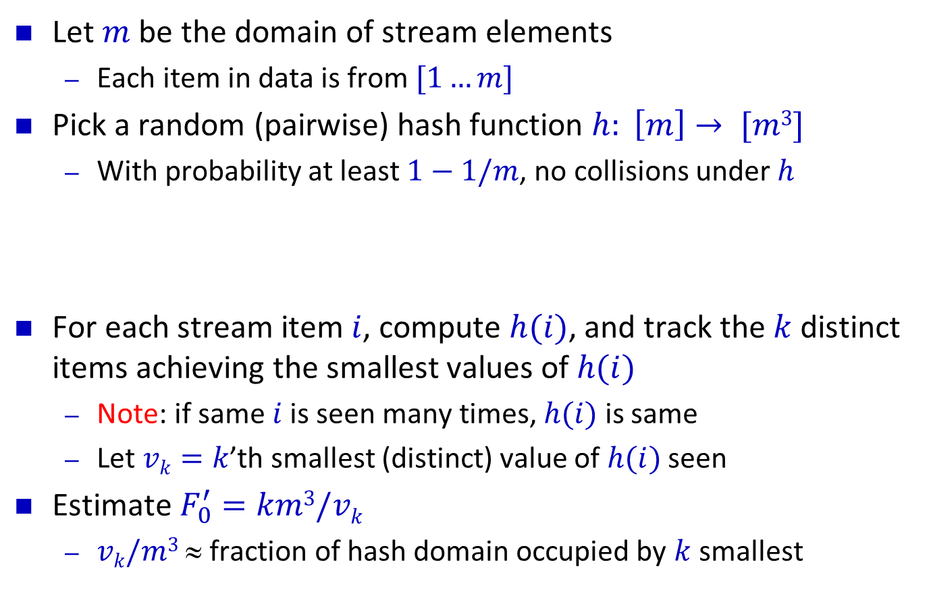

F₀ Algorithm
Let $m$ be the domain of stream elements
Each item in data is from $[1…m]$
Pick a random (pairwise) hash function $h: \left[m\right]→ [m3]$
With probability at least $1−1/m$, no collisions under $h$
For each stream item $i$, compute $h(i)$, and track the $k$ distinct items achieving the smallest values of $h(i)$
Note: if same $i$ is seen many times, $h(i)$ is same
Let $vk=k$’th smallest (distinct) value of $h(i)$ seen
Estimate $F_{0}^{′}=km3/vk$
$vk/m3$ ≈ fraction of hash domain occupied by $k$ smallest
$$vk$$

Slide 25
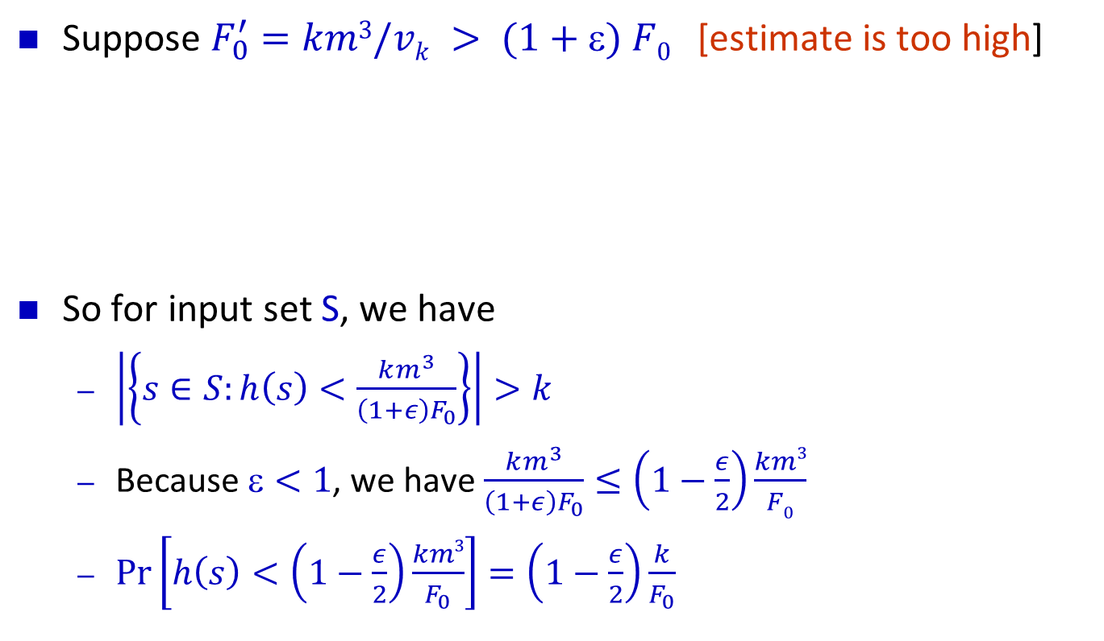
Analysis of F₀ algorithm
Suppose $F_{0}^{′}=km3/vk > (1+) F0$ [estimate is too high]
So for input set S, we have
$\left|\left\{s∈S:h\left(s\right)<\frac{km^{3}}{\left(1+ε\right)F_{0}}\right\}\right|>k$
Because $<1$, we have $\frac{km^{3}}{\left(1+ε\right)F_{0}}≤\left(1−\frac{ε}{2}\right)\frac{km3}{F0}$
$\operatorname{Pr}\left[h\left(s\right)<\left(1−\frac{ε}{2}\right)\frac{km3}{F_{0}}\right]=\left(1−\frac{ε}{2}\right)\frac{k}{F_{0}}$
0
v_{k}
km³/(1+ε)F₀
m³

Slide 26
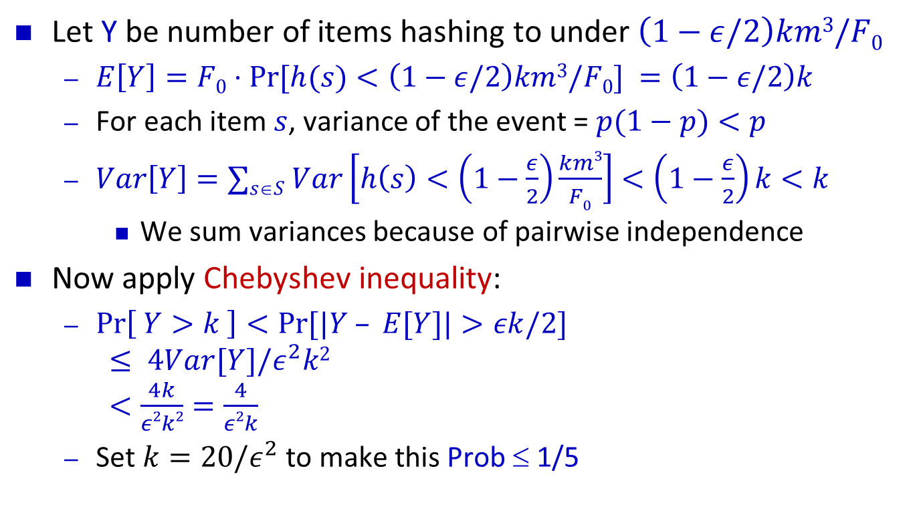
Chebyshev Analysis
Let Y be number of items hashing to under $\left(1−ε/2\right)km3/F0$
$E\left[Y\right]=F0⋅Pr⁡[h(s)<\left(1−ε/2\right)km3/F0] =\left(1−ε/2\right)k$
For each item $s$, variance of the event = $p(1−p)<p$
$Var\left[Y\right]=∑s∈S Var\left[h\left(s\right)<\left(1−\frac{ε}{2}\right)\frac{km3}{F0}\right]<\left(1−\frac{ε}{2}\right)k<k$
We sum variances because of pairwise independence
Now apply Chebyshev inequality:
$\operatorname{Pr}\left[ Y>k \right]<Pr⁡[|Y – E[Y]|>εk/2]$ $≤ 4Var[Y]/ε^{2}k2$ $<\frac{4k}{ε2k2}=\frac{4}{ε2k}$
Set $k=20/ε^{2}$ to make this Prob ≤ 1/5

Slide 27
Completing the analysis
We have shown Pr[ F’₀ > (1+ε) F₀ ] < 1/5
Can show Pr[ F’₀ < (1-ε) F₀ ] < 1/5 similarly
too few items hash below a certain value
So Pr[ (1-ε) F₀ ≤ F’₀ ≤ (1+ε)F₀] > 3/5 [Good estimate]
Amplify this probability: repeat O(log 1/δ) times in parallel with different choices of hash function h
Take the median of the estimates, analysis same as median-of-average

Slide 28
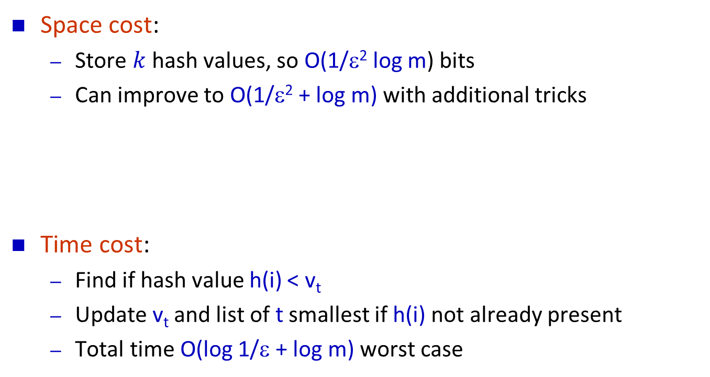
F₀ Issues
Space cost:
Store $k$ hash values, so O(1/ε² log m) bits
Can improve to O(1/ε² + log m) with additional tricks
Time cost:
Find if hash value h(i) < v_{t}
Update v_{t} and list of t smallest if h(i) not already present
Total time O(log 1/ε + log m) worst case

Slide 29
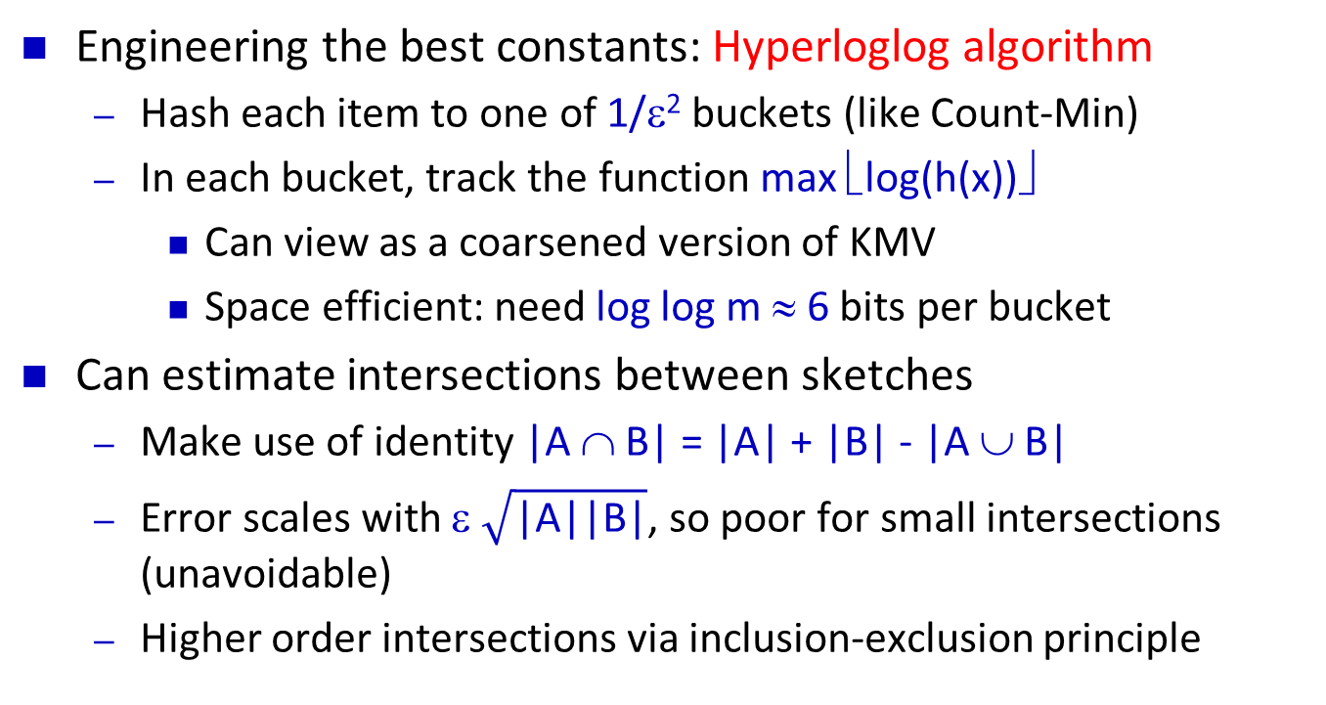
Count-Distinct
Engineering the best constants: Hyperloglog algorithm
Hash each item to one of 1/ε² buckets (like Count-Min)
In each bucket, track the function max ⎣log(h(x))⎦
Can view as a coarsened version of KMV
Space efficient: need log log m ≈ 6 bits per bucket
Can estimate intersections between sketches
Make use of identity |A ∩ B| = |A| + |B| - |A ∪ B|
Error scales with ε $\sqrt{\text{|}\text{A}\text{||}\text{B}\text{|}}$, so poor for small intersections (unavoidable)
Higher order intersections via inclusion-exclusion principle

