Slide 1
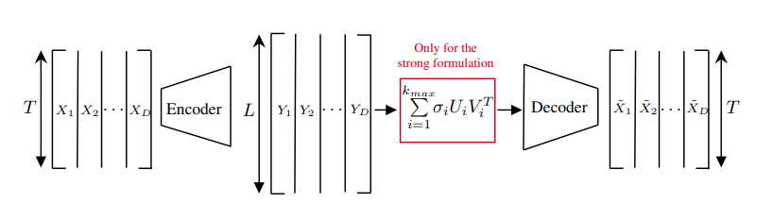
1. Introduction
Rank Reduction Autoencoders (RRAEs). Mounayer, J. et al. (2024)
Perform interpolations in low-rank latent space → generative design
Benefits of the SVD: the basis are ‘learn’ in training

Slide 2
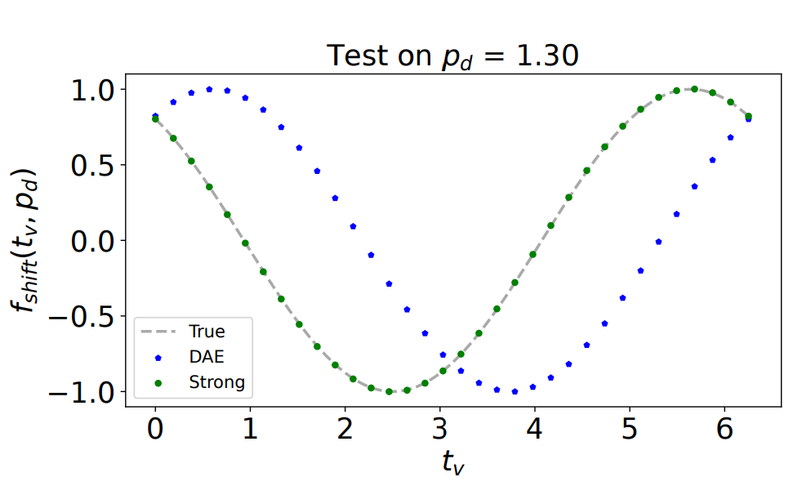
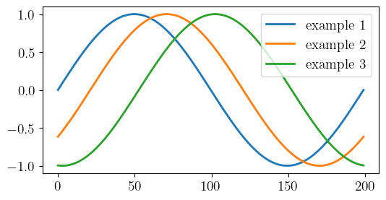
1. Introduction
Examples of application (RRAEs). Mounayer, J. et al. (2024)
Shifted sine curve (dataset varying 1 parameter: the pase)
Compare performance with regular AEs (DAE)

Slide 3
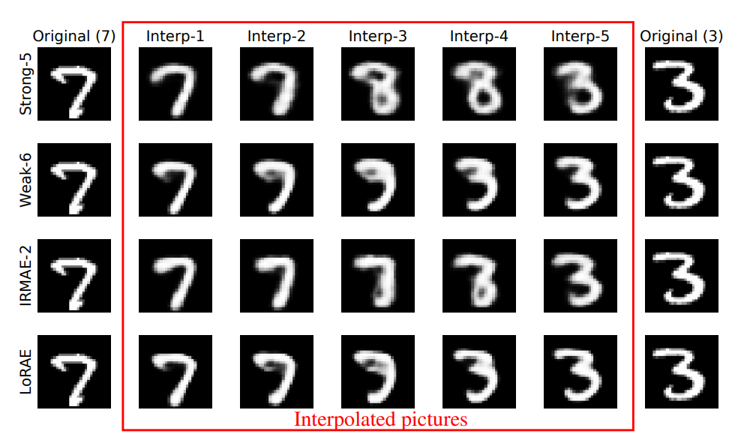
1. Introduction
Examples of application (RRAEs). Mounayer, J. et al. (2024)
MNIST dataset (CNN)

Slide 4
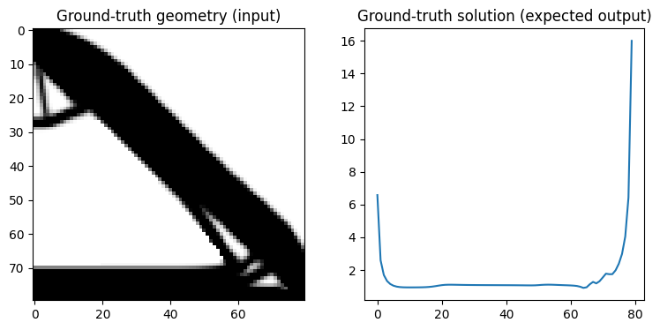
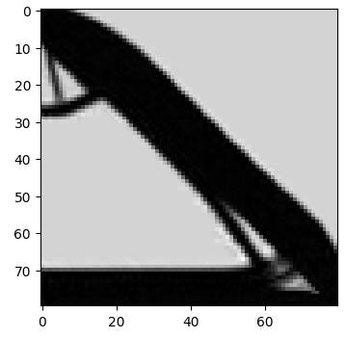

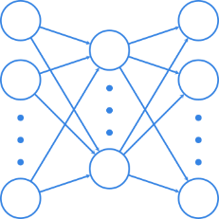
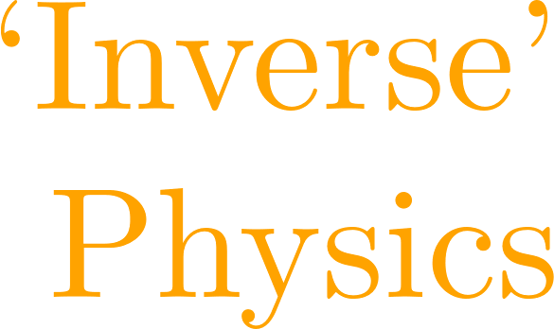

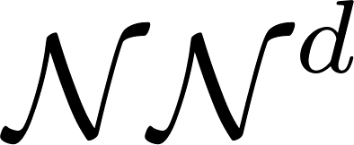
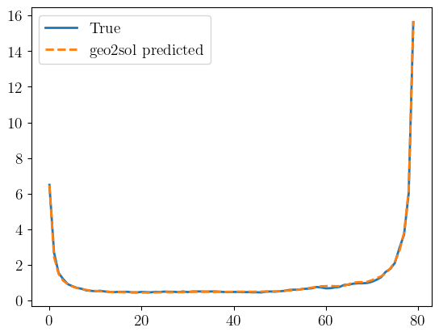
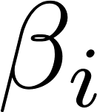
2. Outline

Slide 5
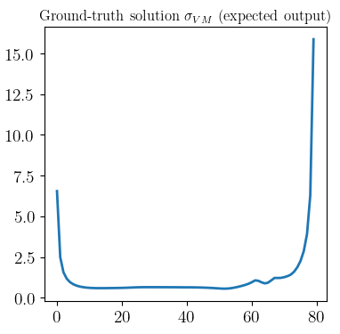
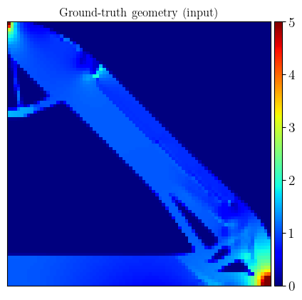
2. Outline
Use for simulation. Advantages of methodology
Bypass expensive problems (forward/direct solutions)
Methodology for addressing inverse problems
Generative design via interpolations of the latent
Geometry – Quantity of Interest (QoI)
Scalar QoI
Field in a fixed domain (either 1D or 2D)
Field in a domain attached to the geometry

Slide 6
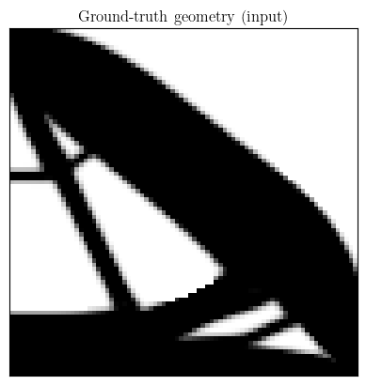
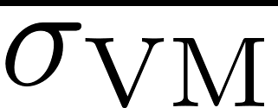
2. Outline. QoI
Scalar QoI
Field in a 1d-domain QoI
Field in a 2d-domain QoI

Slide 7
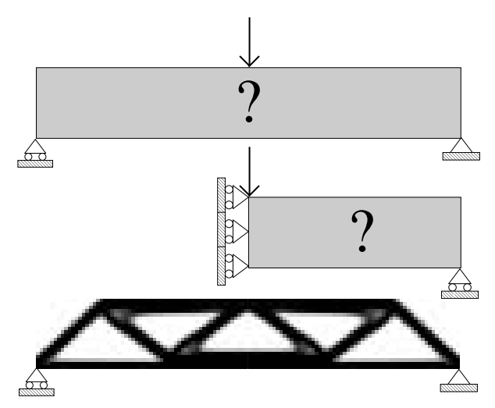
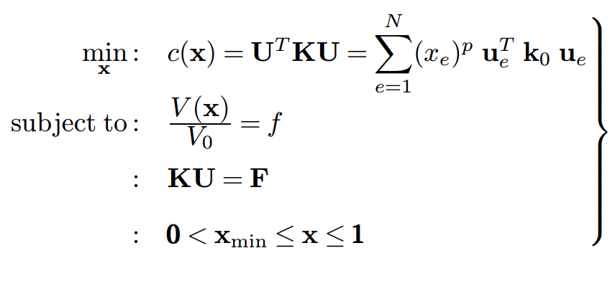
3. Use case: topology optimization
Compliance minimization problem (SIMP)
Design of experiments varying available material

Slide 8
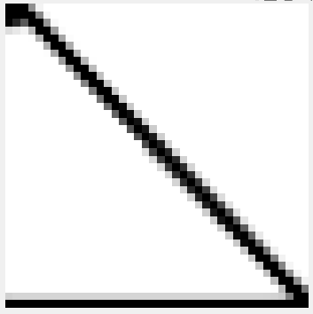

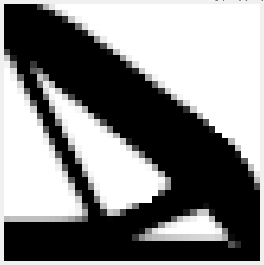
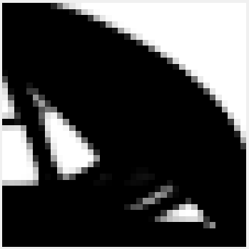
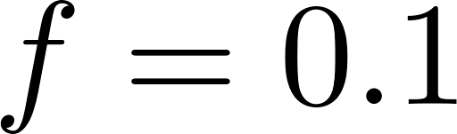
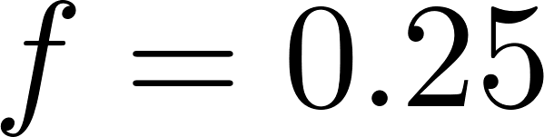
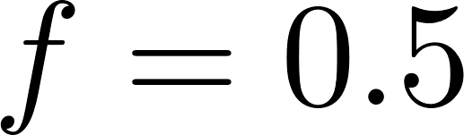
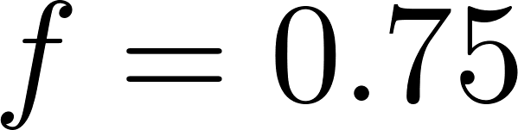
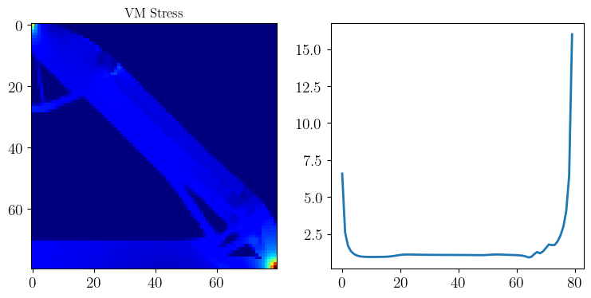
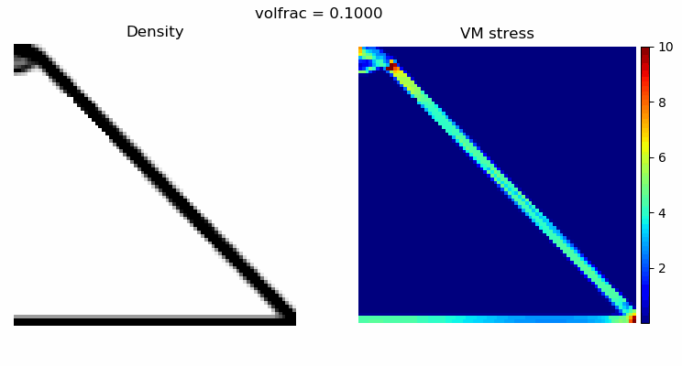
Varying available material (volume fraction) in an 80x80 domain (using quad FEs)
QoI: VM Stress of the elements in the diagonal
Dataset: 100 samples

Slide 9
Reconstruction

Slide 10
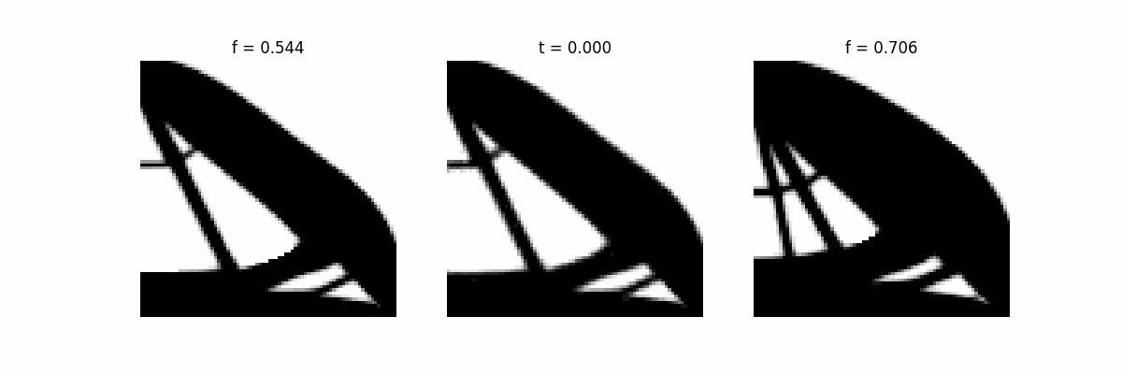
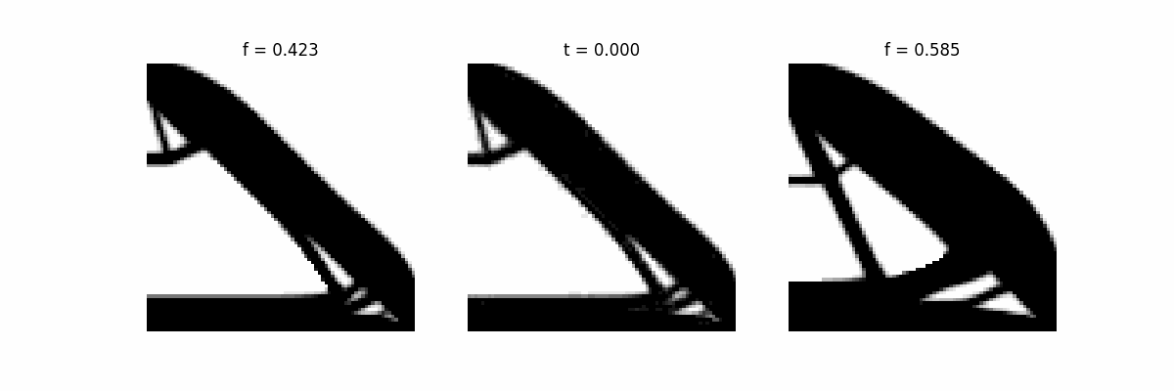
RRAE for geometry. CNN
Training with k_max = 2 (even k_max = 1). Two parameters describe the geometry!
    Successful reconstruction
  Interpolation between samples (DoE). Pending refinement for physical consistency

Slide 11
Reconstruction

Slide 12
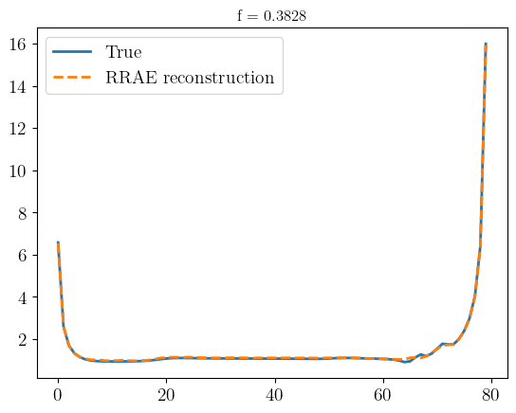
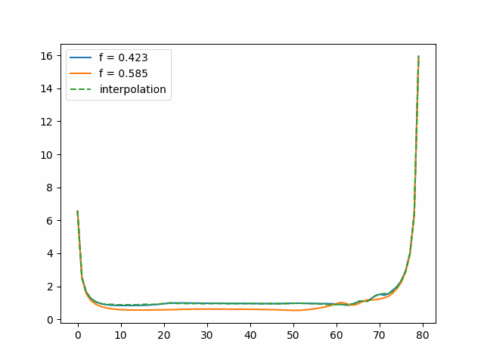
RRAE for solution (QoI). MLP
Training with k_max = 1. (from previous experience, e.g. sine curve)
  Successful reconstruction
  We can also interpolate between curves

Slide 13
Reconstruction

Slide 14
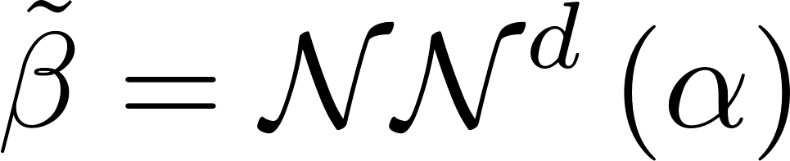
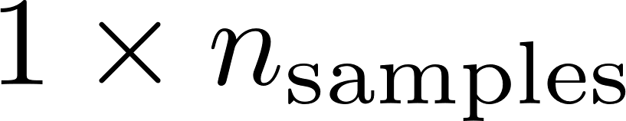
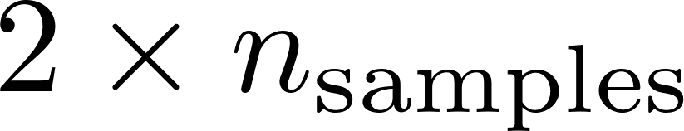
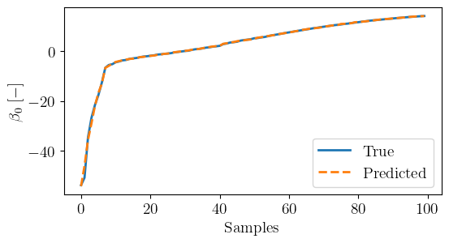
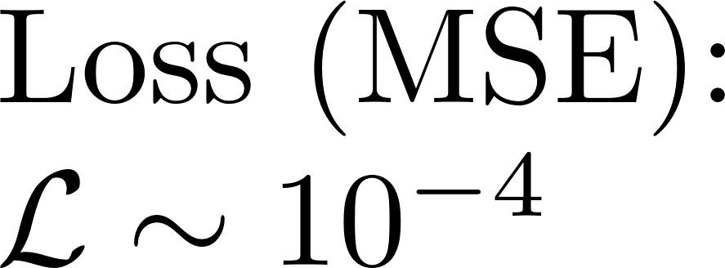
NNd: relating geometries and solutions coefficients
Fit coefficients
Feed-forward network (MLP)
…
…
Successful fitting (validation)

Slide 15
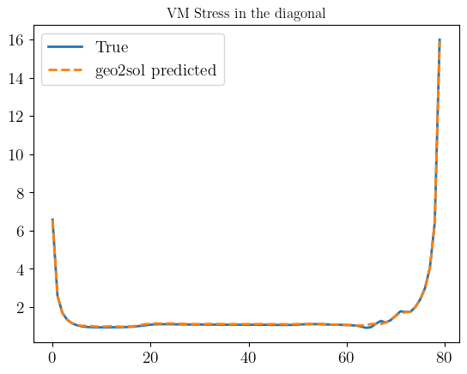
Geometry to solution (geo2sol)

Slide 16
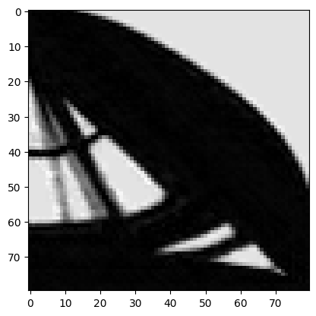
Geometry to solution (geo2sol). Test
Using interpolated geometries (therefore, new)
They are introduced in the geo2sol pipeline (encode, NNd, decode)
In parallel, their solutions are computed with an FE solver (these have never been seen by the model)
Both curves are compared
Example:

Slide 17
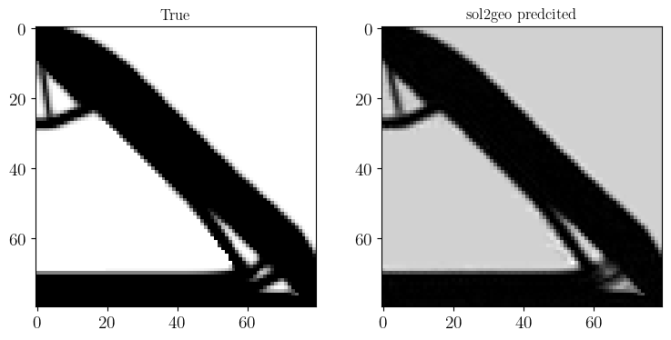
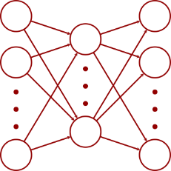
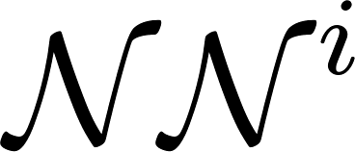
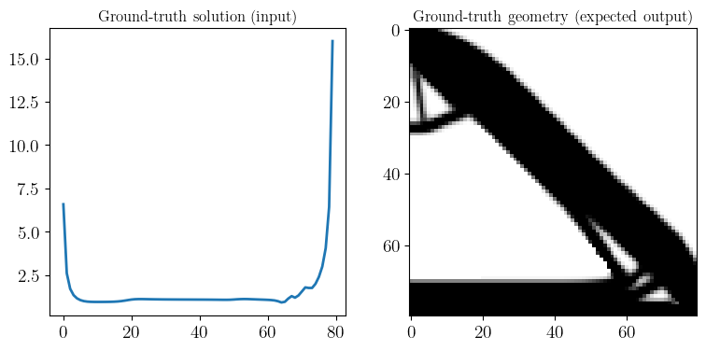
Solution to geometry (sol2geo)

Slide 18
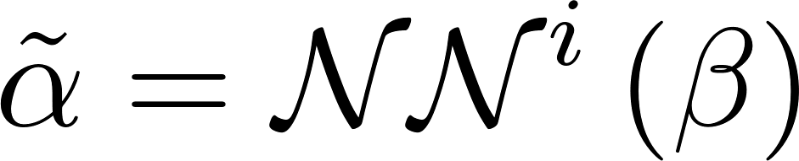
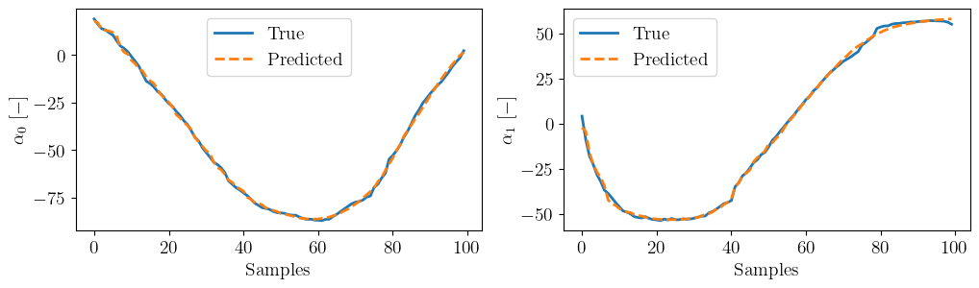
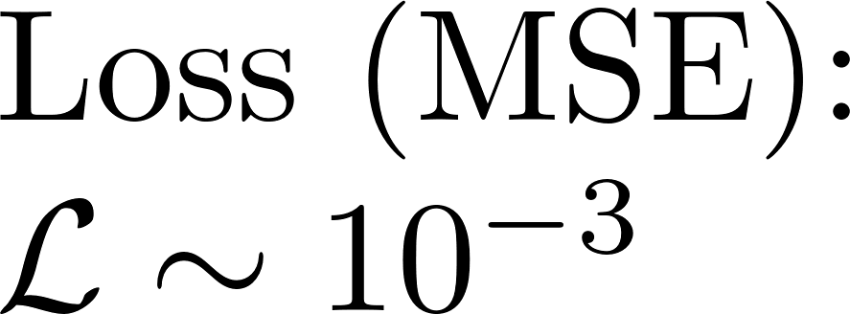
NNi: relating geometries and solutions coeffs.
Fit coefficients
Feed-forward network
…
…
Successful fitting (validation)

Slide 19
sol2geo. Reconstruction check of training sample

Slide 20
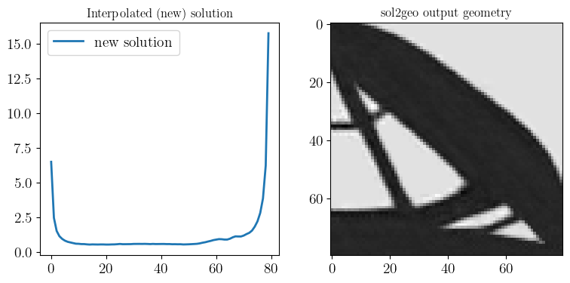
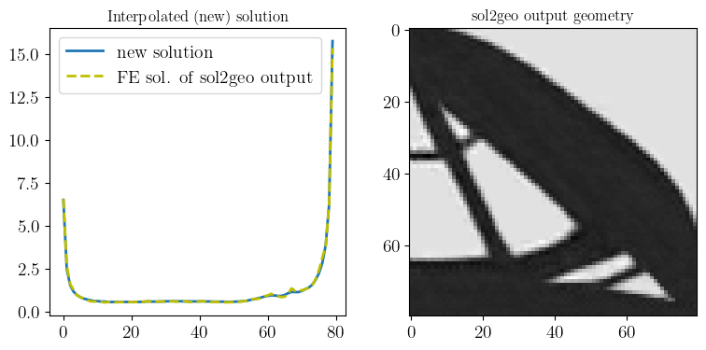
Solution to geometry (sol2geo). Test
Using interpolated solution curves(therefore, new)
They are introduced in the sol2geo pipeline (encode, NNd, decode): generation of a geometry*
The solution of the new geometry is computed with FE
Curves of the interpolated and HF solution of the output geometry are compared
Example:

Slide 21
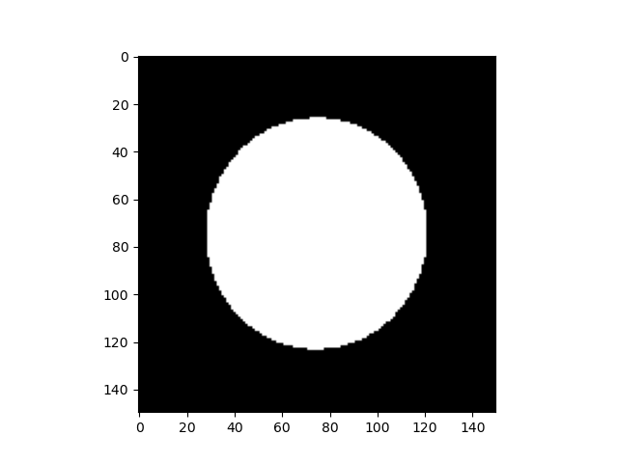
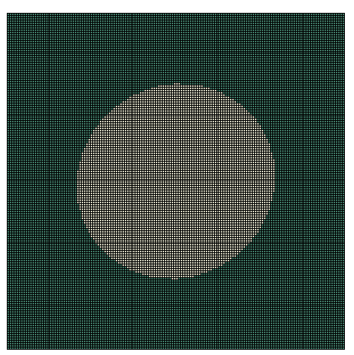
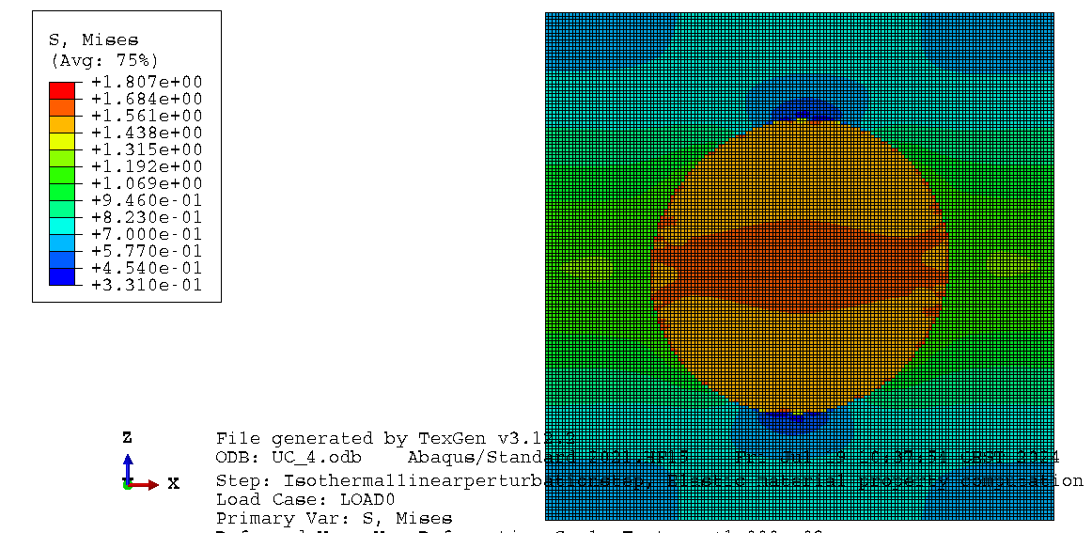
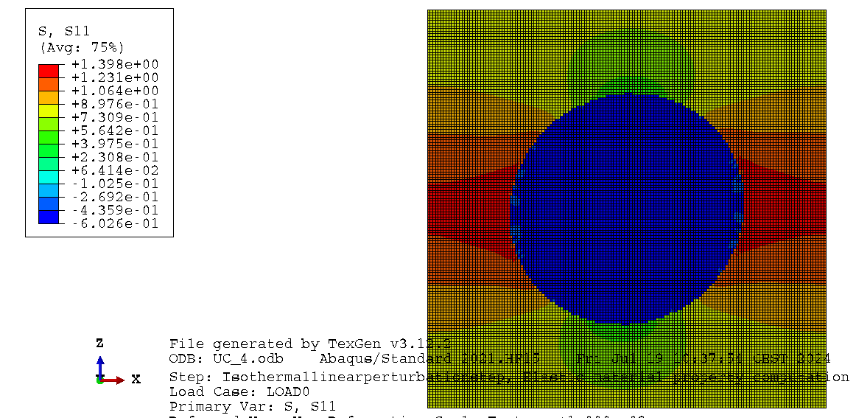







Usecase #2 : Composites
Elastic problem
Periodic Homogenization
RVE
(148*148
Matrix
$${\overline{ɛ}}_{11}$$
$${\overline{ɛ}}_{11}$$
VM
Fiber
$$σ_{11}$$
$$σ_{22}$$
$$σ_{12}$$

Slide 22







Geometry
Solutions
Scaler
Vector (Curve)
Tensor
$${\overline{E}}_{11}$$
$${\overline{E}}_{22}$$
$${\overline{G}}_{12}$$
$${\overline{υ}}_{11}$$

Slide 23






Solution 1: Scaler
$$α$$
Direct
Inverse
$${\overline{E}}_{11}$$
$${\overline{E}}_{22}$$
$${\overline{G}}_{12}$$
$${\overline{υ}}_{11}$$
Direct: from Geometry to Solution
Inverse: from Solution to Geometry

Slide 24


Solution 2: Vector
$$α$$
Direct
Inverse
$$β$$
Direct: from Geometry to Solution
Inverse: from Solution to Geometry

Slide 25


Solution 3: Tensor
$$α$$
Direct
$$β$$
Direct: from Geometry to Solution

Slide 26



Training RRAEs for Geometry
Predicted True
Predicted True
Example 1
Example 2
Interpolation

Slide 27



Training RRAEs for Solutions (1)
Example 1
Example 2
Interpolation

Slide 28



Training RRAEs for Solutions (2)
True
Predicted
True
Predicted
Interpolation

Slide 29
From Geometry to Solution (scaler fields):
$$α$$
Direct
Inverse
$${\overline{E}}_{11}$$
$${\overline{E}}_{22}$$
$${\overline{G}}_{12}$$
$${\overline{υ}}_{11}$$
Direct: from Geometry to Solution

Slide 30




From Geometry to Solution (scaler fields):
Training dataset
Direct
Example 1
Example 2
 | True | Predicted (error)
E11 [MPa] | 2841.24 | 2882.8 (1.4 %)
E22 [MPa] | 2641.19 | 2638 (0.1 %)
G12 [MPa] | 929.99 | 902.93 (2.9 %)
v12 | 0.39 | 0.40 (2.5 %)
 | True | Predicted (error)
E11 [MPa] | 2207.59 | 2212.2 ( 0.2 %)
E22 [MPa] | 2205.85 | 2214.3 (0.38 %)
G12 [MPa] | 813.99 | 812.29 (0.2 %)
v12 | 0.35 | 0.31 (1.4 %)
Test dataset
Example 3
Example 4
 | True | Predicted (error)
E11 [MPa] | 2296.99 | 2314.92 (0.7 %)
E22 [MPa] | 2502.91 | 2599.41 (3.8 %)
G12 [MPa] | 830.59 | 815.05 (1.8 %)
v12 | 0.34 | 0.23 (32 %)
 | True | Predicted (error)
E11 [MPa] | 3077.31 | 3329.57 (8.19 %)
E22 [MPa] | 3058.46 | 3489.55 (14.8 %)
G12 [MPa] | 1079.04 | 1119.62 (3.75%)
v12 | 0.38 | 0.37 (1 %)

Slide 31
From solution to Geometry (scaler fields):
$$α$$
Inverse
$${\overline{E}}_{11}$$
$${\overline{E}}_{22}$$
$${\overline{G}}_{12}$$
$${\overline{υ}}_{11}$$
Inverse: from Solution to Geometry

Slide 32




From solution to Geometry (scaler fields):
Training dataset
Inverse
Example 1
True
Example 2
Predicted
Predicted
True
E11 [MPa] | 2841.24
E22 [MPa] | 2641.19
G12 [MPa] | 929.99
v12 | 0.39
E11 [MPa] | 2207.59
E22 [MPa] | 2205.85
G12 [MPa] | 813.99
v12 | 0.35
Test dataset
Example 3
Predicted
True
Example 4
Predicted
True
E11 [MPa] | 2296.99
E22 [MPa] | 2502.91
G12 [MPa] | 830.59
v12 | 0.34
E11 [MPa] | 3077.31
E22 [MPa] | 3058.46
G12 [MPa] | 1079.04
v12 | 0.38

Slide 33
From Geometry to Solution (curve):
$$α$$
Direct
$$β$$
Direct: from Geometry to Solution

Slide 34




From Geometry to Solution (curve):
Example 1
Predicted
True
Direct
Example 2
Predicted
True

Slide 35
From solution to Geometry (curve):
$$α$$
Inverse
$$β$$
Inverse: from Solution to Geometry

Slide 36




From solution to Geometry (curve):
Example 1
Predicted
True
Inverse
Example 2
Predicted
True

Slide 37
From Geometry to Solution (Tensor field):
$$α$$
Direct
$$β$$
Direct: from Geometry to Solution

